Slide 1
Inter-comparison of ISS-LIS, TRMM-LIS, and GLM
2021 GLM Science Meeting
Daile Zhang
Collaborators: Tim Lang, Ken Cummins, Mason Quick, and Scott Rudlosky
NNH19ZDA001N-ESROGSS
1
dlzhang@umd.edu
09/23/2021

Slide 2
Project Overview
2021 GLM Science Meeting
Background
GLM coarser resolution (8×8 km at nadir and 14×14 km at edges) and LIS finer resolution (~4.5×4.5 km²)
Reduced GLM detection efficiency for short and/or small flashes
Primary Goals
Merge ISS-LIS and GLM datasets by developing a statistical model to downscale GLM resolution
Increase space-based total lightning detection efficiency by combining the two observations
Improve GLM optical area and energy estimation
2
dlzhang@umd.edu
09/23/2021

Slide 3
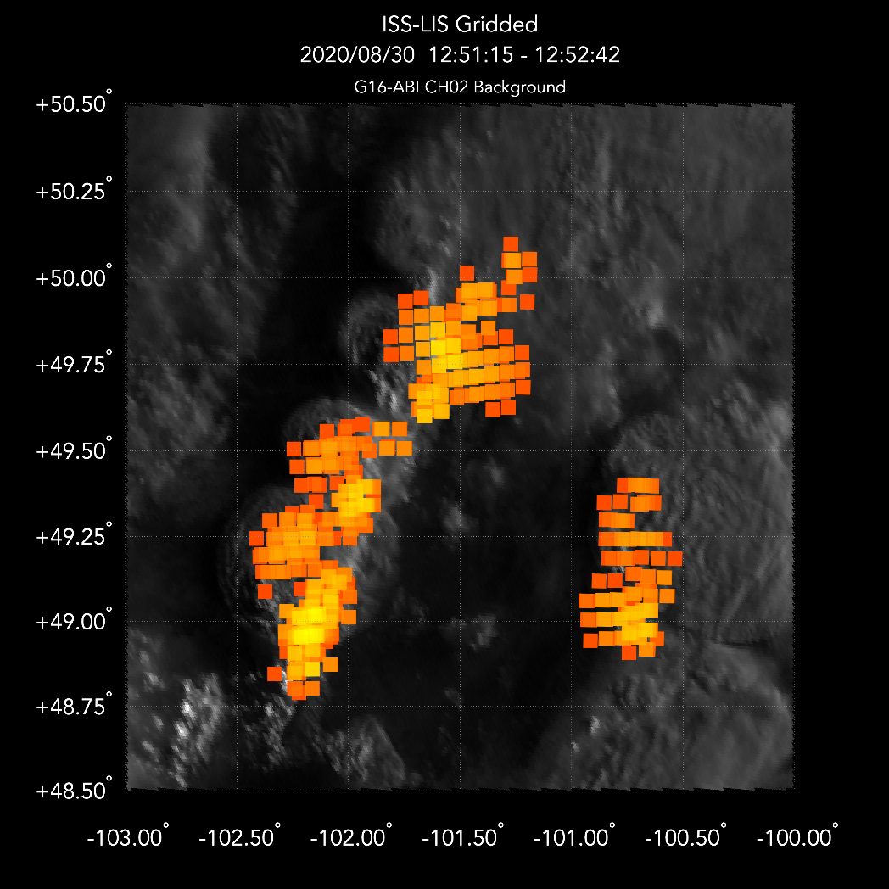
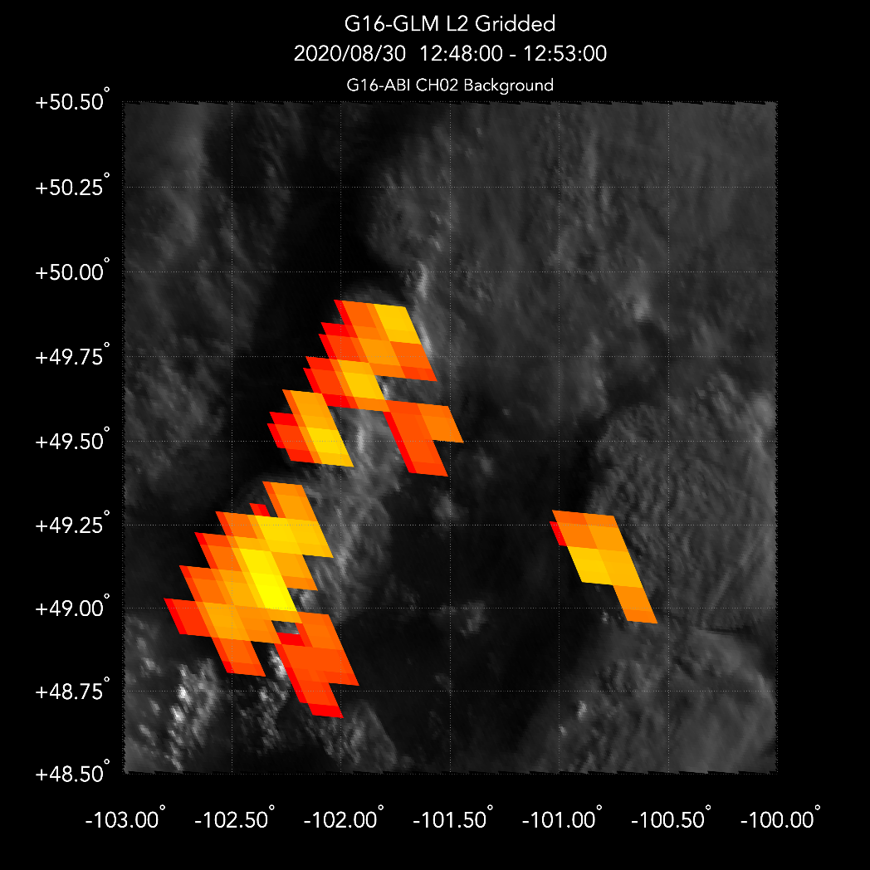
What additional insights can ISS-LIS provide?
2021 GLM Science Meeting
ISS-LIS provides:
1) higher spatial resolution images (more information)
2) help with boresight-dependent parallax correction
3
dlzhang@umd.edu
09/23/2021

Slide 4
First step: Inter-compare ISS-LIS with well-documented TRMM-LIS
2021 GLM Science Meeting
4
dlzhang@umd.edu
09/23/2021

Slide 5
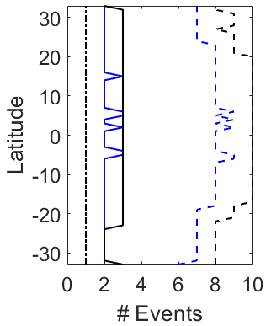
Events, Groups and Flashes
2021 GLM Science Meeting
On average, ISS-LIS detects
50th percentile ISS-LIS groups have 2 events (vs. 3 events in TRMM-LIS)
0.8 less events per group
1.3 less groups per flash
5
dlzhang@umd.edu
09/23/2021

Slide 6
Event Area: QC ISS-LIS vs. TRMM-LIS
2021 GLM Science Meeting
ISS-LIS
ISS-LIS
TRMM-LIS Event Area is more consistent than QC ISS-LIS
6
dlzhang@umd.edu
09/23/2021

Slide 7
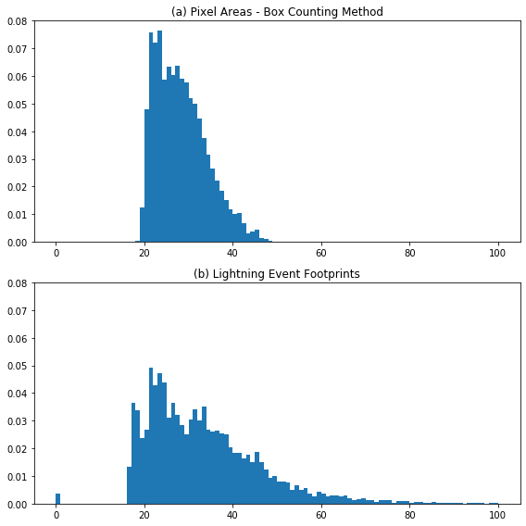
Recalculation of the ISS-LIS Event Area
2021 GLM Science Meeting
New
QC
Tim Lang recalculated the ISS-LIS pixel area by averaging all possible setups
7
dlzhang@umd.edu
09/23/2021

Slide 8
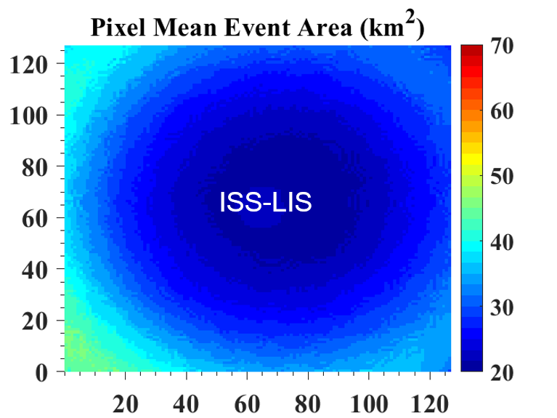
Recalculated Event Area is better
2021 GLM Science Meeting
TRMM-LIS
Recalculated ISS-LIS event area is consistent in the Pixel Array
Related?
8
dlzhang@umd.edu
09/23/2021

Slide 9
Group Radiance : TRMM-LIS vs. ISS-LIS
2021 GLM Science Meeting
The median ISS-LIS group radiance is 25-30% less than that of TRMM-LIS
Large radiance single-event groups exist in ISS-LIS
Is the radiance calculated based on the area? Do we need to recalculate radiance?
Group Radiance
Group Radiance
9
dlzhang@umd.edu
09/23/2021

Slide 10
Inter-compare ISS-LIS group energy with GLM
2021 GLM Science Meeting
10
dlzhang@umd.edu
09/23/2021

Slide 11
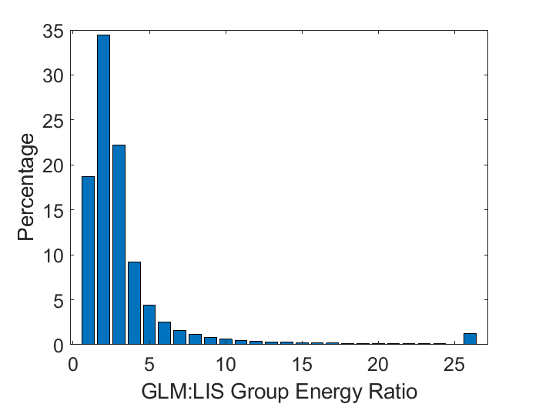
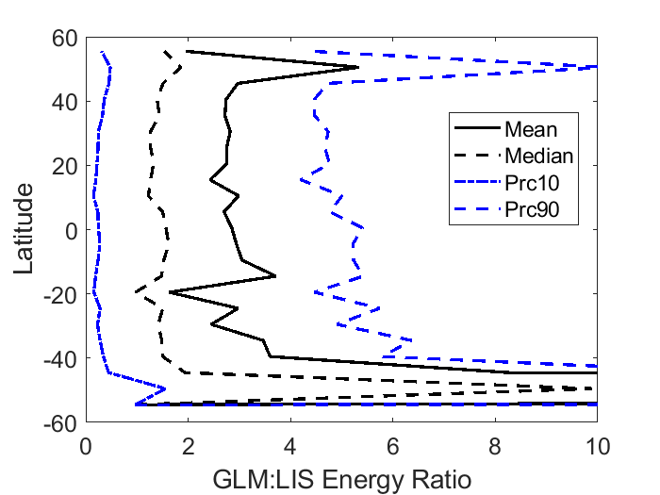
How to compare LIS radiance and GLM energy
2021 GLM Science Meeting
1. Convert LIS radiance to GLM equivalent energy
2. Compare the GLM and LIS isolated groups or "supergroups" coincidence
$$E= \frac{π∆λ\hat{ξ}Α}{n}$$
≥ 50% of the ratios are less than or equal to 4
Where
Δλ = Optical Bandwidth (m)
A = Group Area (m²)
n = # of Events in a Group
Koshak (2017) and
Zhang & Cummins (2020)
Extremes do exist
11
dlzhang@umd.edu
09/23/2021

Slide 12
A Large-Ratio Example (high-latitude)
2021 GLM Science Meeting
Time Series of the Energy
Plan View (color-coded by energy)
GLM did not see the first groups and the very last one when the energy was not high, but detected much higher energy values when the LIS also detected high energy
12
dlzhang@umd.edu
09/23/2021

Slide 13
Future Plans
2021 GLM Science Meeting
GLM pixel
LIS pixel
The recalculated pixel areas/radiance will be used to refine our future calculations
Interpolate GLM Energy onto LIS Pixel Geometry
Spatial deconvolution
13
dlzhang@umd.edu
09/23/2021

Slide 14
2021 GLM Science Meeting
Thank you!
14
dlzhang@umd.edu
09/23/2021

