Slide 1
User Services for Lightning Data at GHRC DAAC
Geoffrey Stano, Leigh Sinclair, Navaneeth Selvaraj, Shannon Flynn, Alan Subedi

Slide 2
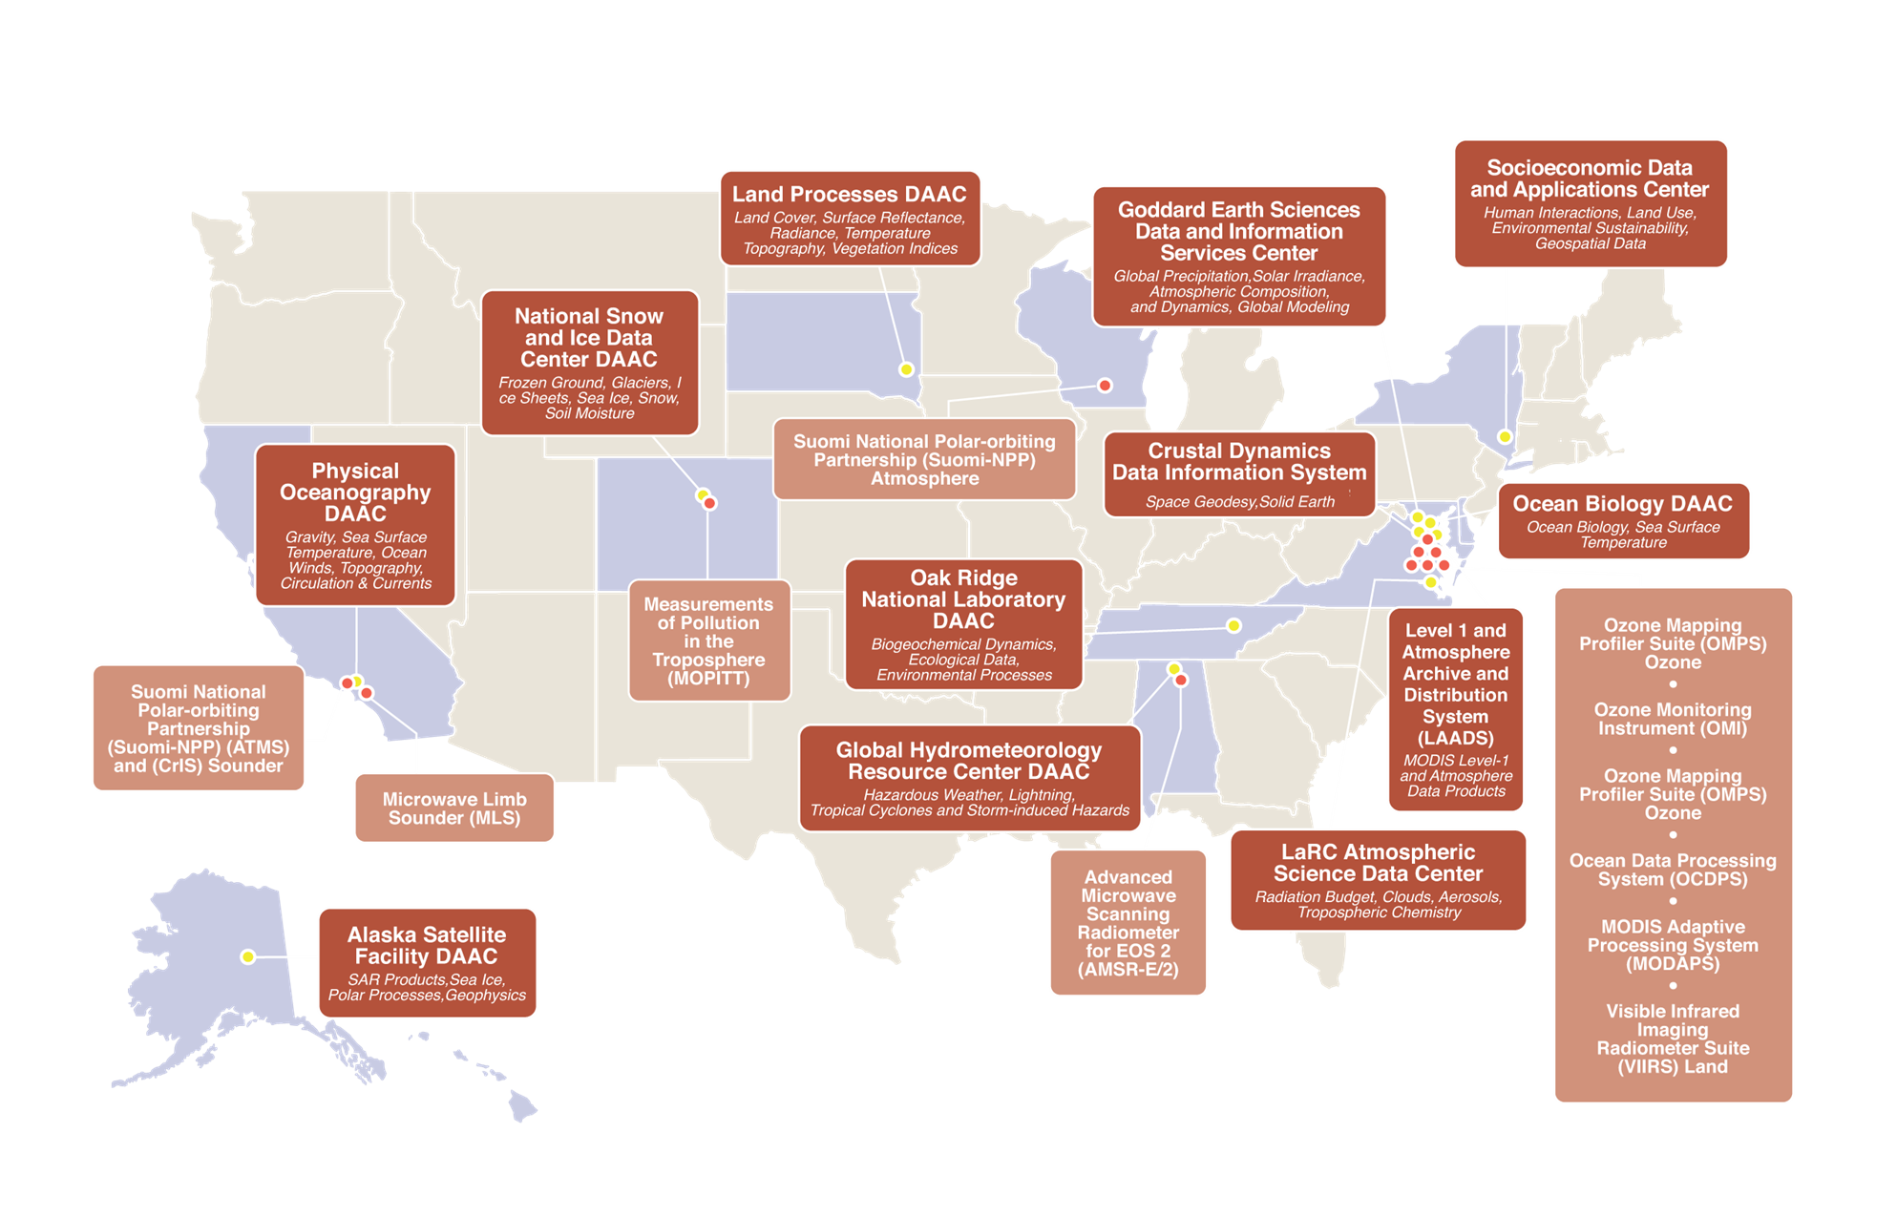
NASA’s Earth Science DAACs
Distributed Active Archive Center (DAAC)
NASA’s Earth Observing System Data and Information System (EOSDIS)
Role
Process, archive, document, and distribute data
Use NASA’s past and current Earth-observing satellites and field measurement programs
Global Hydrometeorology Resource Center (GHRC)
Collaboration between NASA MSFC and the University of Alabama in Huntsville
Science Investigator-led Processing Systems (SIPS) location creating data products working alongside project scientists

Slide 3
GHRC Mission and Holdings
GHRC MISSION
To provide a comprehensive active archive of data and knowledge augmentation services with a focus on hazardous weather, its governing dynamical and physical processes, and associated applications.
Focus on lightning, tropical cyclones, and storm-induced hazards through integrated collections of satellite, airborne, and in-situ data sets.
~60 TB of total data stored
~80% is field campaigns by volume
Anticipate volume doubling with accepted and proposed new data
Lightning is less volume but 7 datasets in top 10 downloads
First DAAC to transition to cloud

Slide 4
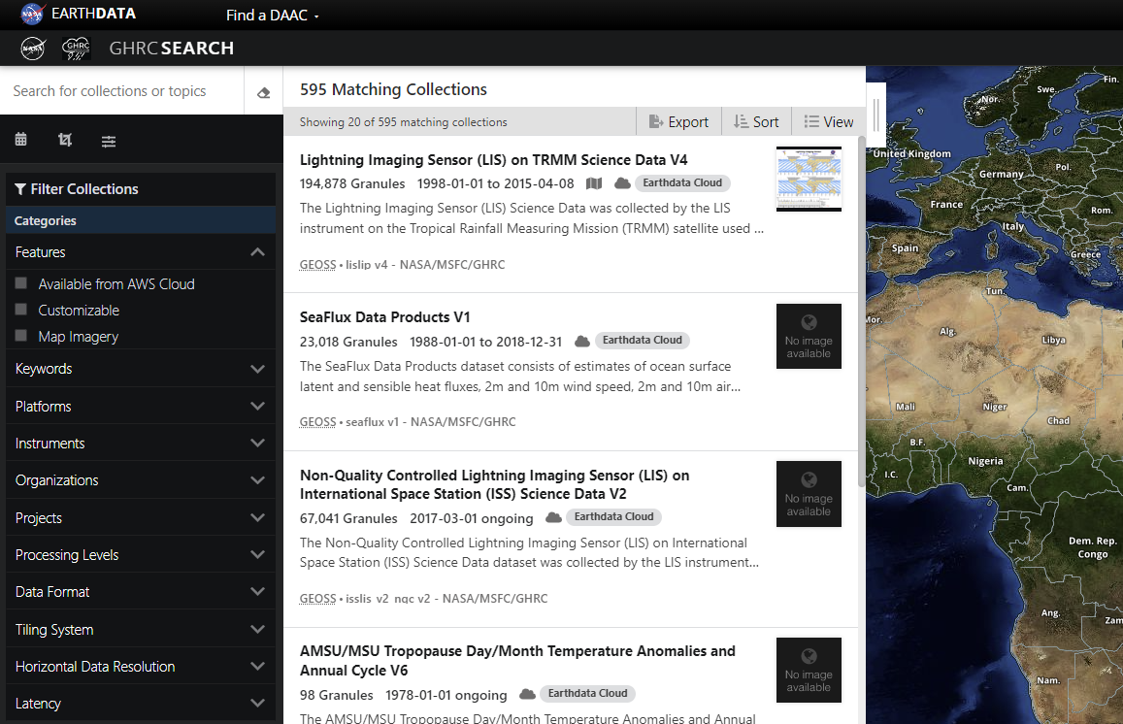
Accessing GHRC Data
HyDRO Decommissioned
As part of GHRC’s transition to the cloud, HyDRO is decommissioned
GHRC data now available via Earthdata Search
https://search.earthdata.nasa.gov/portal/ghrc/search
Example of search for Lightning Imaging Sensor data from the GHRC search portal in NASA’s Earthdata Search

Slide 5
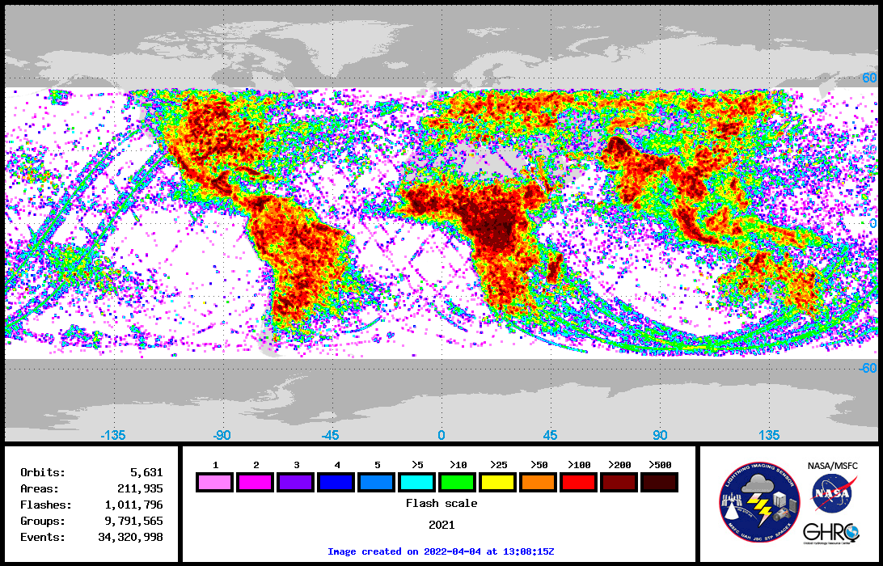
Lightning Imaging Sensor (LIS) – Current Work
International Space Station LIS
5 years on orbit
Instrument successfully moved to a new location on the Space Station
July 2022
2021 annual climatology completed
Work underway to incorporate with the combined OTD/TRMM LIS data
Version 2.1 of data available
Data crossing the 0000Z boundary now placed in correct file
View time error corrected
Version 2.2 underway
GHRC to continue to support ISS LIS while still active on the ISS
ISS LIS 2021 Annual Climatology

Slide 6
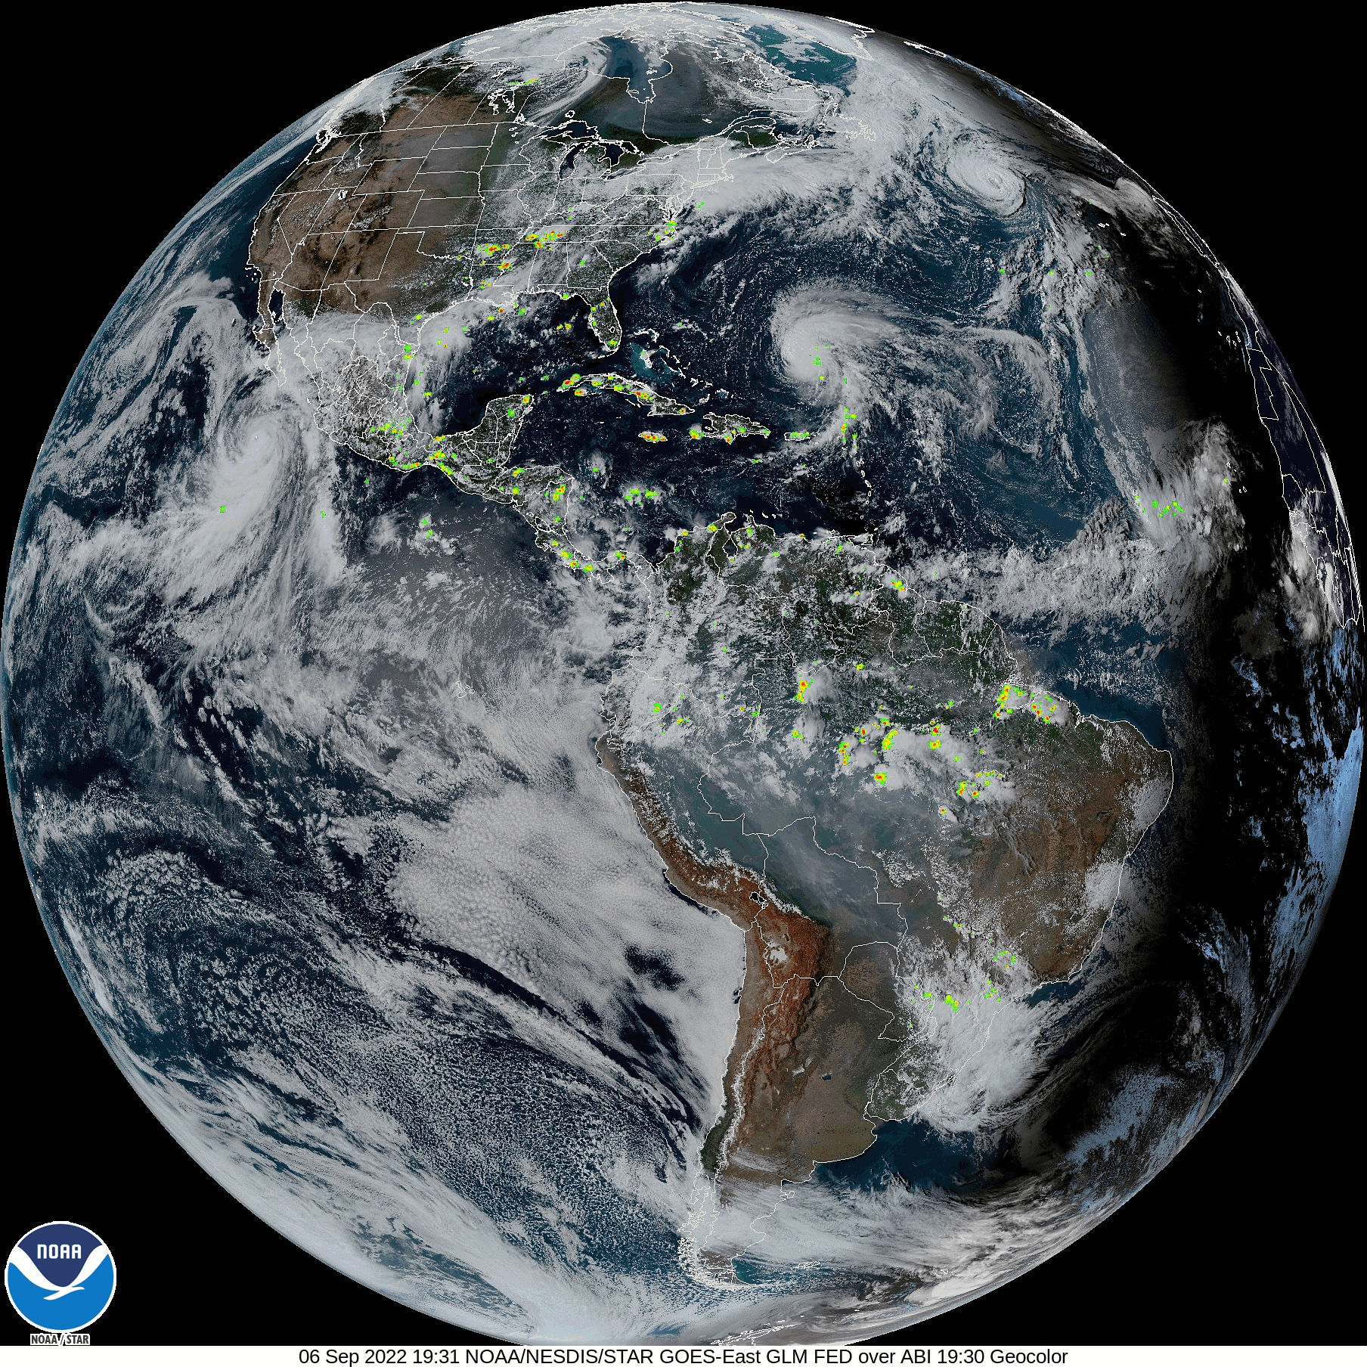
Geostationary Lightning Mapper (GLM)
GLM Level 3 and CIERRA
Developed new workflow to support ongoing datasets in the cloud
Many thanks to Joe Zajic and Michael Peterson
Workflow nearly complete
Anticipating both datasets to be published before the end of the year
GLM Level 3 data will be in an AWIPS readable format for National Weather Service users
Speaking with Michael Peterson on CIERRA versions of OTD and LIS

Slide 7
Field Campaign Explorer (FCX)
FCX
Designed to:
Visualize 3D data
Coincidentally with multiple datasets
Support multiple data types
Serve as data analysis and exploration
Cloud native design
Has been released as open source
Currently focused on GHRC field campaign holdings
Adding more campaigns and datasets
Developing analysis tools
https://ghrc.earthdata.nasa.gov/fcx/index.html
GOES-R Post Launch Test (17 May 2017): OKLMA, ABI, Lightning Instrument Package, GLM events, Cloud Radar System, and ER-2 track

Slide 8
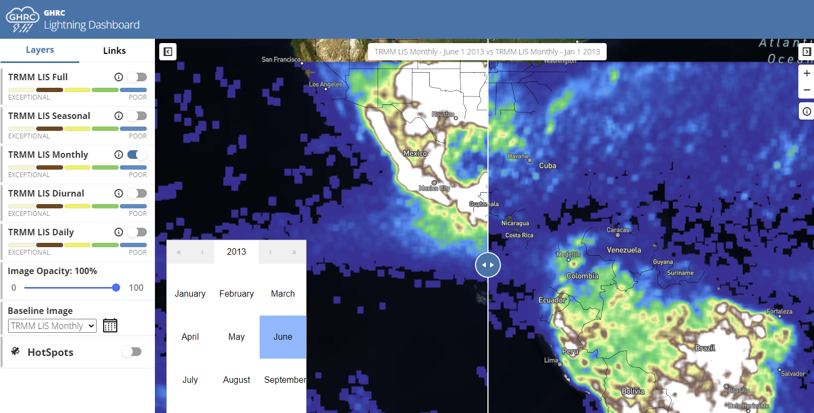
Lightning Dashboard - Overview
Lightning Dashboard
New tool in development this year
Goal is a minimum viable product at the end of FY2022
Aim for additional work in 2023
Focus on TRMM LIS
Basic display
Climatology options
Slider comparison tool
Cloud-optimized geoTIFFs
Demonstrate evolving DAAC role as more than data curators
TRMM LIS June 2013 (left) and January 2013 (right) comparison slider.

Slide 9
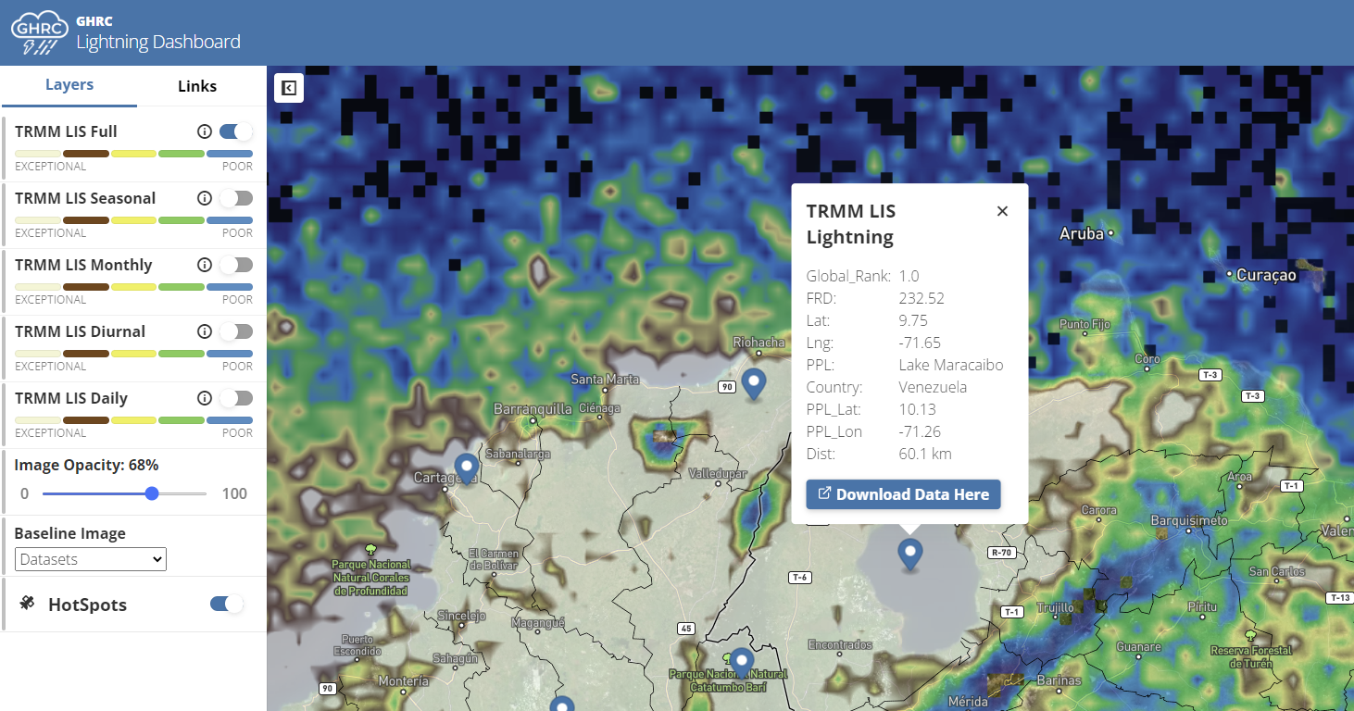
Lightning Dashboard - Demonstration
Lightning Dashboard
Updating user interface
Initial demonstration to the NASA Marshall Lightning Science team
High interest
MSFC to incorporate this as the next generation viewer for NASA lightning data
Incorporated global Lightning Imaging Sensor “hotspot” locations
Albrecht et al. (2016)
Full TRMM-LIS climatology display with lightning hotspots. Shown hotspot is the most active on Earth; Lake Maracaibo, Venezuela.

Slide 10
Upcoming Lightning Activities
Multiple Upcoming Activities
Lightning Essential Climate Variable
GHRC the likely archive, ~2024
NASA Lightning Beyond the Troposphere
Workshop in May
NASA ESDIS supports evaluation data to be archived at GHRC
Lightning Mapping Arrays
Continued North Alabama support
Beginning archival efforts of the Mid-Atlantic Network
Lake Effect Electrification campaign
GHRC part of NSF funded effort
September 2022 – March 2023
Potential tie-in with IMPACTS
Opportunity for GHRC to collaborate data access ties with NASA and NSF
ISS LIS operations will continue
Expanding visualization and analysis tools in collaboration with the Marshall lightning science team
Potential archival of GLM Stoplight safety product from NASA SPoRT

Slide 11
THANK YOU!
QUESTIONS?

