Slide 1
GOES-U GLM Status
Marc Rafal GLM Instrument Manager
2022 GLM Science Meeting
Huntsville, Alabama
Notes:
NOTES: -
Remove special topics from agenda

Slide 2
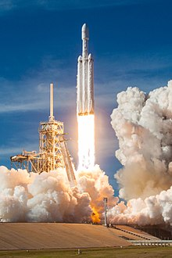
GOES-U Key Milestones
Jan 2022 GLM Installed on GOES-U
Jul 2022 Pre-Environmental Review
Sep 2022 TVAC
Oct 2023 Pre-Ship Review
Dec 2023 Ship
Apr 2024 Launch on Falcon Heavy
May 2024 Start Post Launch Tests

Slide 3
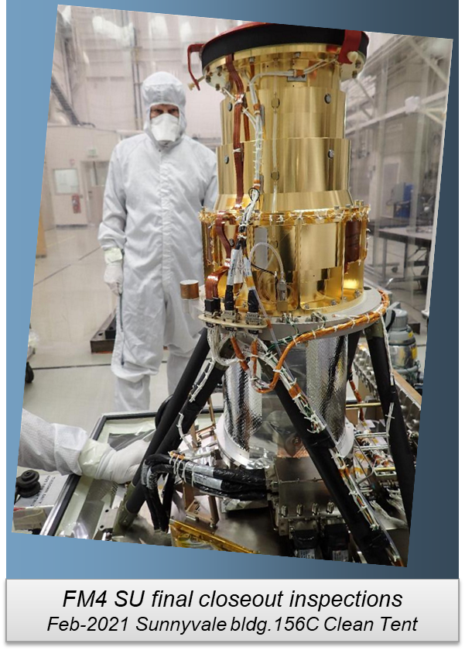
GLM FM4
FM4 has same performance enhancements as FM3
Stray Light Mitigations
Increased Detection Efficiency
Reduced overshoot/undershoot at high contrast boundaries
Reduced system noise
Instrument Level Tests Complete
Installed on GOES-U
Ready for Spacecraft Environments

Slide 4
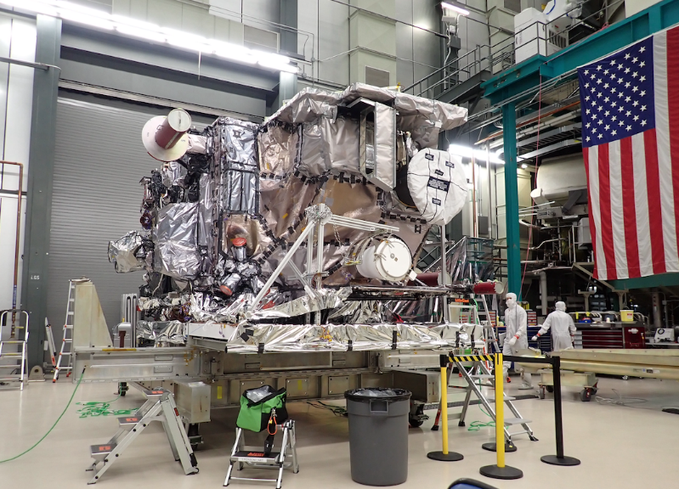
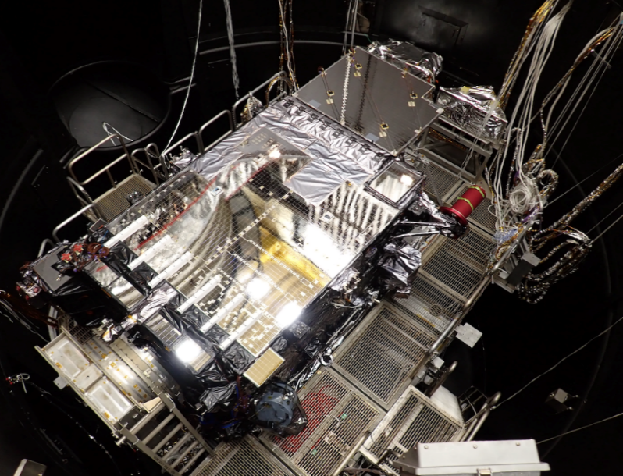
GOES-U/FM4 Remaining Activities
GOES-U TVAC
CPTs/LPTs at each plateau
ETE tests
GOES-U Mechanical Environments
Post-mechanical LPT
GOES-U EMI
Launch Base Activities
LPT and Pad Aliveness Test
GOES-U PLT
Expected to use substantially the same test structure as GOES-18 currently underway
PLT completed at the test location
No split PLT
GOES-U Pre-lift
GOES-U– Inside chamber (view from top)
Notes:
PS-PVR = ?

