Slide 1
GOES-18 GLM Instrument Performance and Optimization
GLM Science Meeting
September 2022
Tewa Kpulun
This presentation was made possible by work performed under NASA contract NNGO8HZOOC
© 2022 Lockheed Martin Corporation. All Rights Reserved.

Slide 2
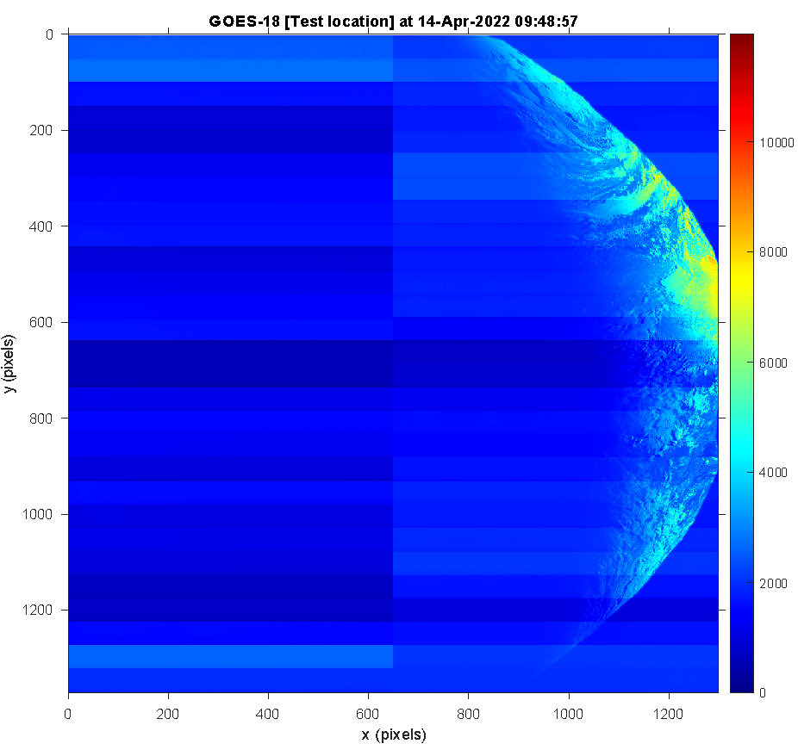
Timeline of Major Instrument PLT Events
Raw First Light Image
Activation
Door Deployment
First Light
Eclipse
Mar Apr May Jun Jul Aug Sep Oct Nov
Launch
Outgas
All ground LUTs updated
Spacecraft Drift
All on orbit parameters set
G18 PLT is on schedule according to the planned sequence of events

Slide 3
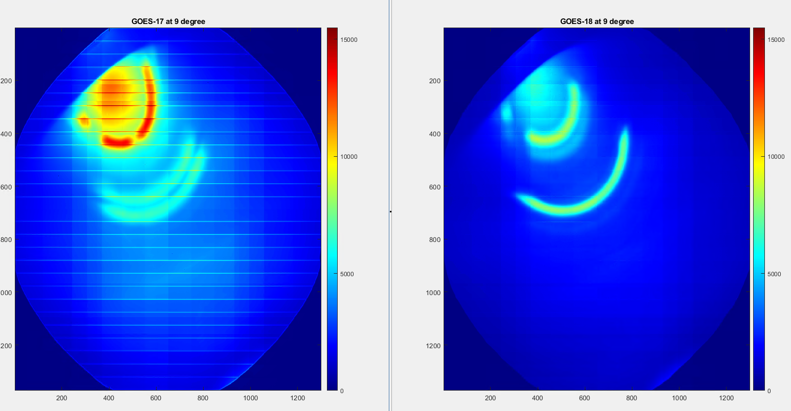
Changes since GOES-17
Hardware changes between FM2 (GOES-17) and FM3 (GOES-18)
Stray light mitigation
G18 BG image intensity during solar intrusion is 10 to 40% less than G17, depending on FOV location
Electronic design modifications
Reduction of CCD readout artifacts (overshoot)
Better dynamic range from lower thresholds under high illumination
Over a 24hr period on August 9th:
G18 has zero saturated pixels
G17 has 63,378 saturated pixels
GOES-17
GOES-18
Solar Intrusion (sun shining into optics)
Hardware changes improved dynamic range, by decreasing the number of saturated pixels

Slide 4
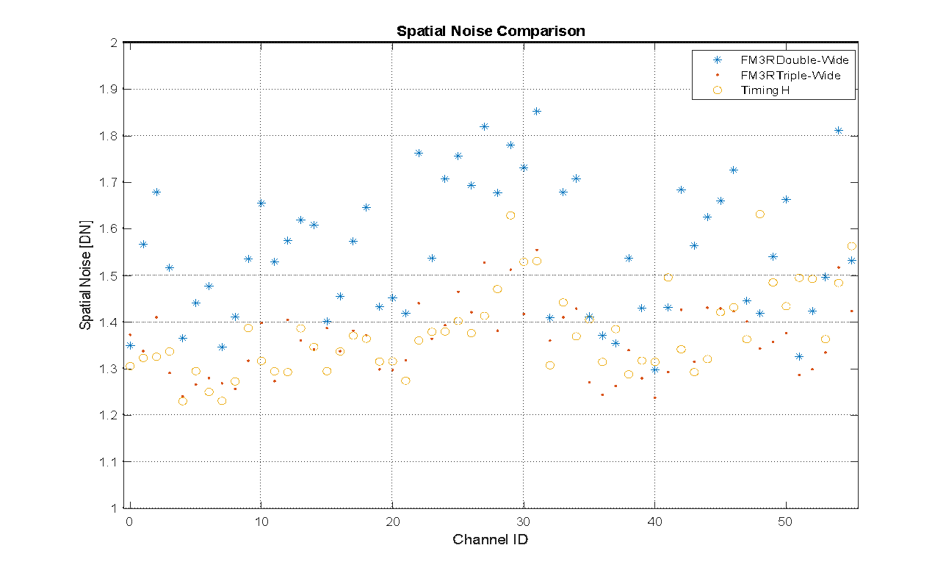
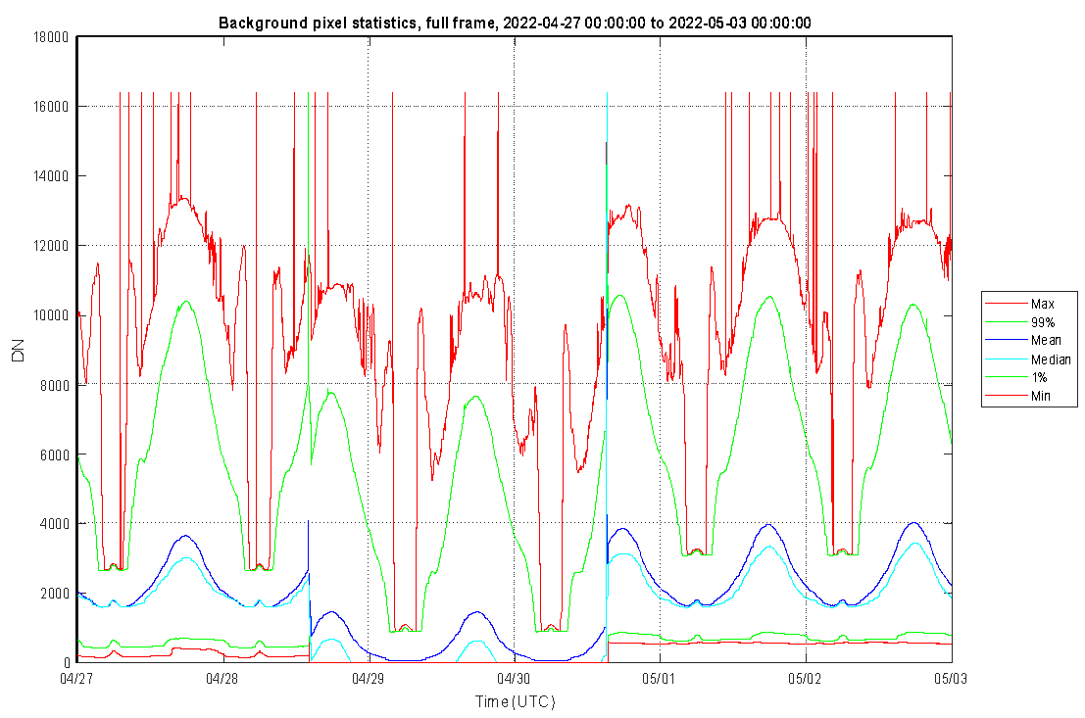
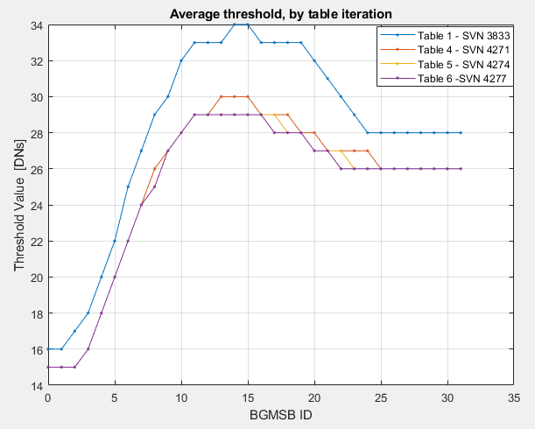
PLT On-orbit Instrument Calibration and Thresholds
FM3R Double-wide
FM4R Timing H
FM3R Triple-wide
RTEP Threshold Results
Spatial noise analysis done in fast BG during solar midnight.
BG pixel statistics for the three different timing settings tested. Slight differences due to scene variation.
Extending the DC restore pulse to a triple-wide coarse waveform lowered the overall instrument noise.
Triple-wide ADC offset settings are sufficient and meet instrument requirements
Too high: risk saturating the instrument
Too low: risk of lowering DE during night time
Decrease of the on-board thresholds improves the detection of low energy flashes.

Slide 5
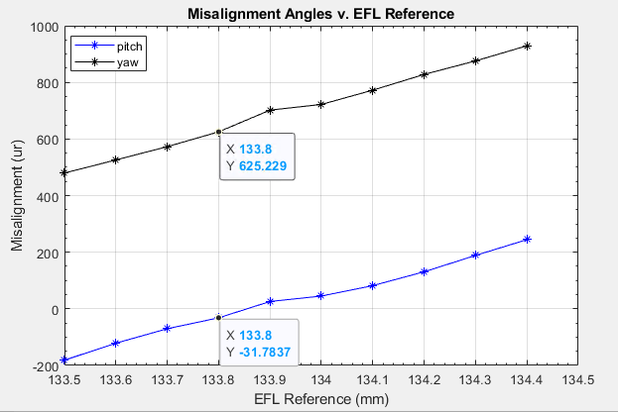
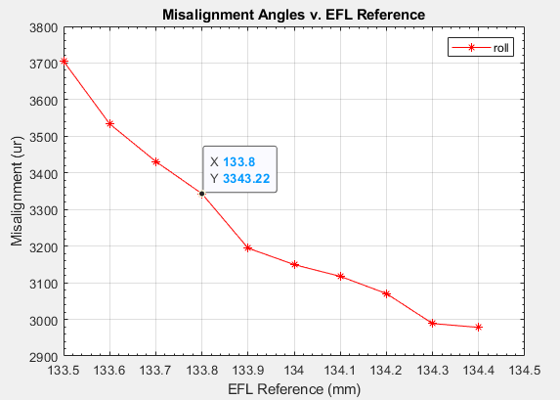
PLT Navigation Parameters
The coastline ID roll, pitch, and yaw (RPY) values were evaluated by fine tuning the instrument’s magnification parameters:
Effective focal length (EFL)
Black arrow are PDR values
Barrel distortion
Navigation checked using coastline overlay on navigated backgrounds
Coastline ID convergence is within 1.5 pixel requirement.
Comparison with GOES-17 GLM shows preliminary agreement
Extensive navigation validation will occur during provisional PLPT
GOES-17
GOES-18
Lake Okeechobee, FL

Slide 6
Lightning Detection Prediction
Used lightning data from G18 and G17 around solar noon and solar midnight in the GOES West location
Solar Noon: 2022-07-28 21:30 to 21:40 Z
Solar Midnight: 2022-07-28 09:25 to 09:35 Z
Case | Number of Events |  | Number of Groups |  | Number of Flashes
 | Full Disk | CONUS | Full Disk | CONUS | Full Disk | CONUS
G17 Noon | 94,640 | 74,225 | 48,923 | 38,960 | 6,698 | 5,267
G18 Noon | 146,695 | 113,907 | 63,895 | 50,666 | 8,087 | 6,151
G17 Midnight | 131,506 | 124,243 | 39,416 | 37,166 | 2,482 | 2,372
G18 Midnight | 200,302 | 188,024 | 59,305 | 55,746 | 2,965 | 2,808
GOES-18 detects more flashes than GOES-17 for both full disk and
For the time periods above, G18 detects ~15% more flashes than G17
Extensive validation and comparison to ground truth will occur during provisional PLPT

Slide 7
Future G18 GLM PLT Activities
Cross-satellite comparison testing
Assist ground in implementation and testing of updated GPAs
e.g. blooming filter
Further event detection and navigation analysis with ground truth systems
Using ENGLN and GLD360
PLT instrument tuning is complete. On orbit performance is excellent.

Slide 8
This presentation was made possible by work performed under NASA contract NNGO8HZOOC
© 2022 Lockheed Martin Corporation. All Rights Reserved.

