Slide 1
PRO Contributors
Steve Superczynski (KBR)
Tom Feroli (OSPO)
Jon Fulbright (ASTS)
Elizabeth Kline (GOES-R)
Randy Race (ASTS)
Curtiss Burnett (ASTS)
GOES-R Ground System Status and Gridded Product Update
2022 GLM Science Meeting – Huntsville, AL

Slide 2
Where are we now?
GOES-16 & GOES-17 GLM product maturity has allowed for a shift from high-priority updates via PRO-Release to a “targeted DO patch” approach over the past 2 years.
Recent GLM updates
GLM Flash area equals fill value for large flashes - ADR 1109 (WR 7990); Included in DO.09.05.00 patch (6/30/21)
G18 GLM TEST slot LUTs - ADR 1211; included in PR.09.08.19 (3/31/22)
G18 GLM WEST slot LUTs - ADR 1241; included in PR.09.08.27 (6/7/22)
G18 GLM CDRL79 Rev D LUTs - ADR 1264; included in PR.09.08.32 (7/29/22)
G18 GLM CDRL79 Rev E LUTs - ADR 1268; included in PR.09.08.34 (9/1/22)

Slide 3
What’s next?
DO.11.00.00/DO.11.02.00 - Separate builds/patches, but will all go live for one satellite at the same time.
ADR 549 (WR 5570): Eliminate GLM L1b dependency on APIDs 384 and 385
ADR 906 (WR 7178): GLM L1b One LUT to rule them all (GLM LUT Tool)
ADR 646 (WR 8478): Add GLM Flash Extent Density (FED) product
ADR 646 (WR 9168): GLM FED tile file naming
Future PRO Release (ADR/PR # TBD) will deploy new set of GLM LUTs in late October ahead of Provisional PS-PVR

Slide 4
ITCO Schedule

Slide 5
GLM LUT Tool
GLM LUTs
GLM CDRL 79 from vendor
GLM LUT Tool
GOES-R Ground System
Vendor provided Python tool to convert parameters into GOES-R GS compatible LUTs
Allows PRO to prepare LUTs for deployment without having to rely on ground vendor to take CDRL delivery and return LUTs in proper run-time format
Tool was successfully used to prep and deploy multiple sets of GOES-18 GLM LUTs in less than a week, preserving product maturity schedule
Tool currently used offline, with resulting LUTs being pushed onto the system for inclusion in PRO Release. There is a plan to obtain necessary COTS to run on the GS and baseline the tool

Slide 6
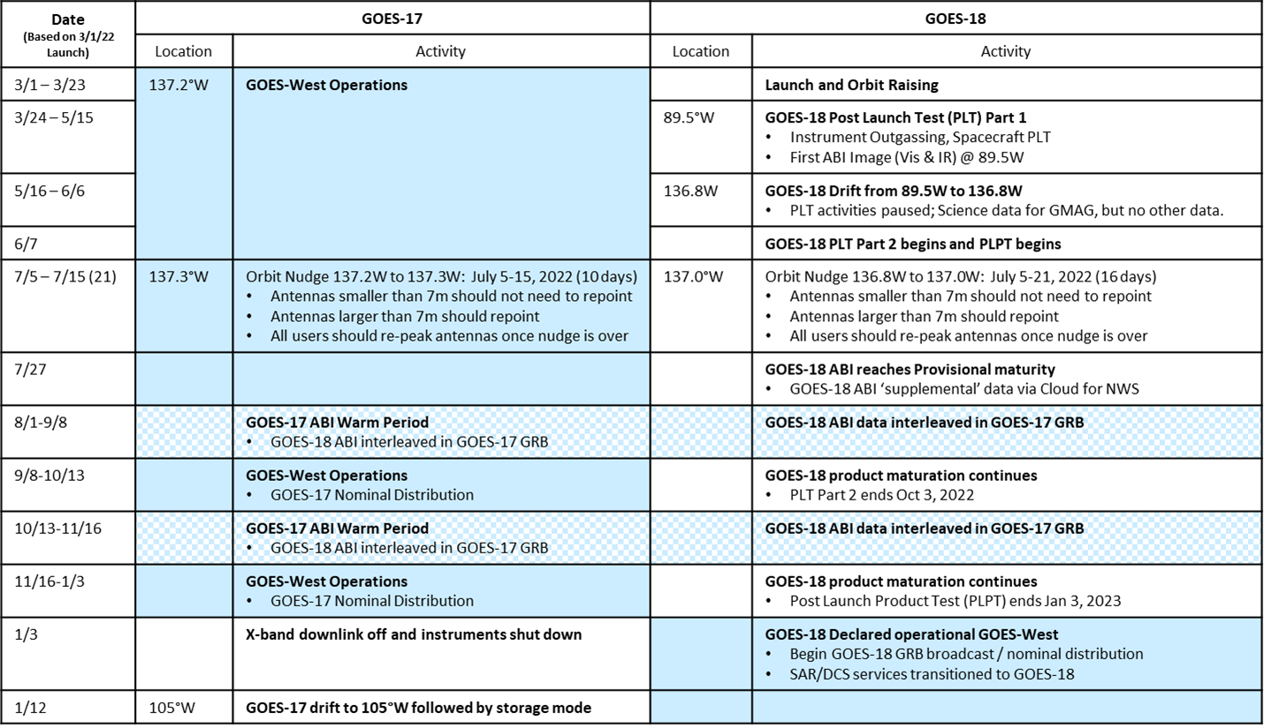
GOES-18 T20
You are here
* version dated 09/08/22

Slide 7
Gridded Products
Incorporated Baseline Python Code
Integrated via Algorithm Bridge Service
1 Minute Aggregation
Distribution Dates
LZSSc - End of November 2022
AWIPS - NST March 6, 2023

Slide 8
Summary
Operational GLM data are at Full maturity and continue to perform well
GOES-18 GLM PLT ongoing; LUT update expected late October
GOES-18 GLM Provisional PS-PVR scheduled for 10/31/2022
GOES-18 Transition to Operations in early Jan 2023
GLM FED is in DO.11+ which is currently installed in SOZ DE; data will be available Nov 2022 via GeoCloud, March 2023 for AWIPS

Slide 9
