Slide 1
GeoXO Program Overview
Andrew Heidinger, Dan Lindsey and Kat Hawley
GeoXO Program Science
September 13, 2022
Pre-Decisional

Slide 2
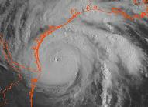
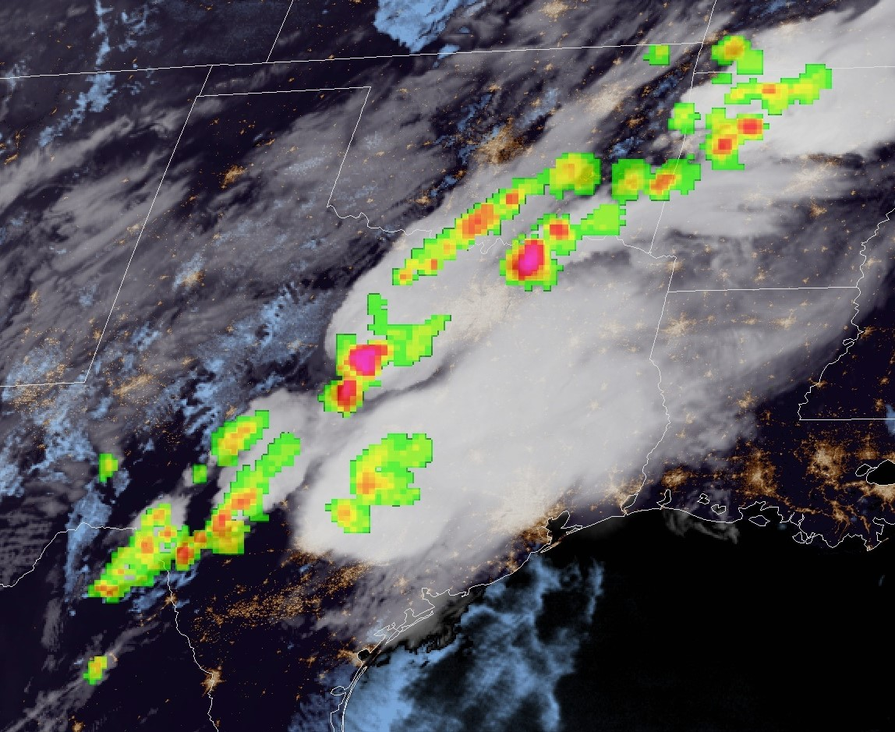
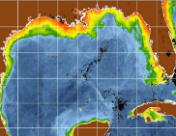
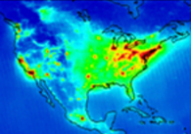
Evolution from GOES-R to GeoXO – 1 Growing needs require new observations
GOES-R provides Visible/Infrared Imagery and Lightning data:
Essential for short-range forecasting, issuing severe weather watches and warnings, and monitoring hazardous environmental conditions including tropical storms, severe storms, damaging winds, snow, ice, flooding, fog, fires, smoke, and volcanic ash
GeoXO will continue and improve Imagery and Lightning data and add new observations:
Hyperspectral IR Sounder for numerical weather prediction and local nowcasting
Ocean Color Instrument for monitoring dynamic coast/ocean features, ecosystem change, water quality, and hazards
Atmospheric Composition Instrument for monitoring air quality and the linkage between air quality, weather, and climate
Vis/Near-IR Imagery
Lightning Mapping
IR Sounding
Ocean Color
Atmo. Composition

Slide 3
GeoXO System
NOAA Satellite Operations
Facility, Suitland MD
Command and Data Acq.
Station Wallops VA
Consolidated Back-Up, Fairmont WV
3-3
4

Slide 4
GeoXO Formulation Milestones
GeoXO Formulation Event/Activity | Timeframe | Note
Phase A Instrument and Spacecraft Studies | 3QFY21 – 3QFY23
Mission Concept Review | June 2021
NOAA-NASA Key Decision Point A | July 2021
DOC Milestone 1 Review (DOC DepSec Approval) | Nov 2021 | Program Initiation
System Requirements Review | Aug 2022 | Requirement Baseline
NOAA-NASA Key Decision Point delta-A | Oct 2022
DOC Milestone 2 Review (DOC DepSec Approval) | Dec 2022 | DOC Program Baseline and Approval
Imager Implementation Phase Contract Awarded | Jan 2023
Other Implementation Phase Contracts Awarded | 1Q - 3QFY24
Mission Definition Review & KDP-B | 1QFY25
Preliminary Design Review & KDP-C | 4QFY25 | Congressional Baseline

Slide 5
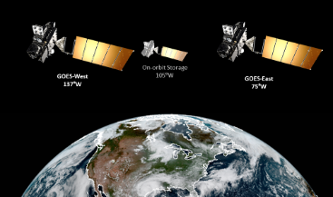
Observational Continuity Sets Need Date
NOAA’s geostationary operational concept requires a GOES East, GOES West, and a satellite in on-orbit storage for continuous 24/7 observations
Mitigates risk of catastrophic failure
Enables restoration of observations in days instead of years
Concept endorsed by stakeholders and National Academies
GOES-R Constellation
On-orbit
Spare
West
East
The GeoXO first launch in 2032 supports projected loss of the on-orbit spare in 2033

Slide 6
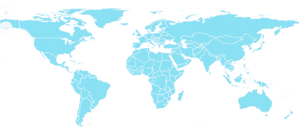
International GEO Plans and Expectations
KEY:
Satellites In Orbit
GOES-R
Imager
LM
GOES-R
Imager
LM
MSG
Imgr
MSG
Rapid
MSG
Imgr
Elk-L
Imgr
I-3DR
Imgr
Sndr
FY2
Imgr
FY4
Imgr
Sndr
LM
GK2A
Imgr
GK2B
AC
OC
H8/9
Imgr
Planned
Satellites
GEO-I
Imager
LM
OC
GEO-S
Sounder
AC
GEO-I
Imager
LM
OC
MTG-I
Imgr
LM
MTG-S
Sndr
AC
MTG-I
Rapid
LM
I-3DS
Imgr
Sndr
FY4
Imgr
Sndr
LM
GK3
Sndr
GK3
Imgr
H10
Imgr
Sndr
New Capabilities
World Meteorological Organization (WMO) Vision for 2040 Includes Imager, Sounder, Lightning Mapper, and Atmospheric Composition Instruments in the GEO Ring

Slide 7
LMX Formulation Status
Parameter | Phase A PORD
Geographic coverage | 84%
Ground sample distance (nadir) | 8 km
Navigation Error | 84 urad
Frame Rate | 500 Hz
Data Latency | 10 sec
SNR (daytime) | 4
Event detection | 70%
False events | 5%
LMX requirements were written based on consideration of stakeholder needs and technological advances since heritage instrument requirements were specified.
Phase-A studies are underway since April 2022.
Notes:
Make footnote bigger

Slide 8
LMX Science Organization
GeoXO has set up Science Working Groups for each sensor.
Instrument Scientist: Peter Armstrong (MIT/LL)
Product Scientist: Scott Rudlosky (NOAA/NESDIS)
User Scientist: Brian Gockel (NOAA/NWS)
We expect these SWGs to evolve into larger Science Teams over time.
We are funding the LMX Team to help with LMX formulation and to conduct value studies.
We’ll continue to fund to LMX, but we’ll start funding these activities:
L2 innovation in Fy24
Risk Reduction and Proving Ground in Fy24
Calibration Activities in Fy26
Given that GXI and LMX are incremental improvements over GOES-R, we expect to continue the innovation activities with GOES-R.

Slide 9
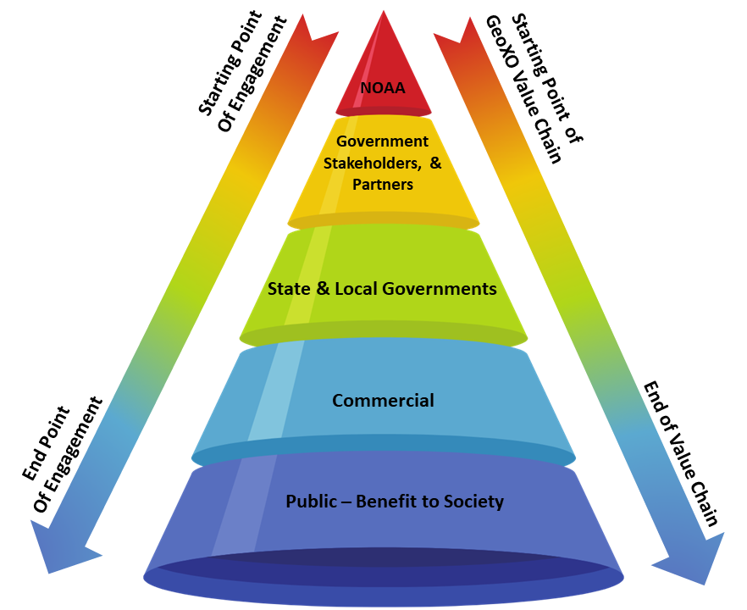
User Engagement
GeoXO UE Priorities
Support GLM NESDIS SPG & NOAA TBPG Activities
Support GLM R2O & O2R2O Activities
Provide support for GeoXO Town Halls, user assessments, workshops, listening sessions (etc)
GeoXO UE LMX FY 23/24 Goals
Scoping meeting to identify how GeoXO UE can support the LMX SWG
Set up cadence with SWG to support UE efforts and GeoXO reporting
Support outreach, education, and communication efforts
Determine desired NOAA Pathfinder participation
Conduct evaluation on existing user info
Develop personas to support LMX product and PPM development
Evaluate future UE studies to support LMX SWG
Define LMX UE Activities for FY23 - FY28

Slide 10
Summary
Space-based observations from geostationary orbit directly support the nation’s critical weather forecasting needs; a follow-on capability is required to launch by 2032 to ensure data continuity
GeoXO will provide the required continuity and add new observations to improve weather forecasting and monitor the ocean and atmosphere through 2050+
Included in this continuity is a GeoXO Lightning Mapper (LMX).
LMX will be an incremental evolution to GLM..
Phase-A studies are underway.
GeoXO LMX Science Working Group is formed and GeoXO UE will work with this team and the LMX Science Team to help develop the LMX user base.

Slide 12
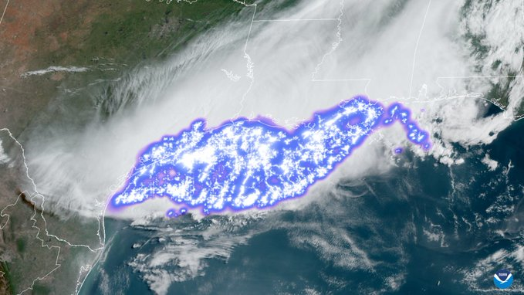
LMX Overview
GeoXO LMX will continue providing lightning detection beyond what is possible with ground-based lightning detection networks alone:
• Full spatial extent of total lightning flashes, both intra-cloud and cloud-to-ground
• Temporal resolution to allow tracking of each lightning flash within a specific storm cell
Continuous FOV lightning measurements for storm warning and nowcasting
• Earlier warnings of potential tornadic activity
• Flash flood warnings and storm tracking in regions
of low radar coverage
Key Performance Features:
• Single channel, high frame and detector read rate
World’s longest lightning flash as detected by GLM on 29 April 2022.

Slide 13
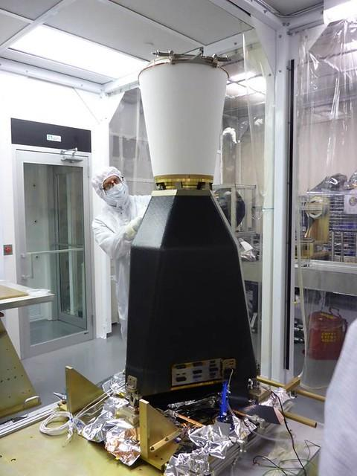
Comparable Flight Instruments: GOES-R Lightning Mapper
Operational regime: Geostationary orbit
Operational lifetime: ≥ 10 yrs
Sensor unit size: 151 cm x 81 cm x 66 cm
Mass: 125 kg (w/o radiator)
Power: 280 W
Single band, single channel optical telescope @ 777.4 nm
CCD Detector (1372 x 1300 pxl)
500 Hz frame rate
8 km Ground Sampling Distance (nadir)
Autonomy: 7 day
Ground processing: L1b
GLM is on-orbit on GOES-16/17/18

Slide 14
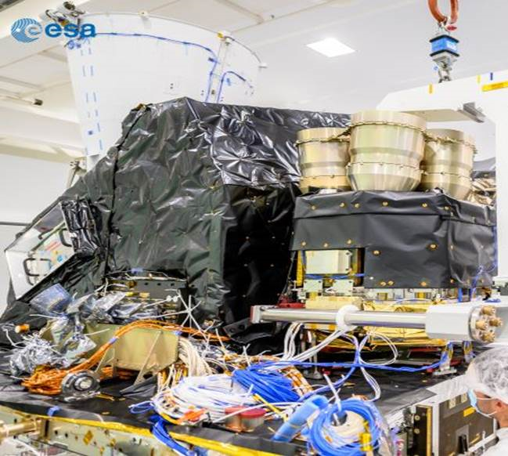
Comparable Flight Instruments: EUMETSAT MTG Lightning Imager
Operational regime: Geostationary orbit
Operational lifetime: 15.5 yrs
Sensor unit size: 71.5 cm x 110 cm x 120 cm
Mass: 130 kg
Power: 210 W
Single band, four channel optical telescope 777.4 nm
CMOS Detector (1170 x 1000 pxl)
1,000 Hz frame rate
4.5 km Ground Sampling Distance (nadir)
Data rate: 30 Mbps
Autonomy: 2 days
Ground processing: L1b
MTG expected launch date Dec 2022

