Slide 1
Update on ISS LIS and the ALOFT 2023 Field Campaign
Timothy Lang
Lead Research AST, Earth Science Branch
With contributions from: Rich Blakeslee, Dennis Buechler,
Steve Goodman, Doug Mach, Nikolai Østgaard, Mason Quick, Katrina Virts

Slide 2
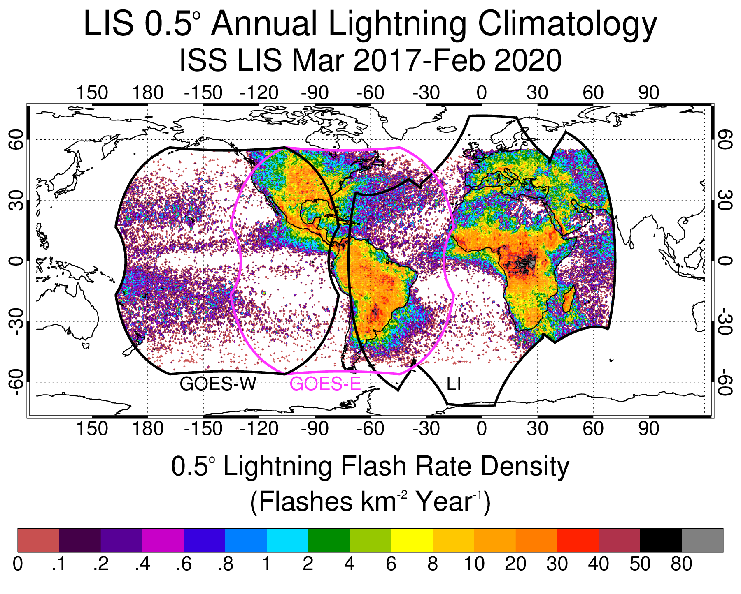
ISS LIS Contributes to Validation of Geostationary Lightning Observations
GLMs have reduced sensitivity near the edges of their FOVs
ISS LIS has a smaller pixel footprint and a more nadir view during overpasses, enabling it to often detect additional lightning

Slide 3
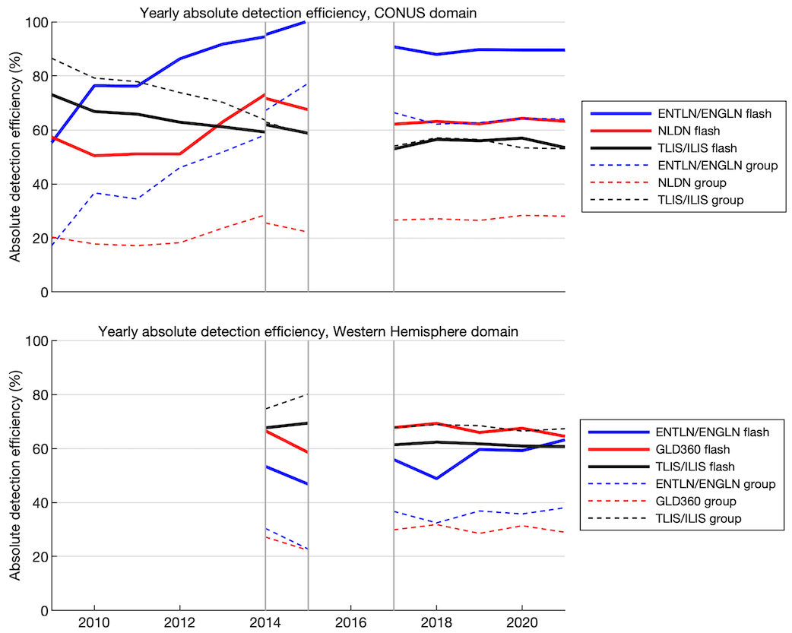
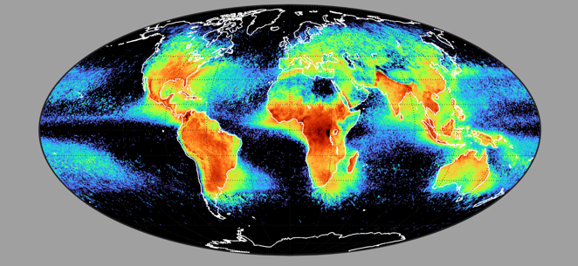
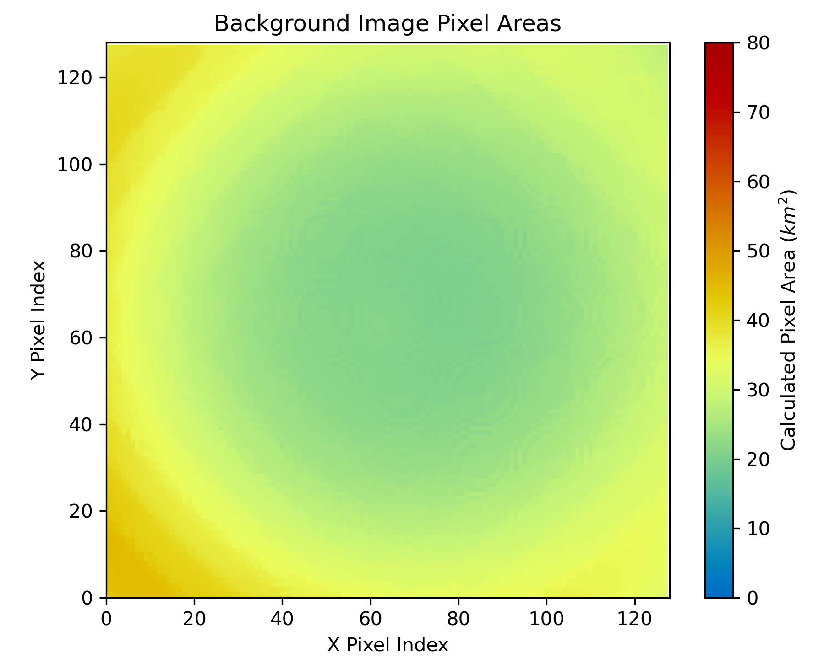
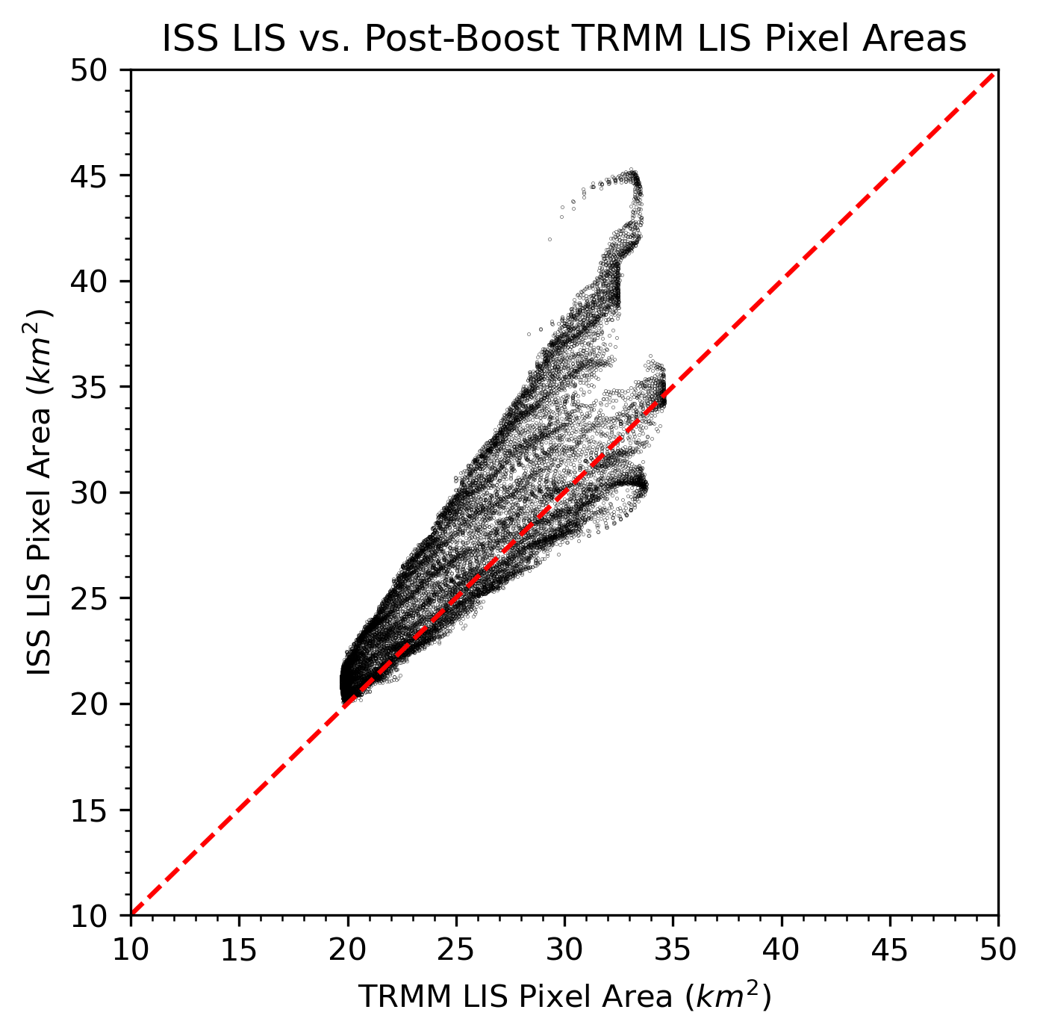
Integrating the Long-Term Global Lightning Record
Building a more accurate 25+ year record of global lightning (i.e., OTD + TRMM/ISS LIS) requires accurate intercalibration, in order to fully account for instrument and mission differences
MSFC is developing a better understanding of absolute detection efficiencies of the LIS missions, which depend in part on pixel size
Ties in with lightning declared as an Essential Climate Variable (ECV) by the WMO

Slide 4
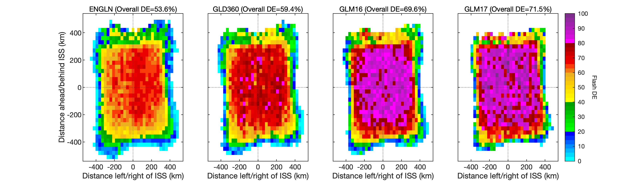
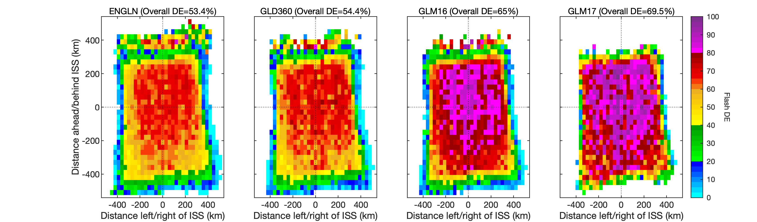
The Russian module added in late July 2021 changed the pitch of the ISS, which modestly degrades LIS detection efficiency (~0.2-5% depending on reference dataset) due to camera angle change
Treat August 2021-early July 2022 as a separate epoch in ISS LIS analyses.
Before (4-7/2021)
After (8-11/2021)

Slide 5
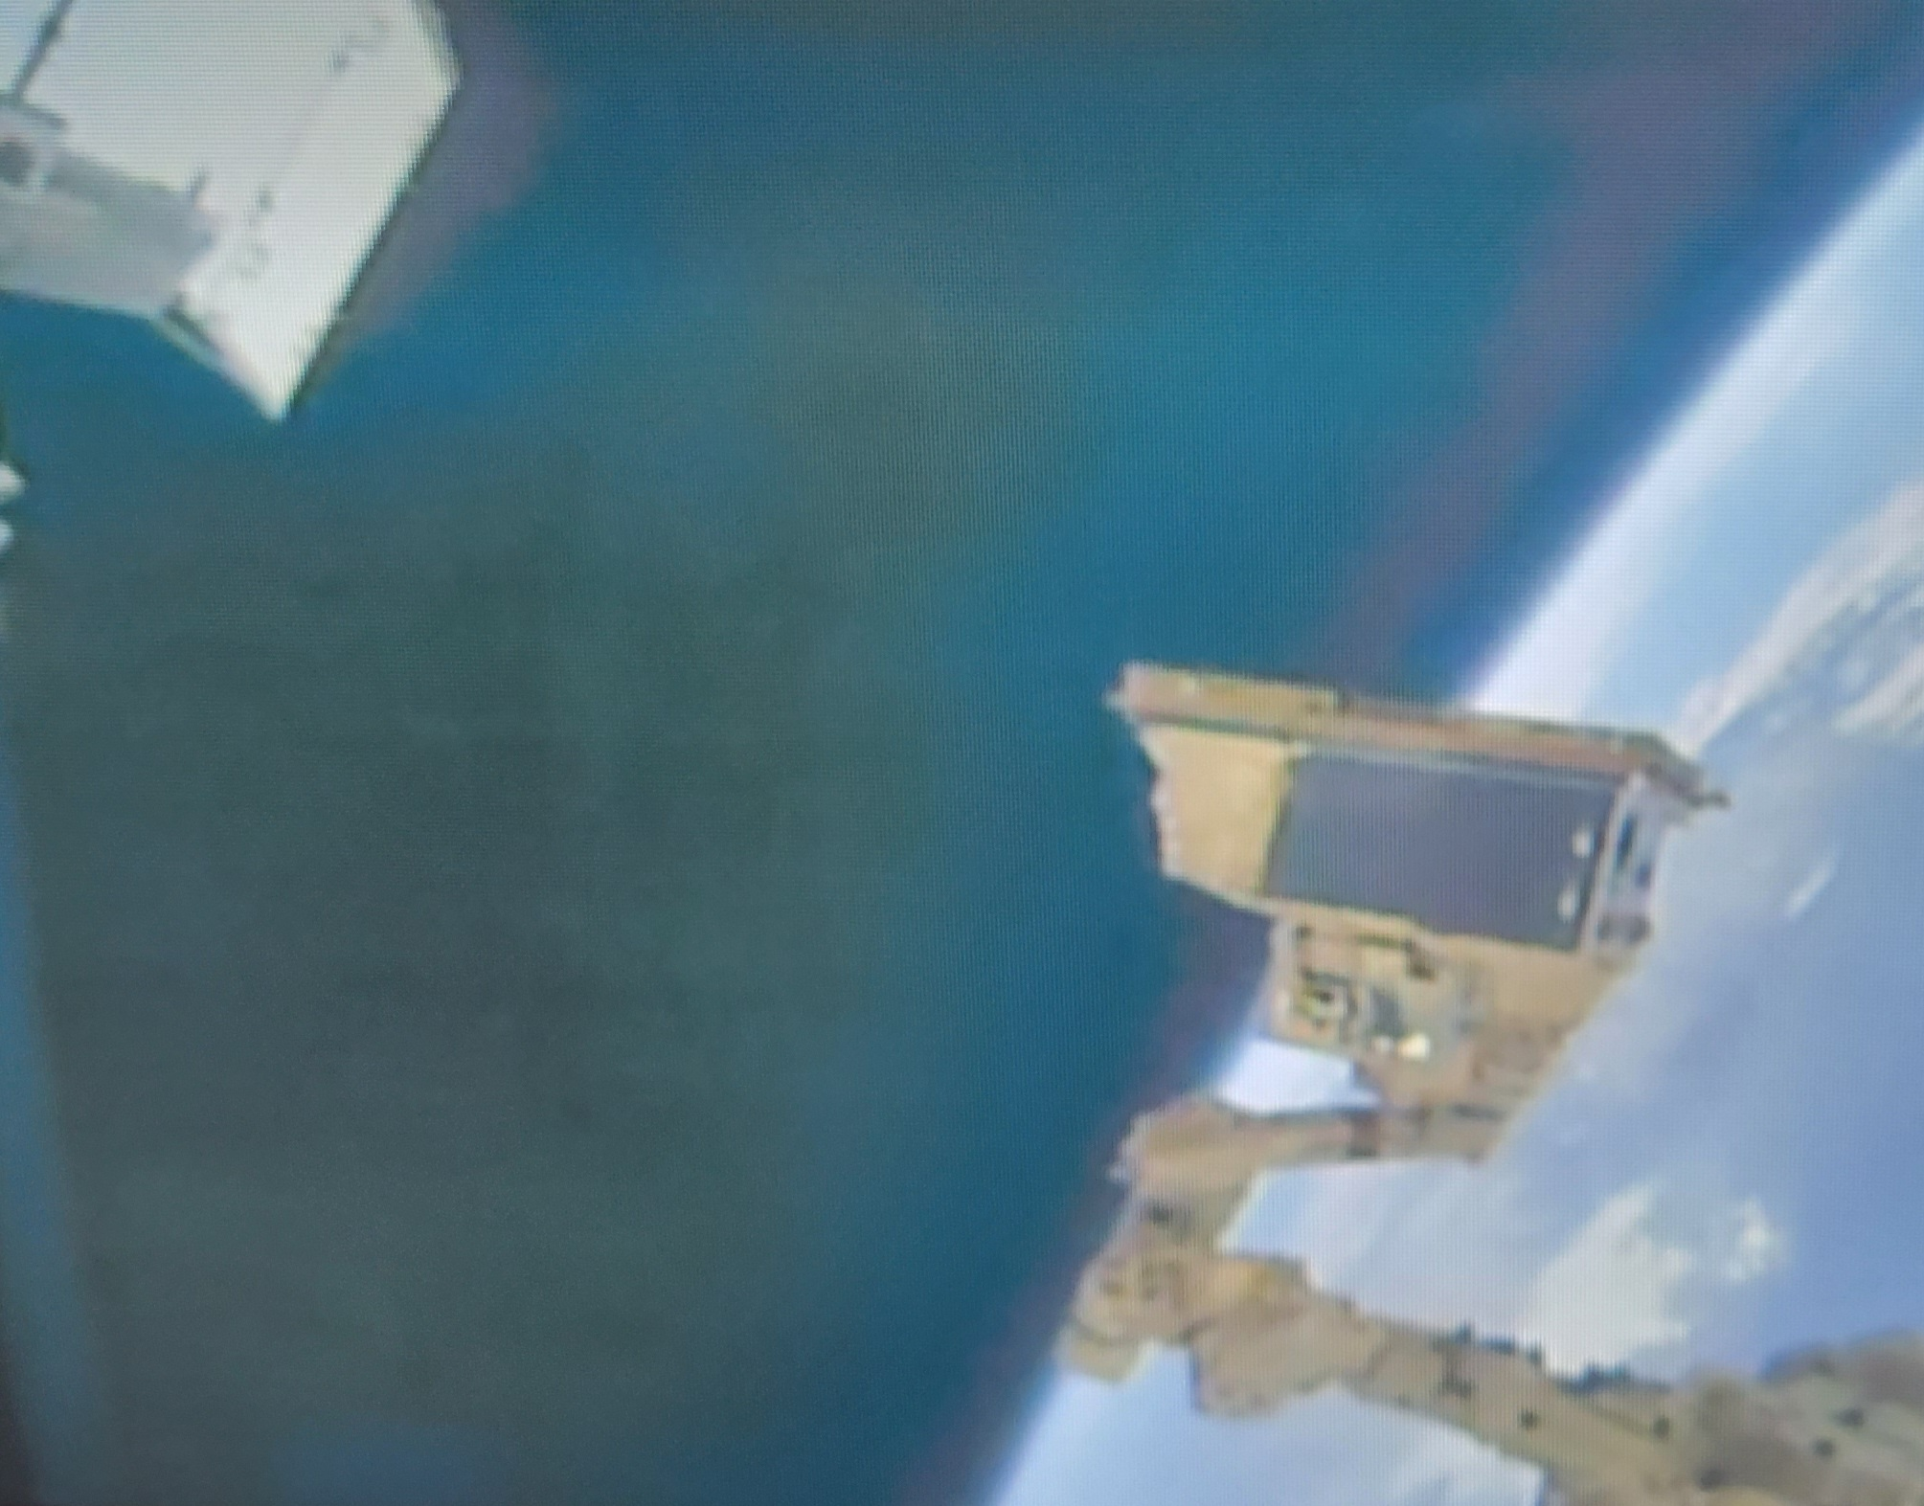
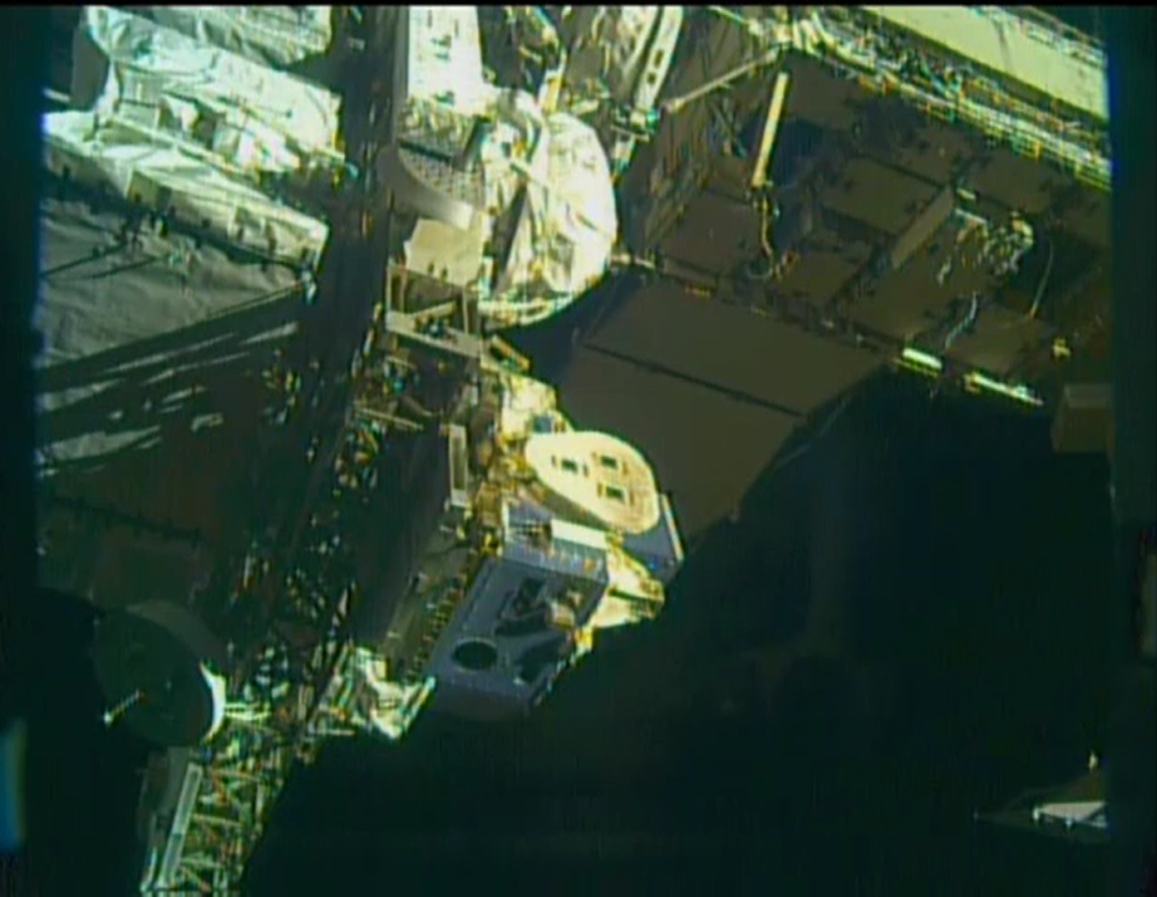
ISS LIS Relocation – 7 July 2022
Former location
LIS viewport
STP-H5/LIS being carried by robotic arm during relocation
STP-H5/LIS in new site on ELC-1 (site 3)

Slide 6
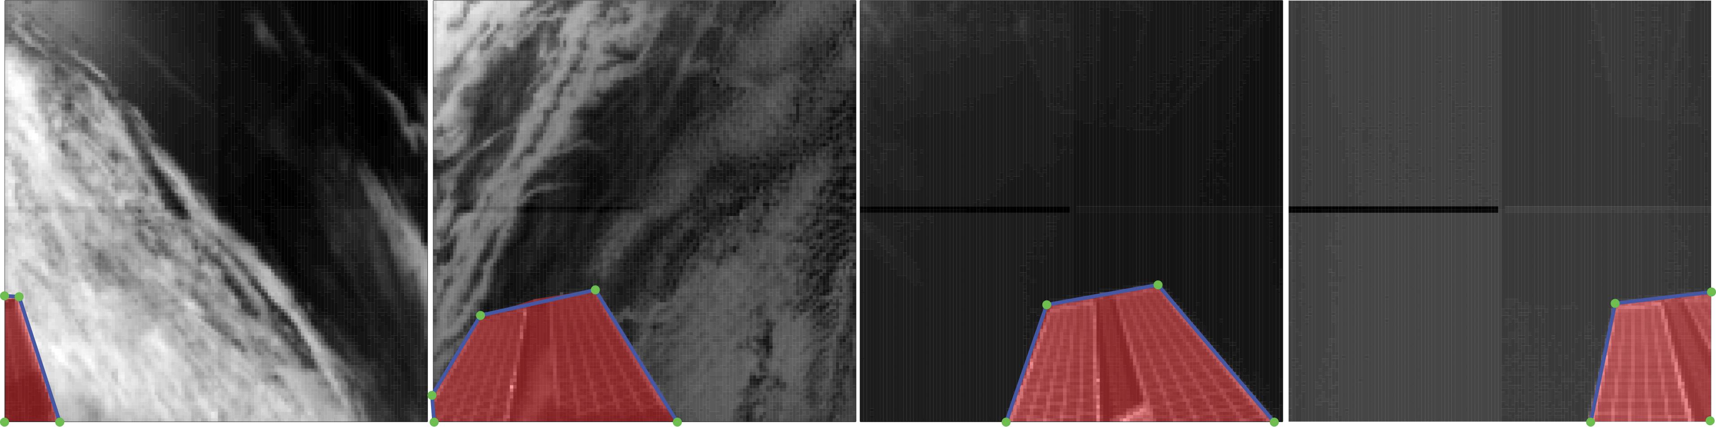
The relocation of STP-H5/LIS enables at least 1.5 years additional time on the ISS (thru December 2023 at earliest)
Work is ongoing to fully account for new FOV, including geolocation and viewtime updates, but instrument is in good health and partially corrected data are currently available from the new site @ GHRC

Slide 7
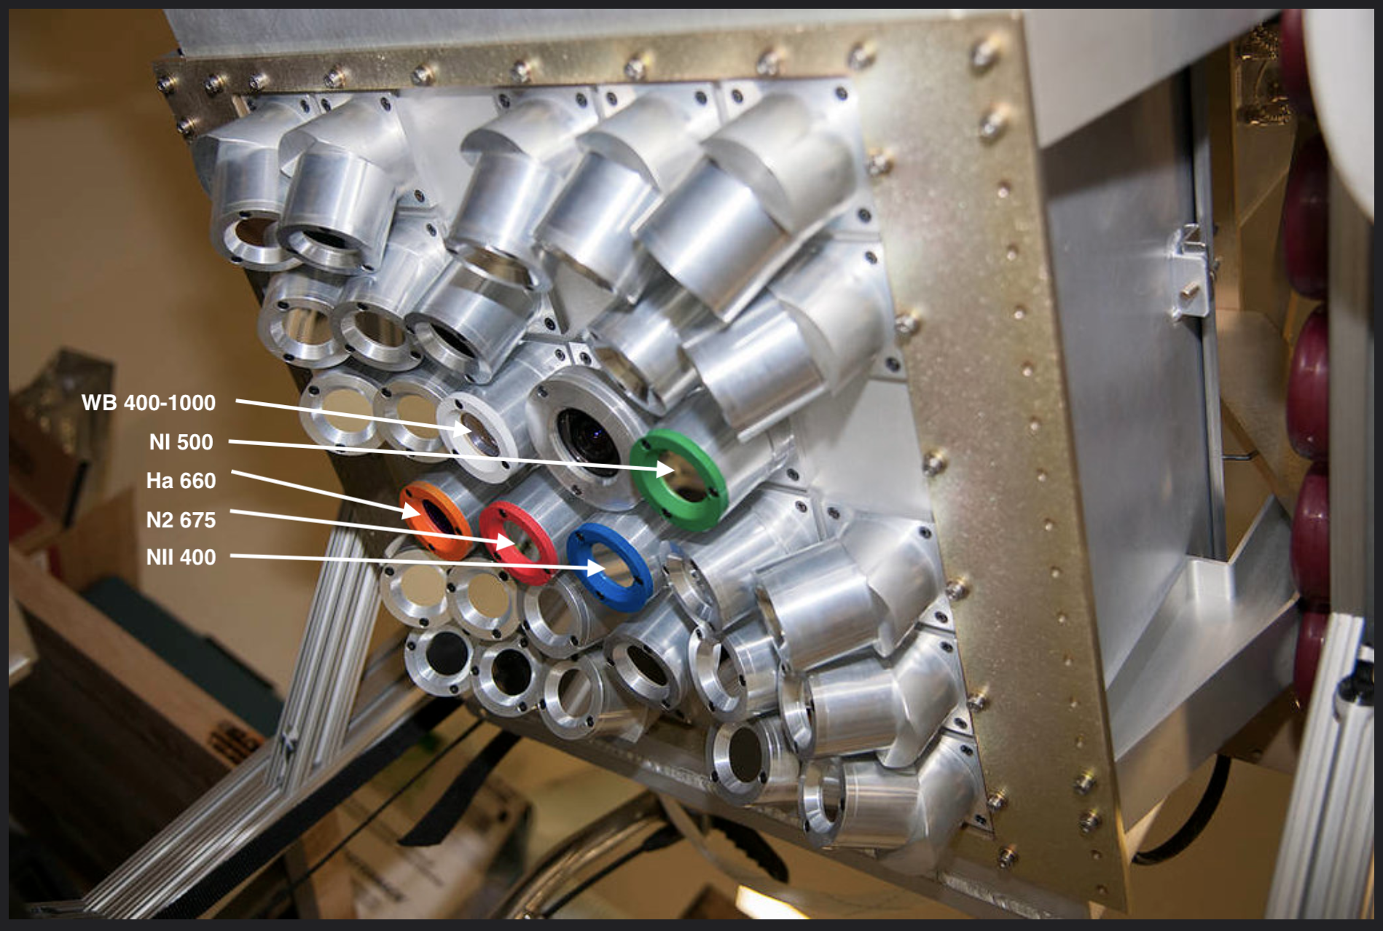
Fly’s Eye GLM Simulator (FEGS) Upgrade
Upgrades planned before July 2023:
Update electronic gains to improve overall performance
Improve filter on wideband camera to mitigate saturation
Improve radiometric precision by mitigating stray light with black paint on metal surfaces
Replace the N₂ channel with 337-nm (UV) channel
Replace 400-nm channel with 868.3-nm channel (to examine viability as 777-nm alternative)

Slide 8
Airborne Lighting Observatory for FEGS and TGFs (ALOFT)
ALOFT is joint venture between University of Bergen (Norway) and NASA
4-week, 50-hour ER-2 campaign scheduled for July 2023 out of Key West, FL (or comparable FL airbase)
Science focus is Terrestrial Gamma-ray Flashes (TGFs) produced by thunderstorms.
Main payload: FEGS, LIP, and two gamma-ray detectors

Slide 9
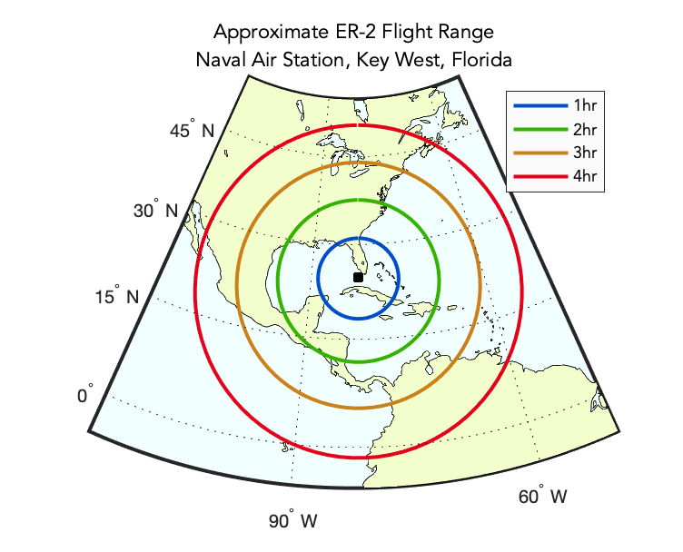
ALOFT Science Goals
Observe TGFs in one of the most TGF-intense regions on the planet.
Observe gamma-ray glows in thunderstorms and their relation to TGFs.
Perform GLM and ISS LIS validation using improved suborbital instrumentation.
Evaluate new design concepts for next-generation spaceborne lightning mappers.
If relevant instrumentation is available, make measurements useful to advance convection science from a suborbital platform.

