Slide 1



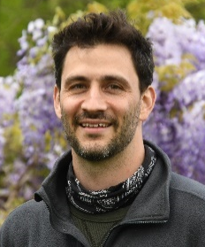






Developing a Raspberry Pi-based Camera Network and Its Applications
Daile Zhang
CISESS/University of Maryland
CISESS/UMD
NASA Marshall
CIMSS/OU
Earth Networks
Guangyang Fang
Joseph Patton
Terrence Pierce
Domenic Brooks
Alex Friedman
?
Mason Quick
Vanna
Chmielewski
Mike Stock
Jeff Lapierre
Karl Stock
NOAA NA19NES4320002 and CISESS Seeds Grant
Special thanks to Ken Cummins, Doug Baker, and Michael Peterson

Slide 2
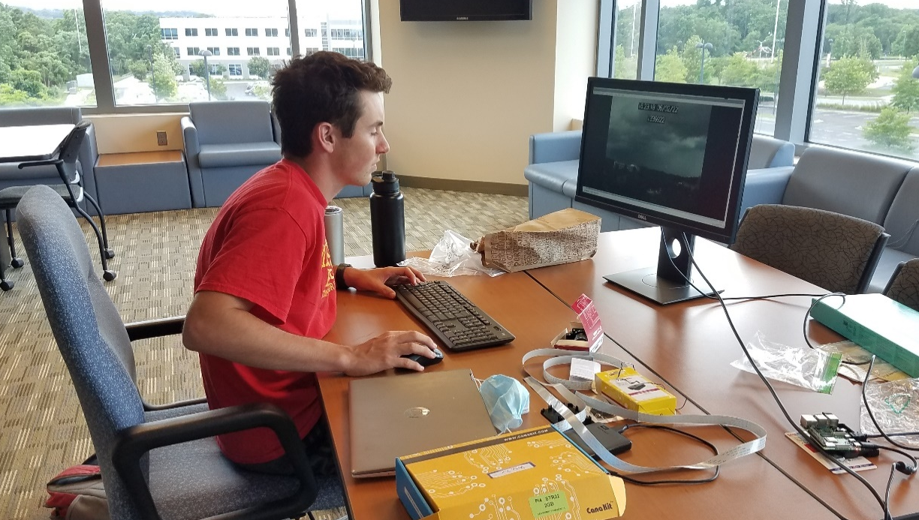
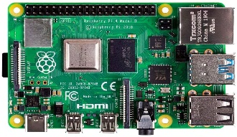
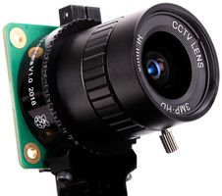
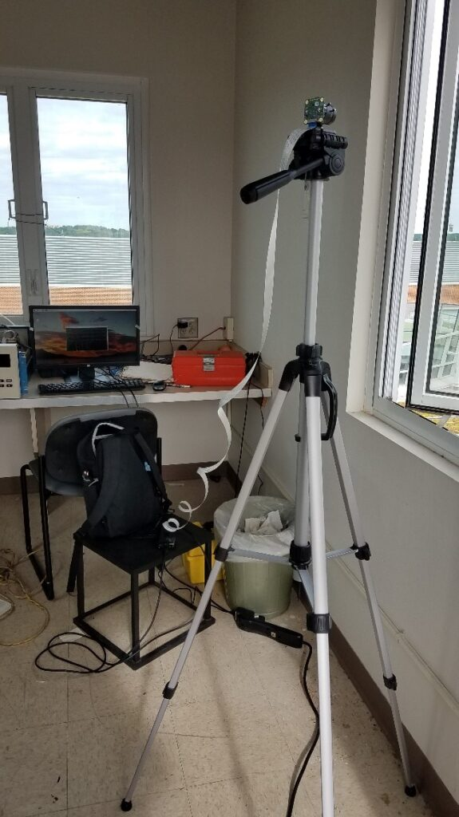
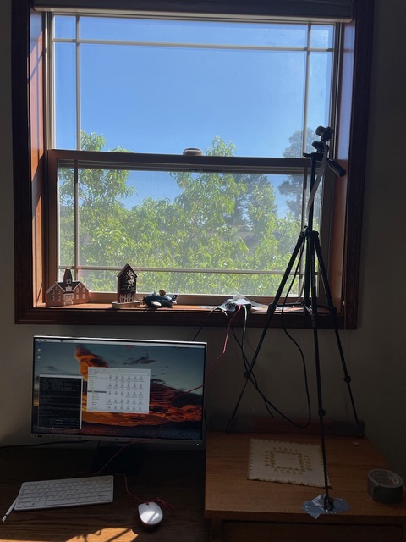
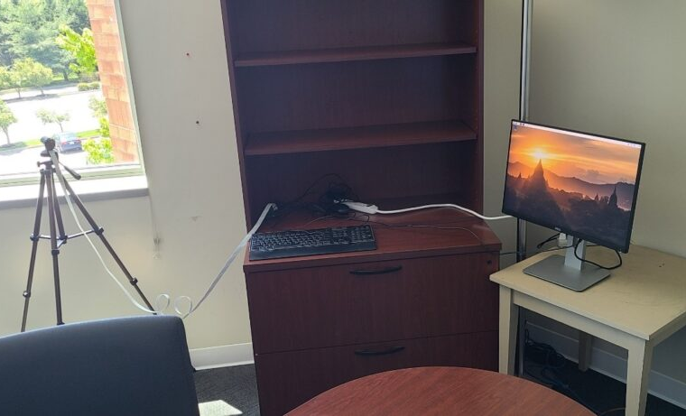
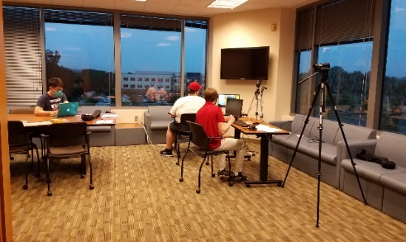
Raspberry Pi cameras and settings
8 in operation
5 in MD, 2 in AZ, and 1 in OK
Raspberry Pi cameras
UMD Campus
College Park, MD
Flagstaff, AZ
Earth Networks
Germantown, MD
CISESS/ESSIC
College Park, MD

Slide 3
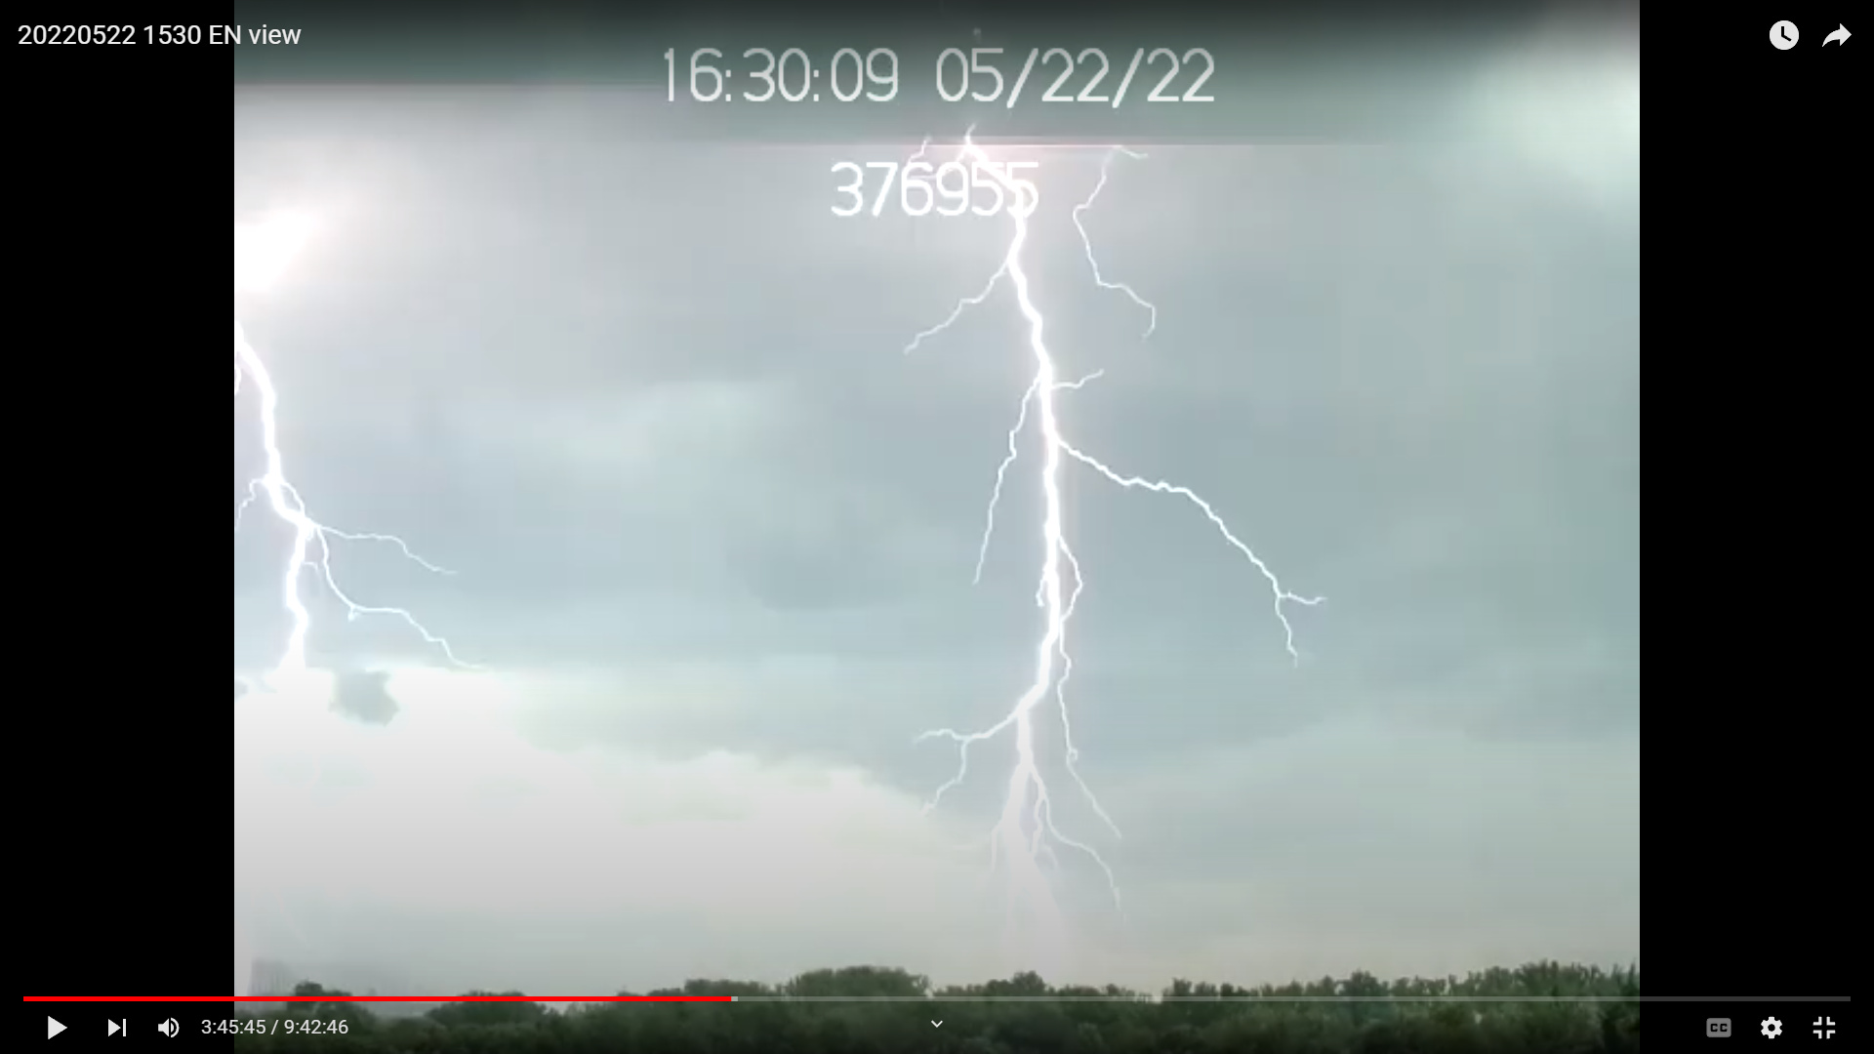
An 8-Stroke CG flash on
20220522 in Germantown,MD
Looking south

Slide 4
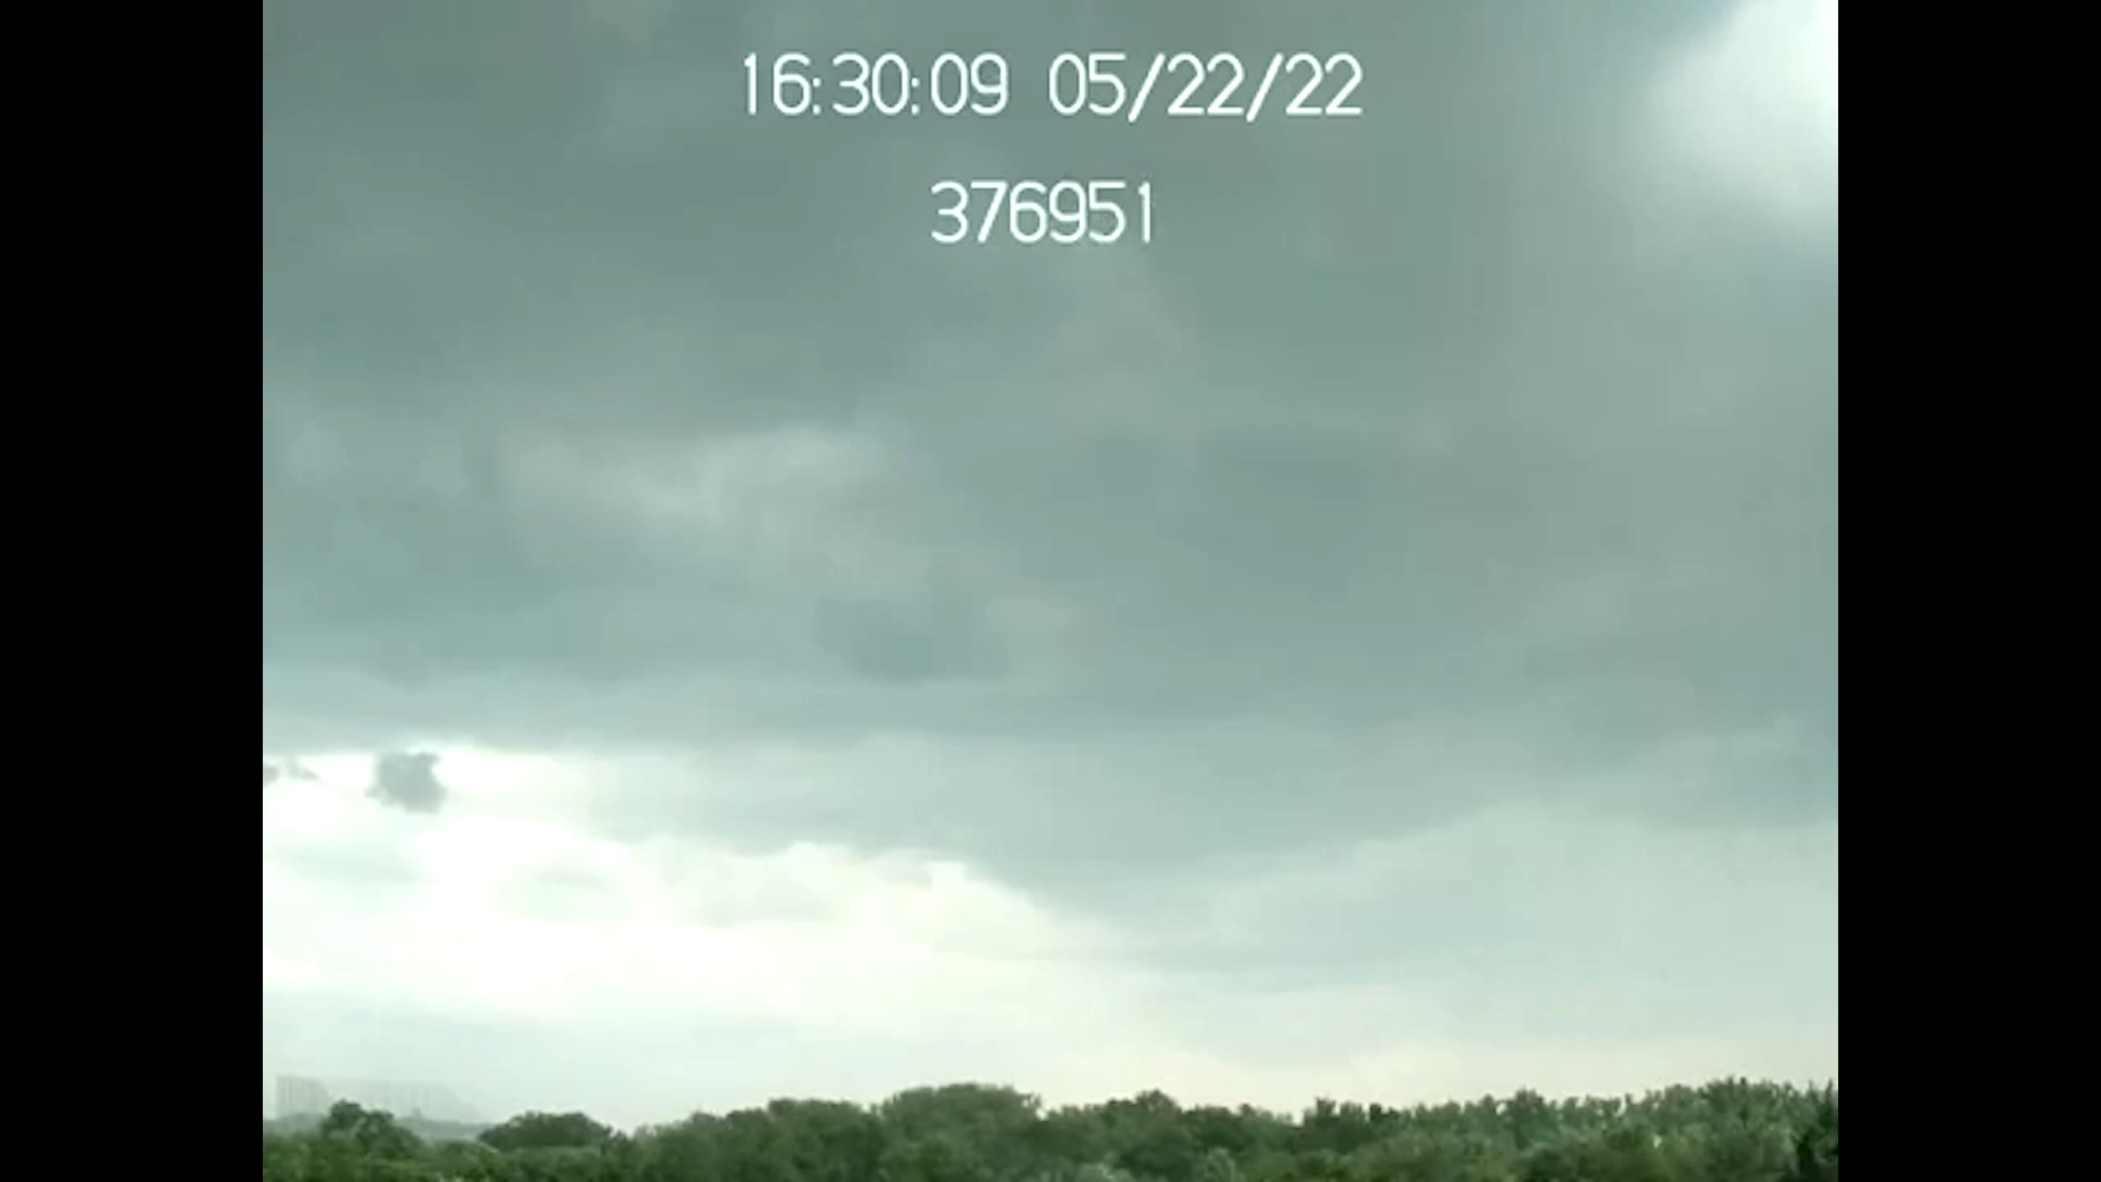

Slide 6
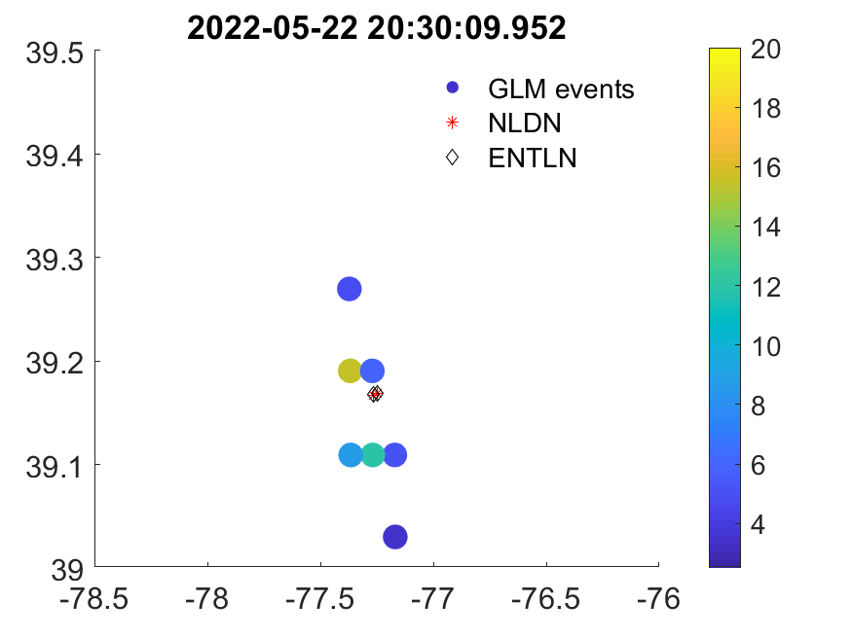
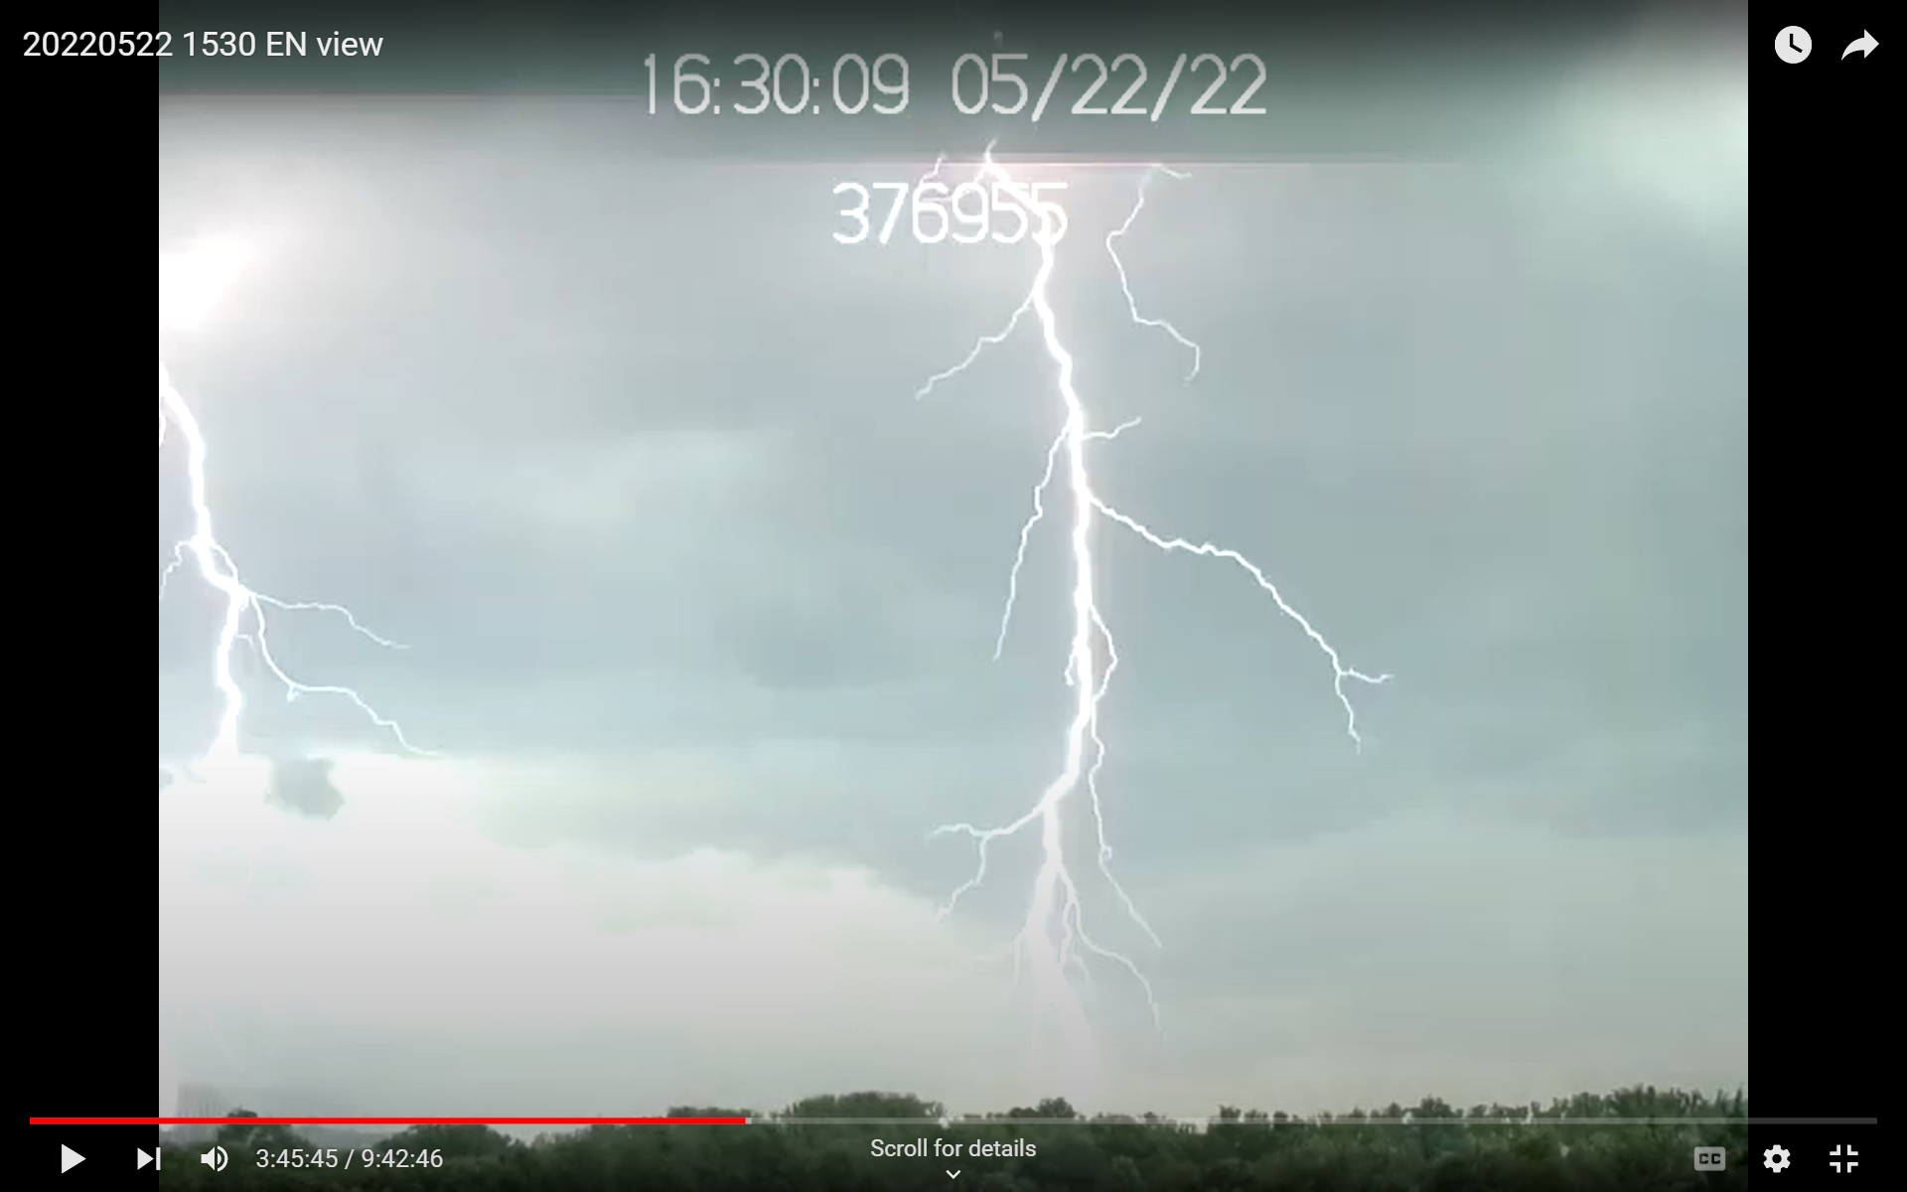
First Strokes – Two Simultaneous Strokes
2 ENTLN CG strokes
2 NLDN CG strokes
-11kA and -9kA
-16.6kA and -15.1kA

Slide 7
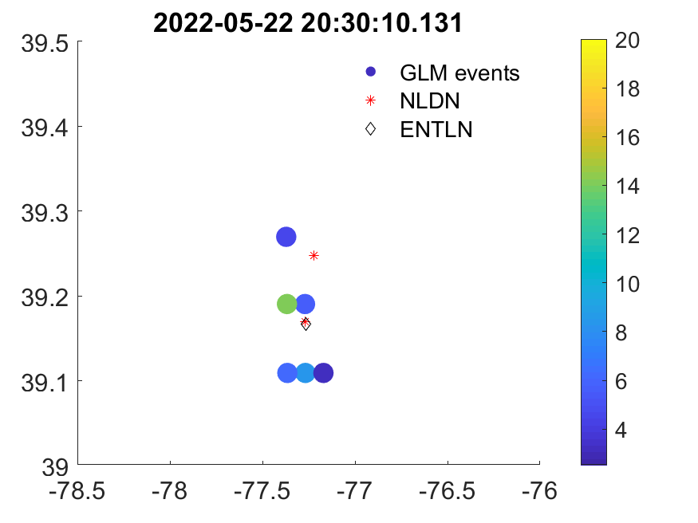
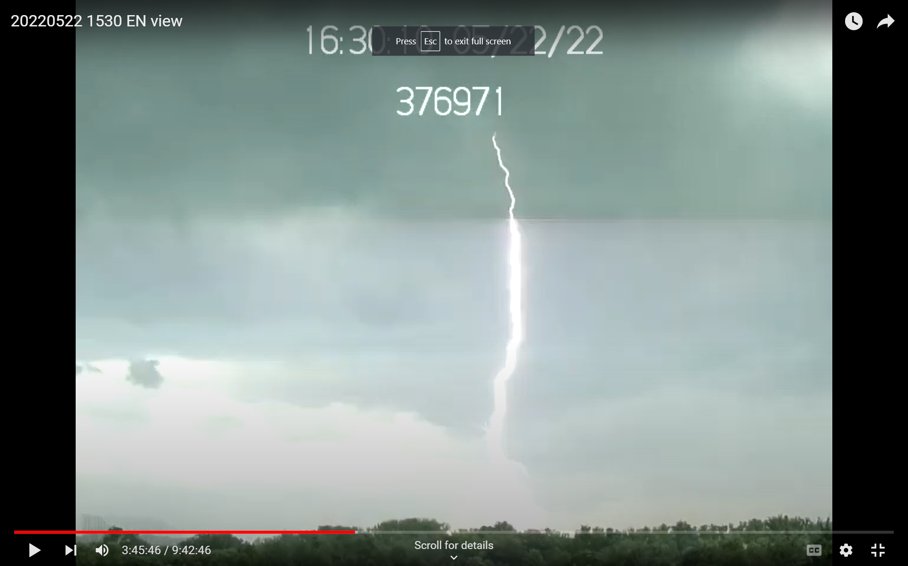
Second Stroke (new leaders/striking point)
A -16kA CG and a 2kA IC
17.7kA CG

Slide 8
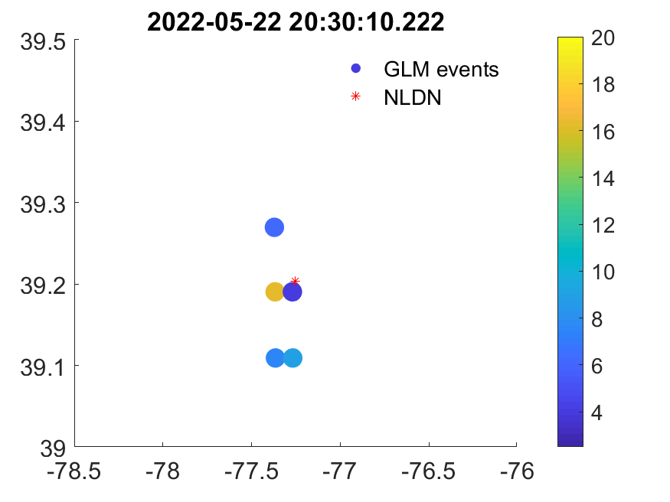
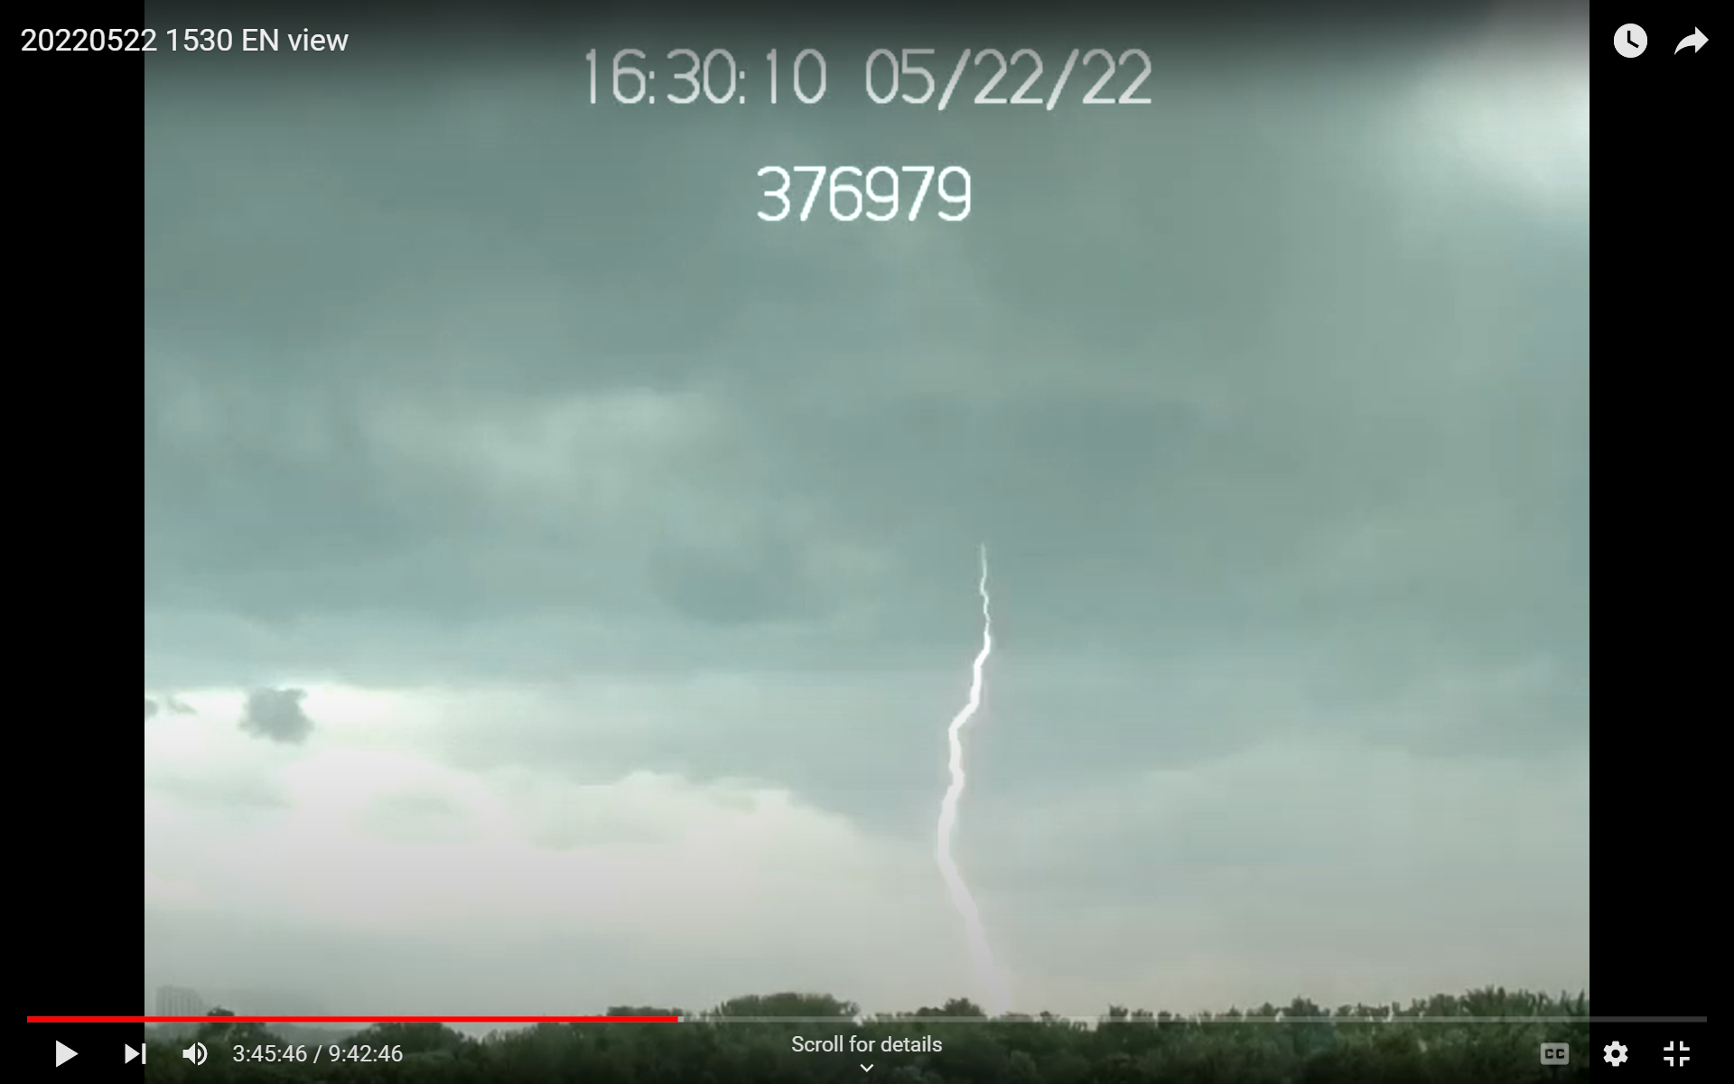
3rd Stroke (continuing current)
-2kA IC
ENTLN didn't detect anything.

Slide 9
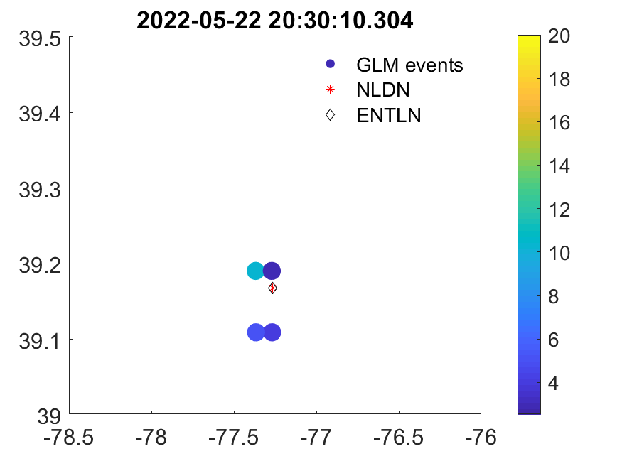
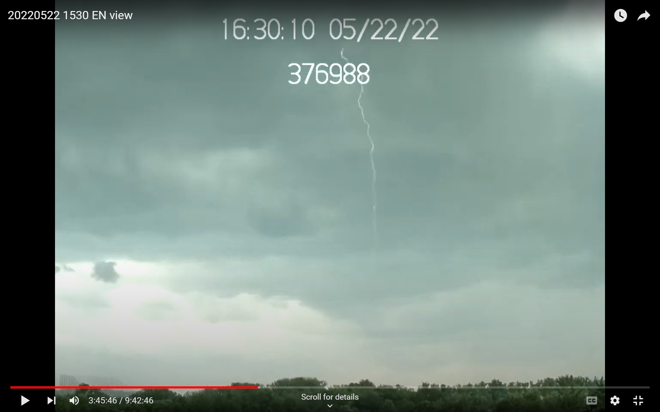
4th Stroke
-14.6kA CG
-12kA CG

Slide 10
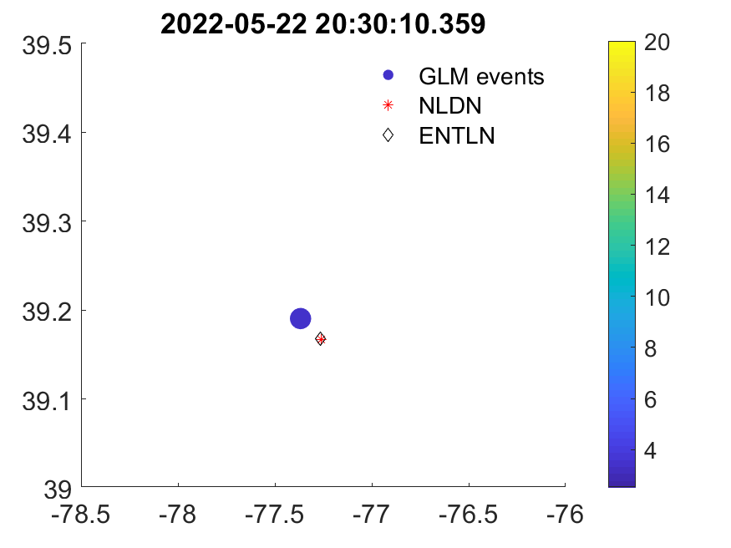
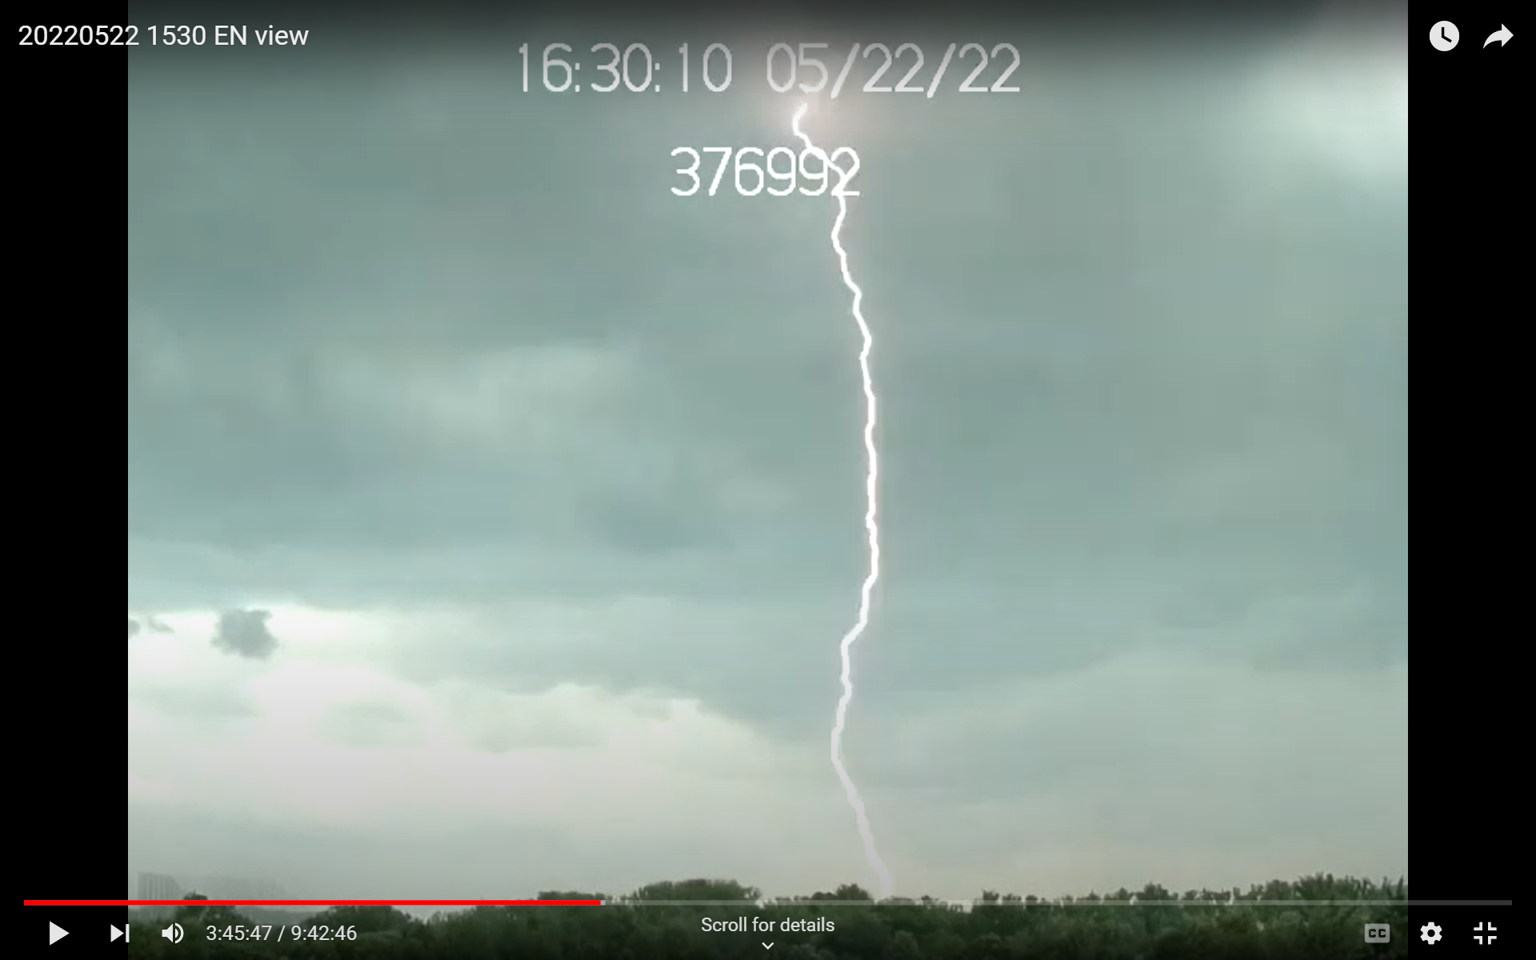
5th Stroke (continuing current)
-5.3kA CG
-3kA IC
NLDN misclassified.

Slide 11
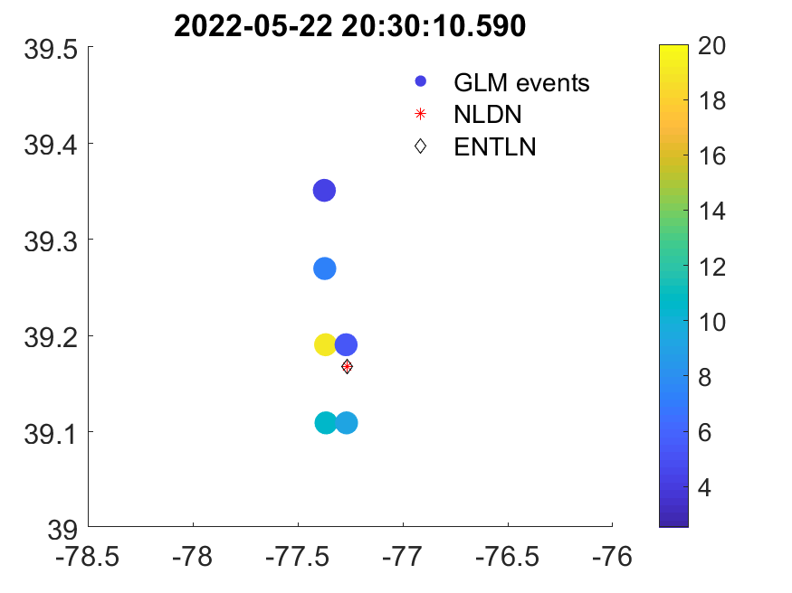
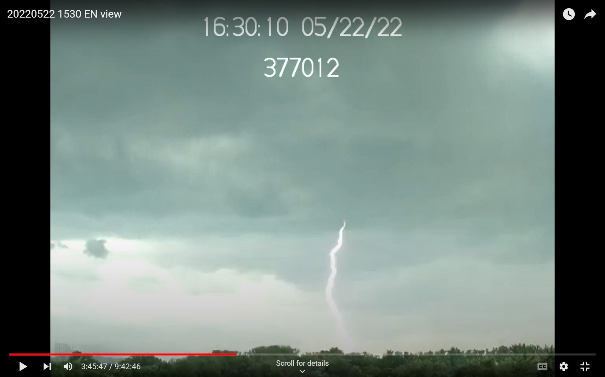
6th Stroke (continuing current)
-11kA CG
-11.6kA CG

Slide 12
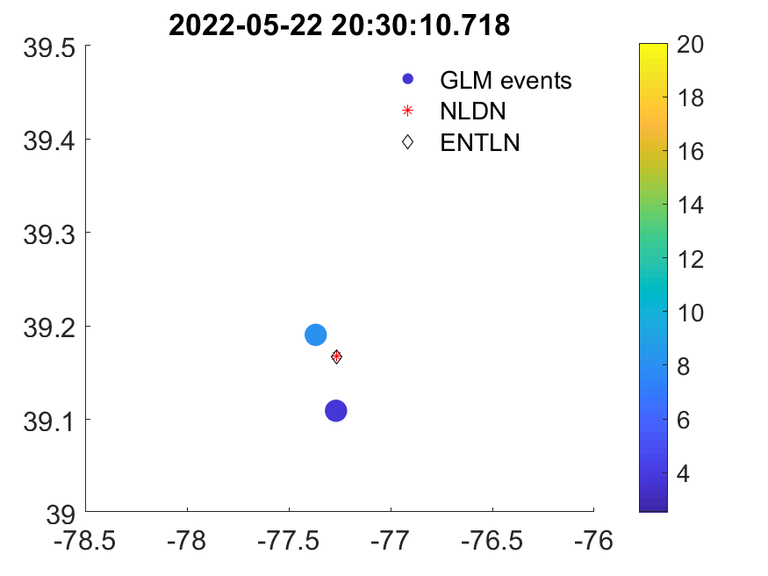
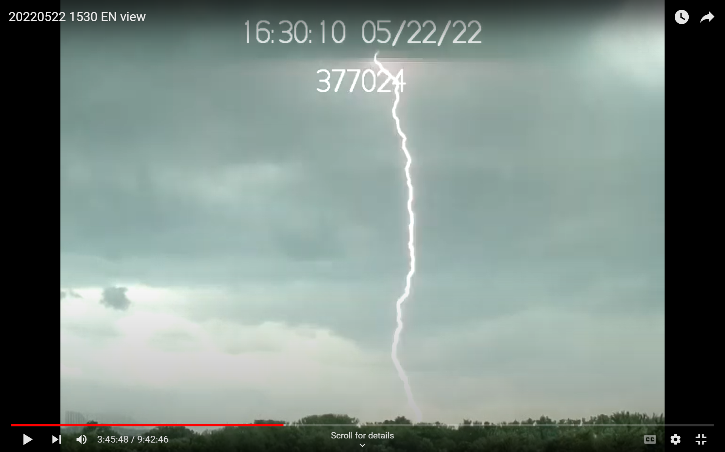
7th Stroke (continuing current)
-8kA IC
-10.0kA CG
NLDN misclassified.

Slide 13

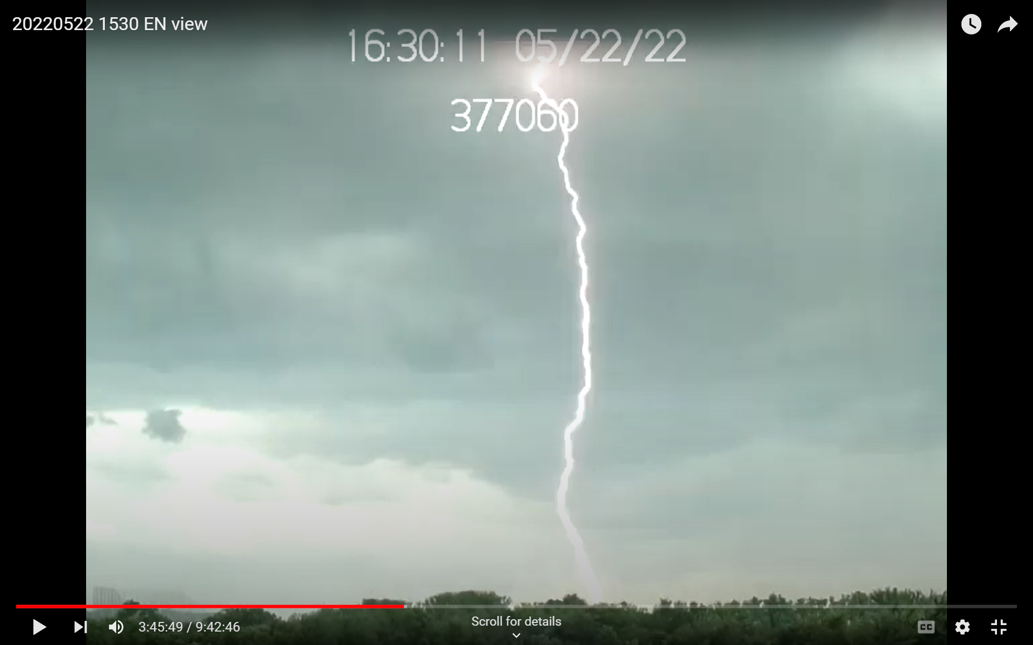
8th Stroke (continuing current)
Video-derived time is 20:30:11.114
NLDN 20:30:11.116 -3kA IC
ENTLN 20:30:11.116 -5.1kA IC

Slide 14
Findings
GLM matched with the video well. GLM detected the first 7 strokes. The 8th stroke was 4-5 ms later than the video (more than 2 ms).
GLM correlated well with the ground-based measurements in both time (within 2 ms temporal resolution) and space (within 1 pixel size), except for the last stroke.
The brightest GLM pixel was not the closest one with the ground-based measurement, but off by one pixel due to parallax.

Slide 15
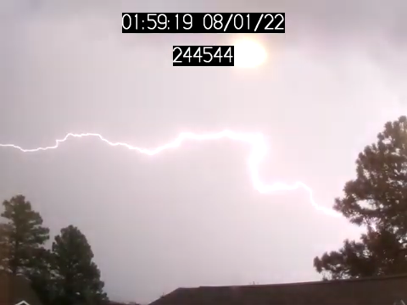
Long Continuing Current Flash in Flagstaff 20220801
Looking east

Slide 16
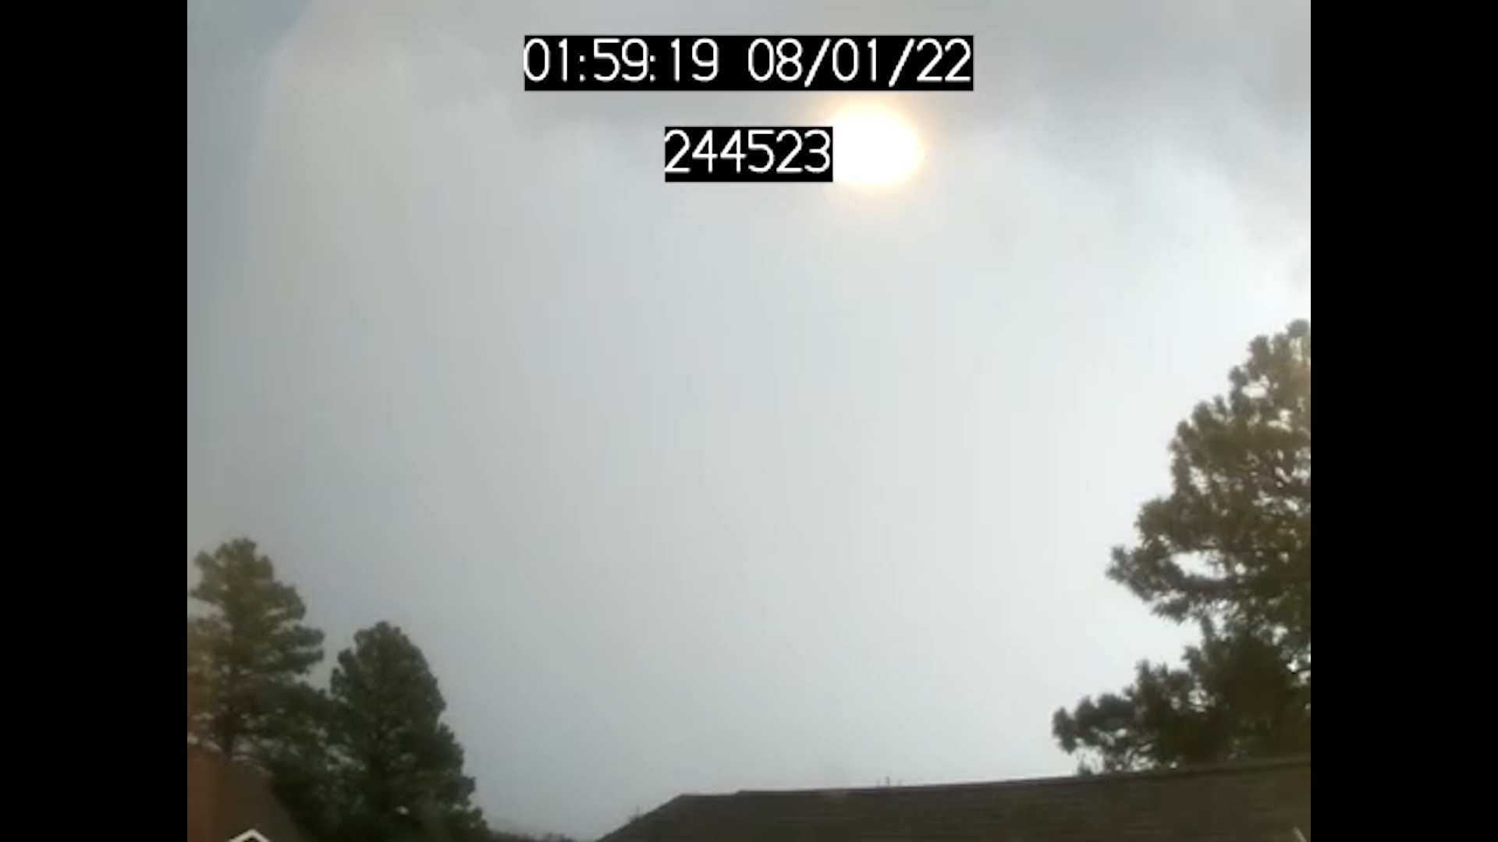
Regular speed

Slide 17
Slow-Mo

Slide 18
Findings
The flash lasted for 45 frames (approx. 500 ms) with long continuing current.
Neither GLM-16 or -17 detected this flash. Nothing within 50 km and 1 second.
ENTLN detected 3 CGs with the first one from WWLLN.
NLDN detected 3 CGs and 3 ICs.
The 3 CGs matched well between ENTLN and NLDN. ENTLN didn’t detect any NLDN ICs.
* Camera time is off by about 177 ms.

Slide 19
Why GLM Miss Detection?
Strokes with continuing currents tend to be less intense.
Flagstaff, AZ daytime detection threshold is about 2 fJ higher than in Germantown, MD.
(Cummins 2021)

Slide 20
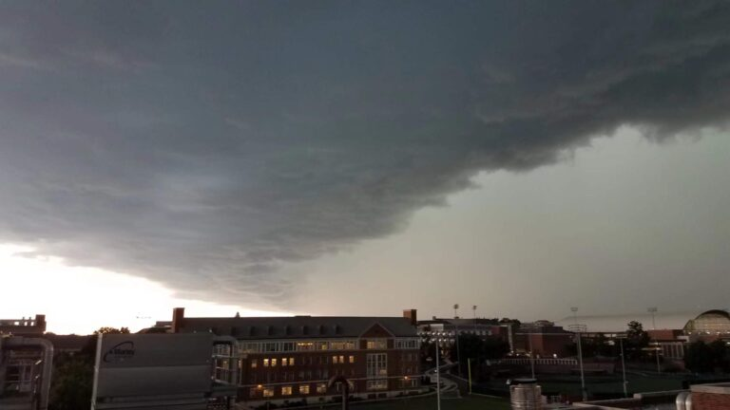
A 12-stroke (or 13?) Flash on 20220712 in College Park, MD
Looking South

Slide 21
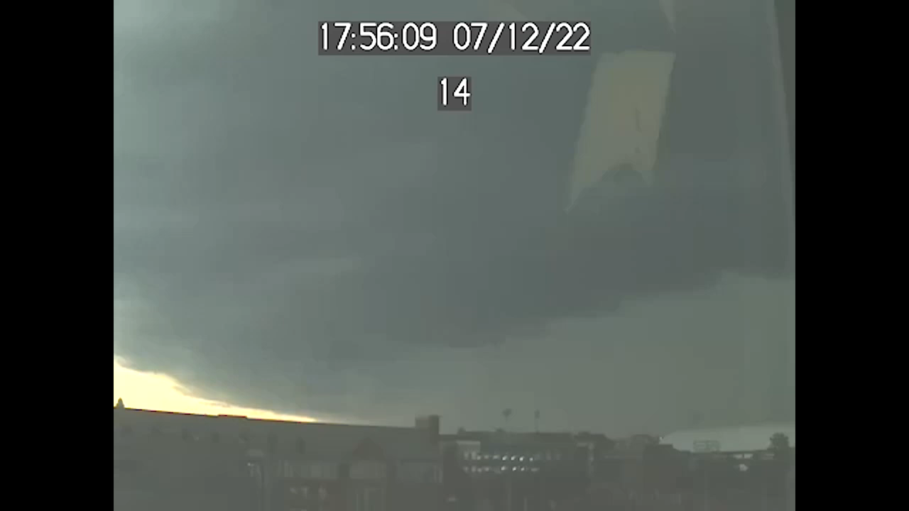
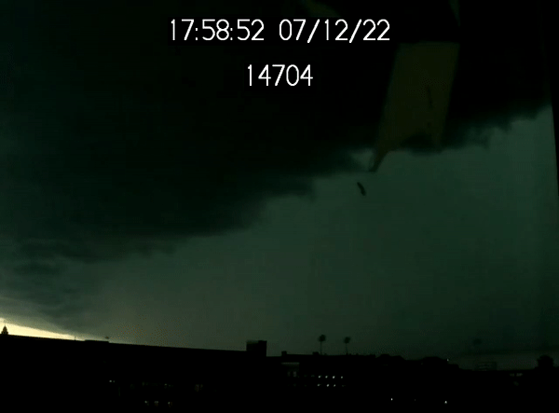

Slide 22
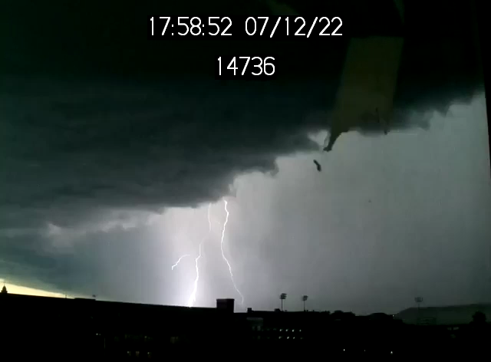
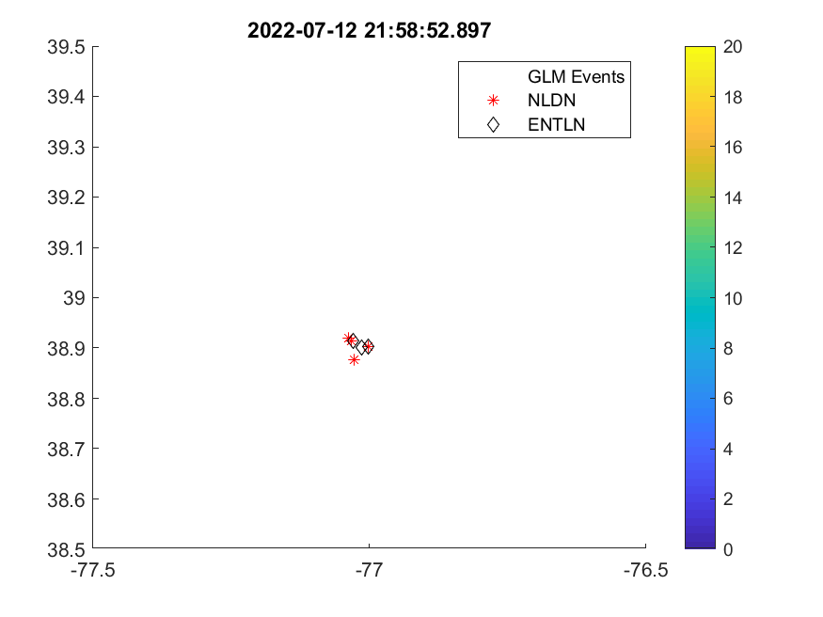
21:58:52.897
-48.9 kA
-37.8 kA

Slide 23
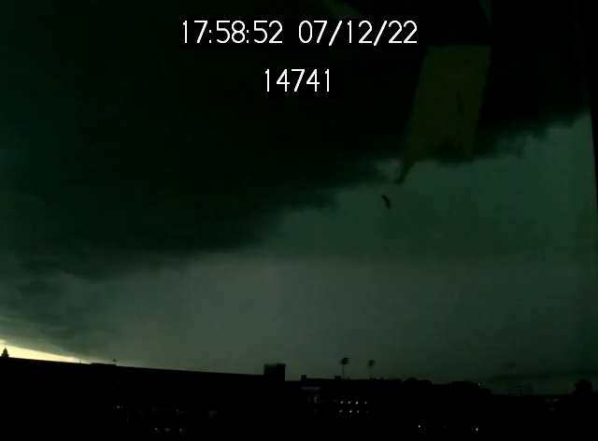

21:58:52.960
-17.7 kA
-10.8 kA

Slide 24
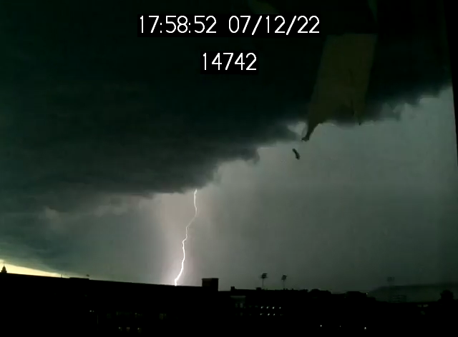
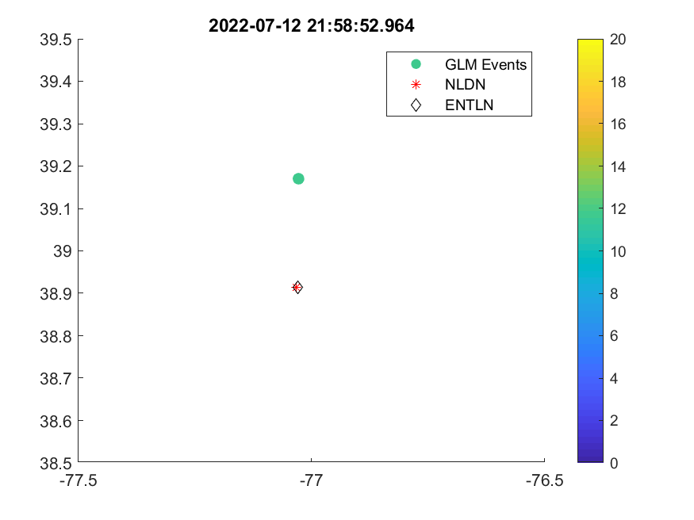
21:58:52.961
-12.4 kA
-10.1 kA

Slide 25
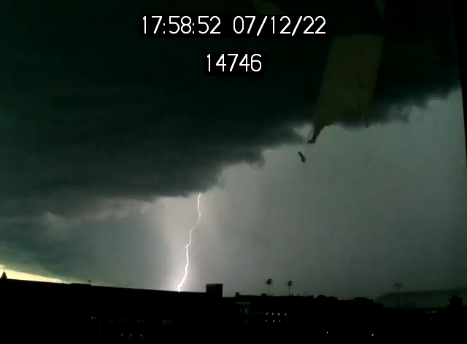

21:58:53.006
-33.1 kA
-25.6 kA

Slide 26
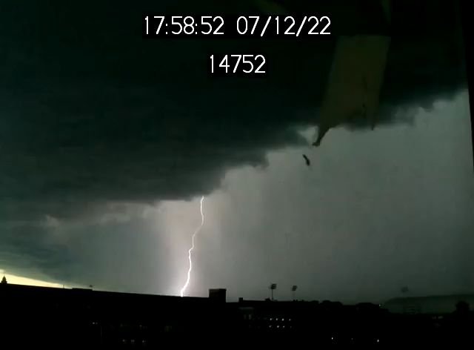

21:58:53.069
-39.0 kA
-27.6 kA

Slide 27


21:58:53.153
-7.6 kA
-4.2 kA
NLDN misclassified.

Slide 28
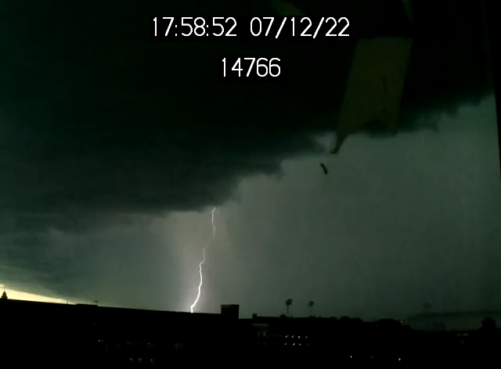

21:58:53.232
-27.5 kA
-17.9 kA

Slide 29
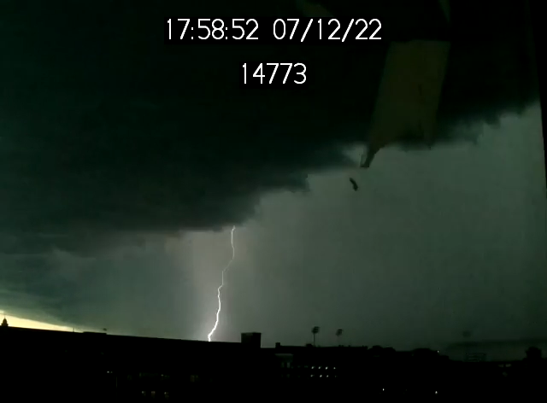

21:58:53.304
-29.9 kA
-19.4 kA

Slide 30
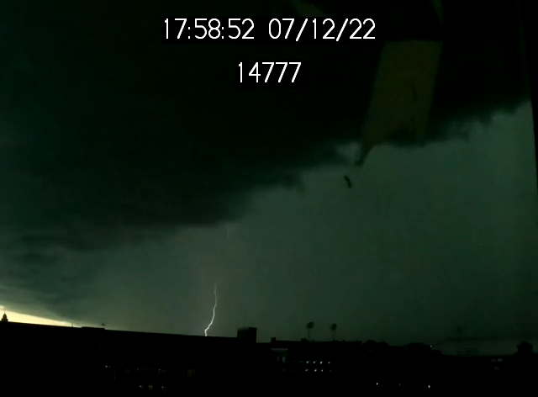
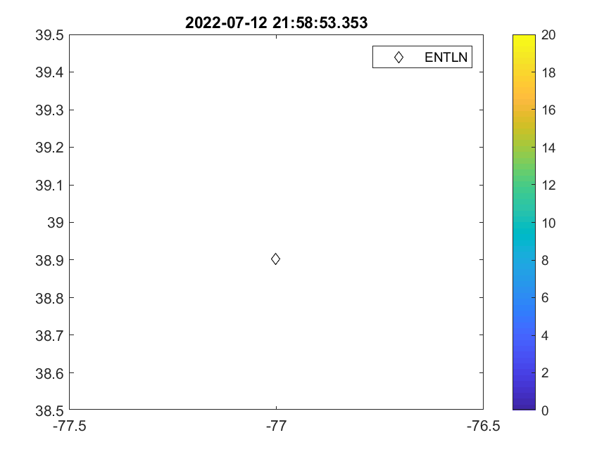
21:58:53.353
-10.3 kA

Slide 31


21:58:53.370
-11.1 kA
-6.0 kA

Slide 32
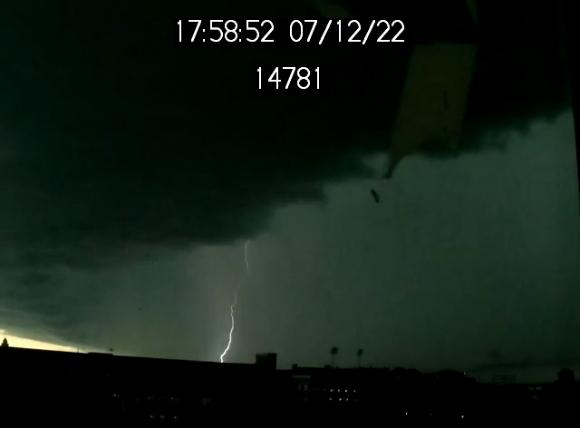

21:58:53.398
-22.5 kA
-12.4 kA

Slide 33
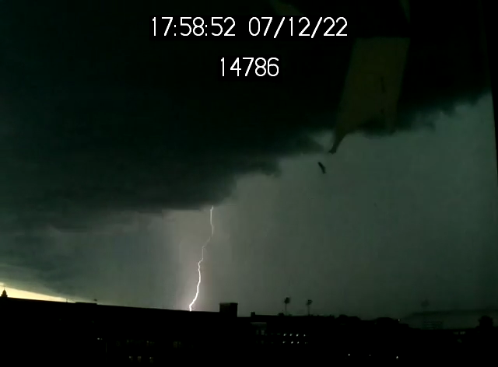

21:58:53.452
-18.7 kA
-10.7 kA

Slide 34
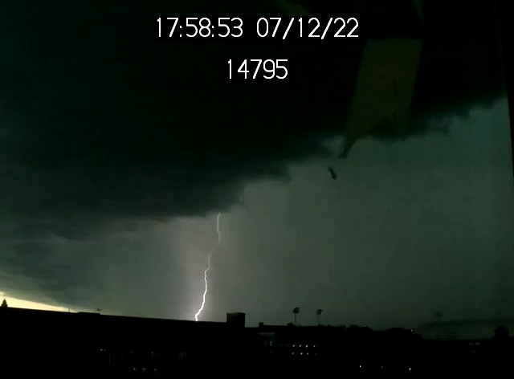
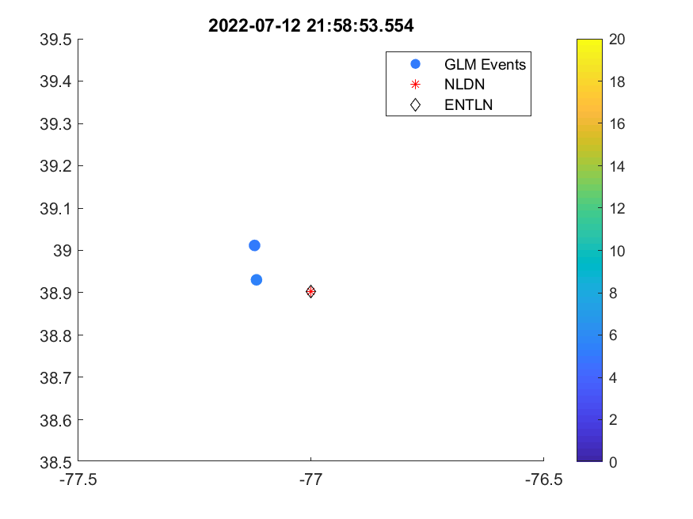
21:58:53.554
-25.0 kA
-14.9 kA

Slide 35
Findings
GLM only detected 2 frames with one frame around 3 ms (>frame rate) from the ground measurement. First GLM frame only had one lit-up pixel at least 30 km from the ground point. Last GLM frame had two closer pixels around 10-20 km from the ground point. But those pixels didn’t match with the first frame in geolocations.
Both ENTLN and NLDN were able to pick up simultaneous strokes in the first frame. ENTLN detected all 12 strokes with one additional stroke not being caught in the frame. NLDN detected 11 out of 12 strokes with the additional one not in the frame. Matched well both in time and space.

Slide 36
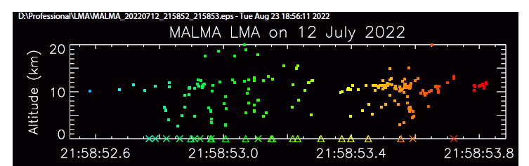
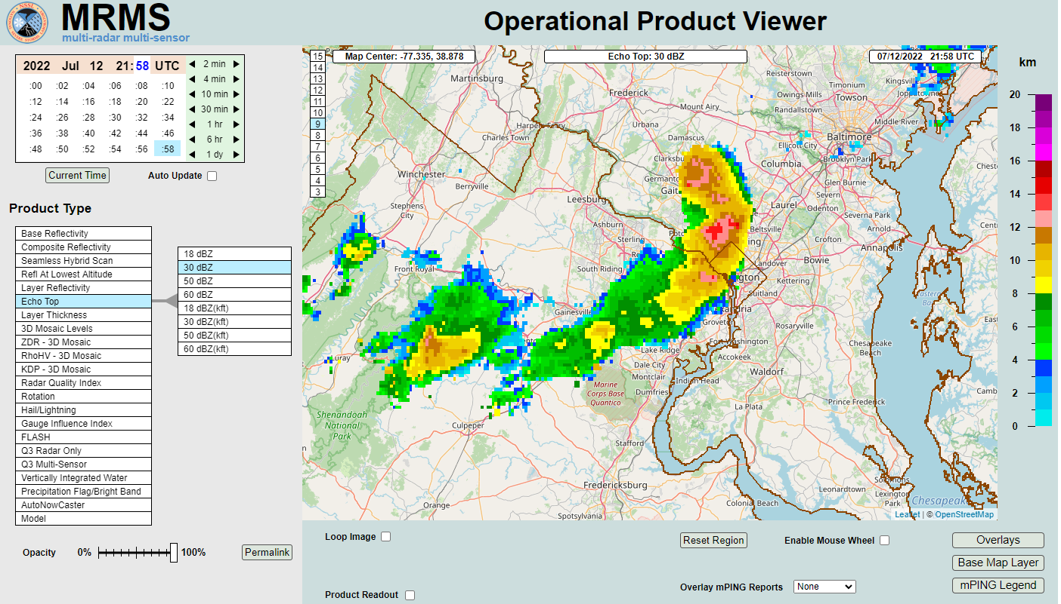
Why GLM Miss Detection?
Higher reflectivity indicated that abundant of hydrometeors between the cloud top and the flash could increase light scattering.

Slide 37
Summary
Overall, GLM detected most CG flashes based on the Raspberry Pi camera observations.
GLM might not detect all the CG strokes in the same flash, especially the first one or two. (see Zhang and Cummins, 2020)
GLM might not detect CG strokes with continuing currents.
GLM might not detect some CG strokes when the clouds were thick.

Slide 38

UMD Lightning YouTube Channel
https://www.youtube.com/channel/UC4RfgtjUbotawHh7UzCRBAw
Thank you!

