Slide 1
Update on the Development and Performance of the Mid-Atlantic Lightning Mapping Array (MALMA)
2022 GLM Science meeting
Guangyang Fang, Daile Zhang
University of Maryland/CISESS
September 13, 2022

Slide 2
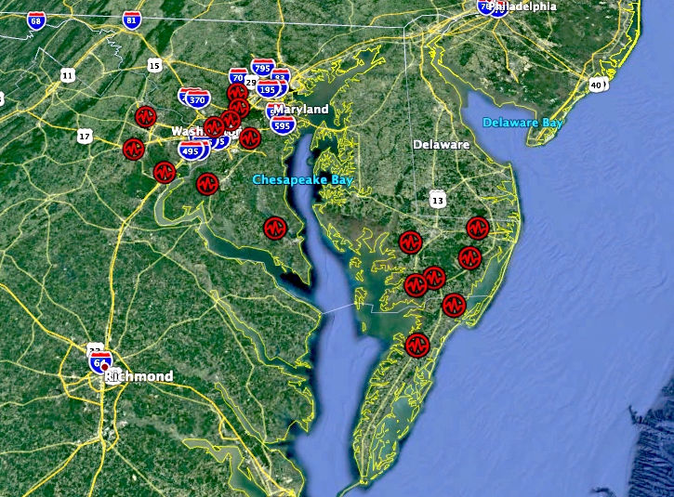
Outline
Update of MALMA
Performance of MALMA
Thunderstorm causing massive outages in College Park on 07/12/2022;
Thunderstorm causing fatalities near the White House on 08/04/2022
Future works

Slide 3
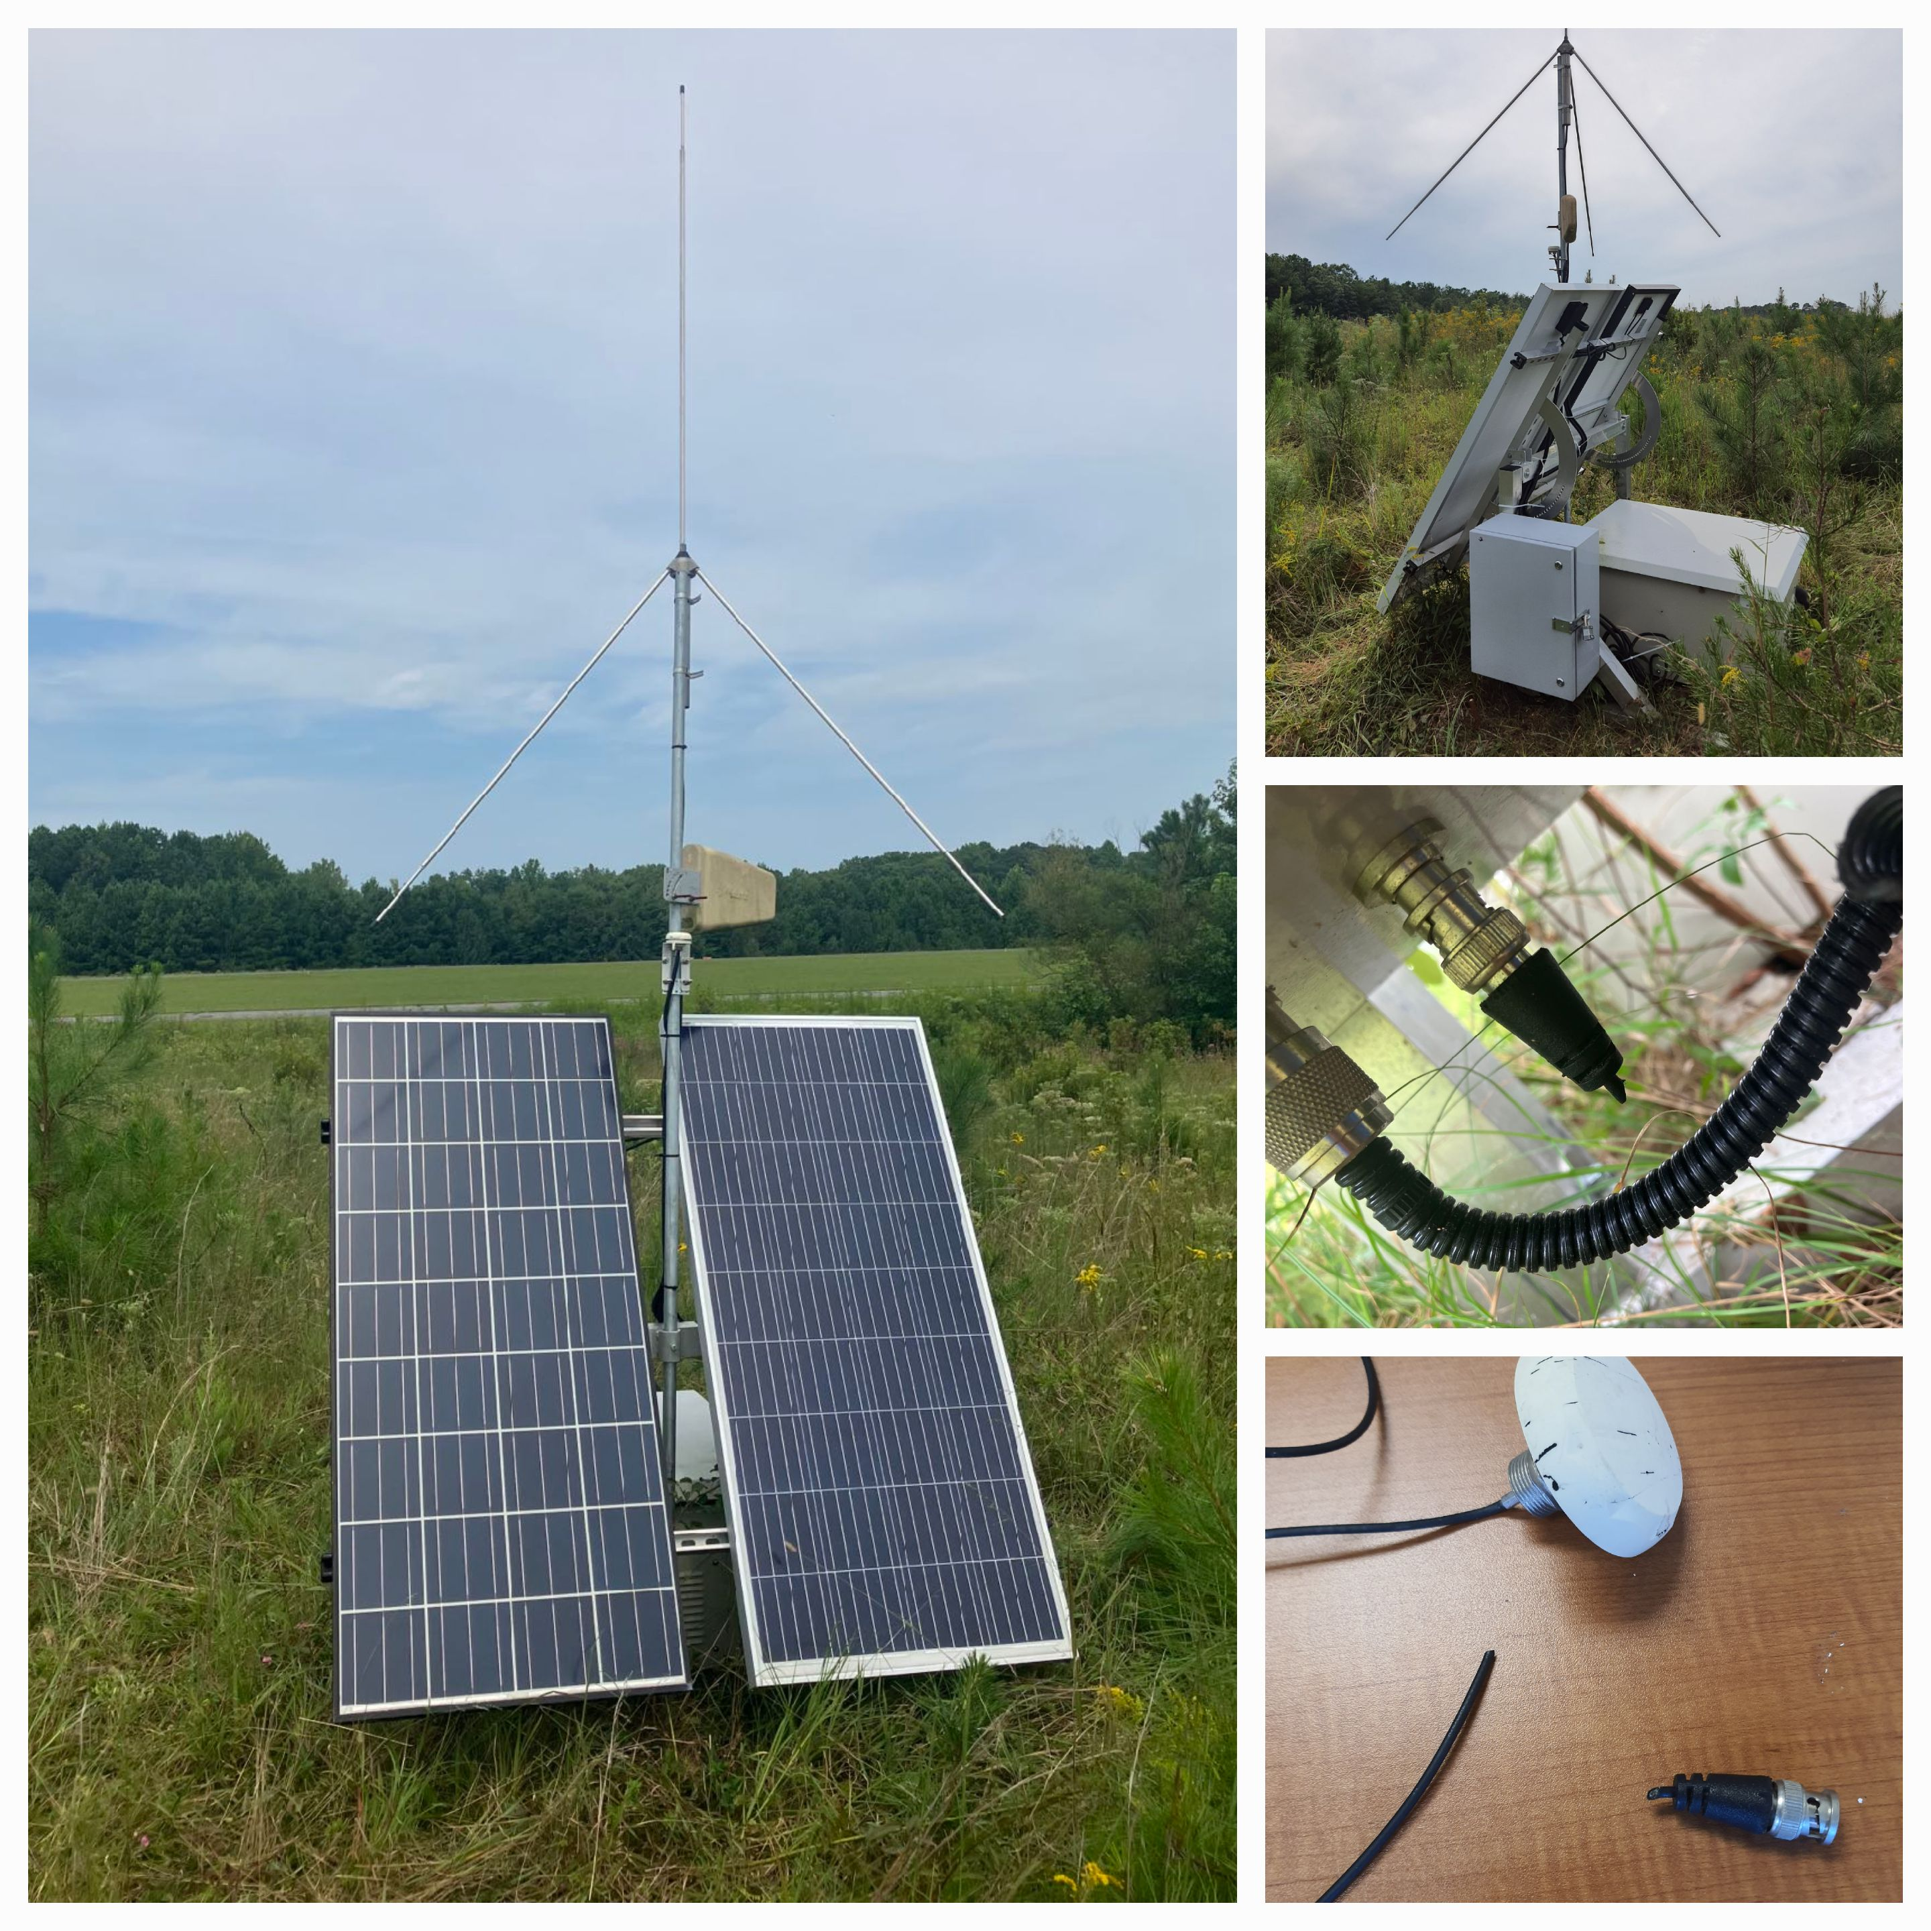
Update of MALMA
Due to intensive maintenance in 2021, DCLMA sites are functioning well;
In March, 2022, Dr. Tim Lang hosted a discussion about the combined MALMA processing. Given the NASA-owned Washington, D.C. LMA (DCLMA) and the NASA Wallops LMA (WFFLMA) are combined and processed as a single entity, the Mid-Atlantic LMA (MALMA), and DCLMA has some challenges with certain stations, it makes sense to perform the combined MALMA processing for a NASA-provided data product rather than creating separate DCLMA & WFFLMA products;
In April, 2022, the server which does the data processing and hosts the web pages located in northern New Mexico was pulled and moved to a safer location because the area was under mandatory evacuation for a nearby forest fire;
In July, the server was moved back to the old location;
In August, one of the WFFLMA stations in UMD_UAS had an issue with the GPS connection. After being inspected on-site, the GPS coaxial cable was found to be cut off from the end near the ground. It seemed to be bitten by some animals. After replaced with a good GPS cable, the site functioned well again.

Slide 4
Current Status of MALMA
DCLMA (Wired) | Status | Detail | Wallops LMA (Wireless) | Status | Detail
a Sterling | Up |  | a Accomack_WESR | Up
b->j Woodbridge | Up |  | b THRN_Property | Up
c CSM | Up |  | c Wallops_Pad | Up
d Howard | Down | To be installed | d Plywood_Plant | Up
e UMD | Up |  | e Sod_Farm | Up
f AgSite | Up |  | f SnowHill_AB | Up
g GMU | Up |  | g Powerville_VFD | Up
h Site8 | Up |  | h UMD_UAS | Up
i Beltsville | Up
A wired spare unit | Ready for use
A solar spare unit | Ready for use

Slide 5
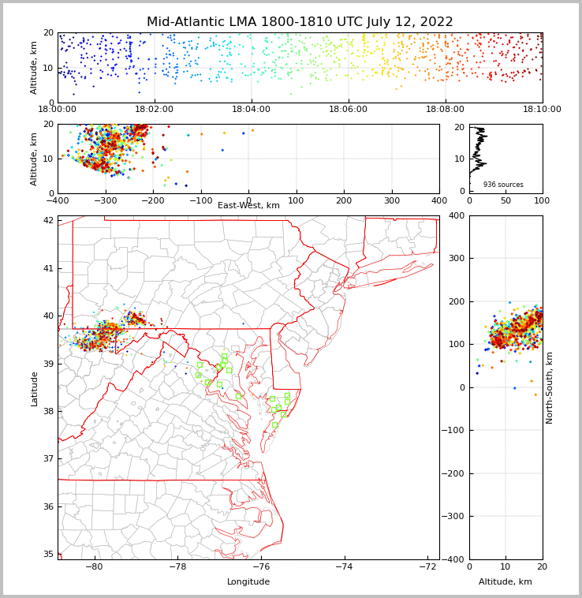
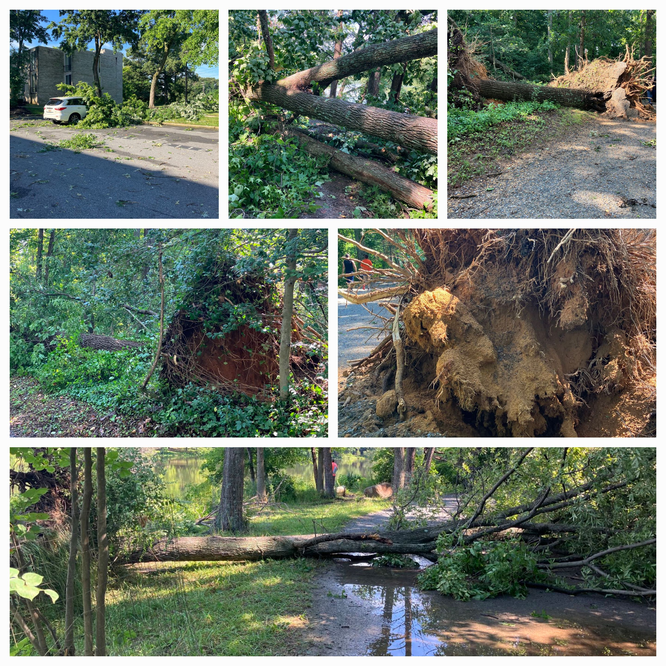
Thunderstorm That Caused Destruction and Power Outage in College Park, MD on July 12, 2022
There were severe thunderstorms with very active lightning flashes;
MALMA detected the flashes;
The strong gust winds in the thunderstorm caused a power outage over 24 hours. College Park, Berwyn Heights, and Greenbelt were among the areas affected;
Power outages left traffic lights functionless.
Destruction in Greenbelt

Slide 6
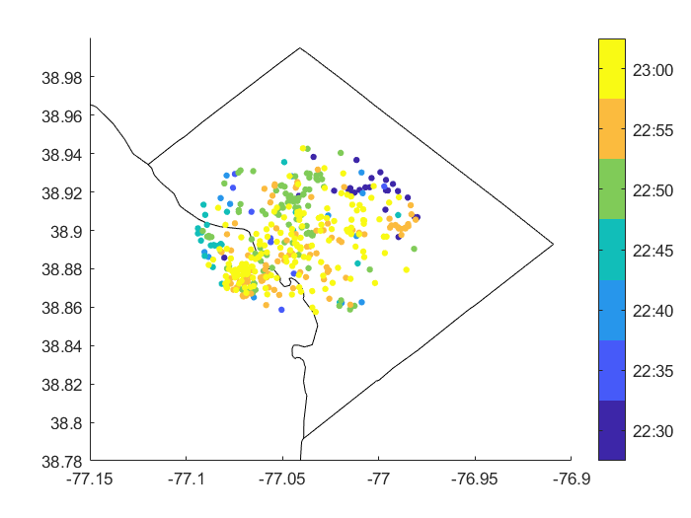
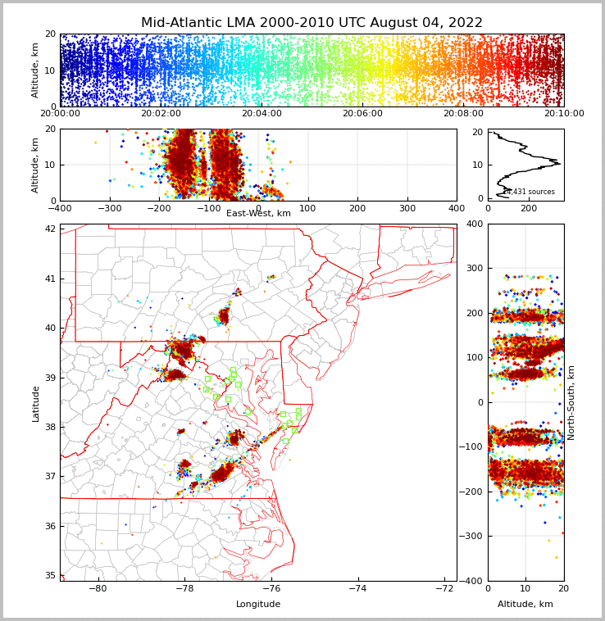
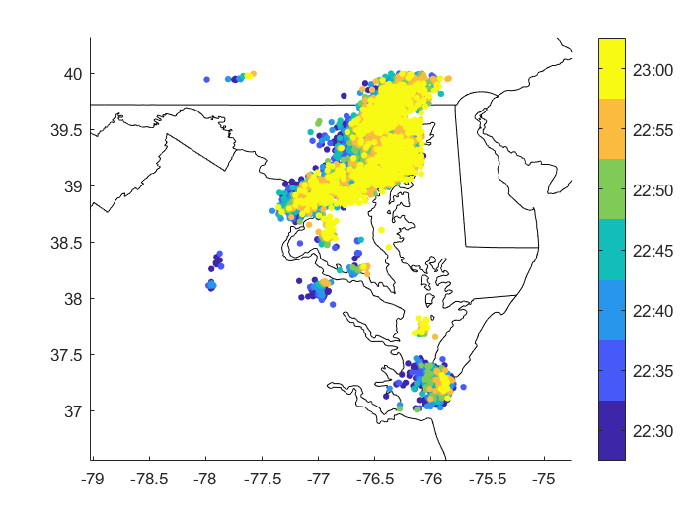
Thunderstorms That Caused Fatalities Near the White House on Aug 4th, 2022
NLDN reports within 3 km
At around 6:50 PM EST, three people were killed and one injured by a lightning strike in the Lafayette Square near the White House in DC;
Both MALMA and NLDN detected these flashes.
All NLDN reports

Slide 7
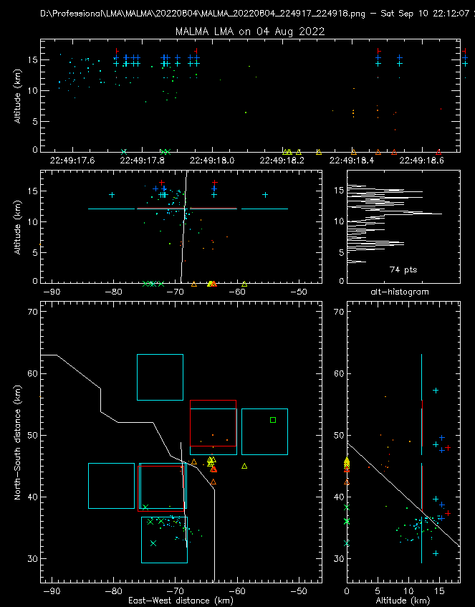
NLDN reported 6 CG strokes. The strongest was the second stroke (-25.5 kA);
Both GLM and MALMA detected the flash
MALMA detected 5/6. Missed the 1st stroke (-16.9 kA).
GLM detected 3/6.
NLDN reported one –IC pulse right after the 1st CG stroke, but the location is fairly close to the 2nd stroke; MALMA detected sources before the 2nd stroke.

Slide 8
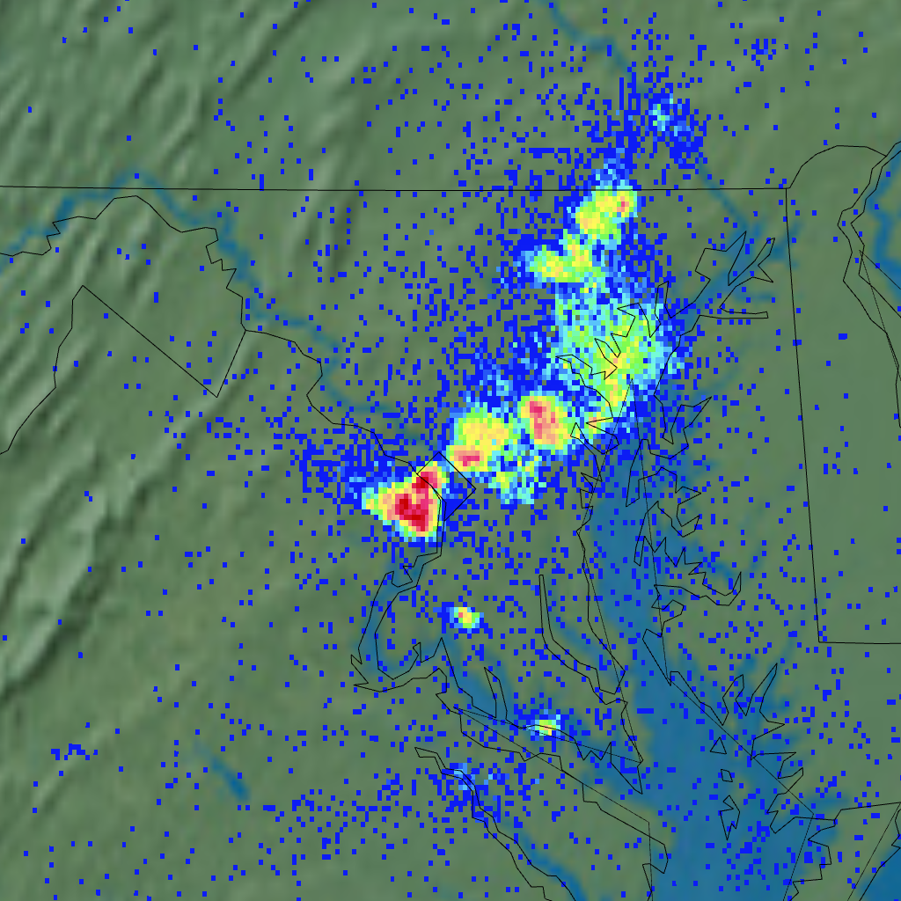
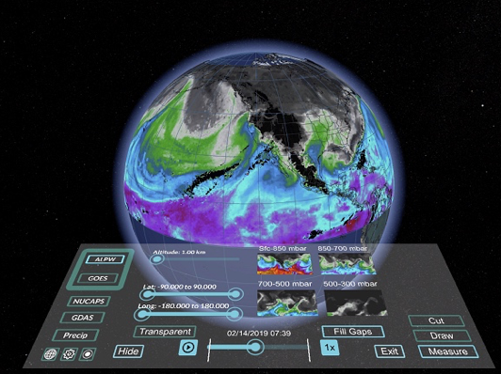
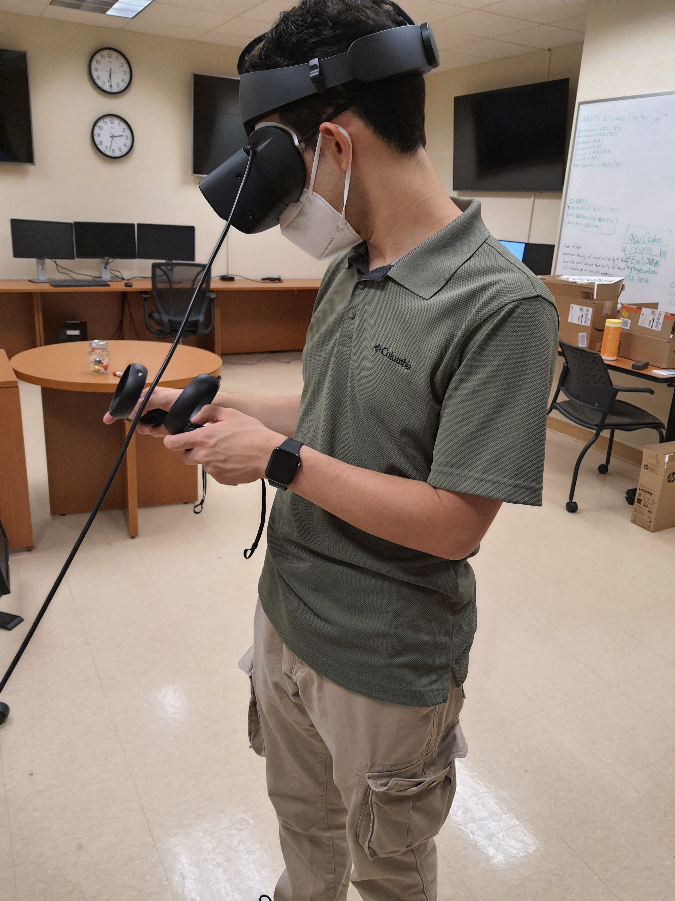
Future work
Installation of a new site at Howard University in D.C.;
Relocation of site at APL/John Hopkins University due to noises;
Installation of a solar LMA site;
VR visualization of lightning data from MALMA, GLM, and other
ground-based observations.

Slide 9
Thank you for your attention!

