Slide 1
The Effect of Ground Processing on GLM Performance
Phillip Bitzer

Slide 2
What goes into GLM detection efficiency?
GLM performance, i.e., detection efficiency, is determined by two factors:
Instrument performance – how well does GLM detect light
Ground algorithms – how well does ground processing filter noise from lightning
Each contribute to what the user cares about – how much lightning is detected.
But can we improve what we have?

Slide 3
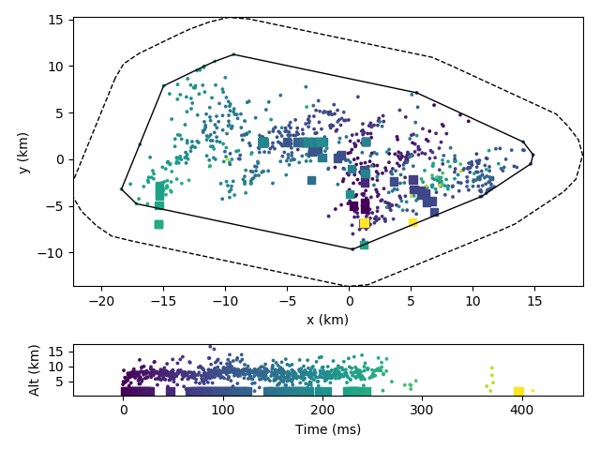
How do we assess performance?
To assess how GLM is performing, we find GLM events that occur within the spatial-temporal bounds of a LMA flash
Eliminates any ambiguities caused by flash grouping
Run matching on both L1b and L0
L0 represents best possible performance with instrument (as currently configured)
L1b represents combined instrument + ground algorithm
Comparison of L1b and L0 yields the effect of ground processing

Slide 4
Previous Results
We’ve reported DE using this technique before, mostly using PLT results
Consistent with other researchers, DE varies as a function of flash area and storm mode/type
But certain storm type/mode also yields low(er) DE for ground based systems
LMA Area (km²) | DE (GLM | NALMA) | DE (GLM | COLMA) | DE (ENI | COLMA)
All | 0.617 | 0.256 | 0.372
> 8 | 0.738 | 0.365 | 0.534
> 16 | 0.806 | 0.429 | 0.609
> 32 | 0.873 | 0.522 | 0.702
> 64 | 0.922 | 0.649 | 0.797
> 100 | 0.947 | 0.746 | 0.850

Slide 5
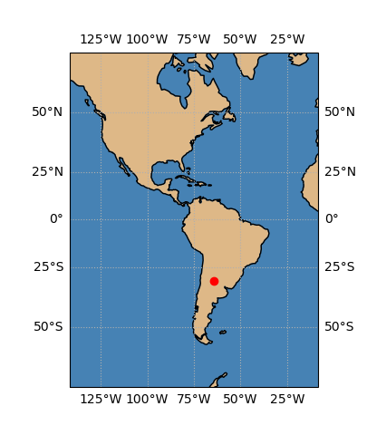
New Results
Now, we’ll look at a couple of cases from the Relampago campaign in Argentina, including an anomalous storm
This gives results for storms post-PLT tuning, in addition to a slightly less off-axis viewing angle

Slide 6
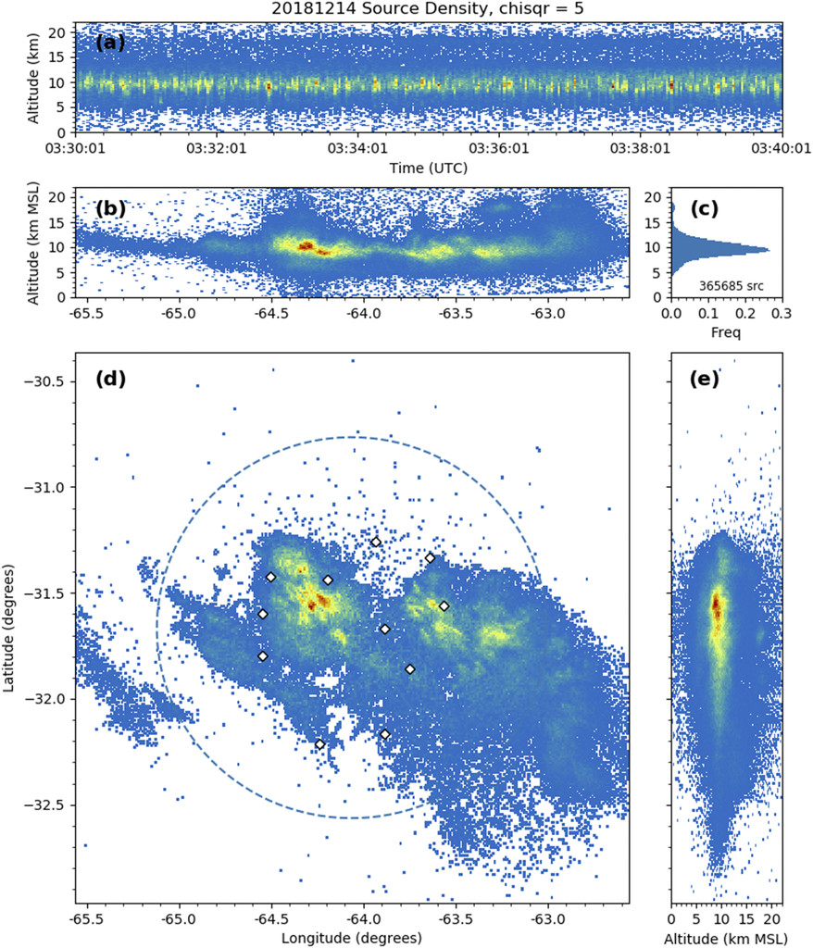
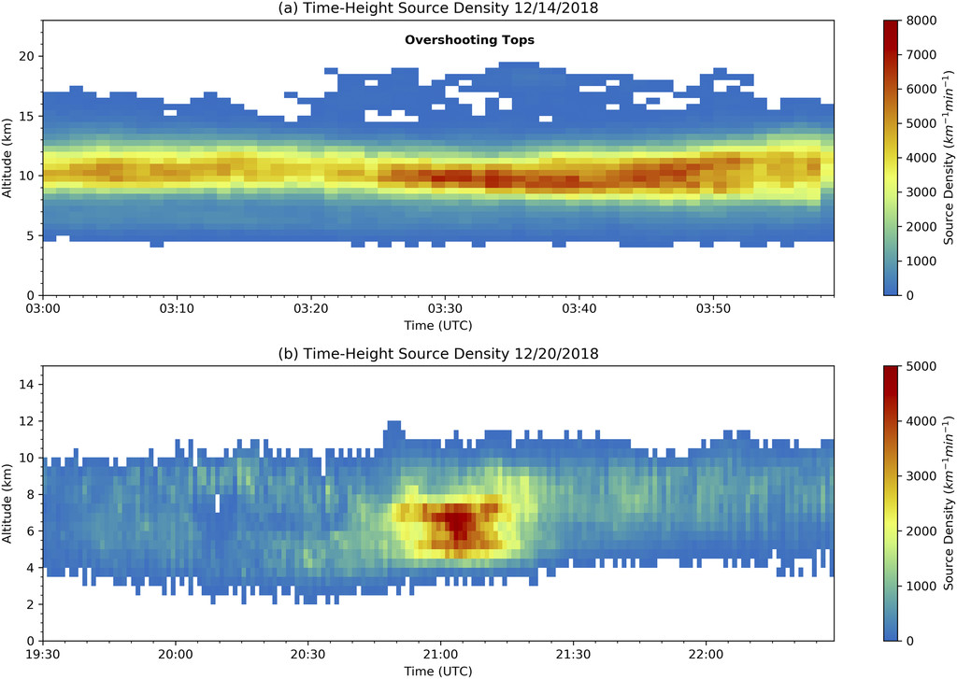
20181214 – High Flash Rate Storm
Dec 14, 2018 00Z-09Z
MCS with max flash rate ~ 600/min and overshooting tops
Almost 22 000 flashes detected
LMA source altitude mode at approximately 10 km
Analyzed in Lang et al. 2020

Slide 7
20181214 – High Flash Rate Storm
Area (km2) | Num LMA Flashes | Num GLM – L1b | DE – L1b | Num GLM – L0 | DE – L0
All | 20822 | 8222 | 0.395 | 12285 | 0.590
> 8 | 12651 | 6953 | 0.550 | 9494 | 0.751
> 16 | 8426 | 5472 | 0.649 | 6972 | 0.827
> 32 | 4918 | 3809 | 0.775 | 4485 | 0.912
> 64 | 2477 | 2185 | 0.882 | 2397 | 0.968
> 100 | 1414 | 1324 | 0.936 | 1399 | 0.989
Operational algorithm yields an overall DE of 40%,
yet almost 60% of the flashes were detected by the instrument
Consistent with previous results,
DE improves (significantly) with increasing flash size.

Slide 8
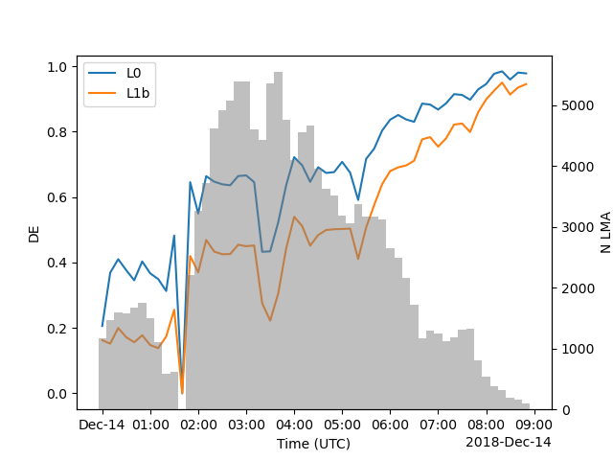
20181214 – High Flash Rate Storm
L0 detects more flashes during times when L1b struggles

Slide 9
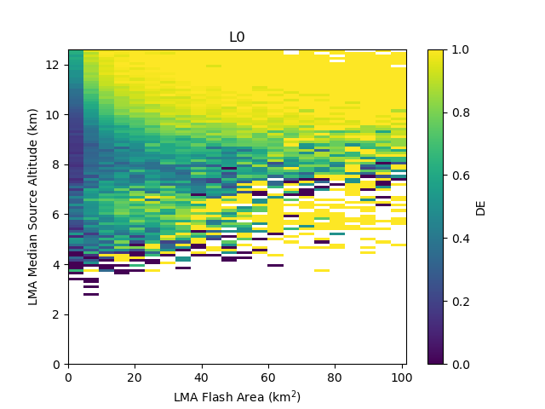
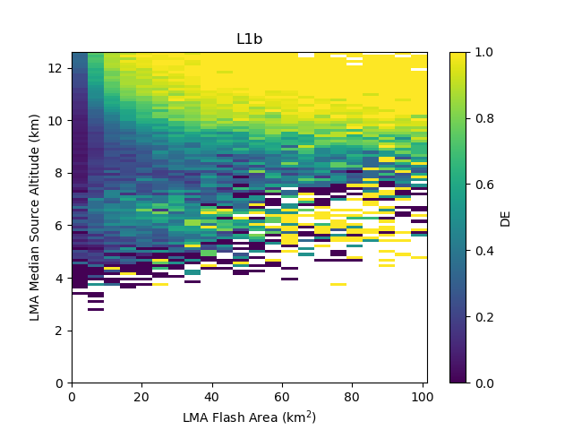
20181214 – High Flash Rate Storm
While there is a dependence of DE on flash area and altitude, it is not linear. Very little light is detected for small flashes at all altitudes.

Slide 10
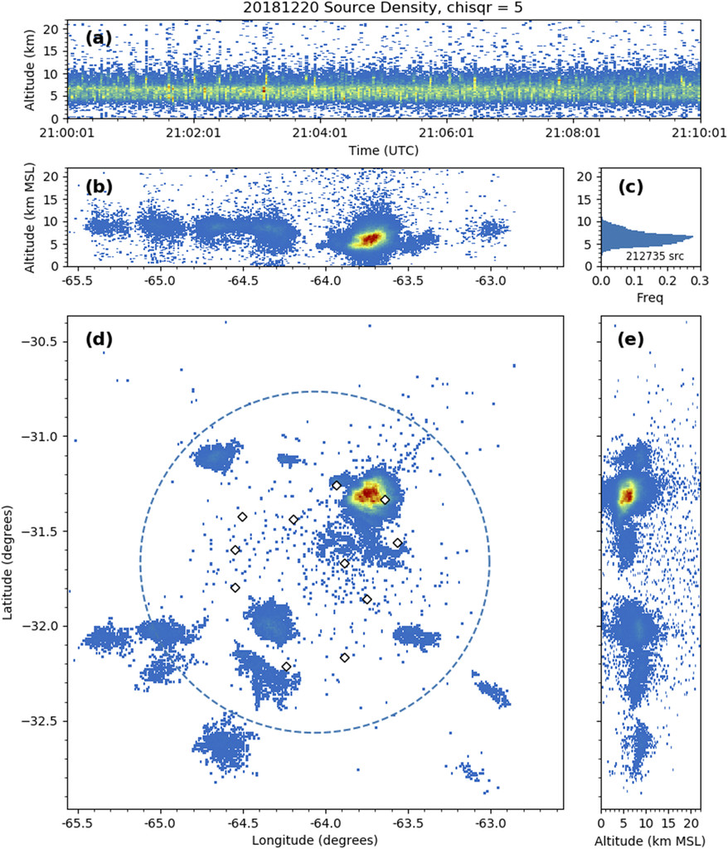
20181220 – Anomalous Storm
Dec 20, 2018 17Z-2359Z
Anomalous charged storm (likely) with max flash rate ~ 250/min
Almost 140 000 flashes detected
LMA source altitude mode at 4-8 km
Analyzed in Lang et al., 2020

Slide 11
20181220 – Anomalous Storm
Area (km2) | Num LMA Flashes | Num GLM – L1b | DE – L1b | Num GLM – L0 | DE – L0
All | 135956 | 62897 | 0.463 | 87888 | 0.646
> 8 | 69687 | 46506 | 0.667 | 57190 | 0.821
> 16 | 43893 | 32775 | 0.747 | 38191 | 0.870
> 32 | 24274 | 19961 | 0.822 | 22192 | 0.914
> 64 | 11940 | 10494 | 0.879 | 11304 | 0.947
> 100 | 7133 | 6430 | 0.901 | 6840 | 0.959
Again, there is almost a 20 percentage point improvement in DE!
There are decreasing gains with increasing area.

Slide 12
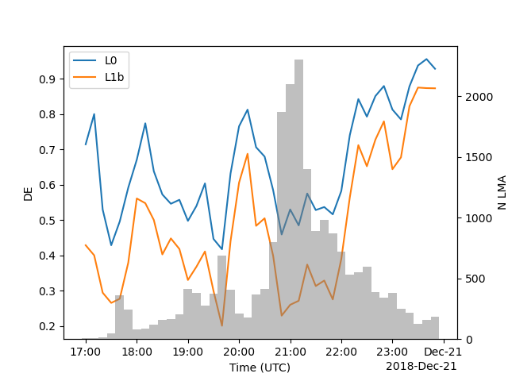
20181220 – Anomalous Storm
L0 detects more flashes during times when L1b struggles

Slide 13
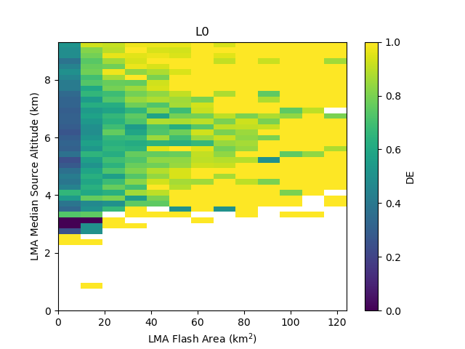
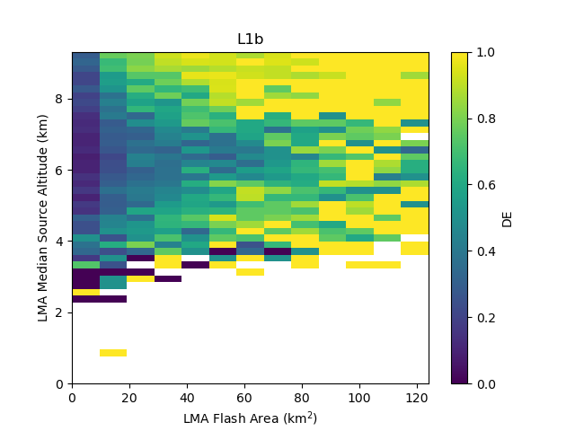
20181220 – Anomalous Storm
While there is a dependence of DE on flash area and altitude, it is not linear. Very little light is detected for small flashes at all altitudes.

Slide 14
Loss Fraction: 1- DE (L0)/DE (L1)
Another way to thing about it is: how much performance is “thrown out” by ground processing?
Area (km2) | DE L0 | DE L1b | Delta DE | Loss Fraction
All | 0.637 | 0.451 | 0.186 | 0.292
< 8 | 0.807 | 0.645 | 0.162 | 0.200
< 16 | 0.861 | 0.728 | 0.133 | 0.155
< 32 | 0.912 | 0.812 | 0.101 | 0.110
< 64 | 0.950 | 0.878 | 0.071 | 0.075
< 100 | 0.964 | 0.907 | 0.057 | 0.059
Almost 30% of flashes are filtered by ground processing!

Slide 15
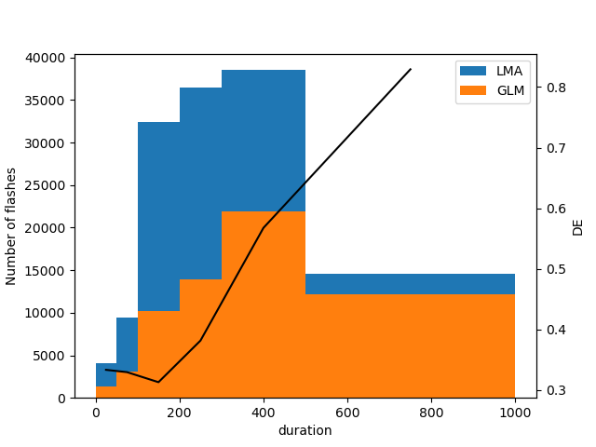
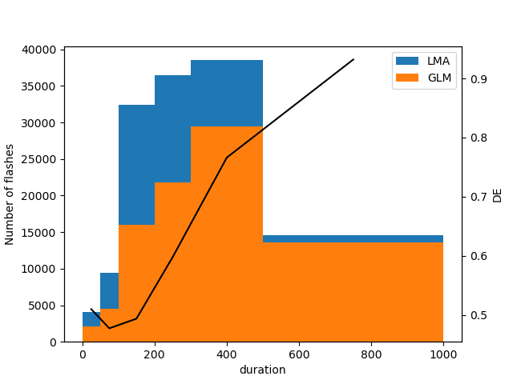
Does duration of the flash matter?
L1b
The L0 detections are slightly better at short duration flashes…
…but the biggest improvement is among 100-500 ms flashes.
Note the L1b result is slightly different from Zhang and Cummins (2020), which showed a monotonic increase of DE with flash size.
Begs the question: is L0 just picking up single event flashes?
L0

Slide 16
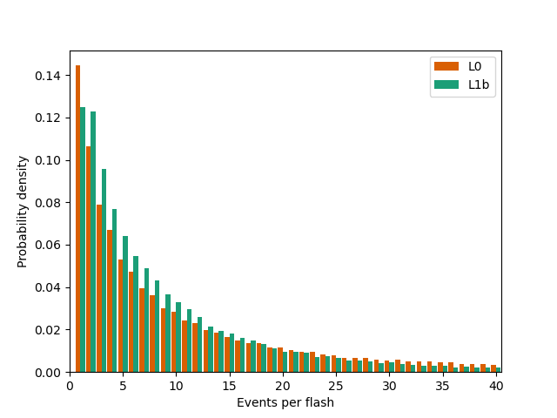
Does L0 matching pick up noise?
Although unlikely, an event during the time of a flash, an event in the spatial footprint of the flash could be due to noise.
However, the distribution of events per flash doesn’t change appreciably.
Since we’re detecting more smaller/shorter flashes, some shift to fewer events/flash is expected
But since the distribution is largely similar, the L0 detections are not just single events detected during longer flashes!

Slide 17
Ground processing affects DE!
Current ground processing throws out almost 30% of flashes that the GLM instrument detects. ﻿
If the detected light during these flashes were correctly (not) filtered, then it leads to a nearly 20 percentage point improvement in detection efficiency.
The largest gains are realized with small flashes.
The distribution of events per flash does not change appreciably.
﻿Also to note: On average, L0 detects flashes about 30 ms earlier that L1b (median: 5 ms).

Slide 18
The next steps
So, if the GLM instrument is detecting light during flashes, but current ground processing are not classifying it correctly, then there is an opportunity to improve the end product.
Current testing of a new operational-type algorithm (i.e., satisfying ordering and latency requirements) shows at least a few percentage points improvement even in these difficult storms
Anomalous storm 39% -> 45% overall
Note: current iteration is unoptimized - more improvements to be realized!
See Clem’s talk Thursday!

