Slide 1
LI-STAR tool for LI Cal/Val and long-term monitoring
Sven-Erik Enno & Bartolomeo Viticchiè
MTG LI Science Team
GLM Science Meeting 2022, Huntsville (AL), USA

Slide 2
LI-STAR (LI STAtistics and Reporting tool)
A centralized tool containing an extensive set of functions for LI Cal/Val and monitoring.
Here presenting a small set of main lightning-related functionalities.
Simple plotting/monitoring
Space and time evolution of LI events/groups/flashes vs other LLSs.
Climatology scale comparisons (e.g. flash accumulation).
Properties of LI groups and flashes.
2. Matching-based statistics
Matching-based LI Detection Efficiency (DE).
Matching-based LI relative Location Accuracy (LA).
3. Gridding-based statistics
Gridded LI False Alarm Rate (FAR).

Slide 3
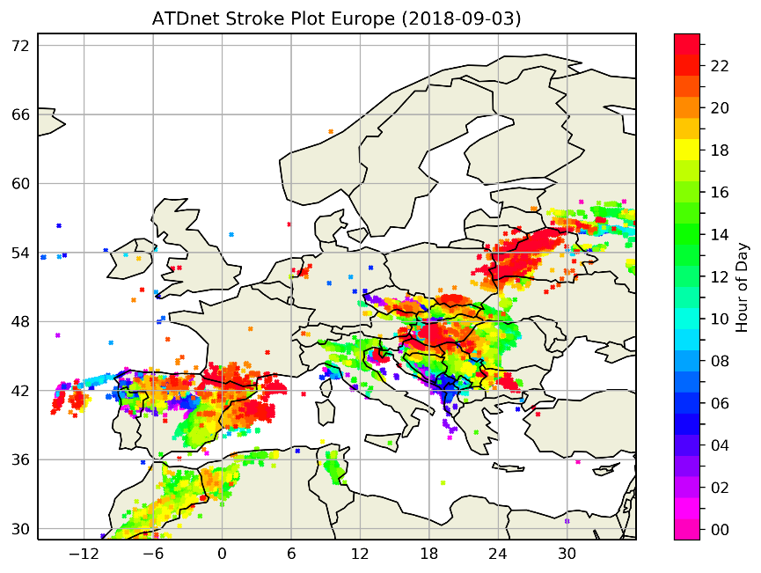
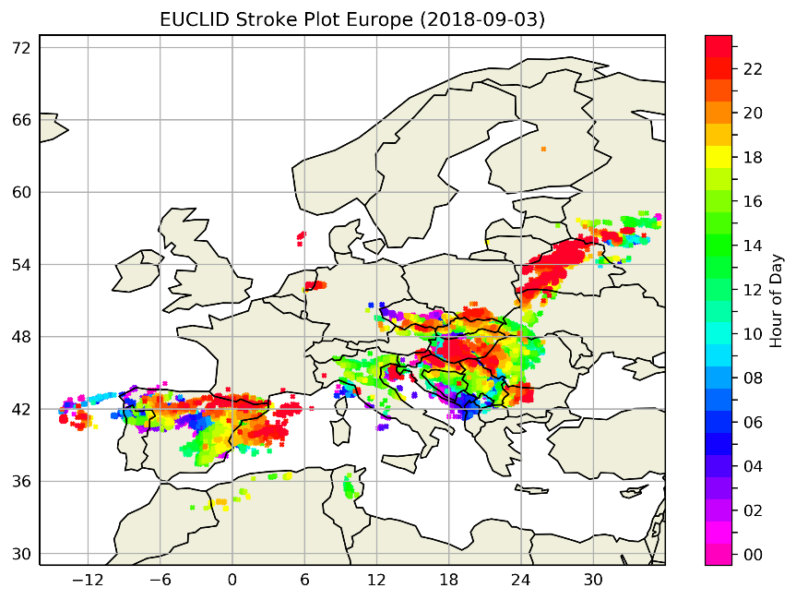
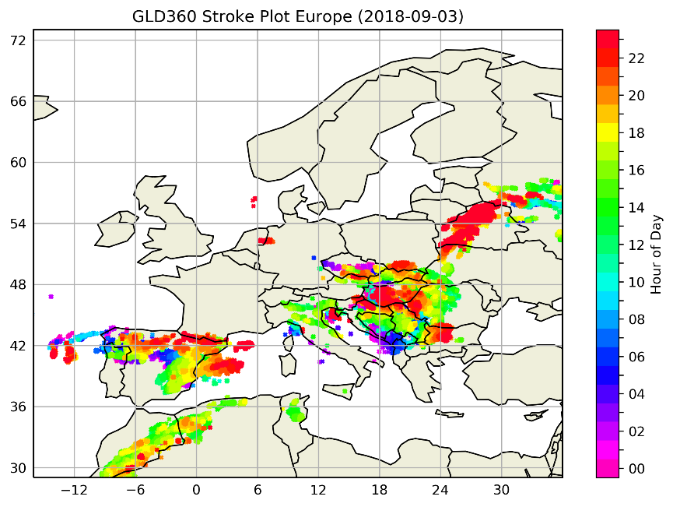
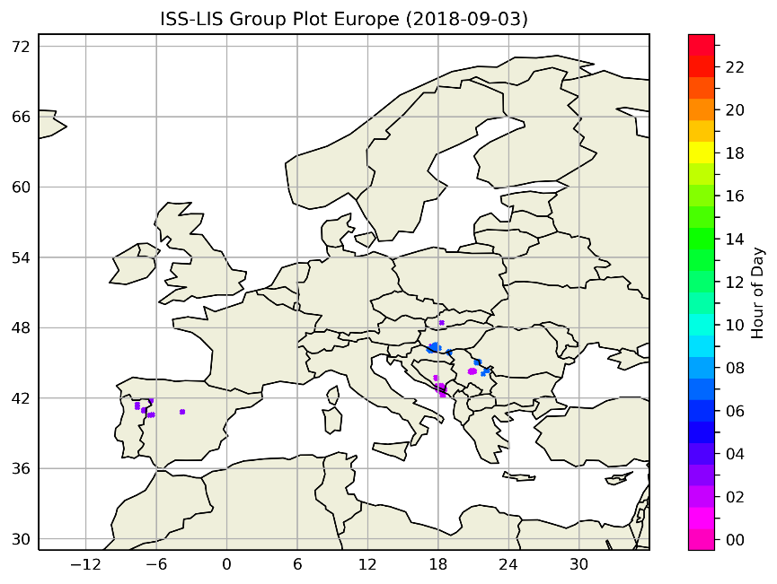
Spatiotemporal distribution of lightning observations
ATDnet (top left), EUCLID top right), GLD360 (bottom left) and ISS-LIS (bottom right) strokes/groups on 2018-09-03, colored by hour (UTC).
Very good initial sanity check. Any large anomaly will show up (in this case it’s expected that ISS-LIS detected much less due to its short view time compared to ground-based ATDnet, EUCLID and GLD360.
Will be automatically generated on a daily basis for selected areas and LLSs (configurable).
Notes:
Can spot large anomalies like ISSLIS (bottom right).
Can also spot smaller anomalies such as ATDnet FARs, i.e. single strokes outside storms areas.

Slide 4
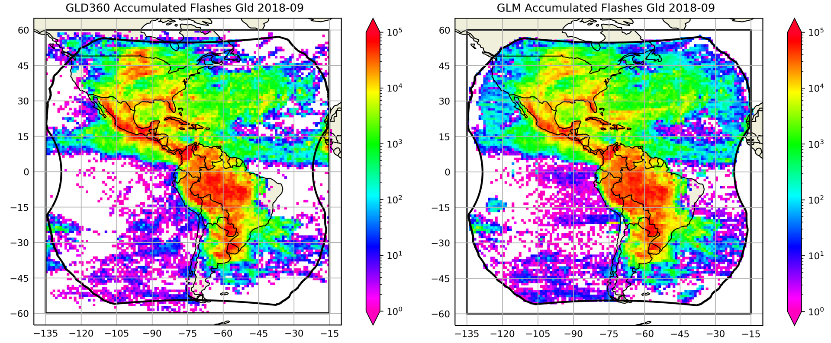
Lightning (flash) accumulation maps
GLD360 (left) and GLM (right) accumulated flashes during September 2018 in a 1x1 degree spatial grid.
Good tool for longer time periods and larger areas as the number of individual lightning points gets very large.
Works best with flashes as space-borne and ground-based flashes are much more similar than groups and strokes.
Notes:
Comparing the accumulation of flashes over a long period of time (e.g. a month).
Better than simply plotting the lightning locations as it does not saturate.
Works better on the flash level as space-borne and ground-based flash datasets are more comparable than groups against strokes.

Slide 5
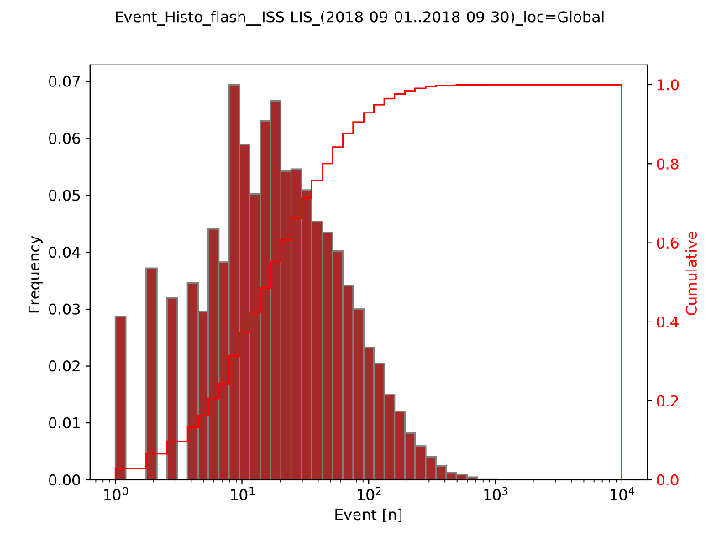
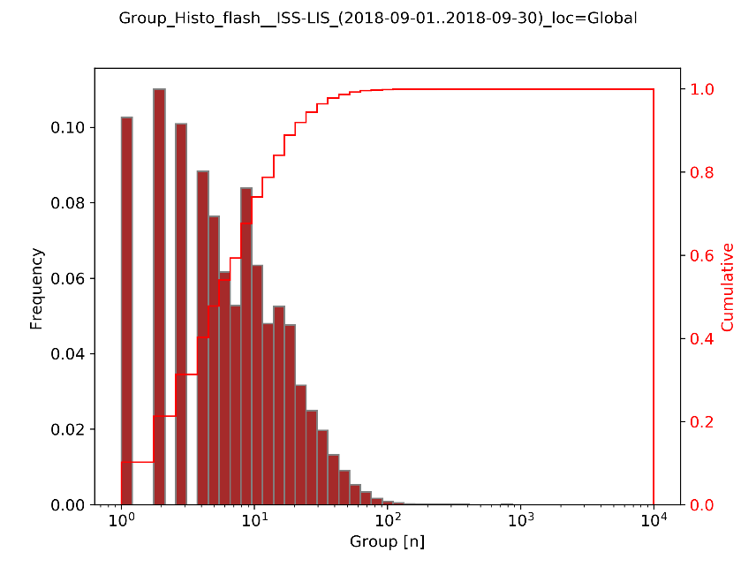
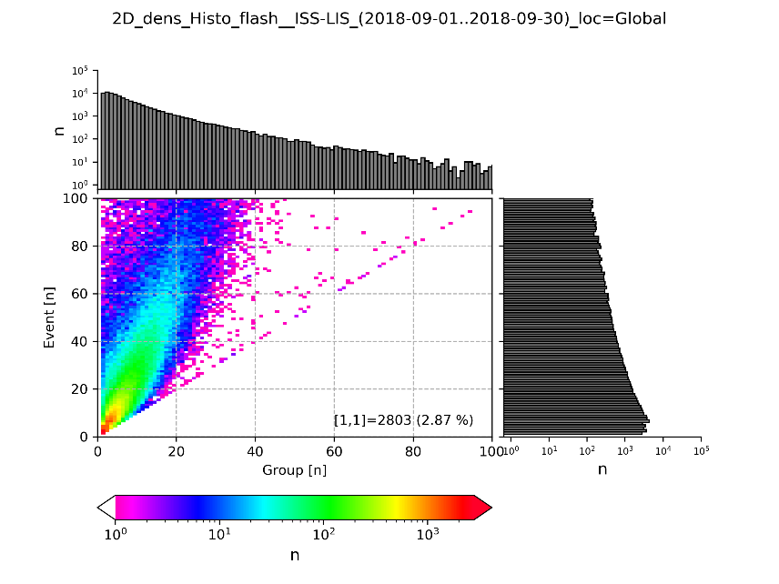
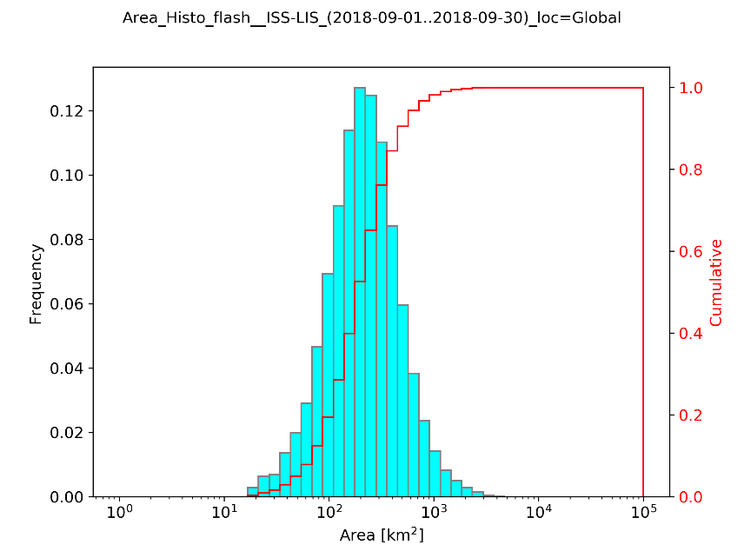
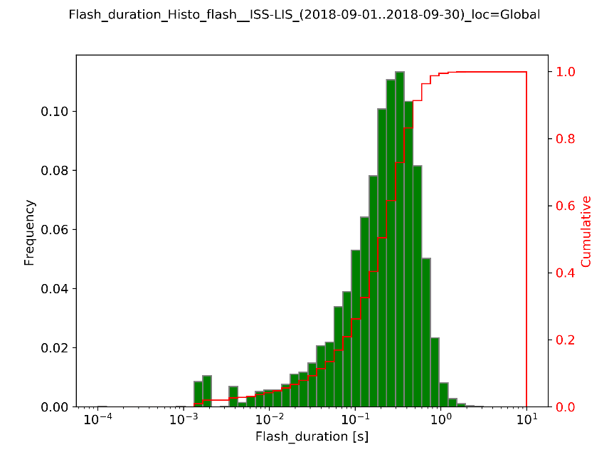
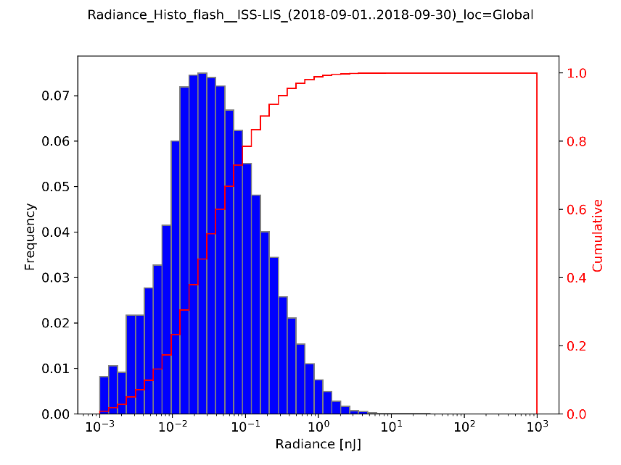
Displaying the properties of LI groups and flashes
These sample plots are produced using ISS-LIS data during September 2018.
N of events per flash (top left), N of groups per flash (top middle), N of events vs N of groups per flash (top right), flash area (bottom left), flash duration (bottom middle) and flash radiance (bottom right).
Notes:
Of course want to examine the properties of LI flashes (N groups and events, area, duration, radiance) and compare these against GLM and ISSLIS flash properties. These functionalities are all there, here showing sample results using ISSLIS during September 2018.

Slide 6
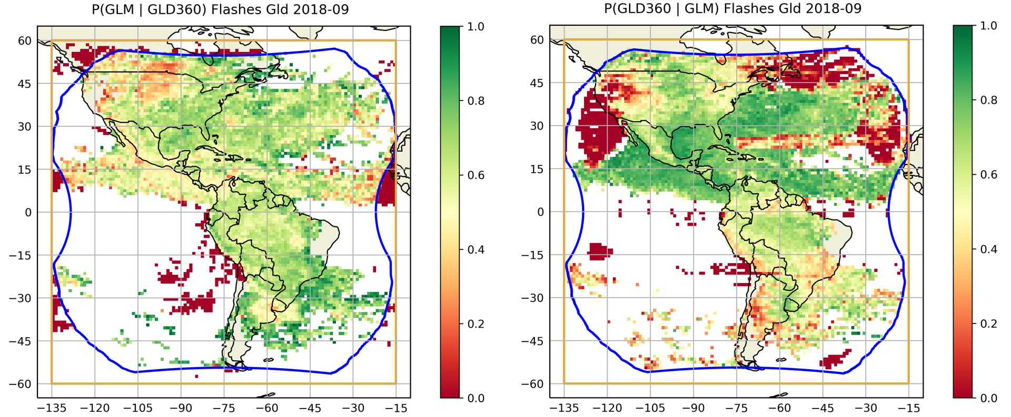
Spatial distribution of flash DE over one moth
GLM flash DE relative to GLD360 (left) and GLD360 flash DE relative to GLM (right) during September 2018 in a 1x1 degree spatial grid.
Notes:
Now to the matching-based statistics.
LISTAR can reproduce all the known features and limitations of GLM DE back in September 2018 such as the lower DE in the NW of the US, the Bahama bar, etc. Not going into details, these are generally known. Just showing that the functionalities are there and working.

Slide 7
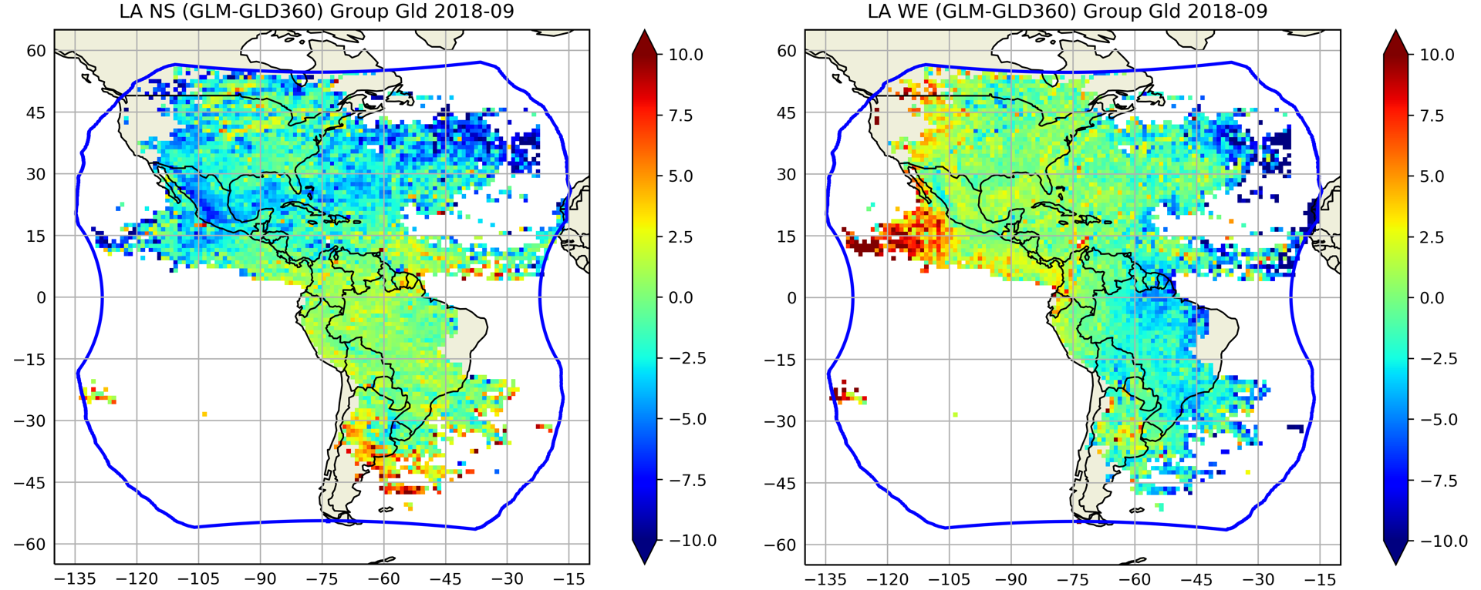
GLM group offset relative to GLD360 strokes
Spatial offset of GLM groups relative to their matching GLD360 strokes in the north-south direction (left) and west-east direction (right) during September 2018 (matching criteria: Δtb=5ms, Δta=10ms, Δz=50 km, 1-to-1 matches).
Notes:
There are also functionalities for the location accuracy, here is spatial offset of GLM groups relative to their matching GLD360 strokes in north-south (left) and east-west (right) direction.

Slide 8
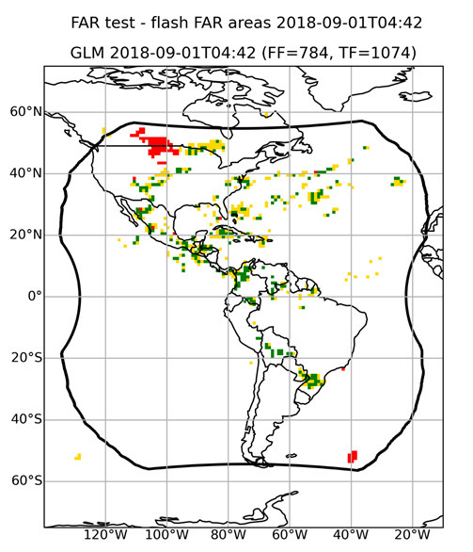
Gridded False Alarm Rate (FAR) method description
At EUMETSAT, not only the final LIL2 data products, but also the intermediate L1B and even L0 products will be monitored. This is much more data and requires optimization.
Combination of time integration and spatial gridding allows for efficient processing of large datasets, such as LIL1B events.
Reference network lightning grid over 20 minutes
 | 0 ref network detections during RNIW | >0 ref network detection during RNIW
0 test network detections during TNIW | Both observed no activity | Test network missed
>0 test network detections during TNIW | Test network False Alarm | Both observed some activity
Test network lightning grid over 1 minute
An example GLM FAR grid map relative to GLD360 (left) on 2018-09-01 at 04:42 UTC. The colors of the grid cells are explained in the table above. RNIW = reference network (time) integration window while TNIW = test network (time) integration window.

Slide 9
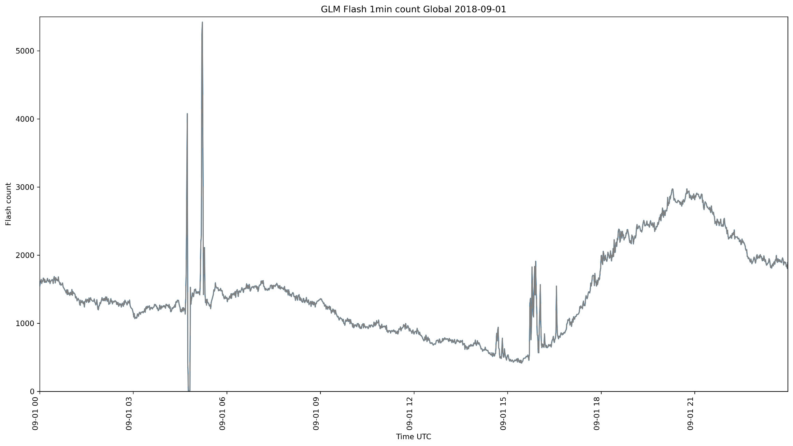
Gridded False Alarm Rate (FAR) example part I
Compare this plot with the next slide where the flashes are divided to true and false, using LISTAR FAR algorithm.
GLM 1-minute flash counts over the whole field of view on 2018-09-01.

Slide 10
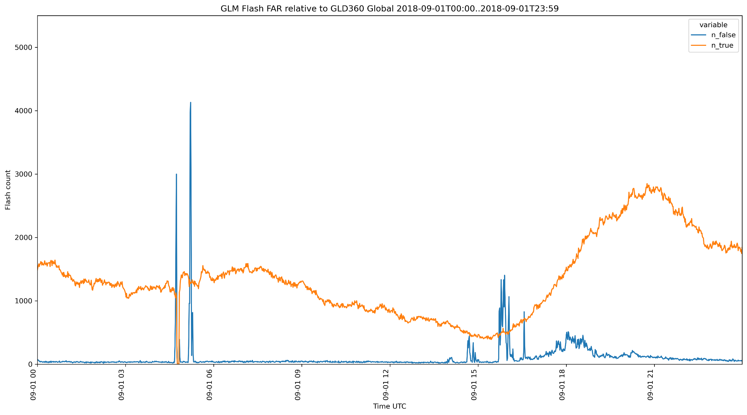
Gridded False Alarm Rate (FAR) example part II
Compare this plot with the previous slide where the minutely totals of all flashes are plotted.
GLM 1-minute true (orange) and false (blue) flash counts over the whole field of view on 2018-09-01.

Slide 11
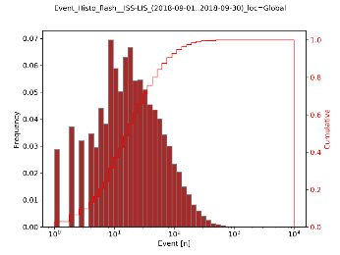
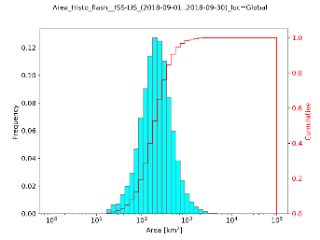
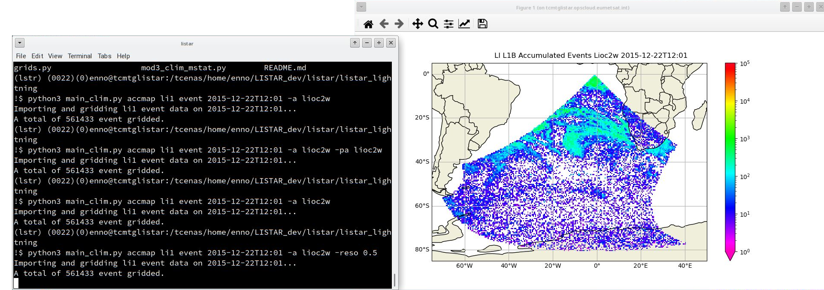
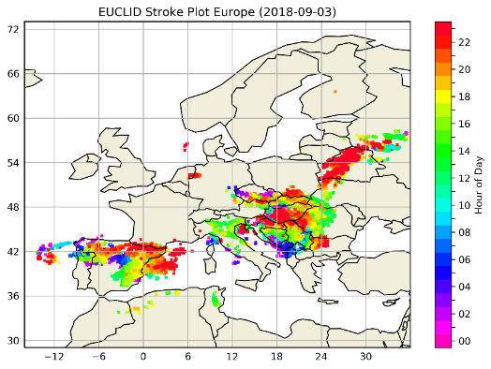
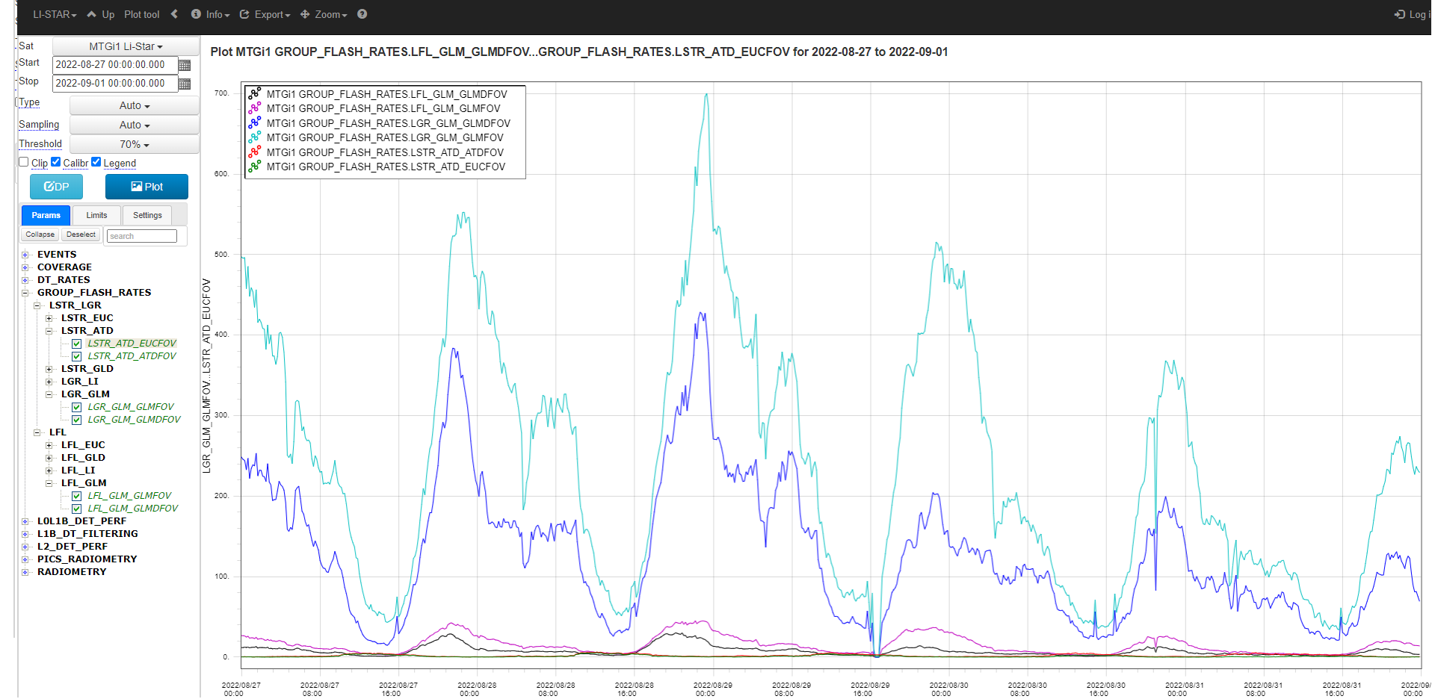
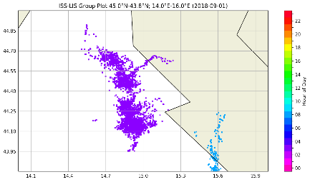
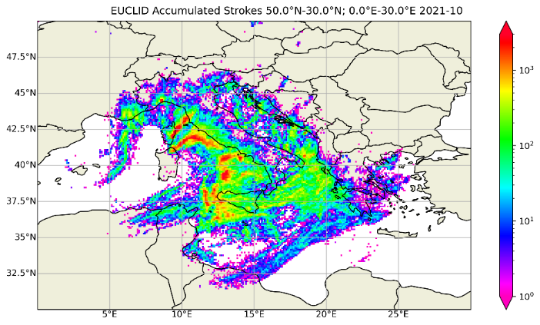
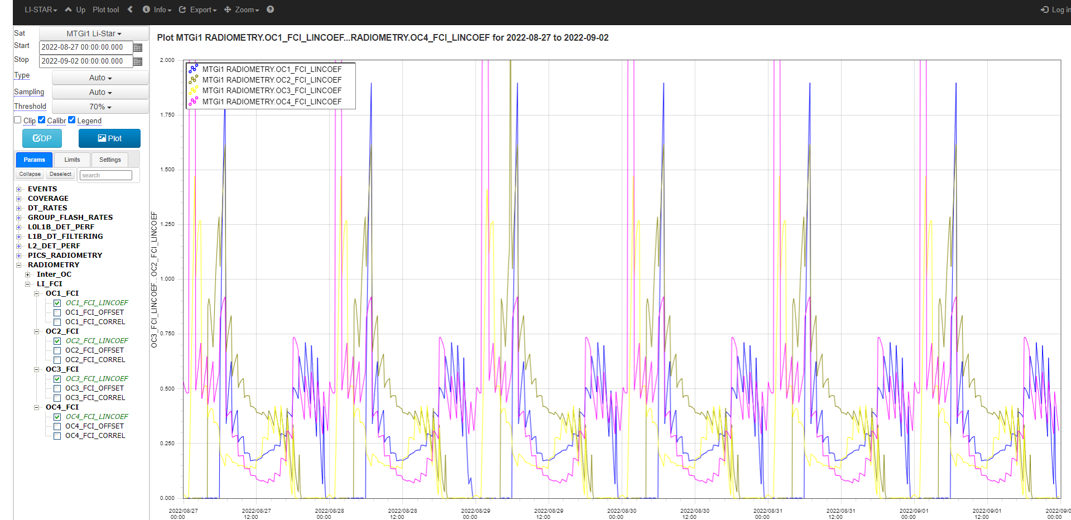
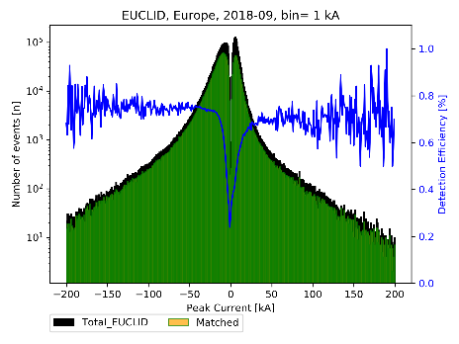
LISTAR has automated and manual mode
LISTAR AUTOMATED MODE
LISTAR MANUAL MODE
A set of functions run daily in EUMETSAT CHART environment, the results can be accessed via the internal web.
Many more functions for detailed scientific analyses available in the manual mode, can be run from the terminal.

Slide 12
Conclusions
LI-STAR tool will be used extensively in the LI Cal/Val activities, starting as soon as the LI data is available. It is going to be one of the main monitoring tool for the LI later.
All the main scientific functionalities are already available and producing scientifically meaningful results (within the limitations of the available test/external datasets).
All the critical external reference datasets (ATDnet, EUCLID, GLD360, GLM) have been tested to work in LI-STAR as near real time data streams.
Some refinements, testing and development still needed, including the following activities:
Tweaking the existing functionalities, parallel processing tests in EUMETSAT automated CHART environment, plugging in external reference data streams (EUCLID and GLD360).
Presented only a small subset of available functionalities that are directly related to lightning. There are much more, e.g. for radiometric performances of the LI, inter-comparison of the four LI camers etc.

Slide 13
Thank you!
Questions?

