Slide 1
Pushing GLM Flash Clustering to its Limits in the Most Active Thunderstorms on Earth
Michael J. Peterson
LA-UR-22-28910

Slide 2
OTD / LIS / GLM Flash Clustering and Failure Conditions
Lightning flash rates are the most important product for OTD, LIS, and GLM because they describe convective processes within the thunderstorm
However, these instruments do not detect flashes directly. They sense impulsive flickers of light in individual pixels caused by currents in the lightning flash illuminating the clouds
Flashes are a derived product created by clustering pixel events that occur in close proximity in space and time
Flash clustering generally works rather well, but it can fail in certain situations
We previously examined artificial flash splitting caused by limitations in the clustering algorithms for OTD, LIS, and GLM that creates unrealistically high flash rates in electrified stratiform clouds
This talk looks at another failure condition: when flashes occur in rapid succession and become artificially merged
Artificial merging is easy to identify by eye and occurs in all storm types – even low flash rate stratiform regions
It artificially lowers the local flash rate while substantially increasing mean/max flash durations
Once flash rates reach 1/330 ms (the clustering threshold), virtually all flashes will be clustered into an amalgamated flash feature. This poses a problem for identifying the most active thunderstorms on Earth

Slide 3
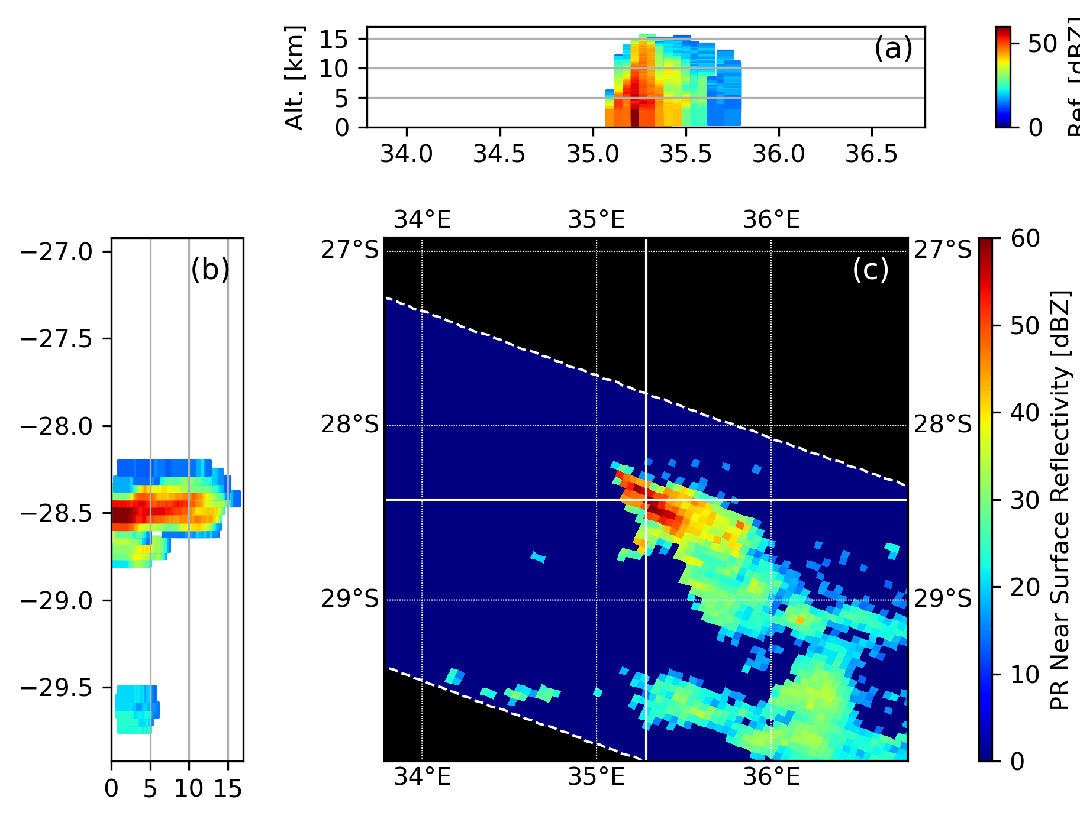
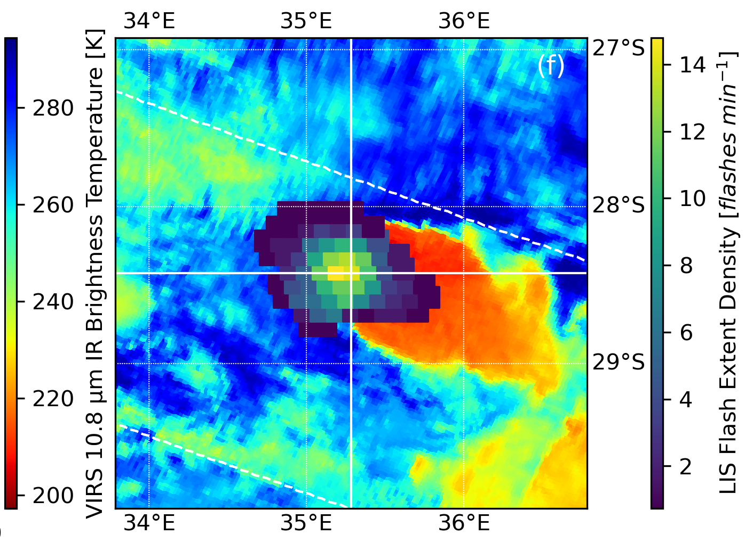
Degraded Performance in a
Lightning-Dense Thunderstorm
Consider the thunderstorm at right that was observed by LIS on the TRMM satellite
At first glance, it appears to be a normal convective thunderstorm
Its moderate size in the Precipitation Radar (PR) (a-c) data and limited anvil shield in the Visible and Infrared Scanner (VIRS) imagery (d) indicate do not provide obvious clues that LIS will not be able to measure its flash rate
When we compute the Flash Extent Density (FED), we find that it peaks at 14 flashes / min, which is entirely reasonable
(d)

Slide 4
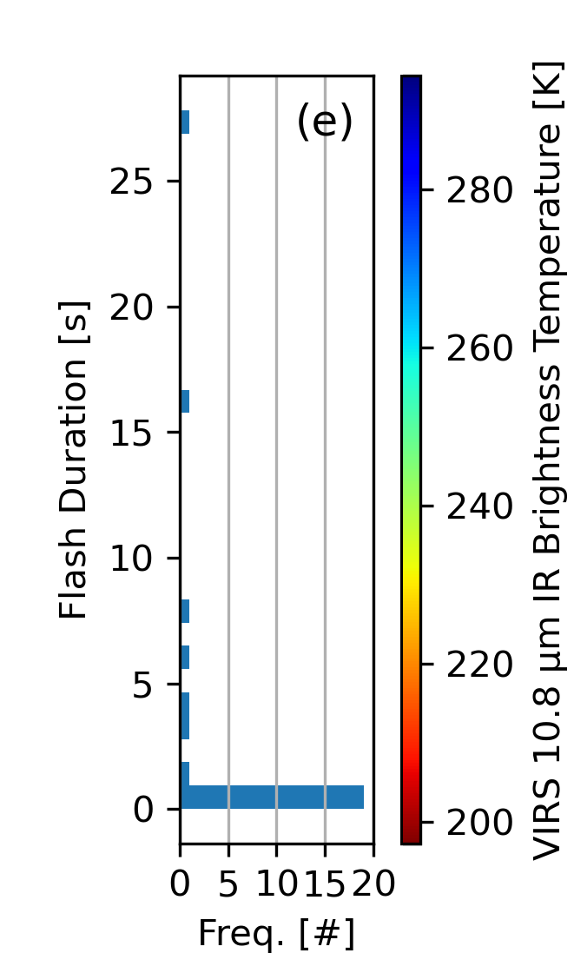
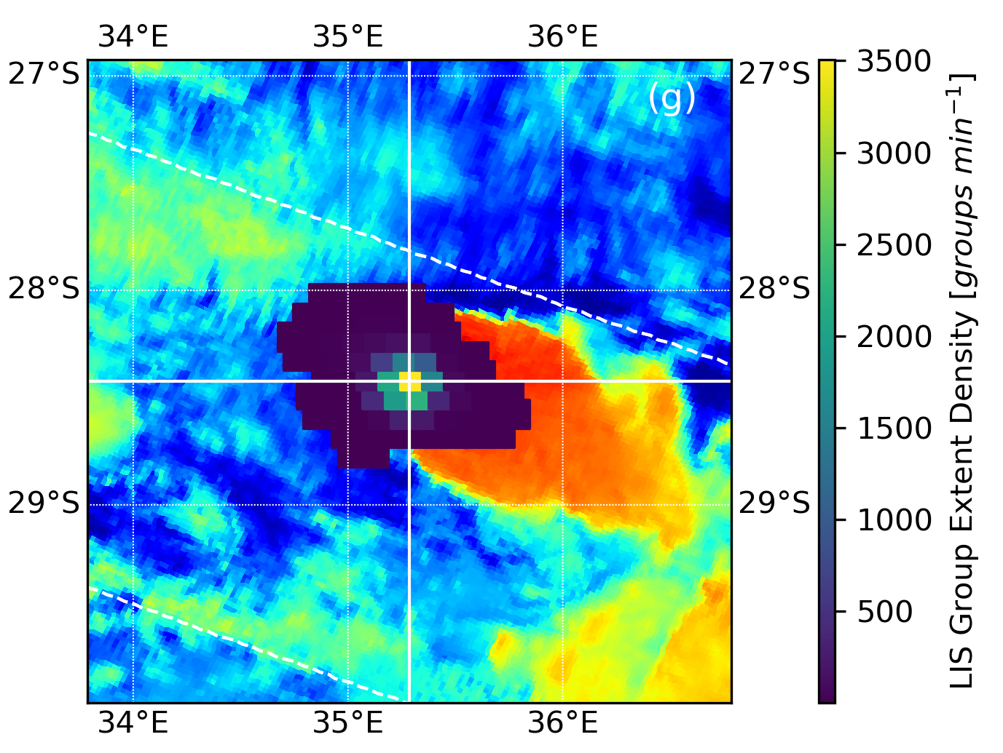
Degraded Performance in a
Lightning-Dense Thunderstorm
However, a closer look at the flash reveals problems in the data
The flash duration distribution (left) shows flashes lasting up to 26 s
The Group Extent Density (GED) grid at right peaks at 3500 groups/min despite FED only reaching 14 flashes/min
The group rate timeseries (bottom) shows a >10 s data outage where LIS entered a fatal error state before recovering
Very frequent small flashes broke LIS clustering and interrupted data collection across its entire FOV

Slide 5
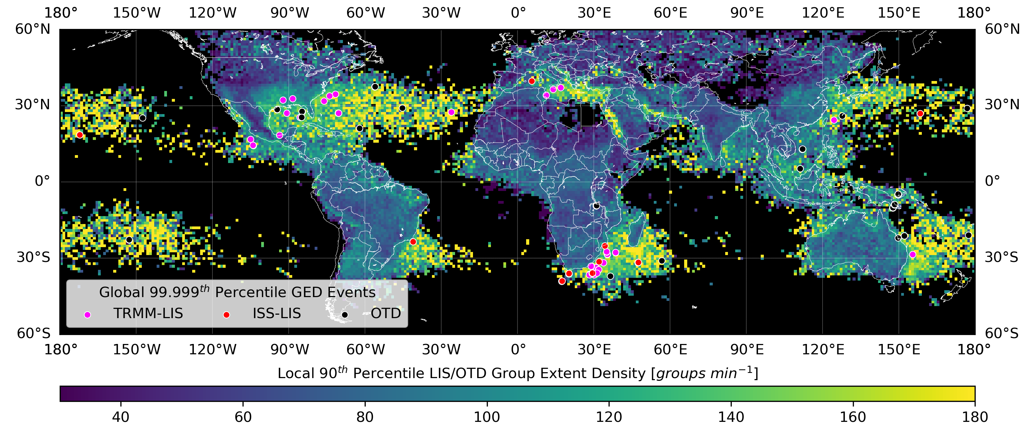
Where do These Lightning-Dense Thunderstorms Occur?
LIS / OTD statistics show that these problematic storms (points) occur in coastal regions including the Gulf of Mexico and the Atlantic / Pacific ocean regions in view of GLM
Because the 90th percentile GED (color contours) is high in these regions, and less-severe overclustering in non-extreme cases is also expected

Slide 6
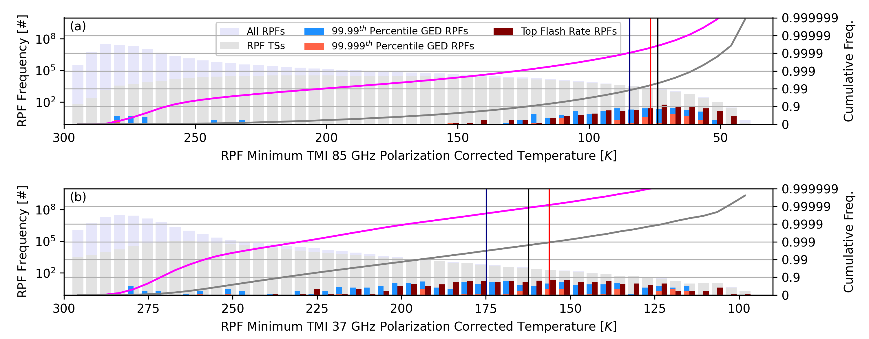
Properties of Lightning-Dense TRMM Thunderstorms
We can use TRMM Precipitation Feature (PF) data to characterize these storms:
All storms (light blue)
Thunderstorms (light red)
Top flash rate storms (black)
Lightning-dense storms (dark red, blue)
Lightning-dense storms that reach the top 100th or 1000th percentile of GED have similar passive microwave Polarization Corrected Temperatures (PCTs) to the highest flash rate thunderstorms on Earth
These are storms with tremendous amount of cloud ice that facilitate the electrification required to produce extreme flash rates

Slide 7
Properties of Lightning-Dense TRMM Thunderstorms
However, PF metrics describing the dimensions of lightning-dense storms (top) fall short compared to the top flash-rate storms
The ice mass may rival the most intense storms on Earth, but it is often concentrated in a smaller cloud volume
Overclustering in these storms reduces PF flash rates (bottom) by an order of magnitude
The top flash rate storms and the top PFs by other metrics of convective intensity are also certainly adversely impacted by artificial flash merging
Therefore, we don’t really know what the top thunderstorm flash rates found in nature actually are
Additional work is needed to correct for these biases, perhaps using a GED-based approach

Slide 8
Lighting-Dense Thunderstorms and GLM Data Degradation
GLM is more sensitive than LIS to overclustering for three reasons:
GLM clustering is based on events rather than group centroids
GLM outages during high group rate periods are on the order of milliseconds rather than seconds
GLM provides continuous staring measurements of lightning-dense thunderstorms
As with LIS, GLM aggregates activity from multiple flashes in high flash rate convective cells into a single feature
This aggregate feature is then split into many pieces by the LFCA according to its 101-group and 3-s maximum thresholds for a flash
GLM flash rates and derived products will be wrong, but not in an easily-identifiable way
The best way to study overclustering (from the top lightning-dense thunderstorms and less-extreme events) is to use reprocessed science-level GLM data
The following slides will use our CIERRA software to generate such a dataset and compare properly-clustered flashes with LCFA data

Slide 9
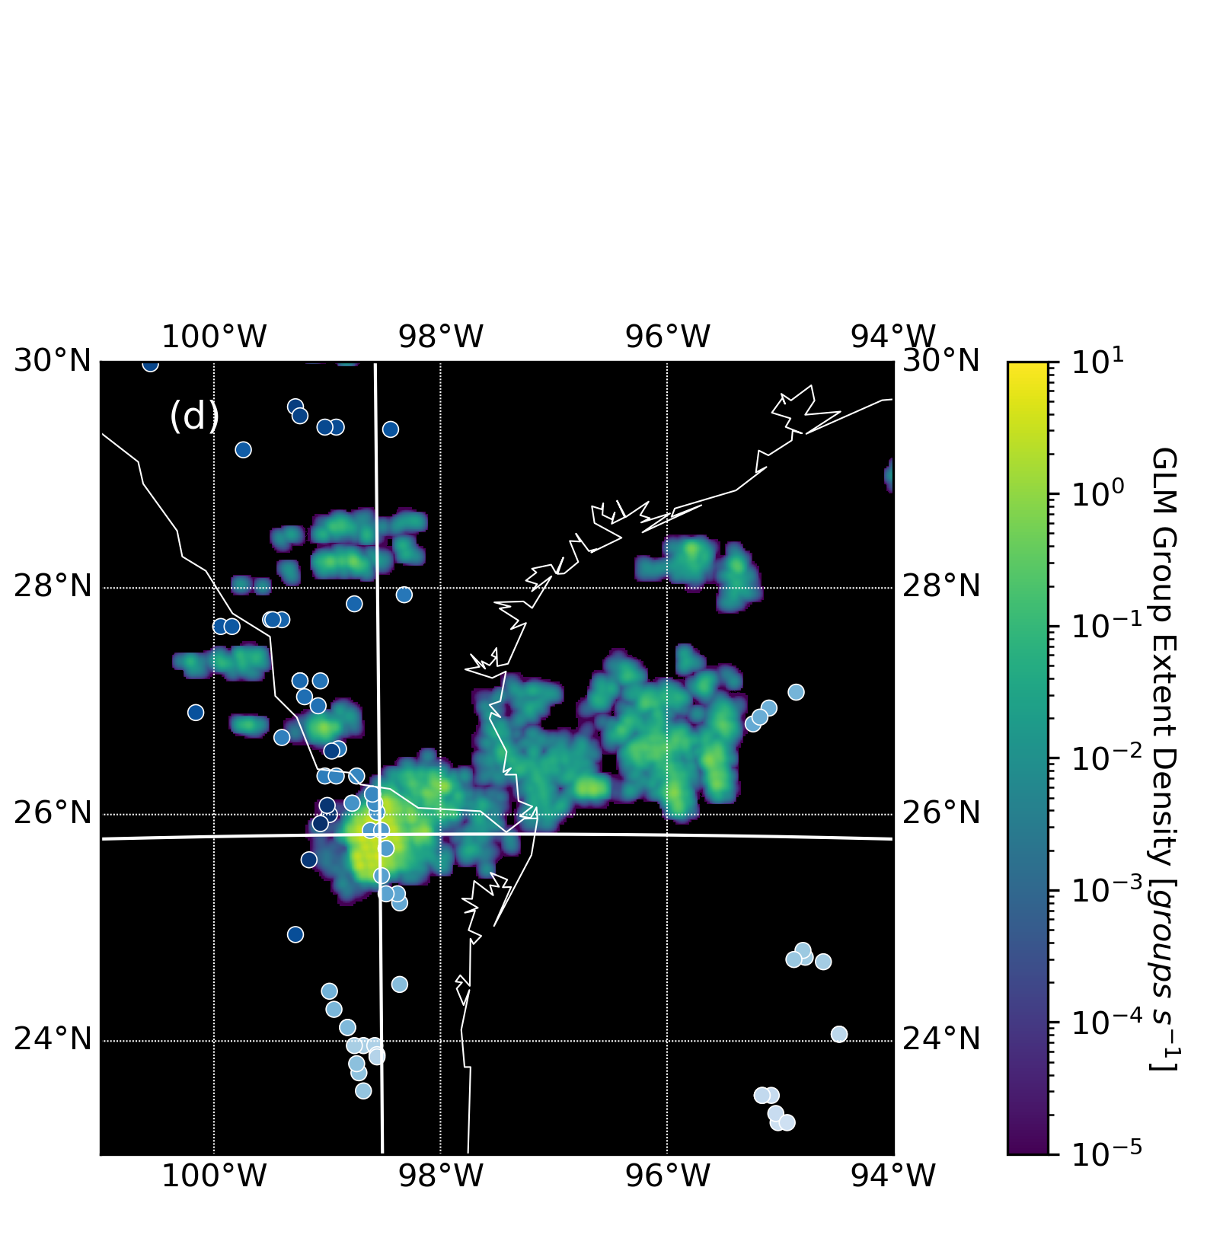
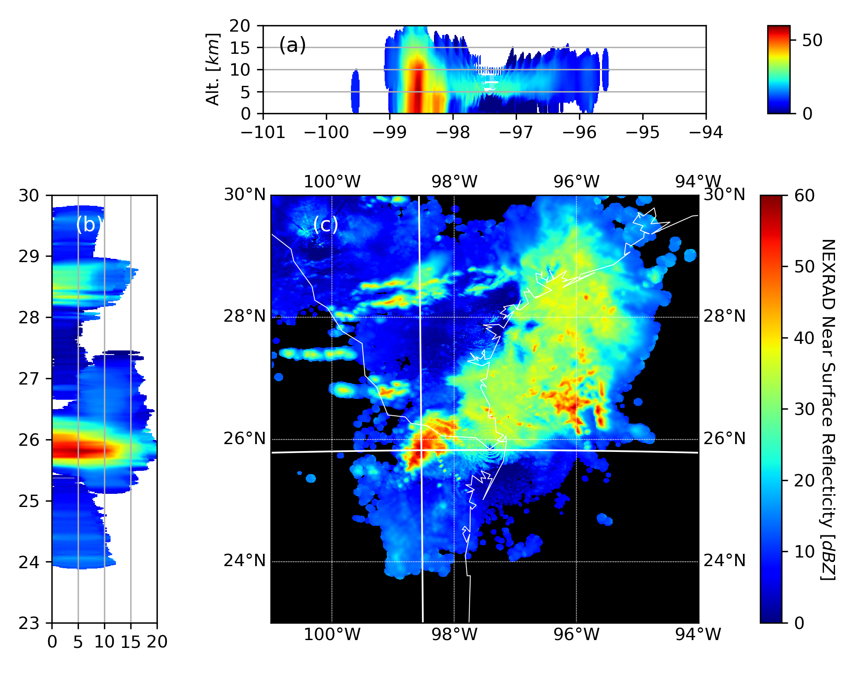
The Top Case of GLM Overclustering: GLM GED and NEXRAD Radar Reflectivity
The case below is the worst offender so far, with the southwest cell generating GEDs (left) exceeding 3 groups / sec averaged over 15 mins
Overclustering occurred over many subsequent flashes rather than single isolated events, and this significantly impacted GLM flash rates for the storm

Slide 10
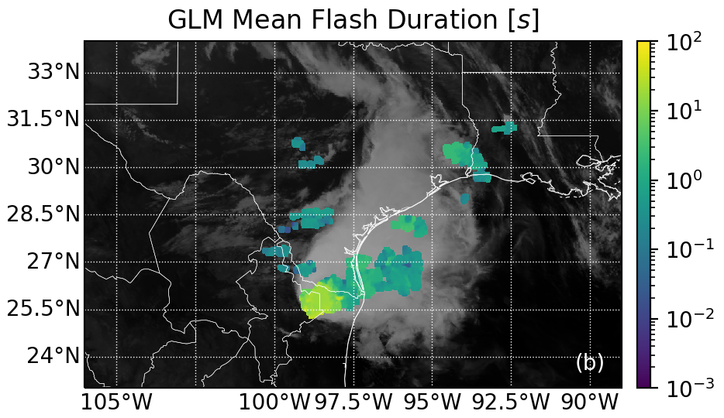
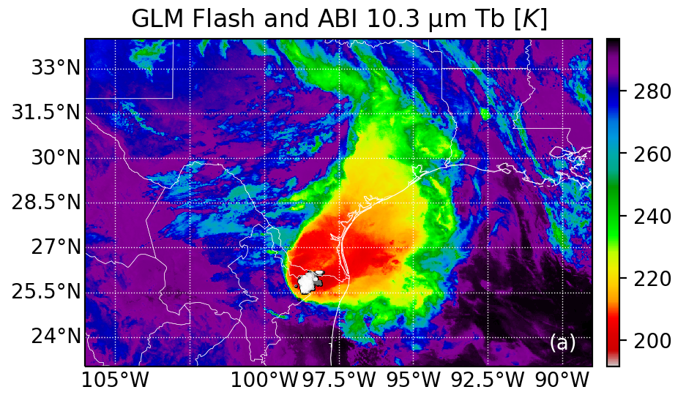
The Top Case of GLM Overclustering: GLM Mean Flash Duration and Group Locations
This overclustering impacts all downstream GLM gridded products. The CIERRA Mean Flash Duration (MFD) product (left) exceeds 10 s over the entire convective cell
Overclustering affects LCFA gridded products, but artificial splitting makes it harder to detect
One way to identify overclustering is to plot the groups in suspect flashes (as in the right panel). Overclustered flashes will not have a logical progression of groups over time. They will occur randomly across the convective cell

Slide 11
The Top Case of GLM Overclustering: LCFA and CIERRA Flash / Group Rates
The best way to identify overclustering is to compare the LCFA data with GLM science data
The worst overclustering (t = 0 below) causes dramatic reductions in CIERRA FEDs as groups become clustered into single flashes lasting tens of seconds
LCFA FEDs (red) are not reduced, but instead mirror the GED curves (upper) as the amalgamated flashes are split largely into 101-group pieces
In addition to FEDs and GEDS, flash durations, areas, and time differences between pulses (interseries times) are useful for diagnosing overclustering degradations
LCFA quality flags can alert clustering problems, but they do not reveal the source of the problem or how it will impact the interpretation of GLM data. For example…

Slide 12
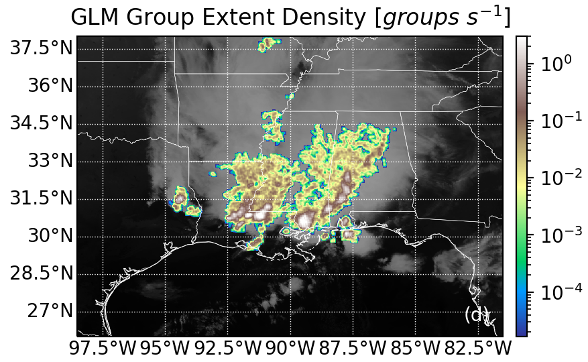
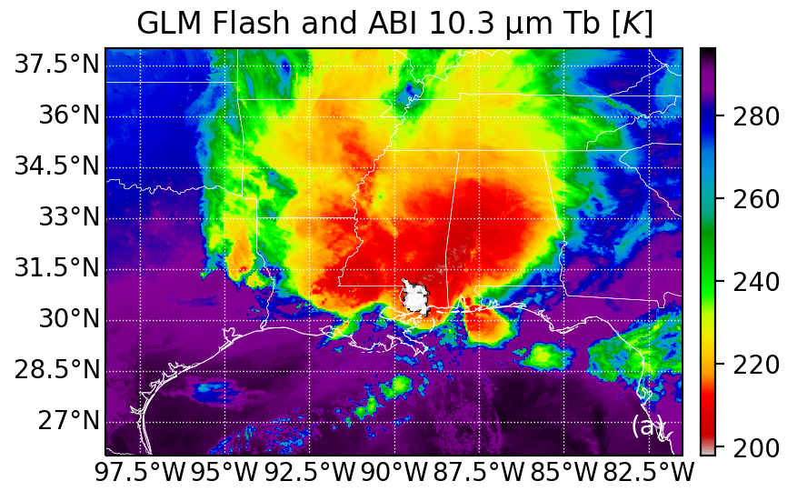
A Very Bad Day for GLM Clustering: Overclustering in a Megaflash-Producing MCS
The MCS below developed over the continent and began to produce megaflashes that were split by the LCFA into 101-s group / 3-s pieces before reaching the Gulf Coast
As it began to move offshore, multiple convective cells became lightning-dense with GEDs reaching 3 groups/s (left) and multi-second flashes detected with random group positions (right)

Slide 13
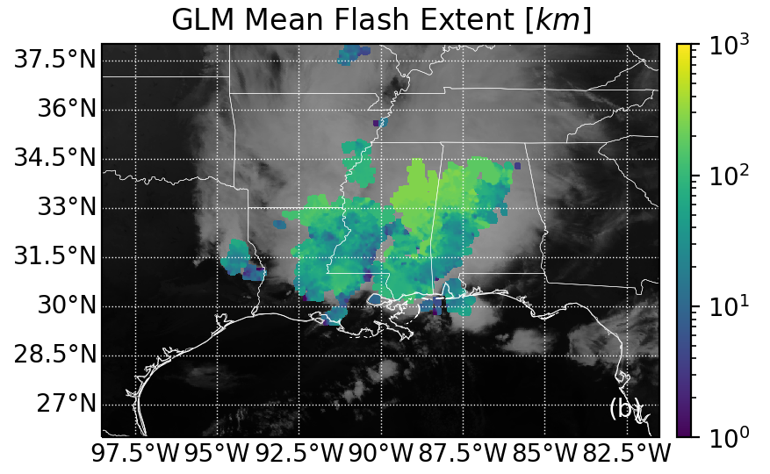
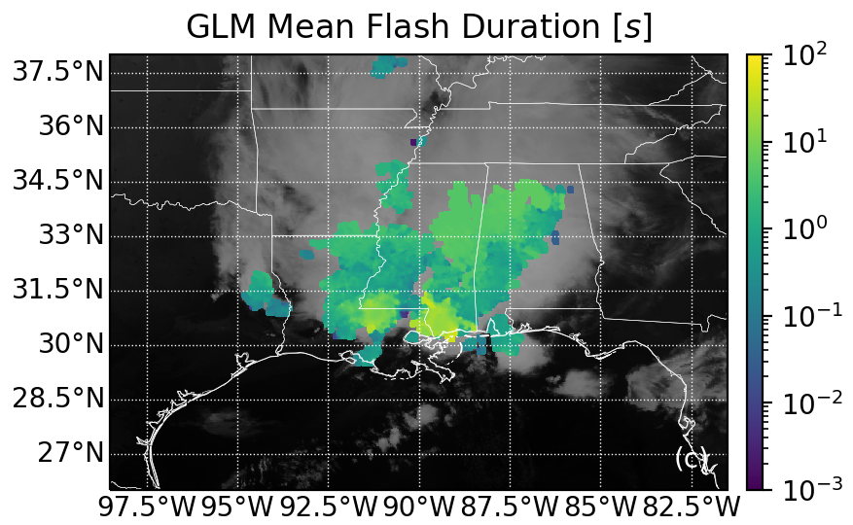
A Very Bad Day for GLM Clustering: Overclustering in a Megaflash-Producing MCS
The CIERRA Mean Flash Extent (MFE) product (left) indicates the locations of 100- 300 km megaflashes in the trailing stratiform region to the north
The CIERRA MFD product (right) highlights the overclustered convective flashes to the south that last 10s of seconds

Slide 14
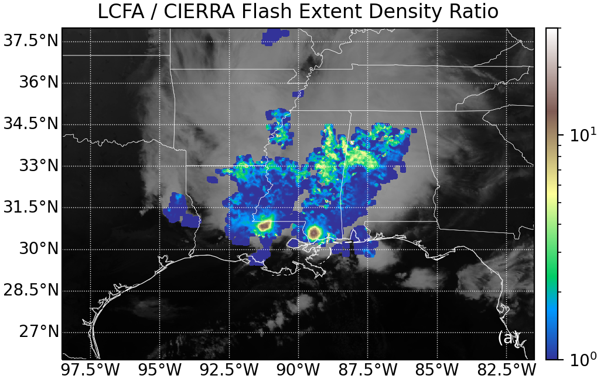
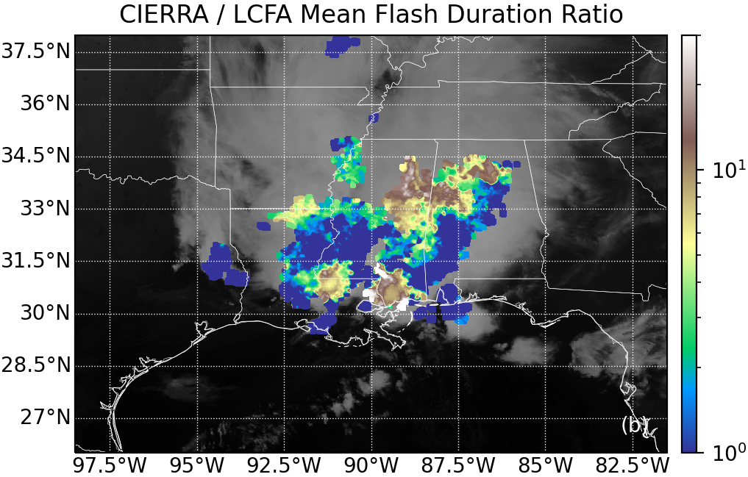
A Very Bad Day for GLM Clustering: LCFA and CIERRA Gridded Products
The LCFA provides a very different picture of this storm, as seen in the grid ratios below
Flash splitting caused LCFA FEDs to be 10x greater than CIERRA in the overclustered convective cells and up to 6x greater in the stratiform region
LCFA flash splitting also reduces flash durations by an order of magnitude
This data degradation obscures these data quality problems in the LCFA gridded products that are readily apparent with properly-clustered data

Slide 15
Conclusion
GLM data degradation can impair the interpretation of the operational GLM level-2 data and the gridded imagery products generated from it
We previously showed how artificial flash splitting by the LCFA overestimates stratiform flash rates and underestimates flash extents
Overclustering should do the opposite: amalgamating flashes to underestimate flash rates and overestimate flash extents / durations
However, the LCFA applies the same thresholds to the amalgamated flashes, causing them to be split into arbitrary segments – yielding values that are not obviously wrong without further analysis
While artificial flash splitting is common in stratiform flashes (and in 4% of all flashes), overclustering is only a problem in particularly active convective cells
It can occur randomly in any storm (even in some stratiform flashes), but its frequency increases with flash rate as there is less of a temporal gap between subsequent flashes
All but the most extreme cases of overclustered flashes can be difficult to identify and interpret in the LCFA data and derived products
The expanded set of products and the properly-clustered flash data in science-level GLM data are useful for identifying overclustering, determining its cause, and quantifying its severity
Insights into overclustering from the science data may be useful for creating a GLM data quality product that could inform clustering issues in real time / near real time

Slide 16
Questions?

