Slide 1
GLM Background Imagery Viewable in
AWIPS
Brianna Witherell
NOAA Lapenta Intern
Mentors: Joe Zajic, Lee Byerle

Slide 2
GOES ABI
What happens when ABI is not available to WFO’s?

Slide 3
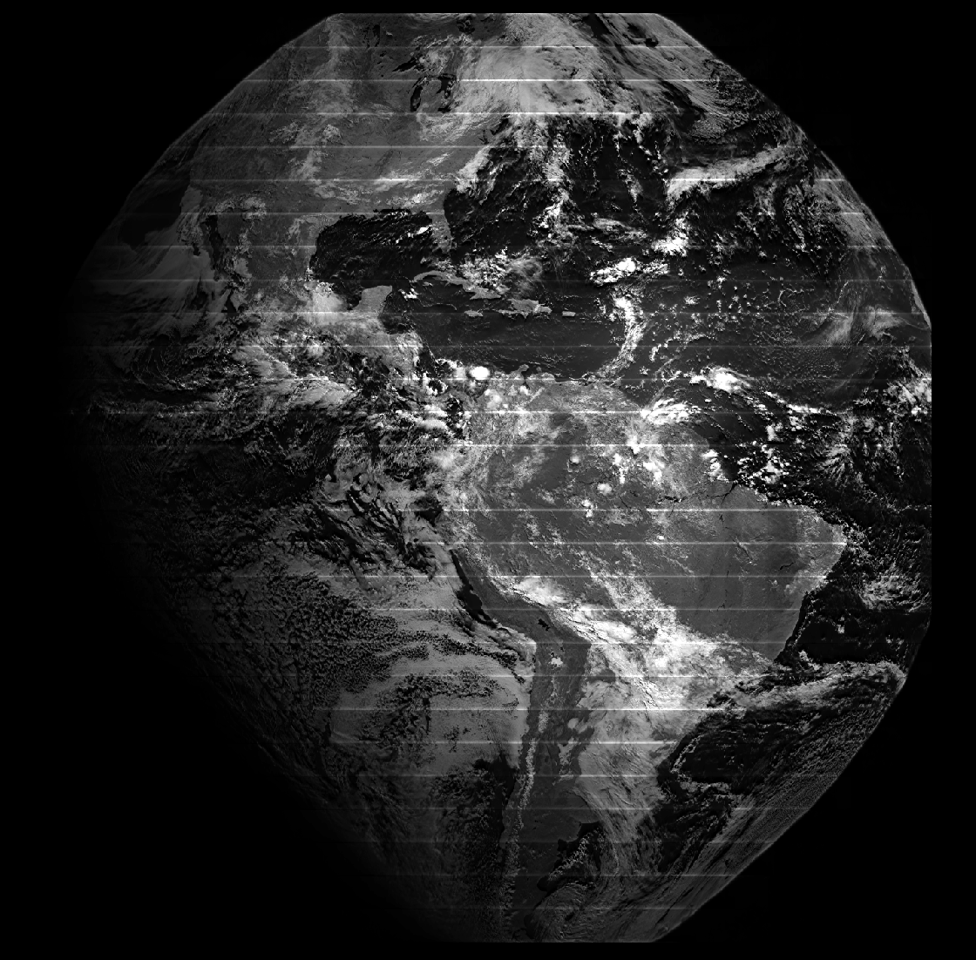
Background on the background imagery
Full disk image produced every ~2.5min
Uncalibrated, not geolocated
Resolution: 8km at nadir
Wavelength: 0.77 µm

Slide 4
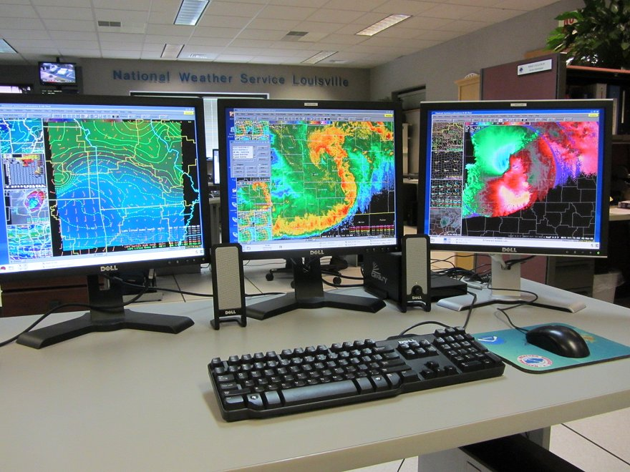
What is AWIPS?
Advanced Weather Interactive Processing System
NWS forecaster “battlestation”
122 Weather Offices, 13 River Centers, 9 Centers

Slide 5
Imagery -> AWIPS
ISatSS pipeline that pulls GLM Background Image from AWS
KD Tree based resampling of GLM background imagery into 5424x5424 pixel output array
Feed resampled imagery to AWIPS for processing

Slide 7
Hurricane Darby, Pacific Ocean (2022)

Slide 9
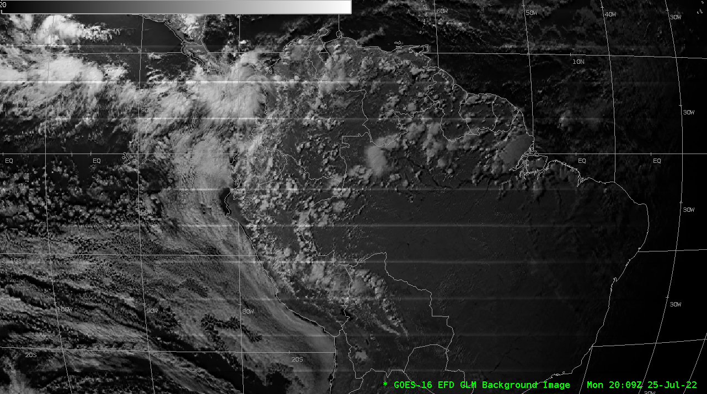
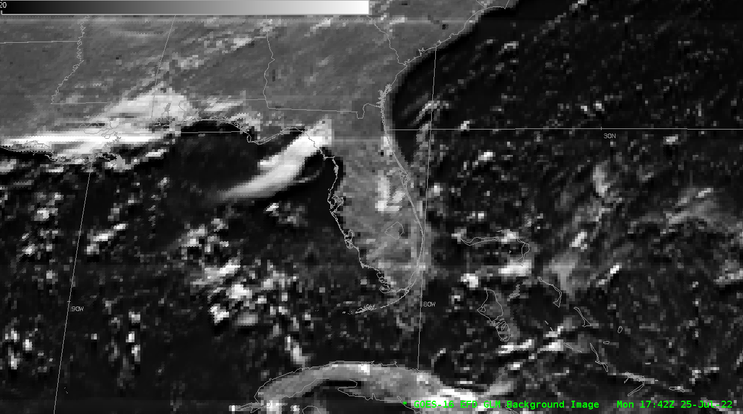
Is it perfect? No.
CCD subarray boundary artifacts
Geolocation offset error

Slide 10
Forecaster Impressions
01
02
Columbia, SC WFO
GLM Working Group
“Huh… it looks a lot like GOES-8.”
“I thought it would look a lot worse than that.”
03
All 5 WFO’s Surveyed
“In the event of an ABI outage, I could forecast off this imagery.”

Slide 11
In summary
GLM background imagery is useful to NWS forecasters in event of ABI outage
Further work is needed for artifact removal and geolocation correction
Email: brianna.witherell@noaa.gov

