Slide 1
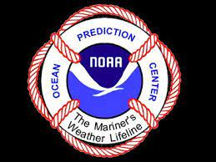
Expanding the Ocean Prediction Center's Convective Nowcasts
Using ProbSevere LightningCast
Javier A. Villegas Bravo
Satellite Liaison to OPC/WPC

Slide 2
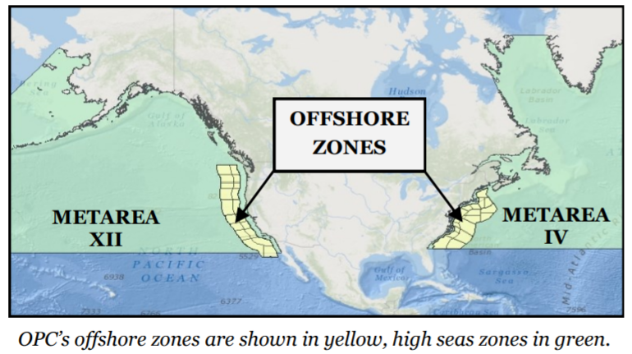
OPC Area of Responsibility
A Look at NOAA's Ocean Prediction Center - WeatherNation (weathernationtv.com)
javier.a.villegasbravo@noaa.gov

Slide 3
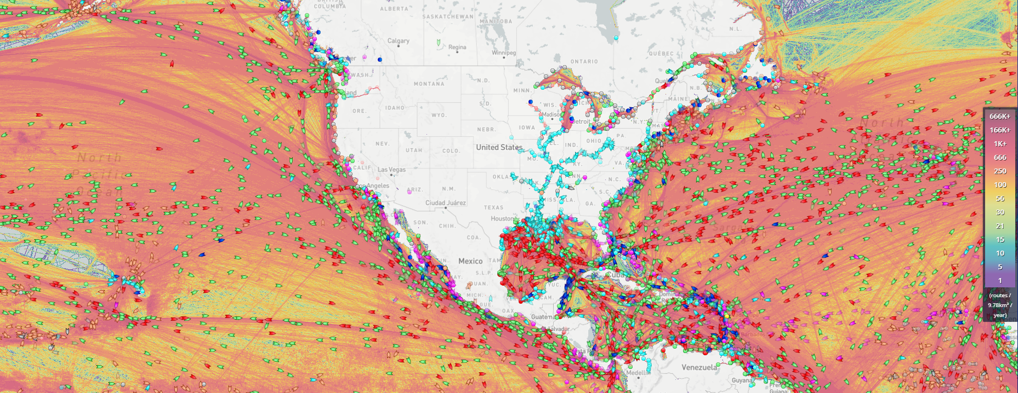
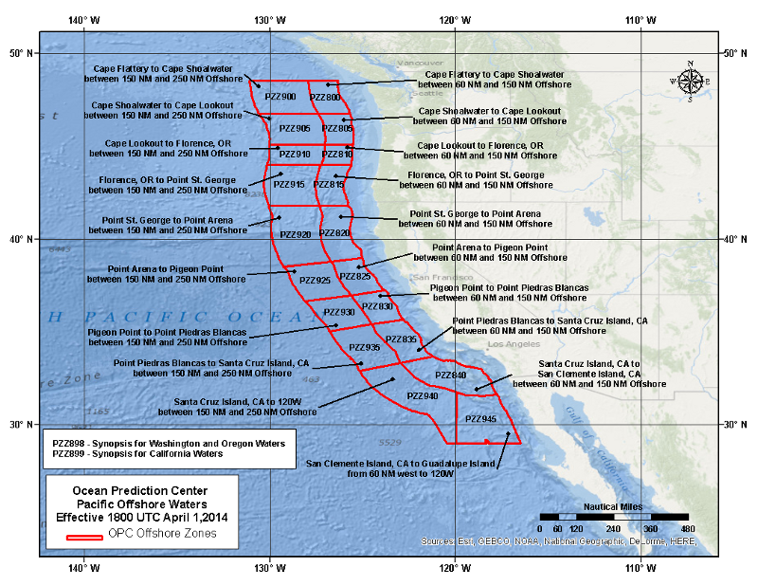
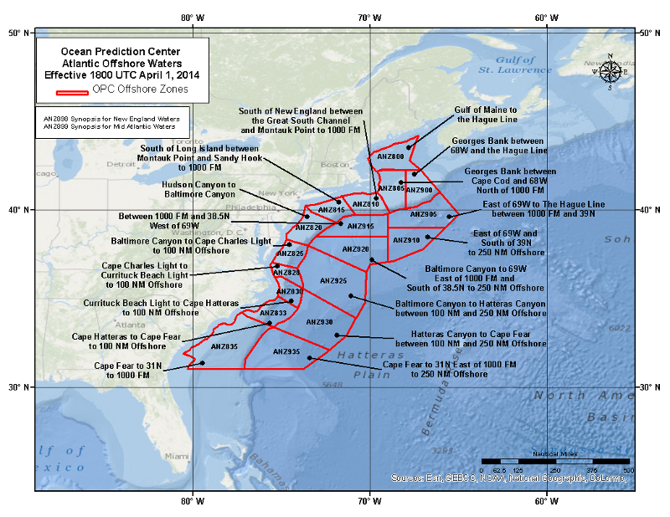
OPC Area of Responsibility
MarineTraffic: Global Ship Tracking Intelligence | AIS Marine Traffic
Offshore Zone Text Product
javier.a.villegasbravo@noaa.gov

Slide 4
OPC Area of Responsibility
javier.a.villegasbravo@noaa.gov

Slide 5
OPC Area of Responsibility
Offshore Zone Text Product
javier.a.villegasbravo@noaa.gov

Slide 6
Motivation to Expand Convective Products
live automated product
monitor marine convection
Delivered directly to mariners
Improve baseline of OPC’s mission
No extra work to forecasters
javier.a.villegasbravo@noaa.gov

Slide 7
ProbSevere Lightning Cast (LC)
Developed at CIMSS by John Cintineo, Mike Pavolonis and Justin Sieglaff
Designed to predict lightning out to 1hr
Lightning is a proxy and precursor to convection
Semantic segmentation convolutional neural network (U-net). Machine learning model trained from GOES imagery to match textures and pixel values to GLM FED within next 1hr
javier.a.villegasbravo@noaa.gov

Slide 8
ProbSevere Lightning Cast (LC)
Input Training Data
GOES-16 ABI
Band 2 (0.64-µm)
Band 5 (1.6-µm)
Band 13 (10.3-µm)
Band 15 (12.3-µm)
javier.a.villegasbravo@noaa.gov

Slide 9
ProbSevere Lightning Cast (LC)
Input Training Data
GOES-16 ABI
Band 2 (0.64-µm)
Band 5 (1.6-µm)
Band 13 (10.3-µm)
Band 15 (12.3-µm)
Target Training Data: GOES-16 GLM Flash Extent Density, 1 or more flashes within the next 60 min
javier.a.villegasbravo@noaa.gov

Slide 10
ProbSevere Lightning Cast (LC)
Input Training Data
GOES-16 ABI
Band 2 (0.64-µm)
Band 5 (1.6-µm)
Band 13 (10.3-µm)
Band 15 (12.3-µm)
Target Training Data: GOES-16 GLM Flash Extent Density, 1 or more flashes within the next 60 min
Trained over CONUS region, 2019 mostly during the convective season, > 76,000 scenes, ~5% of pixels had >= 1 GLM flash/ hr
Ran every 5min on GOES-16/17 CONUS/PACUS and the Meso-sectors
Typical lead times range from 10 to 30 minutes
Cintineo, J. L., M. J. Pavolonis, and J. M. Sieglaff, 2022: ProbSevere LightningCast: A deep-learning model for satellite-based lightning nowcasting. Wea. Forecasting, submitted
javier.a.villegasbravo@noaa.gov

Slide 11
Test Case
A
B
C
D
javier.a.villegasbravo@noaa.gov

Slide 12
Testbed Goals
OPC forecasters document and verify LC product behavior
Decide if LC will improve on OPC’s baseline convective product
Provide feedback to developers
javier.a.villegasbravo@noaa.gov

Slide 13
Testbed Results
Most surveys said that LC tended to under predict lightning but most written feedback said it over predicted.
Textures and pixel values that could lead to lightning don’t necessarily end up producing lightning leading to false positives
Could be a way to monitor areas of interest
but could also be confusing to mariners
Forecasters said LC performed best for land influenced convection
Could mean that the model over ocean should be trained with marine data
Airmass RGB and Geocolor were the most recommended underlays for the contours
Can see boundaries and cloud type development
ASCAT winds and any altimetry (wave height) were also recommended by the forecasters to see associated hazards
31% of surveys said LC could help with wind and wave hazards, 39% said LC could not
Over 30% of surveys said that LC over predicted lightning near marine cold fronts (the major system type of the testbed)
javier.a.villegasbravo@noaa.gov

Slide 14
Summary & Future Work
ProbSevere LightningCast was identified as a tool to capture developing convection for direct use by mariners
OPC performed a testbed to evaluate its viability as a marine convective product
Product will be useful to improve OPC’s baseline convective product
Conduct another testbed in AWIPS-II in the near future and discuss dissemination to mariners
Cintineo, J. L., M. J. Pavolonis, and J. M. Sieglaff, 2022: ProbSevere LightningCast: A deep-learning model for satellite-based lightning nowcasting. Wea. Forecasting, submitted
javier.a.villegasbravo@noaa.gov

Slide 15
Supplemental Slides

Slide 16
NOAA Ocean Prediction Center
ProbSevere LightningCast (LC) Testbed
Javier A. Villegas Bravo
Satellite Liaison to OPC/WPC
Faculty Assistant at UMD CISESS
vllgsbr2@umd.edu or javier.a.villegasbravo@noaa.gov
Expand beyond current offshore zone convective text product
Testbed to verify LC as a graphical convective product for direct use by mariners
LC is a machine learning alg. to predict lightning out to 1hr as seen by GOES GLM from the GOES ABI imagery
LC shows skill in monitoring areas of cumulus and cooling cloud tops that may result in lightning
Suggest to devs to train model over marine convection for OPC mission
Want to test product for Weather Prediction Center and National Hurricane Center Tropical Analysis Forecast Branch
Offshore Zone Text Product
Cintineo, J. L., M. J. Pavolonis, and J. M. Sieglaff, 2022: ProbSevere LightningCast: A deep-learning model for satellite-based lightning nowcasting. Wea. Forecasting, submitted
https://cimss.ssec.wisc.edu/severe_conv/pltg.html

Slide 17
Testbed Design
30 days, Jan 18th - Feb 18th 2022
Performed on outlook desk, typically from 5-6pm EST
Provide support during 5-6pm window everyday
Forecasters pull up product on CIMSS RealEarth website
Load up at least 1 relevant hr of 5-10 min imagery and fill out google form
Optional google drive folder to drop screen shots
javier.a.villegasbravo@noaa.gov

Slide 18
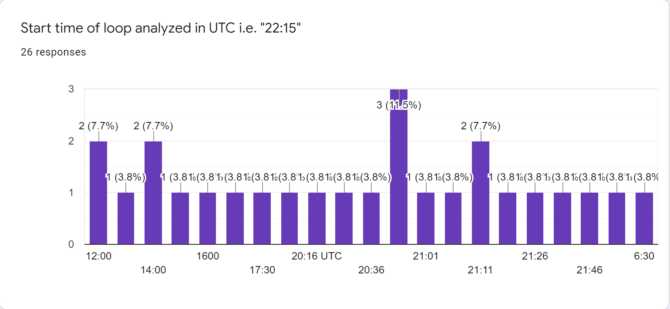
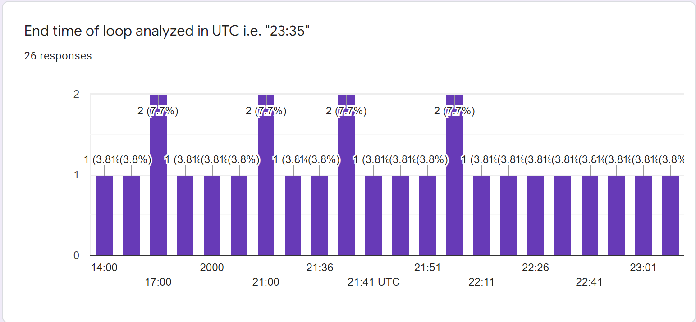
Testbed Results
javier.a.villegasbravo@noaa.gov

Slide 19
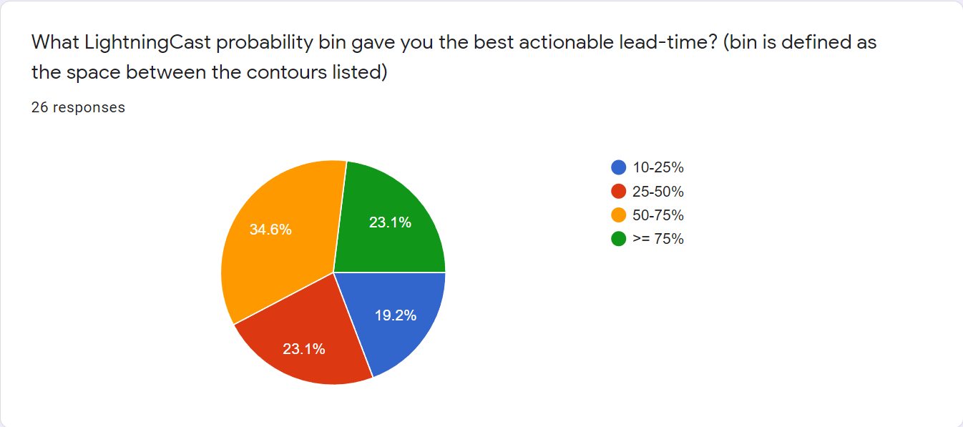
Testbed Results
javier.a.villegasbravo@noaa.gov

Slide 20
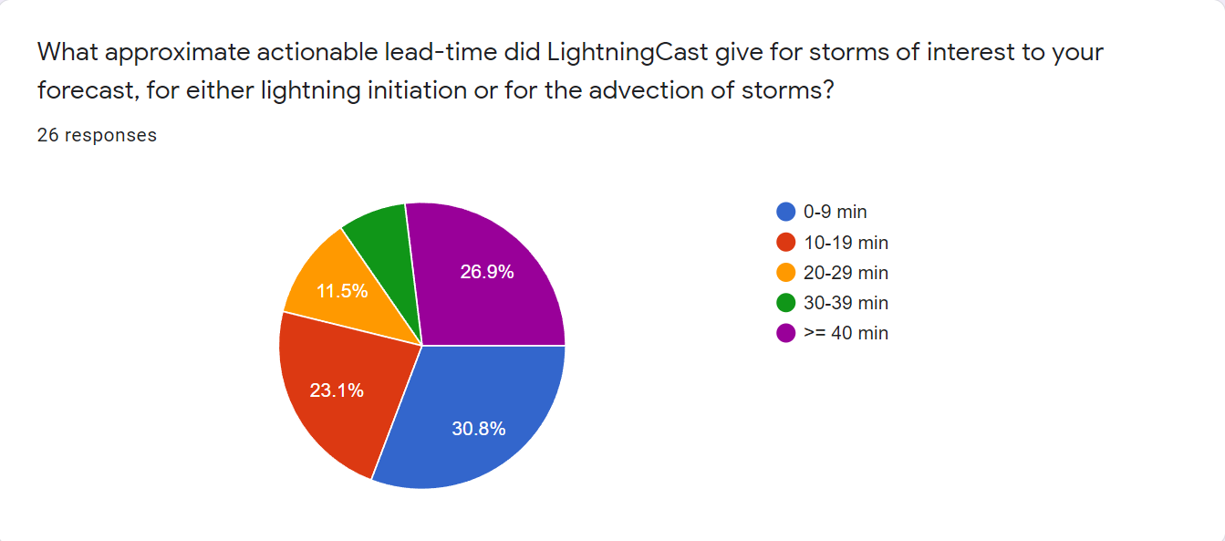
Testbed Results
javier.a.villegasbravo@noaa.gov

Slide 21
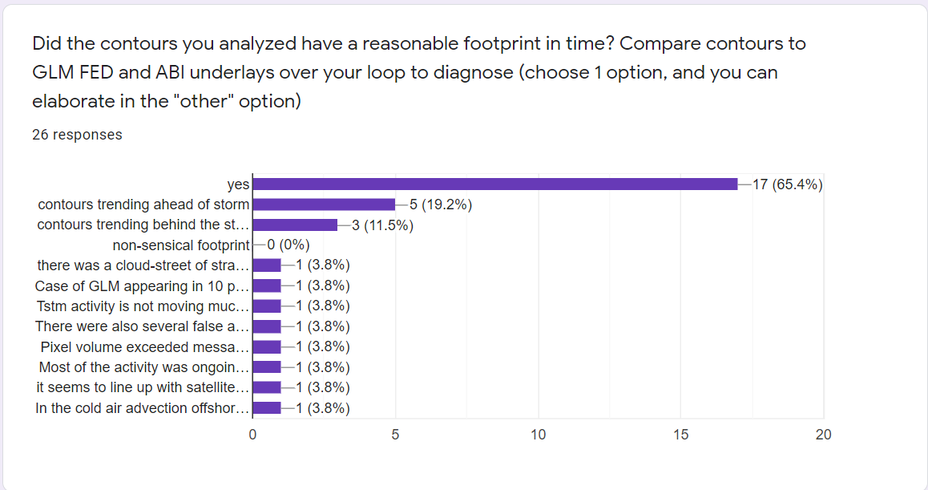
Testbed Results
javier.a.villegasbravo@noaa.gov

Slide 22
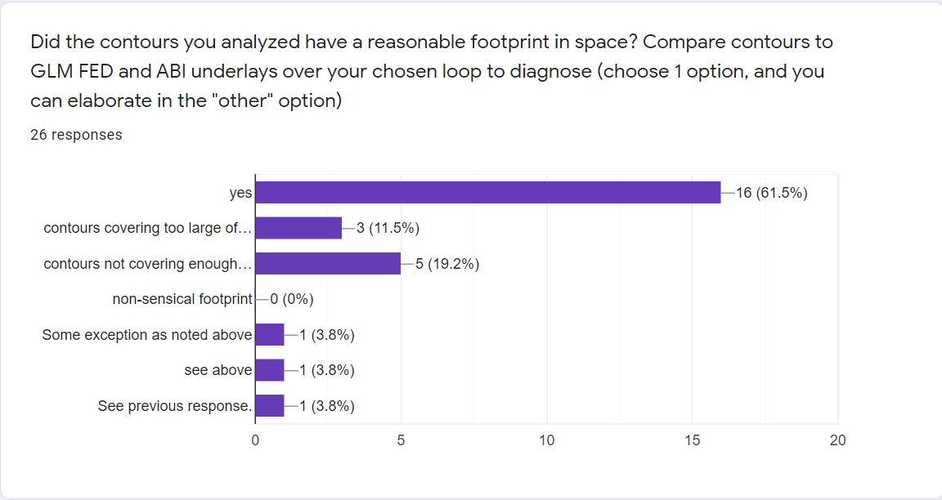
Testbed Results
javier.a.villegasbravo@noaa.gov

