Slide 1
Assessment Overview: Regional Impacts of Using the Day Cloud Phase Distinction RGB for Lightning IDSS
Anita Le Roy – University of Alabama in Huntsville / NASA SPoRT
Christopher J. Schultz – NASA MSFC
Kristopher White – NWS Huntsville
GLM Science Week 14 September 2022

Slide 2
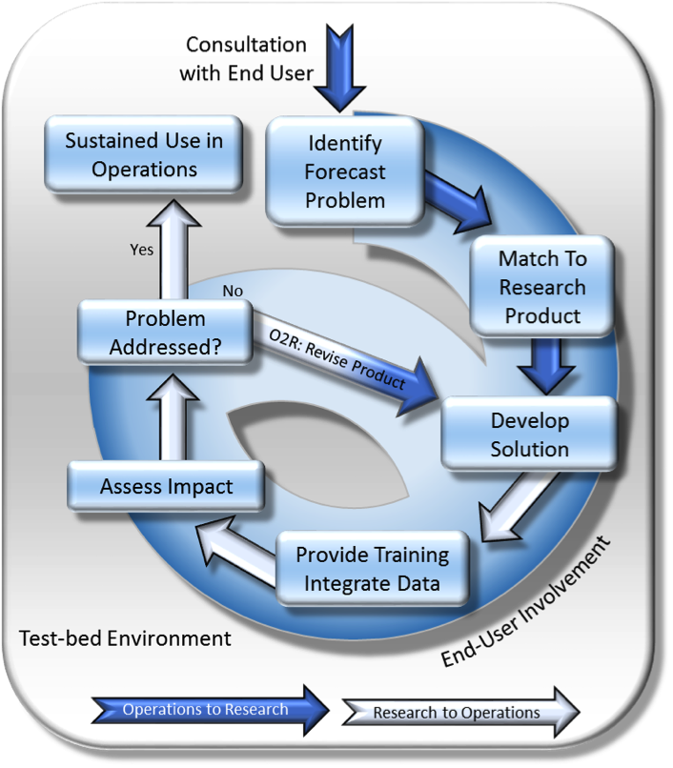
NASA SPoRT
Research to Operations Chasm
How do you get promising, cutting edge research to decision makers?
How do you know what’s promising?
How can researchers learn what is needed in ops?
What products, in what formats, at what latency, etc.?
Who transitions and maintains the product?
Who provides resources for all this?
Successful R2O/O2R requires intentionality.
GLM Science Week 14 September 2022

Slide 3
NASA SPoRT
Current Partners
Current SPoRT “research-to-operations” Thematic Areas:
Research Areas:
Tropical Meteorology
Atmospheric Remote Sensing
Lightning/ Convection
Air Quality / Human Health
Land Surface Remote Sensing
Machine Learning
Transition Activities:
End-User Training
Product Assessments
Data Production
GLM Science Week 14 September 2022

Slide 4
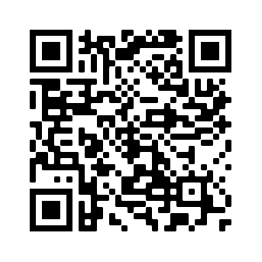
Day Cloud Phase RGB: Quick Basics and Motivation for Our Study
The DCP Distinction RGB helps users efficiently distinguish between cloud types using the 10 um (red), the .64 um (green), and the 1.6 um (blue) bands.
One purpose of the RGB is to help users identify glaciation in clouds, anticipating convection…
…and also lightning (?)
Elsenheimer and Gravelle (2019) provided an excellent methodology and scientific justification for doing just that: in Florida, the NWS Jacksonville CWA was using the RGB to help inform lightning IDSS guidance.
Our question: Can this method be generalized to all CWAs?
And some follow-ups, because we are very thorough: Is the method impacted by viewing angle or other differences in GOES-E and GOES-W? Is the nature of convection and lightning similar enough that this method is reliable throughout the country?
Read Elsenheimer and Gravelle 2019
GLM Science Week 14 September 2022

Slide 5
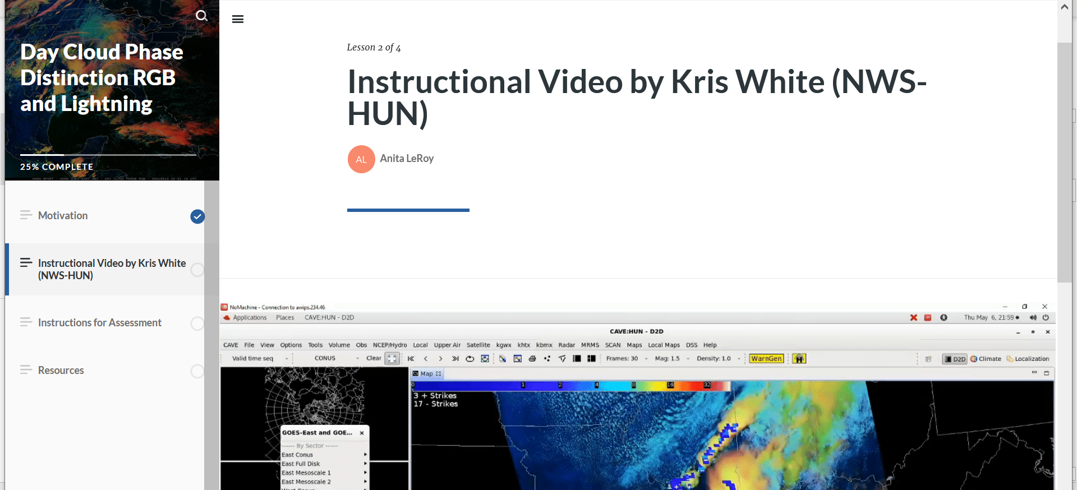
Assessment Methodology
Solicited feedback from NWS forecasters all throughout the country.
Asked some “utility” questions: E.g., could you identify glaciation in the RGB?
Asked some more technical questions, in case we needed to learn more about what they were seeing in the RGB to understand potential regionality.
E.g., what was the max -10C reflectivity in the cell you observed (if available)? What was the lowest 10 um temp?
Brief overview of the DCP RGB and the objectives of the assessment.
GLM Science Week 14 September 2022

Slide 6
Assessment Methodology (cont.)
* Note that we understand these specific quantitative questions potentially spook the participants. We never want our feedback forms to feel like a pop quiz. This is ultimately still social science; we sought to understand what the user could quickly perceive while performing their tasks at the forecast desk.
** In other words, please do not examine these results and assume a level of scientific rigor that we did not intend and didn’t ask for.
GLM Science Week 14 September 2022

Slide 7
Forecaster Demographics
Feedback received | CWAs Observed* | Forecasters | Regions
46 | 18 | 16 | 5 (ER, CR, SR, WR, AR)
*They could observe convection wherever they wished.
GLM Science Week 14 September 2022

Slide 8
Feedback on Utility
Were you able to easily interpret the DCP RGB to see glaciation?
Would you have been able to use glaciation in the DCP RGB to anticipate lightning?
Caveats mainly point to the subjective nature of RGBs. We also expect that, over time, forecasters become increasingly familiar with RGBs and confidently interpret them.
More caveats and some “no” answers here. Some issues were not being able to discern which cells were related to lightning that happened several minutes later in larger fields of convection.
GLM Science Week 14 September 2022

Slide 9
Feedback on Sat Obs
-10C reflectivity was not available to the participants in AK or WR
GLM Science Week 14 September 2022

Slide 10
Feedback on Sat Obs
Are the observations from Eastern Region looking a little different from the others?
GLM Science Week 14 September 2022

Slide 11
Lead time from observed glaciation to first flash
AK uses GLD360.
Broad range of lead times in all regions.
GLM Science Week 14 September 2022

Slide 12
Regionality? It is suggestive, but…
Rank sum tests tell us that we can assume some regionality in these results if we are willing to risk being wrong 10% of the time. (Wcrit at alpha = 0.1)
So, while it looks interesting, it might just be an artifact of sample size. (And remember my caveat about this not being a super rigorous evaluation on our forecasters’ shoulders.)
How about sampling?
In SR, there is a good mix of 5- and 1-min GOES observations.
Again, a little suggestive, but again, rank sum tests indicate, e.g., higher reflectivities in 1-minute data only at 10%.
…But it still makes us curious…
GLM Science Week 14 September 2022

Slide 13
Conclusions and future work
Forecasters in all regions felt mostly comfortable identifying glaciation in the DCP RGB.
Forecasters in all regions felt mostly comfortable using the DCP RGB to anticipate lightning risk for IDSS.
Glaciation preceded lightning in almost all events; lead times over ten minutes.
Sometimes there wasn’t clarity on what cells to focus on amid broad convective activity, which might impact the utility of this method.
Then again, for IDSS, you are usually forecasting for a specific, limited area.
This method provided a wide range of lead times (from glaciation to first detected flash), but generally glaciation preceded lightning initiation by less than 30 minutes.
Forecasters in all regions using GOES-E and GOES-W, and both 1- and 5-min sampling, were able to use and interpret the DCPD RGB for notional lightning IDSS.
We’d love to examine this more rigorously, if the opportunity arises.
GLM Science Week 14 September 2022

