Slide 1



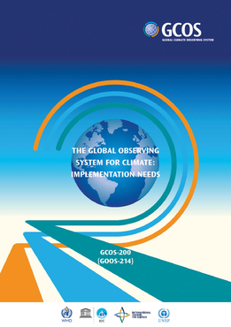
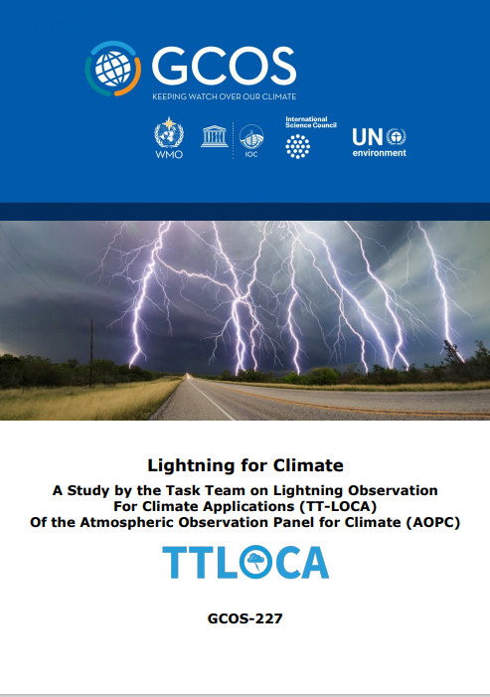
Lightning : An Essential Climate Variable
WMO/GCOS Task Team on Lightning Observations For Climate Applications (TT-LOCA)
Task Team Panel Members:
Steve Goodman, NOAA/NASA (ret), USA, Chair
Robert Holzworth, Univ. of Washington, USA
Vasiliki Kotroni, NOA, Athens, Greece
Yuriy Kuleshov, RMIT, BOM, Melbourne, Australia
Colin Price, Tel Aviv Univ, Israel
Bartolomeo Viticchie, EUMETSAT, Darmstadt, Germany
Earle Williams, MIT, USA
GCOS/WMO: Caterina Tassone, Tim Oakley

Slide 2
Lightning for Climate: Value Proposition
ECV datasets provide the empirical evidence needed to understand and predict the evolution of climate, to guide mitigation and adaptation measures, to assess risks and enable attribution of climate events to underlying causes, and to underpin climate services.
Space-based and VLF ground-based lightning network data are complementary in the information they provide (flash energy, size, duration, extent). Regional ground-based lightning networks would be a useful addition as they also provide more definitive information on flash type to compare or add to the Lightning ECV database.
Although most lightning occurs in the continental tropics and mid-latitudes, recent observations are indicating an increase in lightning at high latitudes associated with a warming arctic. Monthly, daily and even hourly data are available.
The Thunder Day observation at meteorological stations is a long-term WMO database. There is some evidence that this quantity has also been increasing at high latitudes. Lightning has long been associated with severe and high impact mesoscale weather phenomena, precipitation, NOx, aerosols, tropospheric temperature and moisture. Lightning-initiated wildfires and the threat to public safety are increasing concerns.
Global Climate Observing System (GCOS)

Slide 3
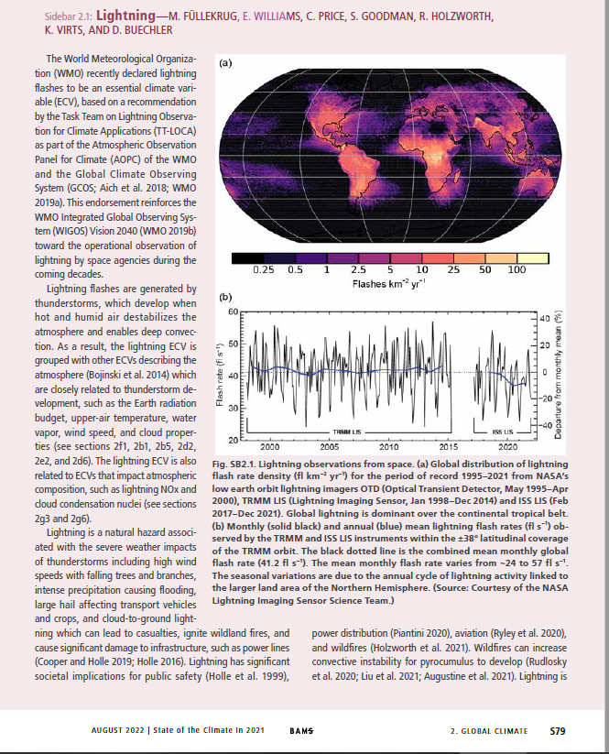
2022 GCOS AOPC IP – Lightning Actions
Accomplishments, Status, and Plans
BAMS, August 31, 2022

Slide 4
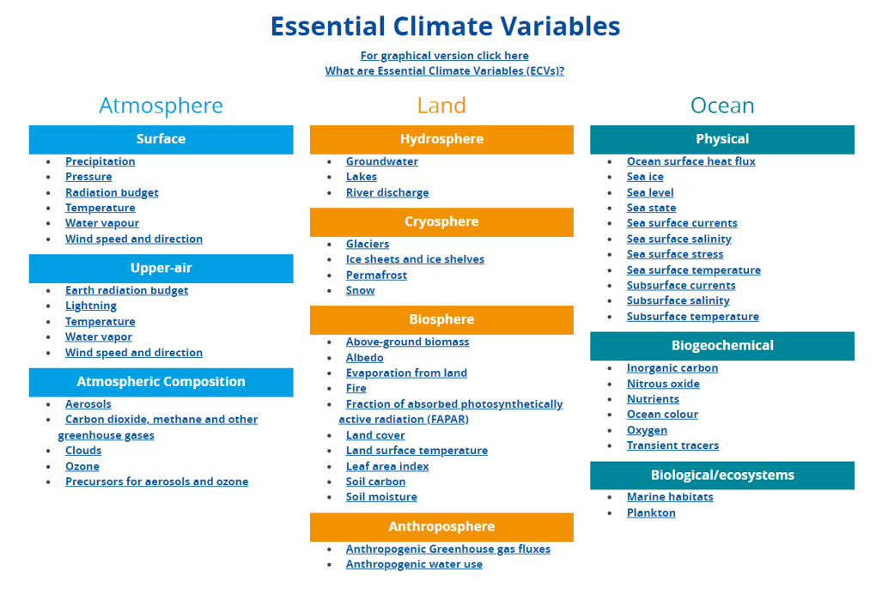
The relationship among ECVs is complex
(https://gcos.wmo.int/en/essential-climate-variables/table

Slide 5
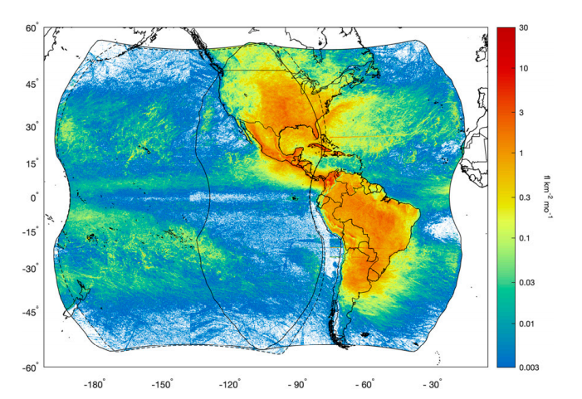
Lightning Data Requirements
  Total Lightning Stroke Density
    Consistent, Harmonized Data
  Global 10 km x 10 km (0.1 x 0.1 deg)
  Temporal (Monthly, Daily, Hourly)
Space-based: GLM Total Lightning Flash Density
  Space-based Optical:
    NASA TRMM/ISS - LIS
    NOAA/NASA GOES - GLM
    CMA FY-4 - LMI
    EUMETSAT MTG - LI
  Ground-based RF (commercial data):
    GLD360 (Vaisala)
    ENTLN (Earth Networks)
    WWLLN (Univ. Washington)
    Regional Networks (IC/CG)
Combined G16 and G17 GLM flash densities from 1 Dec 2018 to 31 May 2020 with units of flash count per square kilometer per month (after Rudlosky and Virts, 2021, MWR, DOI: 10.1175/MWR-D-20-0242.1).
Notes:
Reference: (Rudlosky and Virts, 2021, DOI: 10.1175/MWR-D-20-0242.1

Slide 6
Action C5: ECV-specific Satellite Data Processing Method Improvements
Activity
  Reprocess the LEO NASA 25+ year Lightning Imaging Sensor (LIS) data set from the Optical Transient Detector OTD, 1995-2000), LIS on the Tropical Rainfall Measuring Mission (TRMM-LIS, 1997-2015) and International Space Station (ISS-LIS, 2017-Present).
  Reprocess the GEO Geostationary Lightning Mapper (GLM) on GOES-16/17/18 (2017 -Present)
Status and Plans
  NASA funding the reprocessing of the OTD/LIS full data set archived at the Global Hydrometeorology Resource Center DAAC.
  The ISS-LIS continues collecting data in 2022-2023 (from a newly relocated position on the ISS to make room for another instrument). End of Mission TBD.
  The OTD/LIS global lightning time series and anomaly published in the 2021 AMS August Bulletin Special Issue on Climate; already invited to update the results at the end of 2022
  NOAA GOES-R Program is funding the reprocessing for GLM starting this summer.

Slide 7
Action C5: ECV-specific Satellite Data Processing Method Improvements
Status and Plans (continued)
    Reprocess the data to remove known artifacts and allow for new and improved products using ML/AI (e.g., megaflashes, flash type, continuing current). An Enterprise science algorithm is planned that would be applied to all space-based instruments similar to GLM (e.g., forthcoming MTG-Lightning Imager).
    Year 1 GLM Reprocessing – address artifacts
    Year 2 GLM Reprocessing (if funded) – address ML/AI enhanced products
    Available 2024
Means of Assessing Progress
    Validated and updated 0.1 x 0.1 deg product for satellites and ground based lightning RF data sets (GLD360, WWLLN, TBD Regional networks)
    ThunderHour grids for GLD360, ENGLN, WWLLN, GLM
    Validated and updated space and RF ground-based lightning data at 0.1 x 0.1 deg grids (at monthly cadence).

Slide 8
Action D5: Undertake Additional Data Rescue Activities
Activity
  Continue efforts to advance the rescue of key historical data records from hard copy or image form via an appropriate combination of professional, citizen science and class-based activities.
  The Thunder Day observation at meteorological stations is a long-term WMO database.
Status and Plans
  TT-LOCA team member E. Williams has reached out to NMHS to back-fill missing records.
  Copernicus at ECMWF offered stewardship of the recovered data set.
Means of Assessing Progress
  New funded data rescue efforts leading to the provision of additional data rescued to recognised global repositories for relevant ECVs via a variety of approaches (professional keying, citizen science, participatory learning).
  Methodology can follow that of Lavigne et al. (JGR, 2019) where 43 years and 8000 Thunder Day station reports were correlated to 16 years of TRMM/LIS satellite data to examine trends in global lightning activity. (Lavigne et al., 2019, JGR https://doi.org/10.1029/2018JD029920).

Slide 9
Remaining and Additional Activities
Activity
  TT-LOCA two year extension planned principally to establish the stewardship of the Lightning ECV. Naming a liaison to the AOPC for further coordination through 2024 also under consideration to evaluate the space-based and ground-based ECV data sets, reprocessing, and initial results from the MTG-LI.
  Continue outreach to operators of regional ground-based lightning networks to provide ECV compatible data sets.
  Complete a summary report to follow the initial GCOS-227 Report “Lightning for Climate”. Report format to be discussed at AOPC-27 with WMO-CGOS leads Caterina Tassone and Tim Oakley.
ECV Data Stewardship
  Global VLF operators (GLD360, ENGLN, WWLLN) offered to provide stewardship, maintain and update their ECV product (monthly gridded product, Thunder Hour)
  NCEI - stewardship of operational and GLM reprocessed data
  NASA – GHRC stewardship of the OTD/LIS reprocessed data, and Cloud Service landing page (to be developed and coordinated with NCEI) for all Lightning ECV products.

Slide 10
Summary
Lightning is a global Natural Hazard of great importance and interest
Exemplary datasets – evaluating candidate data sets (satellite – Ground-Based RF)
  Thunder Hour (ENGLN, GLD360, GLM)
  Gridded at 0.1 x 0.1 deg (GLD360, WWLLN, GLM, MTG-LI, Regional Networks)
  Developing input to the GCOS 5 – year Implementation Plan
  Archive and Stewardship in the cloud supported by the NASA GHRC Hydrometeorology DAAC (Distributed Active Archive Center)
Explore how a lightning ECV may be associated with other variables, such as aerosols, temperature, clouds, precipitation, composition, NOx, and surface observations (e.g., surface station thunder, severe weather reports), ENSO, MJO, Upper Level humidity.
Raise lightning safety awareness – collaborate with WHO, WMO Disaster Risk Reduction (Natural Hazards) Programme
Notes:
ACCP – NASA’s Aerosol, Cloud, Convection and Precipitation (ACCP) Mission
GEMS - South Korea's Geostationary Environment Monitoring Spectrometer (GEMS) for Air Quality
TROPOMI - The TROPOspheric Monitoring Instrument (TROPOMI) is the satellite instrument on board of the Copernicus Sentinel-5 Precursor satellite.
TEMPO - Tropospheric Emissions: Monitoring of Pollution (TEMPO) mission will measure atmospheric pollution covering most of North America.
GOSAT-GW -. JAXA’s Global Observing SATellite for Greenhouse gases and Water cycle.

