Slide 1
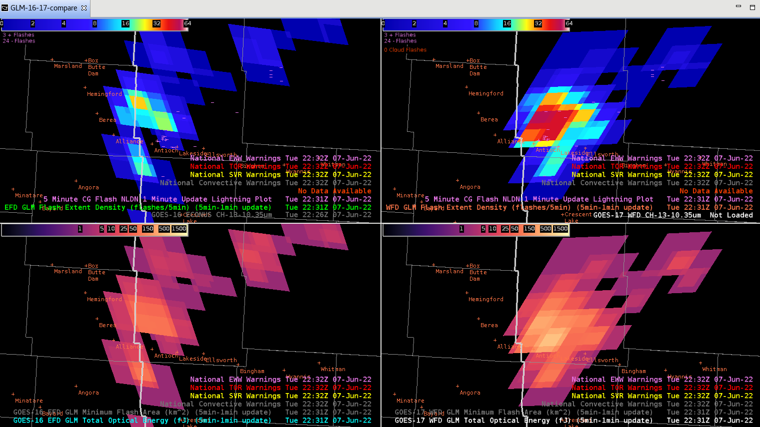
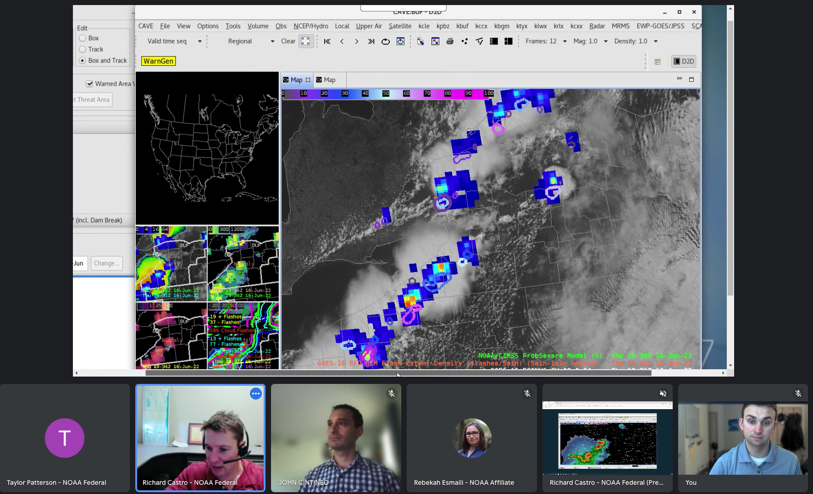
GLM in the 2022 HWT Satellite Proving Ground Experiment
Kevin Thiel (OU-CIWRO, NWS-SPC)
Kristin Calhoun (NOAA-NSSL)
GLM Science Meeting
14 September 2022

Slide 2
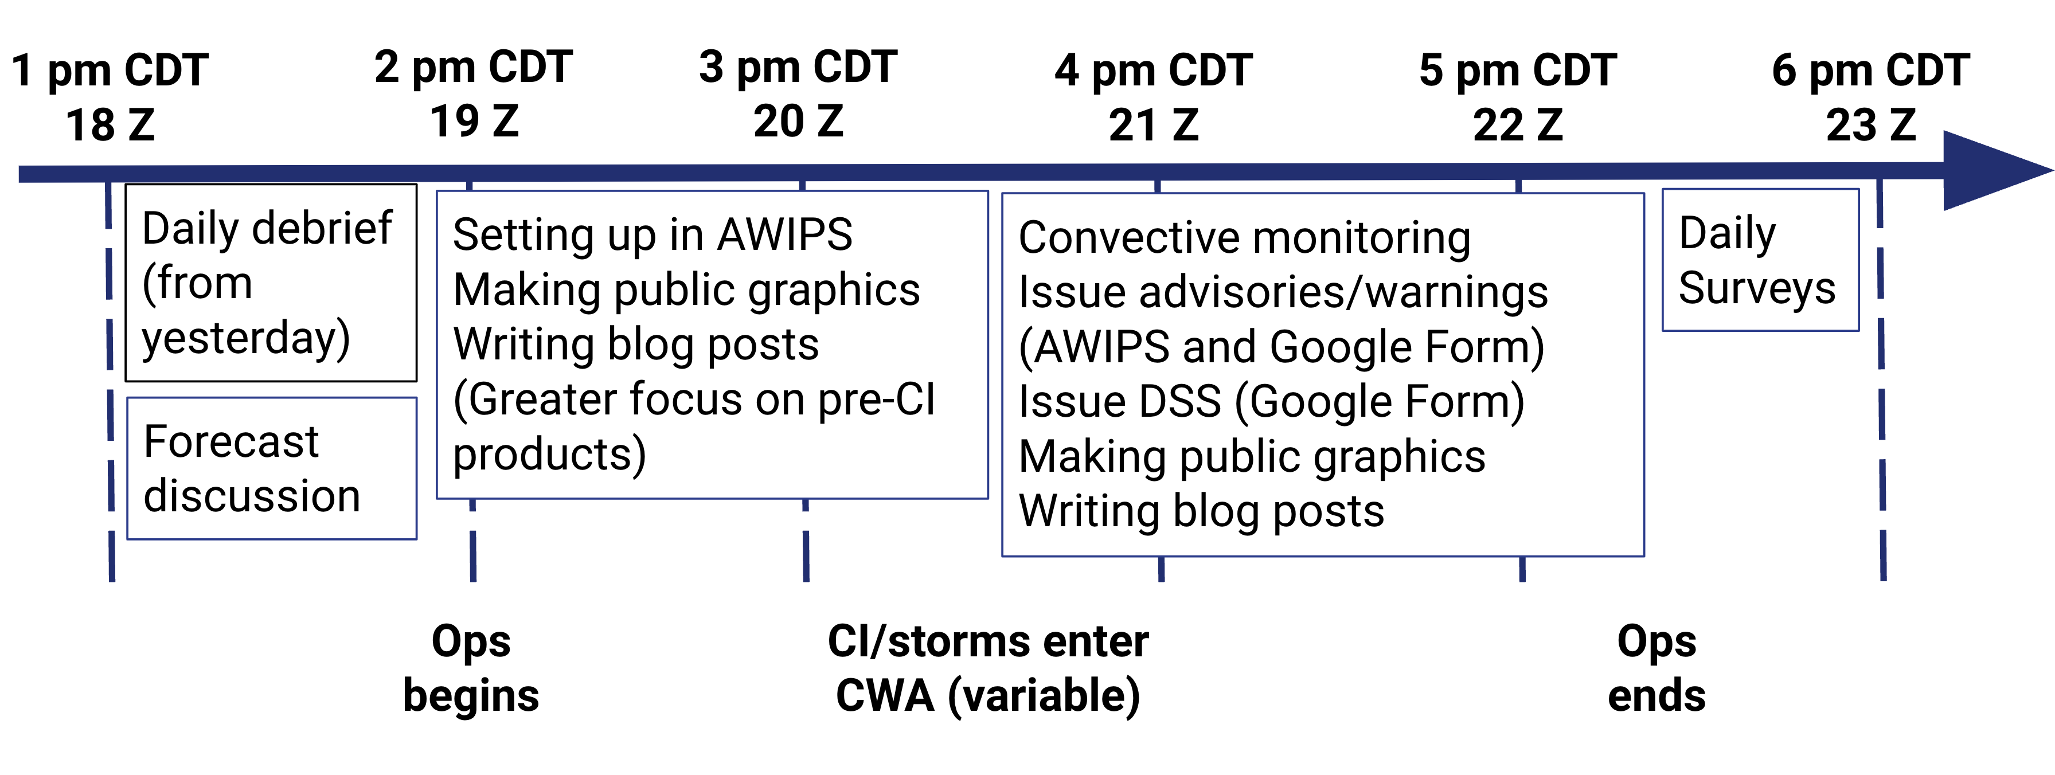
HWT Satellite Proving Ground Setup
3 Weeks
19 NWS Forecasters
Entirely virtual
Increased emphasis on Decision Support Services (DSS)
In operations…
Cloud AWIPS
Moveable, simulated WFOs
Google Meet and Slack
Mock DSS events

Slide 3
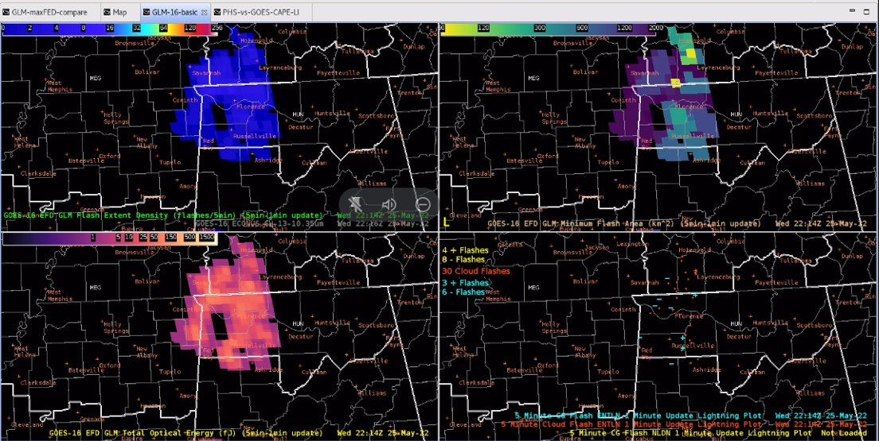
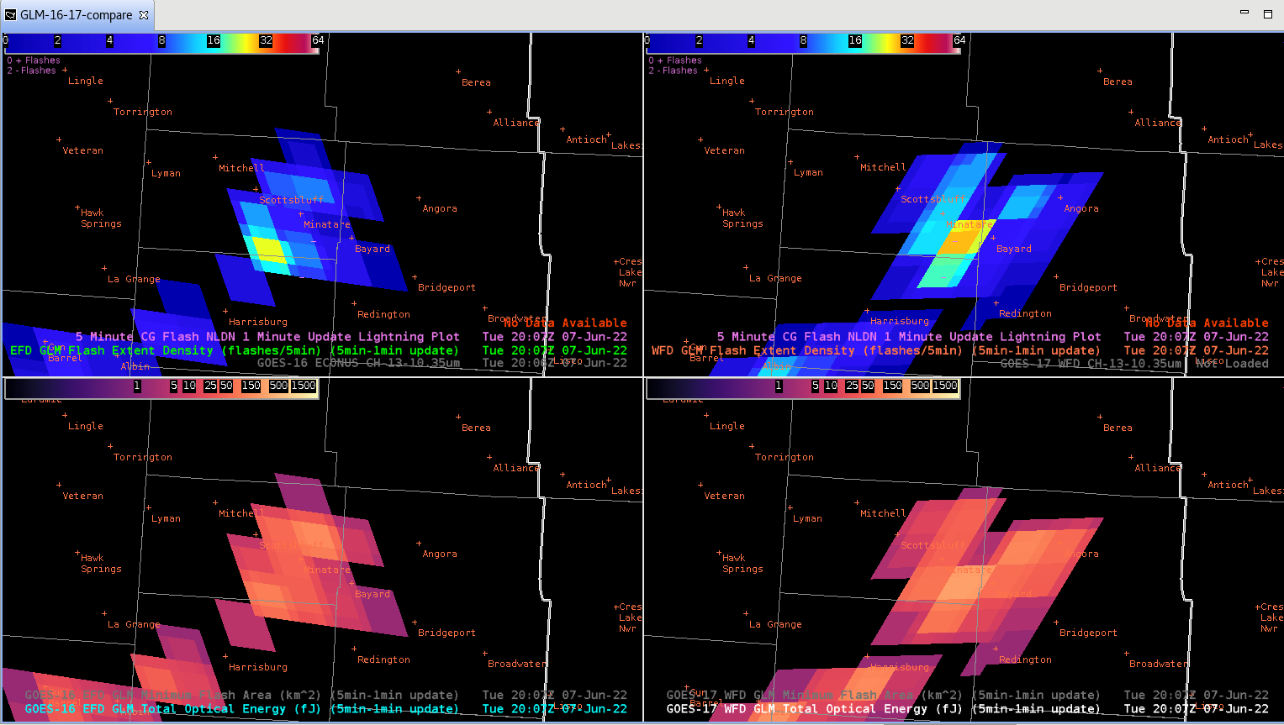
Science Questions in the 2022 HWT
Are MFA and TOE useful?
How does the GLM aid in warning decisions and DSS?
How should forecasters use GOES-E/-W GLM data in overlap regions?
GOES- East GLM
GOES- West GLM
FED
MFA
TOE
Ground Networks

Slide 4
Takeaways from forecasters
MFA is useful (by itself and with FED), however TOE isn’t as useful
GLM is a useful tool for issuing warnings and providing DSS
There’s a need to train forecasters to leverage both GLMs in overlap regions, and more R2O research is needed.

Slide 5
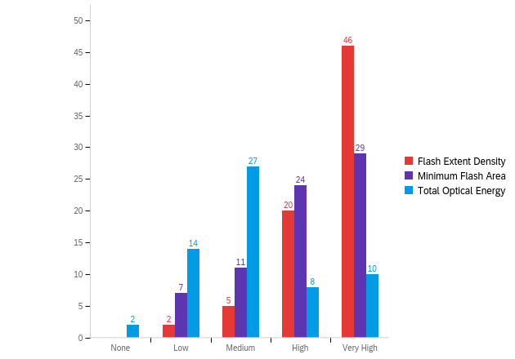
Daily Survey Q: How confident did you feel using the GLM products today?
FED Peak
FED
90%: ‘High’ or ‘Very High’
MFA
75%: ‘High’ or ‘Very High’
TOE
67%: ‘Low’ or ‘Medium’
MFA Peak
TOE Peak
MFA is useful (by itself and with FED), however TOE isn’t as useful

Slide 6
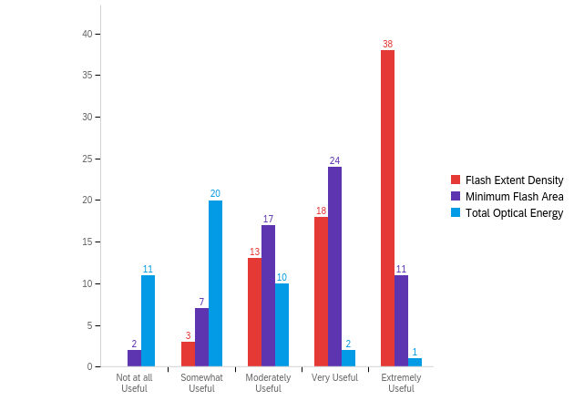
Daily Survey Q: How useful were the GLM products today?
FED Peak
FED
95%: ‘Moderately Useful’ or higher
MFA
85%: ‘Moderately Useful’ or higher
TOE
70%: ‘Not at all Useful’ or ‘Somewhat Useful’
MFA Peak
TOE Peak
MFA is useful (by itself and with FED), however TOE isn’t as useful

Slide 7
Comments from Forecasters…
‘Around 21Z, I noticed a jump in GLM FED for the area of storms in the northwest part of the CWA. Alongside this, the GLM TOE also increased, along with a decrease in MFA with the same storm cell. This area corresponded with increased flash rates in the EarthNetworks.’
26 May 2022, Blog Post: ILX Ramblings https://inside.nssl.noaa.gov/ewp/2022/06/24/ilx-ramblings/
‘Confidence is based on amount of time using the product. Feel confident with FED the most and feel as though MFA was explained well in the training. Still not sure how or when to use TOE and that is why the confidence is lower there.’ Forecaster – End of Day Survey
MFA is useful (by itself and with FED), however TOE isn’t as useful

Slide 8
Warning/DSS Form: Did GLM contribute to your warning or DSS message?
DSS Messaging:
Cited in 35 of 52 DSS messages issued (67%)
Areal extent of flashes
Warnings:
Cited in 31 of 82 warnings issued (38%)
Increasing FED
Increasing FED/Decreasing MFA
‘FED and MFA were confidence boosters for me when deciding whether to issue or hang onto headlines, especially as storms were fairly marginal. Even if reflectivity looked "spooky" at times, I hadn't noticed much change in the GLM trends and that left me feeling more comfortable with letting a headline expire or not issuing at all.’
Forecaster – End of Day Survey
GLM is a useful tool for issuing warnings and providing DSS

Slide 9
Public Graphic for Mock DSS Event

Slide 10
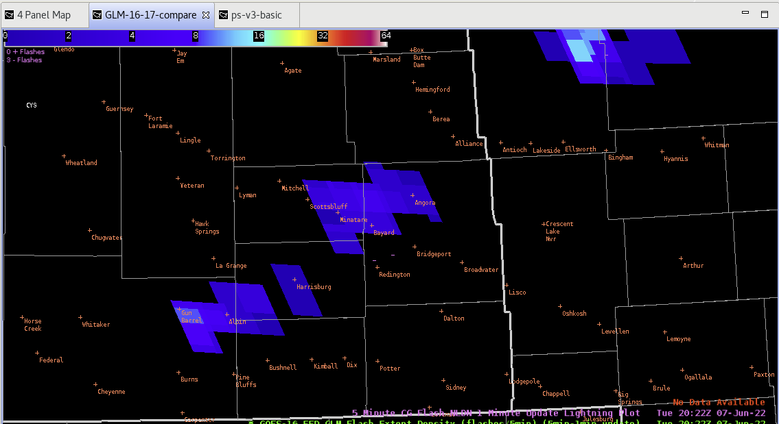
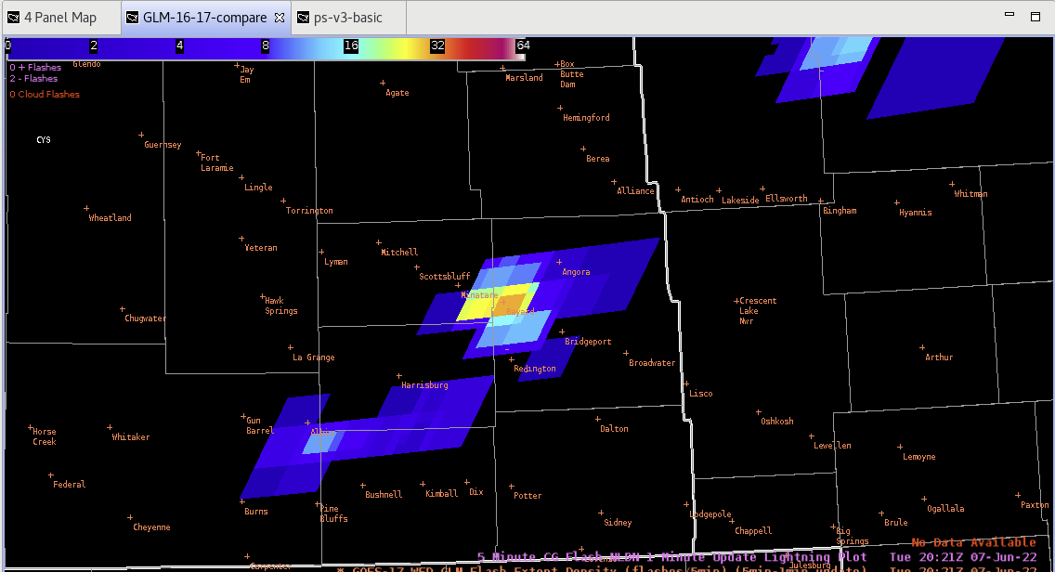
When should forecasters use GOES-E/-W GLM data?
GOES-East GLM, FED
‘GOES-17 had the better angle to see lightning activity in these supercells developing over the high plains of WY and NE. Whereas GOES-16’s perspective from further east had to punch through spreading anvils downstream of the main updraft that likely obscured the light emanating from the lightning, GOES-17 had a more side-on view of the updraft with less to no obscurations of light emanating from lightning occurring in the updraft.’
7 June 2022, Blog Post
https://inside.nssl.noaa.gov/ewp/2022/06/24/glm-goes-16-vs-goes-17/
GOES-West GLM, FED
There’s a need to train forecasters to leverage both GLMs in overlap regions

Slide 11
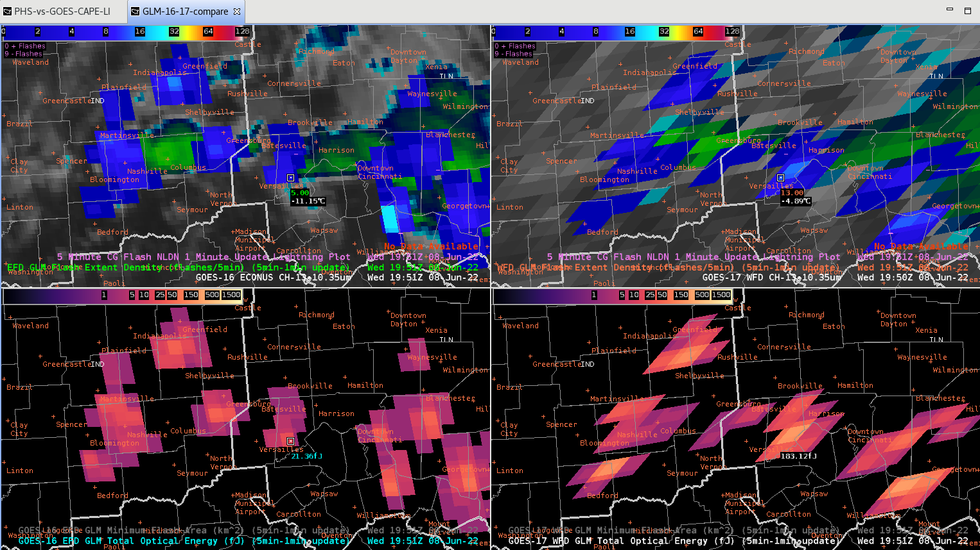
When should forecasters use GOES-E/-W GLM data?
Most forecasters hadn’t considered ways to leverage both GLMs
Set it and forget it (Efficiency)
Looking at data from both GLMs → Better understanding of how the GLM detects flashes
There’s a need to train forecasters to leverage both GLMs in overlap regions

Slide 12
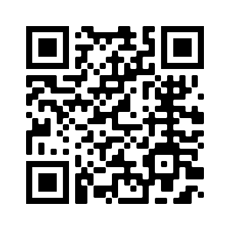
Takeaways from forecasters
MFA is useful (by itself and with FED), however TOE isn’t as useful
GLM is a useful tool for issuing warnings and providing DSS
There’s a need to train forecasters to leverage both GLMs in overlap regions, and more R2O research is needed.
Final Report (coming VERY soon):
https://www.goes-r.gov/users/pg-activities-01.html
kevin.thiel@noaa.gov

