Slide 1
CHARACTERIZATION OF ELECTRIC STORM BEHAVIOR IN PERU WITH THE GLM
Maribel Quispe, UNALM
GLM Science Meeting
14 September 2022

Slide 2
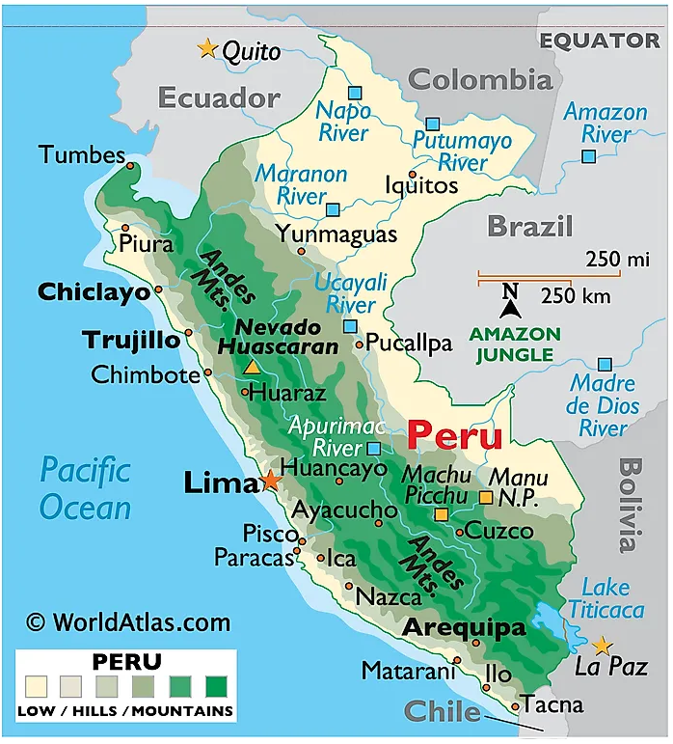
The geography of Peru
The Andes Mountains cover almost 40% of Peru.
The coastal belt is a desert crossed by fertile valleys.
Andean highlands slope down to the rivers and jungles of the Amazon.
https://www.worldatlas.com/r/w768-q80/upload/41/ff/c6/pe-01.png

Slide 3
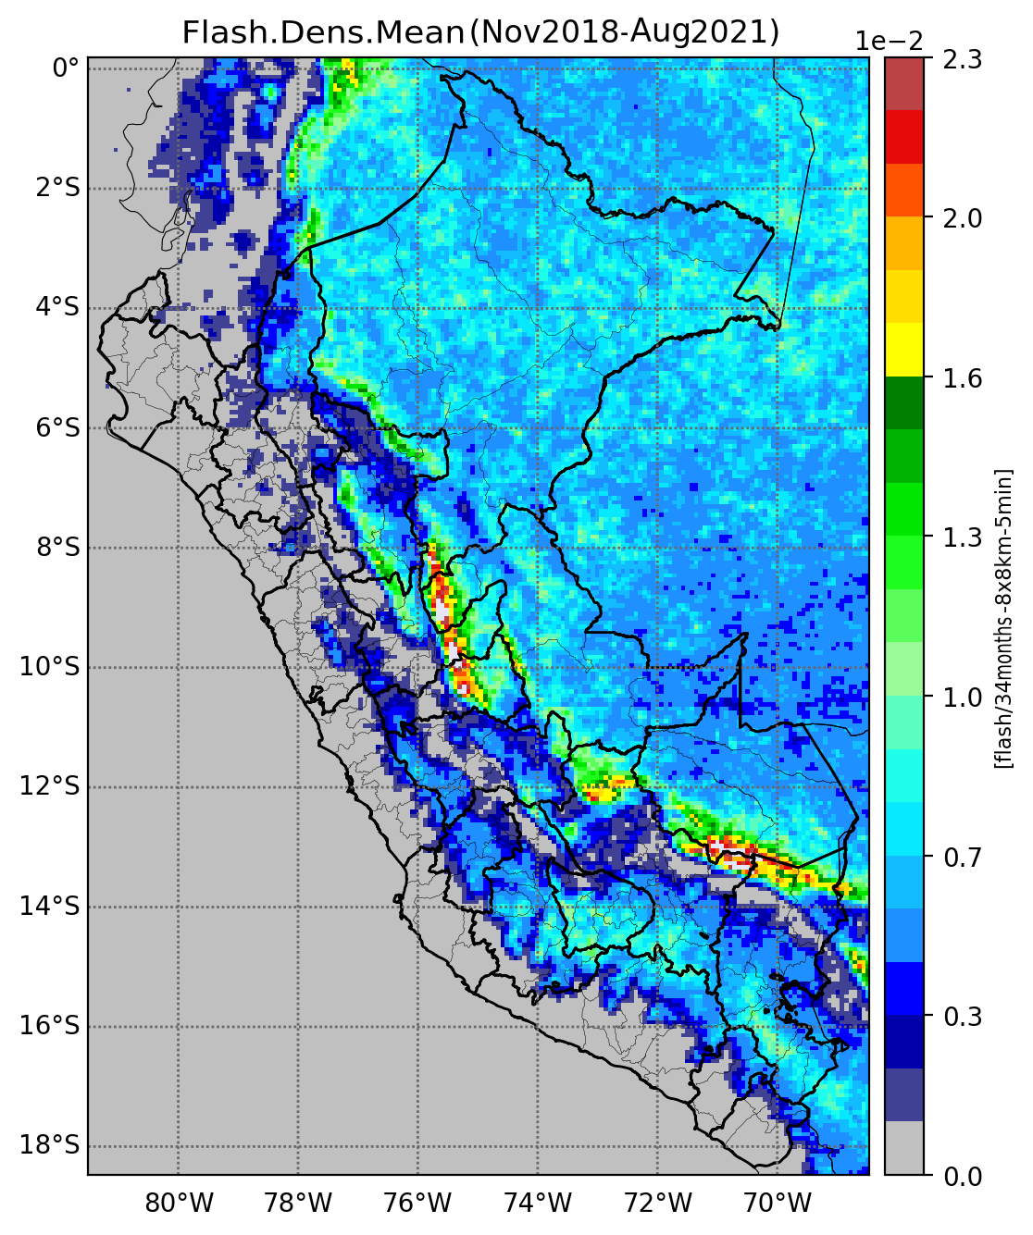
Flash density mean
Is much higher in the Andes-Amazon transition, followed by the Andes and the Amazon plain.
Is very small in the arid coastal region and the higher parts of the eastern slopes of the Andes.
DATA:The GLM lightning flash density (number of flashes in an 8 km grid in 5 minutes for the period from November 2018 to August 2021)

Slide 4
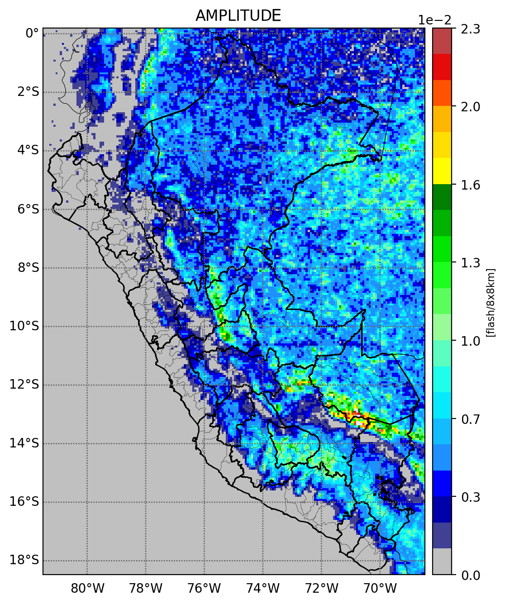
The 1st annual harmonic (amplitude)
The amplitude presents a spatial pattern that approximately coincides with the mean.

Slide 5
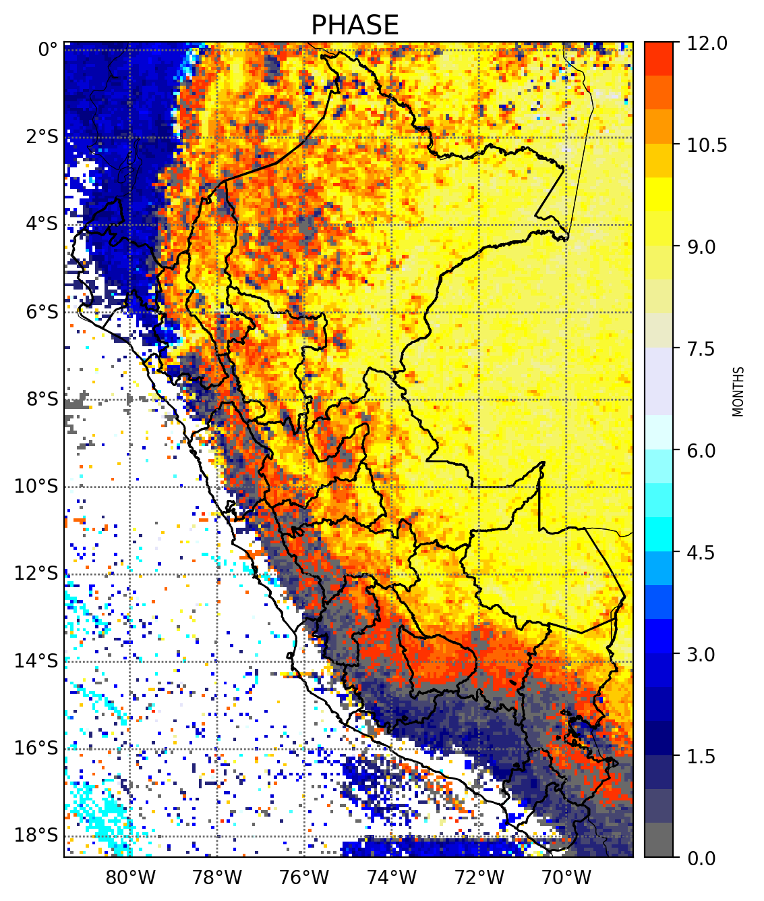
The 1st annual harmonic (phase)
The annual peak in the Amazonian plains occurs mainly in September in the south, and between September and January in the north.
In the Andes, the annual peak varies between September in the east and February in the west.

Slide 6
Comparison between GLM and METAR
GLM
METAR: 2021-08-15 23:00
SPQT 152300Z 24004KT 8000 VCTS BKN015 FEW017CB BKN080 29/24 Q1010 NOSIG RMK CB W N BIRD HAZARD RWY 06/24 PP000

Slide 7
Comparison between GLM and metar
 | Stations of the Andean highlands |  |  |  |  |  | Stations of the jungle
 | ST1 | ST2 | ST3 | ST4 | ST5 | ST6 | ST7 | ST8 | ST9 | ST10 | ST11 | ST12
TP | 23 | 2 | 85 | 50 | 4 | 99 | 214 | 39 | 6 | 73 | 16 | 142
FP | 319 | 97 | 251 | 668 | 167 | 504 | 563 | 391 | 391 | 378 | 205 | 286
FN | 69 | 3 | 98 | 125 | 5 | 94 | 596 | 33 | 10 | 216 | 9 | 307
TN | 22243 | 7220 | 11099 | 30444 | 18803 | 10684 | 23861 | 9978 | 14551 | 18147 | 7745 | 10312
POD | 0.25 | 0.40 | 0.46 | 0.29 | 0.44 | 0.51 | 0.26 | 0.54 | 0.38 | 0.25 | 0.64 | 0.32
FAR | 0.93 | 0.98 | 0.75 | 0.93 | 0.98 | 0.84 | 0.72 | 0.91 | 0.98 | 0.84 | 0.93 | 0.67
TP: True positive. FP: False positive. FN: False negative. TN: True negative

Slide 8
Summary
THANK YOU!
Most of the lightning activity in Peru occurs over land, with a significantly smaller proportion over coastal areas.
The annual peak occurs mainly in September.
Preliminary results suggest that the GLM provides useful information but with moderate correspondence to surface observations.

