Slide 1
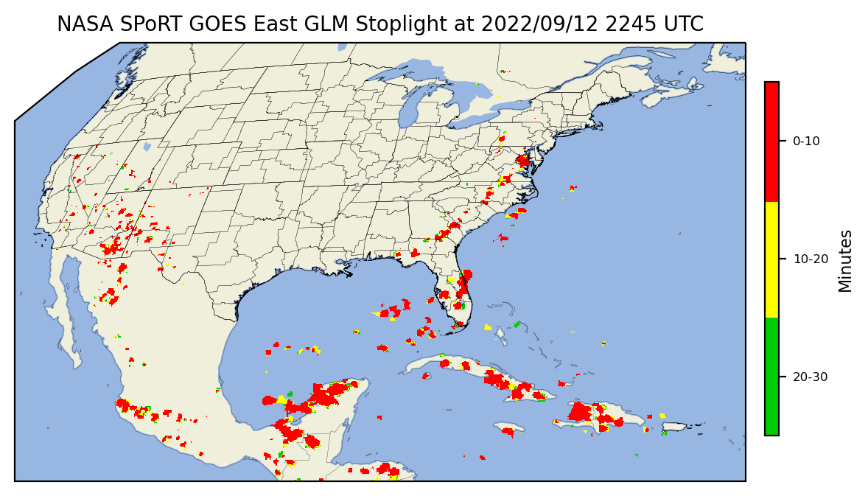
GLM Stoplight Product: Applications & Testing for IDSS
Kelley Murphy¹, Kristopher White², Christopher Schultz³
1 – UAH/NASA SPoRT, Huntsville, AL
2 – NWS Huntsville/NASA SPoRT, Huntsville, AL
3 – NASA SPoRT, Marshall Space Flight Center, Huntsville, AL
GLM Science Team Meeting |September 14th, 2022

Slide 2
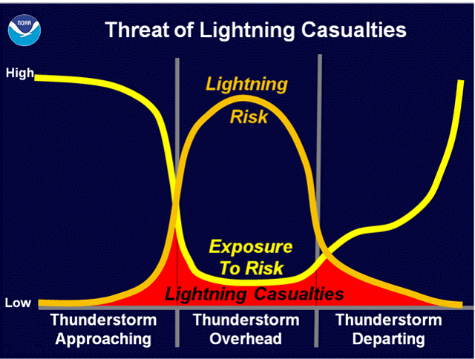
Fatality peak as the thunderstorm approaches a location
Not Raining
Second peak in casualties as the storm exits the location.
Not Raining
Raining

Slide 3
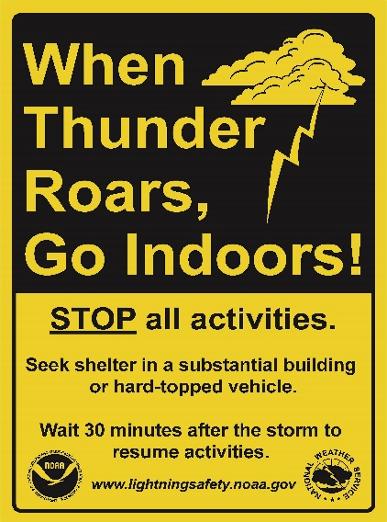
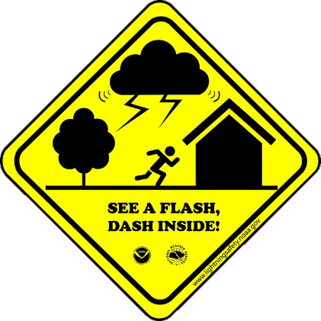
When Thunder Roars,
Go Indoors!
If out in the open – find shelter.
Shelter includes enclosed hard-topped vehicles.
Stay away from water.
Wait at least 30 minutes after hearing thunder before resuming outdoor activities.
20% of the time, the first lightning flash is a cloud-to-ground flash.
Thus there won’t be any thunder prior to the first lightning flash.
If skies begin to darken overhead or rain begins to fall nearby, move indoors.
Most prevalent during the summer months.
Deaf & hard of hearing slogan for lightning safety

Slide 4
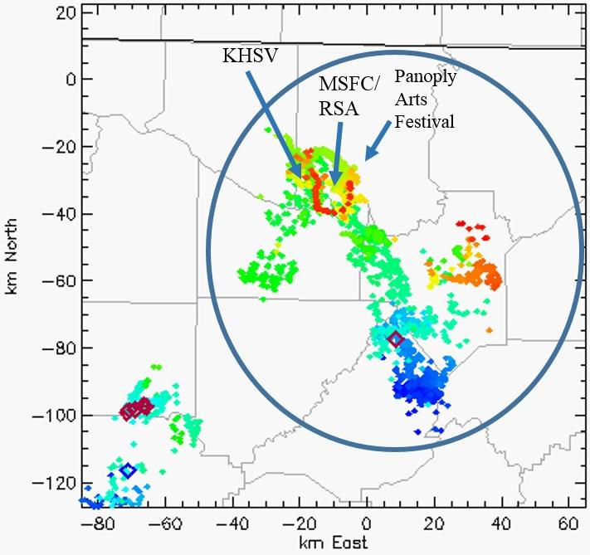
Challenges
Most people don’t know when lightning last was in their area
Can more easily notify first lightning flash (e.g., apps, airport weather warnings, etc.), but there is a gap in notifying “all-clear” for the majority of the public.
Much of the lightning safety protocols are rooted in technology from the 1980s.
Image on the right using newer technology indicates lightning over KHSV, Redstone Army Airfield, and Panoply Arts Festival, while the NLDN indicates nothing within 40 km of any of these locations.
Almost all solutions are REACTIVE vs PROACTIVELY empowering individuals with information to make the best decisions for themselves.
Lightning Mapping Array and National Lightning detection network data on April 27, 2013
- Schultz et al. 2017 J. Operational Meteorology

Slide 5
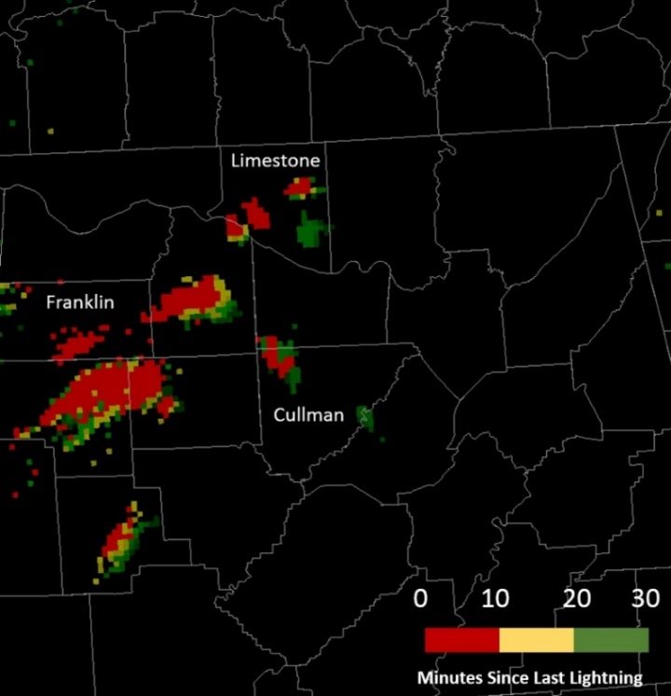
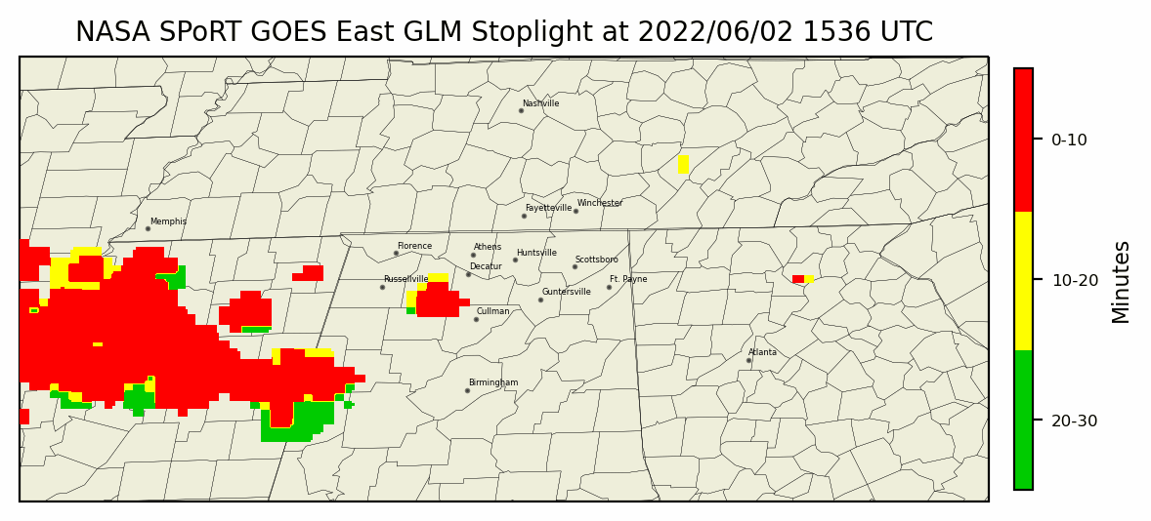
Stoplight
Goal: provide people a tool that they can use to decide on when to return to outdoor activities
LMA heritage, now used with GLM Flash Extent Density
Main strength is using the mapping capabilities of GLM/LMA to provide spatial context on lightning occurrence.
Currently used by NWS Offices in the Southeast
NWS Huntsville at Hydrofest
NWS Atlanta at Quaker State 400 at Atlanta Motor Speedway
NWS Birmingham at the World Games
Stano, G. T., M. R. Smith, and C. J. Schultz, 2019: Development and evaluation of the GLM stoplight product for lightning safety. J. Operational Meteor., 7 (7), 92-104, doi: https://doi.org/10.15191/nwajom.2019.0707

Slide 6
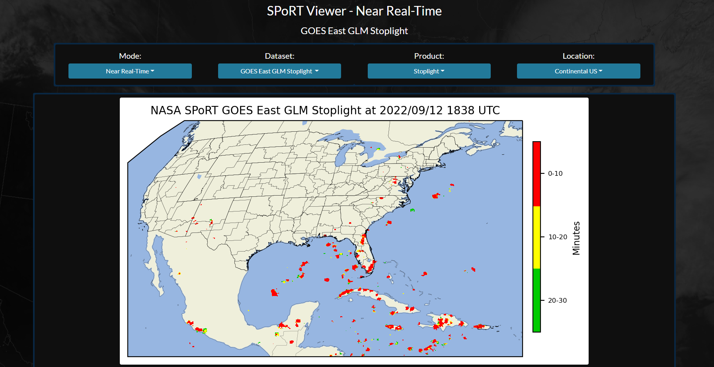
Applications & Testing
Goal to tailor toward needed application & gather forecaster or end-user feedback
NWS Huntsville has access via new/updated SPoRT Viewer: https://weather.msfc.nasa.gov/sport/viewer/?dataset=goeseastabiconus&product=10p35um

Slide 7
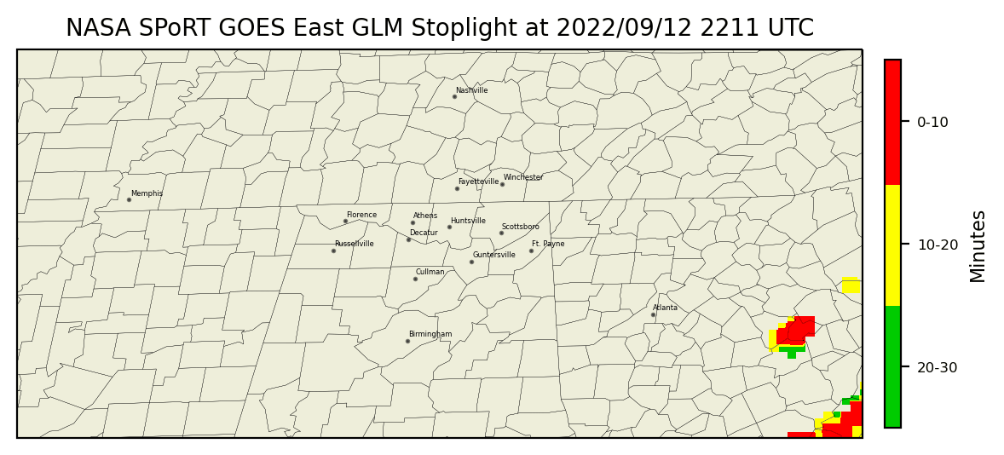
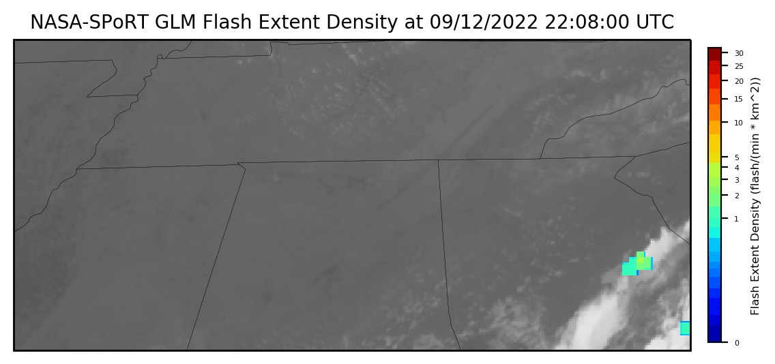
Applications & Testing
Improved functionality, ease of use, ability to share imagery

Slide 8
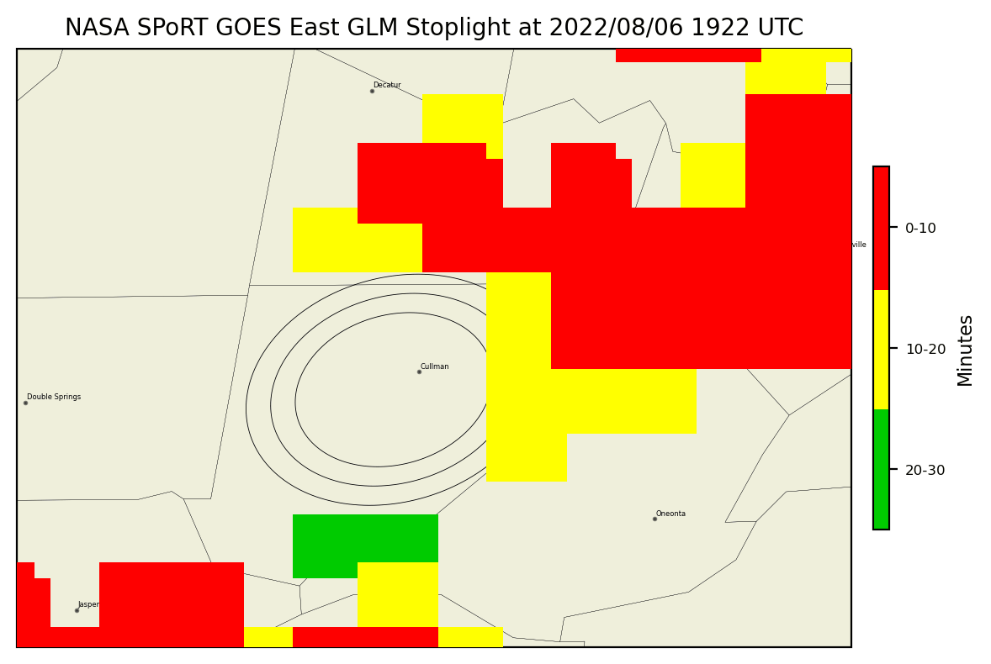
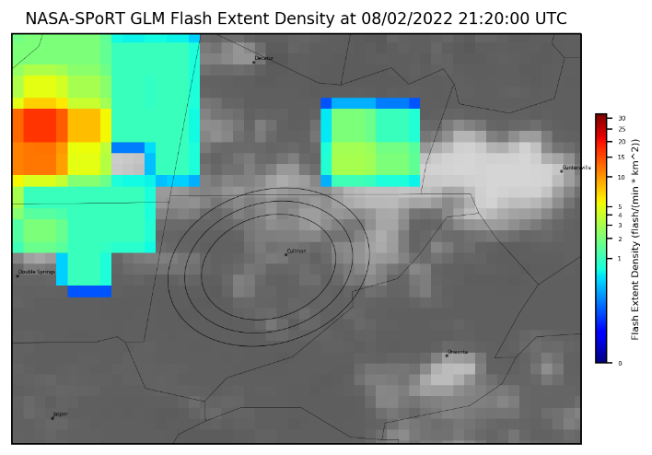
Applications & Testing
User feedback is important
“Rock the South” concert domain:

Slide 9
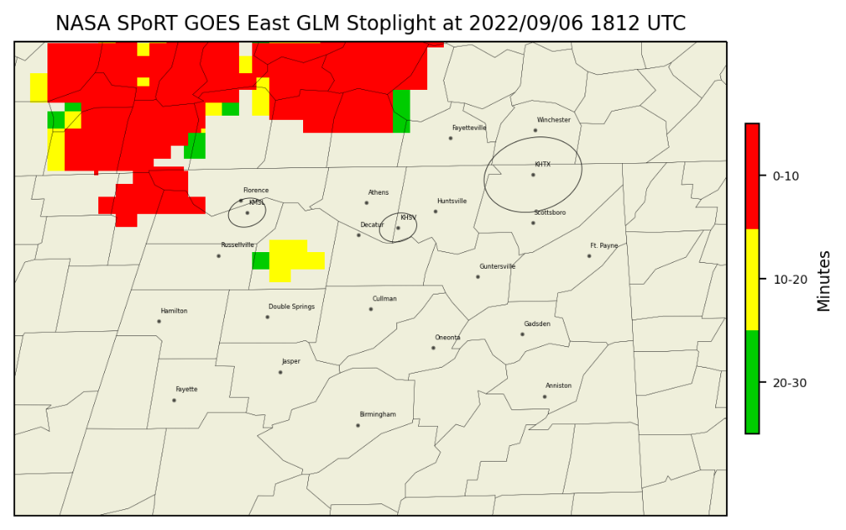
Conclusions
Continue to test and get survey info from end users
Assess usability within workflow, ease of relaying info internally & to partners
Apply to other upcoming IDSS opportunities & airport weather warnings
Will the addition of the stoplight help decide when a warning period could be ended early? Eliminate unnecessary down time?
GLM Stoplight and Airport range rings/ KHTX SLEP upgrade safety rings

