Slide 1
Direct Assimilation of GOES-R Geostationary Lightning Mapper (GLM) Data within JEDI Hybrid System for Operational UFS Convection-Allowing Predictions
Supported by NOAA JTTI project: NA21OAR4590165
Rong Kong¹, Ming Xue¹, Amanda Back², Edward Mansell³
Collaborators: Stephen Weygandt⁵, Curtis Alexander⁵, Jacob Carley⁶
¹Center for Analysis and Prediction of Storms, University of Oklahoma
²Cooperative Institute for Research in the Atmosphere (CIRA), Colorado State University and ³NOAA/Earth System Research Laboratory/Global Systems Laboratory
⁴NOAA/National Severe Storms Laboratory, Norman, Oklahoma
⁵Global Systems Laboratory (GSL), NOAA
⁶Environmental Modeling Center (EMC), National Centers for Environmental Predictions (NCEP), NOAA
Presented on 09/14/2022

Slide 2
Motivations
Backgrounds: In past studies, we developed direct GOES-R Geostationary Lightning Mapper (GLM) Flash Extent Density (FED) assimilation capabilities within the operational Gridpoint Statistical Interpolation (GSI) data assimilation (DA) framework, which, in case studies, noticeably improved the initial representation and prediction of convective storms in numerical weather prediction models for up to several hours. It was found that even for continental storms, the FED DA produces positive impacts comparable to those of radar data.
Target: Develop and test GOES-R lighting DA capabilities within new Joint Effort for DA Integration (JEDI) that can be used by operational Rapid Refresh Forecast System (RRFS).

Slide 3
Accomplishments
Migrated FED DA capabilities in GSI into JEDI LETKF/EnVar with existing graupel-mass FED operator and performed FED DA experiments.
Developed nonlinear FED observation operator based on CAPS 2022 spring experiments.

Slide 4
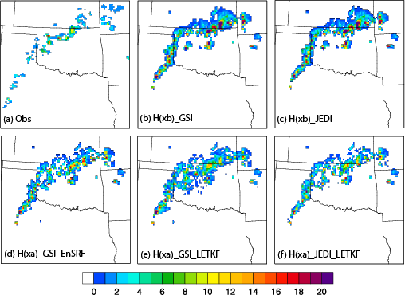
Implemented FED DA within JEDI LETKF, Performed FED-only DA experiments, and validated against GSI results.
Processed GOES-R GLM L2 lighting detection data and generated FED data that can be read by JEDI.
Implemented graupel-mass based FED observation operator used in GSI to JEDI.
Ran single cycle FED DA using JEDI LETKF and compared the results with GSI EnSRF and GSI LETKF.
The JEDI LETKF analysis is similar to those of GSI EnSRF and GSI LETKF, suggesting correct implementation.
(a) The flash extent density (flashes min⁻¹pixel⁻¹) observation, observation priors from (b) GSI, (c) JEDI, and posteriors from (d) GSI using EnSRF, (e) GSI using LETKF, and (f) JEDI using LETKF, respectively.

Slide 5
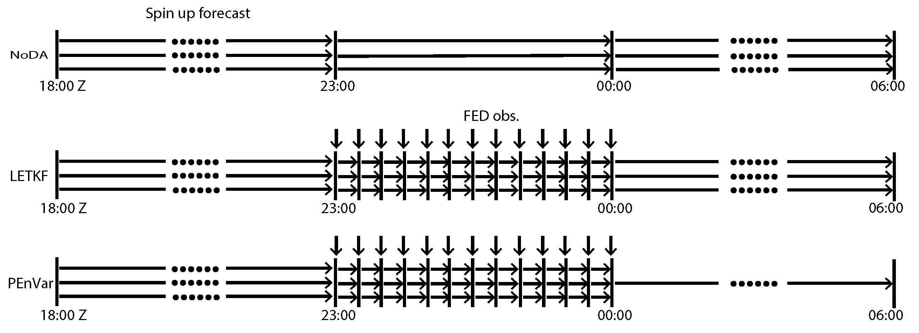
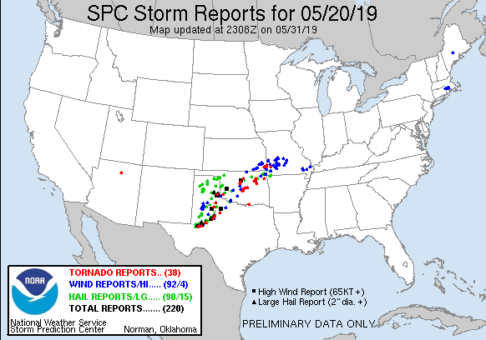
CASE-I
Spin up from GDAS enkf analyses.
Exp. name | Description
NoDA | Do not assimilate any data.
LETKF | Assimilate FED observation using JEDI LETKF.
PEn3DVar | Assimilate FED observation only using JEDI PEn3DVar (with 100% ensemble covariance).

Slide 6
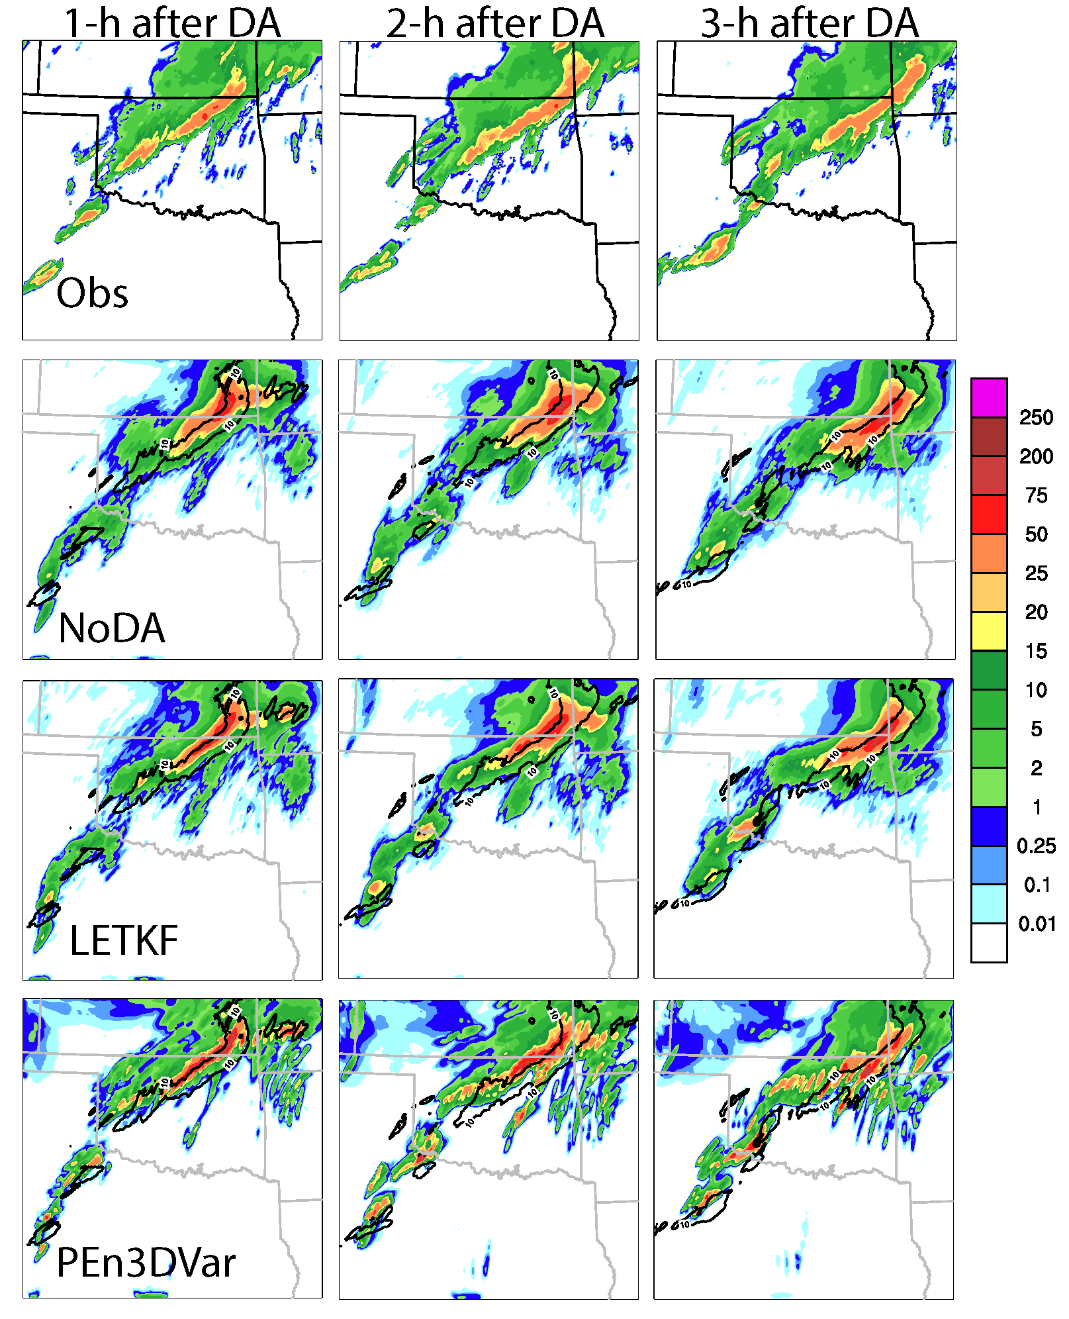
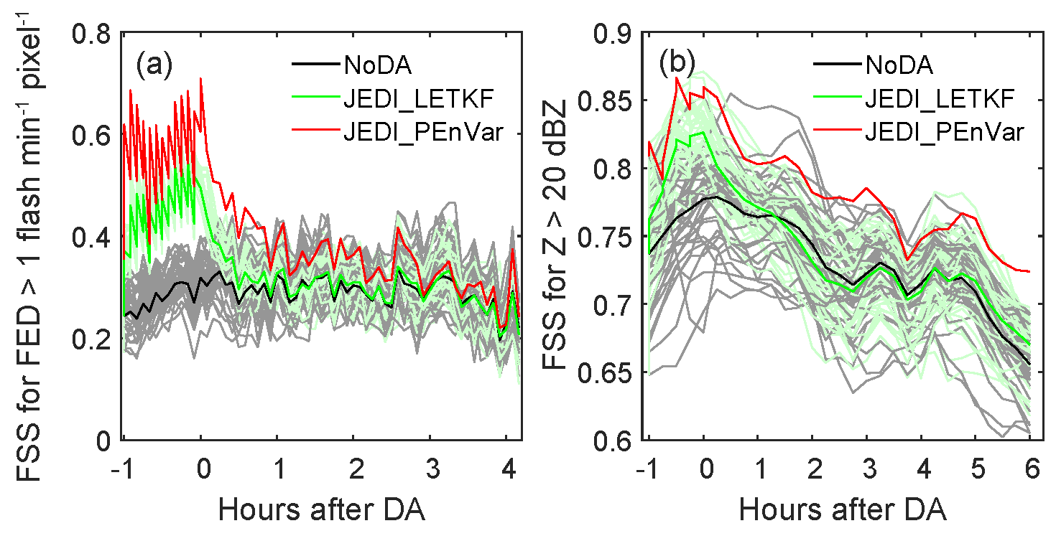
Implemented FED DA within JEDI EnVar, Performed FED DA experiments, and compared with JEDI LETKF and NoDA experiments.
Implemented FED DA capability within JEDI EnVar.
Performed FED-only DA experiments and compared with JEDI LETKF and NoDA experiment that does not assimilate any data.
JEDI PEnVar outperforms JEDI LETKF in terms of FSS in FED and composite reflectivity analyses/forecasts and more accurate precipitation forecasts after DA.
1-3h hourly precipitation forecasts from observations, PEnVar, probability matched mean of NoDA and LETKF, respectively.
The fractional skill score of the (a) FED, (b) composite reflectivity analyses/forecasts and 0-4 h forecasts after DA

Slide 7
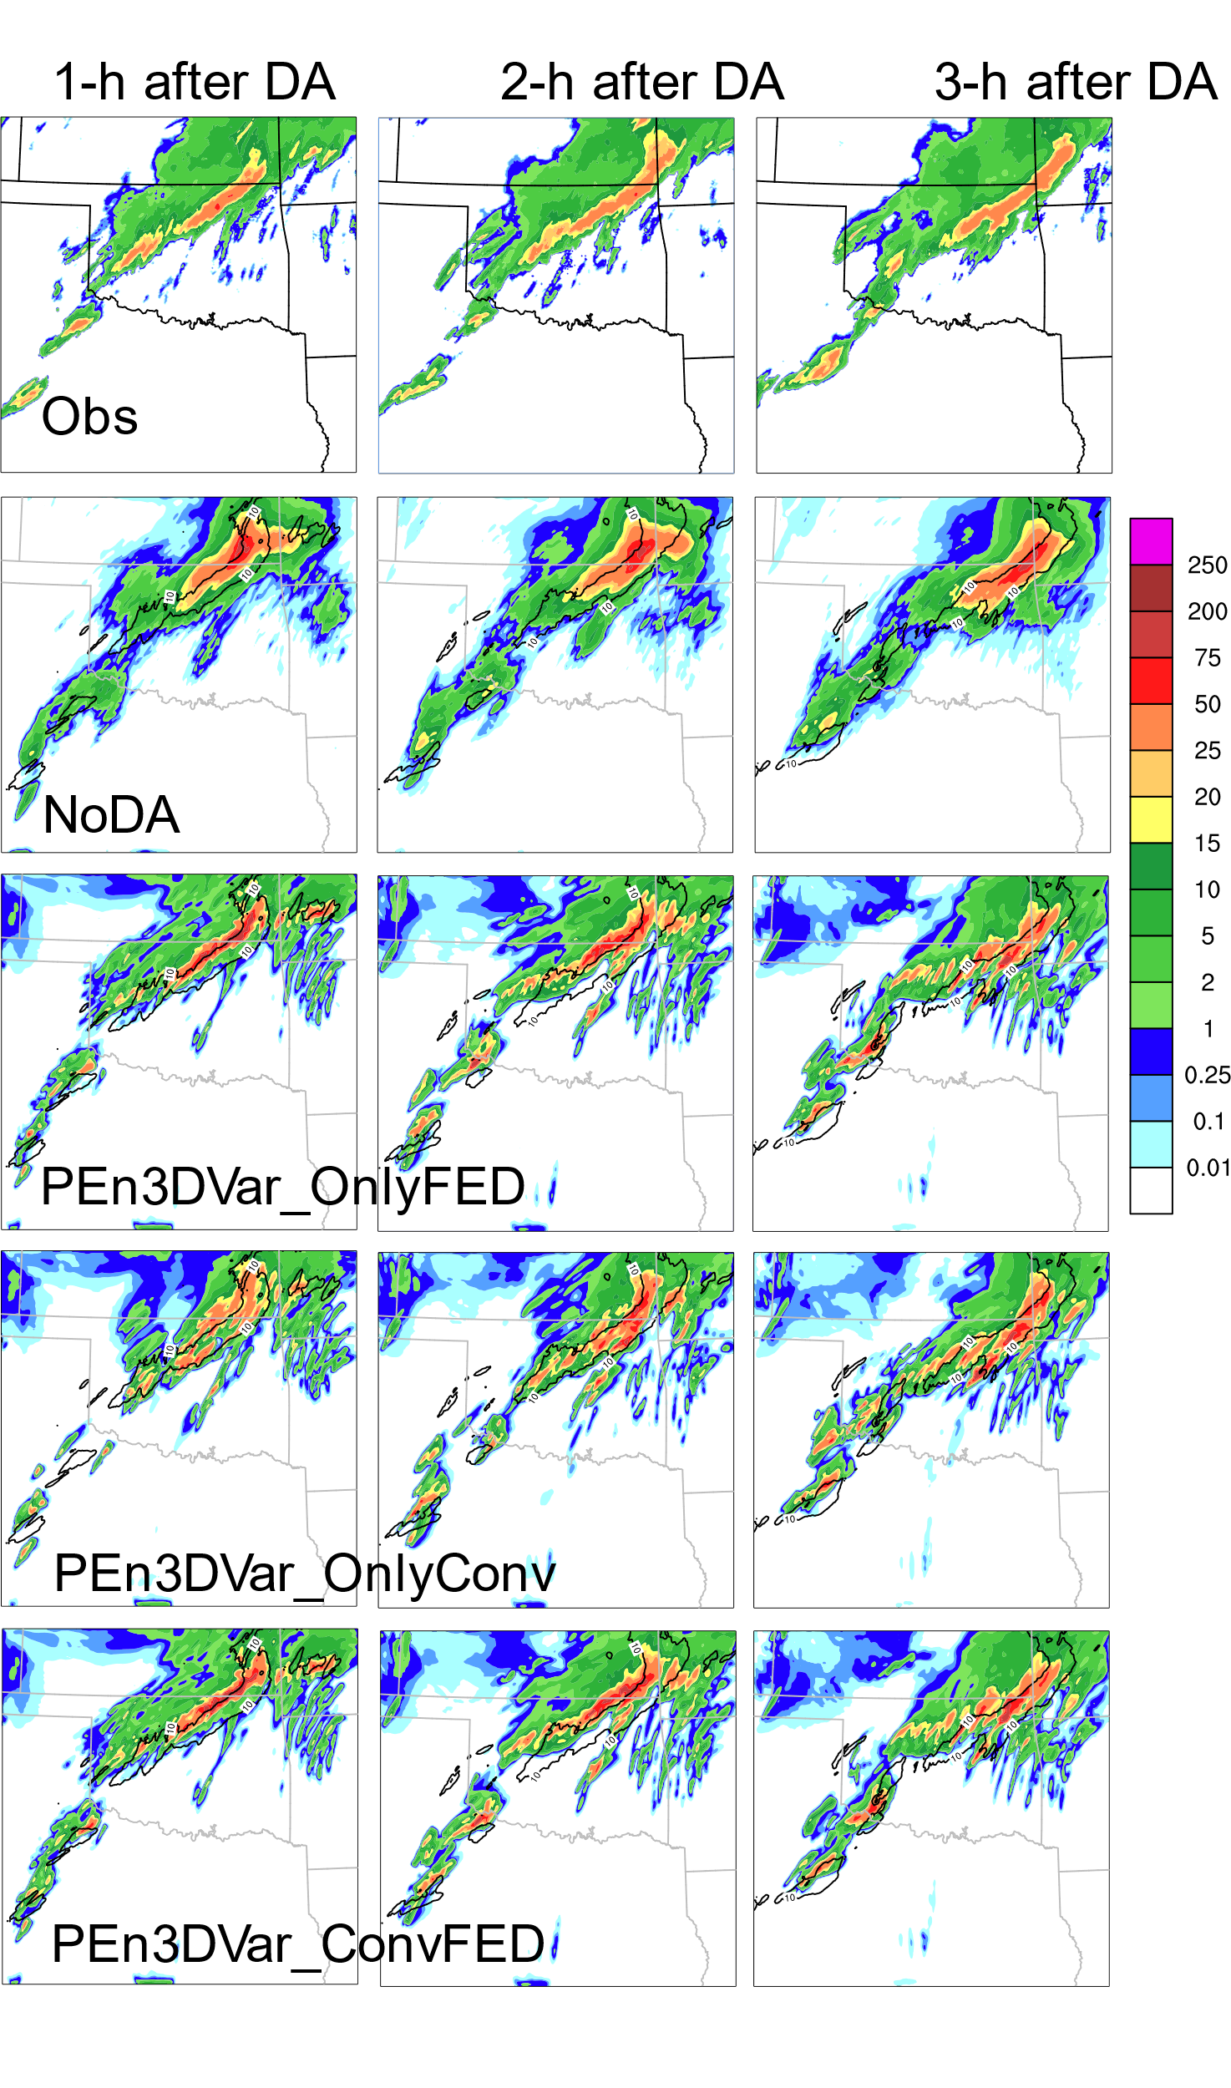
Assimilated FED data with and without conventional data using JEDI PEn3DVar
FSS of 0-6 h composite reflectivity (verified against MRMS observations) from NoDA, PEn3DVar_OnlyFED, PEn3DVar_OnlyConv, PEn3DVar_ConvFED, respectively.
OnlyFED produces better 0-6 h reflectivity forecasts than NoDA and OnlyConv in terms of FSS. Assimilating additional convectional data (Conv+FED) does not further improve the FSS relative OnlyFED.
ConvFED and OnlyFED better capture the southwest convective storms relative to NoDA and OnlyConv.
1-3h hourly precipitation forecasts from observations, NoDA, PEn3DVar_OnlyFED, PEn3DVar_OnlyConv, PEn3DVar_ConvFED, respectively.

Slide 8
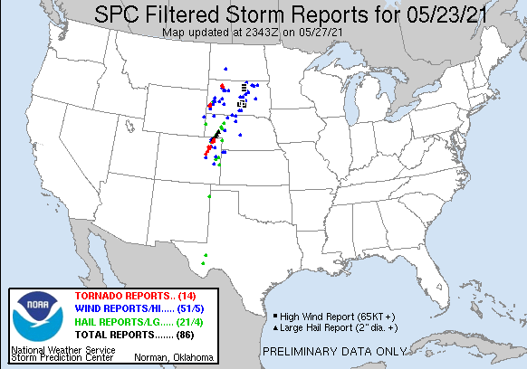
CASE-II
Assimilated FED observations with & without conventional observations using JEDI LETKF
Exp. name | Description
NoDA | Do not assimilate any data.
OnlyConv | Assimilate convectional observation only using JEDI LETKF.
OnlyFED | Assimilate FED observation only using JEDI LETKF.
ConvFED | Assimilate conventional and FED observations together using JEDI LETKF
Most of the tornados were reported between 21:00 and 22:00

Slide 9
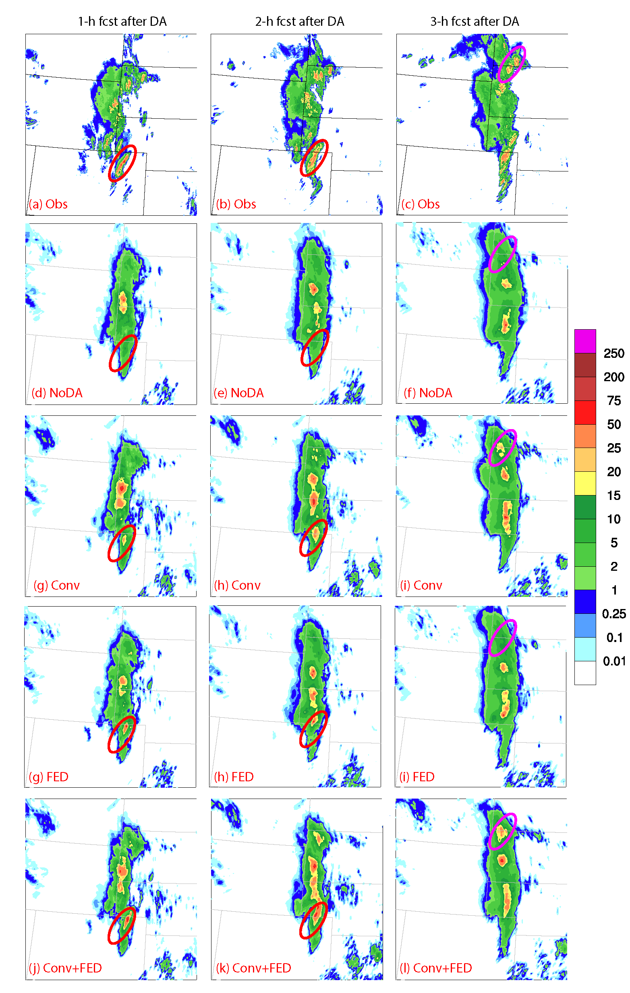
1-h after DA 2-h after DA 3-h after DA
Relative to NoDA, assimilating conventional observation or FED observation improves the forecasts of the tornadic storms indicated by the ellipses.
ConvFED produces much stronger convections relative to OnlyConv and OnlyFED and are more consistent with the tornadic storm observations.
ConvFED OnlyFED OnlyConv NoDA Obs
1-3h hourly precipitation forecasts from observations, probability matched mean of NoDA and LETKF DA experiments that assimilate convectional data only (OnlyConv), FED observations only (OnlyFED), and both conventional and FED observations (ConvFED), respectively.

Slide 10
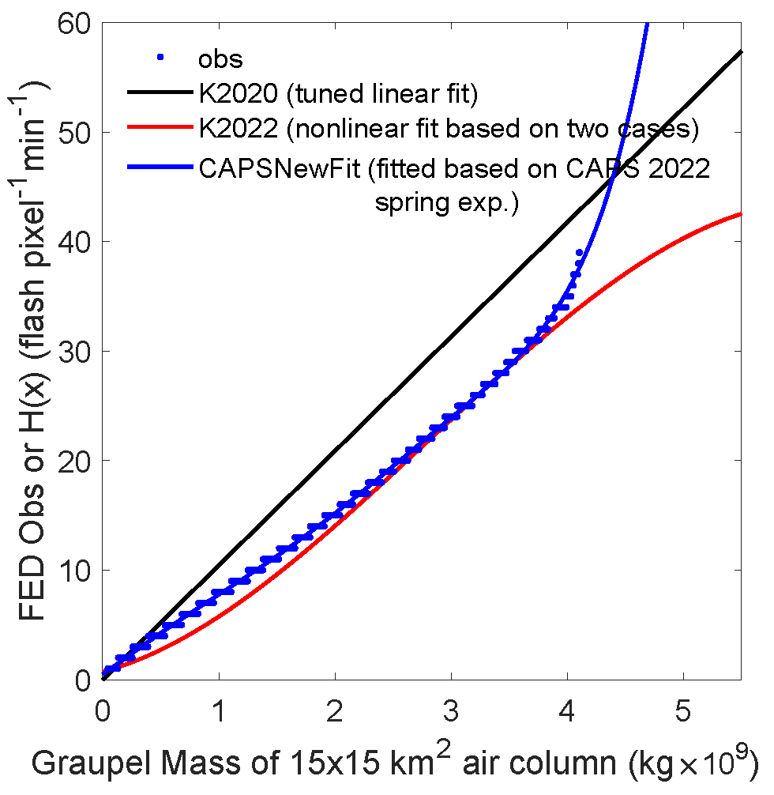
Fitted new nonlinear FED observation operator
2022 prototype RRFS ensemble forecasts for Hazardous Weather Testbed (HWT).
Operator was fitted based on FV3 control run (with the Thompson microphysics scheme) launched from 00Z for workdays between April 29th and June 3rd (~ 25 days).
New operator (CAPSNewFit) prevents excessive adjustment of graupel mass by high FED observations compared to K2022.
Exp. | Microphysics | PBL | Surface | LSM
CTRL | Thompson | MYNN | MYNN | NOAH
The flash extent density (flashes min⁻¹pixel⁻¹) observations (blue dots), tuned linear observation operator from Kong et al. (2020; K2020), nonlinear observation operator fitted from two storm cases (Kong et al. 2022; K2022), and nonlinear observation operator fitted based on CAPS 2022 spring experiments (CAPSNewFit).

Slide 11
Publications
Kong, R., M. Xue, C. Liu, A. O. Fierro, and E. R. Mansell, 2022: Development of new observation operators for assimilating GOES-R geostationary lightning mapper flash extent density data using GSI EnKF: Tests with two convective events over the US. Mon. Wea. Rev., vol 150, 2091-2110.

Slide 12
Future Work
Perform FED DA experiments using JEDI LETKF and EnVar with more storm cases.
Implement the newly fitted operator within JEDI EnVar and LETKF, and assess its impact using ~ 5 cases.
Write up/report on results with JEDI FED DA experiments.

Slide 13
Questions?

