Slide 1
Characterizing the Relation between Lightning and Wildfires in the Western United States
Scott Rudlosky, NOAA/NESDIS/STAR
Feng Zhang, UMD/ESSIC/CISESS
Joseph Patton, UMD/ESSIC/CISESS
GLM Science Meeting
13-15 September 2022
Huntsville, AL

Slide 2
Overview
Lightning ignited wildfires often smolder for some time before being discovered, so there can be a lag between lightning outbreaks and wildfire outbreaks
Working to combine satellite- and ground-based lightning data to better characterize the lightning that ignites wildfires
Near-term Goal: Develop a training dataset of all lightning flashes known to have ignited a wildfire
Long-term Goal: Apply machine learning to determine when and where lightning is most likely to ignite wildfires
Long-term Goal: Leverage any delay between lightning strike and fire ignition to suppress some fires before they grow out of control

Slide 3
Estimating Economic Benefits
Lubar, Jamilkowski, and Lazo (2022) prepared a GOES-R Socioeconomic Benefits Study: Phase 2 – Assessments of Additional Products and Services
Estimated that the baseline GOES-R present value contribution to early wildfire detection is $9.68B (over 20 year program life cycle).

Slide 4
New IIJA Project (NESDIS/STAR and UMD/CISESS)
Geostationary Lightning Mapper Use in Support of Wildland Fire Detection
  Support GLM integration into the NESDIS fire application system
  Integrate new capabilities into centralized NESDIS fire product information storefront
  Incorporate the GLM into different phases of the fire lifecycle / response (i.e., pre-ignition forecasting, monitoring, and detection)
  Develop an application for detecting/indicating regions with the most impactful lightning co-located with conditions conducive to wildland fire ignition
  Lightning ignition region-of-interest application (or LiRoi) will be integrated into downstream fire detection applications including the NESDIS Fire Information System

Slide 5
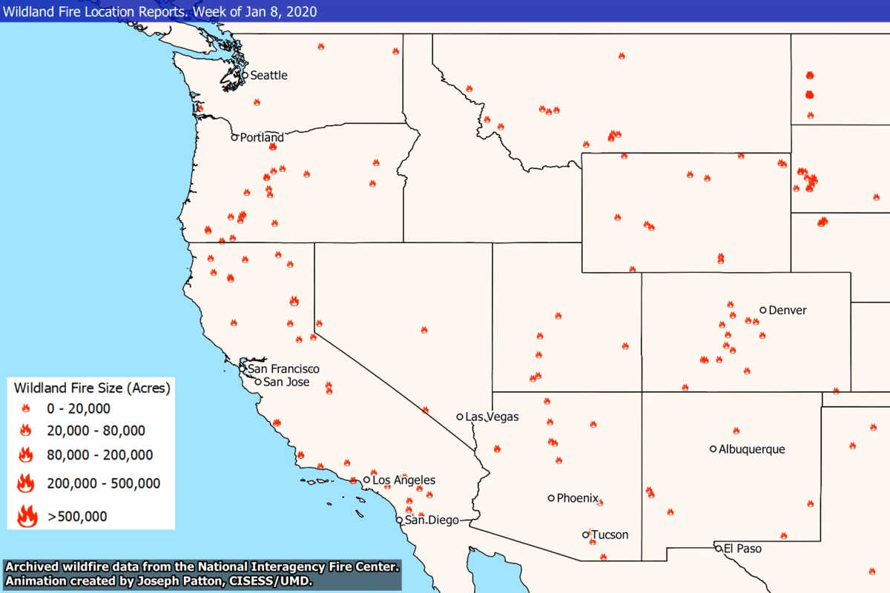
Western Wildfire Distributions
Video of wildland fire location and size during 2020-2021 illustrates the seasonality of fires in the Western U.S.
Our study includes the states of WA, OR, CA, ID, MT, WY, NV, UT, CO, AZ, and NM

Slide 6
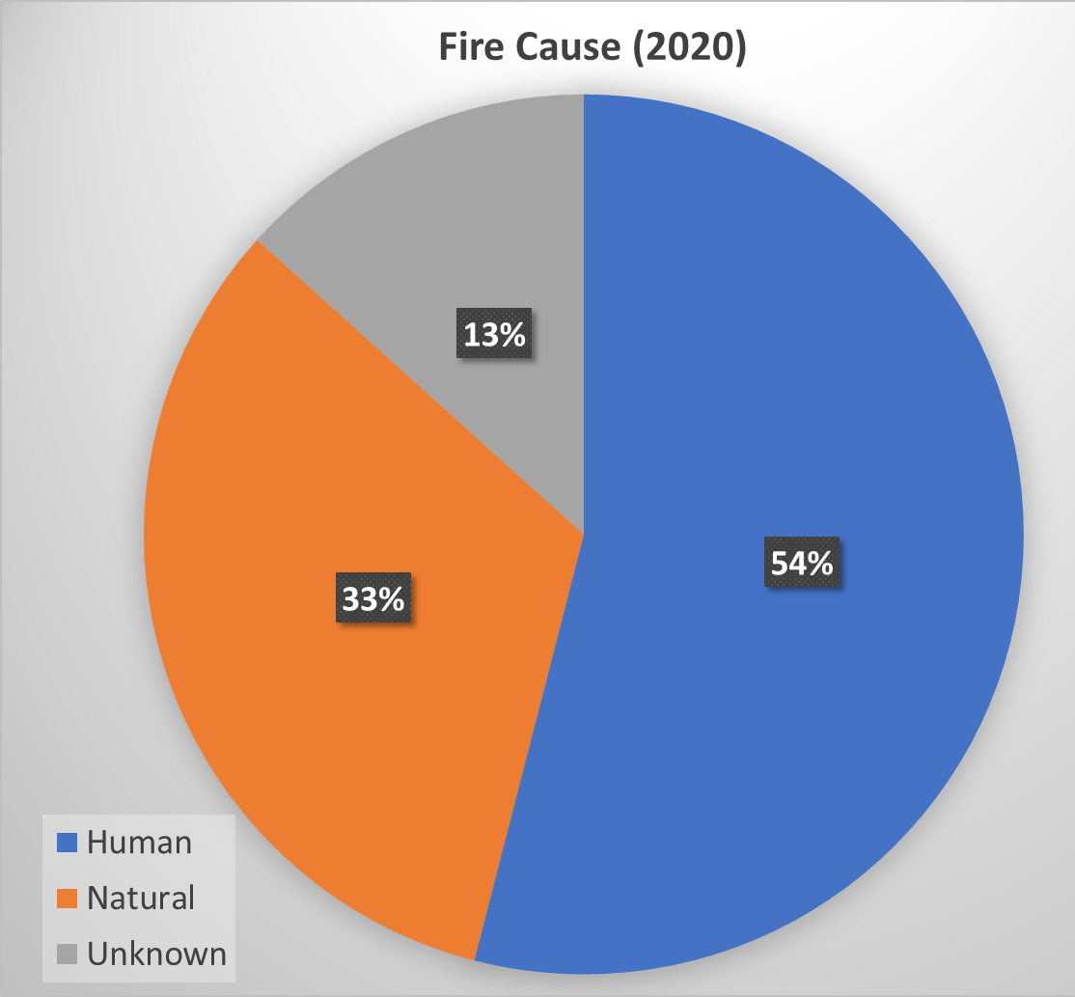
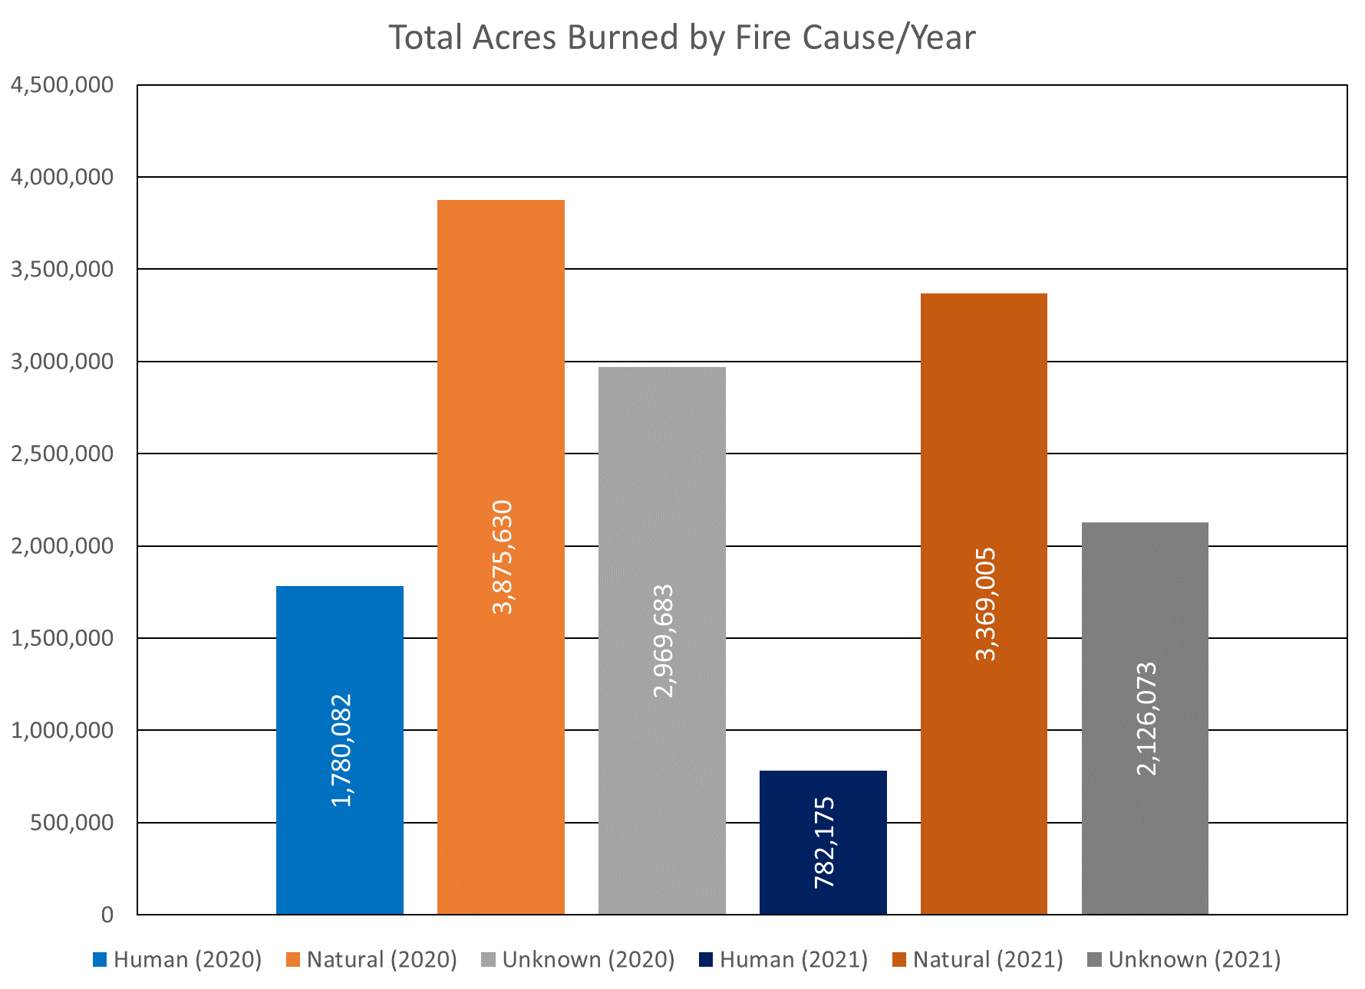
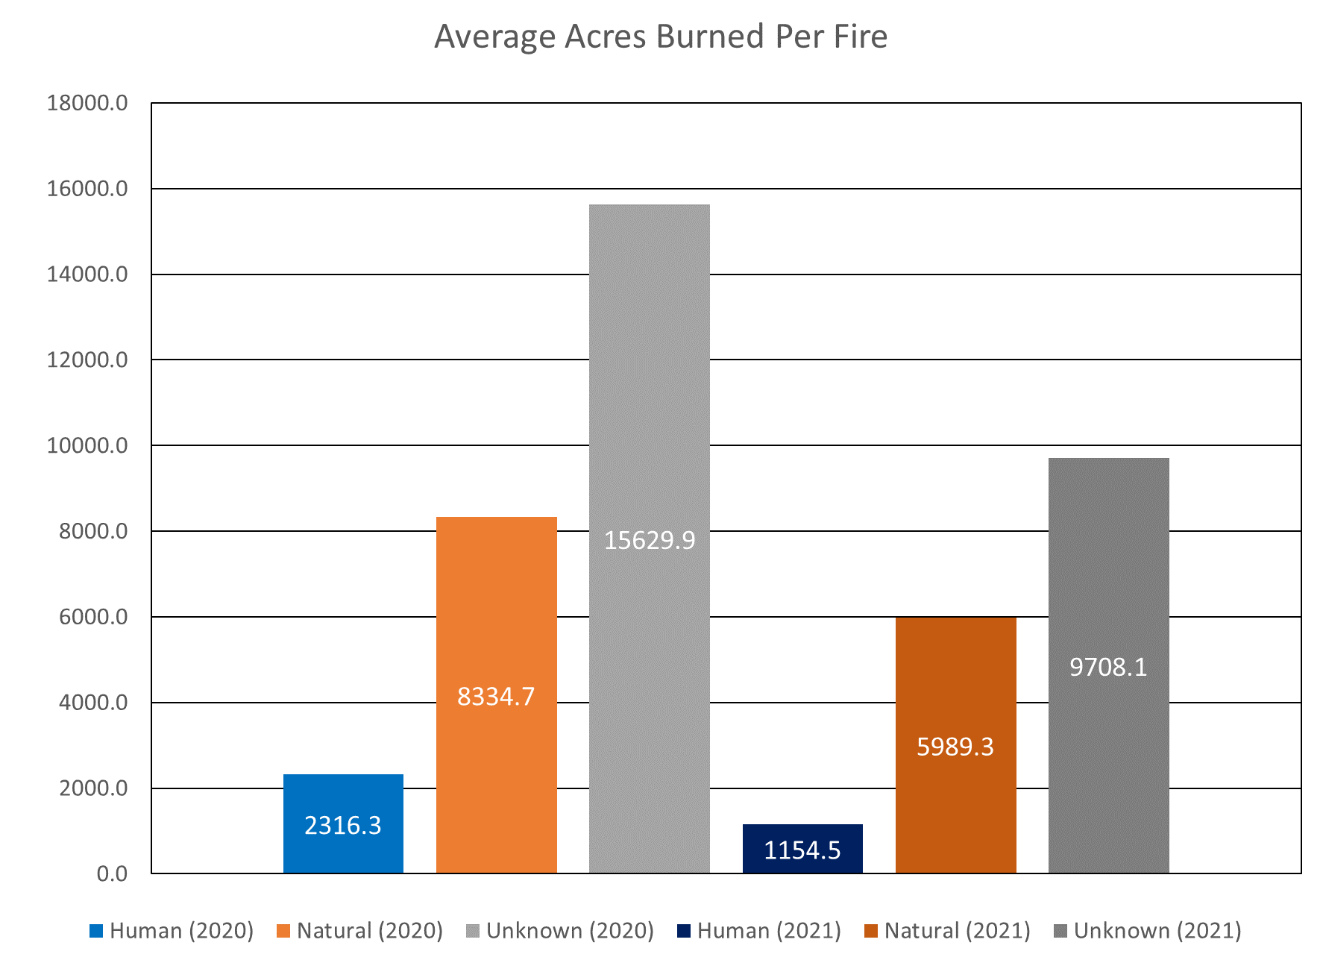
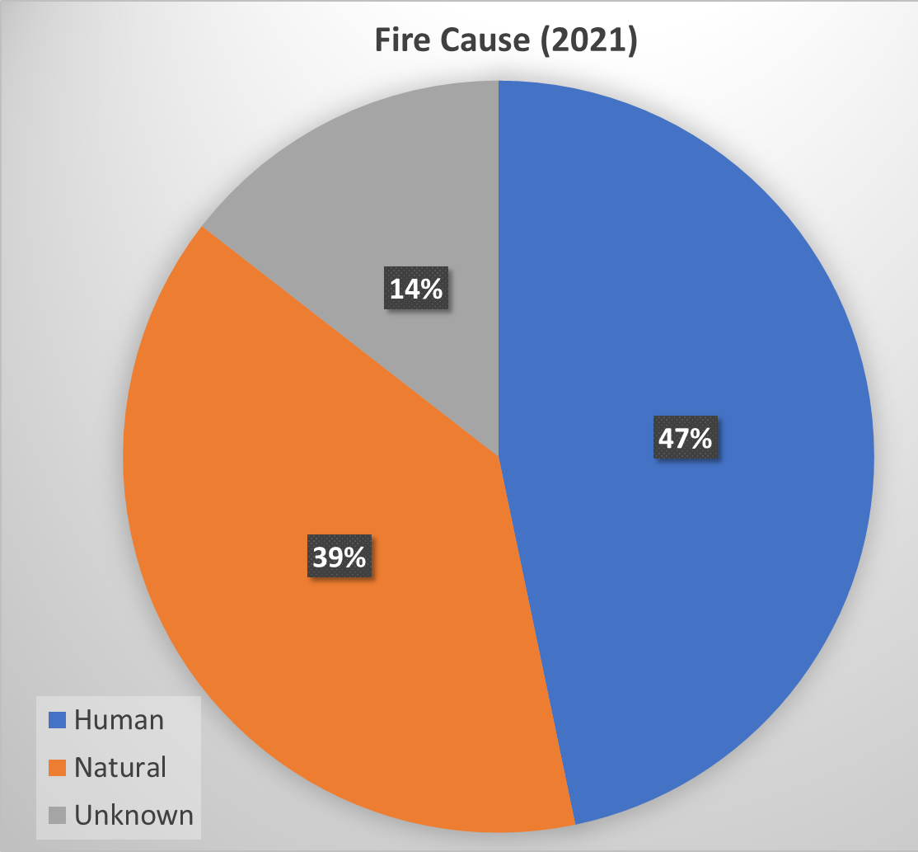
Western Wildfire Distributions
Humans cause more fires, natural fires burn more acres
Results from delayed identification and suppression
Enormous potential value in catching some fires early
*Please pardon the excel ;)

Slide 7
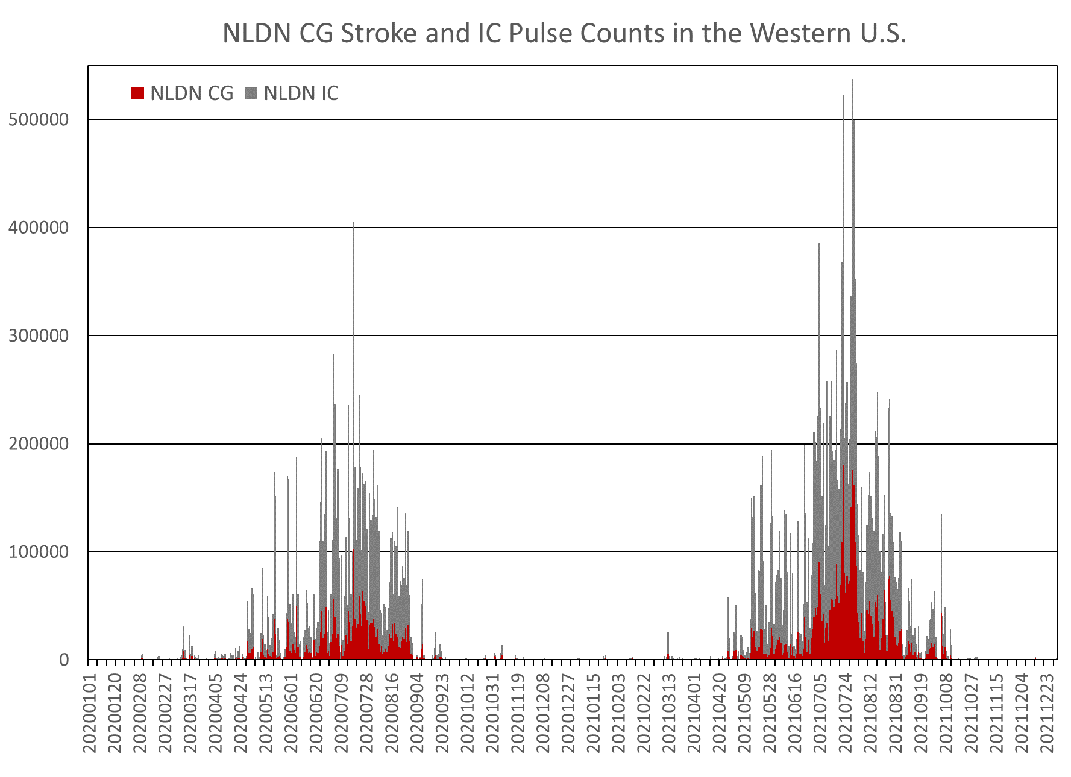
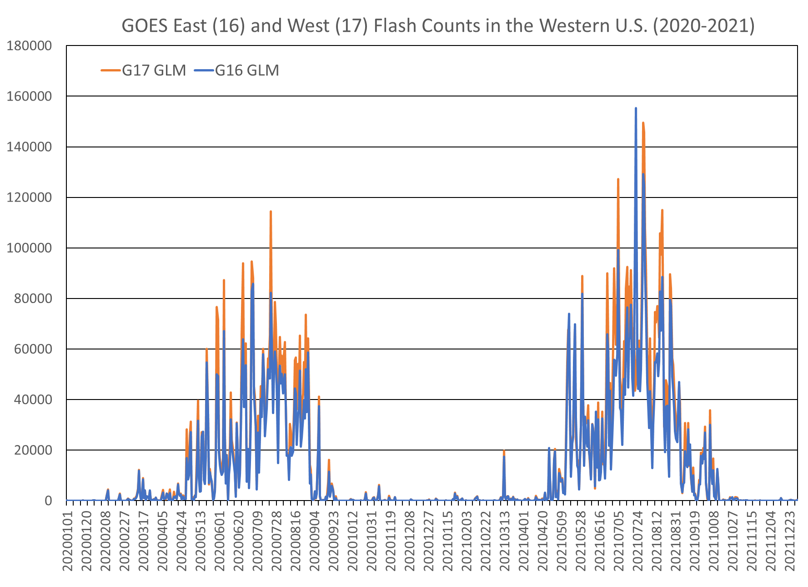
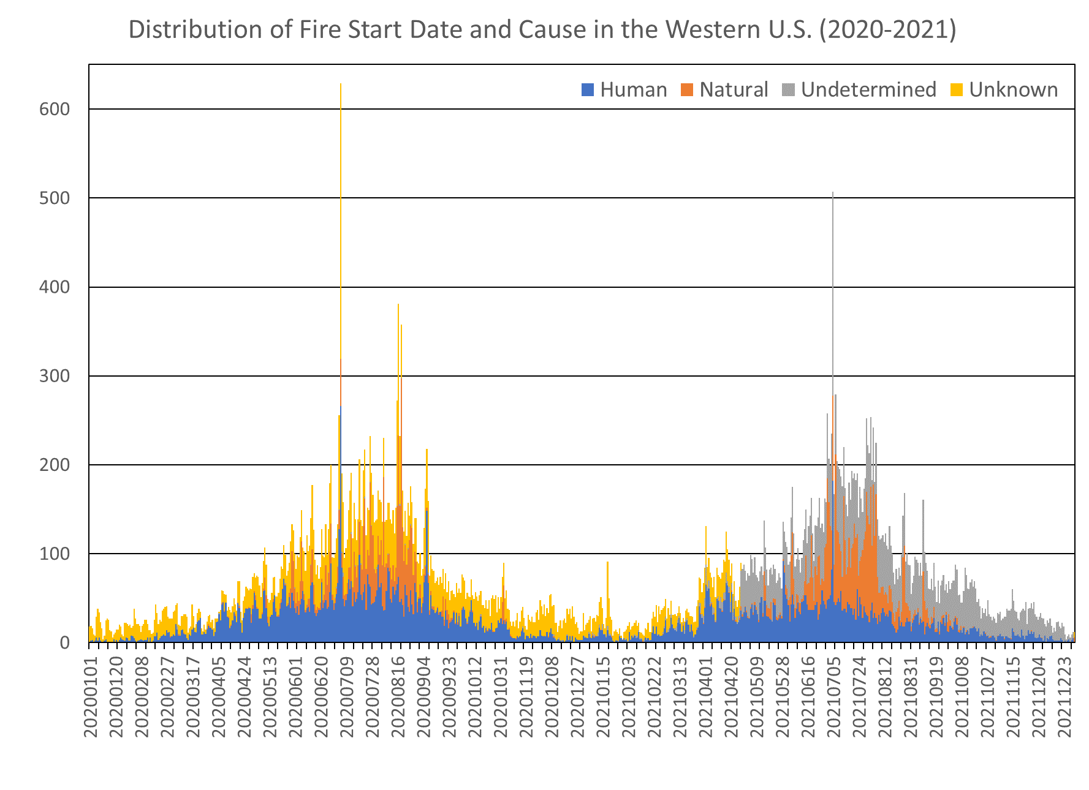
Lightning Distributions
Very strong seasonality in lightning occurrence that strongly contributes to the natural wildfire distribution

Slide 8
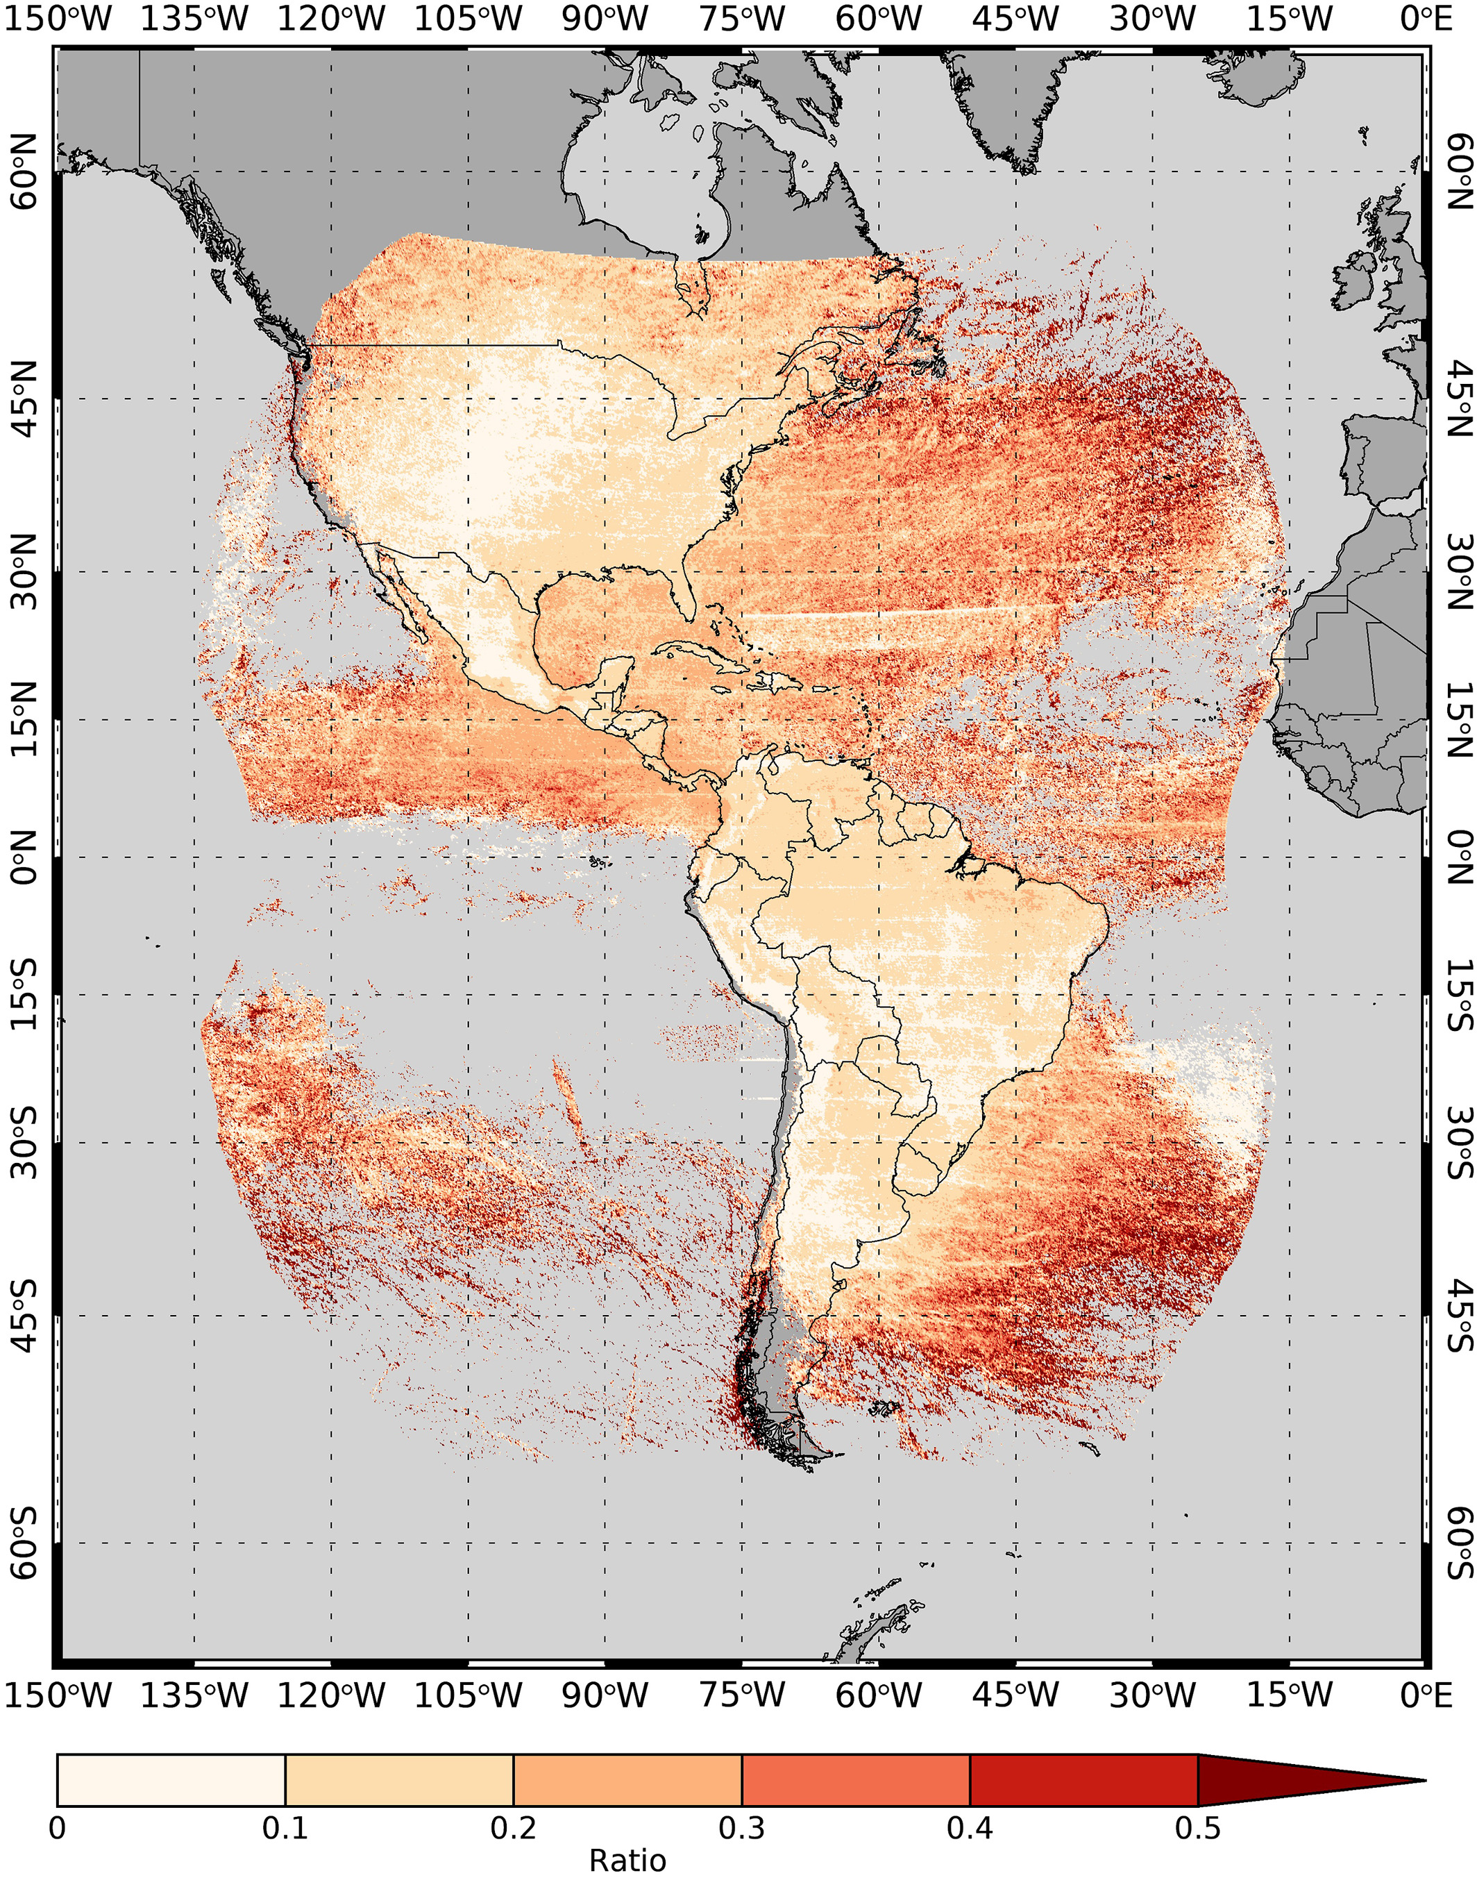
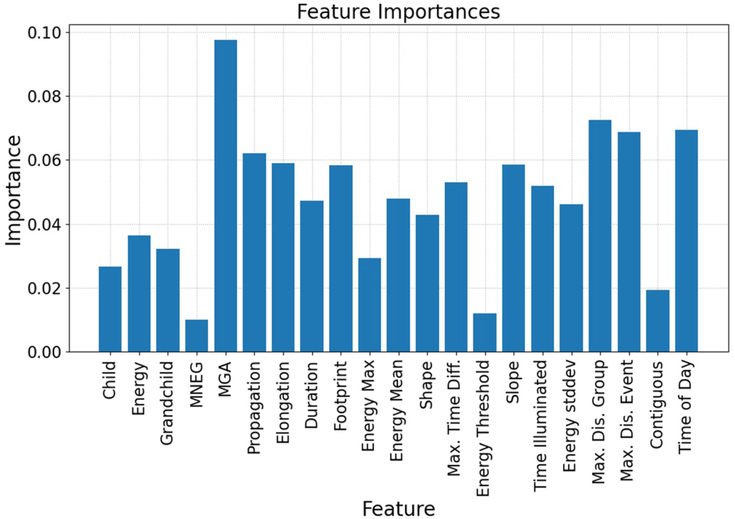
Lightning Distributions
Detection of Continuing Current in Lightning Using the Geostationary Lightning Mapper (Fairman and Bitzer 2022)
Several recent studies have shown skill in classifying GLM flashes by leveraging various optical lightning characteristics
Classification of GLM Flashes Using Random Forests (Ringhausen et al. 2021)

Slide 9
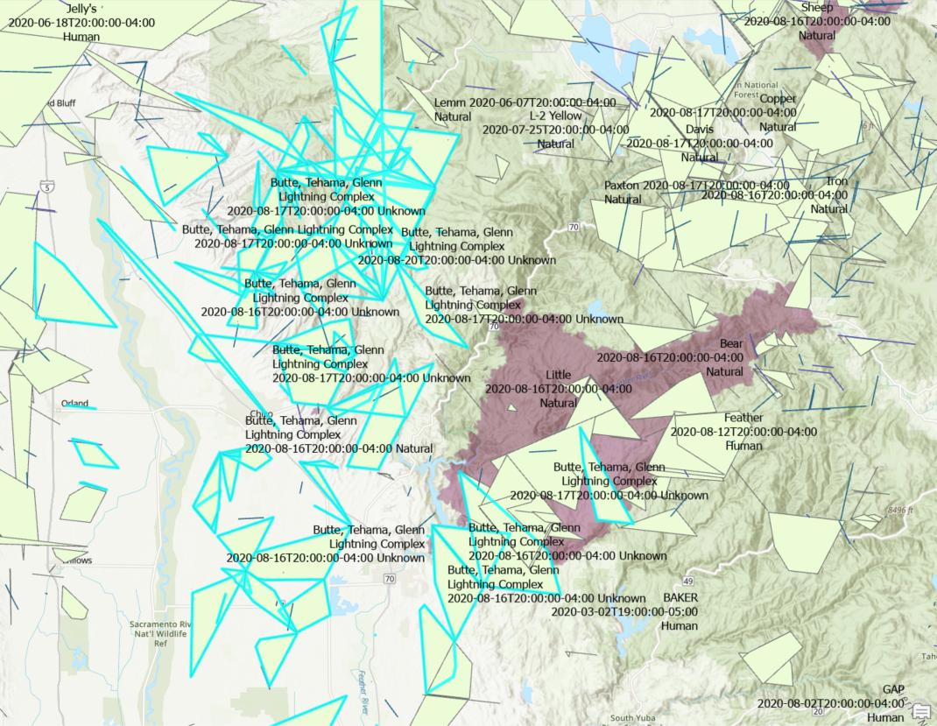
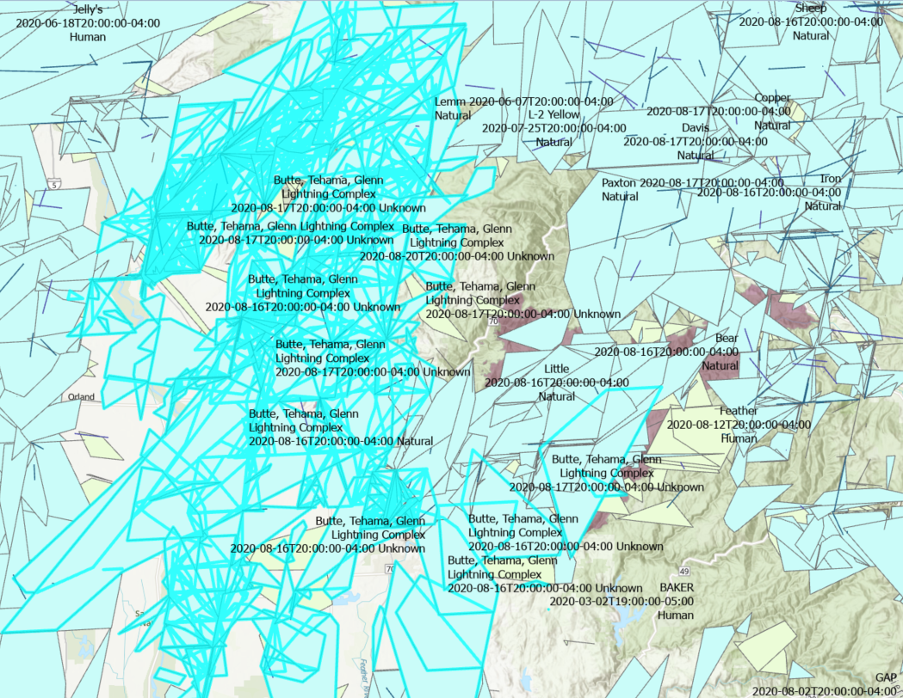
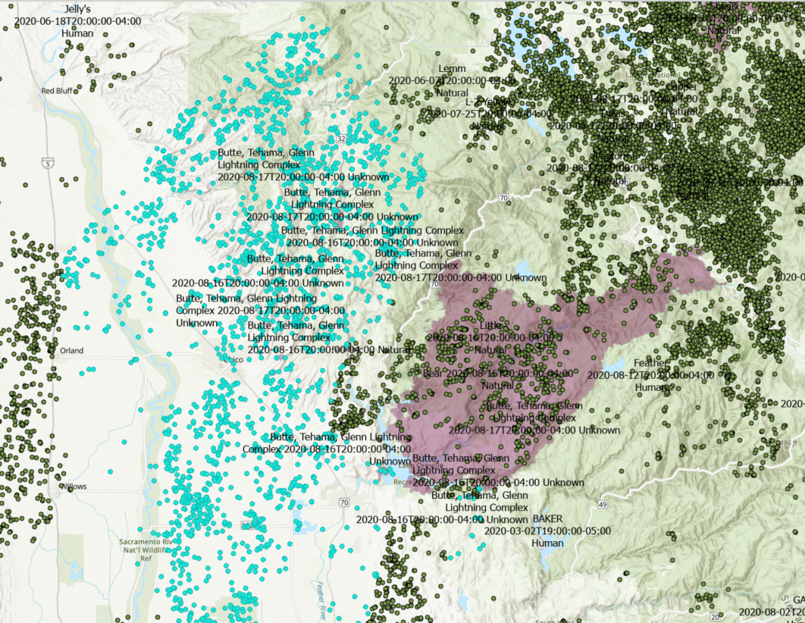
Dataset Development – Initial Matching
Search for all lightning and fire detections within 0.5° of the final fire perimeter polygon
  Initially, lightning must occur within 28 days before fire begins through fire containment
  For GLM flashes, the flash polygon locations are used (stroke/pulse lat/lon for NLDN)
GOES-East GLM Candidate Flashes
GOES-West GLM Candidate Flashes
NLDN Candidate Strokes/Pulses
*Potential matches to the Butte, Tehama, Glenn Lightning Complex are indicated by teal coloring

Slide 10
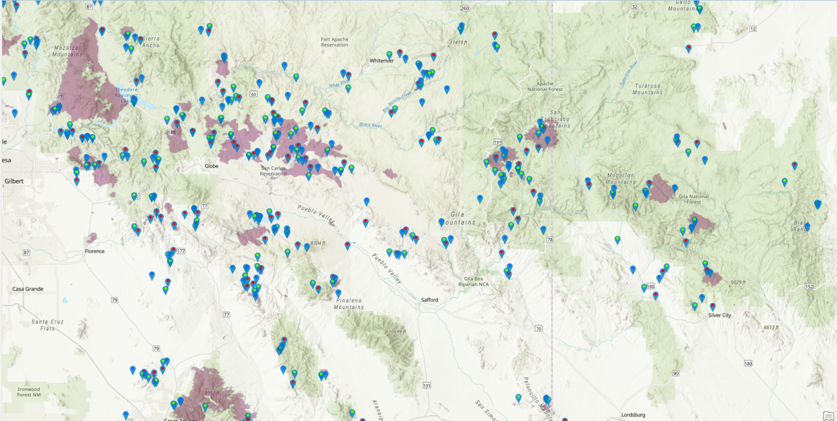
Dataset Development – Detailed Matching
Search for all lightning within various radii of the fire ignition location
  Lightning must occur within 28 days before fire begins through the day of ignition
  For GLM flashes, the flash point locations are used (stroke/pulse lat/lon for NLDN)
Symbols indicate lightning matched to natural wildfires using the 0.2° threshold
GOES-East GLM (Blue)
GOES-West GLM (Green)
NLDN (Red)

Slide 11
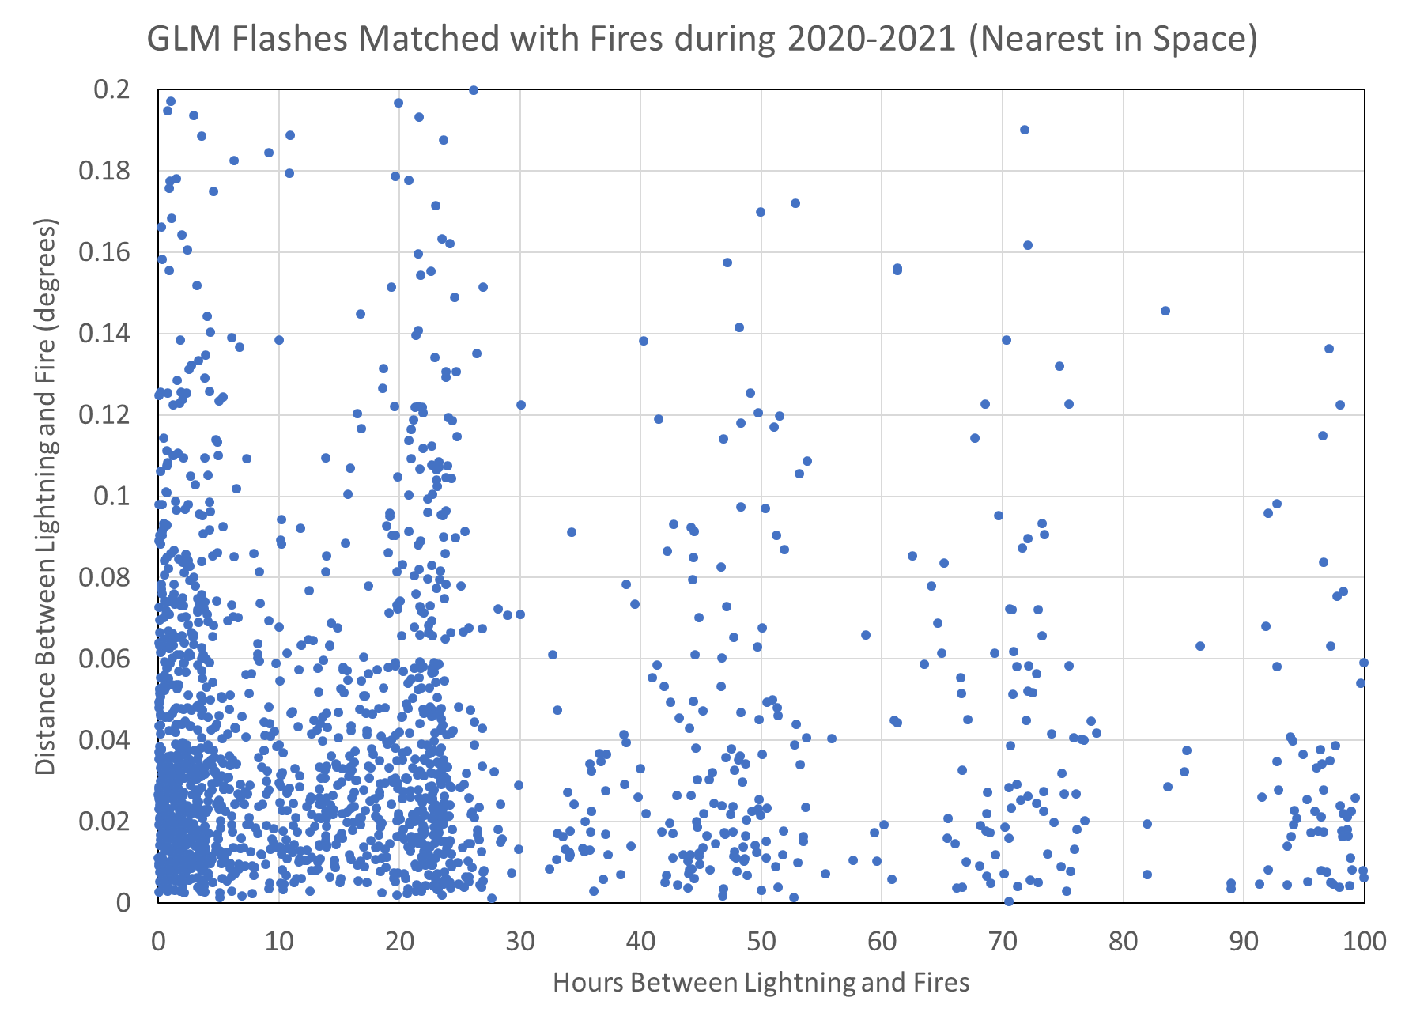
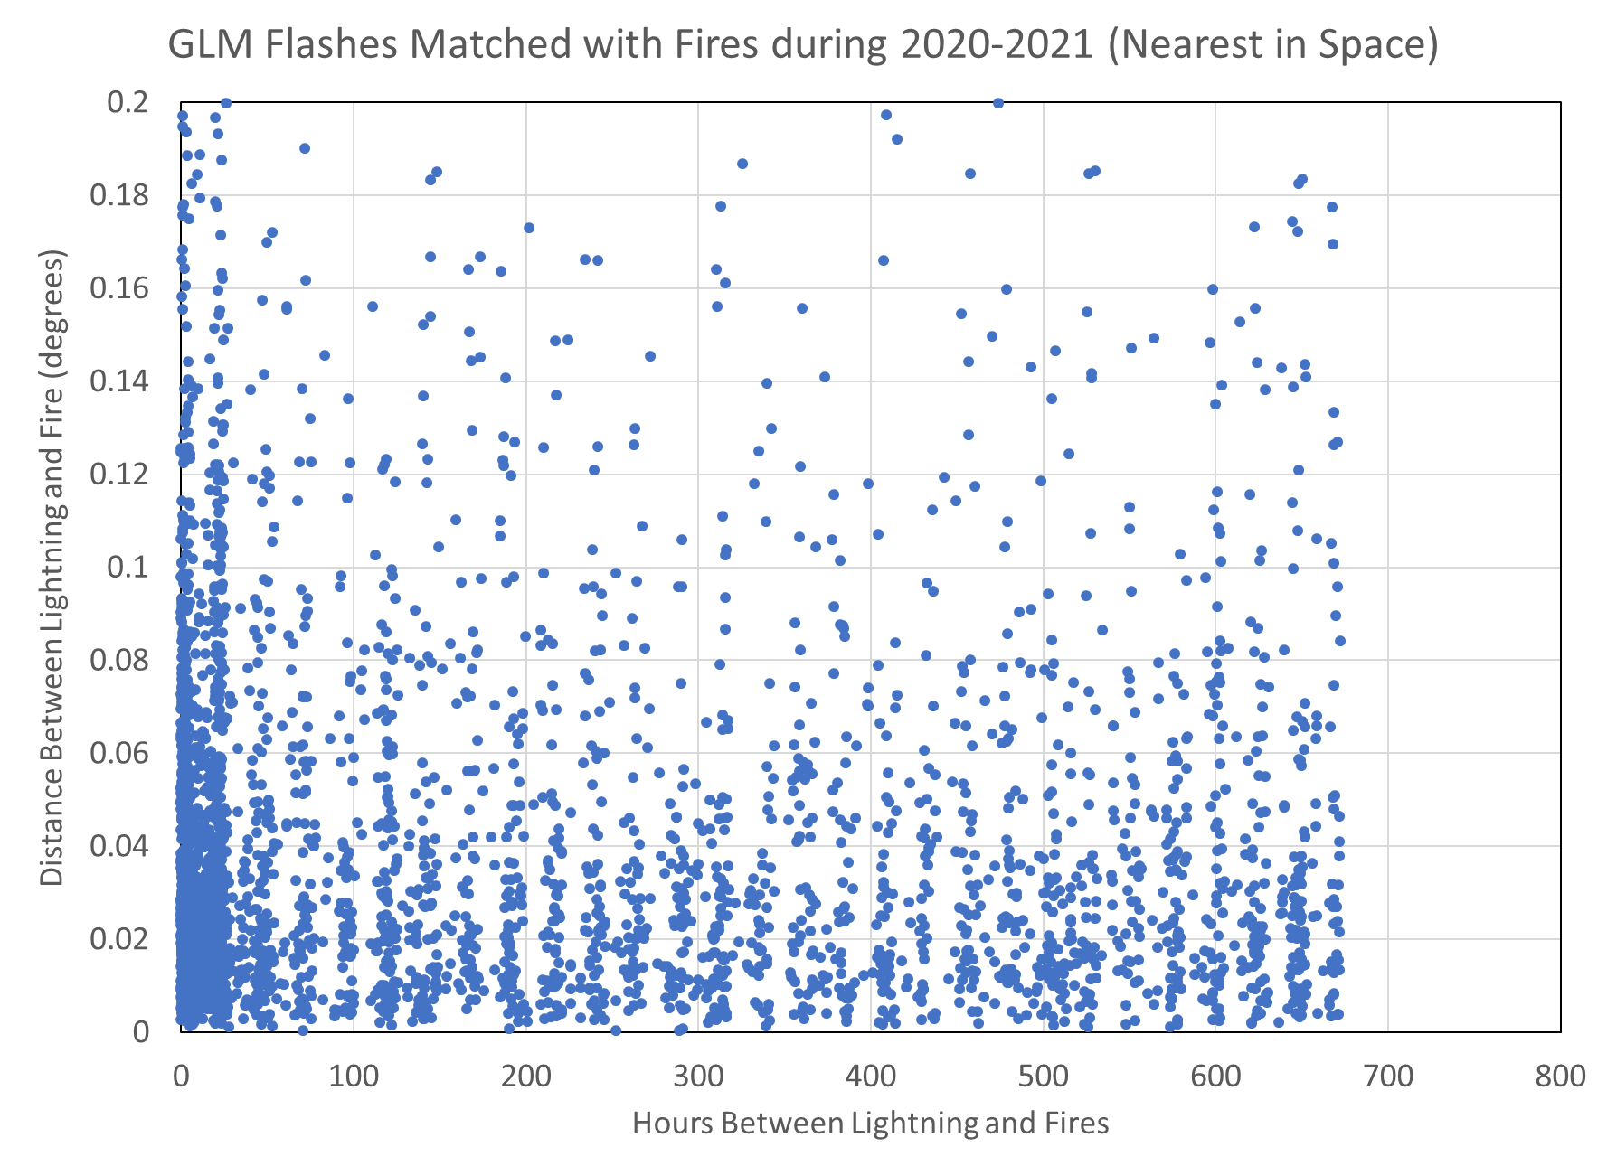
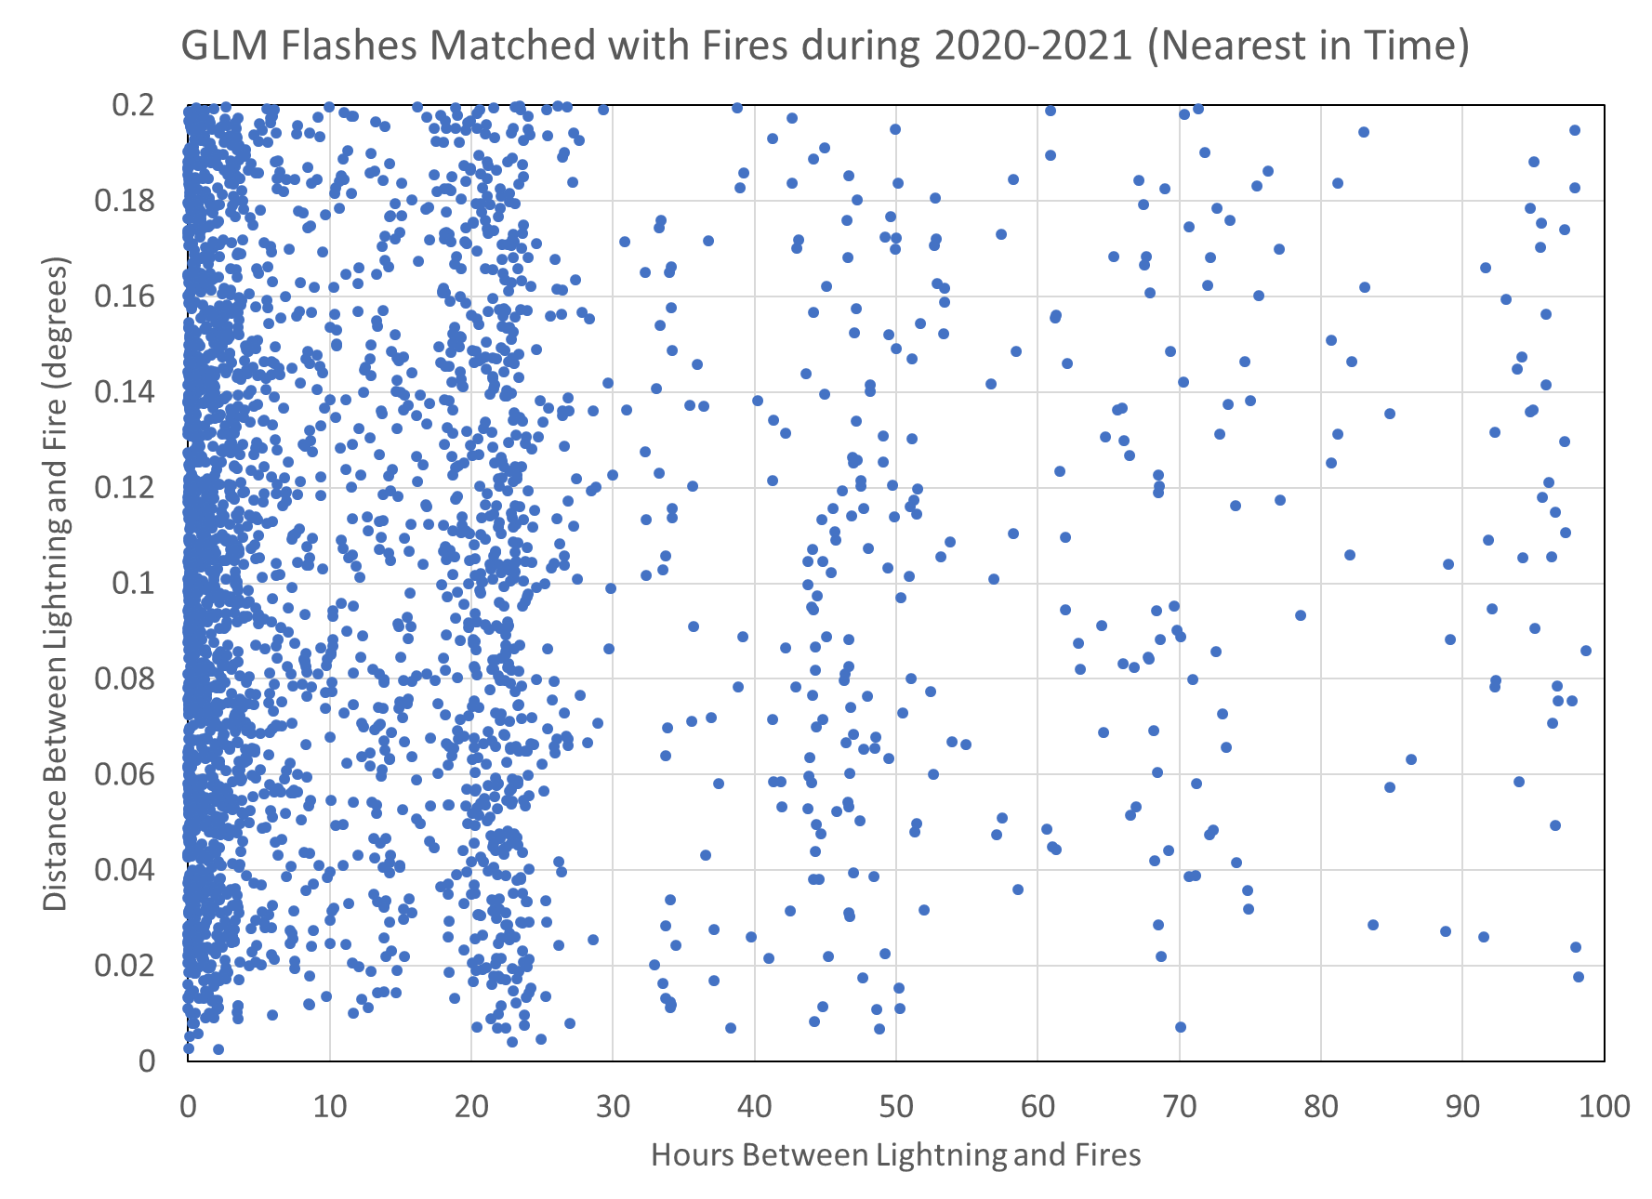
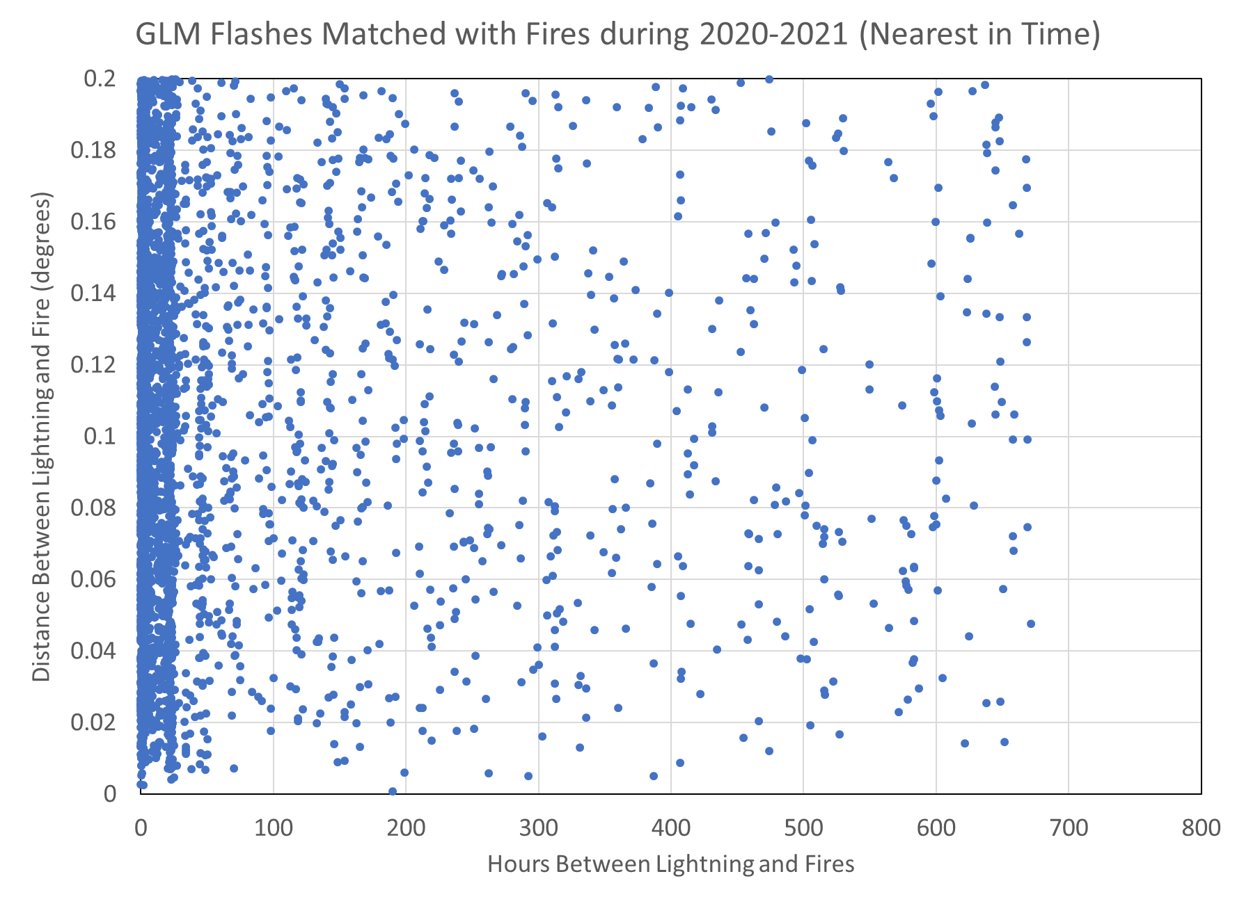
Overview of Matched Lightning
Identify lightning nearest to the fire ignition in space and time
Initially characterize which are very likely matches and identify those requiring closer examination
Matched Fraction | 0.5° | 0.2° | 0.1°
G16 GLM (2020) | 0.83 | 0.79 | 0.70
G17 GLM (2020) | 0.92 | 0.90 | 0.84
GLD 360 (2020) | 0.93 | 0.91 | 0.88
G16 GLM (2021) | 0.81 | 0.78 | 0.68
G17 GLM (2021) | 0.92 | 0.90 | 0.86
GLD 360 (2021) | 0.95 | 0.93 | 0.91
Sensor | Hour Diff | Dist Diff (°)
G16 | 205.5 | 0.050
G17 | 191.9 | 0.033
NLDN | 135.2 | 0.017
G16 | 87.6 | 0.105
G17 | 54.3 | 0.104
NLDN | 29.9 | 0.098
Unknown Fires | 0.5° | 0.2° | 0.1°
G16 GLM (2020) | 0.59 | 0.50 | 0.39
G17 GLM (2020) | 0.69 | 0.64 | 0.52
GLD 360 (2020) | 0.71 | 0.63 | 0.55
G16 GLM (2021) | 0.58 | 0.53 | 0.43
G17 GLM (2021) | 0.68 | 0.64 | 0.54
GLD 360 (2021) | 0.70 | 0.65 | 0.59
Fraction of natural fires with any lightning within various radii
Matched Lightning Statistics

Slide 12
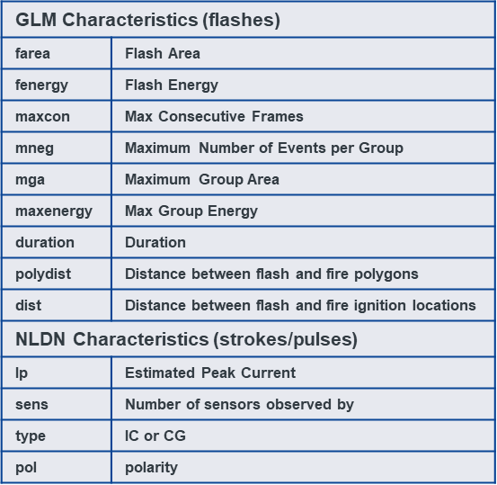
Next Steps
Properly classify as many unknown / undetermined fires as possible
Determine how many fires dwelled before growing and for how long
Quantify the potential benefit/value of identifying and suppressing these fires
Characterize lightning environments where fires dwell versus those with growth quickly after ignition
Begin developing the LiRoi Model

Slide 13
Developing the LiRoi Model
The Value of Probabilistic Prediction for Lightning Ignited Fires (Giuseppe 2022) (https://doi.org/10.1029/2022GL099669)
Once lightning data are properly classified, join with additional data (e.g., Giuseppe 2022)
Integrate findings with parallel effort applying blended lightning grids (Zhang et al. 2022)
Determine the best AI for this application
Train model on subset sample, then evaluate performance on independent sample
Tune/refine model as needed
Develop training resources
Incorporate into NESDIS fire product information storefront
Parameter | Units
IFS volumetric soil water layer 1 | (m3⋅m−3)
IFS 2 m temperature | Kelvin
IFS 2 m relative humidity▽ | %
IFS soil type | Categorical (1–7)
IFS low vegetation cover | Fraction (0–1)
IFS high vegetation cover | Fraction (0–1)
IFS daily accumulated precipitation | mm⋅day–1
IFS 5 days precipitation▽ | mm⋅day–1
IFS Avg 3 days soil moisture▽ | (m3⋅m−3)
IFS Avg 5 days soil moisture▽ | (m3⋅m−3)
IFS Avg 10 days soil moisture▽ | (m3⋅m−3)
IFS Avg 15 days soil moisture▽ | (m3⋅m−3)
IFS Avg 20 days soil moisture▽ | (m3⋅m−3)
SMOS NN soil moisture | (m3⋅m−3)
IFS vegetation drought index | Categorical (1–5)

