Slide 1
Utilization of GLM Products for Early Warning Systems in Local
Governments of Costa Rica
Jean Carlo Rodriguez Chaves
University of Costa Rica
jean.rodriguezchaves@ucr.ac.cr

Slide 2
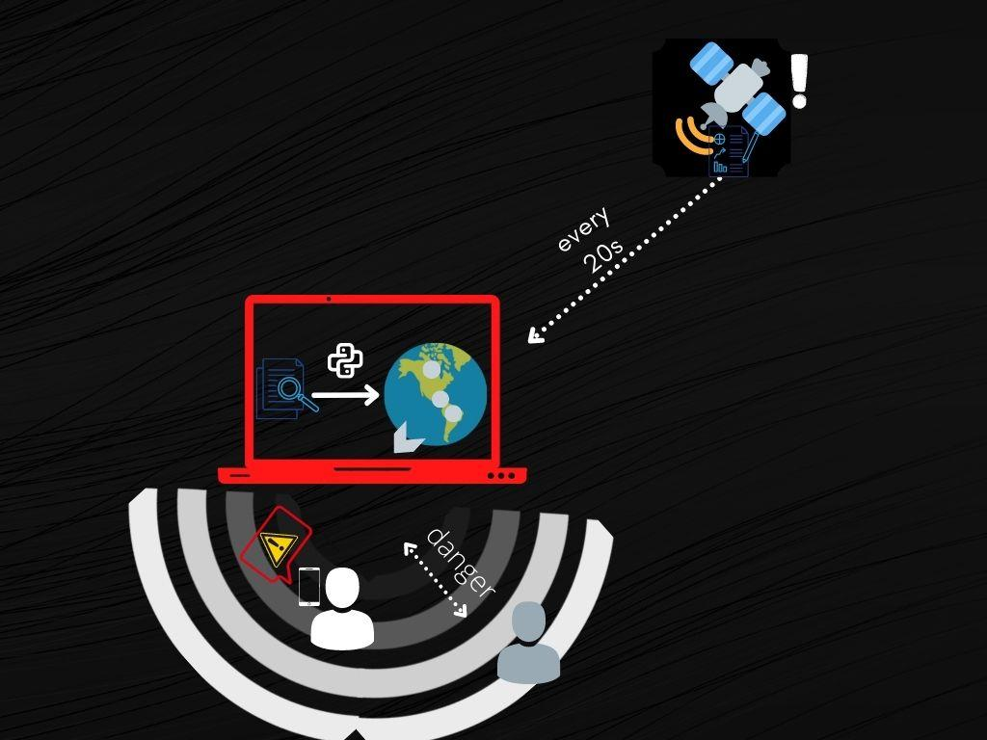
SAT system
SAT is a system that sent alerts of atmospheric discharges near the people.

Slide 3
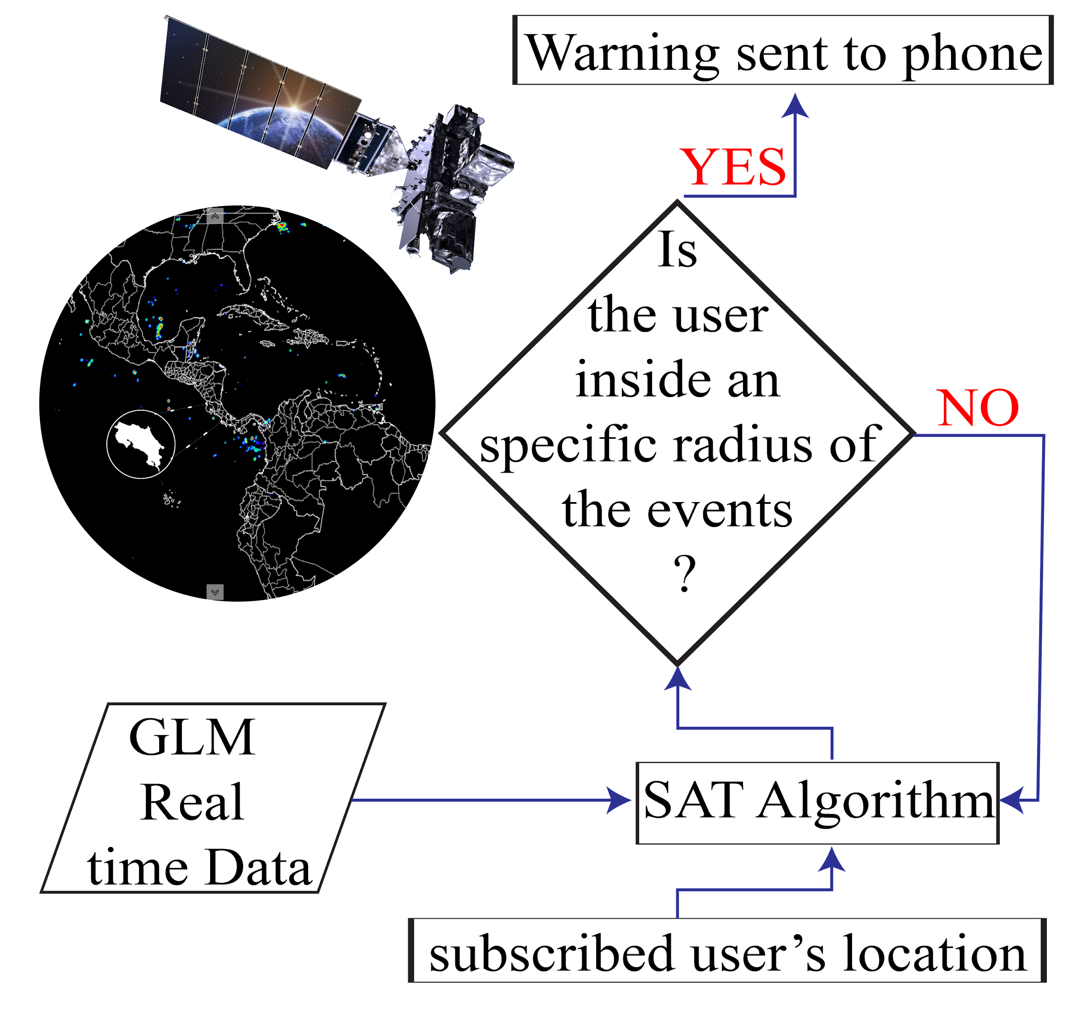
How is SAT system going to work?

Slide 4
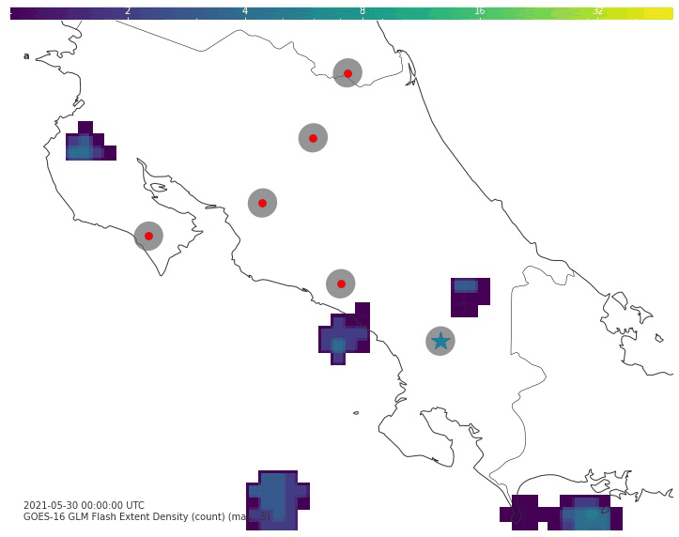
The system is doable ?
Simulation
The information come from the historical data from GLM sensor
The location for the simulation is Costa Rica
use of different radius for the dangerous zone
use of different number of points

Slide 5
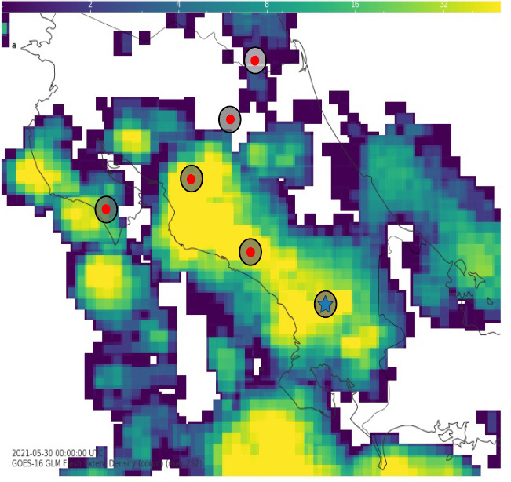
Simulation analysis

Slide 6
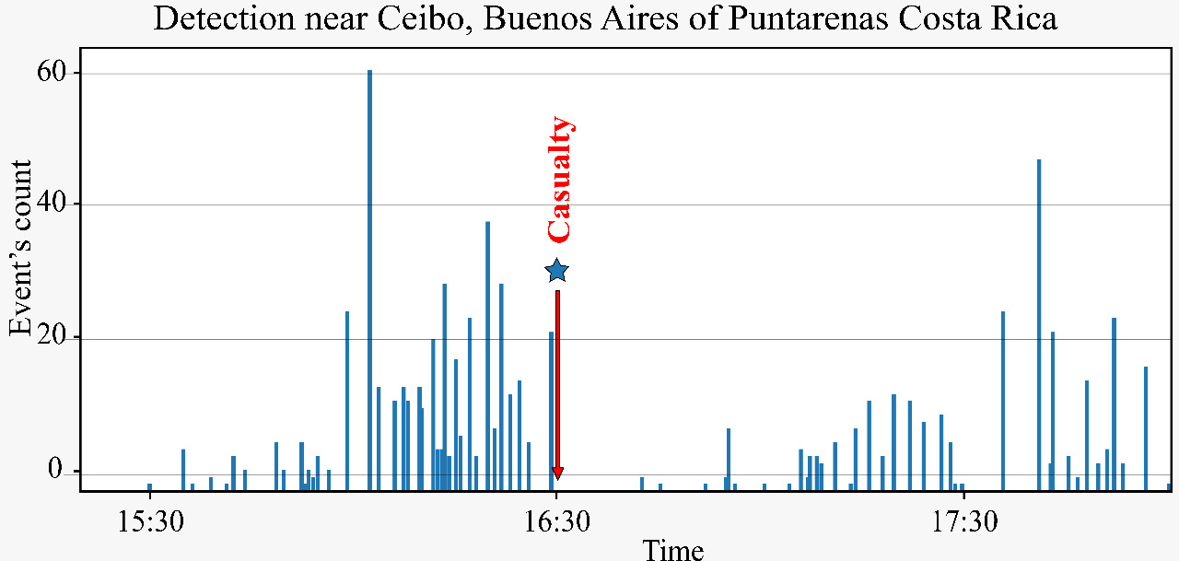

Slide 7
Conclusion and future work
The simulation demonstrates the viability of the development of an early warning system.
Develops a mobile application for the SAT system.
Deicide the way of receiving data.

