Slide 1
Comparing Climate Model and Observed Space-based
Flash Frequencies
Jonathan Wynn Smith, Ph.D.
NOAA/OAR/GFDL and UMD/ESSIC
Collaborators:
Larry Horowitz, Ph.D., Vaishali Naik, Ph.D, John Dunne, Ph.D.
NOAA/OAR/GFDL
2022 GLM Science Team Meeting
Operational Users of GLM Session
Wednesday, September 14, 2022

Slide 2
Motivation
To our knowledge, geostationary space-based lightning data have not been compared to climate model simulations
Establish a framework for comparing other space-based lightning and atmospheric chemistry datasets to climate models
Gather information climate modelers can use to improve model lightning frequency parameterizations, lightning-nitrogen oxide parameterizations, and tropospheric ozone and methane estimates

Slide 3
GOES-16 GLM Data
 | 2018 | Post 2018
Product | Flash Extent Density - Number of flashes coincident with a grid cell over a 1 minute period
Spatial Resolution | 4 km x 4 km | 2 km x 2 km
Grid Cells for the GOES-16 Domain | 2711 x 2711 = 7349521 | 5424 x 5424 = 29419776
Detection Efficiency | Average = 0.82 0.85 from Feng Zhang, UMD Research Assistant, Personal Communication in May 2022 (GOES-16 GLM relative to ENTLN) 0.91 for 60 second intervals (GOES-16 GLM relative to WWLLN in Bateman et al. 2021) 0.7 for 24 hour average over GOES-16 GLM FOV (In design specification in Goodman et al. 2018)
Calculation

Slide 4
GFDL AM4 c96 Model Flash Frequency Output
Model | GFDL Atmospheric Model (AM) version 4 (Zhao et al. 2018 and Horowitz et al. 2019) 2008-2020 simulation forced with SST and nudged to GFS winds produced by Meiyun Lin, Ph.D. (GFDL) Double plume convective scheme (separate shallow and deep convective plume - Zhao et al. 2018) Flash Frequency Parameterization: Convective Cloud Top Height - Price et al, (1997)
Data | Flash frequency (flashes per cm² per seconds in a month)
Resolution and Grid Cells | 1° latitude by 1.25° longitude -> 162 x 130 = 21060
Data Extraction | ncks -d time,10 -d lat,-80.5,80.5 -d lon,204.375,5.625 tracer_level.201901-201912.flash_freq.nc c96_112019.nc
Calculation

Slide 5
Conservative Regridding
Spatial average calculated of all full and
partial source grid cells within the destination
grid cell
Ideal for regridding fine to coarse resolution
Utilities: ncl ESMF_Regridding and
Python xesmf/ESMPy libraries
From: https://www.youtube.com/watch?v=79o6DXr_3zM
Climate Unboxed Youtube Channel

Slide 6
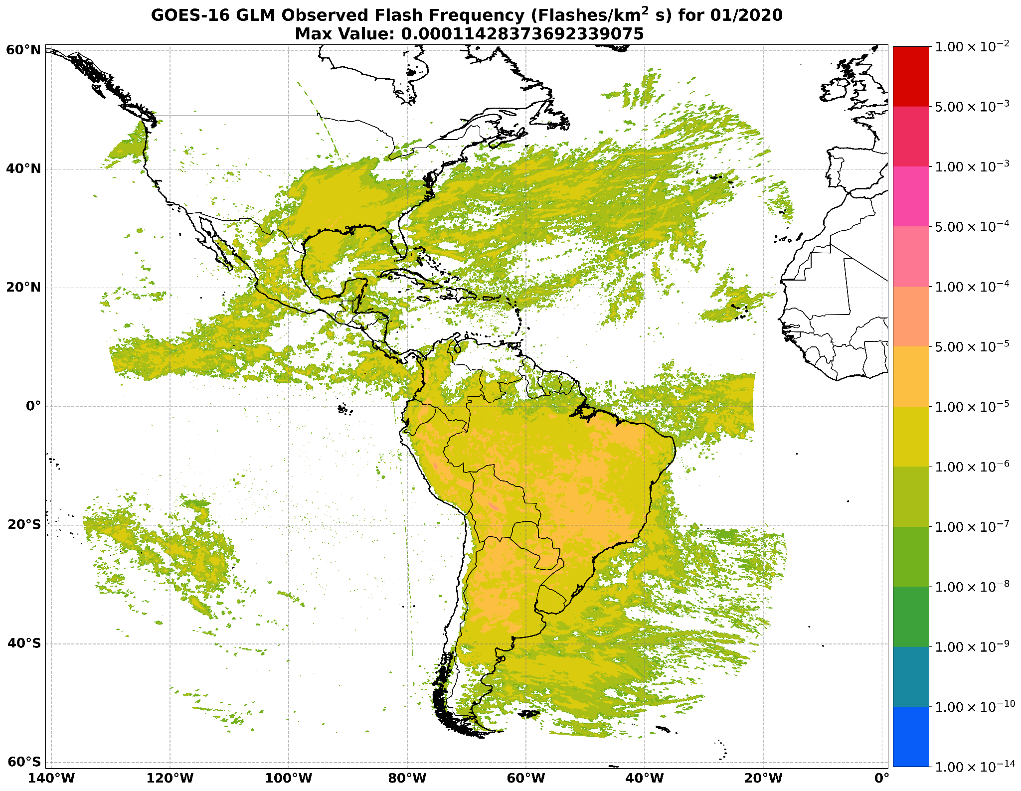
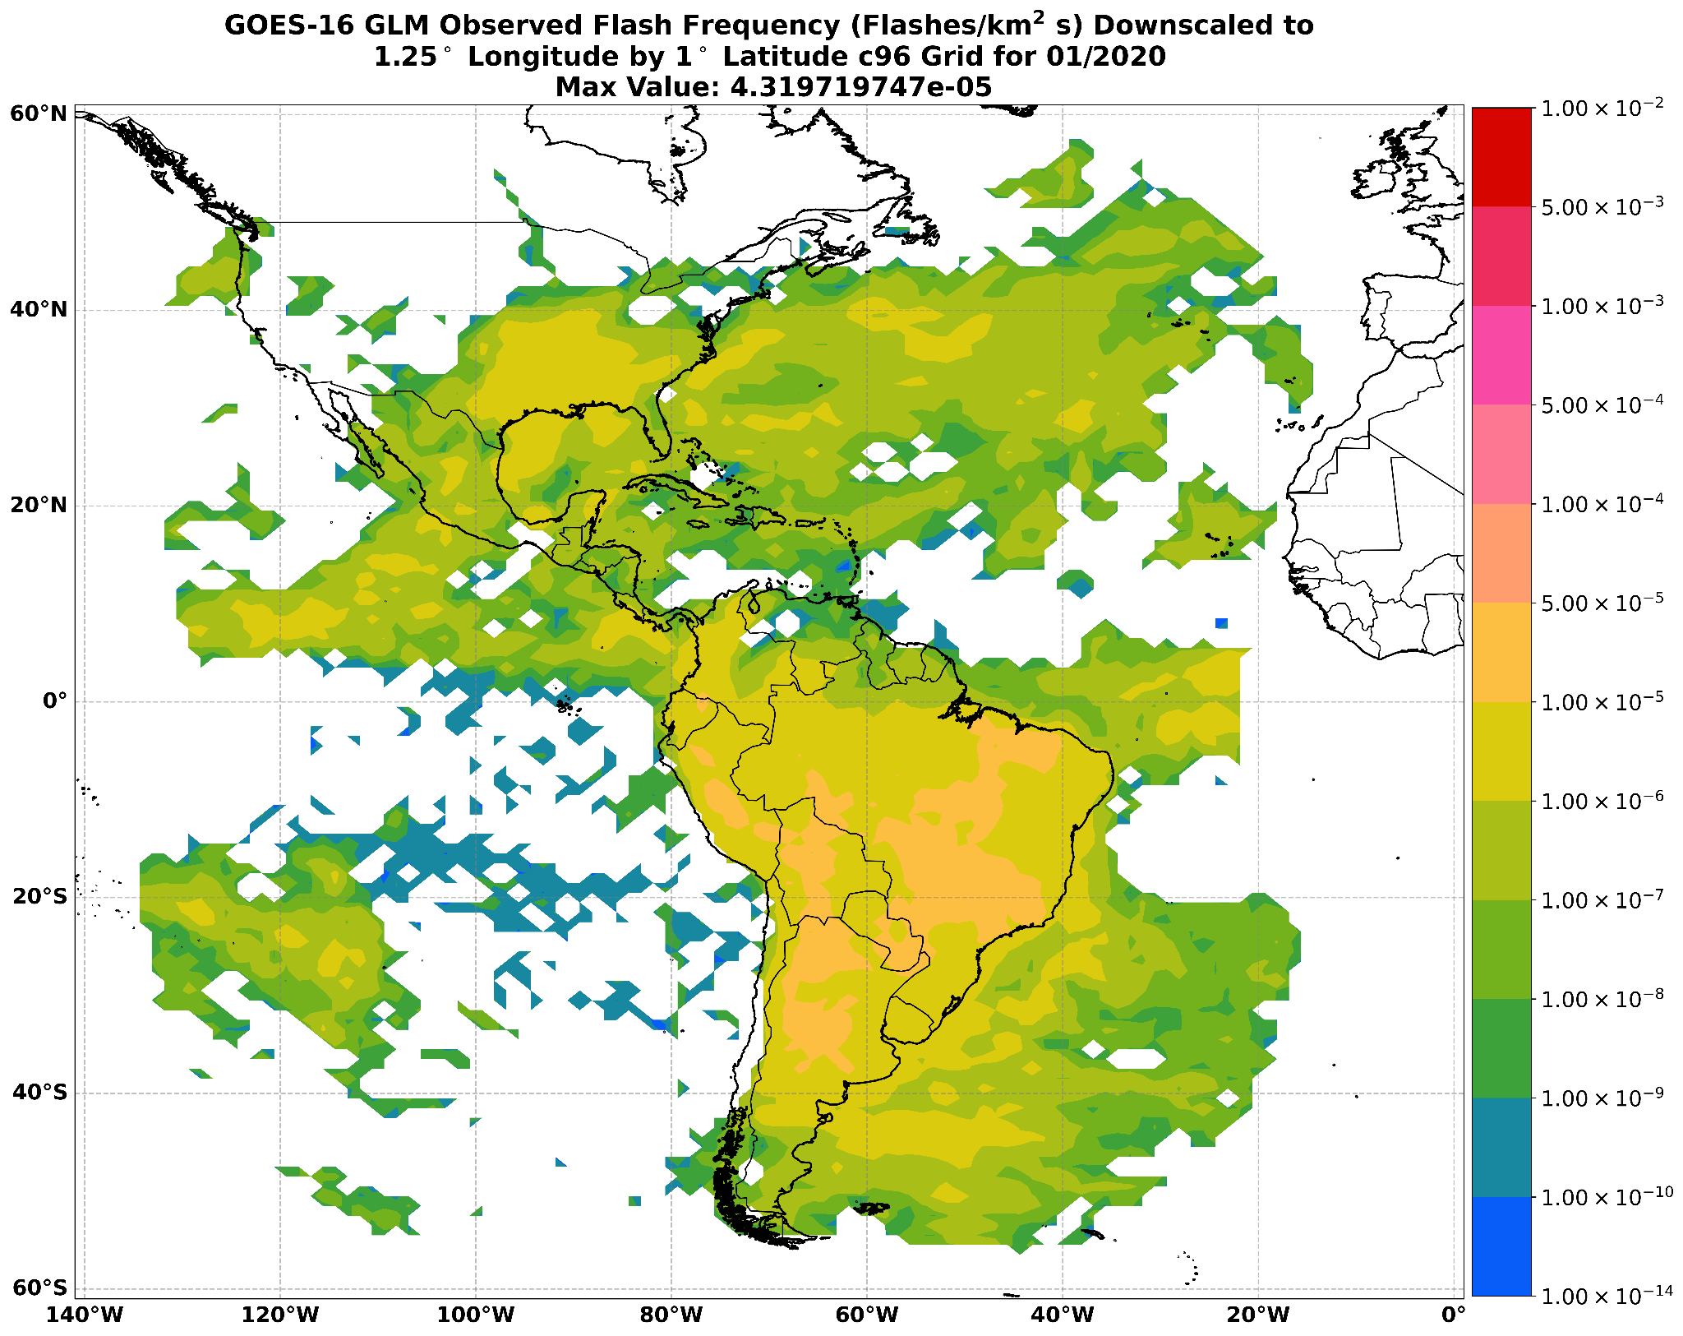
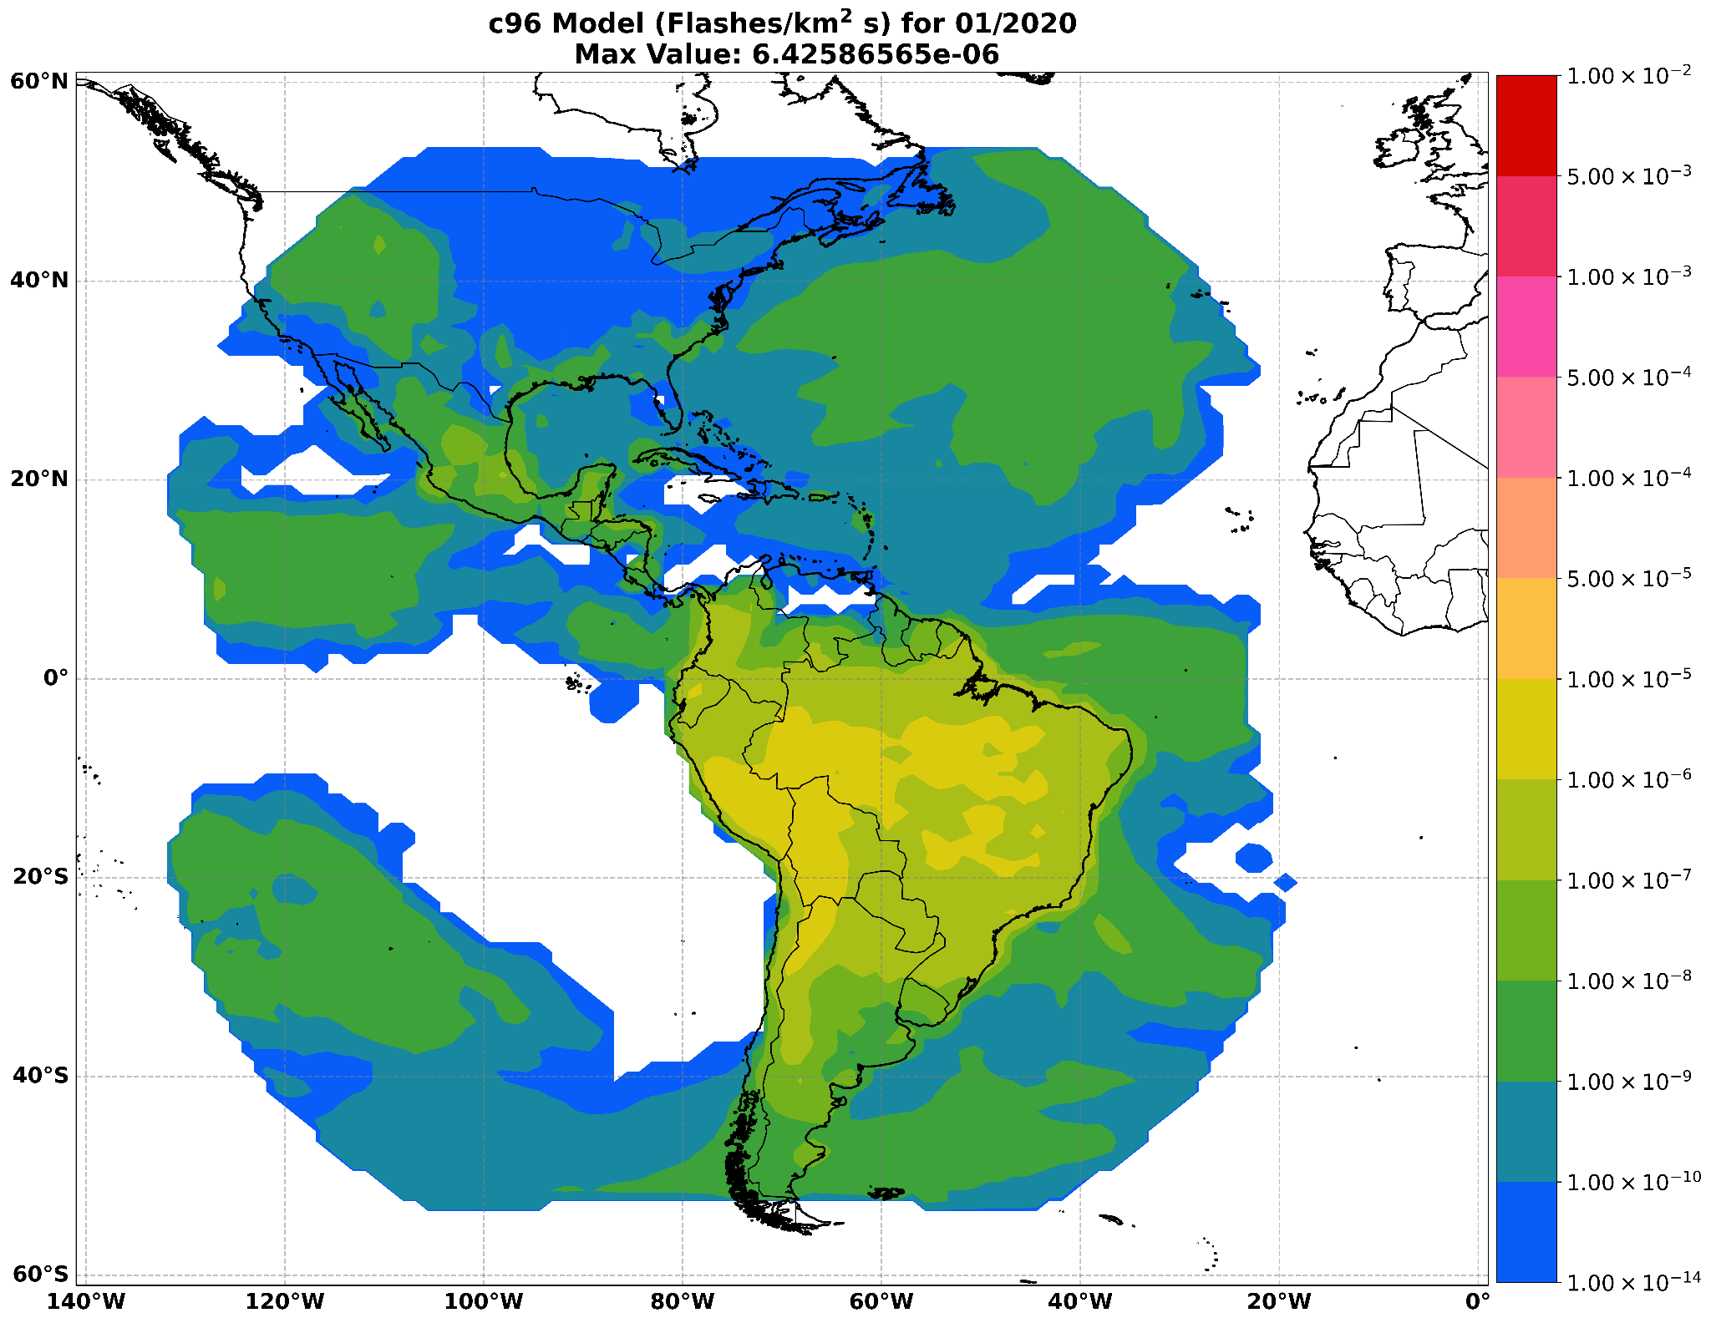
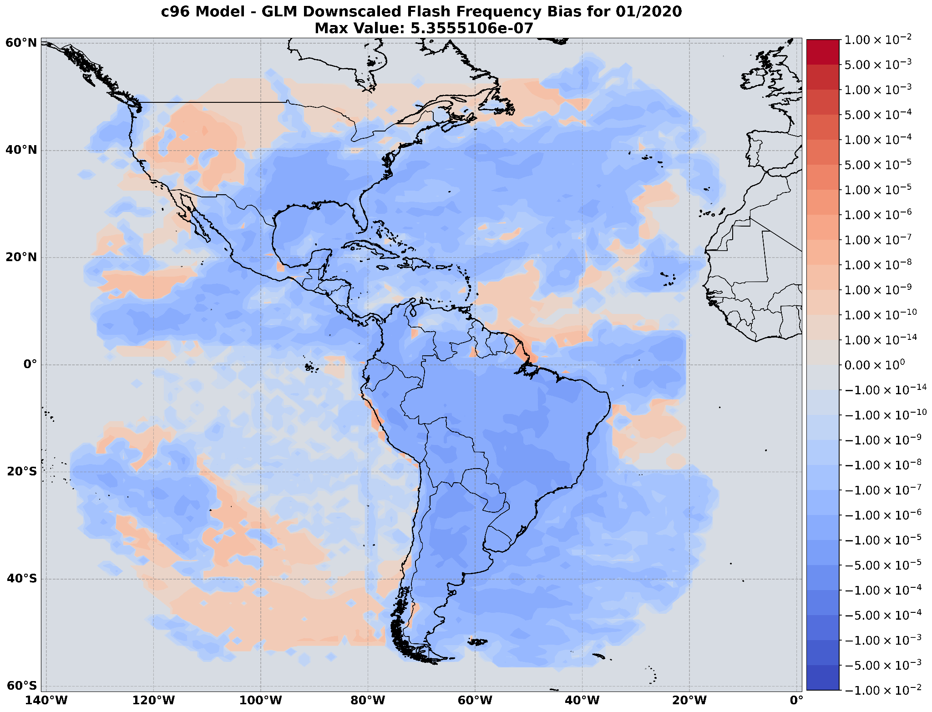
January
2020
Original GLM Grid Regridded GLM
1° Lat x 1.25° Lon
Max flash freq.: Max flash freq.:
1.143 e⁻⁴ flashes 4.32 e⁻⁵ flashes km⁻² s⁻¹ km⁻² s⁻¹
GFDL AM4 c96 Bias
Model Simulation (c96 - GLM)
1° Lat x 1.25° Lon
Max flash freq:
6.426 e⁻⁶ flashes
km⁻² s⁻¹
1e⁻¹⁴ to 1e⁻⁸ flashes km⁻² s⁻¹ underprediction in GLM FOV and the same magnitude of overprediction over the Rockies

Slide 7
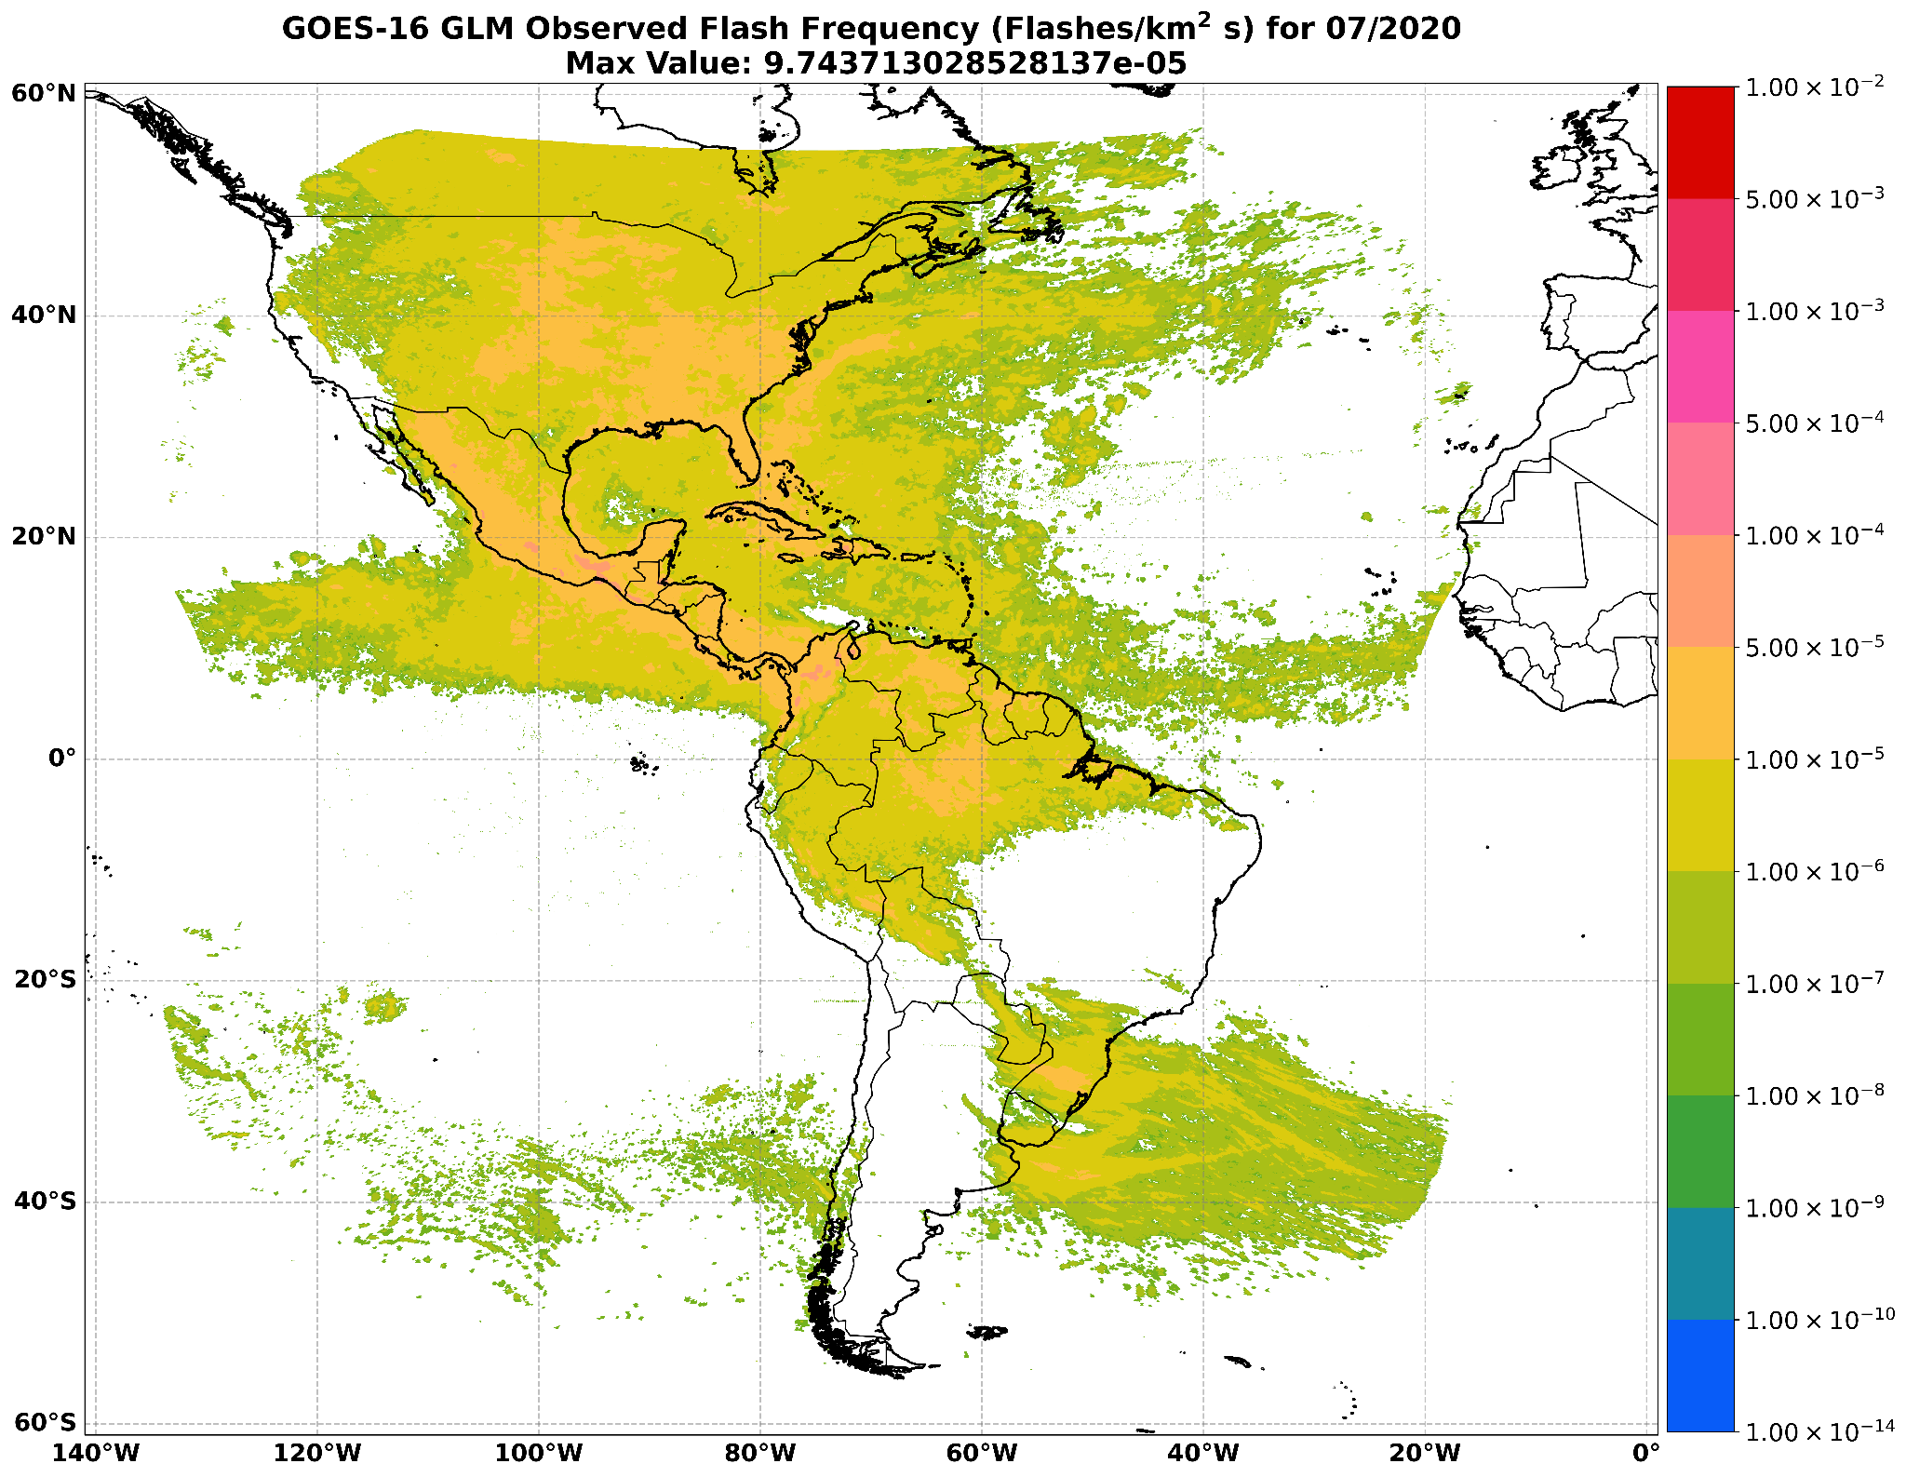
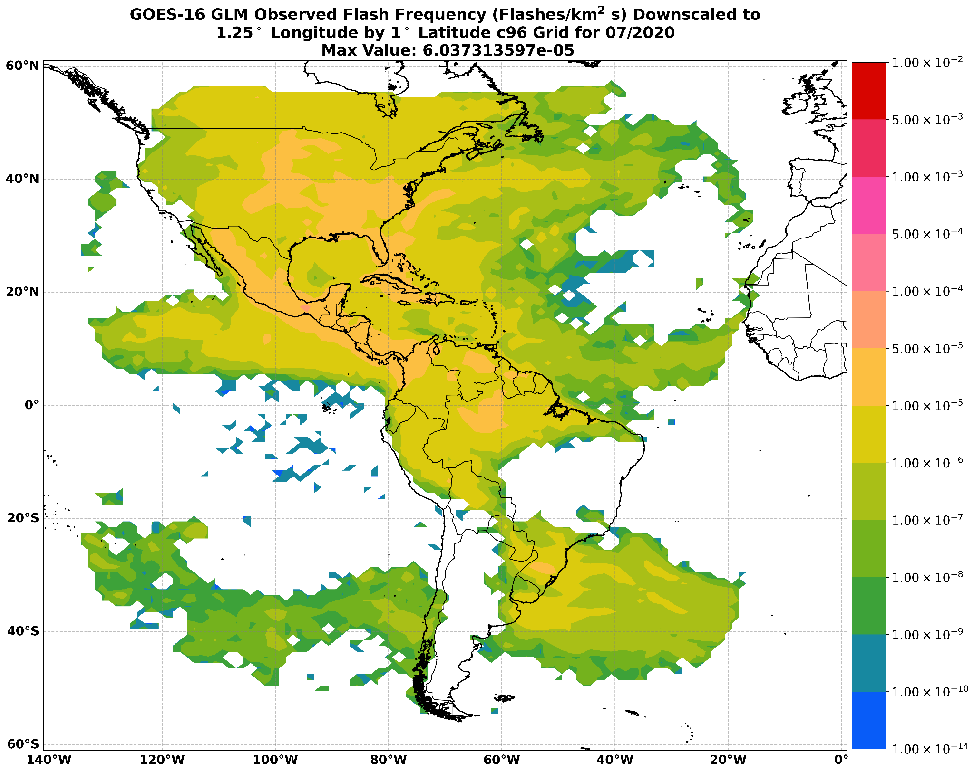
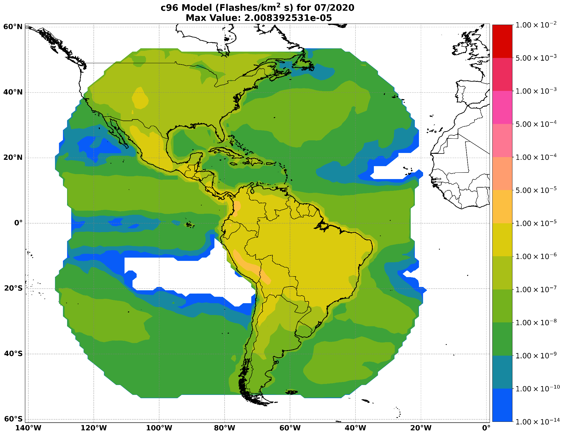
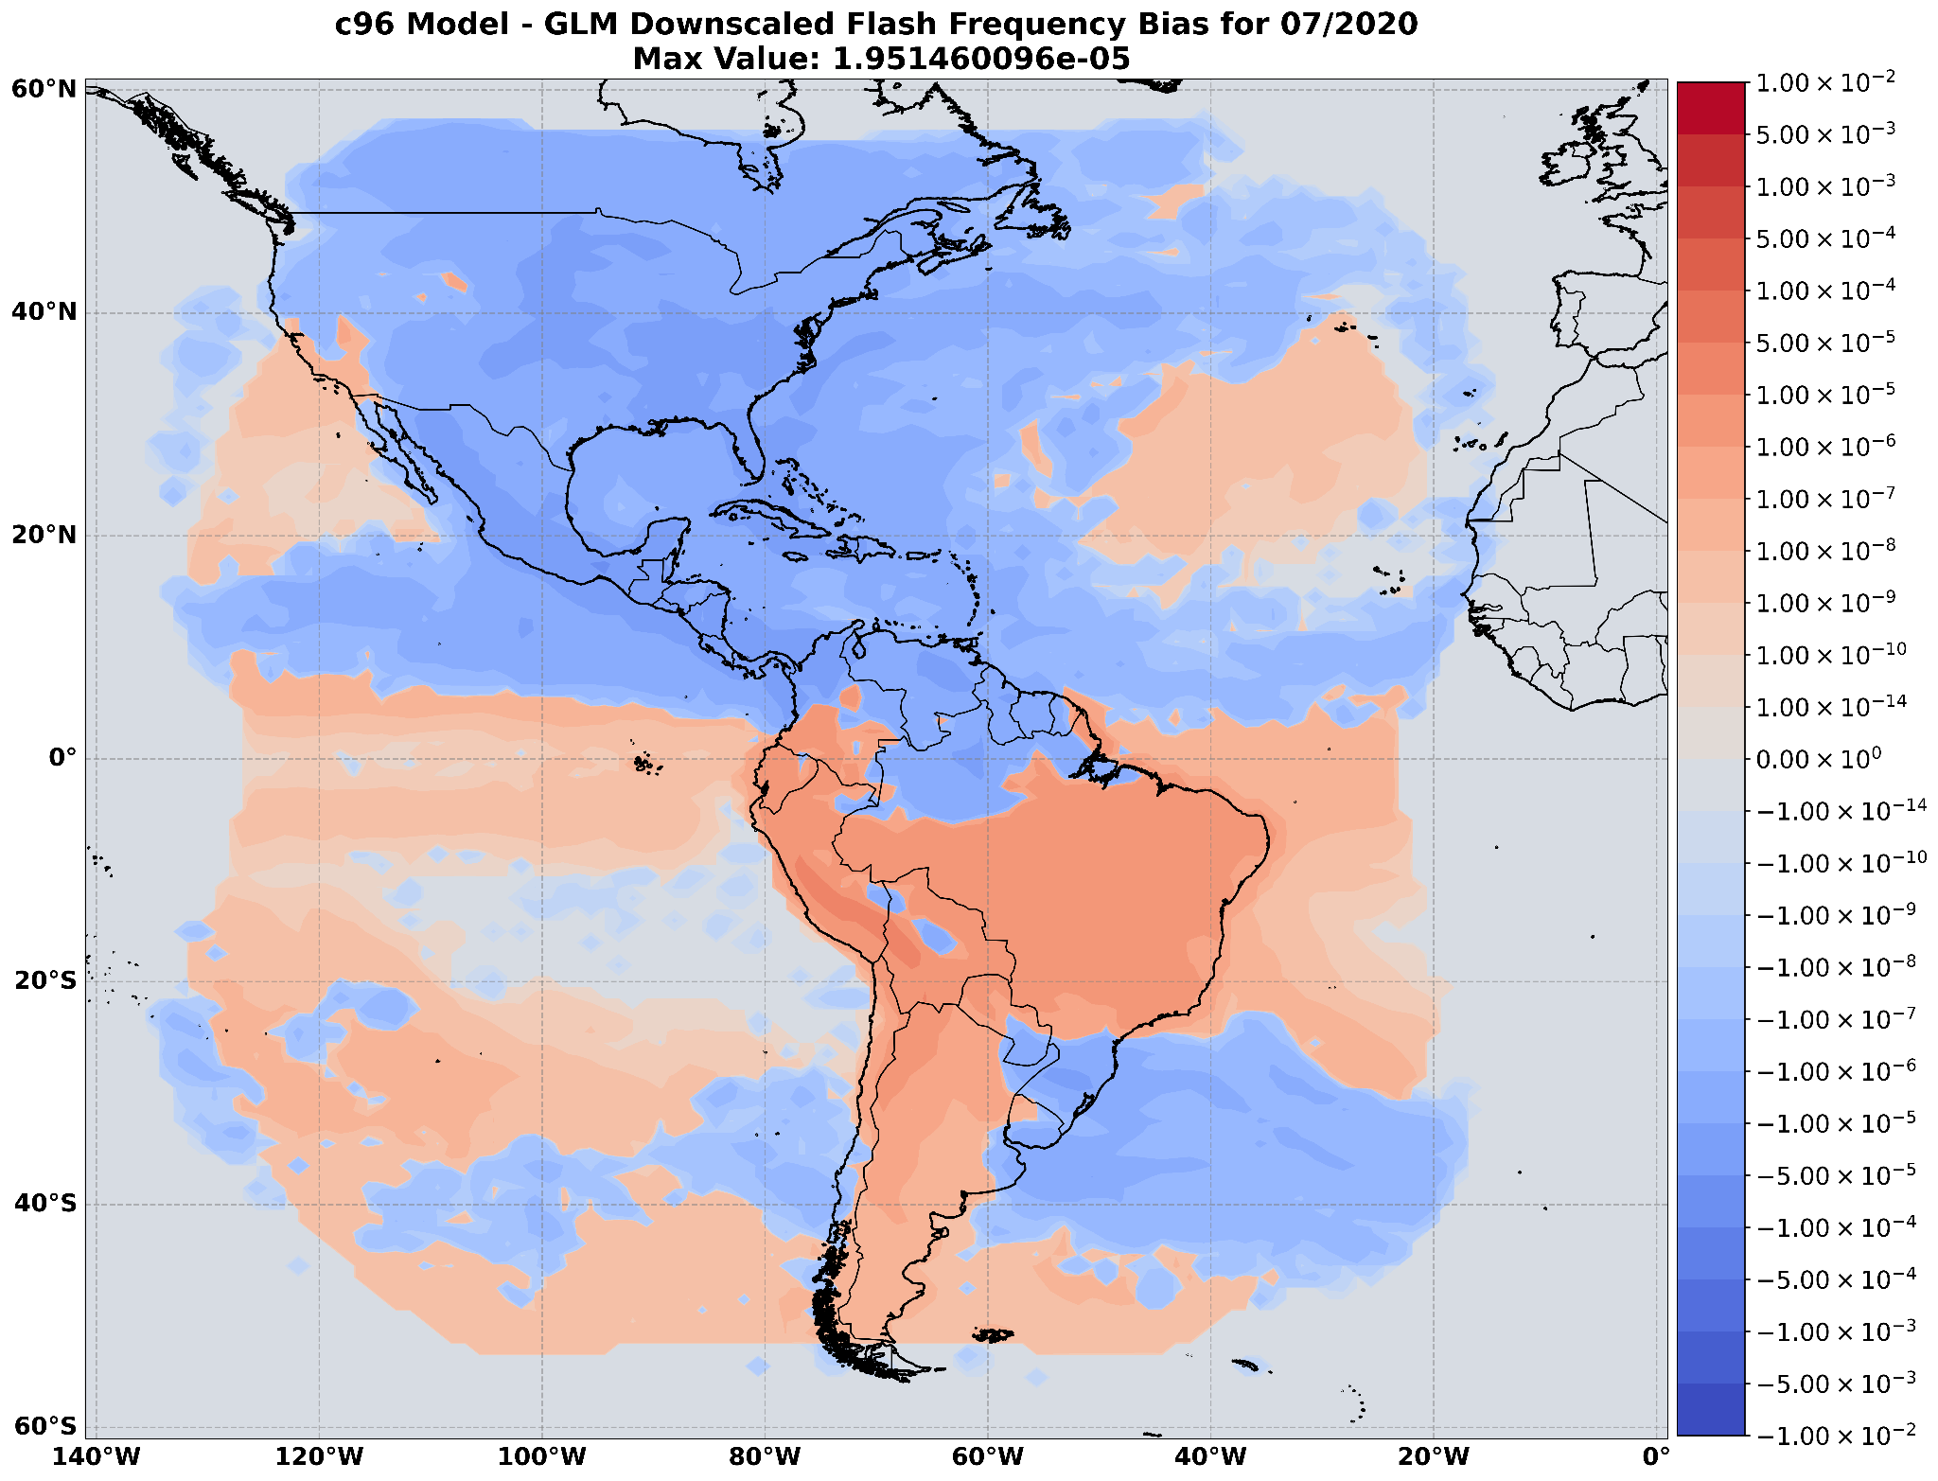
July
2020
Original GLM Grid Regridded GLM
1° Lat x 1.25° Lon
Max flash freq.: Max flash freq.:
9.744 e⁻⁵ flashes 6.037 e⁻⁵ flashes km⁻² s⁻¹ km⁻² s⁻¹
GFDL AM4 c96 Bias
Model Simulation (c96 - GLM)
1° Lat x 1.25° Lon
Max flash freq:
2.008 e⁻⁵ flashes
km⁻² s⁻¹
1e⁻¹⁴ to 1e⁻⁸ km⁻² s-1 (1e⁻¹⁴ to 1e⁻⁶ km⁻² s⁻¹) underprediction (overprediction) in NH (SH, with the exception of the Andes outflow region)

Slide 8
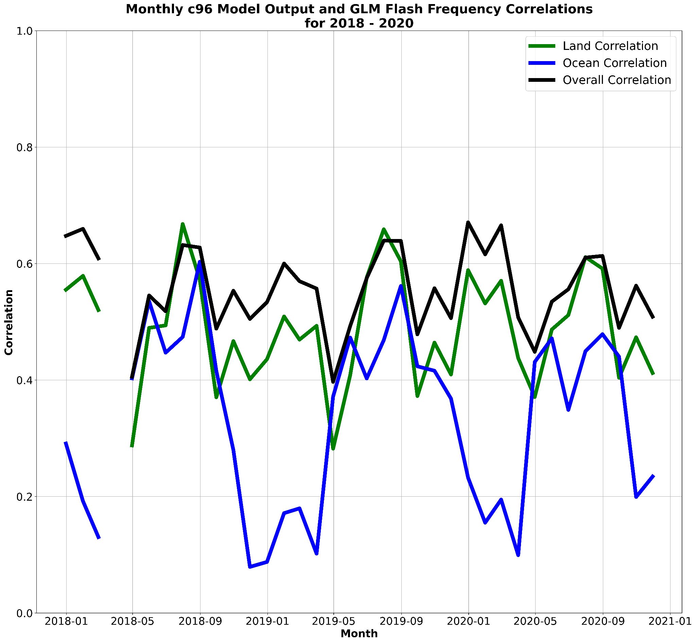
Model and Observation Correlation Trends
Model to observation correlation of ~0.48 exists over the entire GLM FOV and over land
Poor correlation of < 0.2 exists over the ocean in the NH winter and early spring
The best correlations over all land types occur in the NH Summer

Slide 9
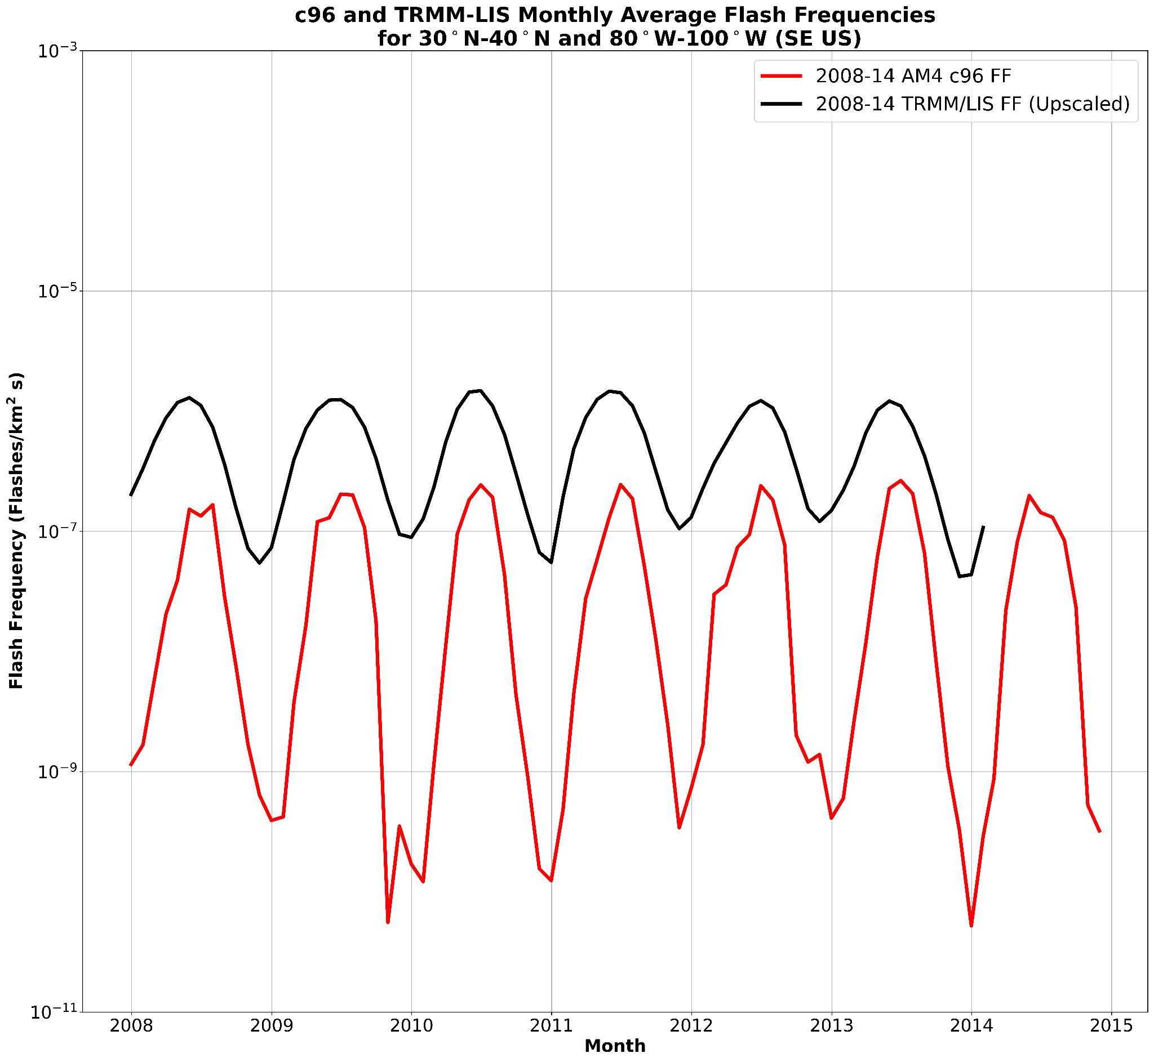
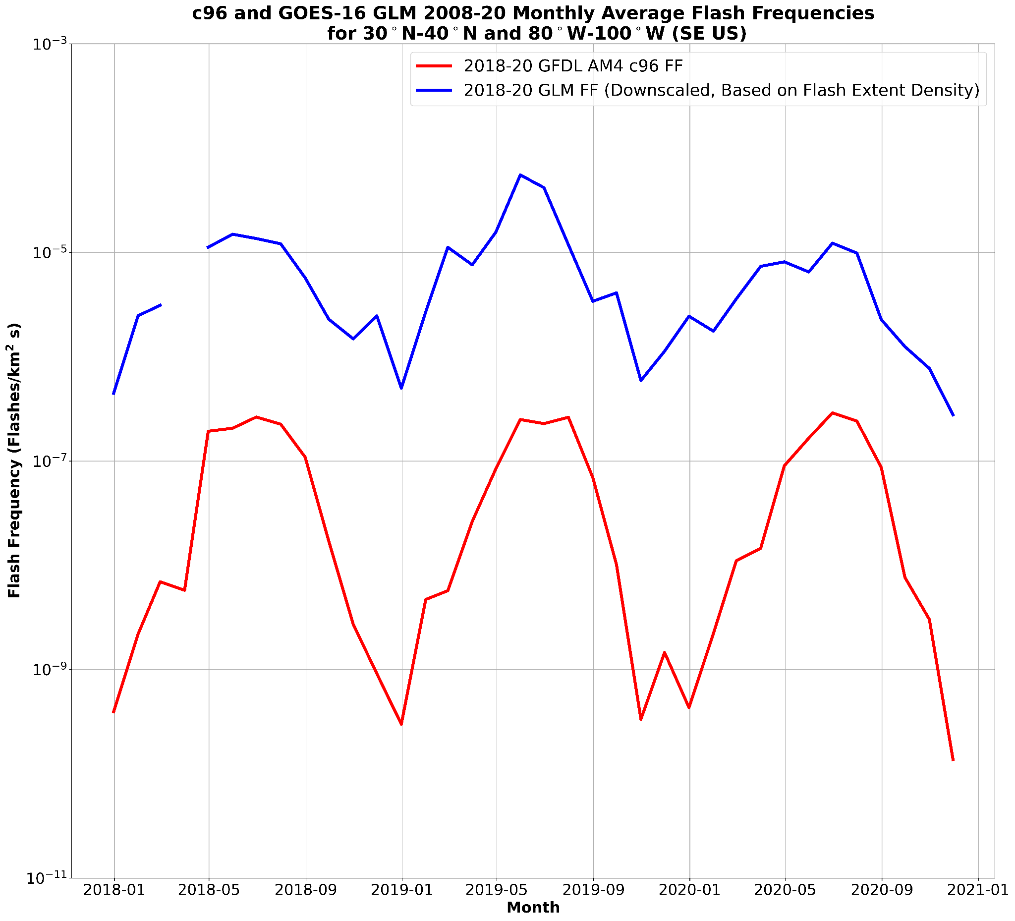
Southeast U.S. Flash Frequency Trends
flasheskm⁻² s⁻¹
TRMM/LIS and GLM capture c96 model flash frequency seasonality
Both are orders of magnitude higher: TRMM/LIS is 1-3 and GLM is 2-4
Comparing the ISS-LIS flash frequency to TRMM/LIS and GLM could provide more certainty

Slide 10
Summary
Regridding fine resolution data to coarser model grid required the conservative method
2-4 order of magnitude under prediction of lightning frequency compared to GLM
Model “over predicts” in mountainous area compared to GLM
Ocean model/obs correlation is poor (< 0.2) during the NH cold season
Model captures TRMM/LIS and GLM seasonality in SE US
Future Work
Calculate ISS-LIS flash frequency based on flash rate to intercompare with GLM and TRMM/LIS
Compute the the GLM flash frequency with flash count as opposed to FED
Explore biases between model and LIS data
Run climate model sensitivity testing with convective schemes and model resolution
Examine how well flash frequency in model correlate with: Cloud Water Path (Han et al. 2021), Ice Mass Flux (Dierling et al. 2008), CAPE + Convective Precipitation (Romps et al. 2014), and others
Give an update on this research and an overview of the conservative regridding of GLM data at the 2023 AMS Meeting
Thanks to: GFDL - Meiyun Lin, Ph.D., UMD/ESSIC - Feng Zhang, Ph.D. and Daile Zhang, Ph.D. and US NRL - Brain Blaylock, Ph.D.

Slide 11
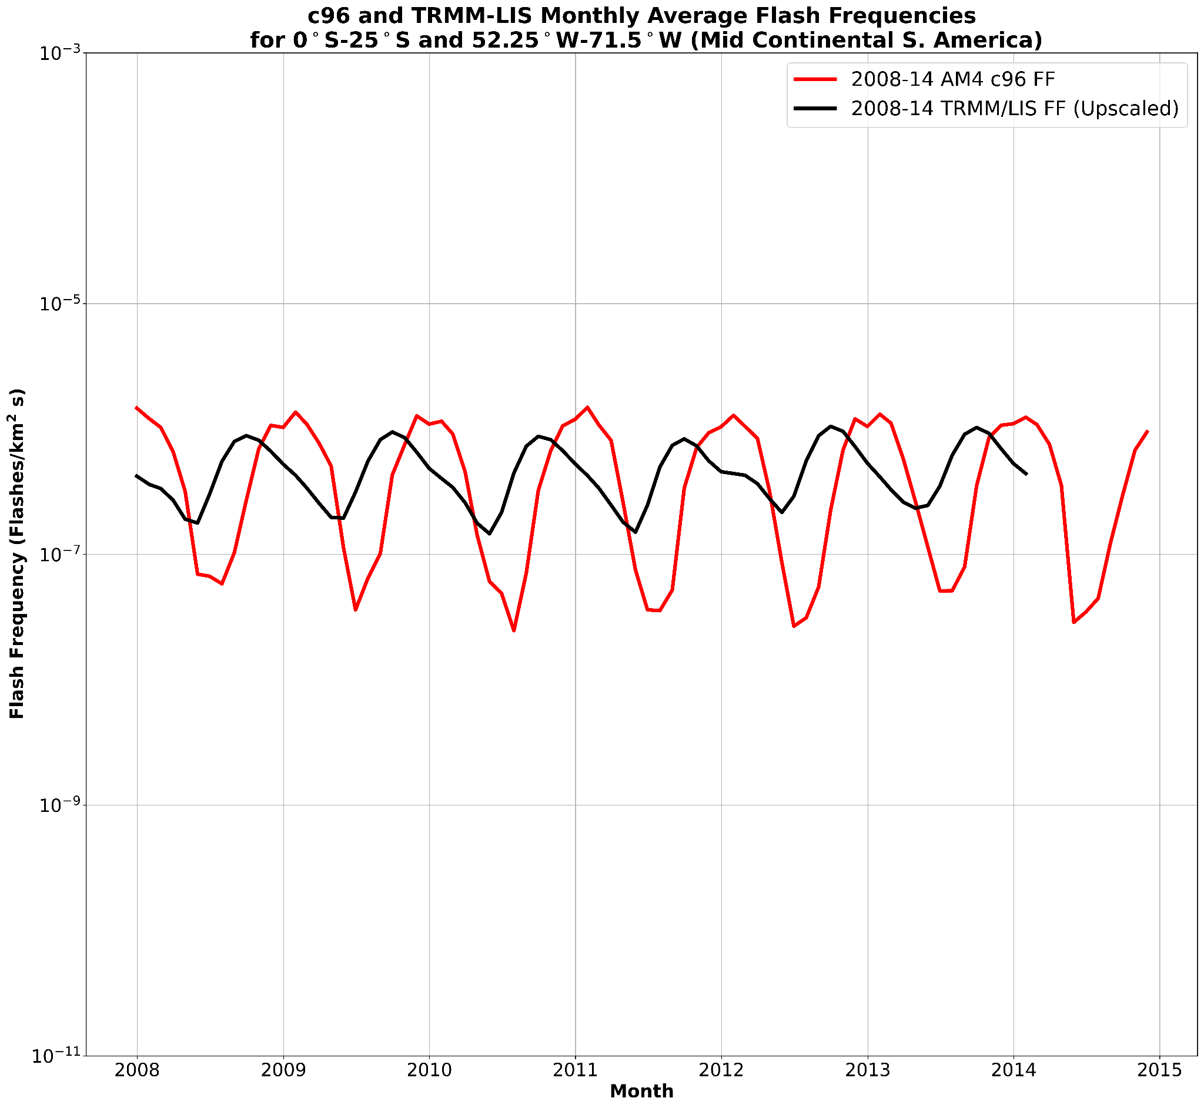
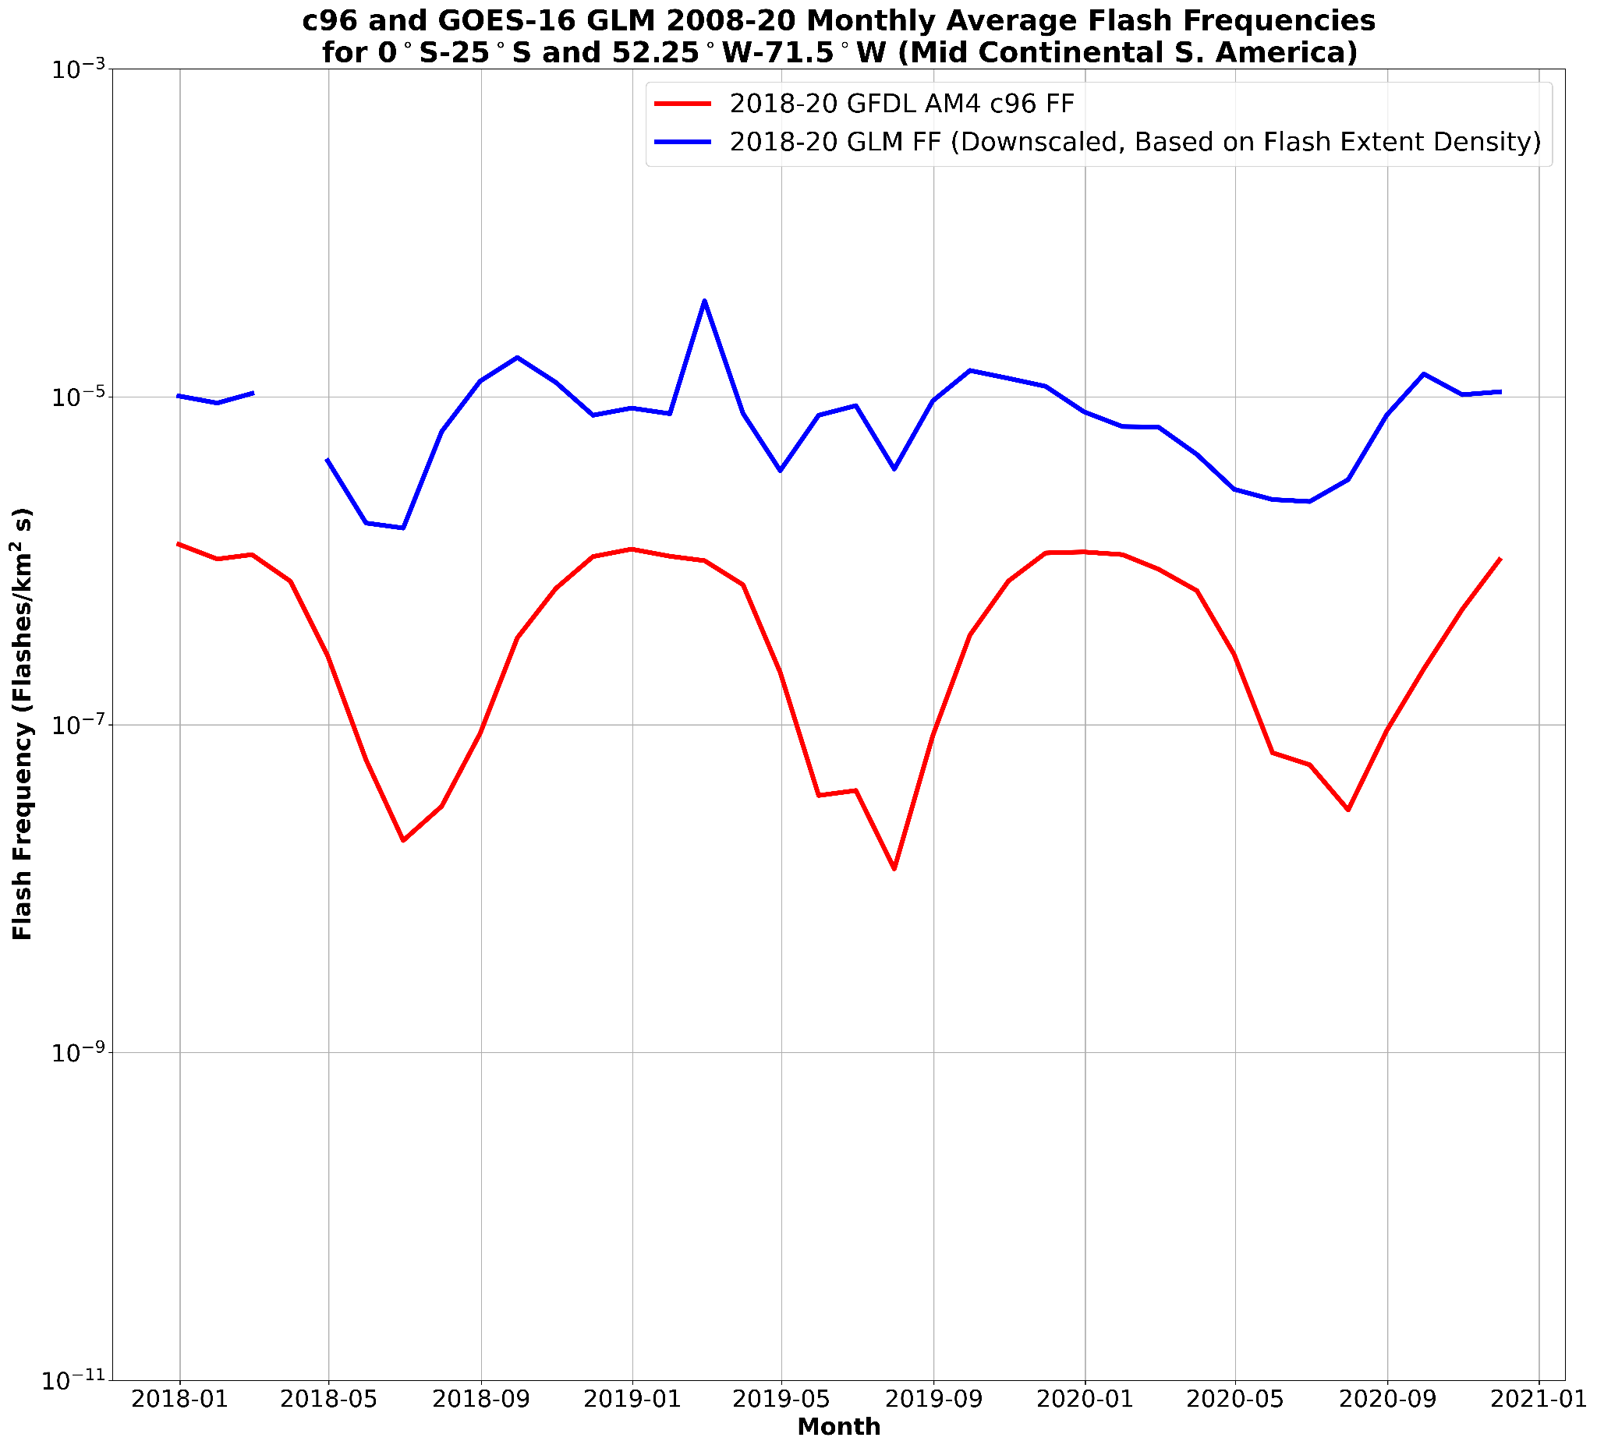
Mid-Continental South America Flash Frequency Trends
flasheskm⁻² s⁻¹
Model TRMM/LIS flash frequencies are similar: ~ 1e⁻⁶ flashes km⁻² s⁻¹
Maxima occur in the SH Spring as opposed to the summer
GLM is 1-2 orders of magnitude higher than the model output

