Slide 1
GLM Flash Trends for a Long Lived Supercell-the Megagraph
Jessica Losego¹
Charlotte Carl²
John Trostel¹
¹Georgia Tech Research Institute
Severe Storms Research Center
²Georgia Tech-Earth and Atmospheric Sciences

Slide 2
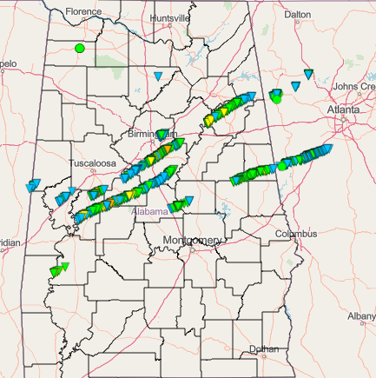
Long Lived Supercells
March 25-26, 2021
Several long-track tornadoes occurred in AL and GA
Analyzed storm that produced the Ohatchee EF-3
Studied this storm to see how jump and dive data calculated from GLM could inform warning operations.
Also analyzed GLM data from a weaker storm to study LJA sigma levels

Slide 3
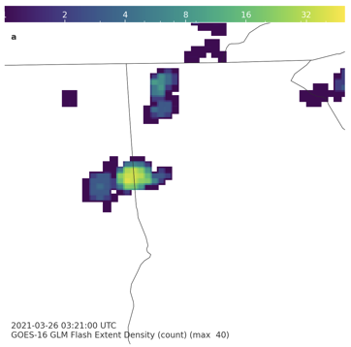
GLM Analysis
Gridding GLM data and calculating flash rate
Used Eric Bruning’s glmtools, an open-source package https://github.com/deeplycloudy/glmtools
Grid raw GLM data into lat/lon coordinates
Box drawn around center of supercell to exclude other nearby cells
Calculate flash counts in one minute chunks
Lightning Jump and Dives
Used Chris Schultz’s 2σ LJA
Sigma value greater than or equal to 2 is a jump, less than -2 is a dive
Flash Extent Density (FED) of lightning jump prior to Newnan, GA EF-4 touchdown plotted using glmtools

Slide 4
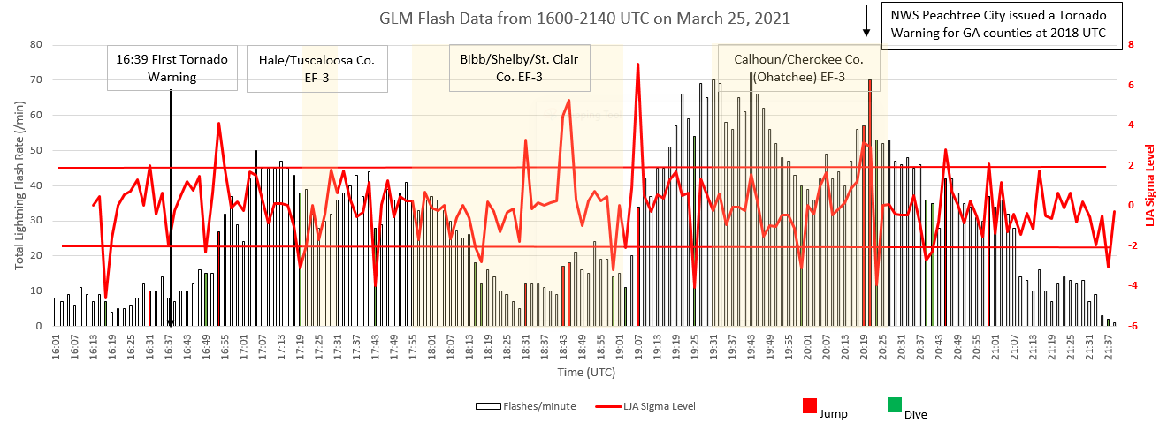
Megagraph of Flash Data
Jump
Jump
Jump
Jump
Jump
Dive
Dive
Jump
Dive
Dive
Dive
Dive
Jump
Dive
Dive
Dive

Slide 5
Discussion
Many jumps occurred
But did not always occur before a tornado
Decent jump at the end of and after the Ohatchee tornado, but did not lead to a tornado in GA
Maybe more interesting were the dives
Dives before and during tornadoes
Could the dives before the storm serve as an indicator that a tornado will form?
Due to RFD surge right before the tornado that could lead to a weaker updraft = less lightning (Williams 1999, Davis 2021, others)
Although a dive (and a jump) occurred after the Ohatchee tornado, no tornado in GA

Slide 6
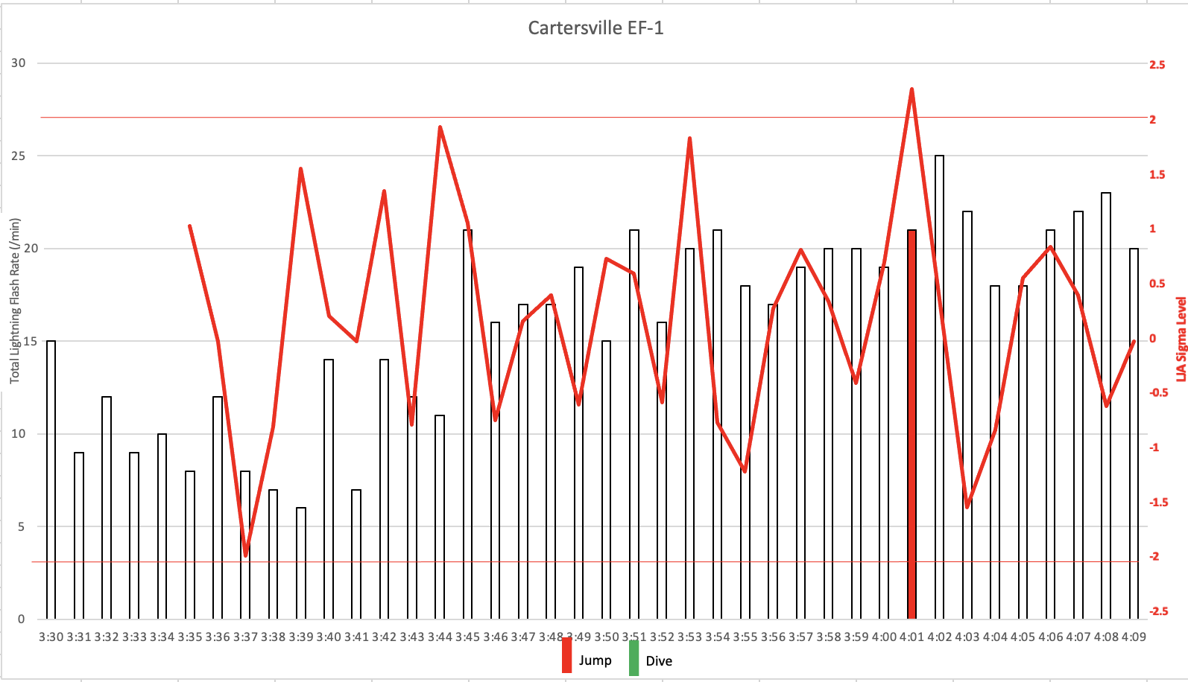
Analysis of a Weaker Storm: Cartersville, GA EF-1

Slide 7
GLM LJA Sigma Level
The LJA sigma level did not reach 2 before the tornado
We have observed with this with other weaker storms, too
Should a smaller threshold be used for the LJA, maybe 1.5σ?
We know that GLM misses flashes, especially short duration IC flashes that occur during severe storms
If the sigma level were adjusted for GLM data, would it be useful to warning operations?

Slide 8
Summary
Jumps are still a good indicator for tornadoes, but maybe dives could be useful to help increase confidence during warning operations?
Should a slightly lower threshold for the LJA Sigma Level be considered when using GLM data?
GTRI’s Severe Storms Research Center
John Trostel, john.trostel@gtri.gatech.edu
Jessica Losego, jessica.losego@gtri.gatech.edu
Dr. Levi Boggs, levi.boggs@gtri.gatech.edu

