Slide 1
Thunder-hour Observations with the GLM
Michael Stock
CIWRO, NOAA
GLM Science Meeting
Sept. 2022

Slide 2
Thunder-hours, some background
A thunder-hour is an hour in which you can hear thunder. The simple measurement turns out to be very useful for the study of synoptic, subseasonal to seasonal and climate-scale lightning behavior
Digangi et. al, BAMS 2022

Slide 3
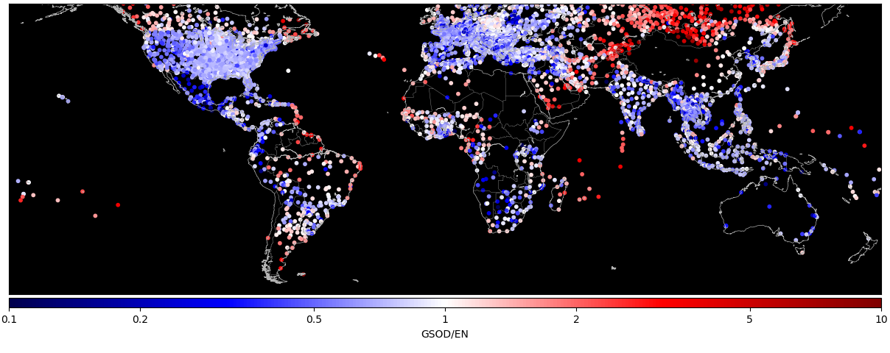
Thunder-hours, some background
Thunder-hours are are well correlated with lightning flash density, like the climatologies from LIS.
They are also correlated to ground based thunder-day observations, the longest lightning climatologies available
Stock et al, ICAE 2022

Slide 4
Thunder-hours, Merging Observations
Thunder-hours are less sensitive to exact timing, location, and network detection efficiency considerations.
It should be easy to take thunder-hour observations from different networks and sensors, and compare or combine them into a unified dataset.

Slide 5
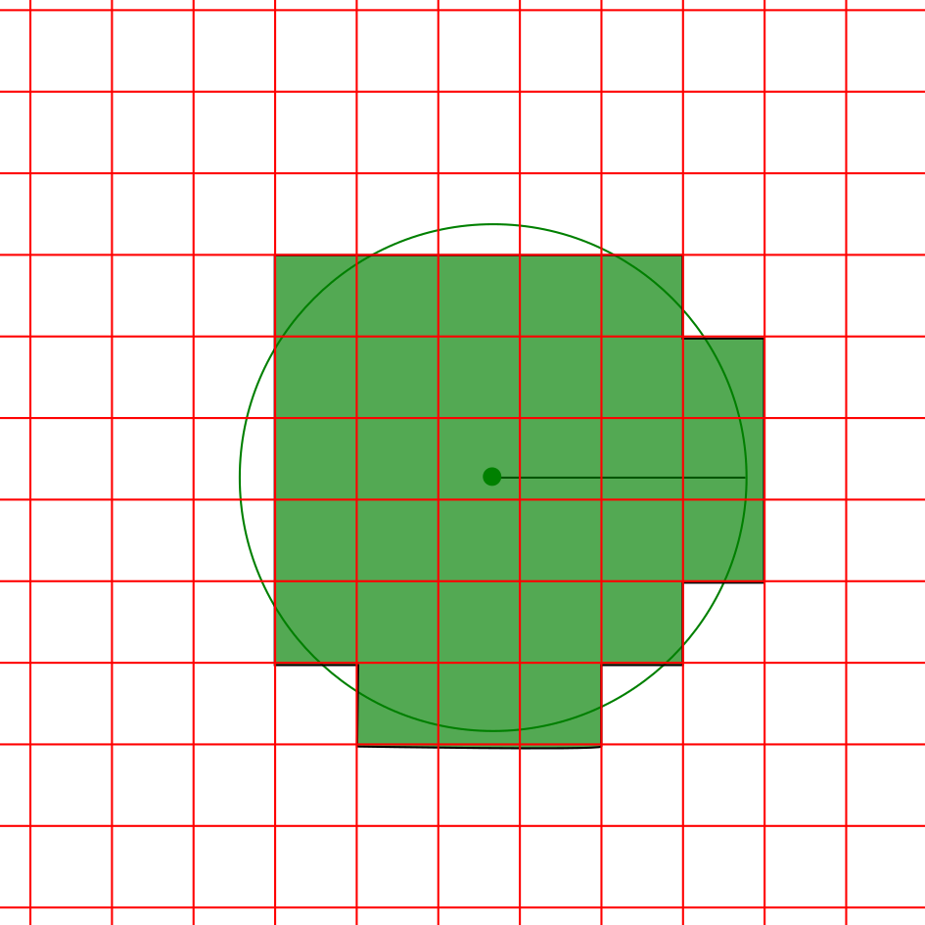
Measuring Thunder-hours with TLN
Thunder-hours are computed on a 0.05 degree grid
For each pulse, all grids whose center is < 15km from the pulse are marked True for that hour
Computation done in UTC time, and local solar time.
0.05 degrees
15 km

Slide 6
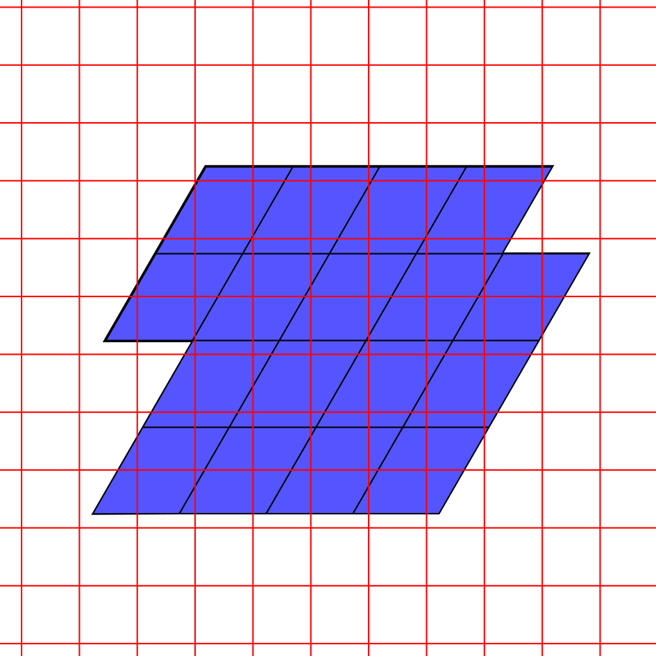
Measuring Thunder-hours with GLM Events
Thunder-hours are computed on a 0.05 degree grid
GLM events are filtered:
Quality flag = 0
Groups > 1 event
Use an 8km search radius from each event to transfer over to the 0.05 degree grid.
Computation done in UTC time, and local solar time.
0.05 degrees

Slide 7
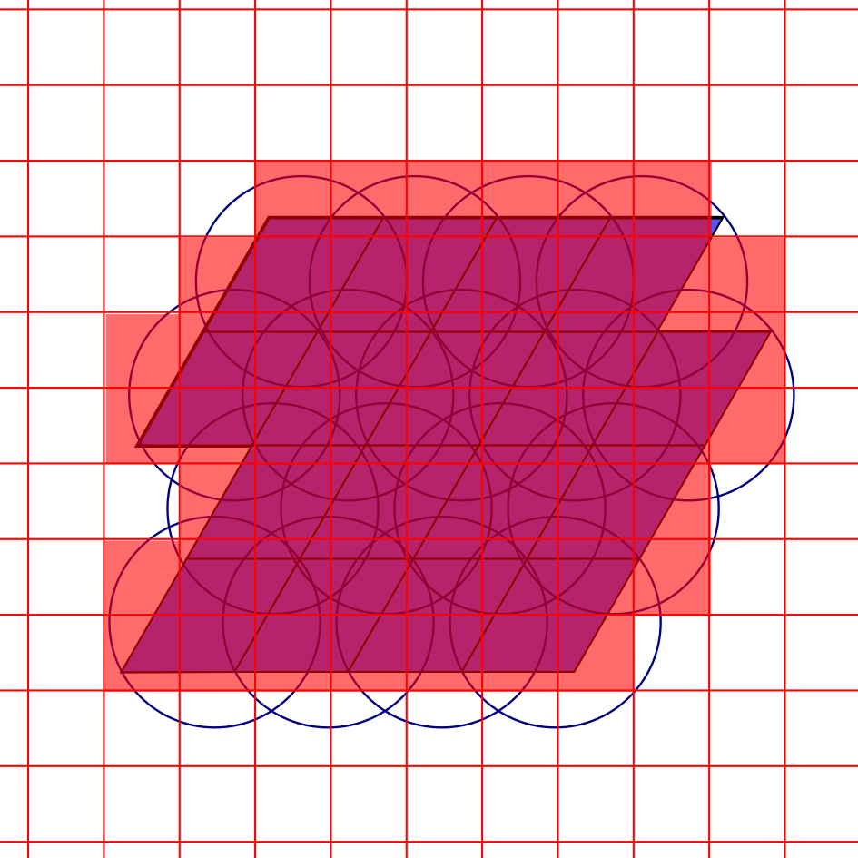
Measuring Thunder-hours with GLM Events
Thunder-hours are computed on a 0.05 degree grid
GLM events are filtered:
Quality flag = 0
Groups > 1 event
Use an 8km search radius from each event to transfer over to the 0.05 degree grid.
Computation done in UTC time, and local solar time.
0.05 degrees

Slide 8
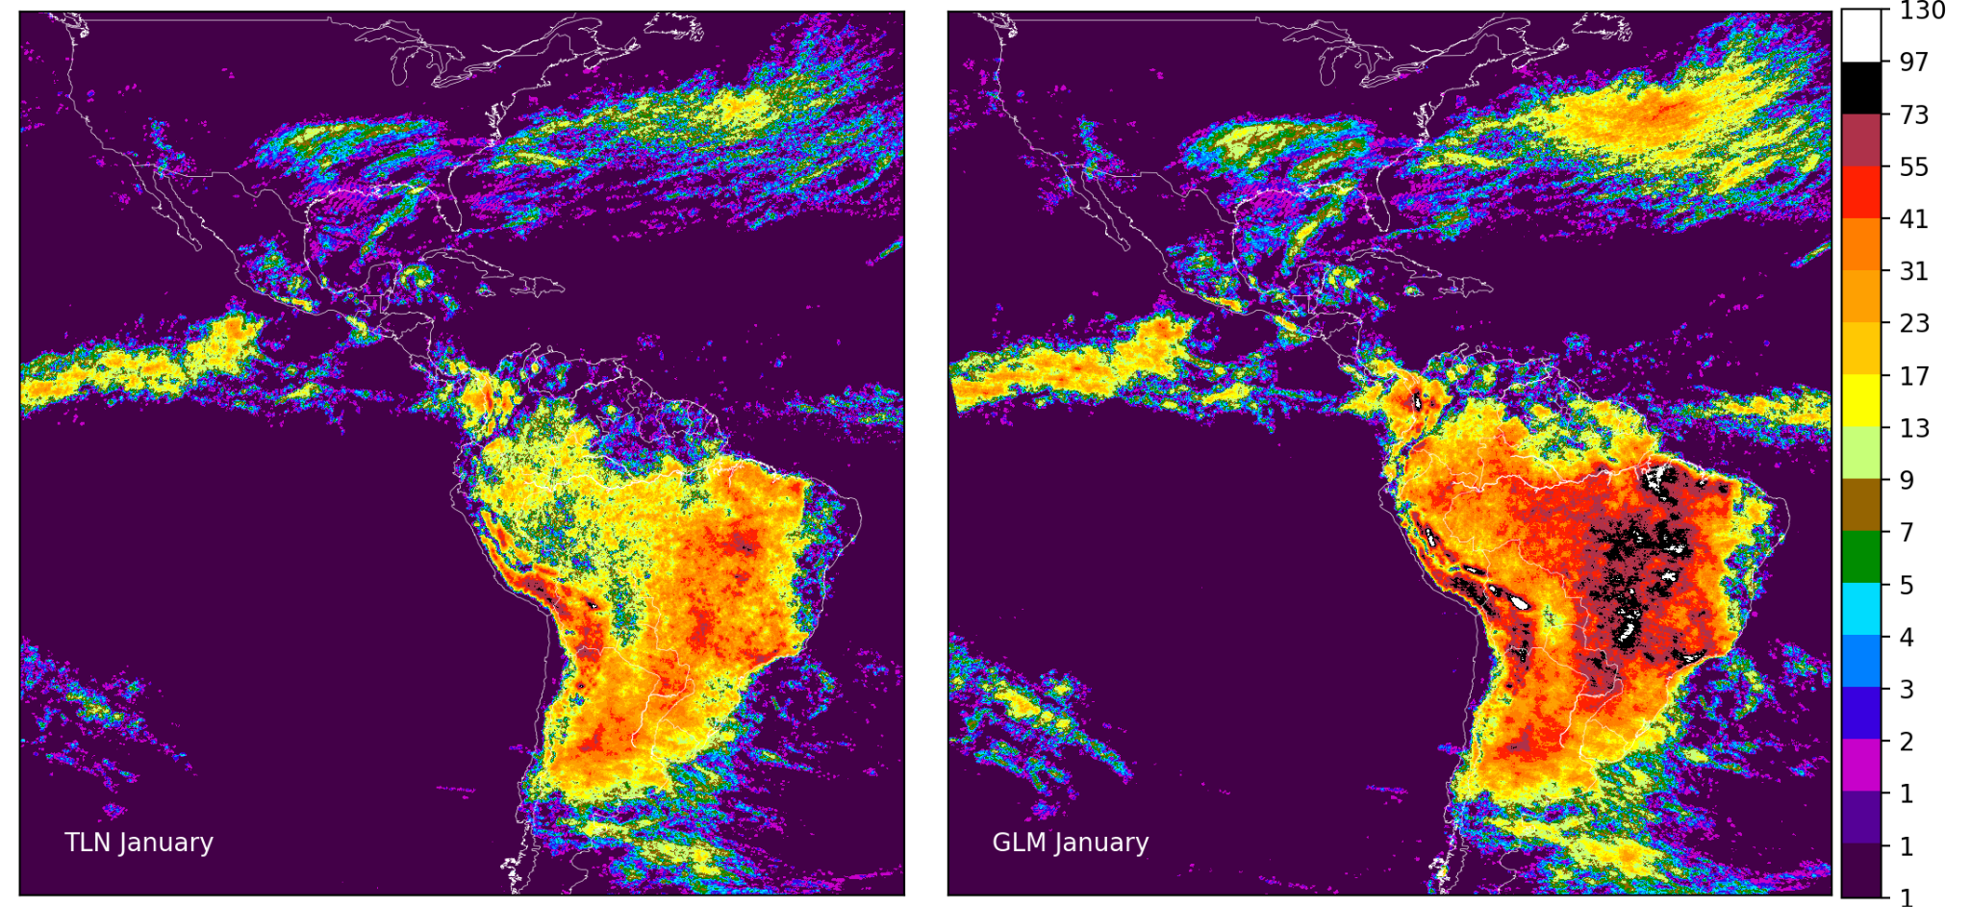
TLN Thunder-hours vs. GLM Events Thunder-hours
Thunder Radius: 15km (pulses)
Thunder Radius: 8km (events)
Hours

Slide 9
Relation between flash area, and thunder-hours
TLN Pulses
GLM Events
Total Thunder-hours is proportional to the Effective Thunder Radius

Slide 10
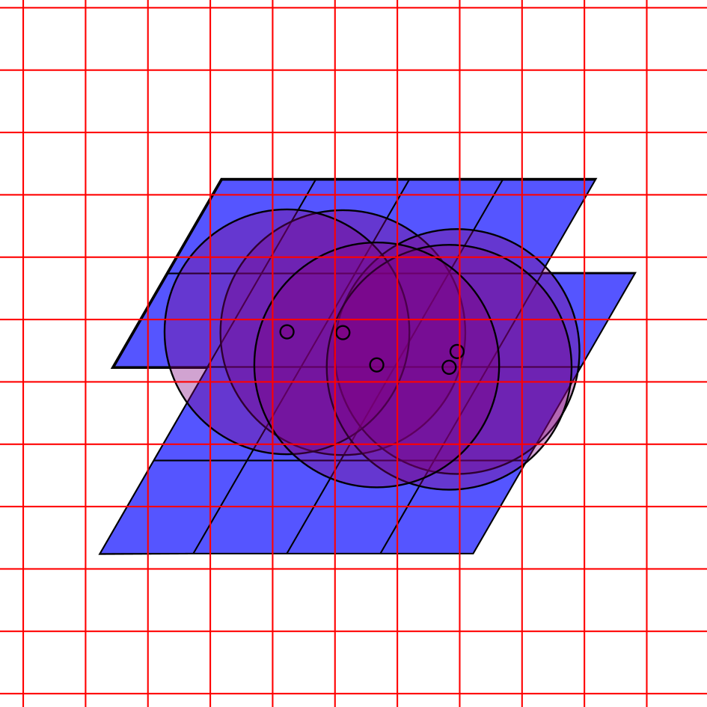
Measuring Thunder-hours with GLM Groups
Thunder-hours are computed on a 0.05 degree grid
GLM events are filtered:
Quality flag = 0
Groups > 1 event
Use an ??km search radius from each group to transfer over to the 0.05 degree grid.
Computation done in UTC time, and local solar time.
0.05 degrees

Slide 11
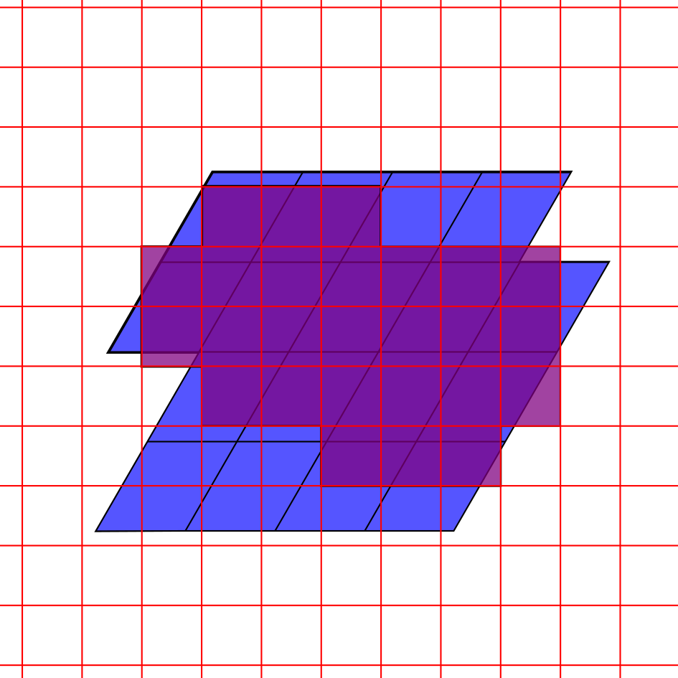
Measuring Thunder-hours with GLM Groups
Thunder-hours are computed on a 0.05 degree grid
GLM events are filtered:
Quality flag = 0
Groups > 1 event
Use an ??km search radius from each group to transfer over to the 0.05 degree grid.
Computation done in UTC time, and local solar time.
0.05 degrees

Slide 12
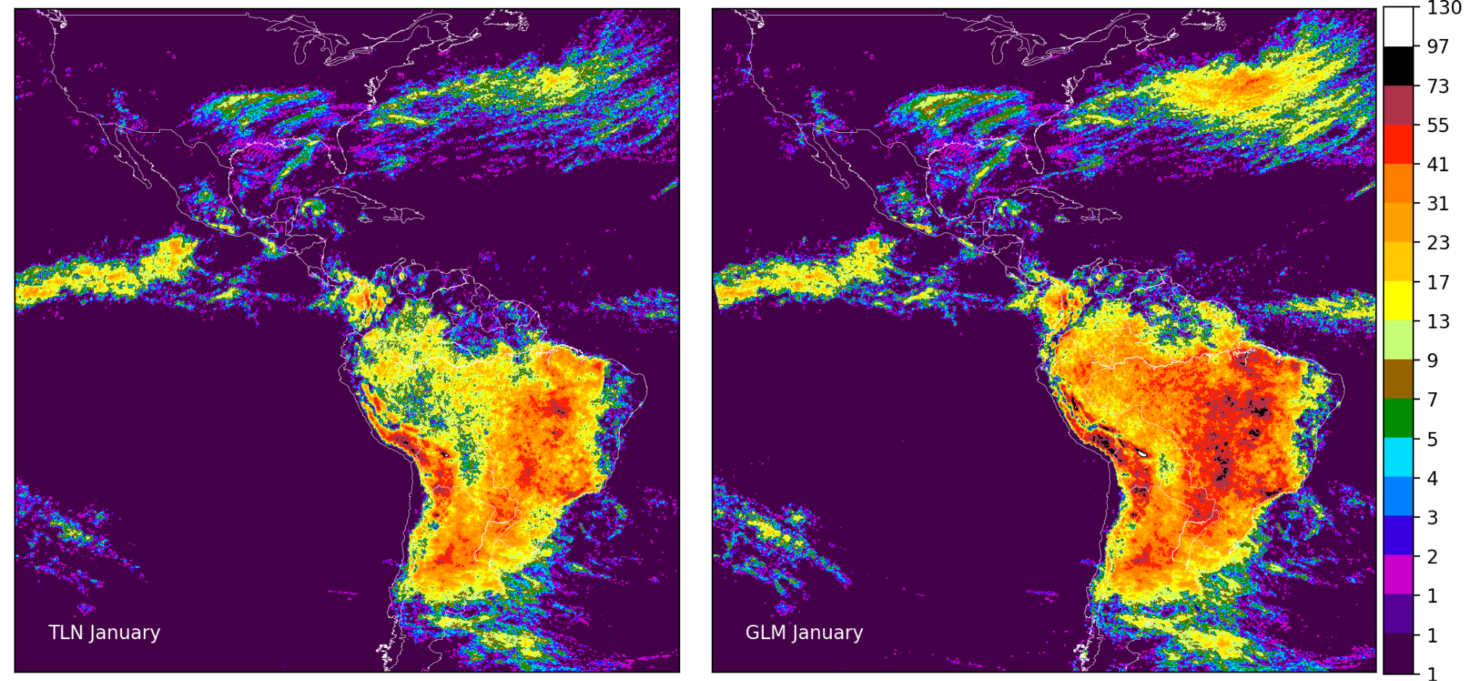
TLN Thunder-hours vs. GLM Groups Thunder-hours
Thunder Radius: 15km (pulses)
Thunder Radius: 15km (groups)

Slide 13
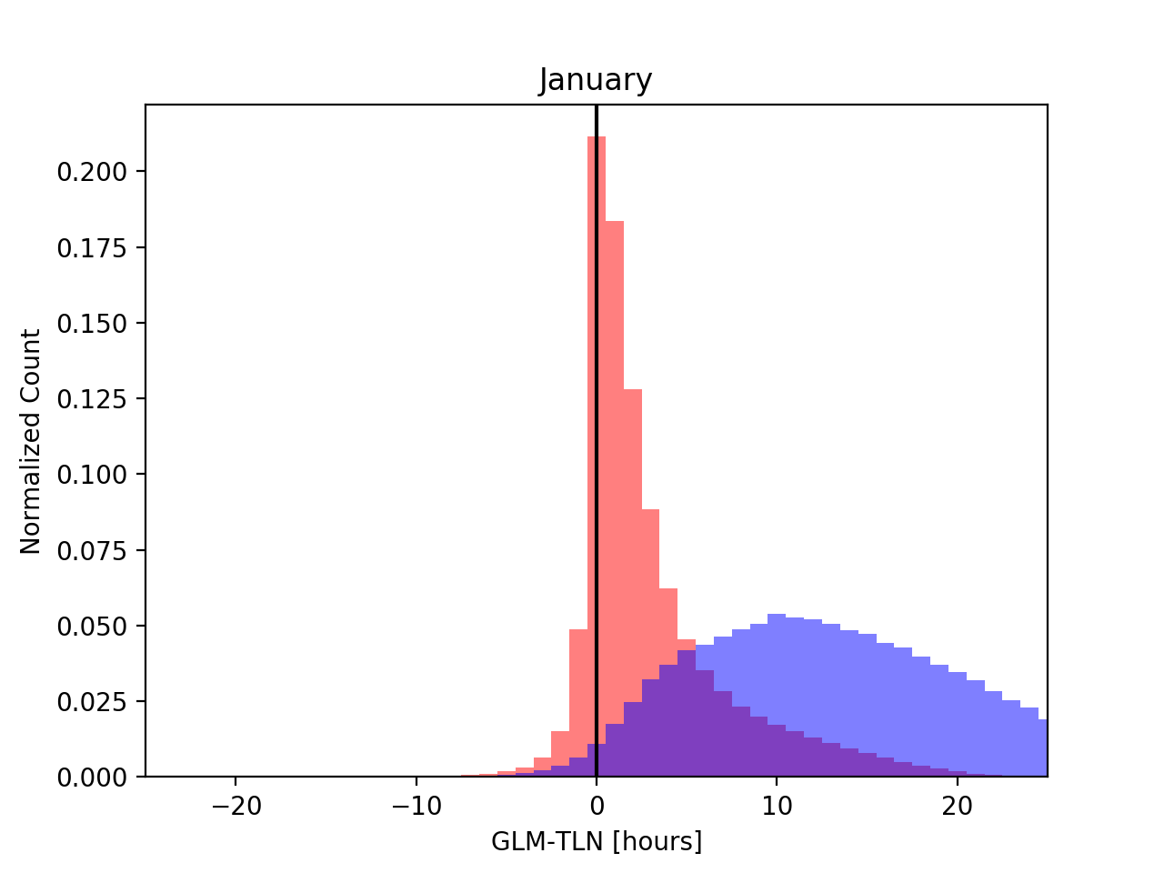
TLN Thunder-hours vs. GLM Groups Thunder-hours
Quantifying the difference between GLM and TLN can be done with a histogram of the difference in total thunder-hours (GLM - TLN hours) for the whole month.
GLM Thunder Radius: 15km
There are two populations in the histogram that behave differently
Areas with a few thunder-hours:
< 30 hours
Areas with a lot of thunder-hours:
> 30 hours
Not shown:
Finding the ‘right’ thunder radius through trial and error

Slide 14
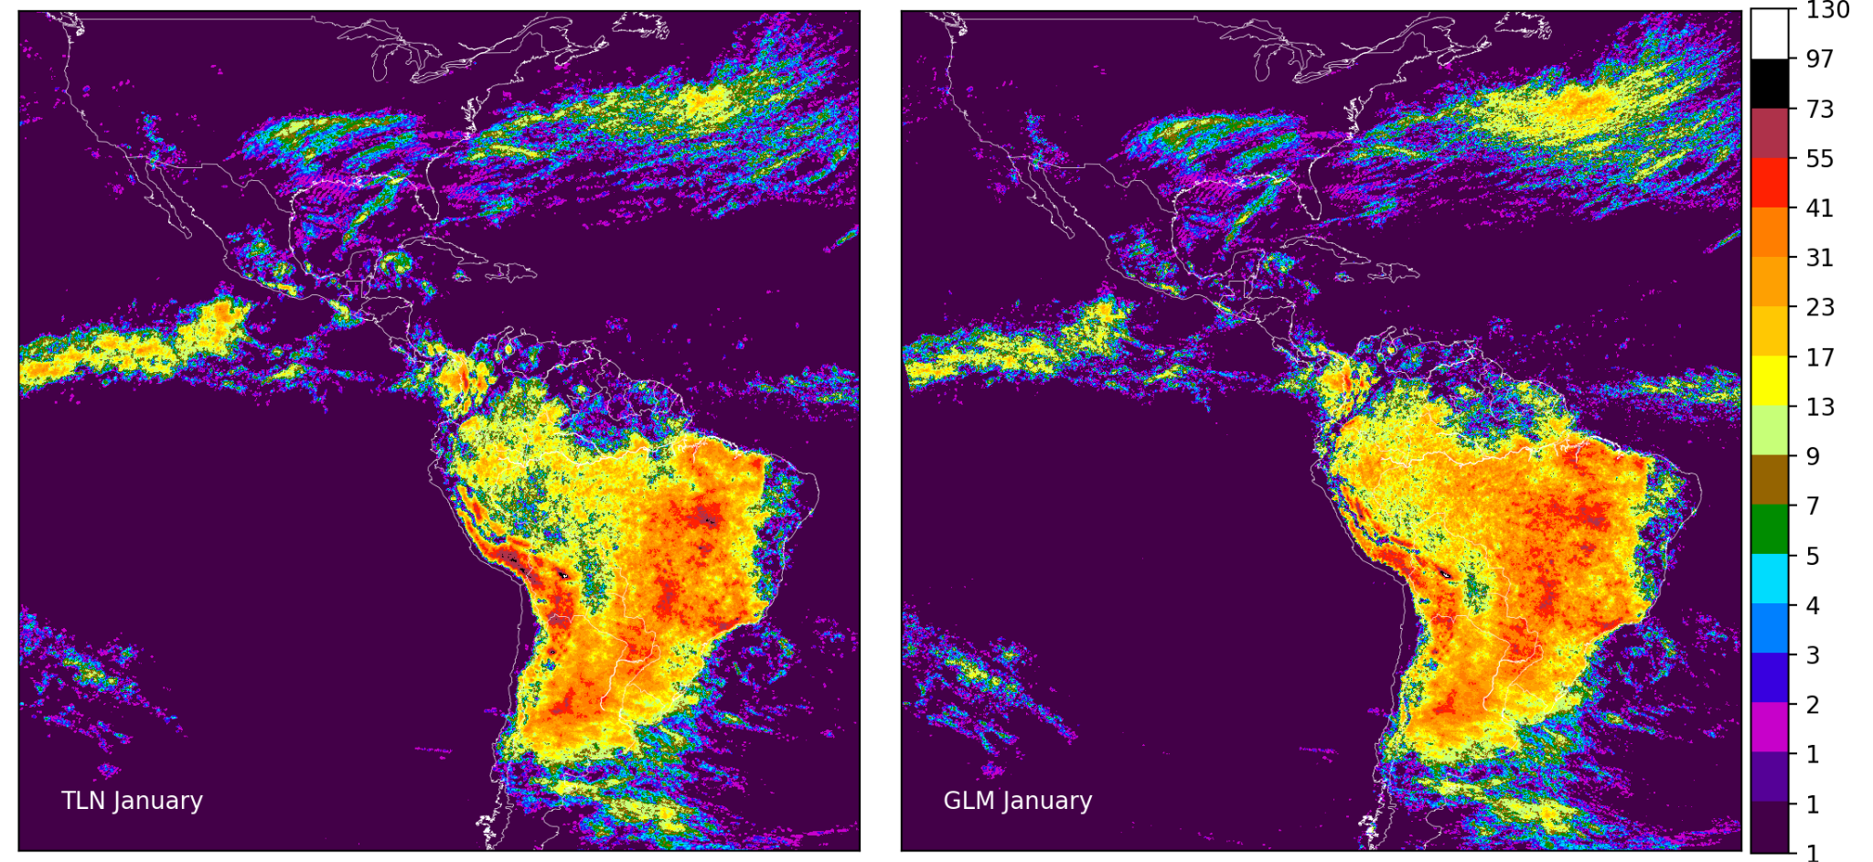
TLN Thunder-hours vs. GLM Groups Thunder-hours
Thunder Radius: 15km (pulses)
Thunder Radius: 10km (groups)

Slide 15
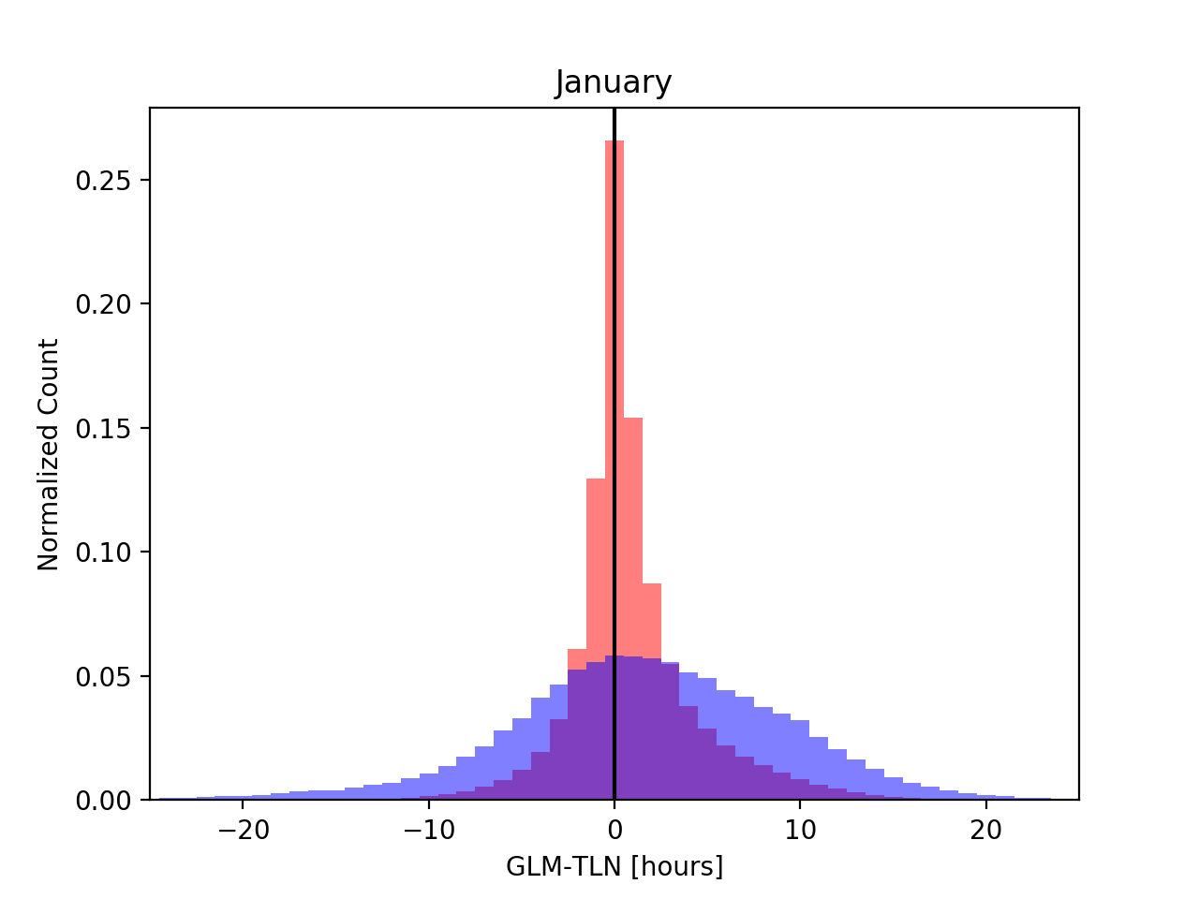
TLN Thunder-hours vs. GLM Groups Thunder-hours
GLM Thunder Radius: 10km
Using a 10km search radius for GLM groups gives much better agreement between TLN and GLM
At least for January

Slide 16
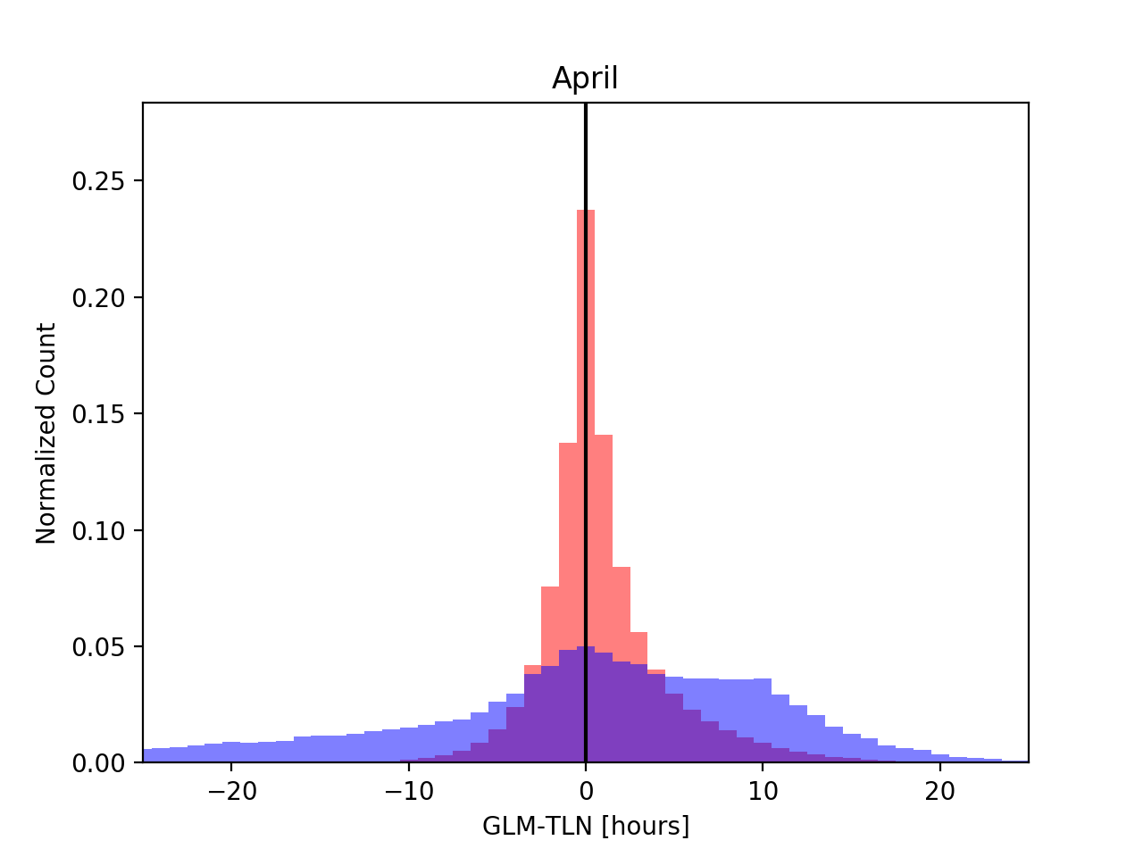
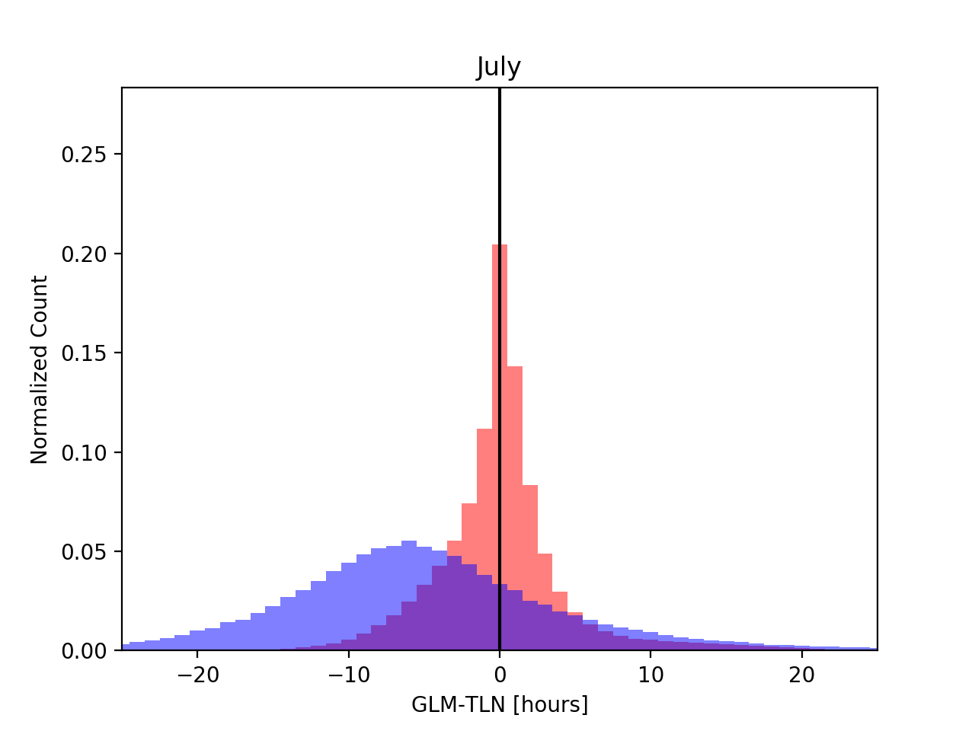
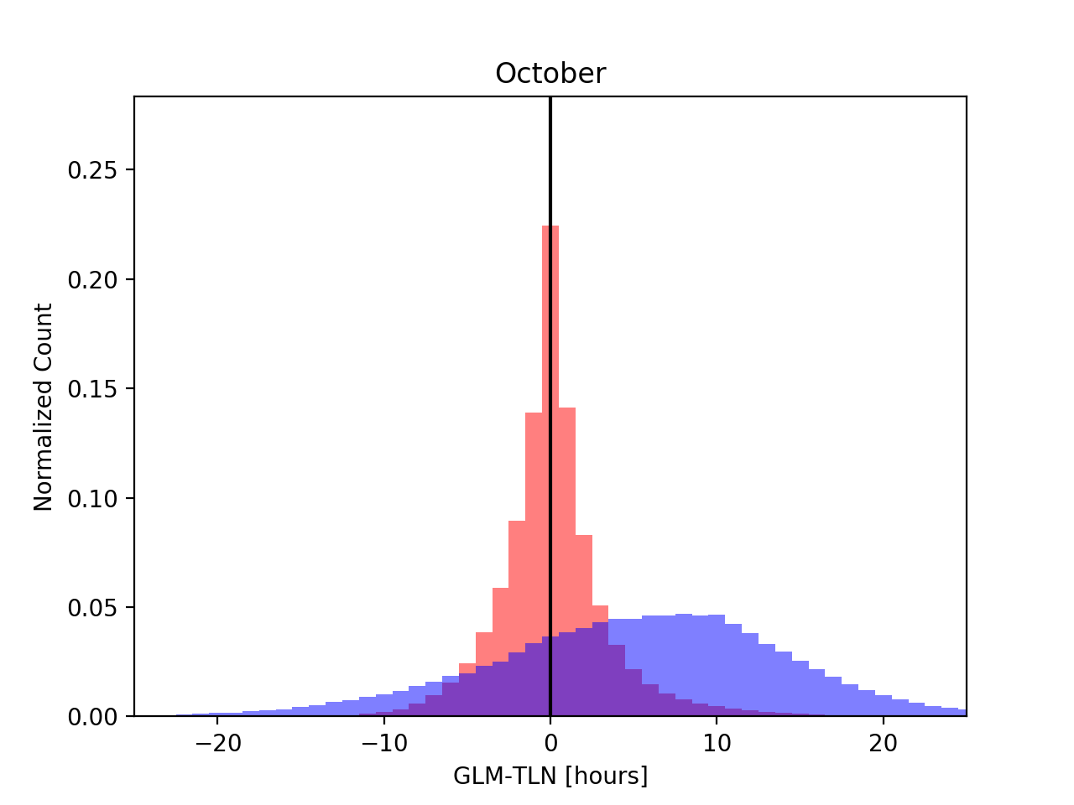
TLN Thunder-hours vs. GLM Groups Thunder-hours

Slide 17
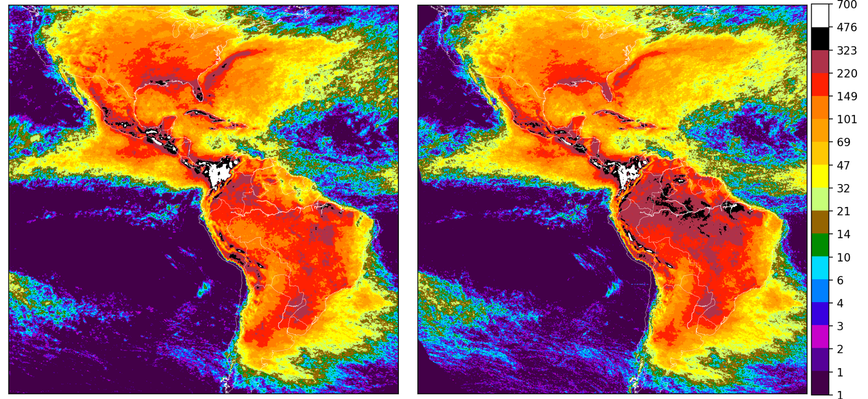
TLN Thunder-hours vs. GLM Groups Thunder-hours
For the whole year!
Thunder Radius: 15km (pulses)
Thunder Radius: 10km (groups)
TLN 2021
GLM 2021

Slide 18
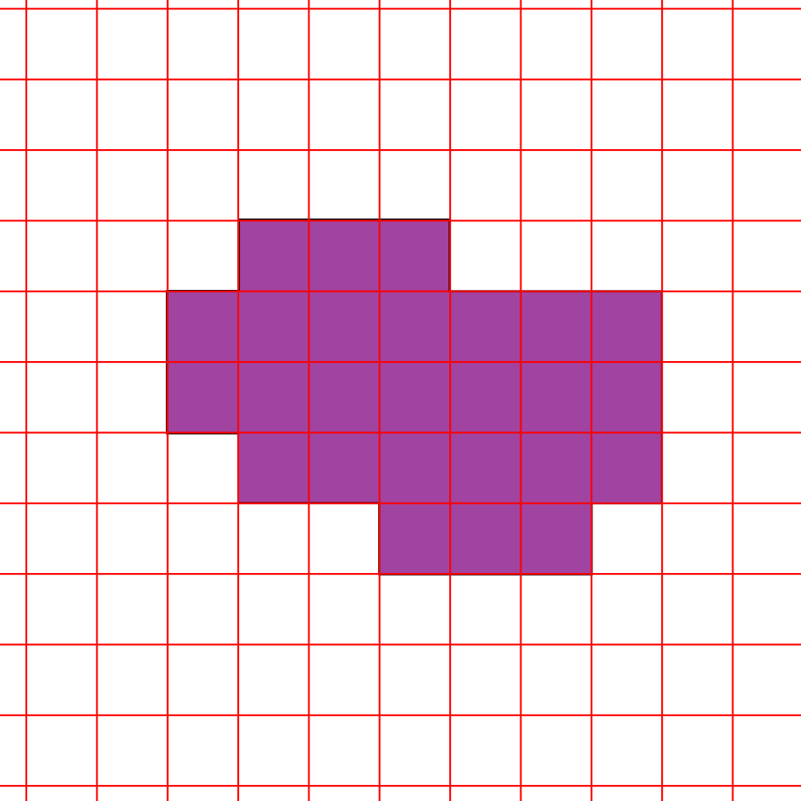
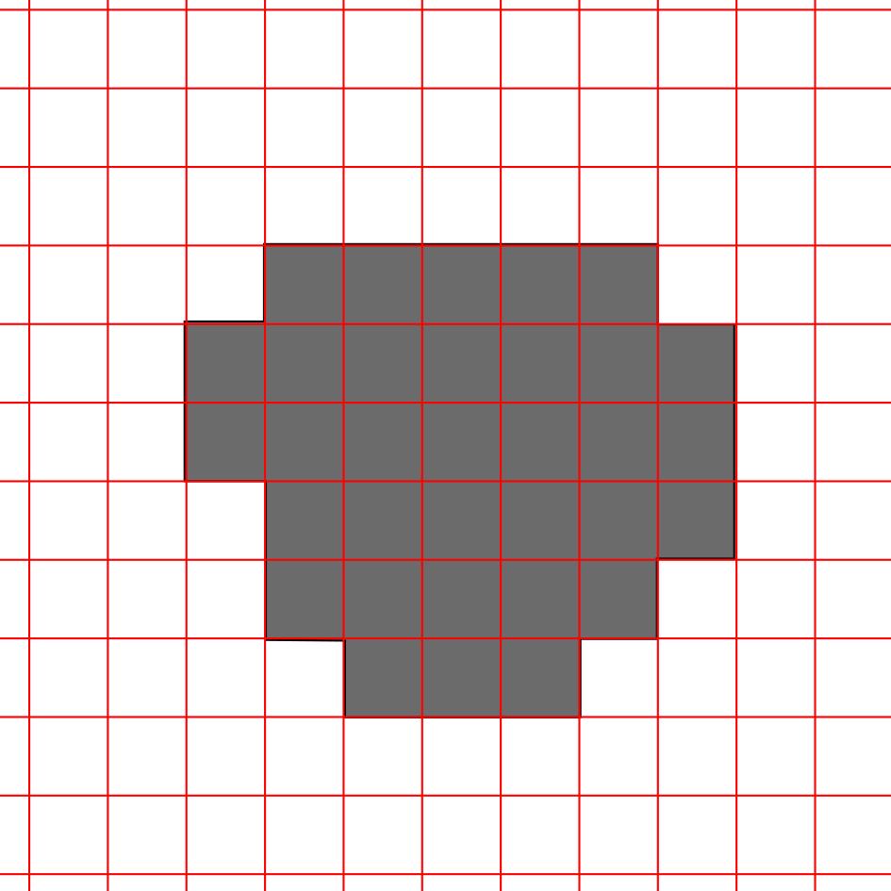
Merging TLN and GLM thunder-hours
It turns out this is pretty easy
Done with a logical or on a per-hour basis
TLN
GLM
Merged

Slide 19
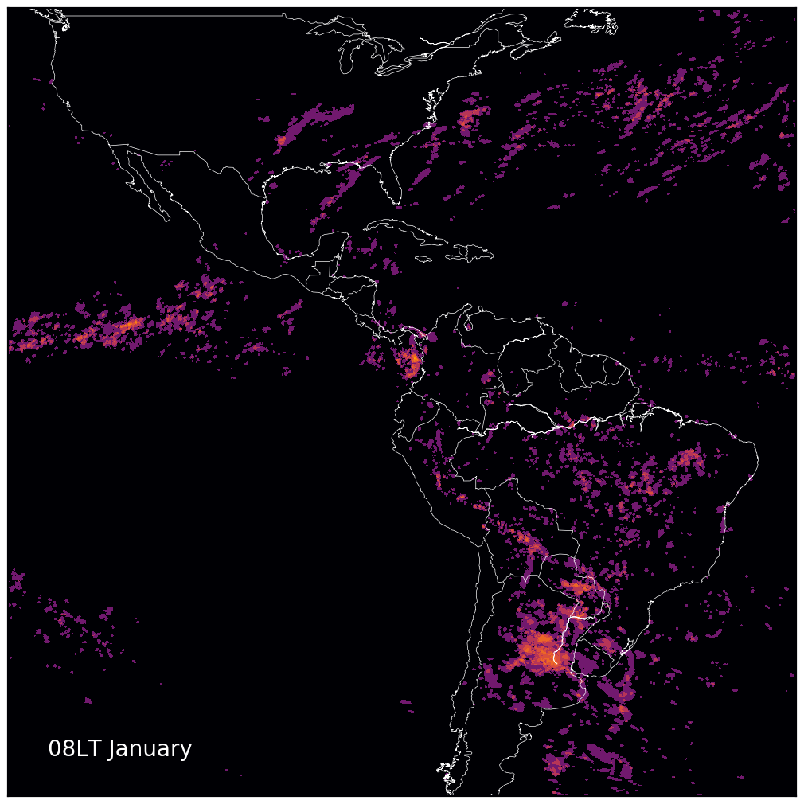
Merging TLN and GLM thunder-hours

Slide 20
In Conclusion
Can the thunder-hour analysis technique be applied to GLM: YES
Do the results match what Earth Networks showed: YES
Can the different networks be merged together: YES, easily
Next Steps:
Better calibration?
GLM 17 can be merged in as well
Relate all of this back to the Global Surface Summary of Day observations, which could be harder
Science

