Slide 1
MICROPHYSICAL AND KINEMATIC SIGNALS IN LIGHTNING TRACKED THUNDERSTORMS
DR. KELCY BRUNNER¹
DR. ERIC BRUNING¹
DR. VANNA CHMIELEWSKI²
DR. VICENTE SALINAS^{2,3}
DR. JACKIE RINGHAUSEN^{2,3}
This work is supported by:
NOAA VORTEX- SE program NA19OAR4590210
Texas Tech University, The National Wind Institute
NOAA OAR National Severe Storms Laboratory, Norman, OK
CIWRO, Norma, OK
Notes:
Where Zdr is sensitive to scatterer shape, and Kdp is sensitive to scatterer concentration, the presence of large positive values above the freezing level is indicative of updraft location and intensity. Elevated volumes of ice, graupel, and supercooled liquid water are necessary for lightning charging
The highly positive Z_{DR} and K_{DP} columns indicative of the updraft location and intensity
The presence of elevated Zdr is indicative of large lofted scatterers, whereas elevated positive Kdp, sensitive to scaterrer concentration,
An example of this is shown in Figure 1 where an increase in flash rate, specifically small flashes

Slide 2
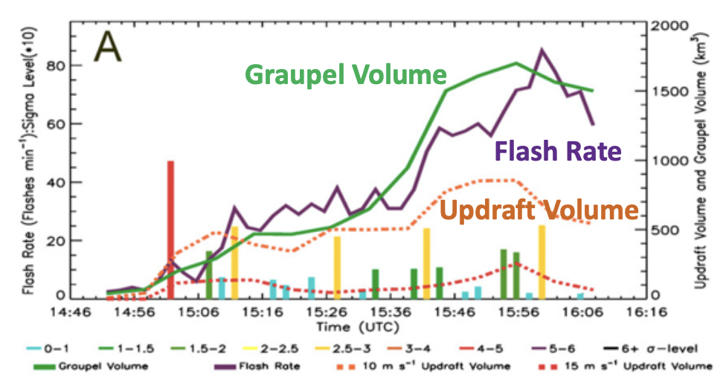
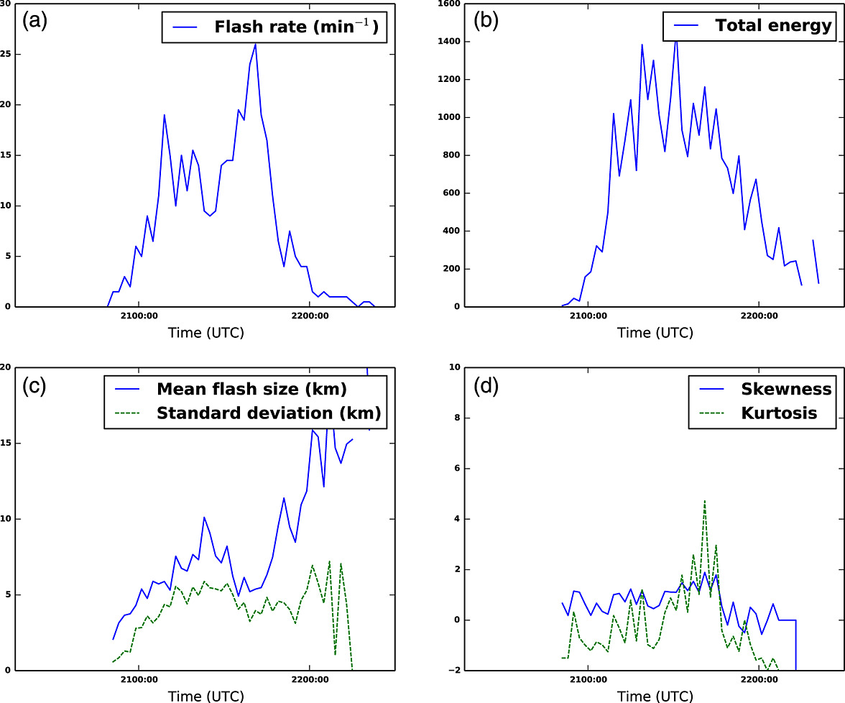
LIGHTNING SIGNALS IN DEEP CONVECTION
Schultz et al, 2015
How can we use lightning as an indicator of deep convection, and what tools do we have to represent relationships with lightning?
Lightning frequency increases with:
Updraft speed, volume (Schultz, 2015,
Graupel mass, volume
Lightning flash size varies with:
Flash rate
Location relative to updraft and region in the thunderstorm
Bruning and Thomas, 2015
Schultz et al., 2015
Notes:
FIG. 3. (a) Updraft volume, graupel volume, and flash rate vs time for an ordinary thunder- storm on 11 Jun 2012 in south-central Tennessee. (b) Graupel mass and flash rate vs time for the same ordinary thunderstorm. (c) Time trend of max updraft speed, 98th percentile updraft speed, and total flash rate. Colored bars in legend refer to sigma-level magnitude multiplied by 10, but results were not calculated because the total flash rate never exceeded 10 flashes min21.

Slide 3
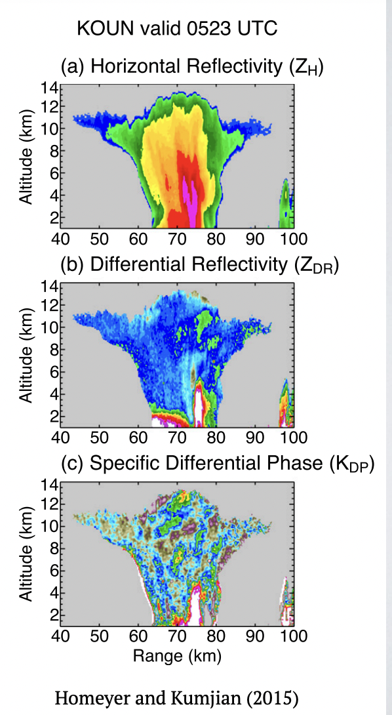
RADAR MICROPHYSICAL OBSERVABLES
How can we identify both deep convection and the microphysics to support more charging and a higher flash rate?
Columns of Kdp and Zdr above the melting level
Strong correlations of KDP volume above the melting level with updraft mass flux, lightning flash activity in identifying deep convection (van Lier-Walqui et al., 2016)
Zdr volume similarly correlated with Kdp columns for deep and moderate convection.
Zdr can suffer from artifacts in deep convection, both Kdp and Zdr are recommended in tandem
Notes:
Typically, ZDR columns show up first (recirculated drops in nascent updraft)
KDP columns show up next indicating substantial rain or liquid-coated hail mass
Lightning peaks then shortly thereafter (mixed-phase microphysics of mature updraft)

Slide 4
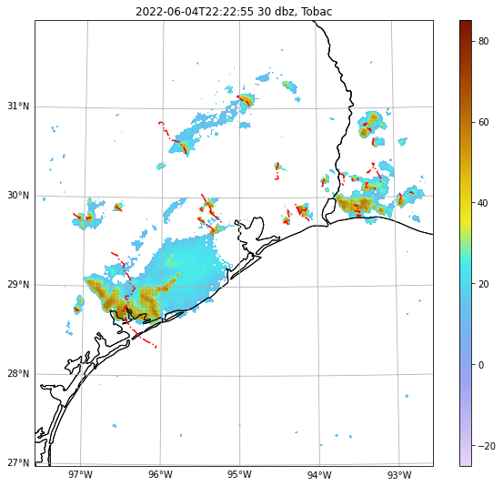
TOBAC - TRACKING AND OBJECT-BASED ANALYSIS OF CLOUDS
Tobac finds Features,
Features are a single reflectivity feature at a single timestep.
Features are transferred to a 2D mask using watershed techniques, shaded in grey on the right.
Features are joined into Cells,
Cells are tracked Features across timesteps, shown on the right in red.
Cells are joined into Tracks,
Tracks are cells which have merged or split (this is an on going tobac development)
Notes:
Tobac is an object tracking tool we can use to analyze storm lifecycles from a variety of perspectives. In this short talk I’m going to give an overview about what this looks like from a
Radar first perspective and then by a lightning forward perspective.
Why does this matter though?

Slide 5
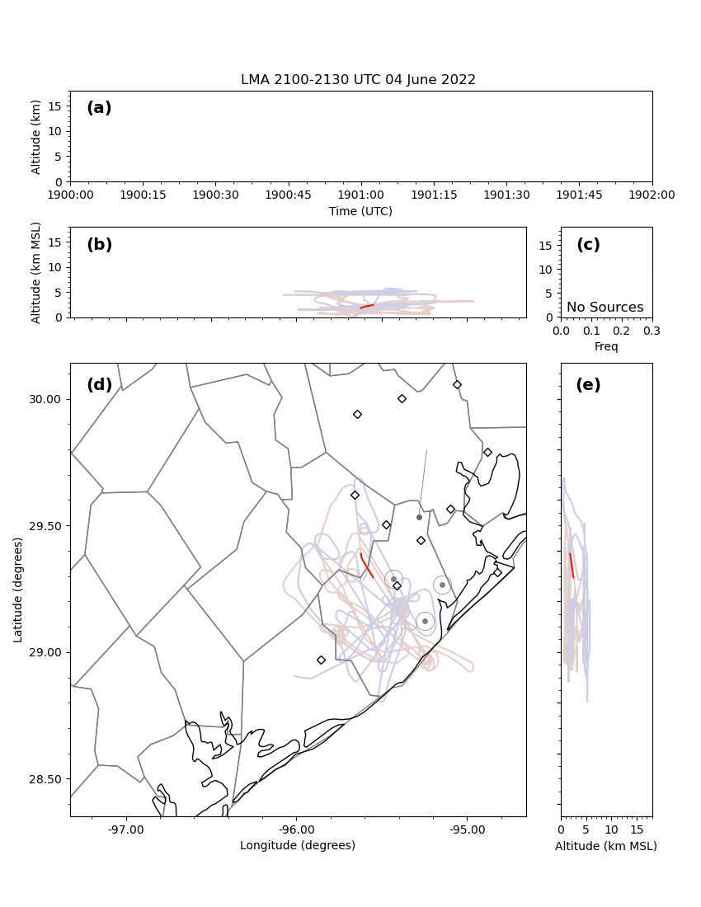
TOBAC - TRACKING AND OBJECT-BASED ANALYSIS OF CLOUDS
Notes:
Tobac is an object tracking tool we can use to analyze storm lifecycles from a variety of perspectives. In this short talk I’m going to give an overview about what this looks like from a
Radar first perspective and then by a lightning forward perspective.
Why does this matter though?

Slide 6
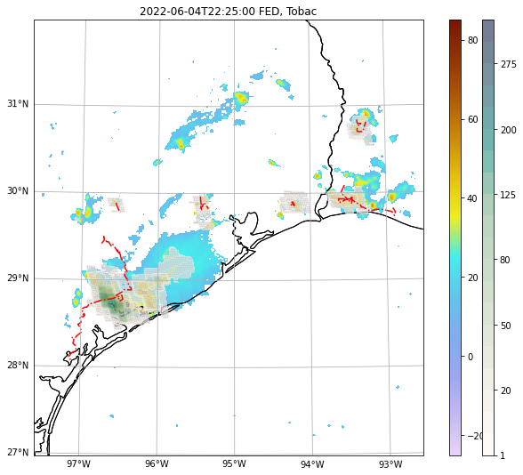
TOBAC - TRACKING AND OBJECT-BASED ANALYSIS OF CLOUDS
GLM FED = 1
KHGX DBZ = 30
Notes:
Tobac is an object tracking tool we can use to analyze storm lifecycles from a variety of perspectives. In this short talk I’m going to give an overview about what this looks like from a
Radar first perspective and then by a lightning forward perspective.
Why does this matter though?

Slide 7
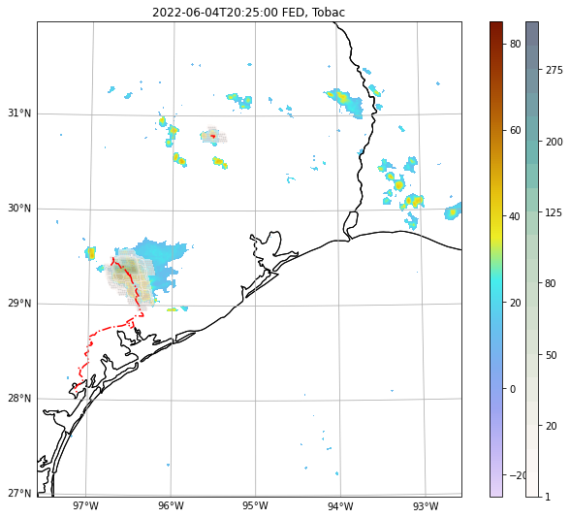
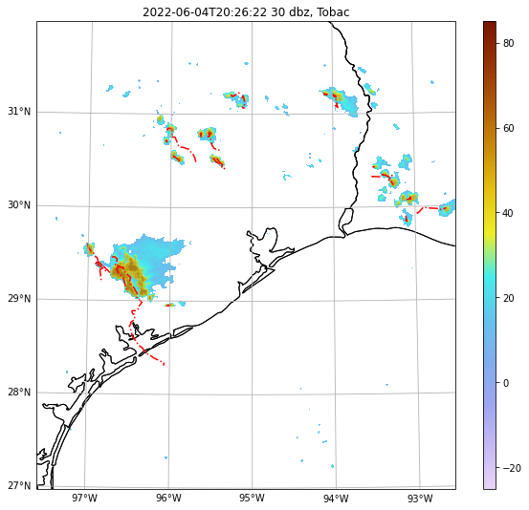
TOBAC - TRACKING AND OBJECT-BASED ANALYSIS OF CLOUDS
GLM FED = 1
KHGX DBZ = 30
Notes:
Tobac is an object tracking tool we can use to analyze storm lifecycles from a variety of perspectives. In this short talk I’m going to give an overview about what this looks like from a
Radar first perspective and then by a lightning forward perspective.
Why does this matter though?

Slide 8
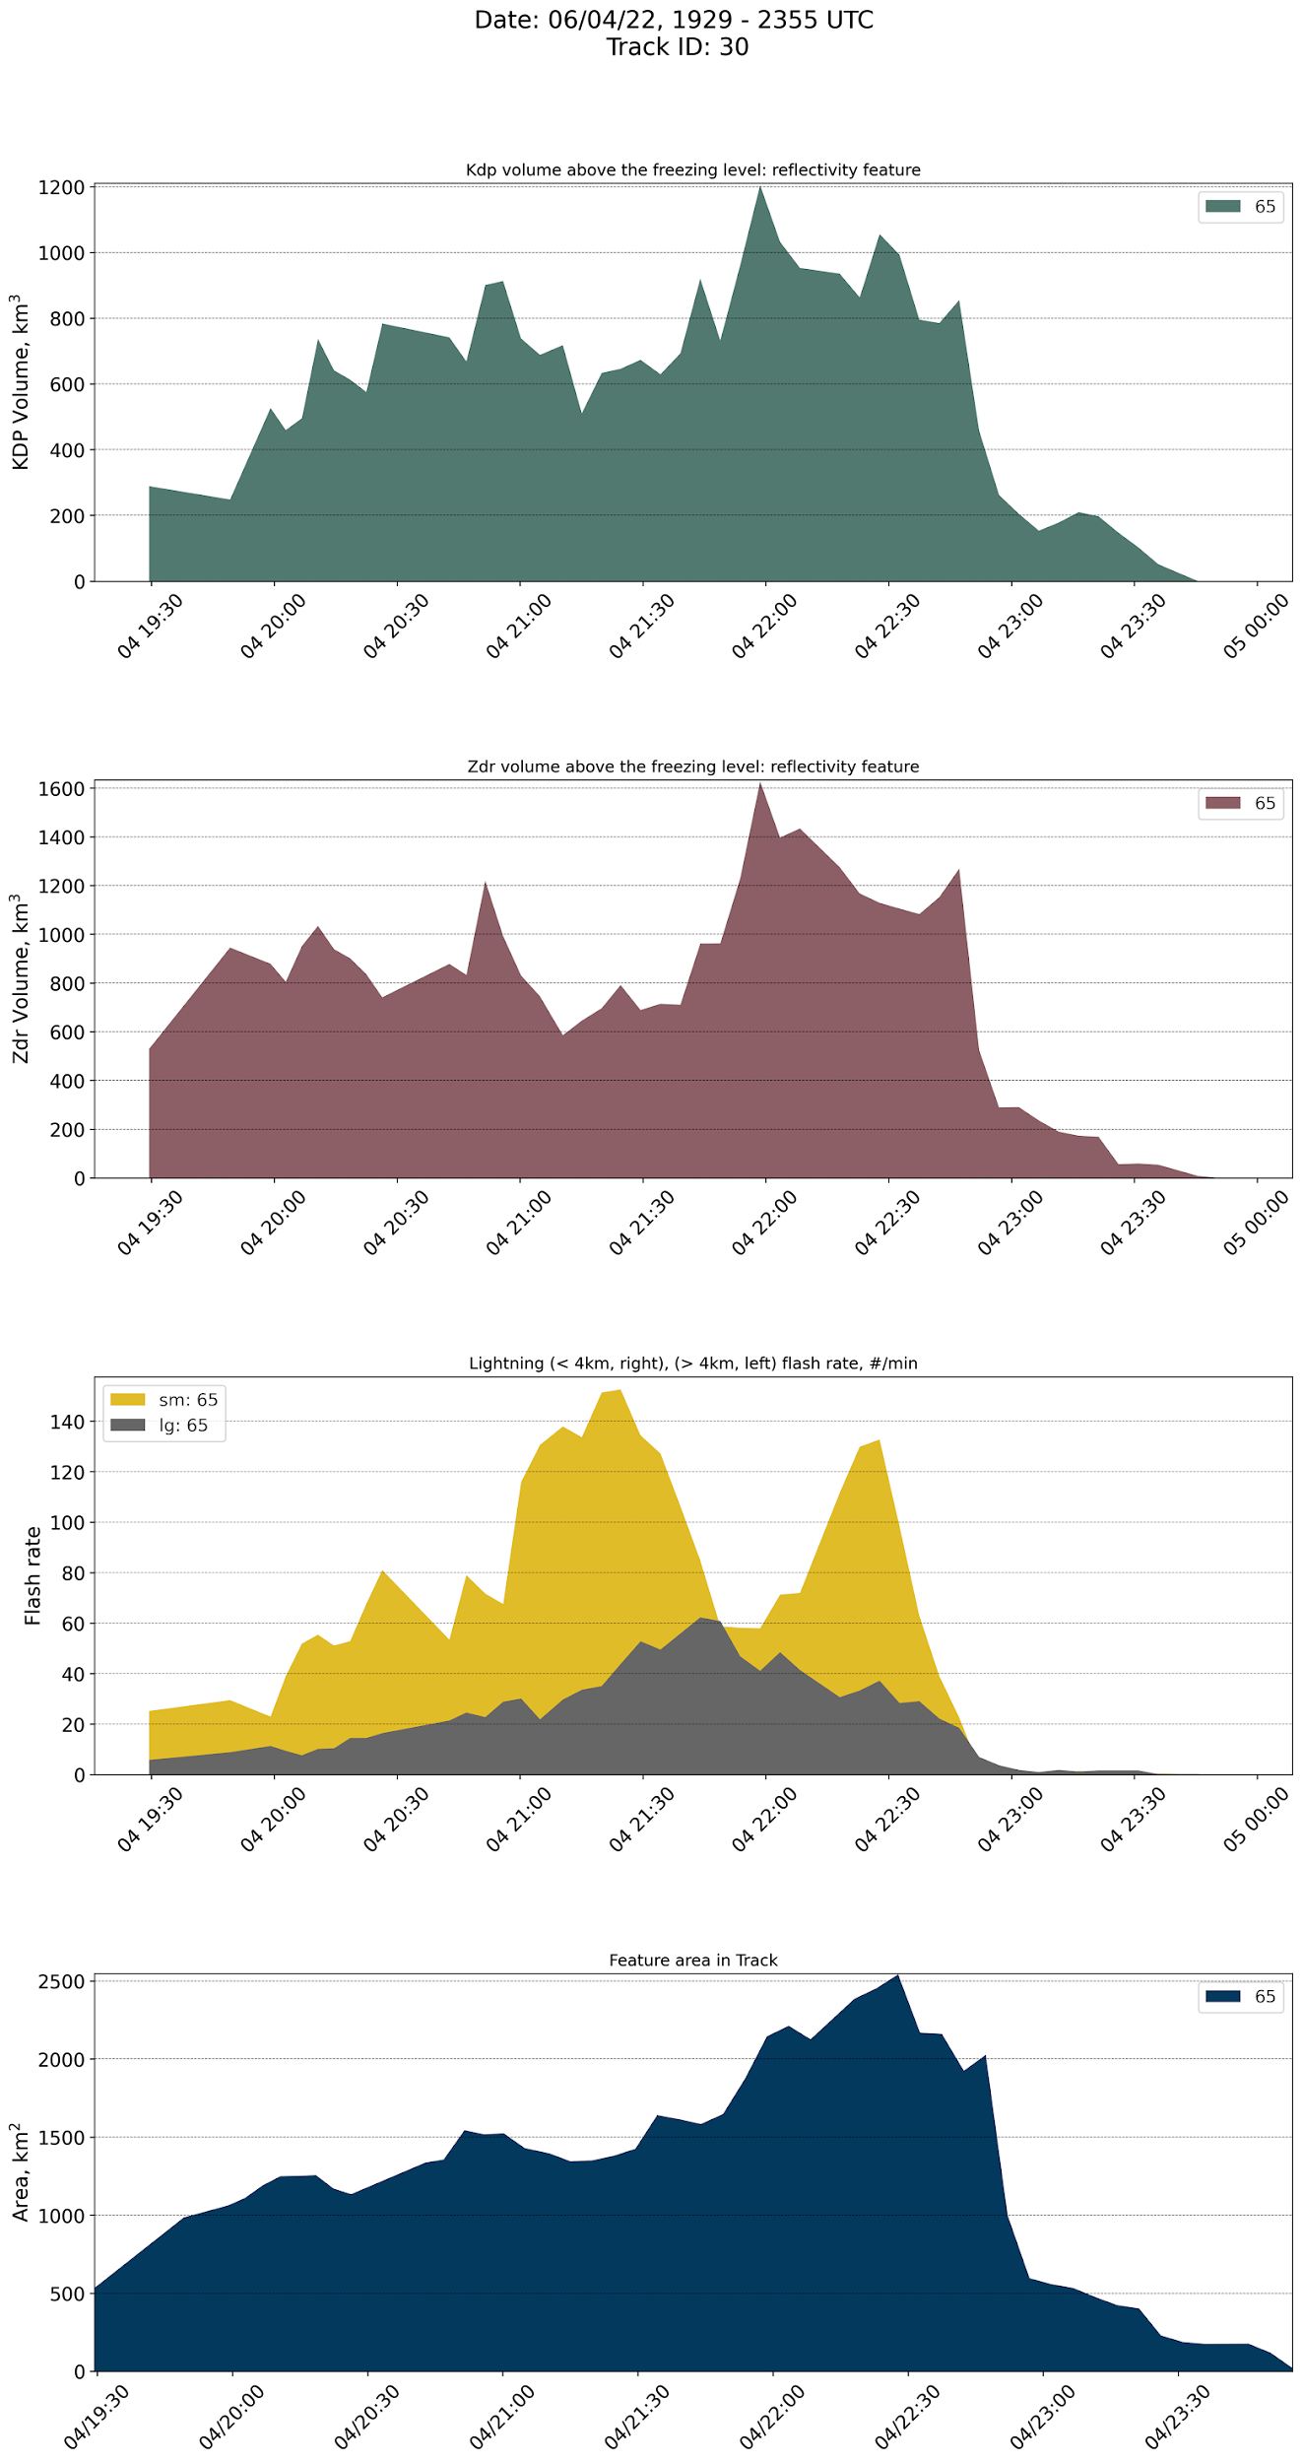
ANALYSIS TECHNIQUES
Within each feature:
Lightning flash count and area, separated by >/< 4km
Kdp column: values > 0.75 above the melting level
Kdp/Zdr volume: greater than threshold in 3km column above the melting level. Threshold of 0.75deg/km (Kdp), 1.0dB (Zdr)
For each Track:
Time series of Kdp/Zdr volume, flash rate, and cell area are evaluated
Sorted by column/lightning association and pattern (shown on right)
Notes:
Explain pattern in the graph on the right

Slide 9
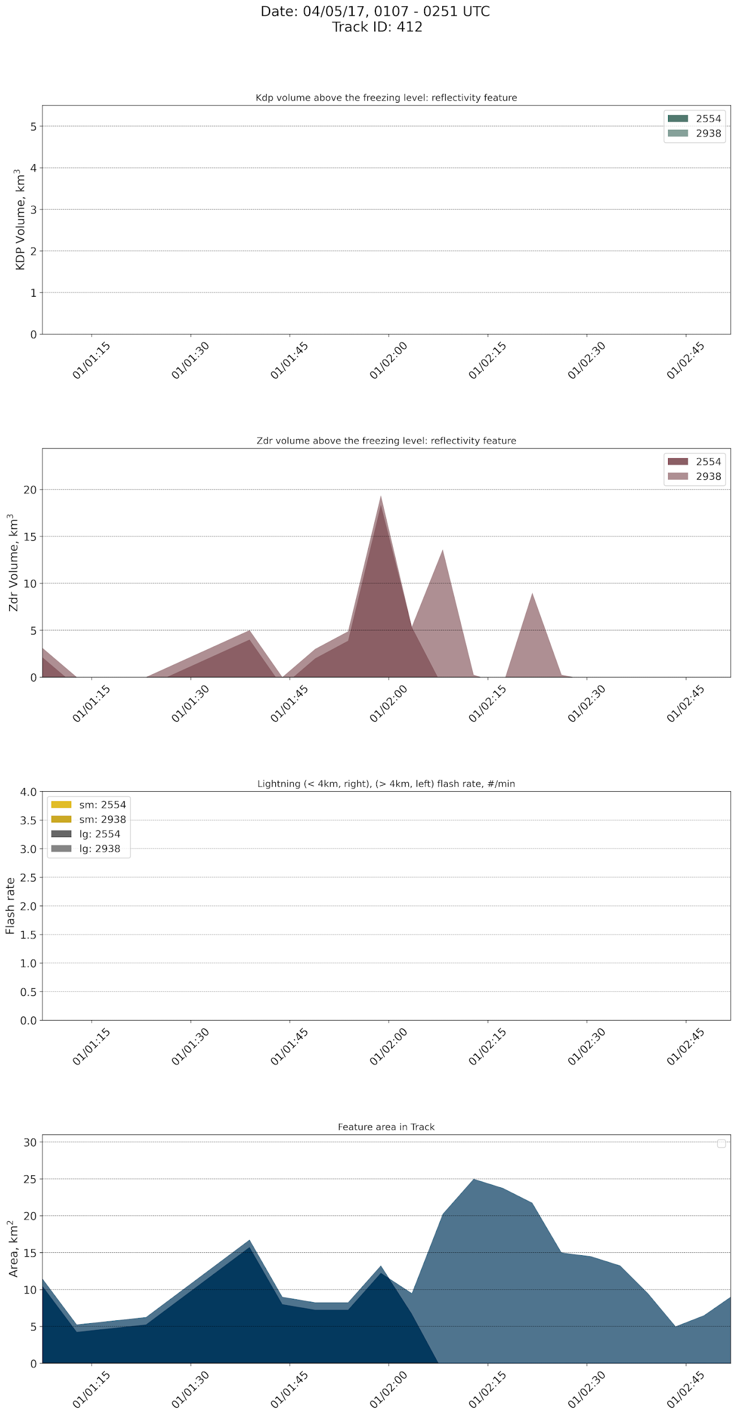
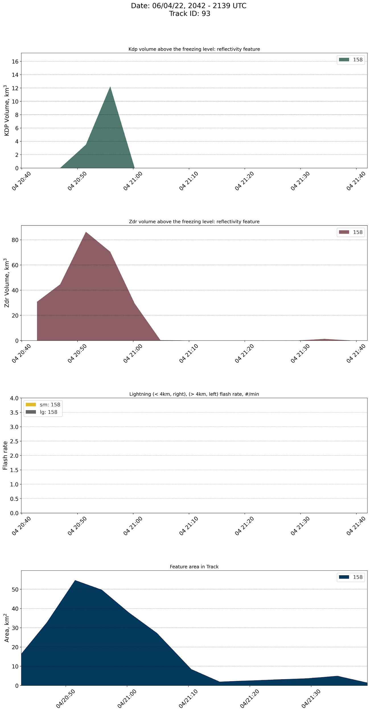
ANALYSIS: PATTERNS WITH TRACKS
Lightning signal + Peak in Kdp/Zdr volume
Ideal signal pattern
No lightning + peak in Kdp/Zdr volume
Little to no charging to produce lightning
Lightning without a peak in Kdp/Zdr volume
Lightning not occurring with deep convection
No peak in lightning or Kdp/Zdr volume
A tracked feature without deep convection or lightning

Slide 10
RESULTS – PATTERNS IN CELL TRACKING
Shown is the track characteristics for June 4th, 2022 for each tracking parameter:
KHGX Radar at 35dBz
GLM FED at 1 Flash
HLMA FED at 1 Flash
Peaks in Kdp/Zdr volume are prevalent in cells with lightning – but not always indicating deep convection
The overwhelming majority of cells tracked are of low interest – no lightning and no deep convection
Many cells that look interesting on radar are not – they’re warm rain cells with high reflectivity
Percentage | Radar | GLM | LMA
Number of Cells | 398 | 113 | 81
Duration (min) max / mean | 970 / 24 | 395 / 25 | 270 / 25
Area (km²) max / mean | 131 / 72 | 612 / 371 | 102 / 47
Lightning? | 88 | - | -
Notes:
Highlight the low percentage in 20170430, the 6.6%
Note that how cells are linked can greatly influence the total number of cells, but the feature is counted regardless.
Another way to present this is as a percentage of tracks with a zdr/kdp volume peak – or as a percentage of tracks with lightning..
But I think this highlights how much data there is, how many cells are just little pukey merge-able pebbles in reflectivity.
Shown is the ratio of tracks with each pattern to the total number of tracks for each storm case
Peaks in Kdp/Zdr volume are prevalent in cells with lightning
The overwhelming majority of cells tracked are of low interest – no lightning and no deep convection
QLCS have a different relationship between lightning and Zdr/Kdp volume in tracked cells

Slide 11
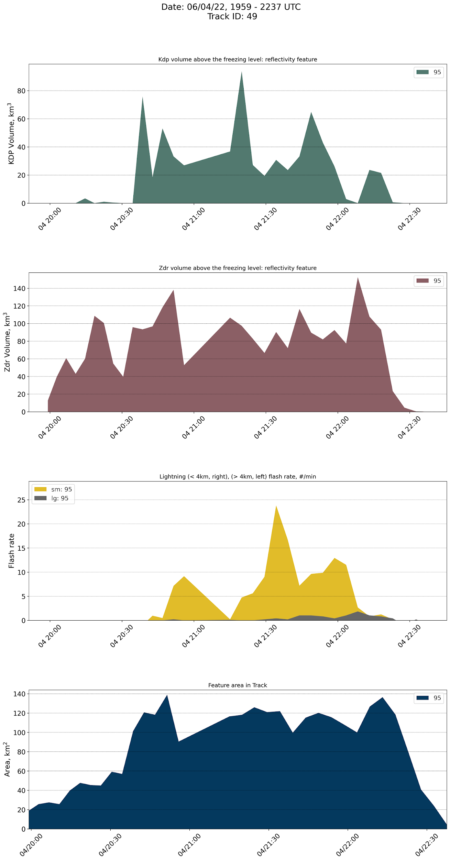
RESULTS – DISCUSSION, FUTURE WORK
Lightning first tracking captures major microphysical features
KDP/ZDR column strength becomes an important parameter
Changes in electrification evident in cells where we have lightning without a strong KDP column
Storm mode and regional influences greatly influences number of cells tracked, cell length etc
Isolated cells are stagnant, relatively short, and aren’t merging/splitting
QLCS electrification processes are influenced by embedded and neighbor cells
Tobac is just one tracking method investigate storms from a lightning-first perspective
https://github.com/tobac-project/tobac
Notes:
Note that when Kdp volume is different than Zdr volume there may be an offset in space, but it would have to be outside of the tracked reflectivity feature
Our signal is stronger in Kdp instead of Zdr – why?
What happens when we only see peaks in ZDR columns? What are we physically viewing?
Why what do peaks in kdp and zdr mean for lightning production?

Slide 12
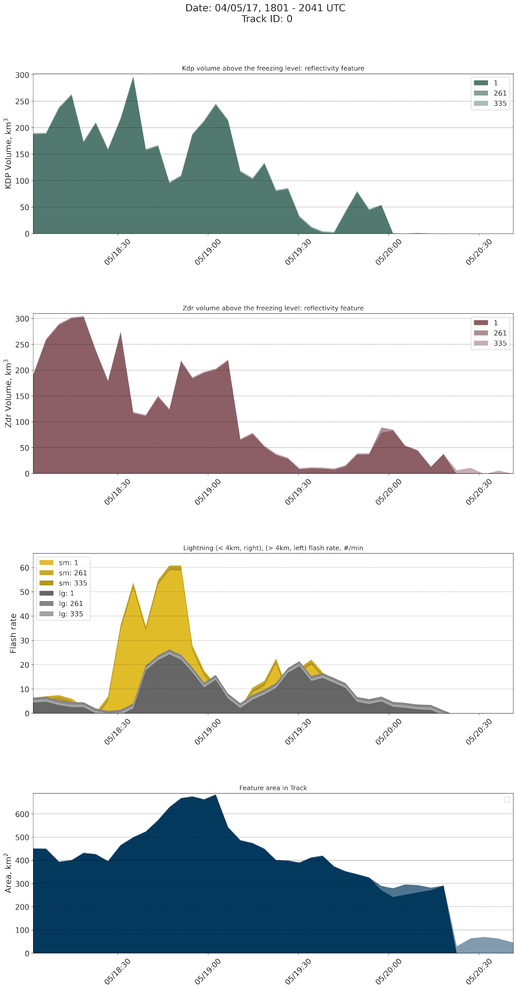
QUESTIONS?
Acknowledgements:
This work was supported by the NOAA VORTEX- SE program under grant NA19OAR4590210.
Special thanks to Tim Logan at Texas A&M, along with PERiLS, ESCAPE, and TRACER collaborators for project support. Data availability is noted via the DOI for each dataset utilized.
Literature and dataset citations
Nexrad Data: doi:10.7289/V5W9574V
HLMA Data: https://lightning.tamu.edu/hlma/
van Lier-Walqui, et al., (2016): https://doi.org/10.1175/MWR-D-15-0100.1
Homeyer and Kumjian (2015): https://doi.org/10.1175/JAS-D-13-0388.1 McDonald and Weiss (2021): https://doi.org/10.1175/MWR-D-20-0226.1
Buning and Thomas (2015): https://doi.org/10.1002/2015JD023766
Schultz et al., (2015): https://doi.org/10.1175/WAF-D-15-0175.1
Tobac: https://doi.org/10.5194/gmd-2019-105

Slide 13
RESULTS – PATTERNS IN CELL TRACKING
Shown is the ratio of tracks with each pattern to the total number of tracks for each storm case
Peaks in Kdp/Zdr volume are prevalent in cells with lightning
The overwhelming majority of cells tracked are of low interest – no lightning and no deep convection
QLCS have a different relationship between lightning and Zdr/Kdp volume in tracked cells
Percentage | 20160331 | 20160430 | 20170405 | 20170430
Lightning + Column | 12.2 | 13.7 | 35.03 | 6.6
Lightning + No column | 5.4 | 1.3 | 5.7 | 4.2
No lightning + Column | 33.8 | 41.3 | 17.2 | 46.9
No lightning + No column | 48.6 | 43.8 | 42.04 | 42.6
Notes:
Highlight the low percentage in 20170430, the 6.6%
Note that how cells are linked can greatly influence the total number of cells, but the feature is counted regardless.
Another way to present this is as a percentage of tracks with a zdr/kdp volume peak – or as a percentage of tracks with lightning..
But I think this highlights how much data there is, how many cells are just little pukey merge-able pebbles in reflectivity.

Slide 14
LIGHTNING DRIVERS AND MICROPHYSICAL SIGNALS
How can we use lightning as an indicator of deep convection, and what tools do we have to represent relationships with lightning?
Lightning evolution in a thunderstorm
Charging, collisions, particle separation, discharge
Increasing flashes rates have been related to increasing updraft volume
Signals in Specific Differential Phase (KDP) and Differential reflectivity (ZDR)
ZDR is a ratio of the horizontal and vertical reflectivity components.
Positive values of specific differential phase (KDP) above the melting level are associated with deep convection updraft cells, so-called “KDP columns
Notes:
ZDR: Sensitive to oblateness of particles ∴ rain size (and N0) I
Insensitive to concentration I Strongly affected by attenuation
KDP: I Similar in some ways to ZDR - sensitive to oblate particles
Insensitive to attenuation
Sensitive to (rainwater) concentration

