Slide 1
An update on the CubeSpark 3D Lightning Mapping Concept
Patrick Gatlin, Timothy Lang, Mason Quick, Jackson Remington, Bill Koshak, Chris Schultz, Dan Cecil, NASA Marshall Space Flight Center
Phillip Bitzer, Sarah Stough, Univ. of Alabama in Huntsville
Sonja Behnke, Harald Edens, Los Alamos National Laboratory
GLM Science Meeting 2022

Slide 2
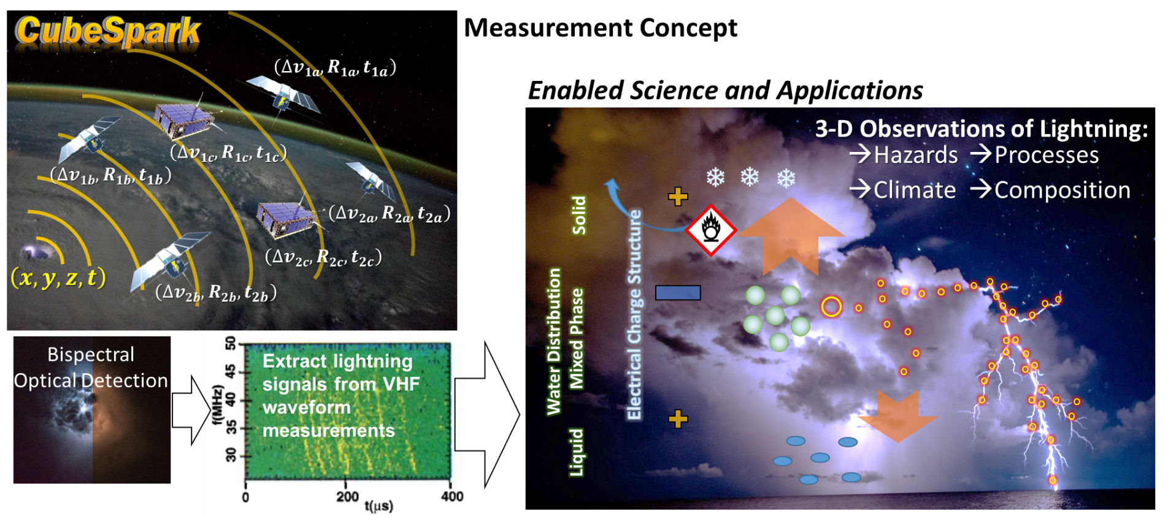


Primary Measurement Objectives:
Locate the horizontal and vertical origin of lightning events with an uncertainty ≤2-km (1-km goal)
Improve detection of small, optically dim pulses that can evade current imagers and frequent intense or anomalous storms
Notes:
Coincident Bispectral lightning detector and VHF lightning detector onboard constellation of LEO small satellites
Want to retrieve 3D observations of lightning to unlock a wealth of new information about thundercloud environments, their processes and hazards
Also, we want to improve detection of these small flashes that may hold vital clues about thunderstorm intensification and hazards
Science Questions that can be addressed:
How does the vertical distribution of lightning relate to processes of thundercloud environments and occurrence of severe weather?
What is the global distribution of anomalously charged thunderstorms, their relationship to severe weather, and impact on LNOx?
What is the distribution of LNOx in the troposphere and its relation to ozone variability?
How does the altitude of lightning impact detection of its optical signatures at cloud top?
What is the vertical structure of winter-storm lightning, and how does it relate to human-built structures?

Slide 3
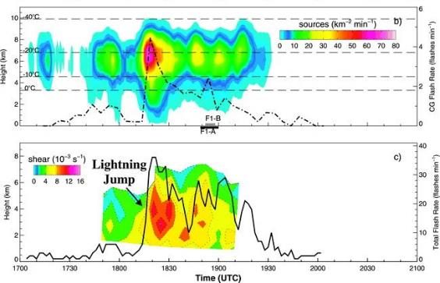
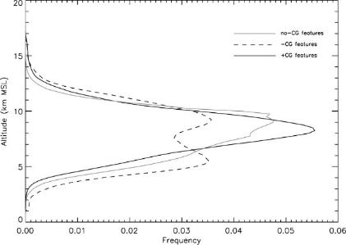
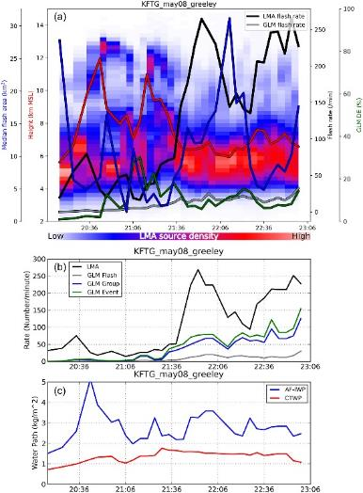
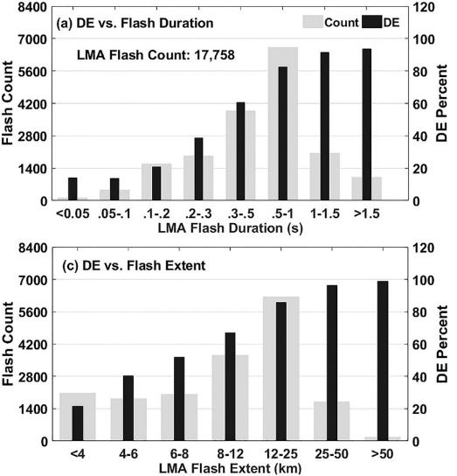
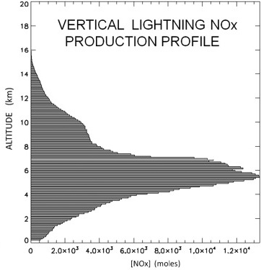
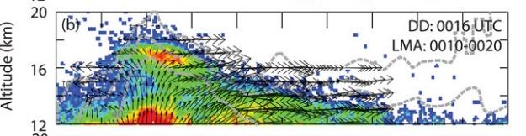
Vertical information provides key insights about thundercloud effects on its surrounding environment
Detecting small and low-altitude flashes are important for diagnosing storm intensification and severe weather
Vertical growth as storm intensifies
Anomalous Charge Storms and Flash Type/Polarity
GLM vs KSCLMA Detection
GLM vs COLMA
(Lang et al. 2011)
(Gatlin & Goodman 2010)
Lightning in Overshooting Tops
(Zhang & Cummins 2020)
(Rutledge et al. 2020)
(Calhoun et al. 2013)
3D LMA observations are extremely insightful but limited to regional networks
Small, dim flashes are difficult detect with coarse resolution imagers
→ Need to better resolve unknown characteristics of these lightning flashes
(Koshak et al. 2014)
Notes:
Vertical evolution of lightning closely follows storm intensification
Vertical distribution reveals charge structure for identifying anomalous storms and preferential flash types
Vertical extent of flashes important for constraining LNOx production rates
As storms intensify smaller flashes become more frequent making it more difficult to fully capture storm flash characteristics
Low altitude discharges that are frequently found in anomalous storms can be optically dim and below the detection threshold of current imagers
We need sensors that can help us better resolve the smaller and weaker quadrant of the flash area-radiance distribution

Slide 4
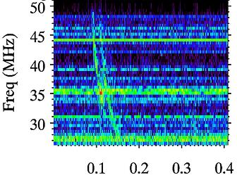
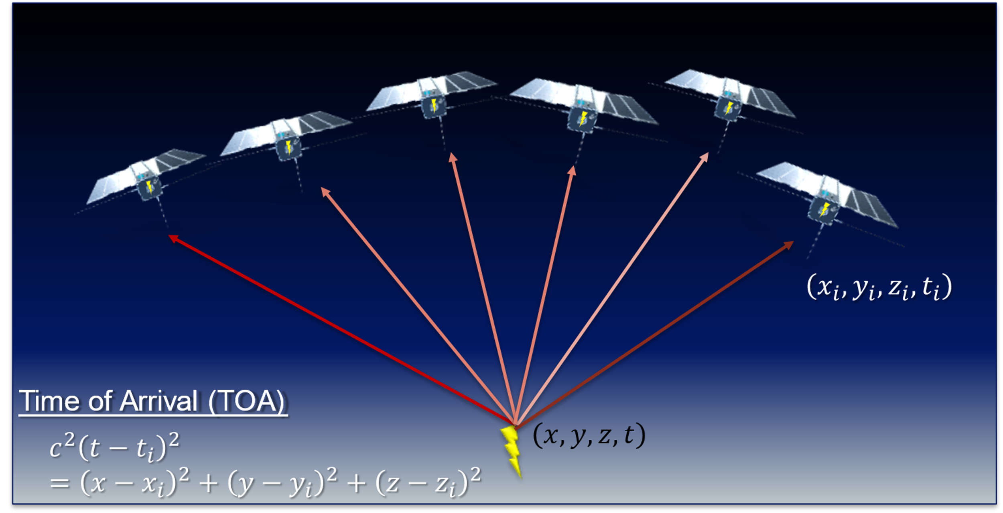



Single vs Multi-satellite Approaches for 3-D retrieval
Transionospheric Pulse Pair (TIPP)
Time-of-arrival of impulsive VHF events
VHF TIPP
Direct pulse
Direct pulse
Reflected pulse
Reflected pulse
Z
(Light 2020)
(Jacobson et al. 1999)
RF gives altitude; Optical gives latitude and longitude
3D requires detection of reflected pulses coincident with optical
  ~12-37% of FORTE VHF+optical dataset are TIPPs (Light & Jacobson 2002; Petersen 2022)
3D location accuracy in single-satellite retrieval:
  Horizontal RMS error ~ resolution of optical (≤2-km)
  Vertical RMS error ~ 300 m (assumed σ_{timing}=0.5 µs )
Doesn’t rely on reflected pulse for 3D
Optical increases observation time
  Train of satellites to observe evolution of storm for several minutes
  Parallax-based pulse altitude
  Constrain TOA solution (requires fewer VHF detections for 3D retrieval)
3D location from solely VHF time-of-arrival (TOA)
  Horizontal RMS error ~ 500 m
  Vertical RMS error ~ 1-2 km
Notes:
Key take-aways:
2 approaches for getting the 3D location of lightning from space
Single-sat gives better vertical resolution
Multi-sat gets more flashes and better reveals their structure

Slide 5
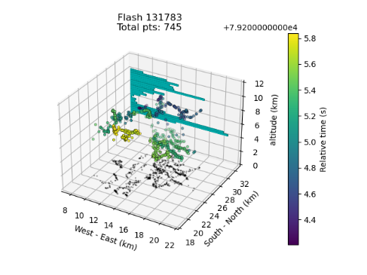
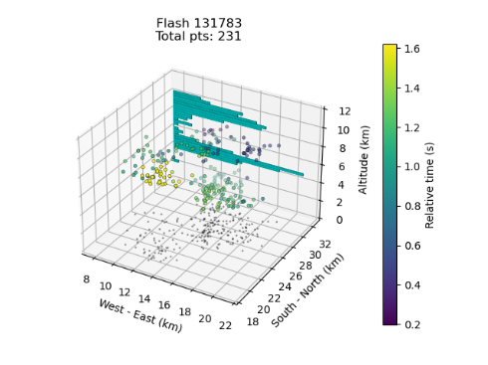
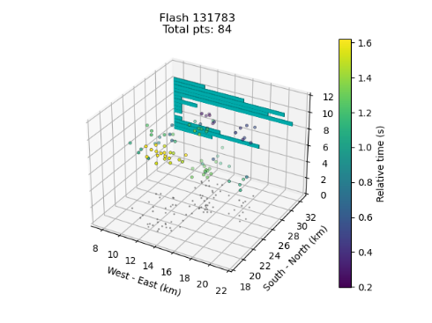
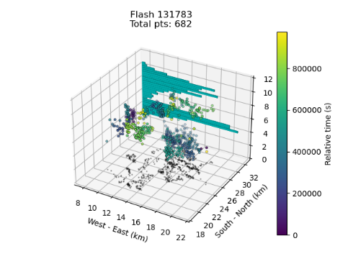
Simulations: Single vs Multi-satellite
LMA Source Flash​ | Single-sat solution 32 % TPP ​ | Single-sat solution 12 % TPP ​ | Multi-sat solution​
37% of FORTE (VHF+optical) pulse reflections detected (Light & Jacobson 2002)
12% of VHF pulse reflections detected (Peterson 2022)
Single-sat captures general charge regions
Multi-sat gives more detail of 3D flash structure
  LNOx needs robust estimate of flash length (Koshak et al. 2014)
  Flash extent closely tied to kinematics (e.g., Bruning & MacGorman 2013)
Examining bulk flash statistics of simulations initialized from a larger LMA dataset (RELAMPAGO, NALMA, WTLMA)
Notes:
LMA flash used to initialize simulations
Random sampling of LMA flash using different constraints for the expected percent of flash observable from single or multi-satellite
General charge regions captured by single-satellite approach
3D flash structure better captured by multi-satellite, which would be important for LNOx and thunderstorm process studies
Additional simulations using larger LMA dataset to study impact of 2 satellite approaches on measuring bulk flash staticts (e.g., flash size metrics like area and vertical extents)

Slide 6
CubeSat Lightning Imaging and Detection Experiment (CLIDE)
Purpose: To detect small and optically dim lightning flashes that frequent intense thunderstorms
Specifications:
  Center wavelengths: 777.4±0.5 nm; 337±1 nm
  Spectral bandwidth: ≤ 1 nm FWHM
  60 x 60 deg FOV (≥90-sec storm observation time)
  ≤ 2-km spatial resolution
  < 1-ms temporal resolution
  Event detection threshold: ≤ 2 µJ m⁻² sr⁻¹
Being designed for use on small satellite missions like CubeSpark
  Includes a more compact optics design to reduce size, weight, and cost of telescope
  Uses faster and higher resolution CMOS detectors with new AI-based storm detection and dynamic sampling strategy
Notes:
Higher resolution 777.4-nm to detect smaller flashes
777.4 nm sensor undergoing evaluation at MSFC
Adding 337-nm to improve detection of flashes, in particular streamer processes
Completing analysis of ASIM/MMIA dataset to refine sensor requirements of UV channel.
Working with Synopsys on telescope design
Use CMOS detectors and AI-based concept for storm detection and enhanced ROI sampling

Slide 7
Collecting community input for a White Paper on the CubeSpark concept
Objectives:
Capture scientific justification and benefits
Demonstrate community support
Recommendations to stakeholders at NASA, NOAA, DoD, others
Target completion date: January 2023
How can you contribute?
10-min questionnaire: https://tinyurl.com/CubeSpark
Send this link to colleagues
Notes:
Desire to write a white paper on satellite-based 3D observations of lightning
The purpose of the white paper is to provide PMs with a summary of the impact of 3D, multi-spectral observations of lightning
Also, to provide recommendations on how a capability like CubeSpark can be incorporated in future satellite missions
Questionnaire takes 10-minutes and includes a video overview of CubeSpark
Share link with colleagues.

Slide 8
THANK YOU!
More information: patrick.gatlin@nasa.gov

