Slide 1
Developing Short-term Lightning Prediction Products and Data Services and Tools for Commercial and Public Sector Applications
UNCLASSIFIED
Elise Schultz
CFD Research
GLM Science Team Meeting
15 September 2022
R & D Team:
Abby Whiteside, Jeremy Martin, Jake Reed, Walker Skeeter
This work is funded by NOAA SBIR Phase II Grant #NA21OAR0210106
“Developing Lightning Services for Commercial and Public Applications”

Slide 2
Research Objective
Can GLM data be used to provide quality lightning information and value-added lightning nowcast product consisting of initiation and cessation products to application developers in addition to researchers through an API?

Slide 3
From R20 to End-User Applications
Motivation
GLM data use-cases beyond NWS forecasters
Create value-added products
Lightning Nowcasting
End-user needs for initiation and cessation
Protection of people and assets
Research focus:
Stratiform flashes in Mesoscale Convective Systems
NOAA/NWS
Government/State Partners
Academia
Industry
Public

Slide 4
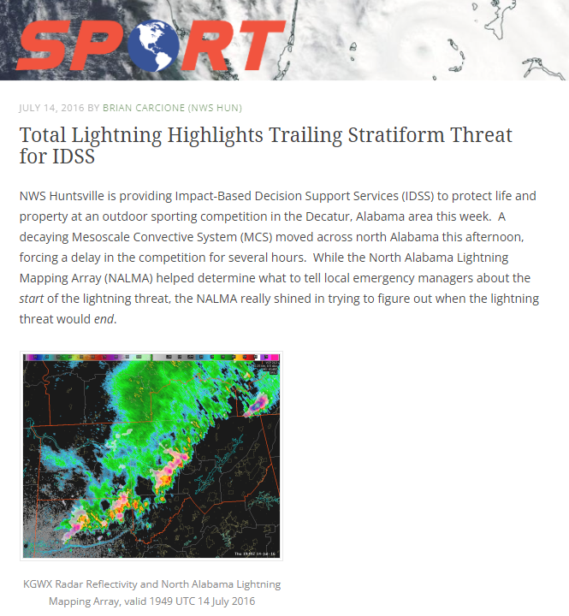
Motivation
Lightning threat from stratiform flashes result in long delays
Important implications to areas such as public safety, aviation, and defense.
There is a gap in knowledge about the electrification and cessation of the stratiform region that can generate these large, dangerous flashes.
Lightning is one physical metric to observe MCS intensity
MCS research is heavily focused on forecast, growth, and mature phases. Little research has been conducted on the decay portion of the MCS life cycle. (Geerts et al. 2017; Nesbit et al. 2021; Cunning 1986; Davis et al. 2004; Jensen et al. 2016; Gale et al. 2002)
GOES Geostationary Lightning Mapper (GLM) provides spatial information on lightning extent
Has been observed to separate convective and stratiform regions (e.g., Petersen et al. 2005; Carey et al. 2005, Steiger et al. 2007, Schultz et al. 2015)
”This is a known threat with MCSs, but it was not clear at the time how long the lightning threat would persist. Use of total lightning information from NALMA enabled NWS Huntsville staff to determine that the lightning threat would not subside until rain subsided.” – Brian Carcione, NWS
https://nasasport.wordpress.com/2016/07/14/total-lightning-highlights-trailing-stratiform-threat-for-idss/

Slide 5
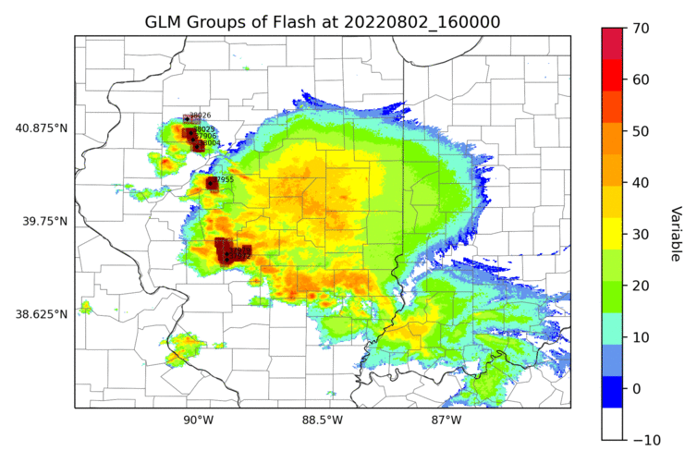
Stratiform Flashes
Composite Reflectivity (dBZ)

Slide 6
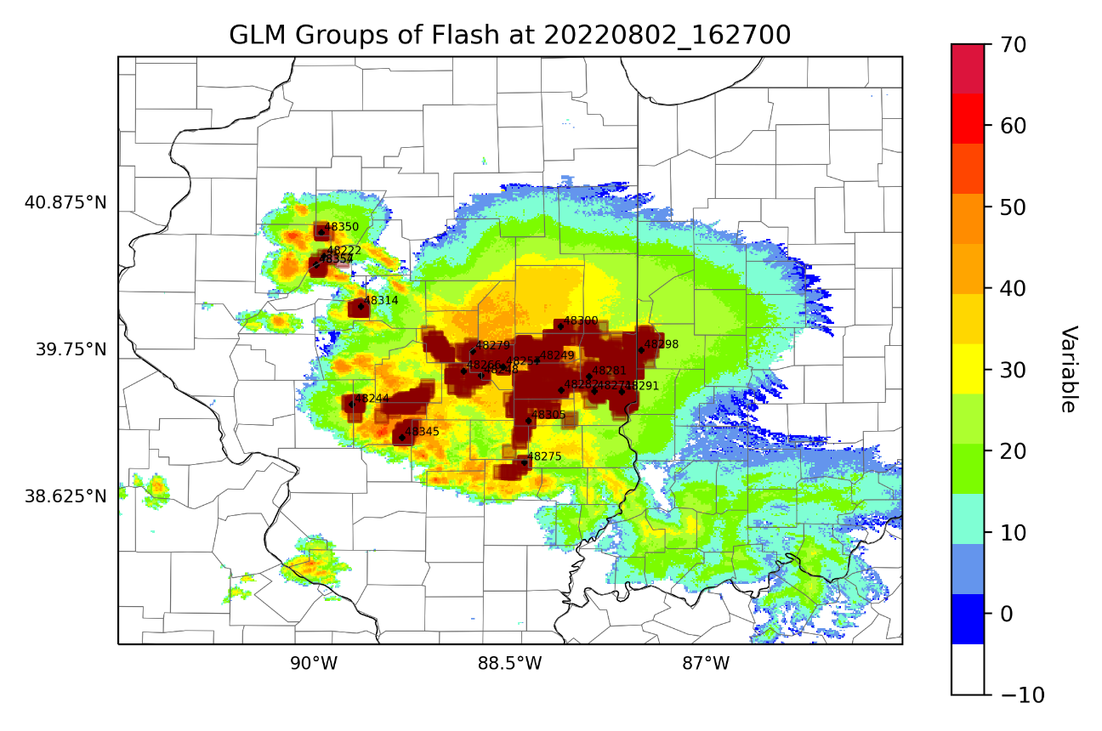
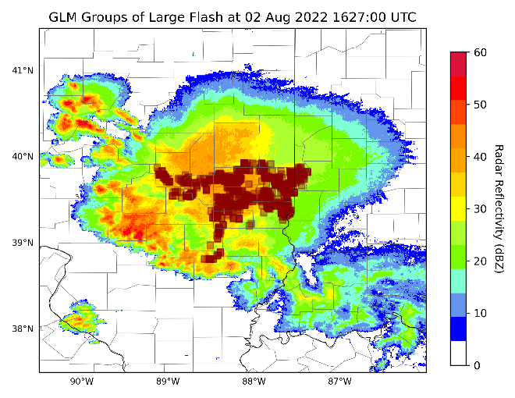
Flash recombination
Thresholds set at:
16.5 km
0.3 seconds
Composite Reflectivity (dBZ)

Slide 7
Summary
There’s a need for a consistent flash reclustering algorithm
Differences in algorithms affect safety, severe weather, climate applied metrics
API released for testing to partners and customers late 2022/early 2023
Lightning nowcast product released early 2023
Customers excited for spatial lightning information GLM provides

Slide 8
Questions?
Elise Schultz
Elise.schultz@cfd-research.com
This work is funded by NOAA SBIR Phase II Grant #NA21OAR0210106
“Developing Lightning Services for Commercial and Public Applications”

