Slide 1
Enhancing Tropical Cyclone Forecast Applications using GOES-R GLM
Kyle Hilburn⁺, Stephanie Stevenson*, Kate Musgrave⁺, Ben Trabing⁺
⁺ Cooperative Institute for Research in the Atmosphere
* National Hurricane Center
2022 GLM Science Team Meeting
15-September-2022

Slide 2
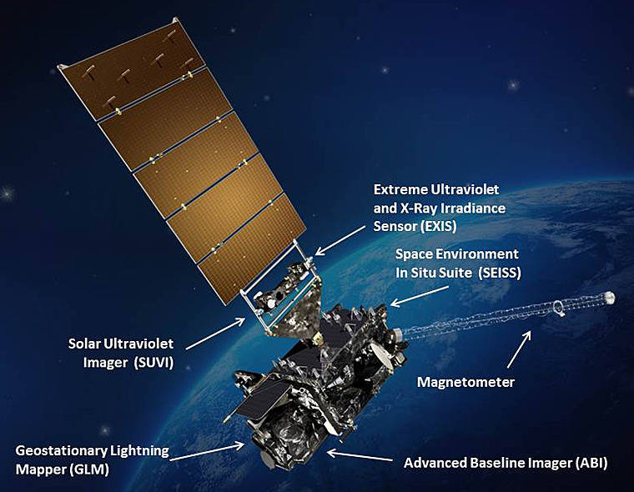
Introduction
Statistical models for TC intensity prediction incorporate the areal extent and symmetry of cold cloud tops from GEO infrared imagery
Statistical Hurricane Intensity Prediction System (SHIPS)
Rapid Intensification Index (RII)
But cirrus canopy can obscure convection below the cloud tops
Opportunity: Geostationary Lightning Mapper (GLM) provides new information
Location and intensity of lightning producing convection
Can see beneath cirrus canopy cover
Hypothesis: lightning information can improve statistical prediction models of TC intensity change
Lightning version of RII using GLM running this season
GOES-R Satellite (Image credit: NASA)
https://www.nasa.gov/content/goes-r/index.html

Slide 3
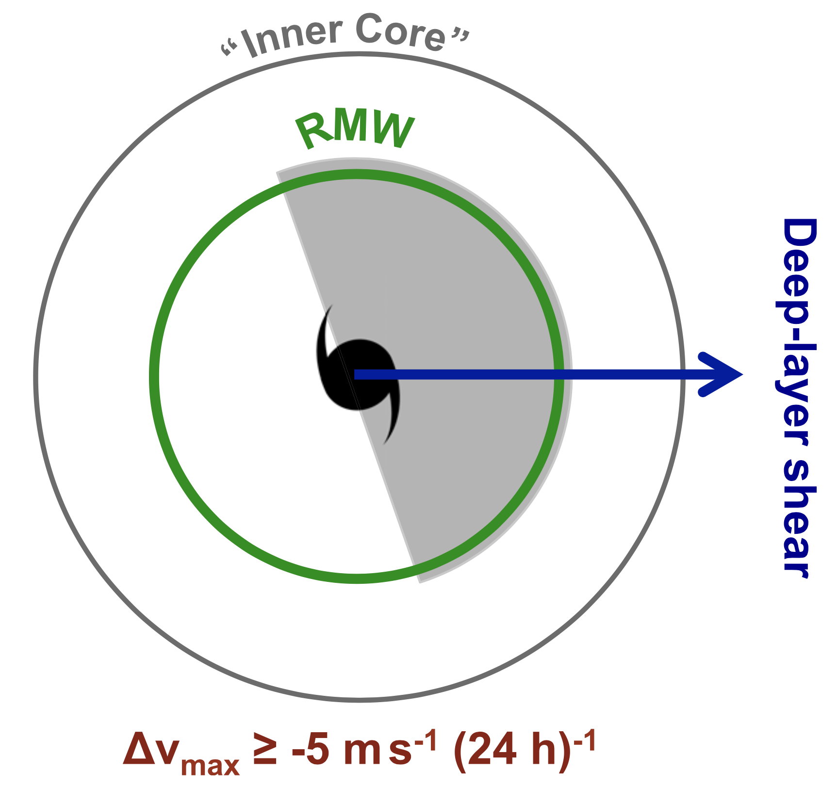
Physical Basis
Positive correlation between rainband lightning and TC intensity change (DeMaria et al. 2012, Stevenson et al. 2018)
TC embedded in favorable environment
More complicated relationship between inner-core lightning and TC intensity change
Stevenson et al. (2018) showed importance of interpreting inner-core lightning relative to TC structure
Lightning (thus diabatic heating) within RMW is favorable for intensification
Also depends on prior intensity change
From Stevenson et al. (2018)
DOI: 10.1175/WAF-D-17-0096.1

Slide 4
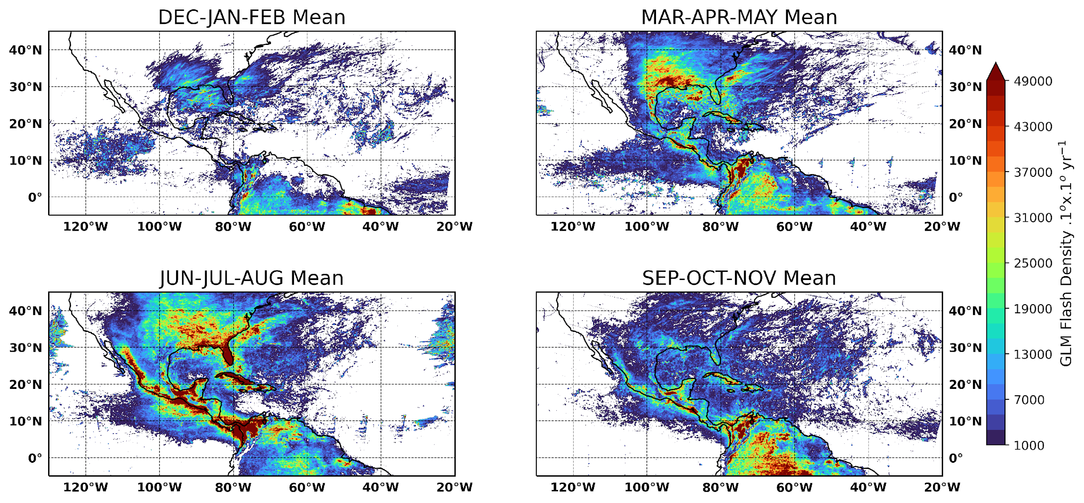
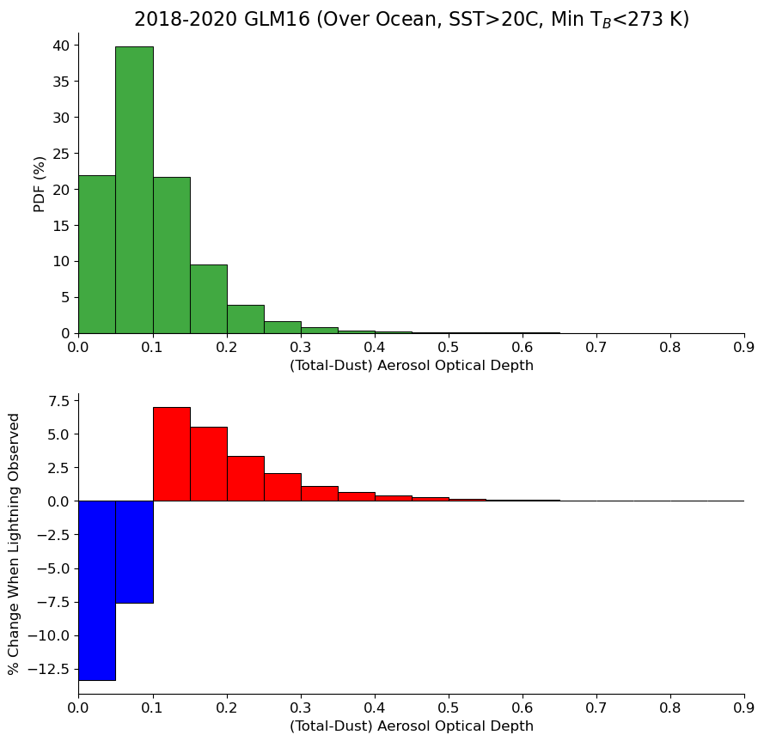
Accounting for Climatological Factors
What large-scale factors contribute to variations in lightning coverage and densities?
Lightning more likely in environments with:
More (non-dust) aerosols
Warmer SST
Higher ocean heat content

Slide 5
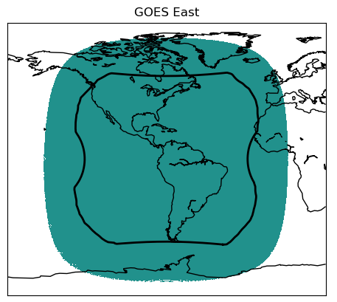
GOES-R TC Dataset
Time period: 2017-2021
Time sampling: Synoptic times (0, 6, 12, 18Z)
Spatial coverage: GOES-East and GOES-West domains
Includes duplicate samples that have both GOES-16 and GOES-17
Spatial format:
Resampled to common ABI 2 km grids
Storm-centric (Best Track centers)
Extracted 512 x 512-pixel image patches
Require both ABI and GLM data to be present
GLM Group Extent Density
GLM Min, Mean, and Max Group Area and Optical Energy
1-, 3-, and 6-hour accumulation periods
Total of 5541 samples
249 cases of RI (+30 kts in 24 hours) from 53 storms
Other variables:
Scalar: SHIPS predictors, ABI and GLM metadata
Image: WWLLN, ISS-LIS, SST, OHC, AOD, GFS, geometry
Coming soon: PMW, Aircraft
Format: NetCDF (65 GB with compression)
Rapid Intensification Cases
Year | Atlantic | East Pacific
2017 | Franklin, Harvey, Irma, Jose, Katia, Lee, Maria, Nate | Dora, Eugene, Fernanda, Kenneth, Otis, Max
2018 | Beryl, Florence, Michael | Aletta, Bud, Hector, John, Lane, Norman, Olivia, Rosa, Sergio, Willa
2019 | Dorian, Jerry, Lorenzo | Barbara, Erick, Juliette, Kiko
2020 | Laura, Teddy, Delta, Epsilon, Zeta, Eta, Iota | Douglas, Genieve, Marie
2021 | Elsa, Grace, Ida, Sam | Felicia, Hilda, Linda, Olaf, Rick

Slide 6
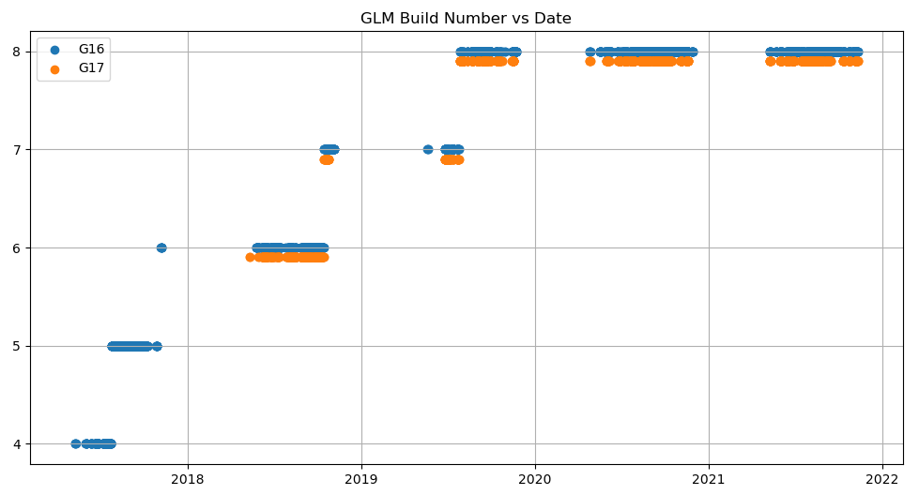
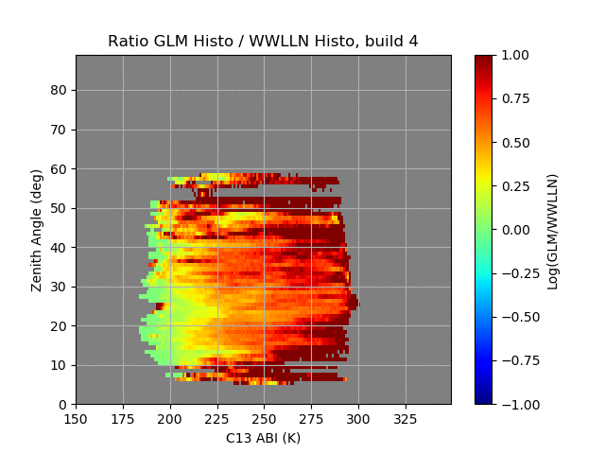
GLM Data versus Algorithm Version
GLM is a first-of-its-kind geostationary sensor
Our samples span algorithm build numbers 4-8
Lightning locations are improved after algorithm build 5
This leads to improved comparisons with WWLLN over time
Note that, in general, GLM sees more lightning than WWLLN

Slide 7
ML-Based Anomaly Detection for Q/C
Trained model to translate GLM imagery into (bias-corrected) WWLLN imagery
Trained on best quality BN 7-8
Evaluated on BN 4-6
Inputs: ABI C13, GLM GED + Area + Energy
Identified anomalous samples based on large RMSD between the prediction and the original GLM data
Found 30 samples with unphysical linear features
Removed these samples from training, but could snip these regions from the images to make use of those samples
Other Q/C applied:
Removing extremely small GEDs
Removing lightning over warm TBs
Investigating use of area/energy relationships

Slide 8
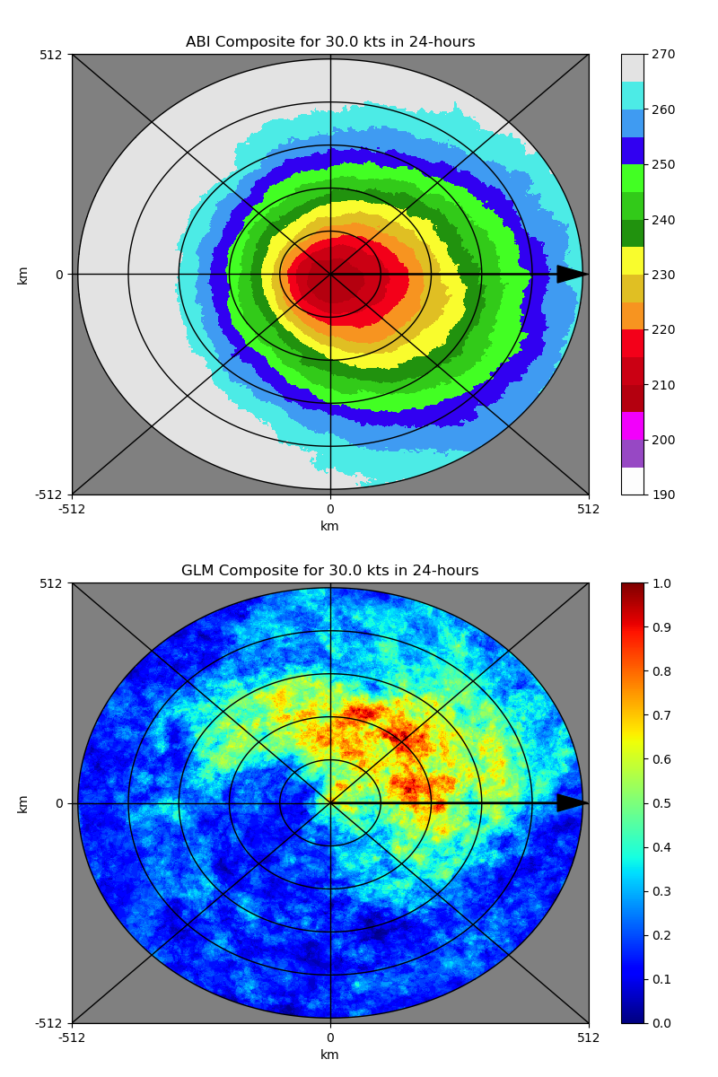
ABI+GLM Composites for RI Samples
Figures show composites across all rapid intensification samples in a storm-centered coordinate system
100-500 km range rings
Rotated imagery to have shear vector pointing to the east
Top: Average ABI C13 Brightness Temperature
Bottom: GLM 6-hour accumulated Group Extent Density histogram
Based on binary lightning presence (GED > 1 group/km²/6-hours)
Similar downshear-left lightning preference as in Stevenson et al. (2018)
Lightning is most prevalent in the range 100-300 km from center

Slide 9
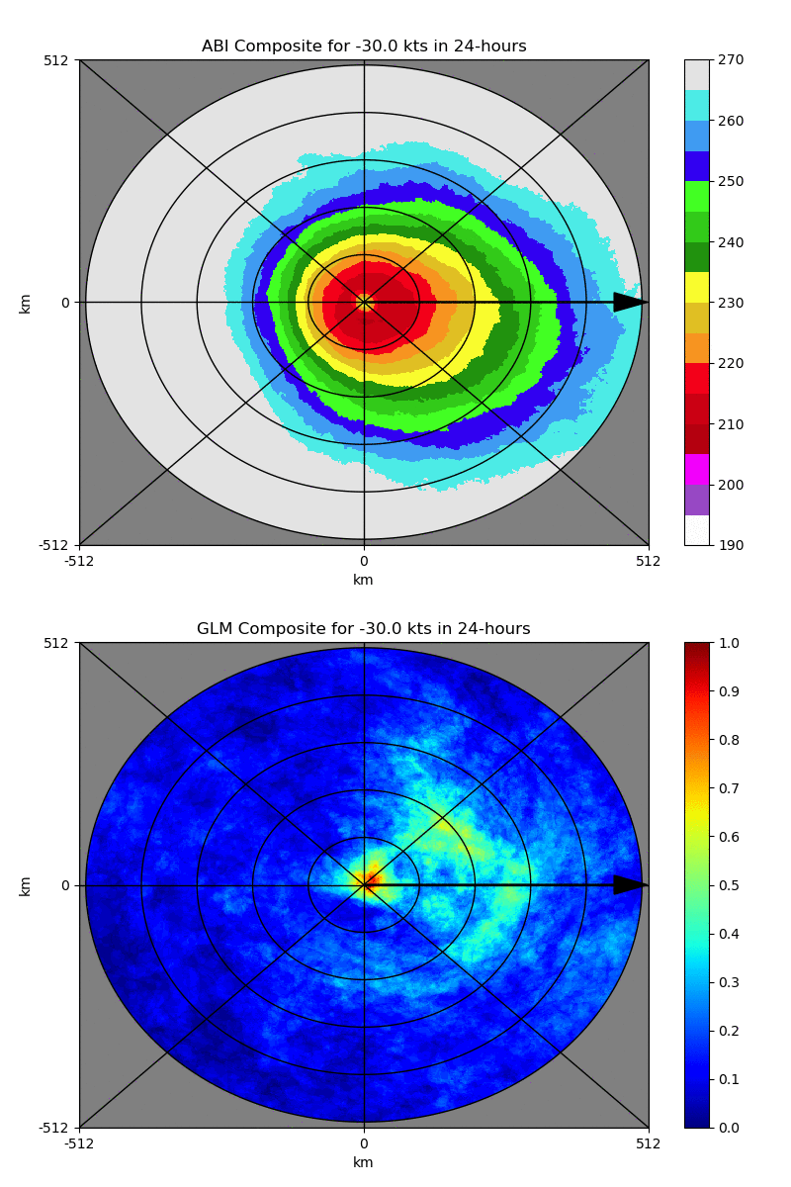
ABI+GLM Composites for All Samples
Loop progresses from weakening to strengthening
Averages across all initial wind speeds and previous wind speed changes
Weakening cases have
More lightning within 0-100 km
Less spatial extent of lightning
More downshear-right located
Strengthening cases have
More lightning out to 300 km
Greater spatial extent, greater azimuthal extent
More downshear-left located

Slide 10
Summary and Conclusions
GLM provides information on convection below cirrus canopy
A comprehensive dataset of TC-centered GOES-East and GOES-West ML-ready imagery from ABI and GLM has been assembled
We are examining factors that lead to basin-to-basin differences in the interpretation of lightning
Machine learning can help analyze lightning information relative to the TC spatial structure
Even relatively simple Convolutional NNs exhibit overfitting and we are also exploring dimensionality reduction strategies (i.e., physically-based feature engineering)

