Slide 1
Blending Lightning Data from Space- and Ground-Based Networks
Feng Zhang, UMD/CISESS
Scott Rudlosky, NOAA/NESDIS/STAR
GLM Science Meeting, 15 September 2022

Slide 2
Purpose
Generate a blended dataset that combines GLM products with ground-based stroke-level lightning observations (NLDN/GLD/ENTLN) to support data assimilation efforts.
Dataset will leverage the strengths of both observing platforms to produce a clean, concise, and informative lightning product for assimilation.

Slide 3
Recently,
We have generated three versions of blended data.
Version 1 (BV1): blending GLM16 L3 gridded 2x2km full disk data with GLD/NLDN/ENTLN stroke-level data.
Version 2 (BV2): blending GLM16 L2 LCFA ECDs (event centroids) with GLD/NLDN/ENTLN stroke-level data.
Version 3 (BV3): blending GLM16 L2 LCFA GCDs (group centroids) with GLD/NLDN/ENTLN stroke-level data.
Resolution: 2x2km in G16 full disk; time resolution: 1min, 10min.
In our study, we’ve designed a brand-new blending method based on the ground stroke-level data instead of the ground flash-level data. Our purpose is to include into our blended data more flash details from ground observations.

Slide 4
To blend ground- stroke-level data and GLM16 data, we have:
Grouped the stroke-level data into flashes;
Assigned a unique parent_flash_id to each ground observed IC/CG (in-cloud pulse/cloud-to-ground stroke);
Besides flash extent density (FED), two more fields are created:
For more details, please refer to Zhang et al. 2022 (in preparation)
2: confidence, to show our confidence on our blended data quality (only in BV3).
1: data_source, to indicate the data networks from which we get the observations in each grid during that period.
Kept as many ground-based observations as possible;
1: GLM;
2: GLD/NLDN;
4: ENTLN;
3: GLM+GLD/NLDN;
5: GLM+ENTLN;
6: GLD/NLDN+ENTLN;
7: GLM + GLD/NLDN + ENTLN;

Slide 5
Table 1. Blending methods being explored
 | BV1 | BV2/BV3
GLM data used | GLM L3 2x2km full disk gridded data | GLM L2 LCFA event centroid (ECD, BV2) or group centroid (GCD, BV3)
Ground-based observations | 1. GLD/NLDN stroke-level data; 2. ENTLN pulse stroke-level data.
Grouping method | Group the stroke-level observations into flashes by using Weighted Euclidean Distance: ${WED}^{2}={\left(\frac{X}{16.5}\right)}^{2}+{\left(\frac{Y}{16.5}\right)}^{2}$+ ${\left(\frac{T}{330}\right)}^{2}$ (1) where X, Y are the east-west distance, the south-north distance between two ICs/CGs in kilometers, respectively. T is the time difference between them in milliseconds. Here, the same spatial (16.5km) and temporal (330ms) constraints as those in GLM L2 LCFA data are used, along with the same “full fit” method. When the ${WED}^{2}≤1$, then the two stroke-level observations belong to the same flash.
Blending methods (please refer to Zhang et al. 2022 (in preparation)) | Grouping GLD/NLDN and ENTLN ICs/CGs to flashes by using eq(1) to be consistent with GLM flashes. A unique parent_flash_id is assigned to each IC/CG. Distributing ground observed ICs/CGs to G16 2x2km full disk to generate the gridded ground FEDs (Flash extent density). Currently, ground FEDs only are used to modify the GLM L3 gridded FEDs by a simple way: if in a grid, ground FED > GLM FED, then ground FED will be used instead of GLM FED. | Grouping ground observed ICs/CGs and GLM ECDs (BV2) or GCDs (BV3) together to flashes by eq (1): If a flash have both observations from ground- and GLM, then all stroke-level data in it will be assigned the same parent_flash_id as that in GLM L2 LCFA data. If a flash has only GLM observations, then the parent_flash_id will be kept the same as that in GLM L2 LCFA data. If a flash doesn’t have any GLM observations, then a new unique parent_flash_id will be given to it. Distributing these space- and ground- blended dataset to G16 2x2km full disk to get the gridded blended FEDs.

Slide 6
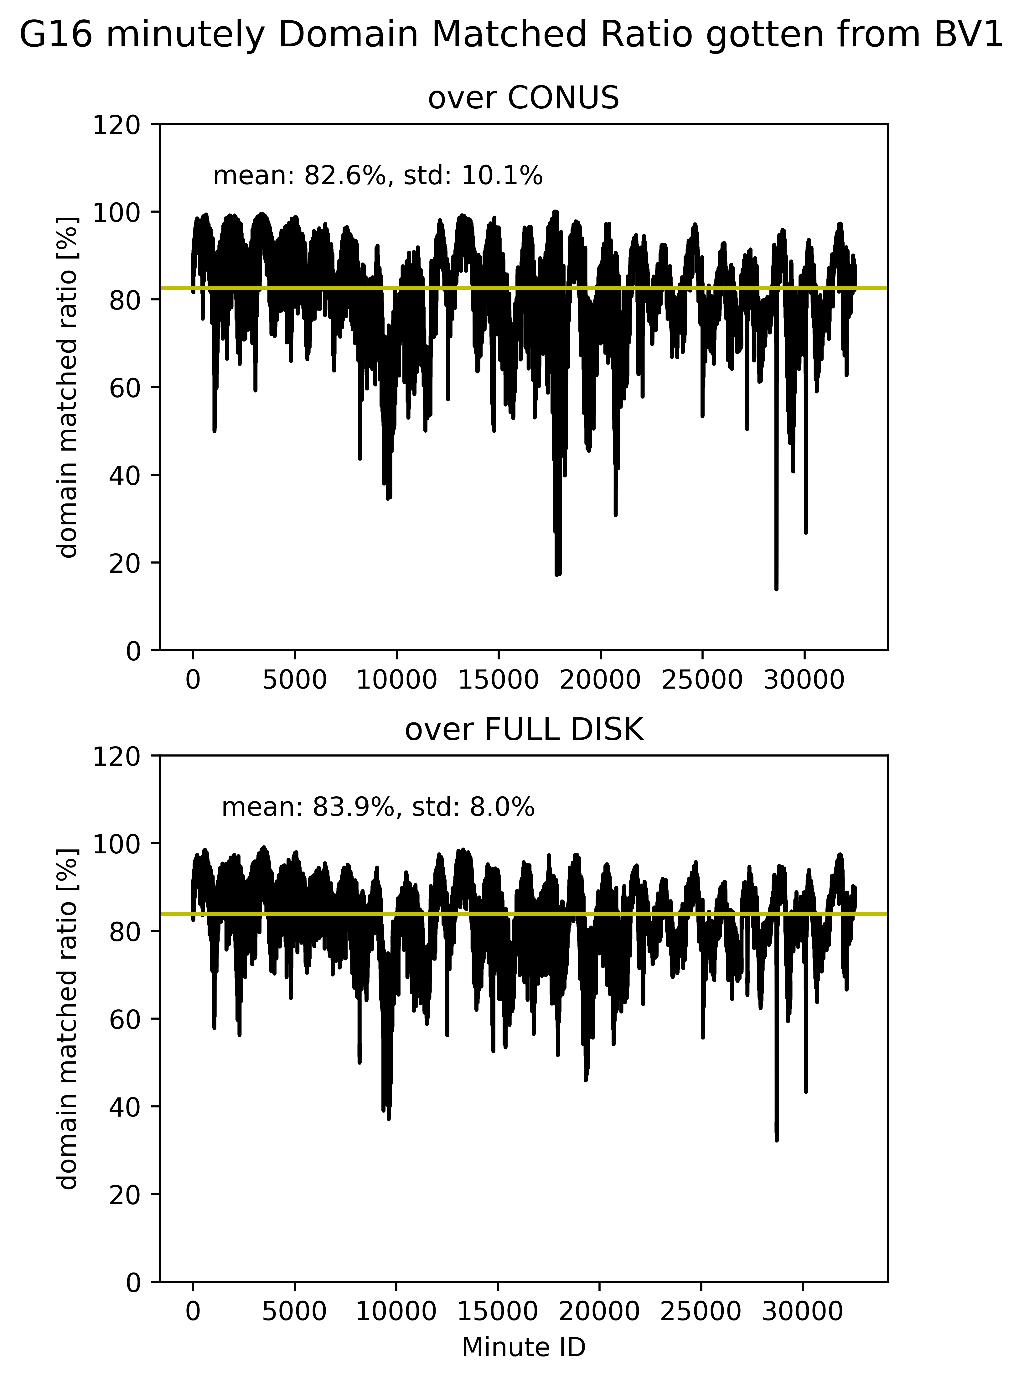
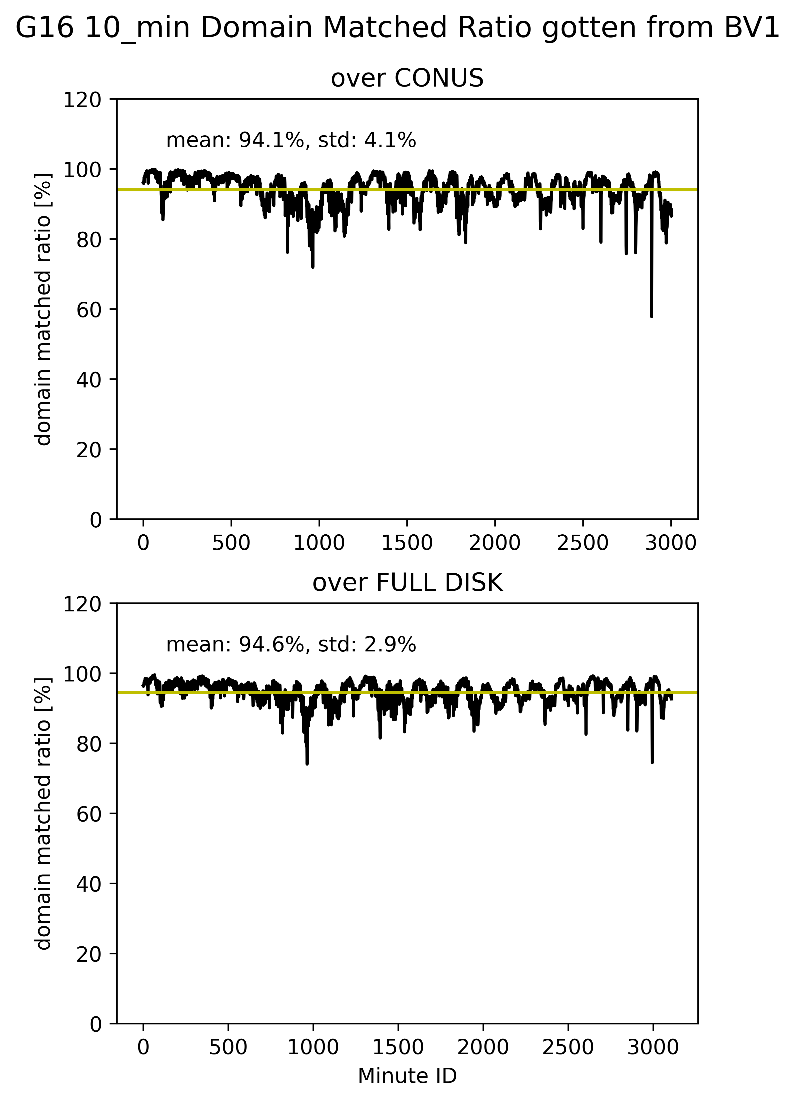
G16 Domain matched ratio
The analysis is based on BV1 Blended data (2x2km, 1-min and 10-mins).
$$domain matched ratio=$$
$$\frac{N_{gm}}{N_{g}}×100\%$$
Where:
$N_{g}$: total number of grids only with ground observed CGs/ICs;
$N_{gm}$: total number of grids with both ground observed CGs/ICs and GLM $FED>0.$
1-minute, domain matched ratio > 70%
10-minutes, domain matched ratio > 90%,
the similar results as Bateman et al. 2020
Notes:
Bateman et al. 2020, when they used 20 minute time window, they found that G16 and G17 have a DE of over 90%.

Slide 7
GLM16 FAR and DE
The analysis is based on flash matchings by using BV3 (GLD+ENTLN+GLM blended data). Total minutes are 3923 with samples from May 2019, July 2020, and the summer 2021.
DE, detection efficiency:
$$DE=\frac{N_{gom}}{N_{go}}×100\%$$
Where:
$N_{gom}$: total number of ground observed ICs/CGs matching with GLM flashes;
$N_{go}$: total number of ground observed ICs/CGs;
FAR, False alarm rate:
$$FAR=\frac{N_{glm_um}}{N_{glm_tot}}×100\%$$
Where:
$N_{glm_um}$: total number of GLM16 group centroids without any ground matchings;
$N_{glm_tot}$: total number of GLM16 group centroids.

Slide 8
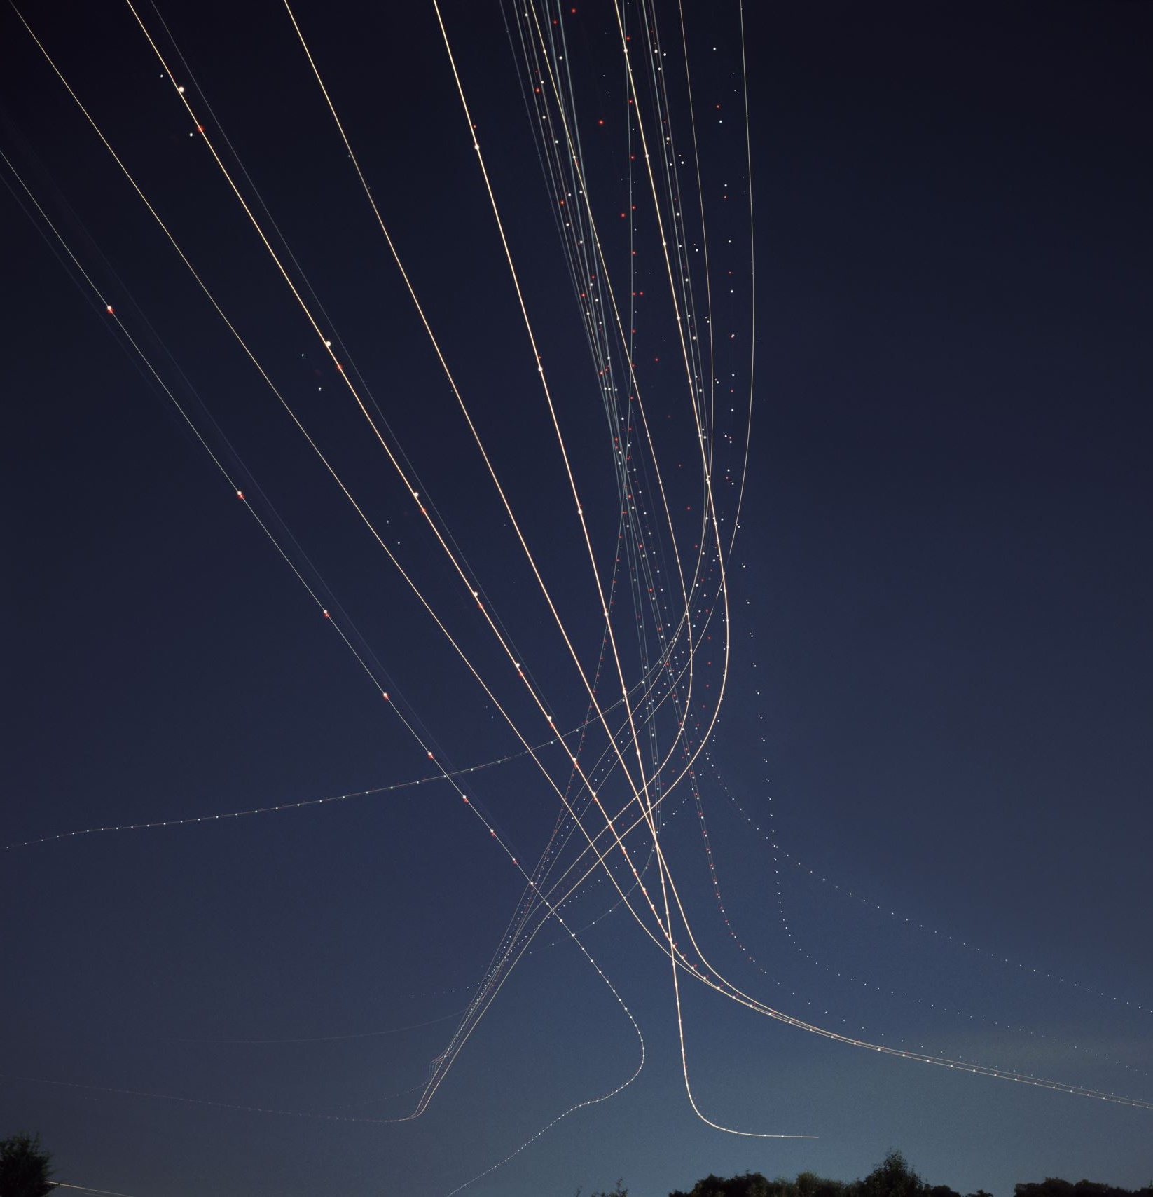
Some comments:
FAR, DE, domain_matched_ratio shown above all indicate:
The GLM observations present quite good quality;
But no single network can detect all lightning discharges. Some lightning discharges can only be seen by one system but not the others.
Hence, how to find a reliable and consistent way to combine different systems to maximize the amount of lightning detected: in one side, to fill the GLM observation gaps, and in another side, to lessen the GLM parallax effects? → our blended data.

Slide 9
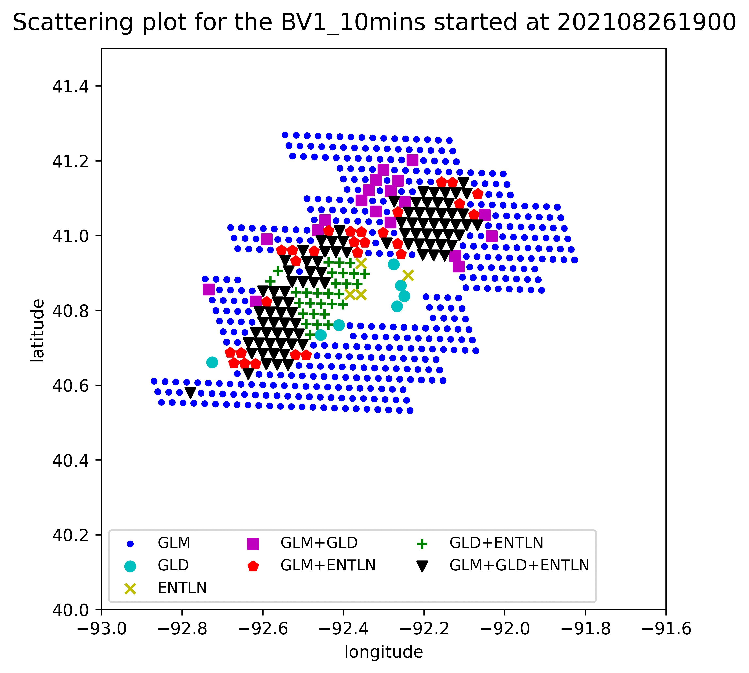
Verification of blended data products
Incorporation of ground-based observations has the ability to
partially fix the GLM holes;
partially correct the parallax errors as compared with ground observations.

Slide 10
Verification of blending data products
This figure shows 10-min Flash extent density from different data sources.
Here take 19:00 $\sim$ 19:10 on Aug. 26, 2021 as example.
LMA: MALMA (Mid-Atlantic LMA; Quick et al. 2020, Fang 2021, Fang et al. 2021).
We’ve found that:
GLM L3 and blending v1 have largest lightning coverage. This is reasonable, because these two take the flash spatial extent into account.
If there are FED centers missed in GLM L3, then incorporation of ground-based observations will fill that gap. Please see red circles.
GLM L2 LCFA event centroids data show discrete FED distributions, which is aligned quite well with the GLM CCDs.
Blending ground-based CGs/ICs with GLM observations always show obvious improvements than their original ones.
The BV3 on GLM L2 LCFA group centroids seems to be the best one as compared with LMA data.

Slide 11
Verification of blending data products
This figure shows scattering plots for 10-min Flash extent density including MALMA FEDs.
Here take 19:00$\sim$19:10 on Aug. 26, 2021 as example.
Again, we’ve found that:
BV3 (on group centroids) has better matching with MALMA than BV2 (on event centroids) and BV1.

Slide 12
These Figures show the bar plots of our blended FEDs (GLM included) and MALMA FEDs.
Here, take hour 19 on Aug. 26, 2021 as example. Time resolution: 10 minutes.
Table 2. Correlation coefficients (CCs) between 10-min FED and 10-min MALMA FED over MALMA domain.
 | CC(glm fed, MALMA) | CC(BV1, MALMA) | CC(BV3, MALMA)
19:00 to 19:10 | 48.8% | 62.9% | 76.0%
19:10 to 19:20 | 43.9% | 61.3% | 91.0%
19:20 to 19:30 | 26.0% | 58.8% | 91.9%
19:30 to 19:40 | 46.7% | 80.0% | 98.0%
19:40 to 19:50 | 38.8% | 78.8% | 97.0%
19:50 to 20:00 | 56.3% | 75.3% | 95.9%
Clearly, CC (glm fed, MALMA) < CC (BV1, MALMA) < CC (BV3, MALMA)
Blending ground-based with GLM observations always show obvious
improvements than the original GLM observations.

Slide 13
Table 3. The time averaged correlation coefficients (CCs) between 10-min FED and 10-min LMA FED over the corresponding LMA domain for different cases.
NO. | Cases | LMA data | CC(GLM, LMA) | CC(BV1, LMA) | CC(BV3, LMA)
1 | 2021.08.26 19:00 $\sim$ 20:00 | MALMA | 43.4% | 69.5% | 91.6%
2 | 2021.08.19 00:00 $\sim$ 02:00 | NALMA | 54.2% | 58.6% | 67.5%
3 | 2021.08.01 03:00 $\sim$ 05:00 | NALMA | 40.6% | 41.2% | 47.9%
4 | 2021.07.11 21:00 $\sim$ 23:00 | NALMA | 47.4% | 51.3% | 78.5%
5 | 2021.06.12 17:00 $\sim$ 23:40 | NALMA | 45.4% | 53.6% | 68.5%
MALMA: Mid-Atlantic LMA; Quick et al. 2020, Fang 2021, Fang et al. 2021; NALMA: North Alabama LMA; Bitzer et al. 2013, Zhu et al. 2020.

Slide 14
Conclusion:
Our blending data products include the lightning data from both Space- and ground- networks. In our products, we’ve tried to:
Maximize the amount of lightning detected;
Fill the GLM observation gaps partially;
Lessen the GLM parallax effects to some degree.
After blending ground-based observations into GLM data, obvious improvements on data quality have been found, as indicated by
The better positive correlation coefficients of (BV1/BV3 FED, LMA FED) than those of (GLM FED, LMA FED);
The better positive correlation coefficients of (BV1/BV3 FED, MRMS VII) than those of (GLM FED, MRMS VII). (Not shown here due to the time limit; Multi-Radar/Multi-Sensor (MRMS) Vertically Integrated Ice (VII, $kg/m^{2}$));
BV3 always have the highest positive CCs with LMA FEDs, even higher than 90%, and highest positive CCs with MRMS VII.
Another benefit from our blended data products is: we can easily and directly get the GLM16 DE and FAR directly from BV3 and GLM 16 domain matched ratio directly from BV1.

Slide 15
Discussion for next step
How to remove the false reports in both GLM and ground-based observations?
How to further correct the parallax errors?
We will keep improving our blending data products in the near future.
THANKS!

Slide 16
Some references
Bateman, M. and D. Mach, 2020: Preliminary detection efficiency and false alarm rate assessment of the Geostationary Lightning Mapper on the GOES-16 satellite. J. Appl. Remote Sens., 14(3), 032406, doi: 10.1117/1.JRS.14.032406.
Bateman, M., D. Mach, and M. Stock, 2020: Further Investigation into detection efficiency and false alarm rate for the Geostationary Ligthning Mappers aboard GOES-16 and GOES-17. Earth and Space Sci., 8, 2020EA001237, doi: 10.1029/2020EA001237.
Bitzer, P. M., Christian, H. J., Stewart, M., Burchfield, J., Podgorny, S., Corredor, D., Hall, J., Kuznetsov, E., & Franklin, V. (2013). Characterization and applications of VLF/LF source locations from lightning using the Huntsville Alabama Marx Meter Array. Journal of Geophysical Research: Atmospheres, 118, 3120–3138. https://doi.org/10.1002/jgrd.50271.
Bruning, E., Tillier, C. E., Edgington, S.F., Rudlosky, S.D., Zajic, J., Gravelle, C., et al., 2019: Meteorological imagery for the geostationary lightning mapper. J. Geophys. Res.: Atmospheres, 124, 14,258-14,309. https://doi.org/10.1029/2019JD030874.
Fang, G. Y., 2021: Maintenance and Development of the Mid-Atlantic lightning mapping array (MALMA), 2021, Oral Presentation, GLM Science Virtual Meeting, September 21-23.
Fang, G.Y., S. D. Rudlosky, J. Patton, M. Quick, D. Zhang, 2021: Update of Maintenance and Development of the Mid-Atlantic Lighting Mapping Array (MALMA). 2021 AGU Meeting, poster presentation, New Orleans, LA & Online everywhere, December 13-17.
Mach D.M., 2020, Geostationary Lightning Mapper Clustering Algorithm Stability. J.G.R. Atmospheres, 125, e2019JD031900. https: //doi.org/10.1029/2019JD031900.
Quick, M.G., W. Rison, D. Rodeheffer, S.D. Rudlosky, M.T. Wingo, R.J. Blakeslee, R.G. Brown, T.J. Lang, J. Chen, 2020: Mid-Atlantic Lightning Mapping Array (MALMA) multi-band network performance. American Geophysical Union, Fall meeting 2020, abstract #AE008-0003. https://ui.adsabs.harvard.edu/abs/2020AGUFMAE0080003Q/abstract.
Zhu, Y., Bitzer, P., Stewart, M., Podgorny, S., Corredor, D., Burchfield, J., Carey, L., Medina, B. and Stock, M., 2020. Huntsville Alabama marx meter array 2: Upgrade and capability. Earth and Space Science, 7(4), p.e2020EA001111.
Zhang, F., $Rudlosky, S.$, Zhang, D., 2022: GLM Lightning data assimilation, part I: Blending Lightning Data from Space- and Ground-Based Networks. In preparation.

