Slide 1
A Comparison of GLM, WTLMA, and LF/VLF Stroke Data to Two Photographed CGs
GLM Science Meeting
15 September 2022
David Singewald
Texas Tech University

Slide 2
Purpose Compare and Validate GLM, WTLMA, & LF/VLF Networks to Photographed CGs
Captured CGs
Did the WTLMA detect what I captured?
Did the GLM detect the photographed CGs?
Did other lightning detection networks capture what I captured?
How did other lightning detection networks perform for other cells in the area?
Source Code: JJ Helmus and SM Collis, JORS 2016, doi: 10.5334/jors.119

Slide 3
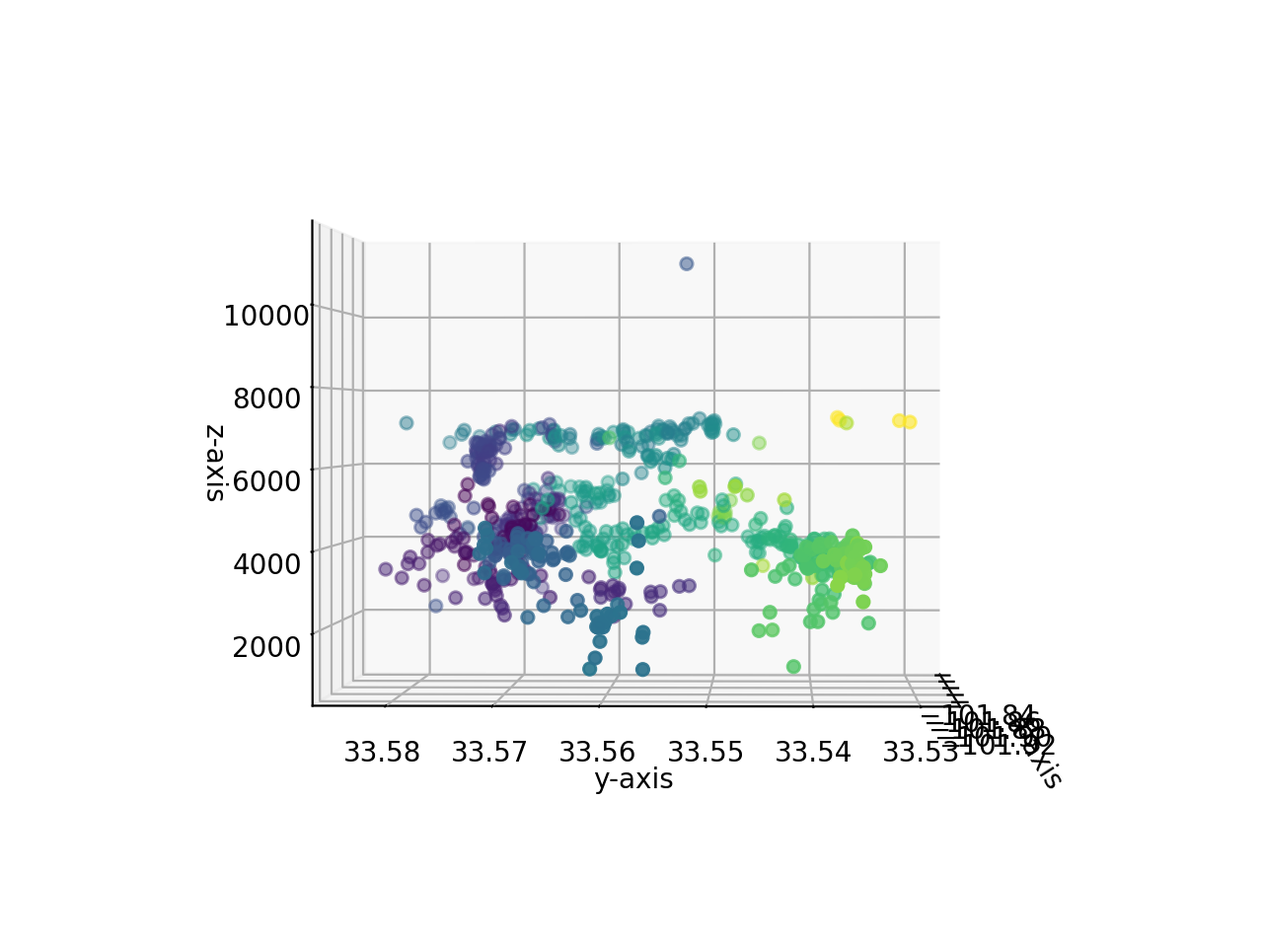
Photographed CGs
WTLMA = 2 (maybe 3) negative CGs
GLM = no detection
“Network A” = 1 negative IC & CG
“Network B” = 1 negative IC & CG

Slide 4
Overall View of Event
1 Hour of Data
9 July 2022 0100-0200 UTC
4 Cells Analyzed
Photographed CGs were produced in “Cell 3”
Data Sources
GOES-16 & -17 Geostationary Lightning Mappers (GLM)
Earth Networks Total Lightning Network (ENTLN)
West Texas Lightning Mapping Array (WTLMA)
National Lightning Detection Network (NLDN)
Cell 1
Cell 3
Cell 2
Cell 4

Slide 5
Cell 1
Key
“Net. A” Pos. CG =
“Net. A” Neg. CG =
“Net. A” Pos. IC = +
“Net. A” Neg. IC =
“Net. B” Pos. CG =
“Net. B” Neg. CG =
“Net. B” Pos. IC =
“Net. B” Neg. IC =
GLM-16 =
GLM-17 =

Slide 6
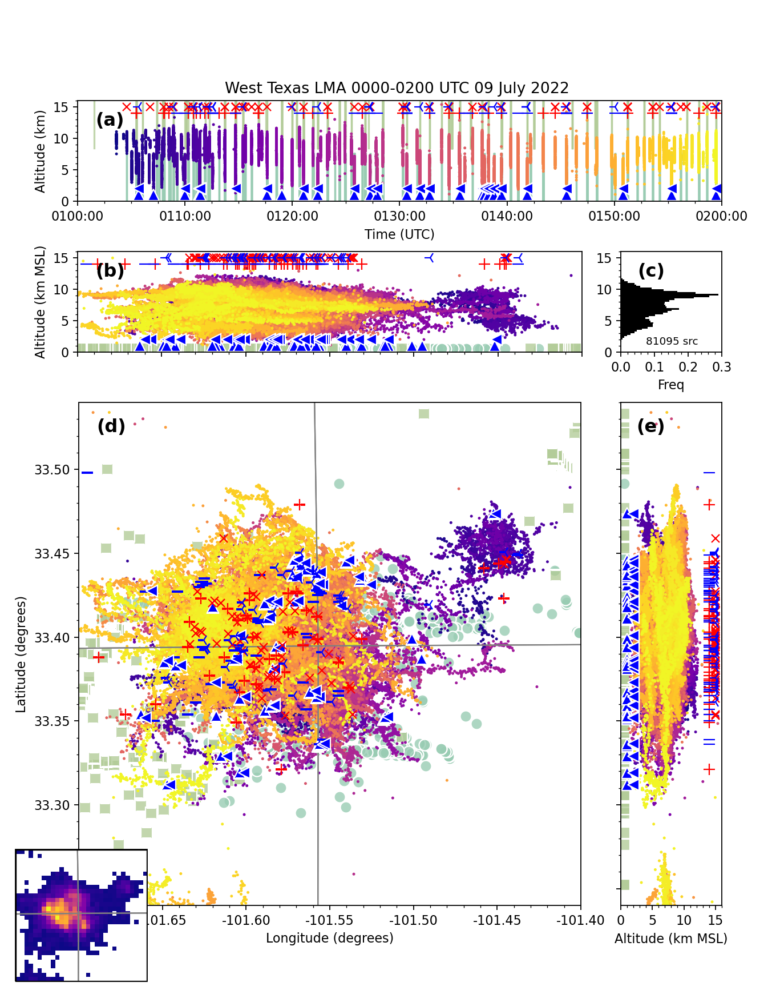
Cell 2
Key
“Net. A” Pos. CG =
“Net. A” Neg. CG =
“Net. A” Pos. IC = +
“Net. A” Neg. IC =
“Net. B” Pos. CG =
“Net. B” Neg. CG =
“Net. B” Pos. IC =
“Net. B” Neg. IC =
GLM-16 =
GLM-17 =

Slide 7
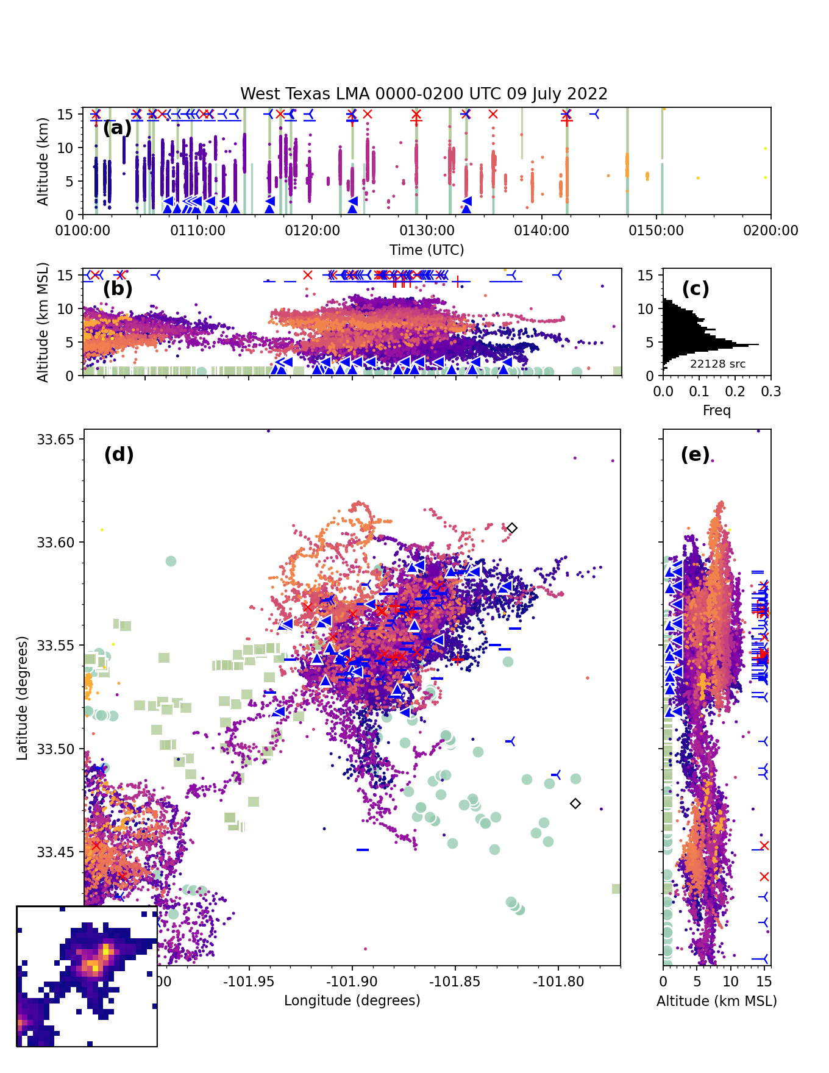
Cell 3
Key
“Net. A” Pos. CG =
“Net. A” Neg. CG =
“Net. A” Pos. IC = +
“Net. A” Neg. IC =
“Net. B” Pos. CG =
“Net. B” Neg. CG =
“Net. B” Pos. IC =
“Net. B” Neg. IC =
GLM-16 =
GLM-17 =

Slide 8
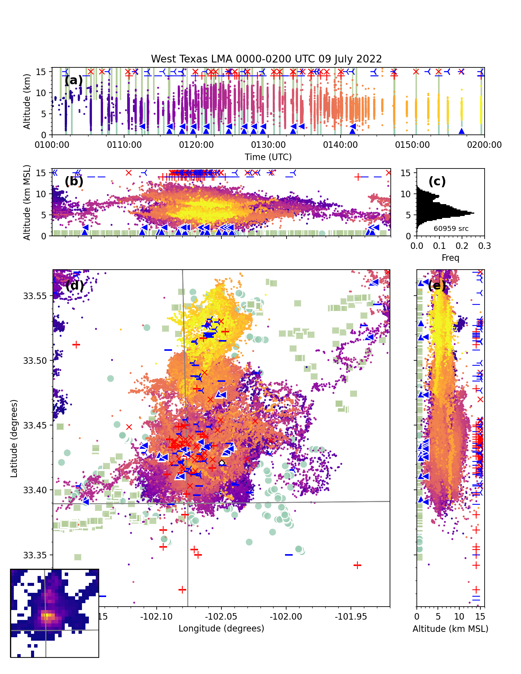
Cell 4
Key
“Net. A” Pos. CG =
“Net. A” Neg. CG =
“Net. A” Pos. IC = +
“Net. A” Neg. IC =
“Net. B” Pos. CG =
“Net. B” Neg. CG =
“Net. B” Pos. IC =
“Net. B” Neg. IC =
GLM-16 =
GLM-17 =

Slide 9
Summary Compare and Validate GLM, WTLMA, & LF/VLF Networks to Photographed CGs
Cell | Network A (# of Flashes with CG) | Network A (# of Flashes with IC) | Network B (# of Flashes with CG) | Network B (# of Flashes with IC) | GLM -16 Flashes | GLM -17 Flashes | WTLMA
#1 | 10 | 25 | 6 | 23 | 14 | 6 | 87
#2 | 26 | 55 | 25 | 62 | 81 | 62 | 117
#3 | 11 | 17 | 9 | 32 | 25 | 19 | ~56
#4 | 11 | 39 | 12 | 45 | 48 | 53 | ~112
Total | 58 | 136 | 52 | 162 | 168 | 140 | 372
Overall Totals of Instances for Specific Classifications
“Network A” Classified 194 Instances of CGs and ICs Combined
“Network B” Classified 214 Instances of CGs and ICs Combined
GLM -16 Recorded 168 Instances
GLM -17 Recorded 140 Instances
WTLMA Recorded 372 Instances
WTLMA Performed More Favorably Possibly Due to the Lightning Origins Being Lower in Elevation
Data | WTLMA Cell 1 & 2 | WTLMA Cell 3 & 4
Total GLM -16 Missed | 109 | 95
Total GLM -17 Missed | 136 | 96
Total WTLMA 1 & 2 | 204
Total WTLMA 3 & 4 |  | 168
% Missed | GLM -16 = 53% | GLM -17 = 66% | GLM -16 = 56% | GLM -17 = 57%

Slide 10
Summary Compare and Validate GLM, WTLMA, & LF/VLF Networks to Photographed CGs
Cell | Net. A & B Agree Flashes with ICs | Net. A & B Disagree Flashes with ICs | Net. A Self Disagree Flashes with ICs | Net. B Self Disagree Flashes with ICs
#1 | 11 | 10 | 5 | 5
#2 | 34 | 18 | 6 | 13
#3 | 14 | 6 | 2 | 7
#4 | 29 | 7 | 1 | 4
Total | 88 | 41 | 14 | 29
Cell | Net. A & B Agree Flashes with CGs | Net. A & B Disagree Flashes with CGs | Net. A Self Disagree Flashes with CGs | Net. B Self Disagree Flashes with CGs
#1 | 5 | 5 | 0 | 0
#2 | 24 | 3 | 0 | 0
#3 | 9 | 2 | 0 | 0
#4 | 10 | 3 | 0 | 0
Total | 48 | 13 | 0 | 0
In-depth Analysis of Network Agreement/Disagreement Instances for Specific Classifications
Greatest Polarity Disagreement in Ground Based Detection Occurred in “Network B” +/- IC Flash Data Specifically in Cell # 2

Slide 11
Summary Compare and Validate GLM, WTLMA, & LF/VLF Networks to Photographed CGs
Cell | GLM -16 & -17 Agree | GLM -16 & -17 Disagree | GLM -16 Missed Detection | GLM -17 Missed Detection | GLM -16 & -17 False Alarms*
#1 | 6 | 11 | 73 | 81 | 0
#2 | 50 | 48 | 36 | 55 | 10
#3 | 15 | 14 | 31 | 37 | 4
#4 | 35 | 23 | 64 | 59 | 10
Total | 106 | 96 | 204 | 232 | 24
* More Processing Needed to Determine if True False Alarm or Flash Detected From Other Cells in the Area

