Slide 1
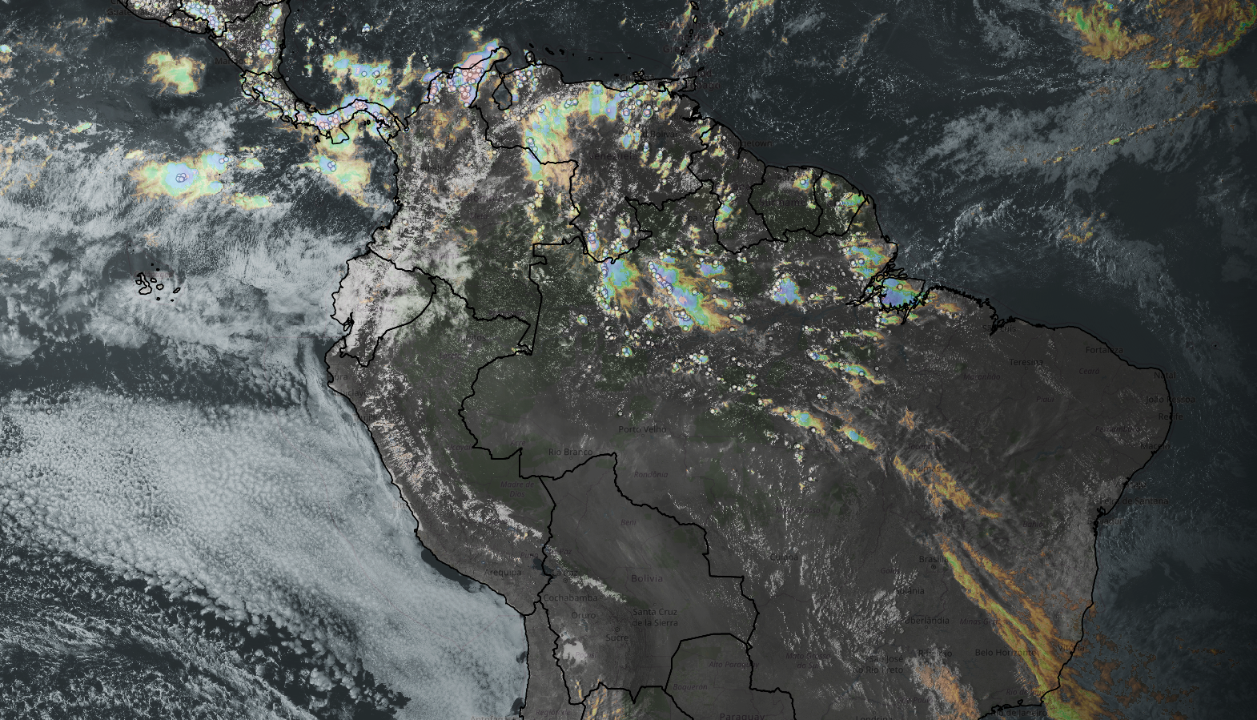
Frequency and Distribution of Lightning over South America Using Data of GOES-16
Joao H. Huamán Chinchay
2022 GLM Science Meeting

Slide 2
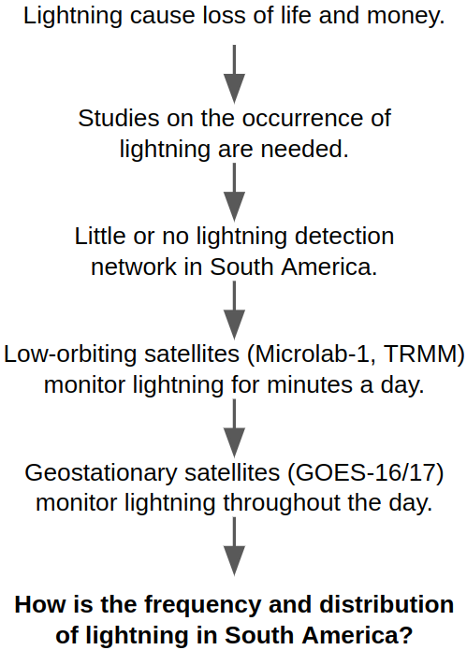
INTRODUCTION
Catatumbo - Venezuela
Source: BBC
2022 GLM Science Meeting

Slide 3
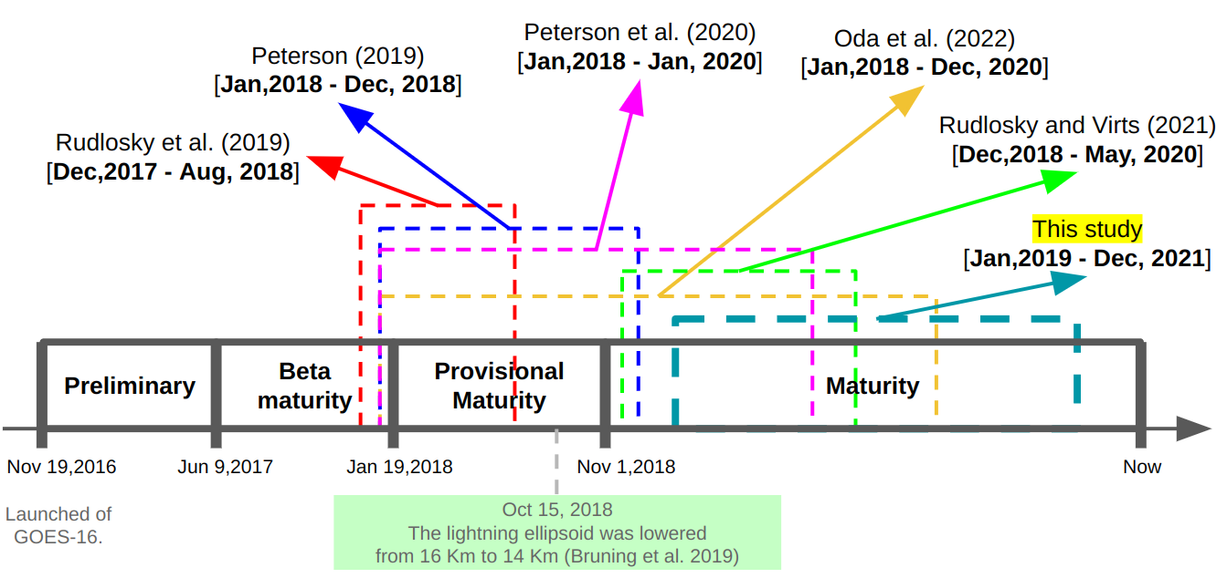
INTRODUCTION
Evolution of the status of GLM products (Koshak et al., 2018).
2022 GLM Science Meeting

Slide 4
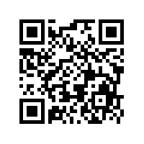
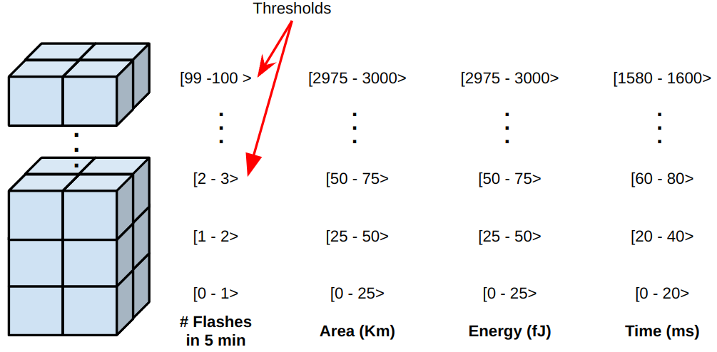
DATA AND METHODS
Package development in python
GLM data (GOES-16)
from 2019 to 2021
https://github.com/joaohenry23/GOES
Flash product
(qf=0)
- Coordinates (°) - Area (km2)
- Energy (fJ)
- Time (ms)
Percentiles
Counts occurrences (by thresholds over pixels)
Yearly and monthly flash density
Flash (5 min)
Counts occurrences (over pixels)
2022 GLM Science Meeting

Slide 5
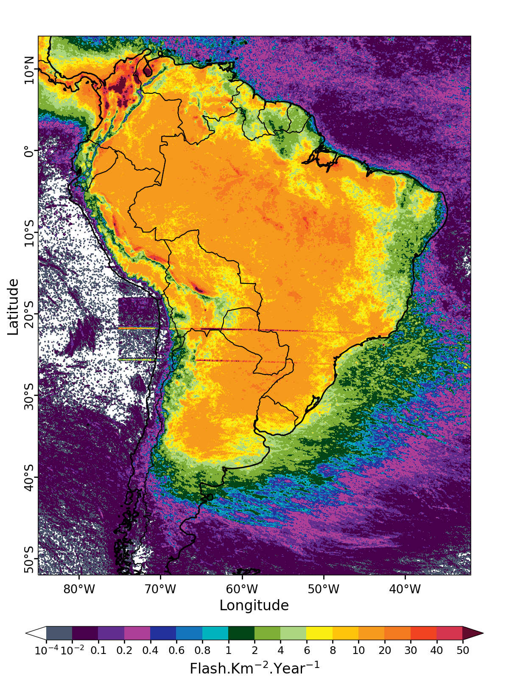
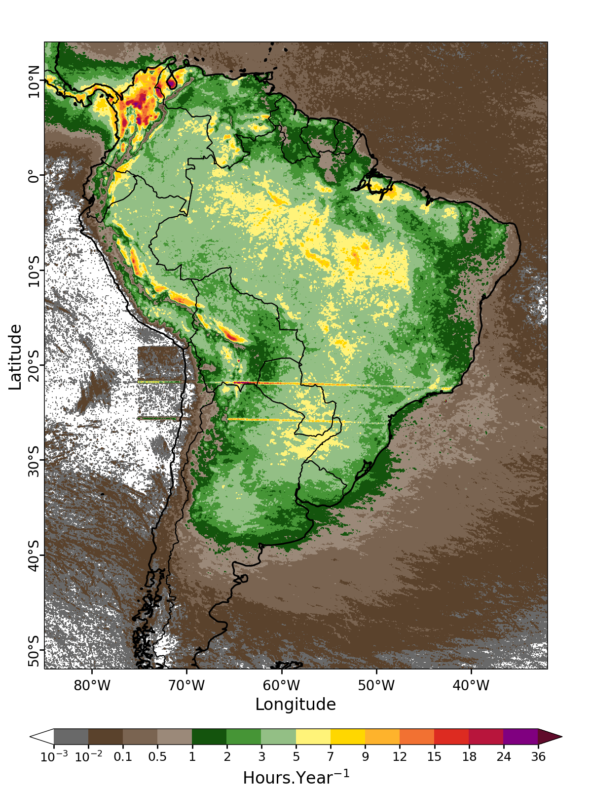
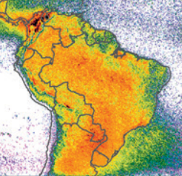
RESULTS
Annual mean density of flash (TRMM/LIS)
Annual mean density of flash (GOES-16/GLM)
Annual mean of hours with flash occurrence
Albrecht et al. (2016)
2022 GLM Science Meeting

Slide 6
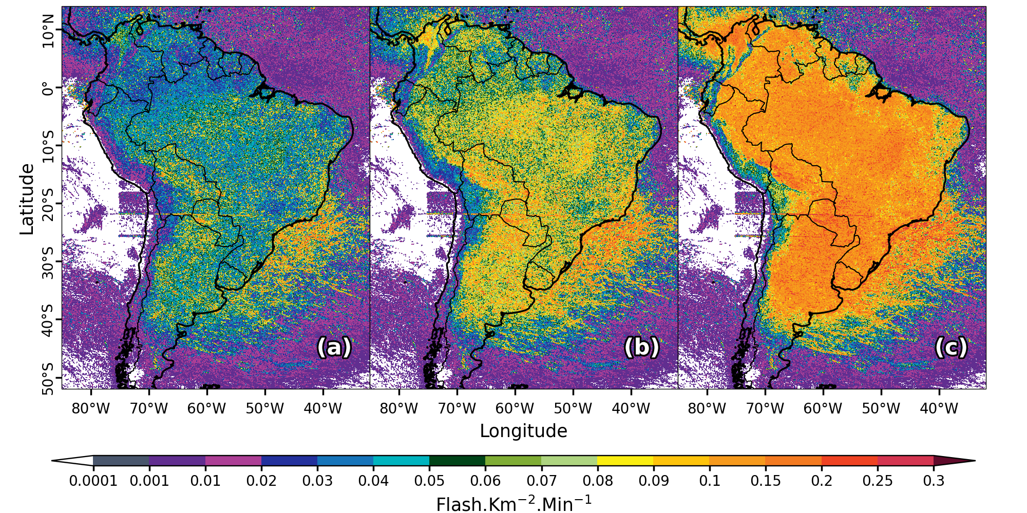
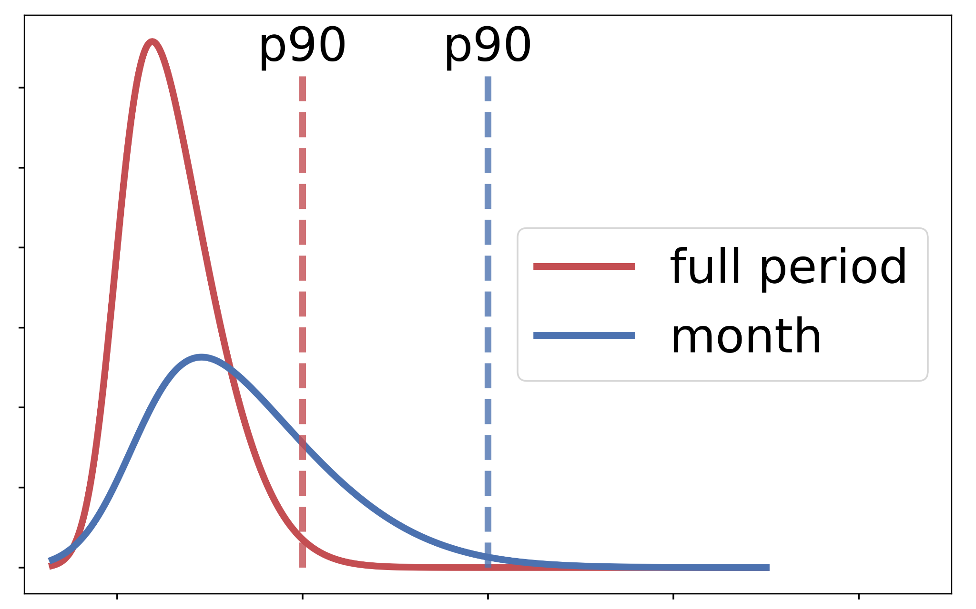
RESULTS
90th percentile of flash density in 5 min
95th percentile of flash density in 5 min
99th percentile of flash density in 5 min
2022 GLM Science Meeting

Slide 7
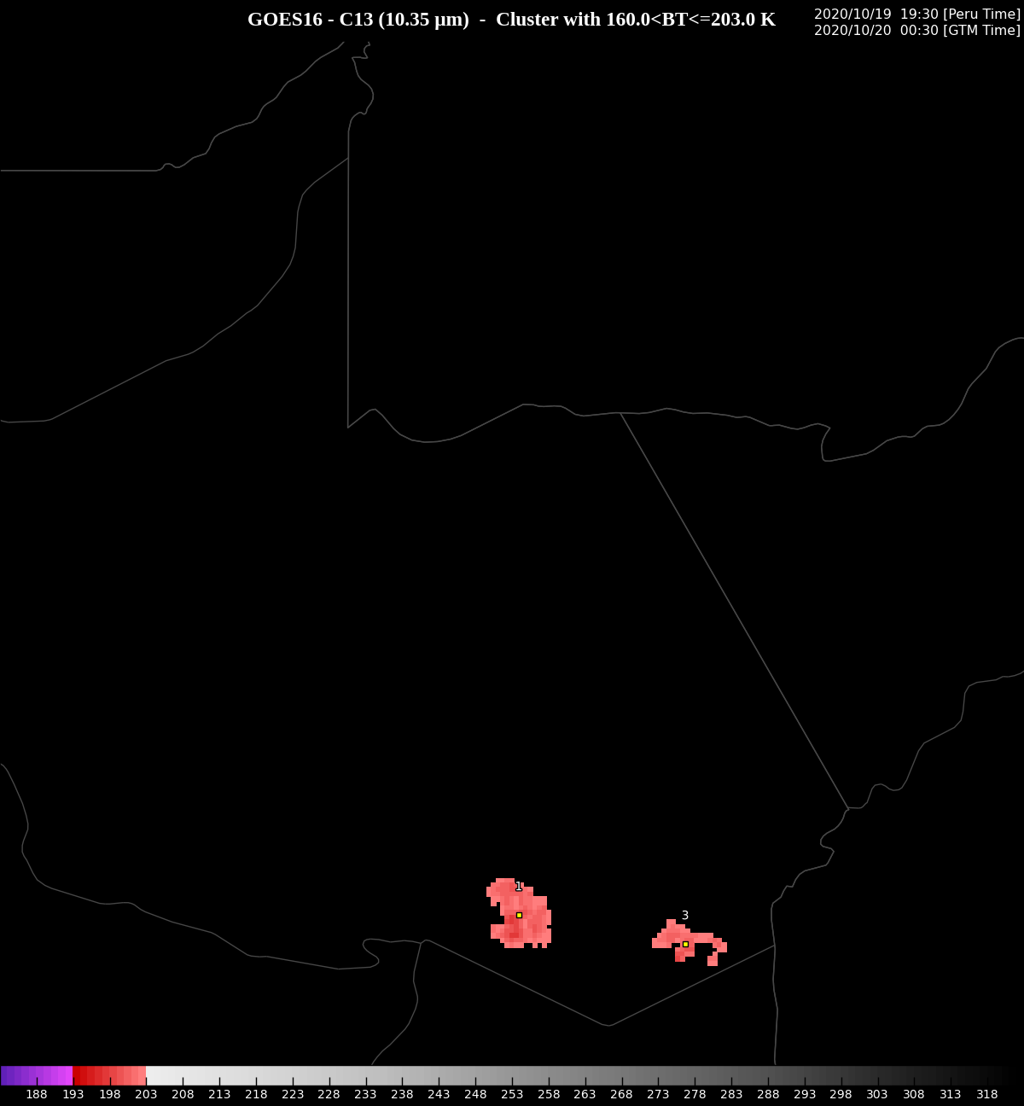
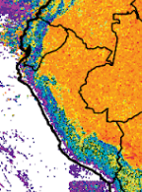
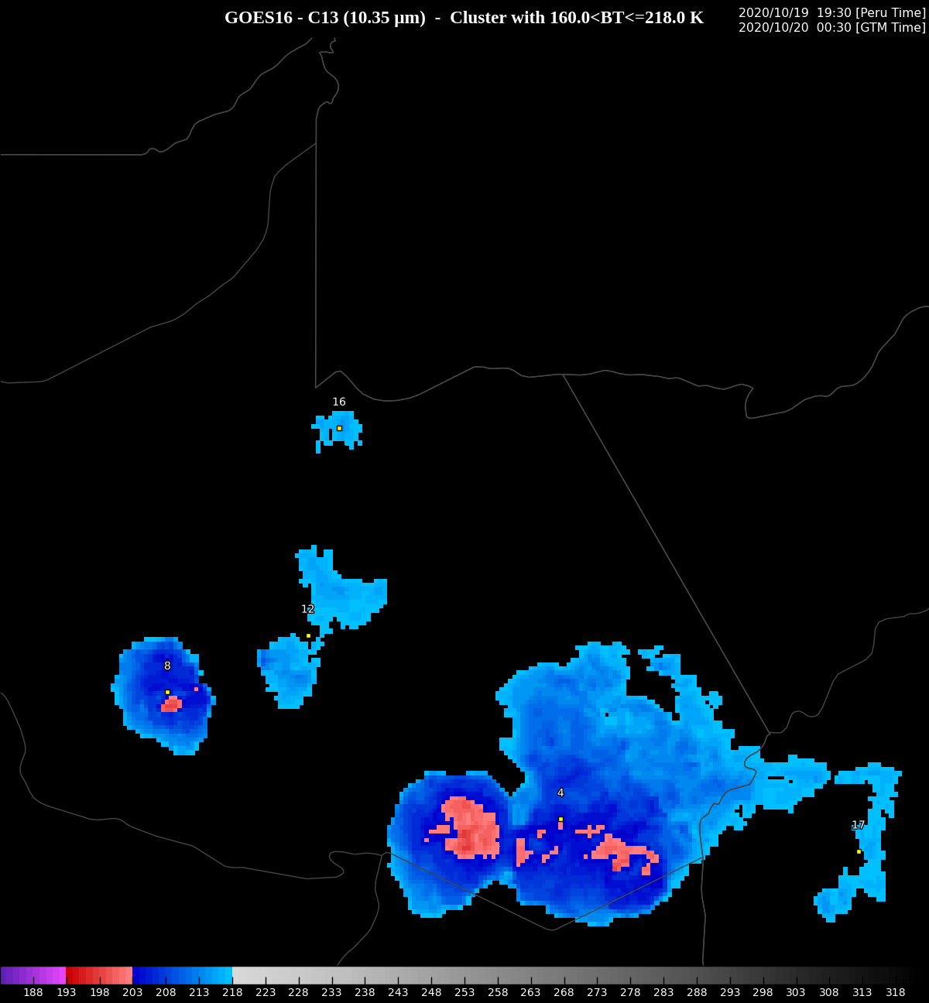
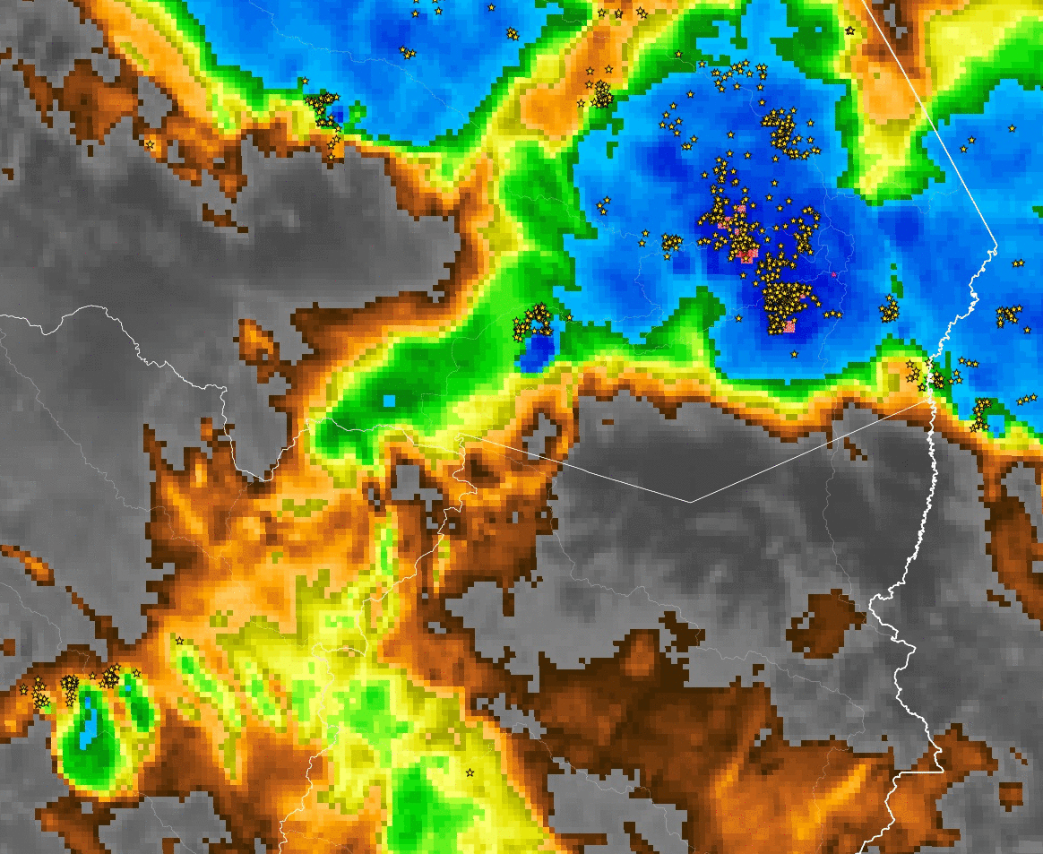
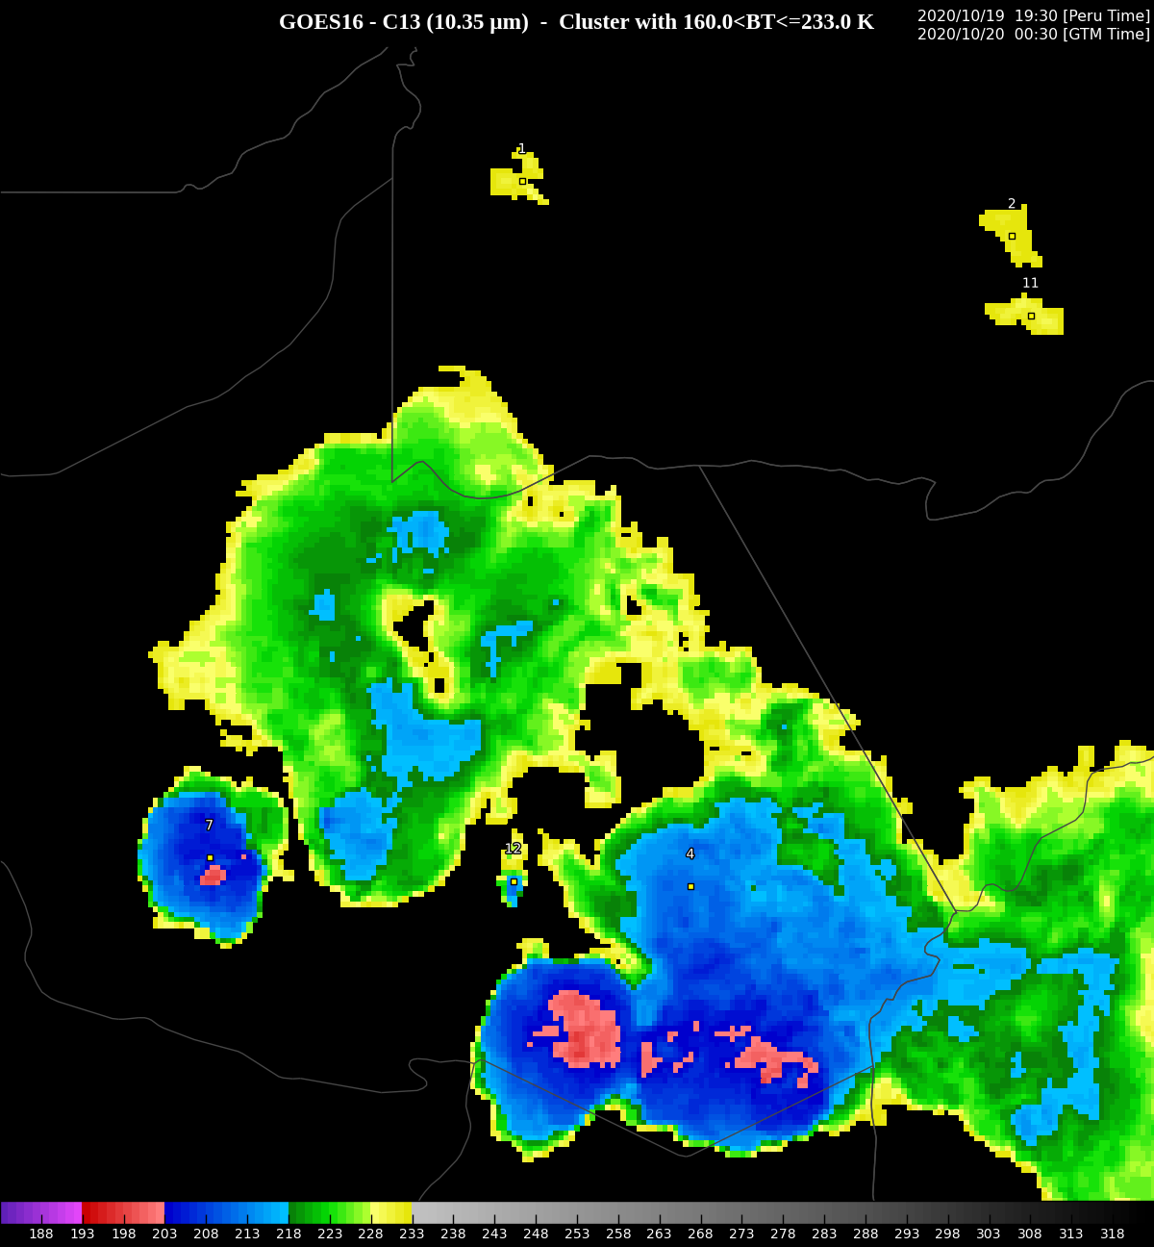
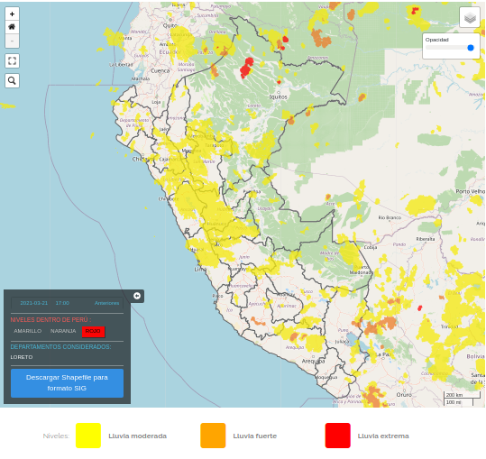
RESULTS
BT < 203 K (-70°C)
DT/Dt [K/15min] | Level
DT/Dt > -4 | 1
-8 < DT/Dt <= -4 | 2
DT/Dt <= -8 | 3
Percentile of flash density in 5 min
Mecikalski e Bedka (2006)
BT < 218 K (-55°C)
Identification of the most convective region
Fl. Dens. in 5 min (FD) | Level
1 <= FD < 5 | 1
5 <= FD < 20 | 2
FD >= 20 | 3
BT < 233 K (-40°C)
Empirical severity level based on FD
Identification of severity
Nowcasting of precipitation
(experimental product)
Extrapolation of features
Severity indicator (precursor of convection)
2022 GLM Science Meeting

Slide 8
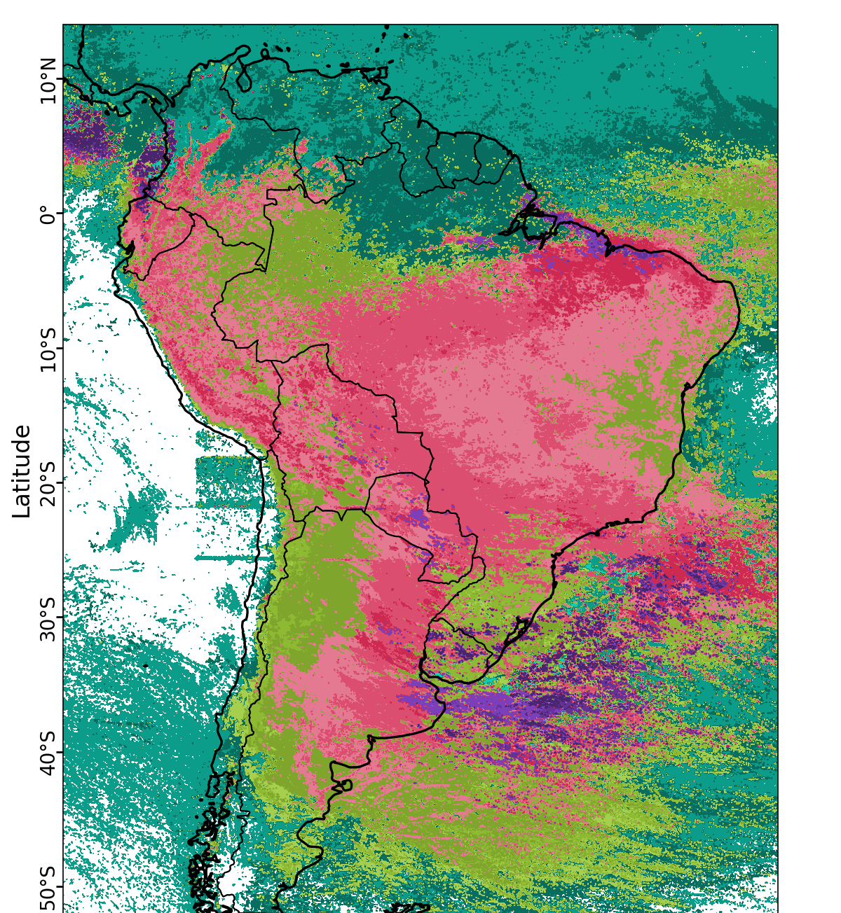
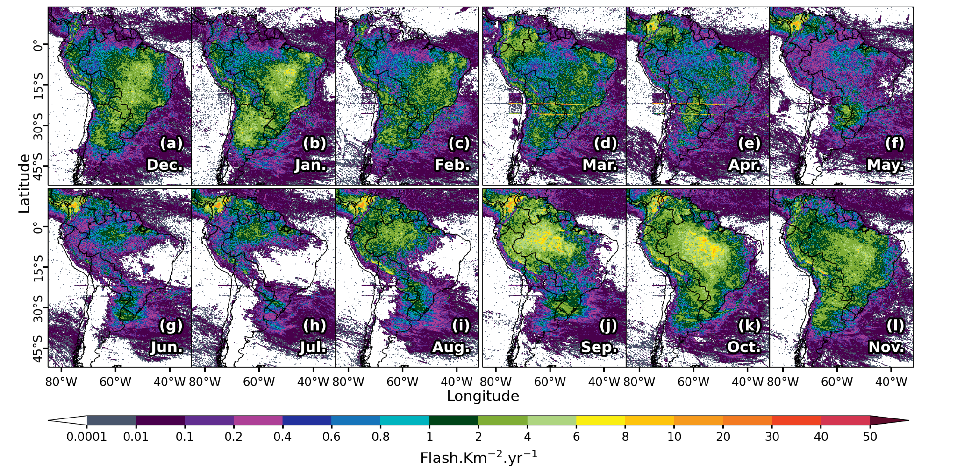
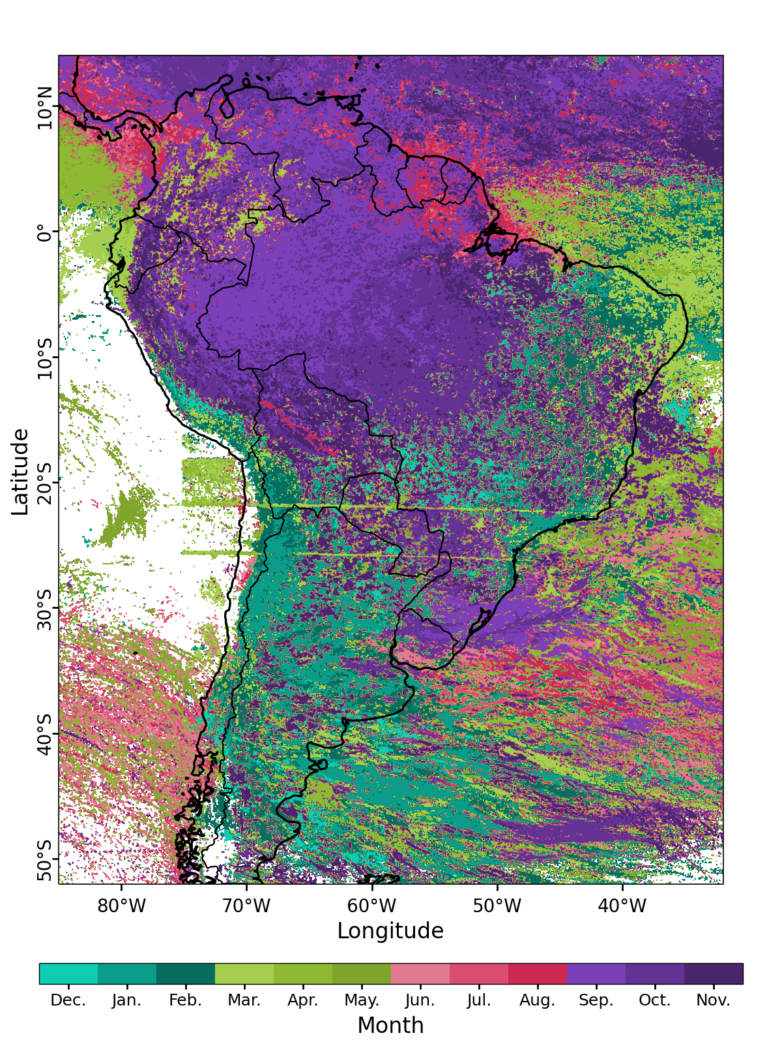
RESULTS
Monthly mean flash density from December to november [(a)-(l)]
Month with minimum lightning
Month with maximum lightning
The artifacts located in front of northern Chile are observed only from January to April, while the two artifact lines between 20°S and 25°S are present throughout the year.
2022 GLM Science Meeting

Slide 9
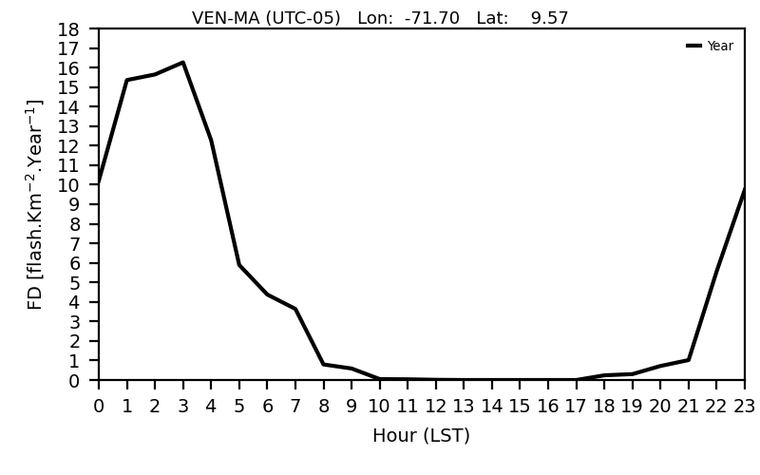
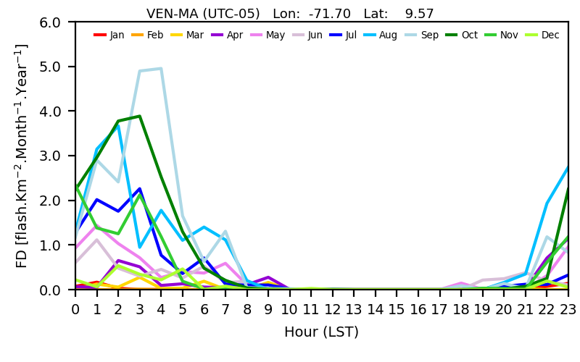
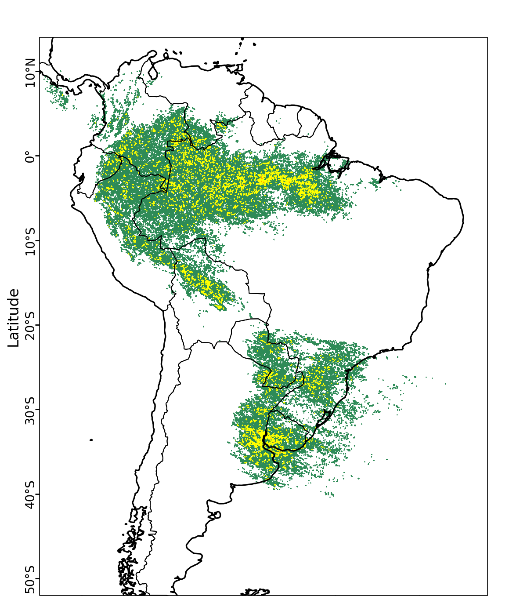
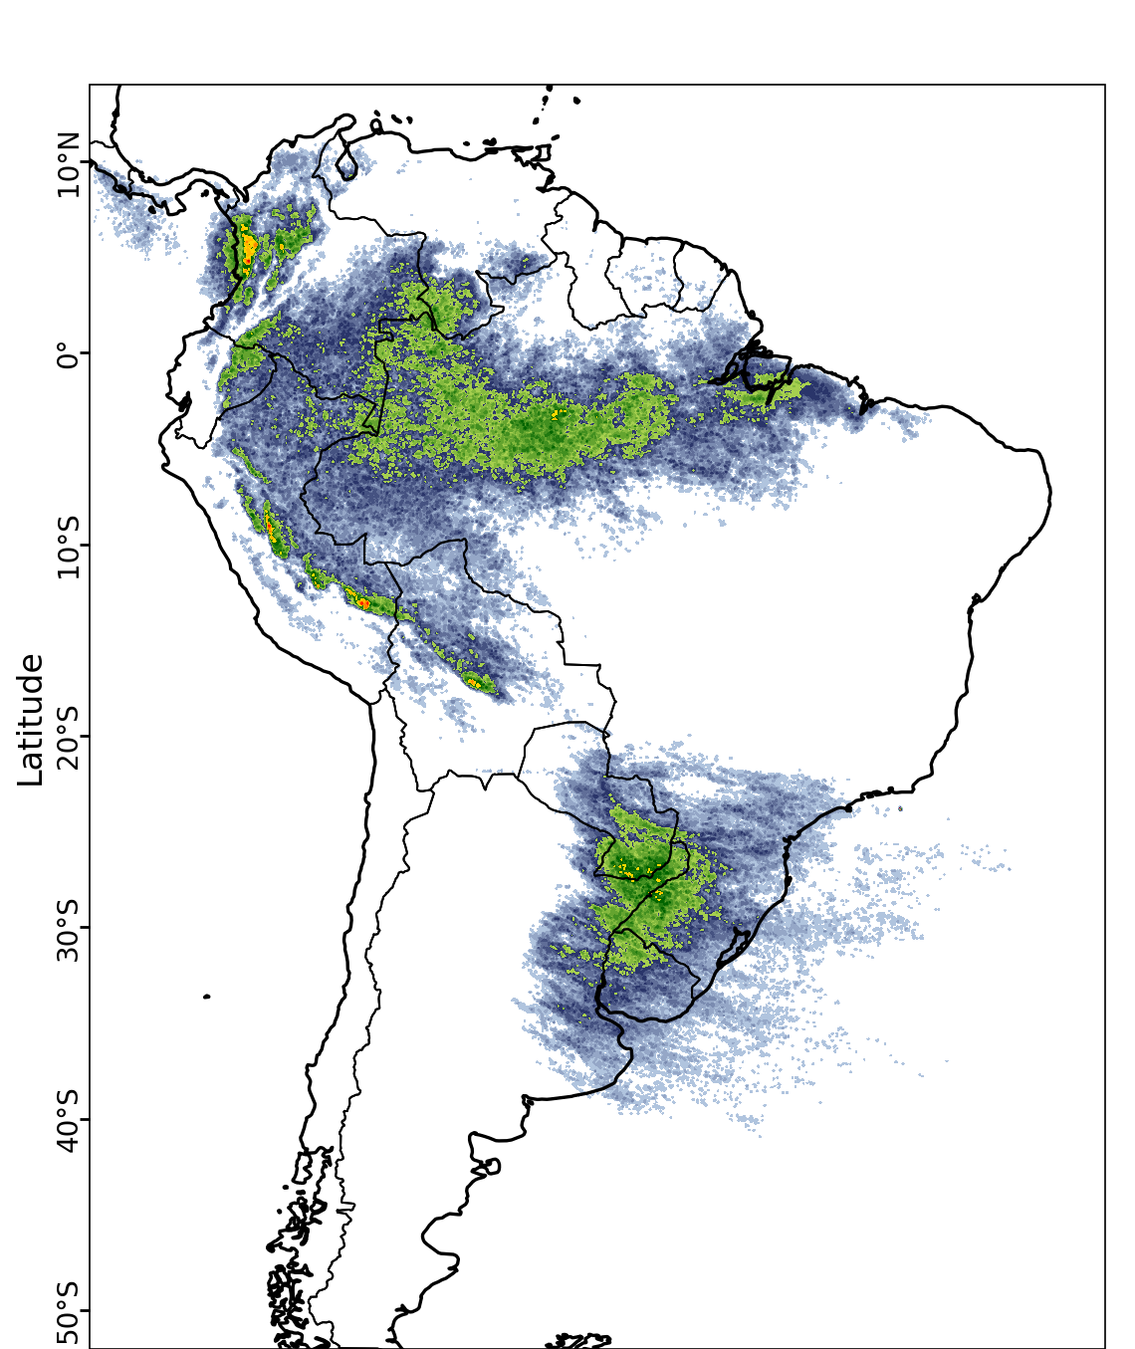
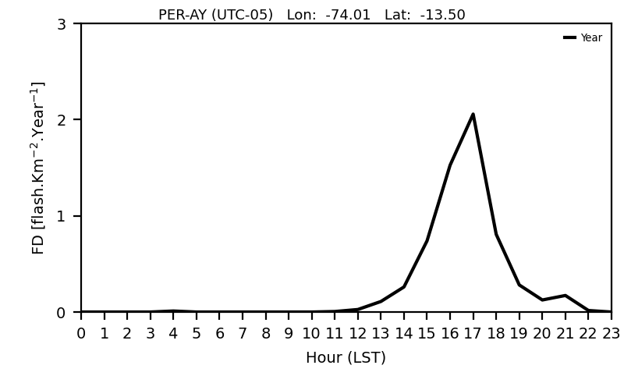
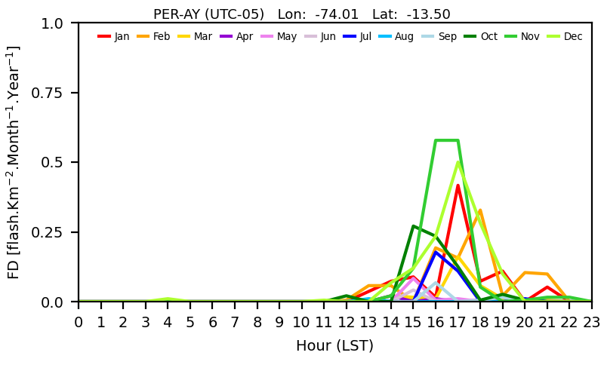
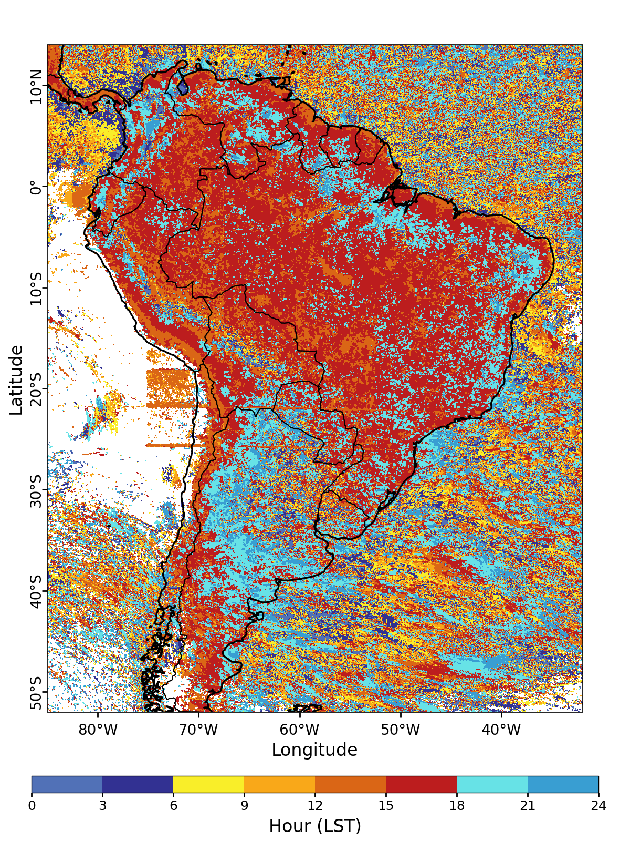
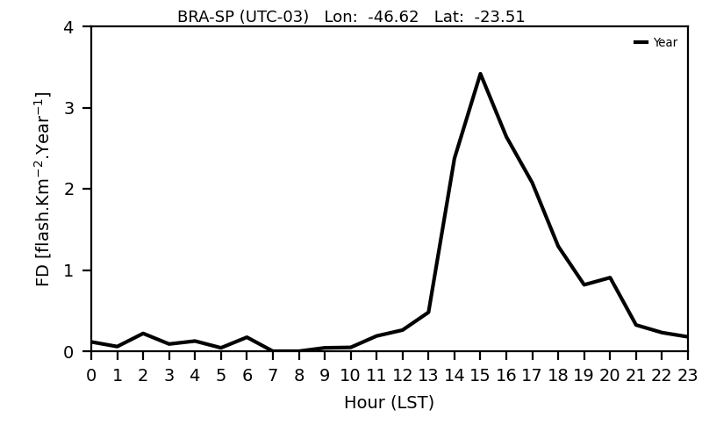
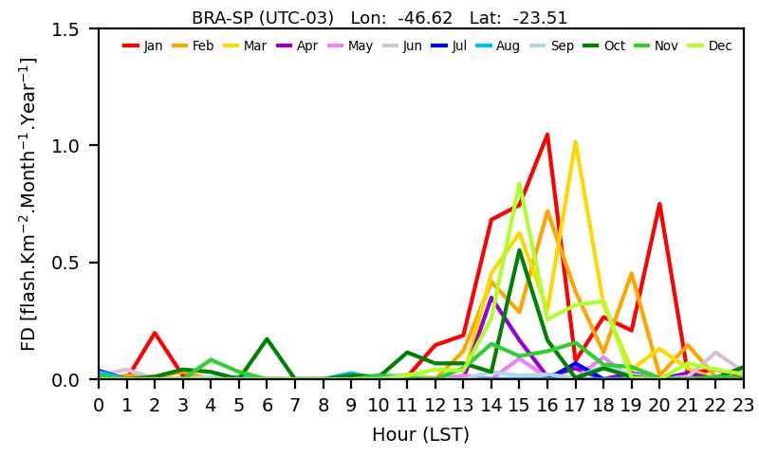
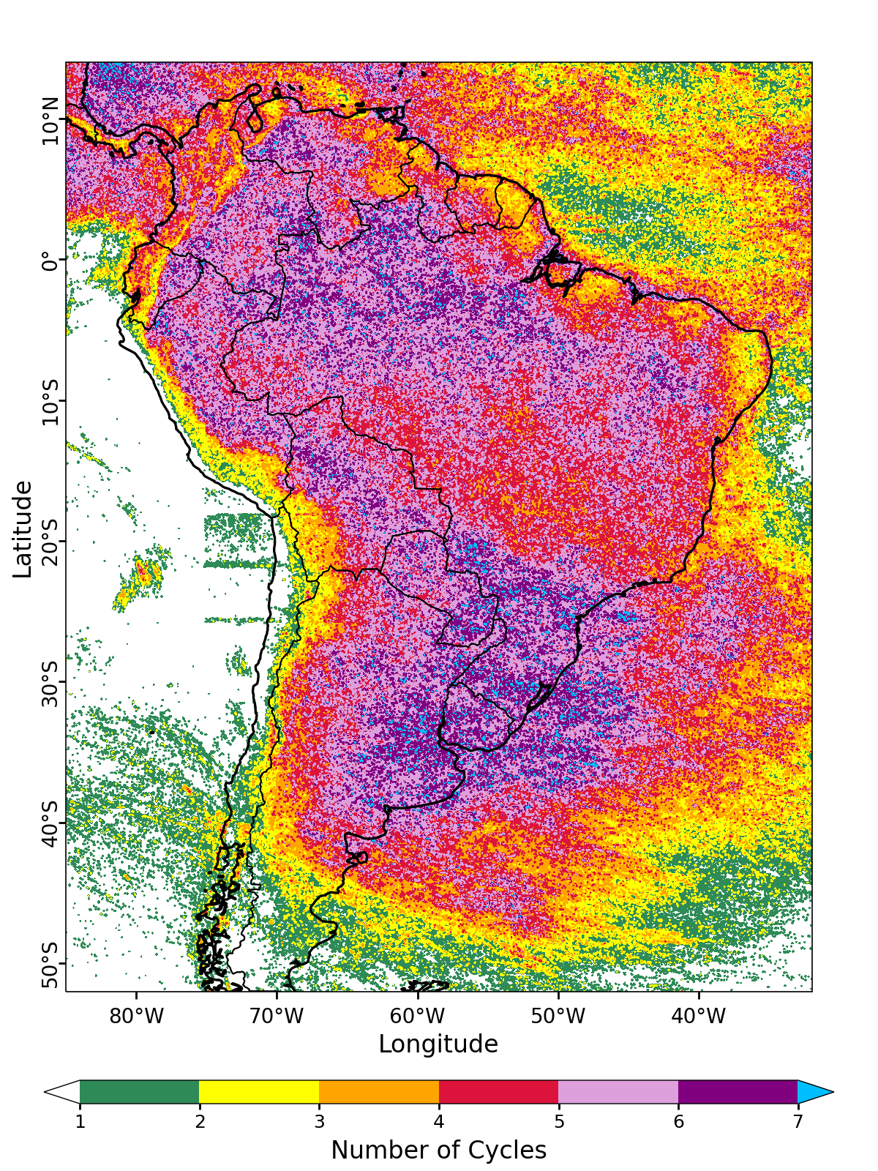
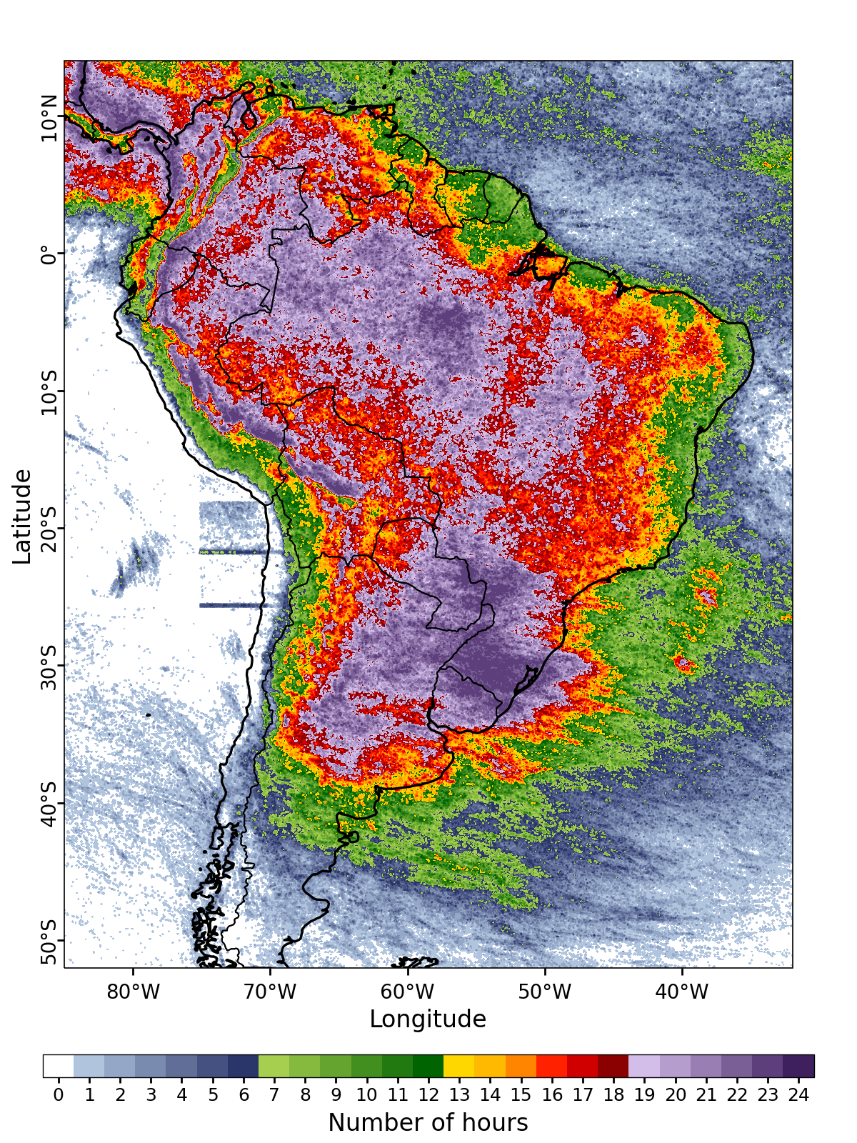
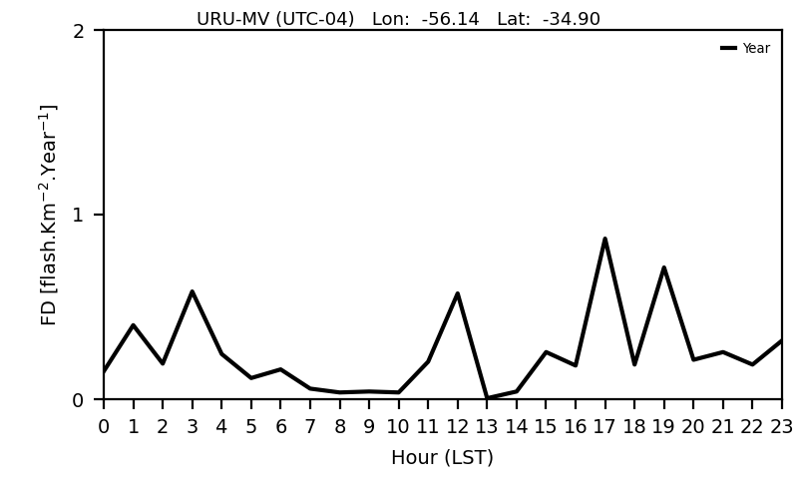
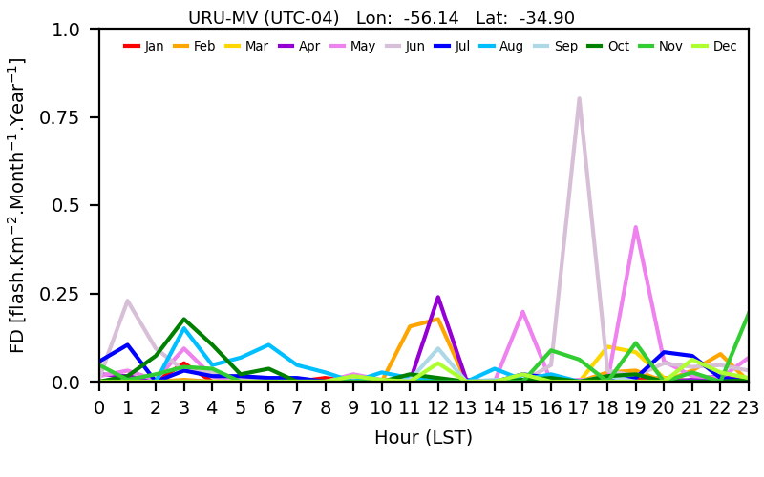
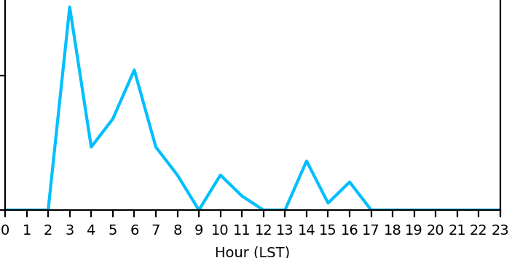
RESULTS
All data
Data by month
Number of cycles at day with lightning
Number of hours at day with lightning
Local standard time with maximum lightning
Minimum
Minimum
A cycle is defined as the period of time with the consecutive occurrence of lightning
Cycle 1
Cycle 2
Cycle 3
Maximum
Maximum
Artifacts at midday caused by sunlight
Hours with lightning
2022 GLM Science Meeting

Slide 10
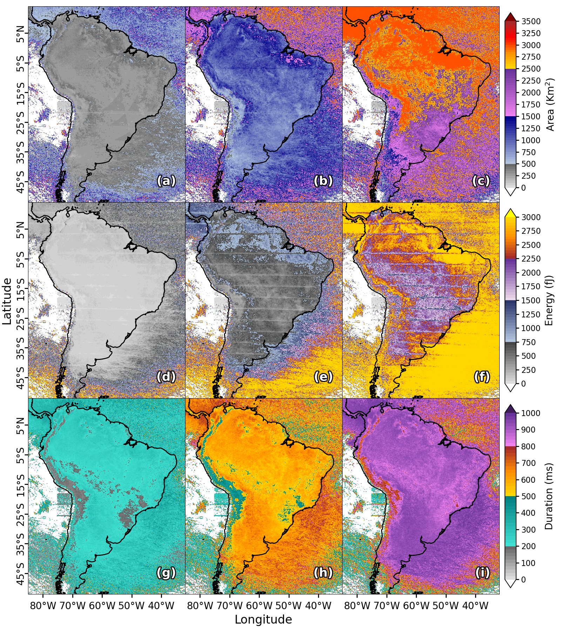
RESULTS
50th percentile
90th percentile
99th percentile
The flashes over the north and center of South America reach larger extensions of areas.
The brightest flashes occur over and near the sea.
Almost in all of South America flashes have the same potential to have long durations.
Percentiles of Area, energy and duration.
50th, 90th y 99th percentiles of area [(a)-(c)];
50th, 90th y 99th percentiles of energy [(d)-(f)];
50th, 90th y 99th percentiles of duration [(g)-(i)].
2022 GLM Science Meeting

Slide 11
CONCLUSIONS (1/2)
- The annual mean density of flashes obtained from GOES-16 has a distribution similar to that observed from low-earth orbit satellites, the main difference being the decrease in the maximum density of flashes over Argentina and Paraguay.
- Lightning hotspots with the highest annual mean density of flash (>50 flashes.Km-2.Year-1) and the highest number of hours with flash occurrence (>18 hours.64Km-2.Year-1) were found in Venezuela, Colombia, Peru and Bolivia.
- The regions located to the east of the Andes mountains show the same potential as the lightning hotspots to present high flash densities in short intervals of time (> 0.15 flash.Km-2.Min-1).
- Hotspots are caused for a greater number of hours with flashes than of a high density of flashes in short intervals of time (5 minute).
- The greatest electrical activity (in terms of more lightning areas and higher flash density) over South America occurs between September and March, while the lowest occurs between June and July.
2022 GLM Science Meeting

Slide 12
CONCLUSIONS (2/2)
- The greatest lightning activity during the day occurs between 15 and 24 local time over South America.
- The Andes mountain present the diurnal period with lightning more short and least variable in the region, while the longest and most variable diurnal period with lightning occurs in southeastern of South America.
- The flashes that occur in the northern and central regions of South America are more likely to reach large areas (>2500 Km2) than the southern region of South America.
- The brightest flashes occur more frequently over and near the ocean than within the continent.
- With the exception of the Andes mountains, South America has the same potential to present long-duration of flashes (>800 ms).
2022 GLM Science Meeting

Slide 13
REFERENCES
- Albrecht, R. I., Goodman, S. J., Buechler, D. E., Blakeslee, R. J., & Christian, H.J. (2016). Where are the lightning hotspots on Earth?.
- Bruning, E. C., Tillier, C. E., Edgington, ... & Meyer, T. C. (2019). Meteorological imagery for the geostationary lightning mapper.
- Goodman, S. J., Blakeslee, R. J., Koshak, W. J., Mach, ... & Stano, G. (2013). The GOES-R geostationary lightning mapper (GLM).
- Koshak, W. J., Mach, D. M., Bateman, M., Armstrong, P., & Virts, K. (2018). Product performance guide for data users.
- Mecikalski, J. R., & Bedka, K. M. (2006). Forecasting convective initiation by monitoring the evolution of moving cumulus in daytime GOES imagery. Monthly Weather Review, 134(1), 49-78.
- Oda, P. S., Enoré, D. P., Mattos, E. V., Gonçalves, W. A., & Albrecht, R. I. (2022). An initial assessment of the distribution of total Flash Rate Density (FRD) in Brazil from GOES-16 Geostationary Lightning Mapper (GLM) observations.
- Peterson, M. (2019). Research applications for the Geostationary Lightning Mapper operational lightning flash data product.
- Peterson, M. J., Lang, T. J., Bruning, E. C., Albrecht, R., Blakeslee, R. J., ... & Cerveny, R. S. (2020). New World Meteorological Organization certified megaflash lightning extremes for flash distance (709 km) and duration (16.73 s) recorded from space.
- Rudlosky, S. D., Goodman, S. J., Virts, K. S., & Bruning, E. C. (2019). Initial geostationary lightning mapper observations.
- Rudlosky, S. D., & Virts, K. S. (2021). Dual geostationary lightning mapper observations.
2022 GLM Science Meeting

