Slide 1
GLM Single Group Flash Analysis
Thursday, 15 September 2022
Douglas Mach
Senior Scientist, USRA/STI

Slide 2
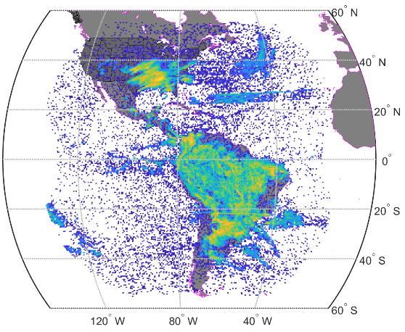
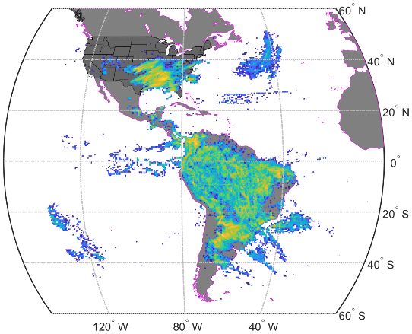
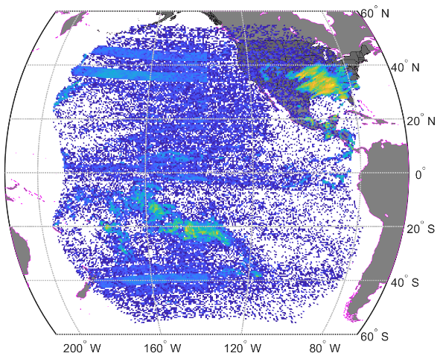
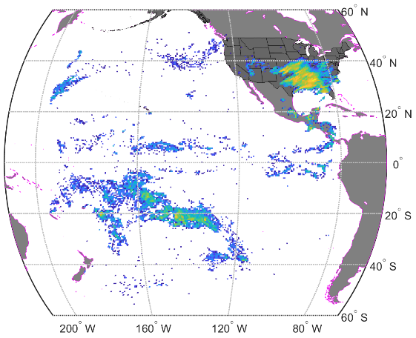
Introduction
The current operational GLM Lightning Cluster Filter Algorithm (LCFA) removes all flashes with a single group
Single Group Flashes (SGFs)
Multiple Group Flashes (MGFs)
Operational algorithm
GLM on GOES-16 (GLM16)
GLM on GOES-17 (GLM17)
How much “real lightning” is removed by the SGF filter?
How much lightning consists of only a single group?
Create a “ground truth” dataset
Common flashes between GLM16 and GLM17
Compare ground truth to GLM16 and GLM17 SGFs
Determine fraction (and locations) of SGFs that are in/not in the ground truth dataset

Slide 3
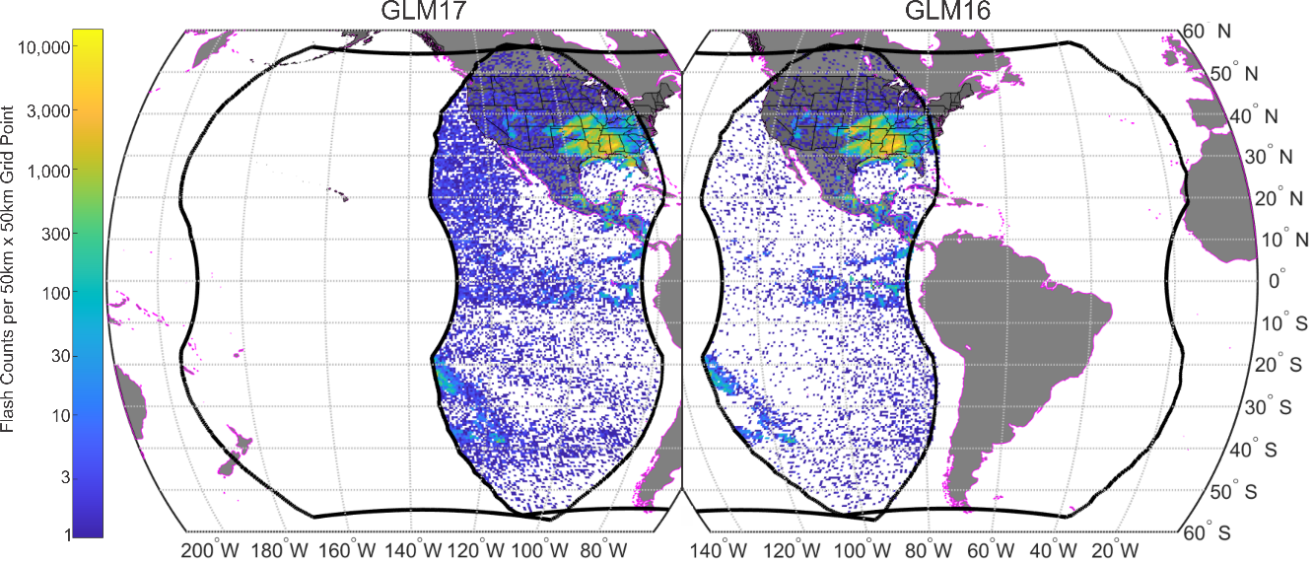
Study Dataset
L1b events (not filtered for SGFs)
Clustered into L2 flashes (without the Operational Algorithm group and flash count and temporal limits)
GLM16 and GLM17 flashes in overlap region
00:00Z 16 March 2021 to 00:00Z 19 March 2021
740248 GLM16 flashes in overlap region (including SGFs)
623084 GLM17 flashes in overlap region (including SGFs)

Slide 4
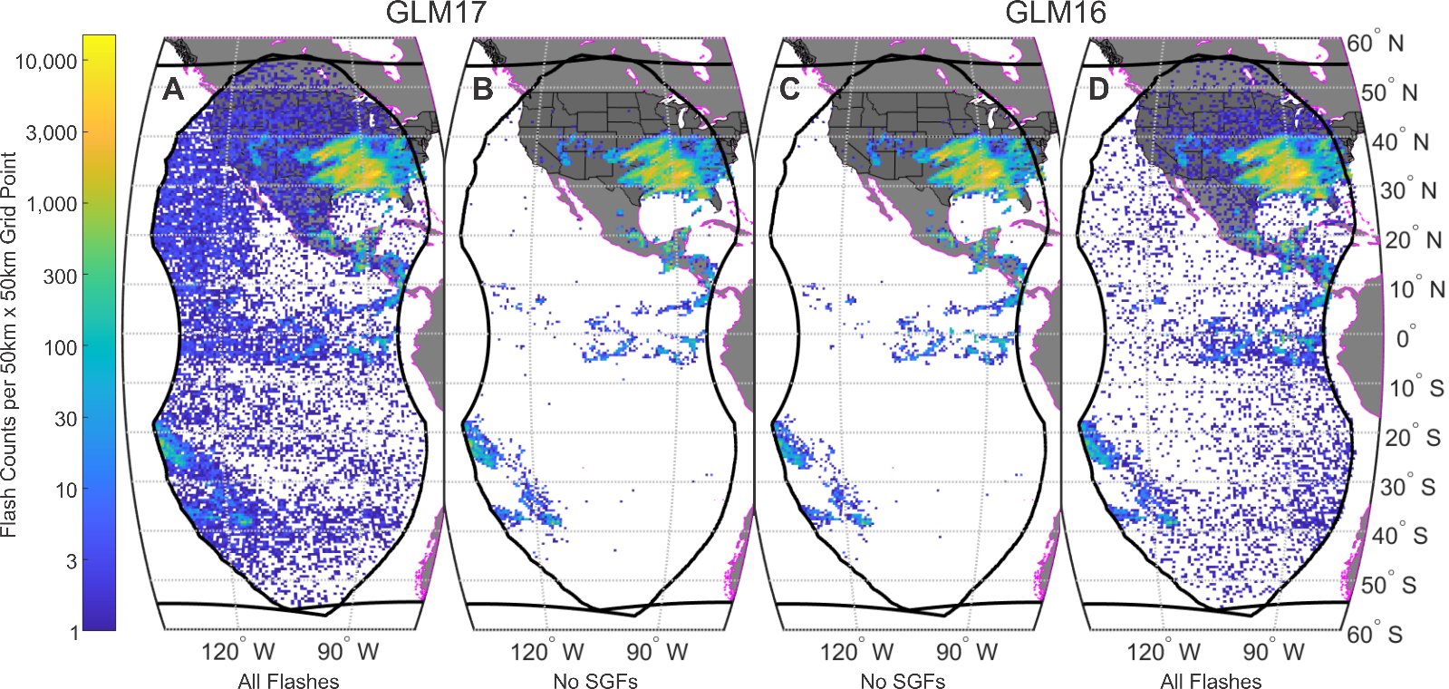
Operational Algorithm vs. All Flashes (no SGF filter)
GLM16
661699 MGFs (C)
740248 total flashes (D)
11% SGFs
GLM17
520407 MGFs (B)
623084 total flashes (A)
16% SGFs

Slide 5
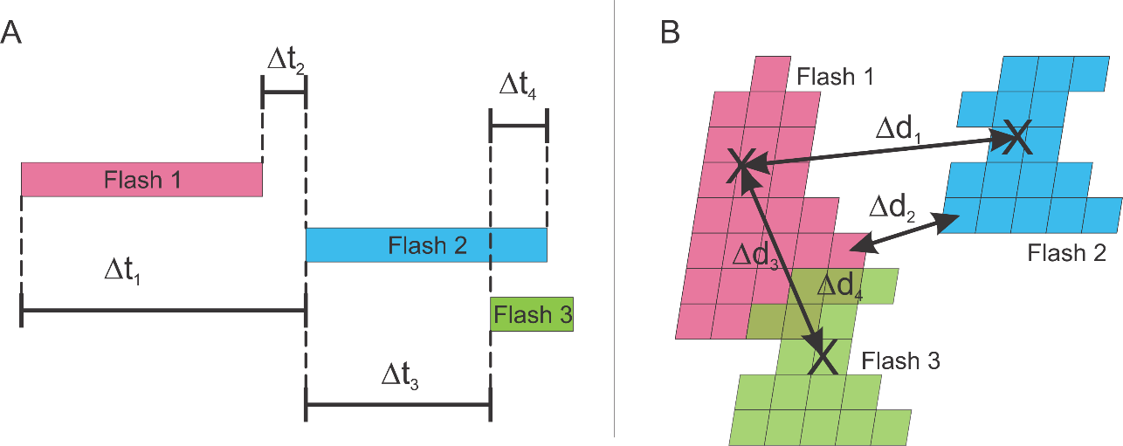
Coincidence Determination
Two general ways to determine temporal and spatial separation
Difference between flash start times (∆t₁, ∆t₃)
Time gap between flashes (∆t₂, ∆t₄)
Distance between flash centroids distances (∆d₁, ∆d₃)
Minimum distance between events in the two flashes (∆d₂, ∆d₄)
Time gap between flashes (∆t₂, ∆t₄)
Note that for the coincidence determination, ∆t₄ will be considered 0 s
Minimum distance between events in the two flashes (∆d₂, ∆d₄)
Note that for the coincidence determination, ∆d₄ will be considered 0 km

Slide 6
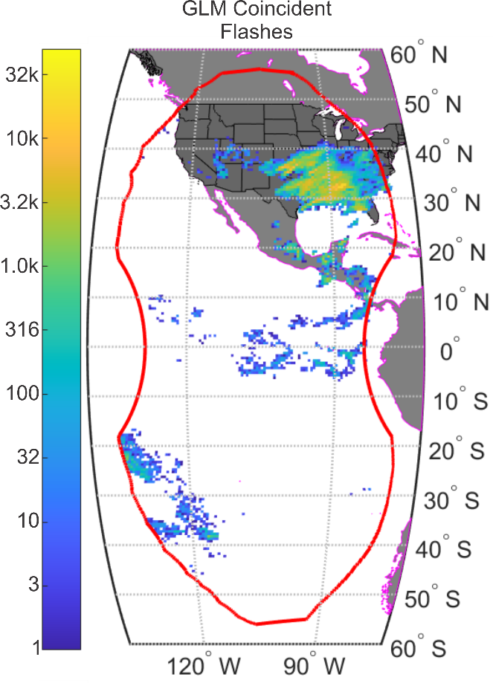
Common Flash Determination
Spatial limit in this analysis is set to 20 km
Based on parallax measurements in Mach (2021)
Temporal limit is set to 0.5 s
GLM flash times are more accurate than 0.5s
The larger time window allows for the possibility of one GLM missing the initial groups of a flash
Utilizing the parameters above…
558490 GLM16 common flashes
586423 GLM17 common flashes
Not always one-to-one GLM16 to GLM17 flashes

Slide 7
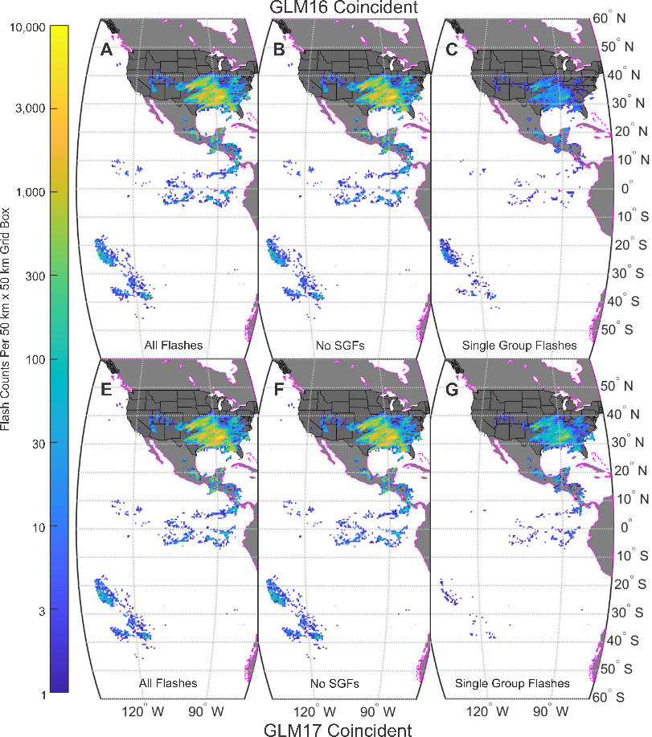
Results: Coincident Flashes
 | Coincident Flashes
 | All | Multiple Group Flashes | Single Group Flashes
GLM16 | 558490 (75%) | 537218 (73%) | 21272 (3%)
GLM17 | 586423 (94%) | 508454 (82%) | 77969 (13%)

Slide 8
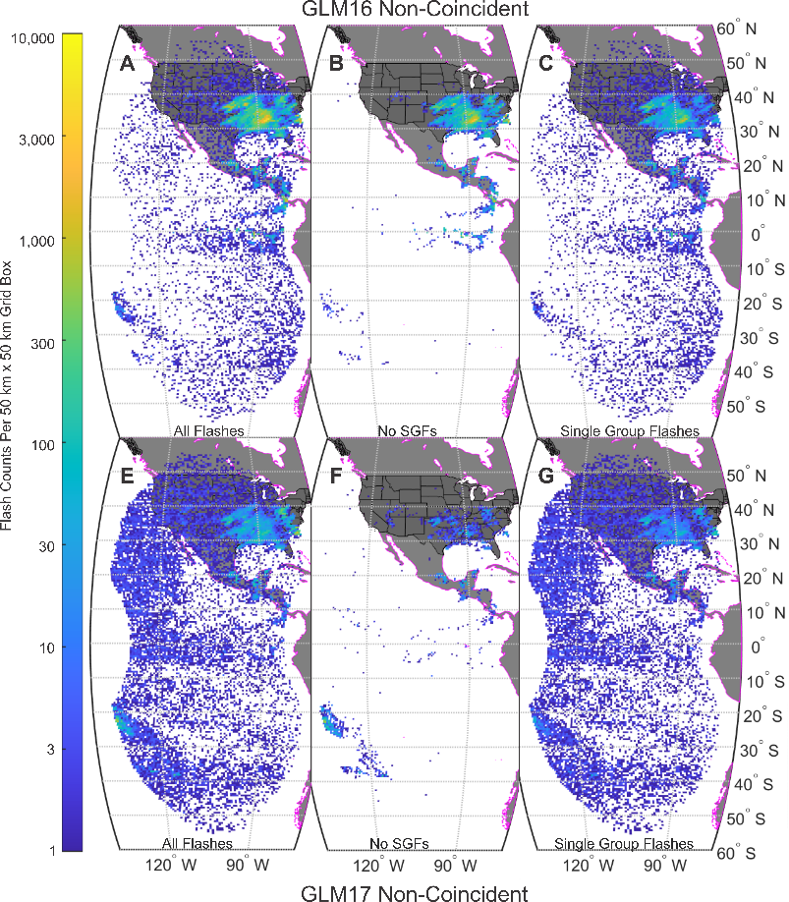
Results: Non-Coincident Flashes
 | Non-Coincident Flashes
 | All | Multiple Group Flashes | Single Group Flashes
GLM16 | 181758 (25%) | 125582 (17%) | 56176 (8%)
GLM17 | 36661 (6%) | 11953 (2%) | 24708 (4%)

Slide 9
Conclusions
11-16% of flashes that pass the L1b filters are SGFs
75-94% of flashes that pass the L1b filters are coincident between GLM16 and GLM17
Most of the flashes (73-82%) that are coincident are MGFs
Non-coincident flashes tend to have a more random distribution
Coincident SGFs cluster with the coincident MGFs
The SGF filter eliminates much of the “random” flashes from the L1b data

Slide 10
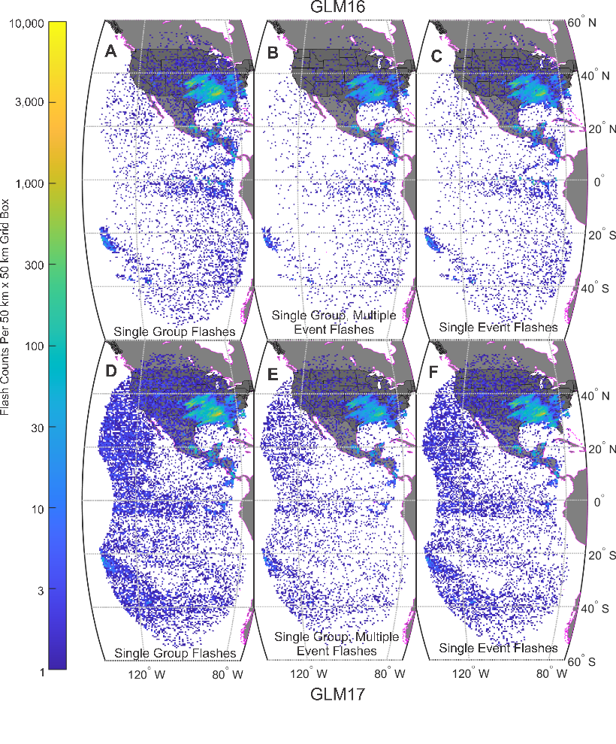
Single Event Flashes NOT the Solution

