Slide 1
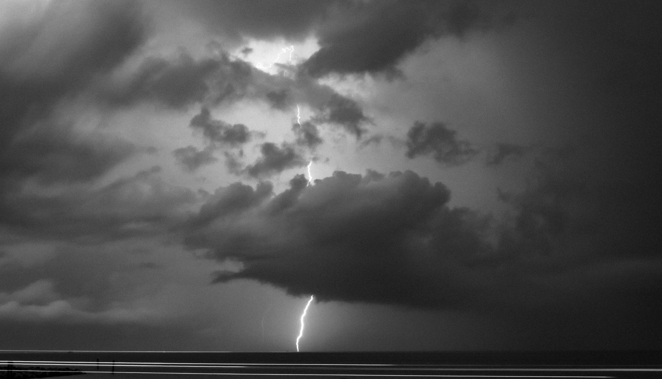
Determination of GLM observed Lightning clouds by applying neural network models to the GMI passive microwave brightness temperatures over the American continents
Florian Morvais and Chuntao Liu
Texas A&M University – Corpus Christi

Slide 2
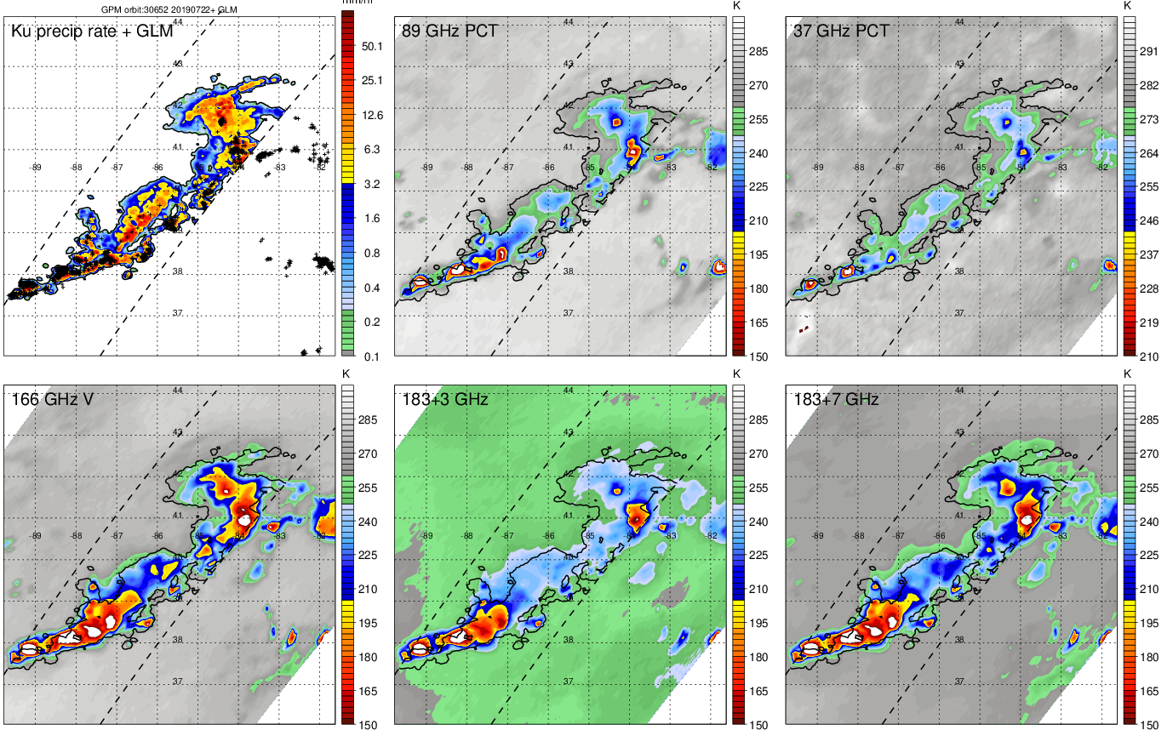
GPM Precipitation Feature (PFs) and GLM Lightning Collocation
2
PFs are defined by contiguous area with surface precipitation by Ku radar (≥ 4 pixels * 25 km²)
Minimum GMI TBs within each PF is calculated
GLM lightning counts within 10 minutes before and after the time of each PF are calculated within the ellipse of each PF
Liu, Chuntao, et al. "A cloud and precipitation feature database from nine years of TRMM observations." Journal of Applied Meteorology and Climatology 47.10 (2008): 2712-2728.
mm/h

Slide 3
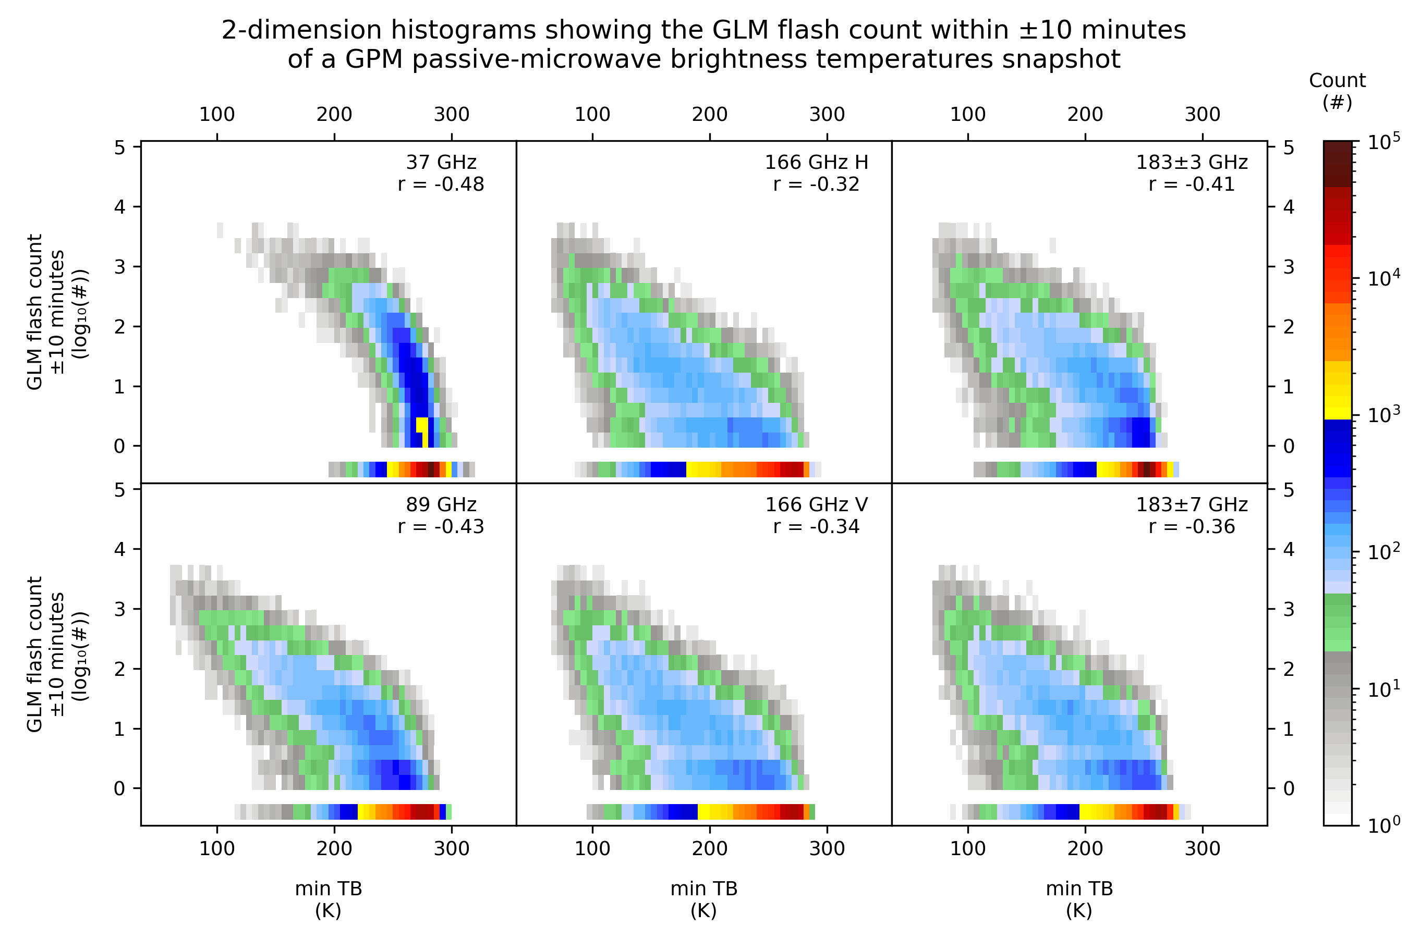
PFs Minimum TBs vs. Lightning counts
3
Good relationship between minimum Brightness Temperature (TB) and Lightning (e.g., flash rate)
- Liu, C., Cecil, D., & Zipser, E. J. (2011)
- Heuscher, L., Liu, C., Gatlin, P., & Petersen, W. A. (2022)
Feb 2018 – Apr 2020 (207,189 PFs)
PFs over the American Continent (over Land)
Correlation Y/N Lightning :
 | 37 PCT | 166 H | 183±3
r (Pearson) | -0.43 | -0.65 | -0.67
 | 89 PCT | 166 V | 183±7
r (Pearson) | -0.68 | -0.67 | -0.69

Slide 4
Goals
4
Take advantage of the GLM-GMI collocation to train a Neural Network able to differentiate lightning-producing PFs (LPFs) from non-lightning ones (no-LPFs, with flash rate < 0.05/minute)
Why ? Because GLM is not global, CubeSats will provide a lot of passive microwave observations in the future. We can utilize passive microwave observations to indicate the convective intensity/electrification in cloud systems.
What channels of TBs contain information to identify LPFs ? What are the limitations ?
26 months of data (v6)
(Feb 2018 - Apr 2020)
207,189 PFs
(21,680 - 10.46% LPFs)
Min PCT 37 GHz
Mixed Phase
Min PCT 89 GHz
AI NN
2 layers
13 neurons
14 epochs
Min 166 GHz H
input
output
0 – 1
(No – Yes)
Training set (70%)
Min 166 GHz V
Solid Phase
Threshold = 0.313
CSI = 0.500
PSS = 0.830
Validation set (10%)
Min 183±3 GHz
Testing set (20%) = 41,438 PFs
Min 183±7 GHz

Slide 5
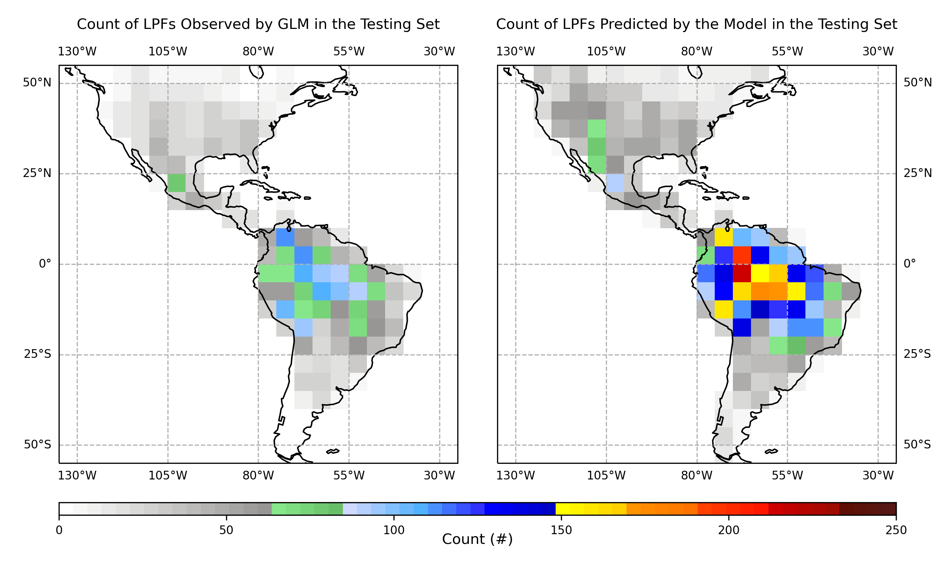
Observations vs. Predictions
5
Testing Set (20%) : 41,438 PFs (4,401 LPFs - 10.62% )
Uneven distribution of LPFs (5° bins)
Metrics computed in bins with low count (~edges) are not to be trusted
Differences between Observations and Predictions :
→ False Alarms
→ Missed LPFs

Slide 6
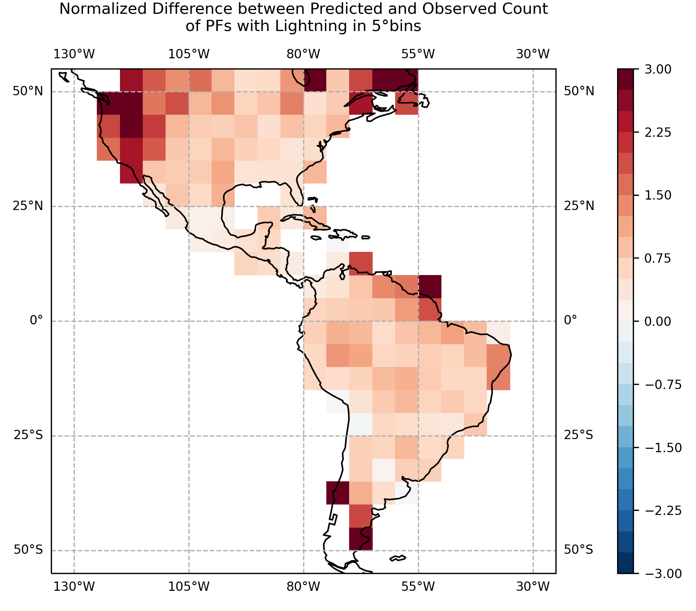
Testing Set: Spatial Results
6
GLM Observation
 | Flash Count ≥ 1 | Flash Count = 0
Lightning | 4,104 (GF) | 3,815 (FA)
No Lightning | 297 (MF) | 33,222 (GF0)
Testing Set (20%) : 41,438 PFs (4,401 LPFs - 10.62%)
→ 4,401 LPFs : 93.3% Good Forecast event (GF)
6.7% Missed Forecast (MF)
→ 37,037 no-LPFs : 89.7% Correct Forecast nonevent (GF0)
10.3% Miss-Classified (i.e., False Alarms (FA))
False Alarm Rate : 48.2%
Neural
Network
AINN is good at detecting LPFs
Large overprediction of the number of LPFs (1/2)
Question :
Why is the model overpredicting the number of LPFs?

Slide 7
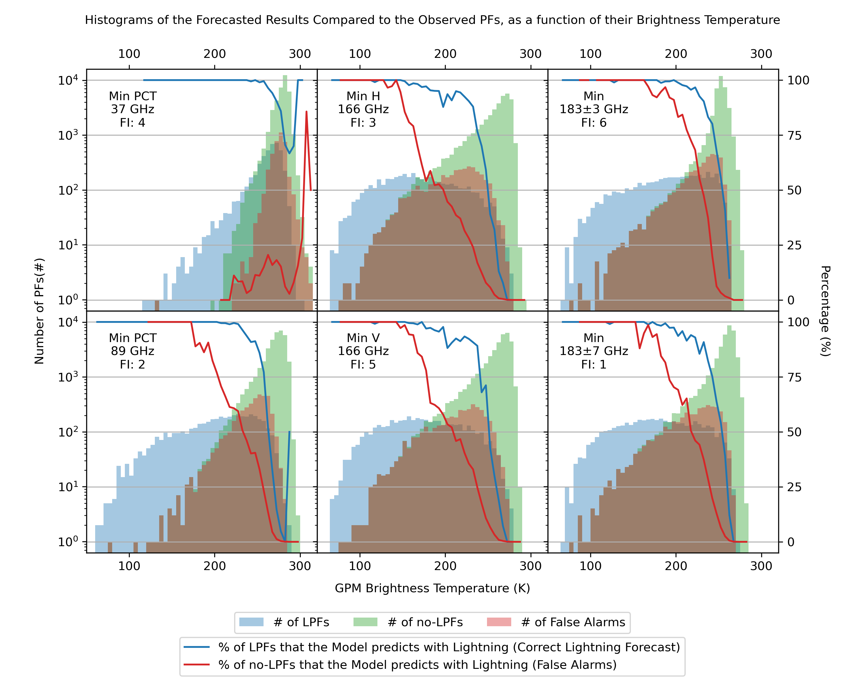
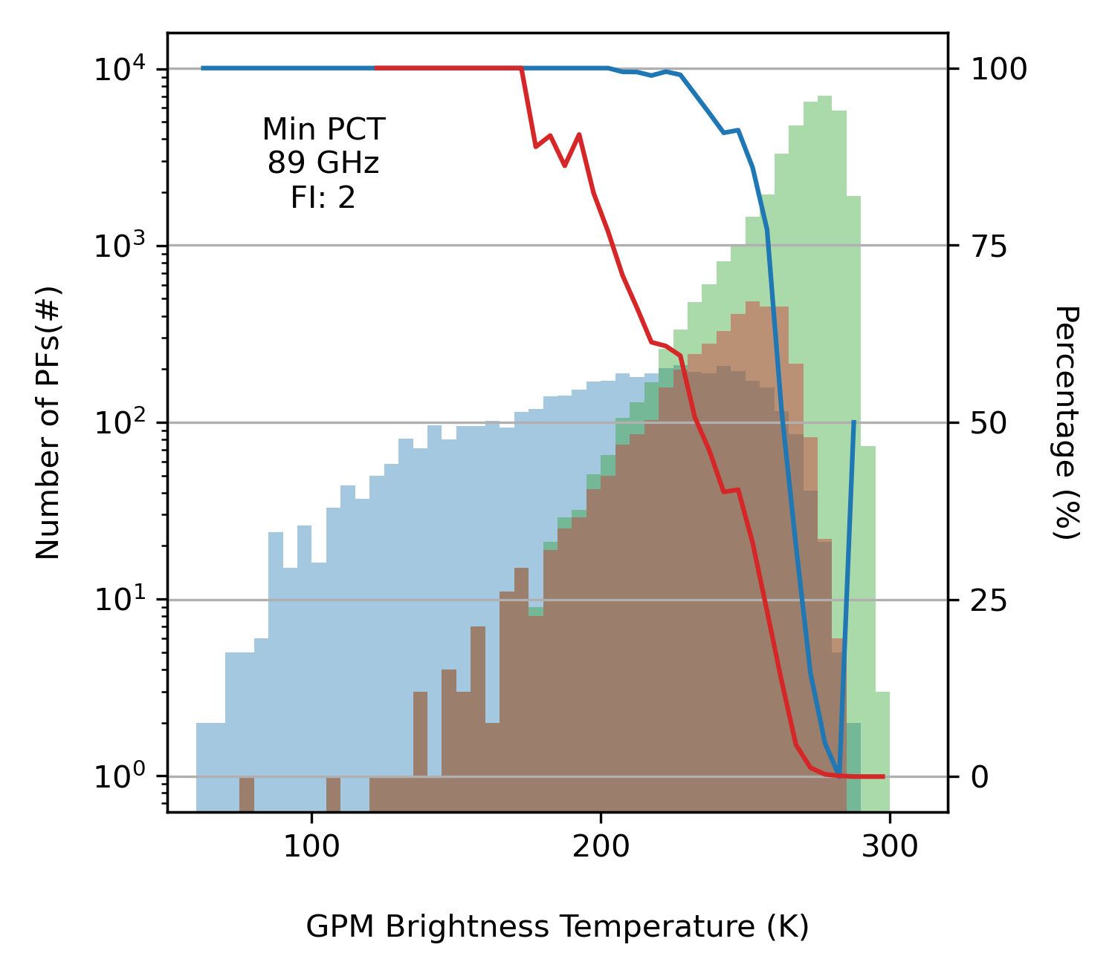
Physical Limitations
7
The lower the TBs :
→ The higher probability of Correct LPF Prediction, and False Alarms
Large overlapping of the min TBs of PFs with and without Lightning
Maximum False Alarm Count around 200-250 K

Slide 8
Conclusions and Future Work
8
Conclusion :
→ GPM Passive-Microwave Brightness Temperature does allow the differentiation of LPFs and no-LPFs
→ Lack of information (FAR ~ 48%)
→ Real FAR probably lower (GLM issues / Electrified Clouds)
→ Results are promising
Future work :
→ Flash Rate / Lightning Count (good correlation with area of cold TB)
→ Use minimum TBs to estimate maximum echo top heights

Slide 9
Thank you !
Questions / Comments ?

Slide 10
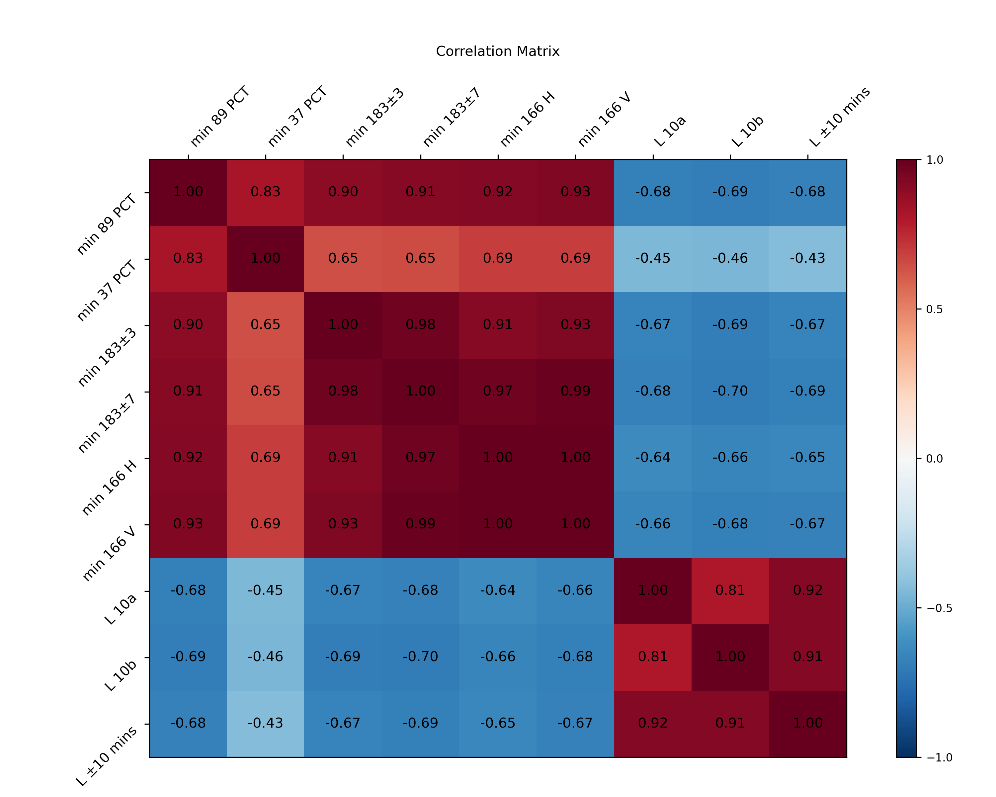
Correlation
Matrix
L 10a = Lightning in the 10 minutes after the GLM Snapshot
L 10b = Lightning in the 10 minutes before the GLM Snapshot
L ±10 mins = Lightning within the 10 minutes before and after → What the model tries to predict
Autocorrelation

Slide 11
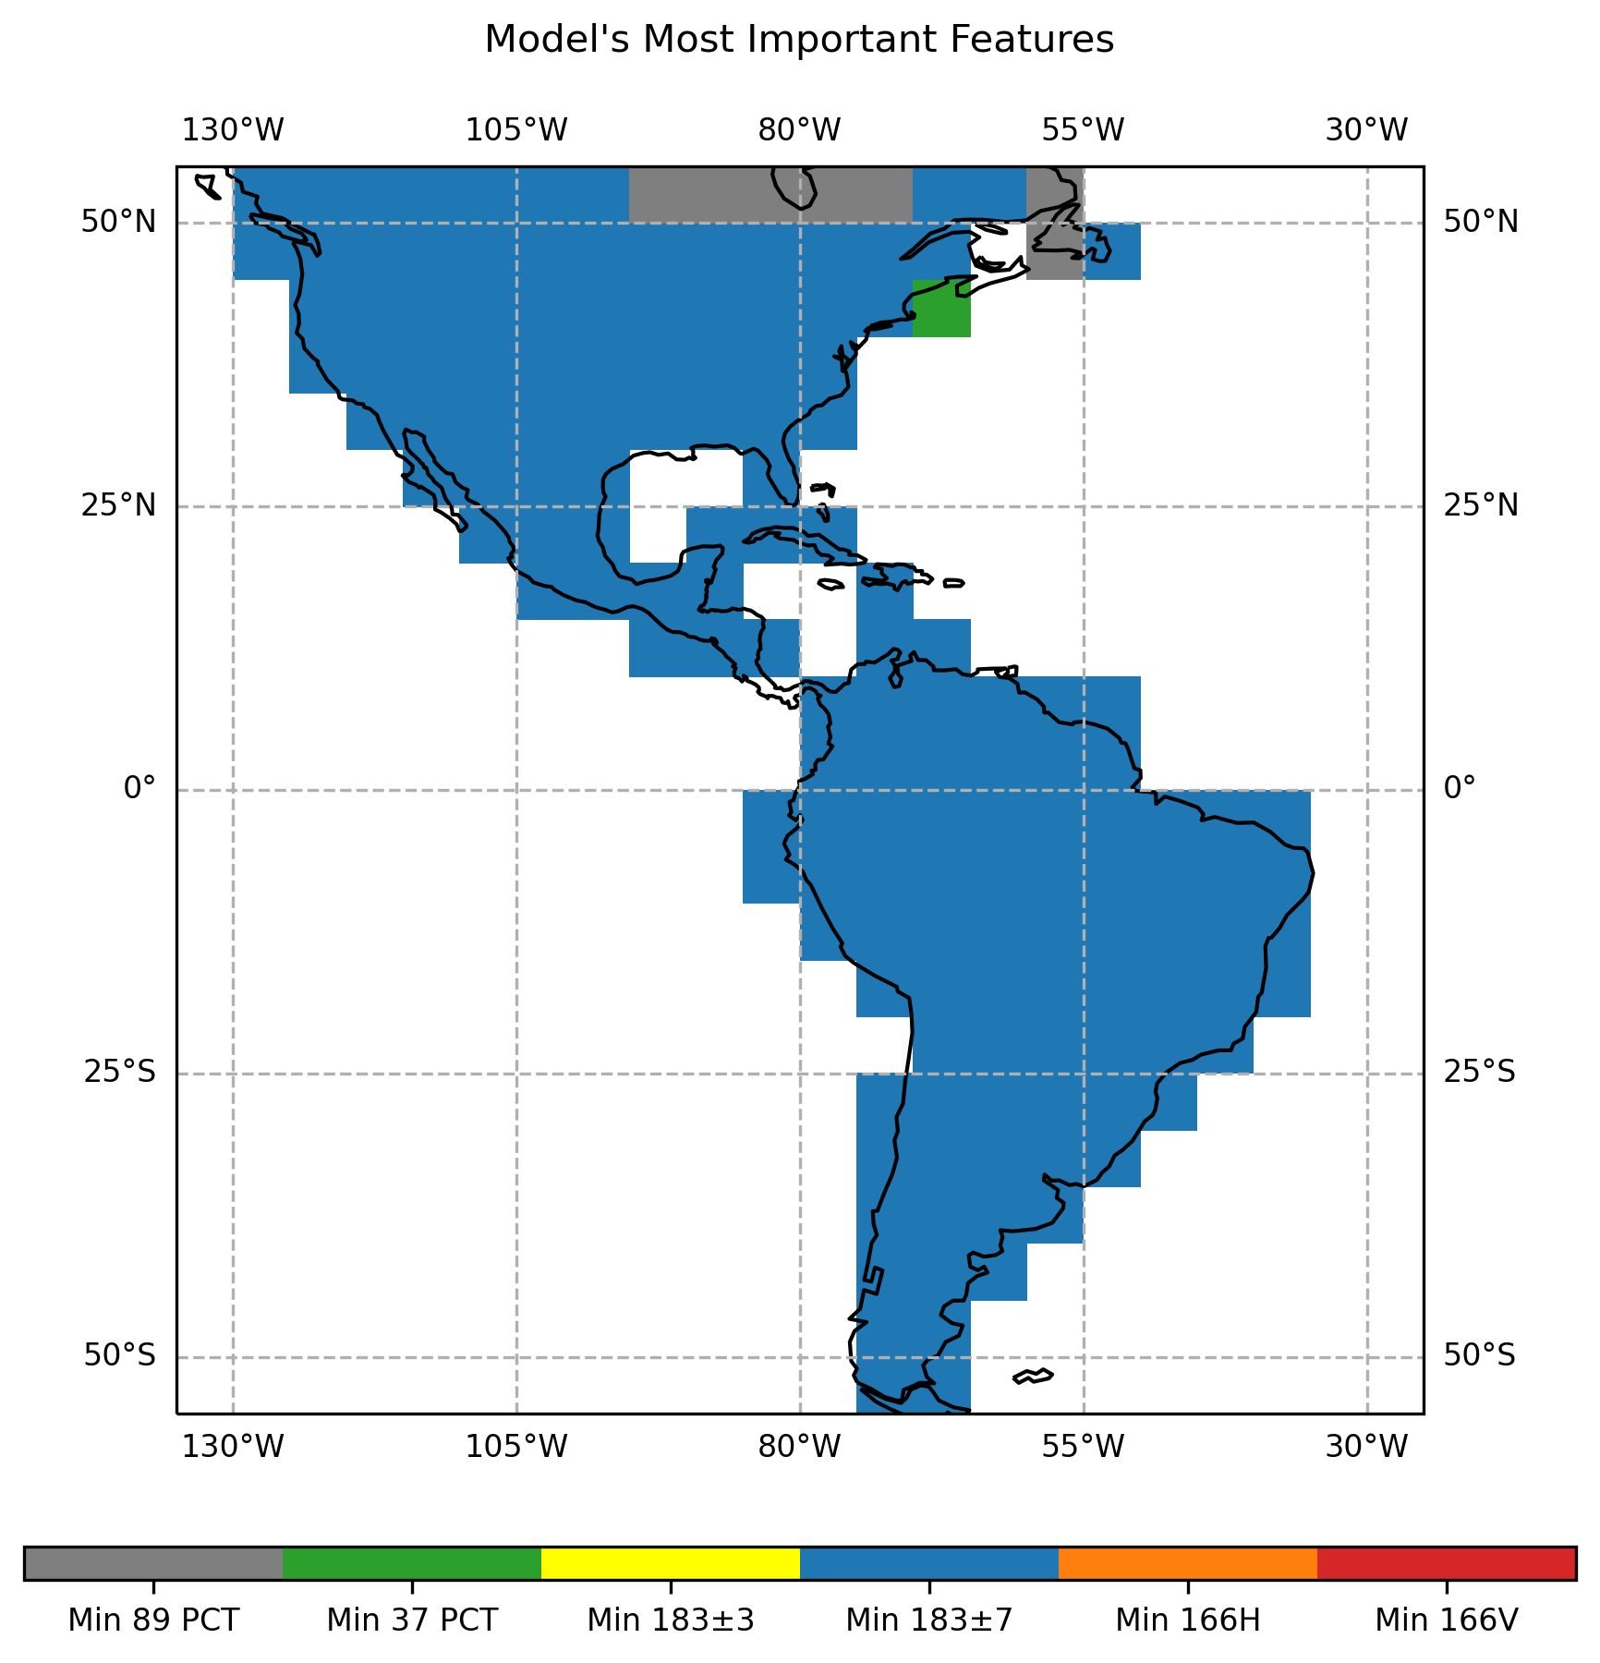
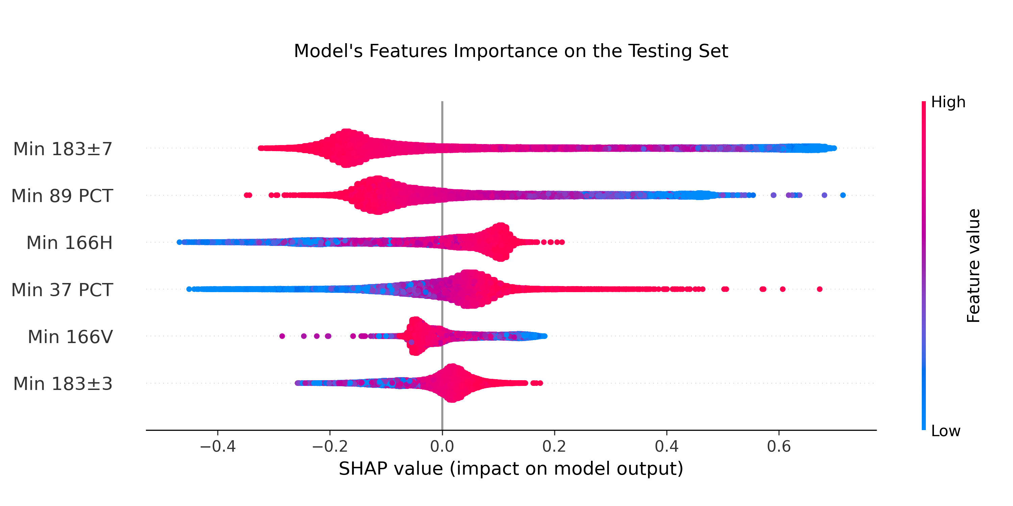
Features Importance
Signature of THIS PARTICULAR MODEL’s behavior (Any new training with the exact same parameters will give a model with a slightly or totally different behavior)
Different from Physical Importance
~ Probably driven by autocorrelation here ~

Slide 12
AI Models Comparison / Choice
GLM Observation
 | Flash Count ≥ 1 | Flash Count = 0
Lightning | 4,104 (GF) | 3,815 (FA)
No Lightning | 297 (MF) | 33,222 (GF0)
Lightning | 3,875 (GF) | 2,568 (FA)
No Lightning | 526 (MF) | 34,469 (GF0)
Threshold = 0.313
CSI = 0.500
PSS = 0.830
Note : The Threshold value is the one maximizing the Pierce Skill Score (PSS)
Neural
Network
No Threshold Needed
CSI = 0.556
PSS = 0.811
Random
Forest
Both seem to give similar results
A choice has to be made to either focus on lowering the Missed Forecasts Count (→ NN) or lowering the False Alarms Count (→ RF)

Slide 13
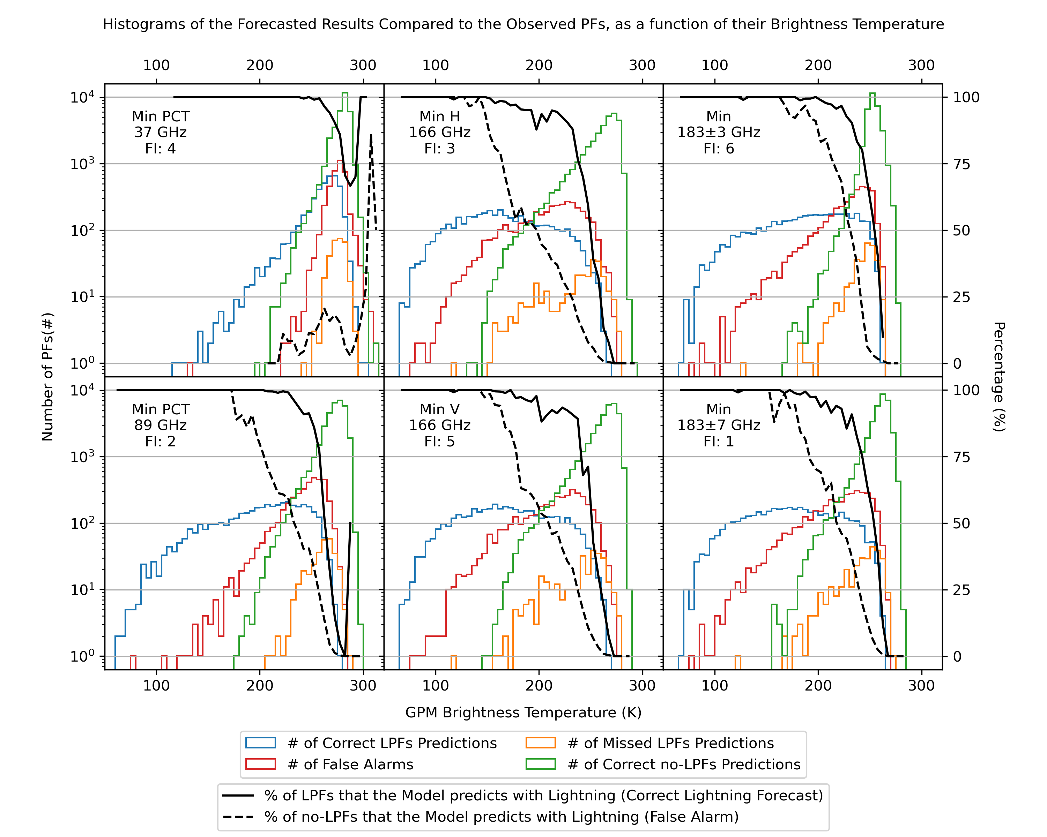
Physical
Limitations
Same figure as slide 7
With the 4 possible outputs of the model instead

