Slide 1
A GLM Flash Energy Model for Climate Study Applications
Vicente Salinas^{1,2} and Vanna Chmielewski²
University of Oklahoma, CIWRO, Norman, OK
NOAA/OAR NSSL, Norman, OK
2022 GLM Science Meeting
September 15, 2022
vicente.salinas@noaa.gov

Slide 2
Overview
Electrical Energy Discharged by lightning (EED) related to nitrous oxide it releases (LNOx)¹.
Modeling trace gas energy budgets².
Various EED models exist (e.g, capacitor model³, using electric field measurements⁴, etc)
Implementation varies by what kind of data is used/available
What data to use? Something with large spatial coverage.
Ground based networks (i.e., NLDN and ENTLN) have large coverage but provide limited flash information.
LMAs provide sufficient flash details but have limited coverage and sparsely available.
Electric field measurements not always available.
GLM provides robust spatial coverage and flash details.
Goal: Introduce a model by which the EED of lightning may be estimated using only flash areas for making quick estimates of the average and storm total EED.
Peyrous and Lapeyre, 1982; Hill 1984; Stark et al., 1996.
Stark et al., 1996; Schumann et al., 2007; Murray et al., 2016
Boccippio 2001; Dahl et al., 2011; Bruning and MacGorman, 2013; Salinas et al., 2021
Coleman et al. 2003; Maggio et al., 2009

Slide 3
Data and Cases Used
GLM Data-[For Proposed Model]:
GLM L2-LCFA data
Subsetted into bounding boxes (dashed square in B) surrounding LMA networks,
Quality flag: 0
Variables: flash start times, centroids and areas
LMA Data-[For Model Evaluation]:
LMA L1 data from the Oklahoma and NSSL mobile LMA networks (deployed during the PERiLS field project).
Flash sorted data were generated using xlma-python (based on lmatools) with a minimum station threshold of 6, minimum events per flash of 10, reduced chi squared maximum of 5, and minimum time threshold of 125 ms and distance of 3 km, and total flash duration of 3s.
Variables: 3D flash initiation locations, flash start time, flash area
Figure: Total counts for entire analysis duration
Cases:
6 cases were used, example shown is for a QLCS (quasi-linear convective system) during the PERiLS field project on March 22, 2022 in Eastern Mississippi and Western Alabama (herein SE-0322b). GLM detected 52,782 flashes and LMA detected 66,965.

Slide 4
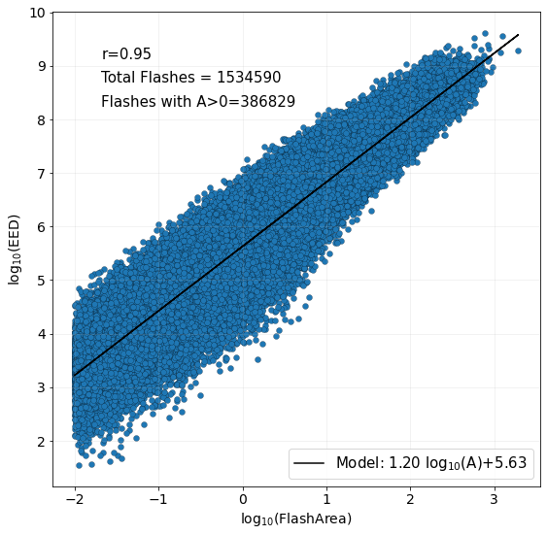
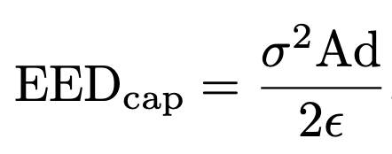
Models
Capacitor Model: used to train Linear model and for Evaluating Results.
𝜎 = surface charge density
A= flash area
d = plate separation
𝝐 = electric permittivity
A>1
Flash area and EED – positively correlated (Salinas et al., 2021).
Linear Model: Trained using LMA data retrieved from 3 cases,
2021-06-12 OKLMA
2019-06-18 WTLMA
2021-03-17 OKLMA
Why? GLM flash data only reports horizontal properties of flash, cannot use capacitor model or anything requiring altitude information.
Cutoff for flashes with areas < 1 square km

Slide 5
Expected Caveats and Adjustment
GLM Caveats
Limited detection through deep cloud layers (convective updrafts)
Light pooling combines many small flashes into larger flashes.
Lower flash rates and larger flash areas.
Adjustment
Preliminary results 2 orders of magnitude > capacitor.
Why? Primarily due to large GLM flash areas.
How do we account for this?
LMA to GLM flash area ratio (FAR*).
LMA flash areas << GLM
Scale EED estimates by average FAR=0.012
*Not to be confused with False Alarm Ratio!
Note: Adjustment does not fix lower flash rates nor is it meant to correct the actual flash areas, instead they are used only to adjust EED trends in space and time to match what is expected when using ground-based systems such as the LMA.

Slide 6
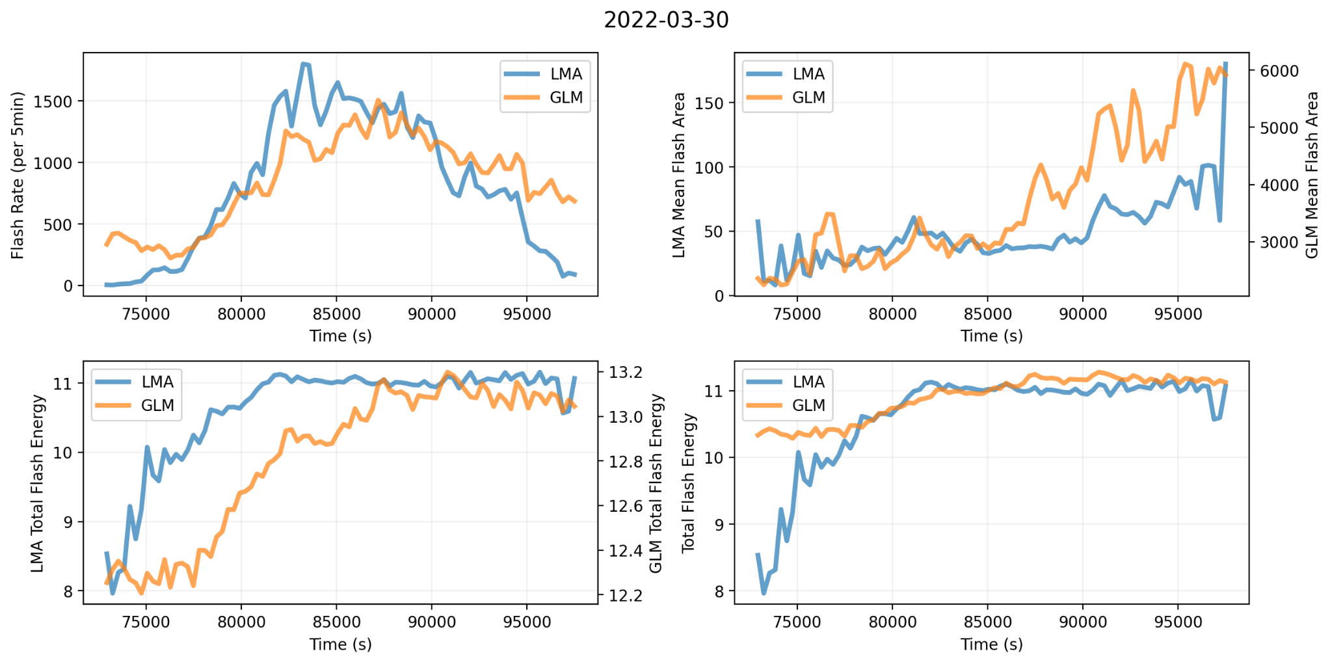
Analysis Design and Results
A)
B)
Seconds since start of day
*EED axes log-scaled
C)
D)
Design
How well does the GLM EED linear model capture total EED fluctuations in time? Where does it fail?
Time bins = 300 s, or 5 minutes
What is compared:
Flash rates,
Mean flash areas
Total GLM and LMA EED estimates per bin,
Adjusted Total GLM EED estimates per time bin
Results
Flash rates similar (not for all cases) but trends dont always match,
GLM flash areas >> those of LMA
Larger GLM areas → Larger EED estimates,
After adjustment: Trends best match towards later stages of storm, but magnitudes not in range of each other.
Lack of variability also due to model simplicity (i.e, not considering flash altitudes).

Slide 7
Results: Impact of where Lightning is Detected
Mean Flash Area
Adjusted EED
MeanFAR
Mean FAR
Mean FAR
Mean FAR
Non-Convective Regions
Convective Regions
Non-Convective Regions
Convective Regions
FAR can be used to also determine where GLM and LMA see similar large flash activity, and where sensitivity lies where small flashes prevail.
Although not exact, GLM and LMA flash areas [Panel A] (and unadjusted EED estimates, not shown) closer in magnitude (and distribution shape) where mean FAR >= 0.012 (outside regions of enhanced flash activity–convective updrafts).
Where FAR < 0.012, departure from what GLM and LMA see – i.e., LMA sees more small flash activity and GLM does not. GLM bias towards larger EED estimates.
Sensitivity to spatial analysis on where flash activity is being examined, seek to compare totals.

Slide 8
Discussion: Utility using storm Total EED
Adjusted
Improvement
March 22, 2022
Un-Adjusted
Case | Total EED Ratio (LMA/GLM) % | % Difference | EED Ratio (LMA/GLM) Unadjusted % | % Difference
June 12, 2021 (OK-0621) | 102 | 2 | 87 | -13
October 27, 2021 (OK-1021) | 99 | -1 | 86 | -14
March 22, 2022 (SE-0322a) | 101 | 1 | 85 | -15
March 30, 2022 (SE-0322b) | 98 | -2 | 83 | -17
April 5, 2022 (SE-0422a) | 101 | 1 | 86 | -14
April 13, 2022 (SE-0422b) | 98 | -2 | 85 | -15
Adjusted
Not Adjusted
The total GLM flash EED per storm were within 2% of those of the LMA EED estimates.

Slide 9
Summary
Because natural LNOx emissions are important to model trace gas energy budgets in climate studies using GLM given the lack of ground-based network coverage for total lightning networks is ideal – especially if producing estimates rapidly (computationally) is desired.
The linear EED model introduced in this study was tested on 6 cases, and results consistently showed:
Temporal and spatial fluctuations typically match those of the LMA capacitor EED model well, but not always during periods of enhanced lightning activity,
Total energy estimates were within 2% of each other indicating that the model does well in estimating a storm’s bulk EED and thus would find use in estimating the total LNOx released.

Slide 10
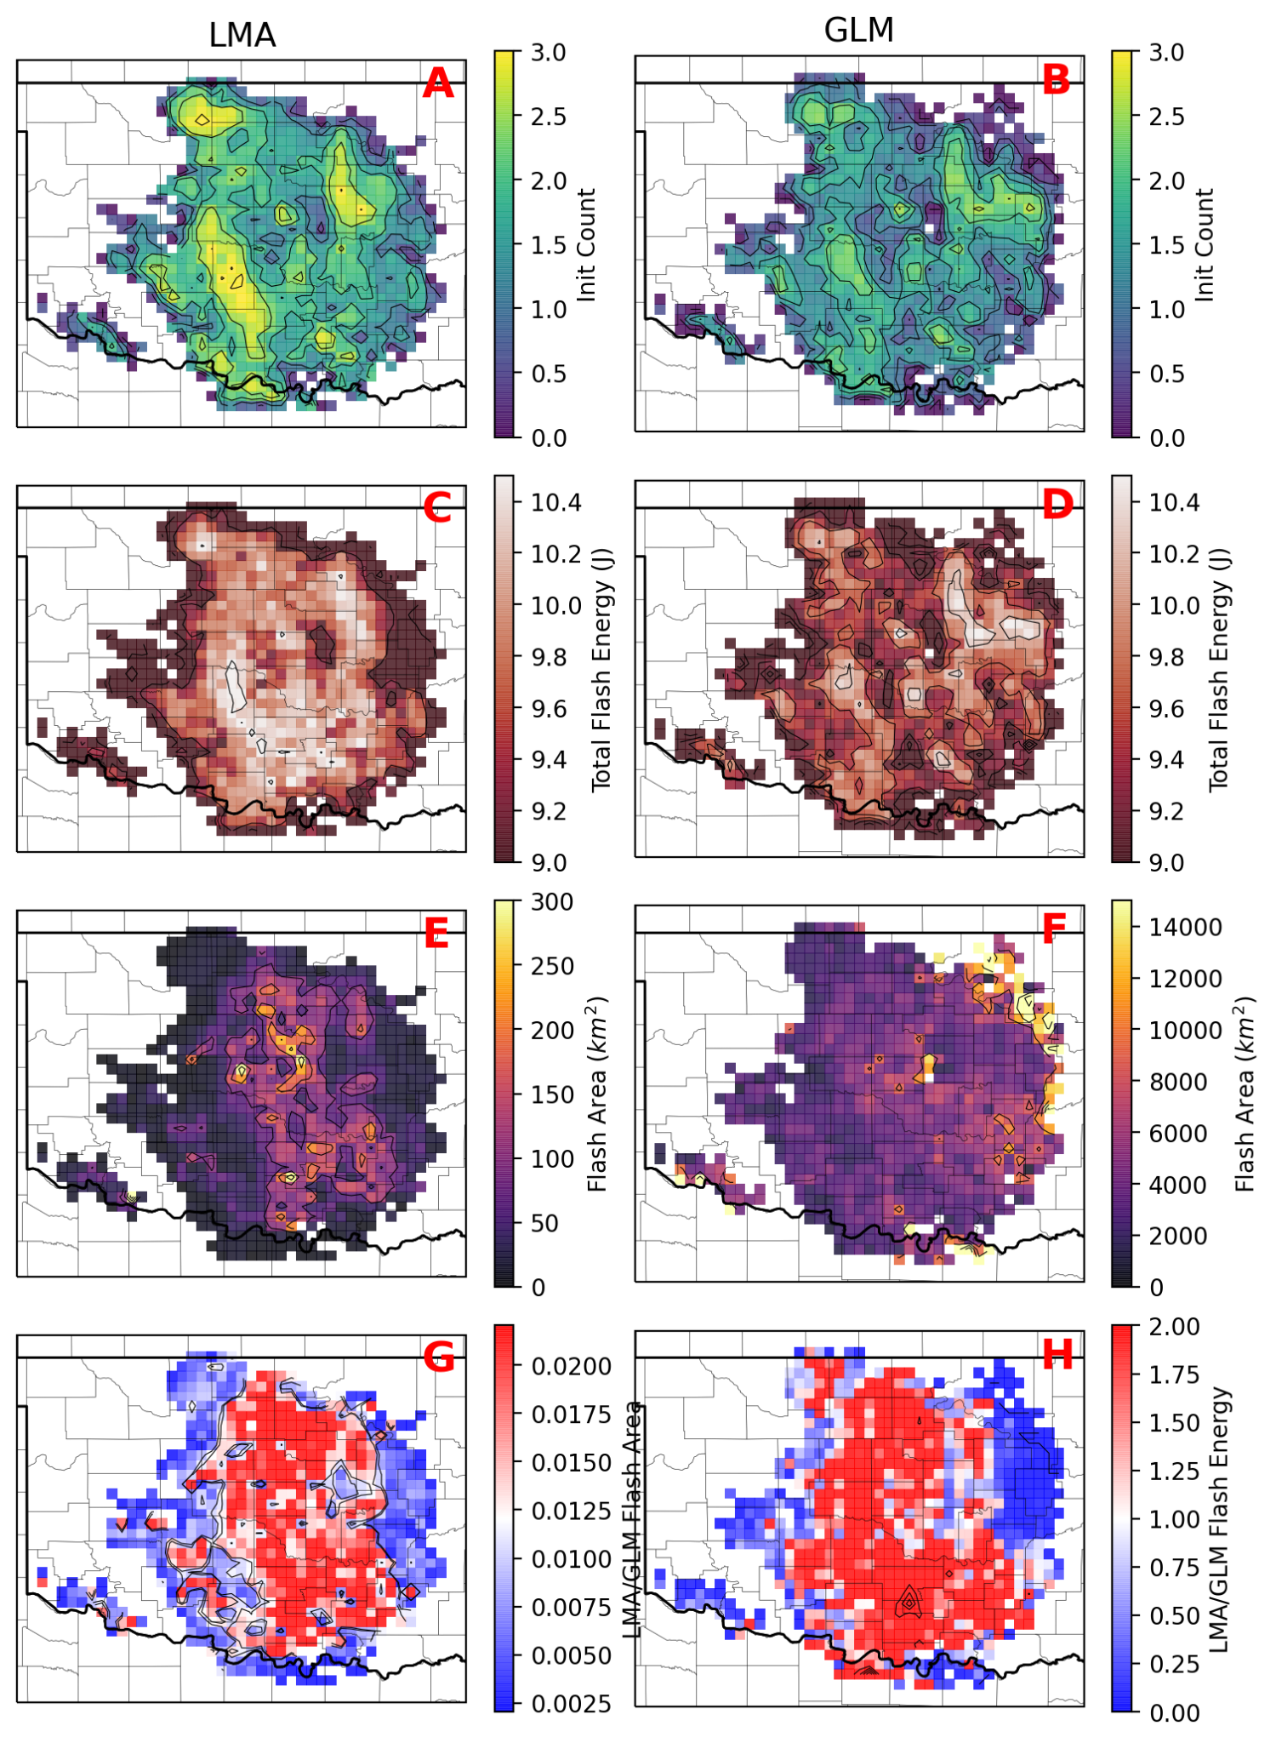
Results - Spatial Depiction
2021-06-12
A-B) Initiation density maxima reveal where either network detected most flash activity,
C-D) Total EED (if detecting same flash activity would reveal similar features–true for some cases)
E-F) Mean flash area varies less in domain for GLM than LMA,
G) Flash area ratios (centered on median)--where LMA/GLM flash areas varied similarly (>alpha) in time and space.
H) Ratio of LMA to GLM EED

Slide 11
Overview
Context:
The electrical energy discharged (EED) by lightning is related to nitrous oxides it releases (LNOx)-- important for modeling trace gas energy budgets.
Various methods to model the EED by lightning flashes exist (e.g, capacitor model – Boccippio 2001; Dahl et al., 2011; Bruning and MacGorman, 2013; Salinas et al., 2021, via electric field measurements – Coleman et al. 2003; Maggio et al., 2009), but their implementation varies by what kind of data is used/available.
Challenges:
Ground-based networks (i.e, NLDN and ENTLN) cover most of the U.S., however, only provide limited information about a flash,
Lightning mapping arrays (LMAs) provide more information, however, LMA networks coverage and availability is sparse.
Electrostatic measurements not always available.
Goal: This study introduces a model by which the EED of lightning may be estimated using only flash areas for making quick estimates of the average and storm total EED by lightning–for use with GLM data.

Slide 12
Data and Cases Used
GLM Data:
GOES-16 GLM L2-LCFA data (good DE over central to southeastern US; Mach et al.,. 2021)
Data were subsetted into bounding boxes (dashed square in B) surrounding LMA networks,
Quality flag = 0
Variables: flash start times, centroids and areas
Figure: Total counts for entire analysis duration
LMA Data:
LMA L1 data from the Oklahoma and NSSL mobile LMA networks (deployed during the PERiLS field project).
Flash sorted data were generated using xlma-python (based on lmatools) with a minimum station threshold of 6, minimum events per flash of 10, reduced chi squared maximum of 5, and minimum time threshold of 125 ms and distance of 3 km, and total flash duration of 3s.
Variables: 3D flash initiation locations, flash start time, flash area
Cases:
6 cases were used, example shown is for a QLCS (quasi-linear convective system) during the PERiLS field project on March 22, 2022 in Eastern Mississippi and Western Alabama (herein SE-0322b). GLM detected 52,782 flashes and LMA detected 66,965.

Slide 13
Analysis Design
Time Series Comparisons
Time bins = 300 s, or 5 minutes
What is compared:
Flash rates,
Mean flash areas
Total GLM and LMA EED estimates per bin,
Adjusted Total GLM EED estimates per time bin
Flash Initiation Density Comparisons
Grid spacing = 8 km
Initiation counts for entire case duration (all flashes at once)
What is compared?
Flash Initiation Density,
Total flash EED
Mean flash area
Flash area ratios and LMA to GLM EED ratios

Slide 14
Results: Impact of GLM Limited Detection
Mean Flash Area
Unadjusted EED
Adjusted EED
FAR
FAR
FAR
FAR
FAR
FAR
Categorization: FAR < or > mean FAR determines where LMA and GLM see similar or different flash activity (convective or non-convective).
Flash rates often lower and flash areas much larger– requires adjustment in regions of high flash rates, vice versa elsewhere.
Less variable flash areas result in bias towards larger flash EED–especially in regions of high flash activity (FAR < 0.012)
Sensitivity to spatial analysis on where flash activity is being examined, seek to compare totals.

