Slide 1
Preliminary Comparison of Bolide Measurements by the Geostationary Lightning Mapper (GLM) GLM-17 and GLM-18
GLM Science Meeting, September 15th , 2022
Randy Longenbaugh, Sandia National Laboratories

Slide 2
Overview
Objective
Comparisons of bolide observations between GLM-17 and GLM-18 PLT help evaluate and understand the performance of our bolide detection capabilities
Hopefully help everyone to understand GLM-18 performance using non lightning sources
Manual Comparison
Selected a handful of examples for visual comparison
Only compared L2 data
Did not use the new continuum calibration tables
Picked more recent events to allow more RTEP tuning
Compared the time/intensity recordings of bolides AKA “Light Curves” and ground tracks
Sandia can do a more extensive statistical comparison now that we have access to GLM-18 data through UAH data portal
Use NASA’s GLM-17 bolide detections as comparison basis
NASA Ames bolide detection pipeline does not have access to GLM-18 data
We would like to start testing our detection algorithms with GLM-18 data

Slide 3
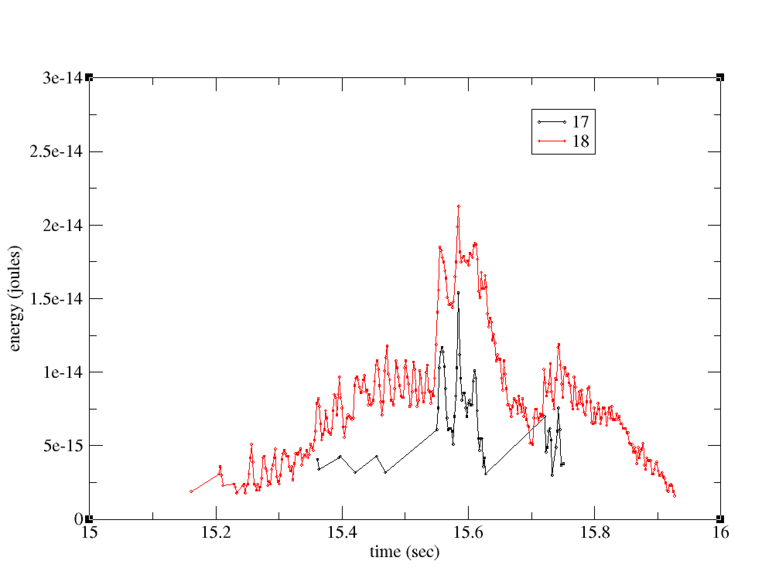
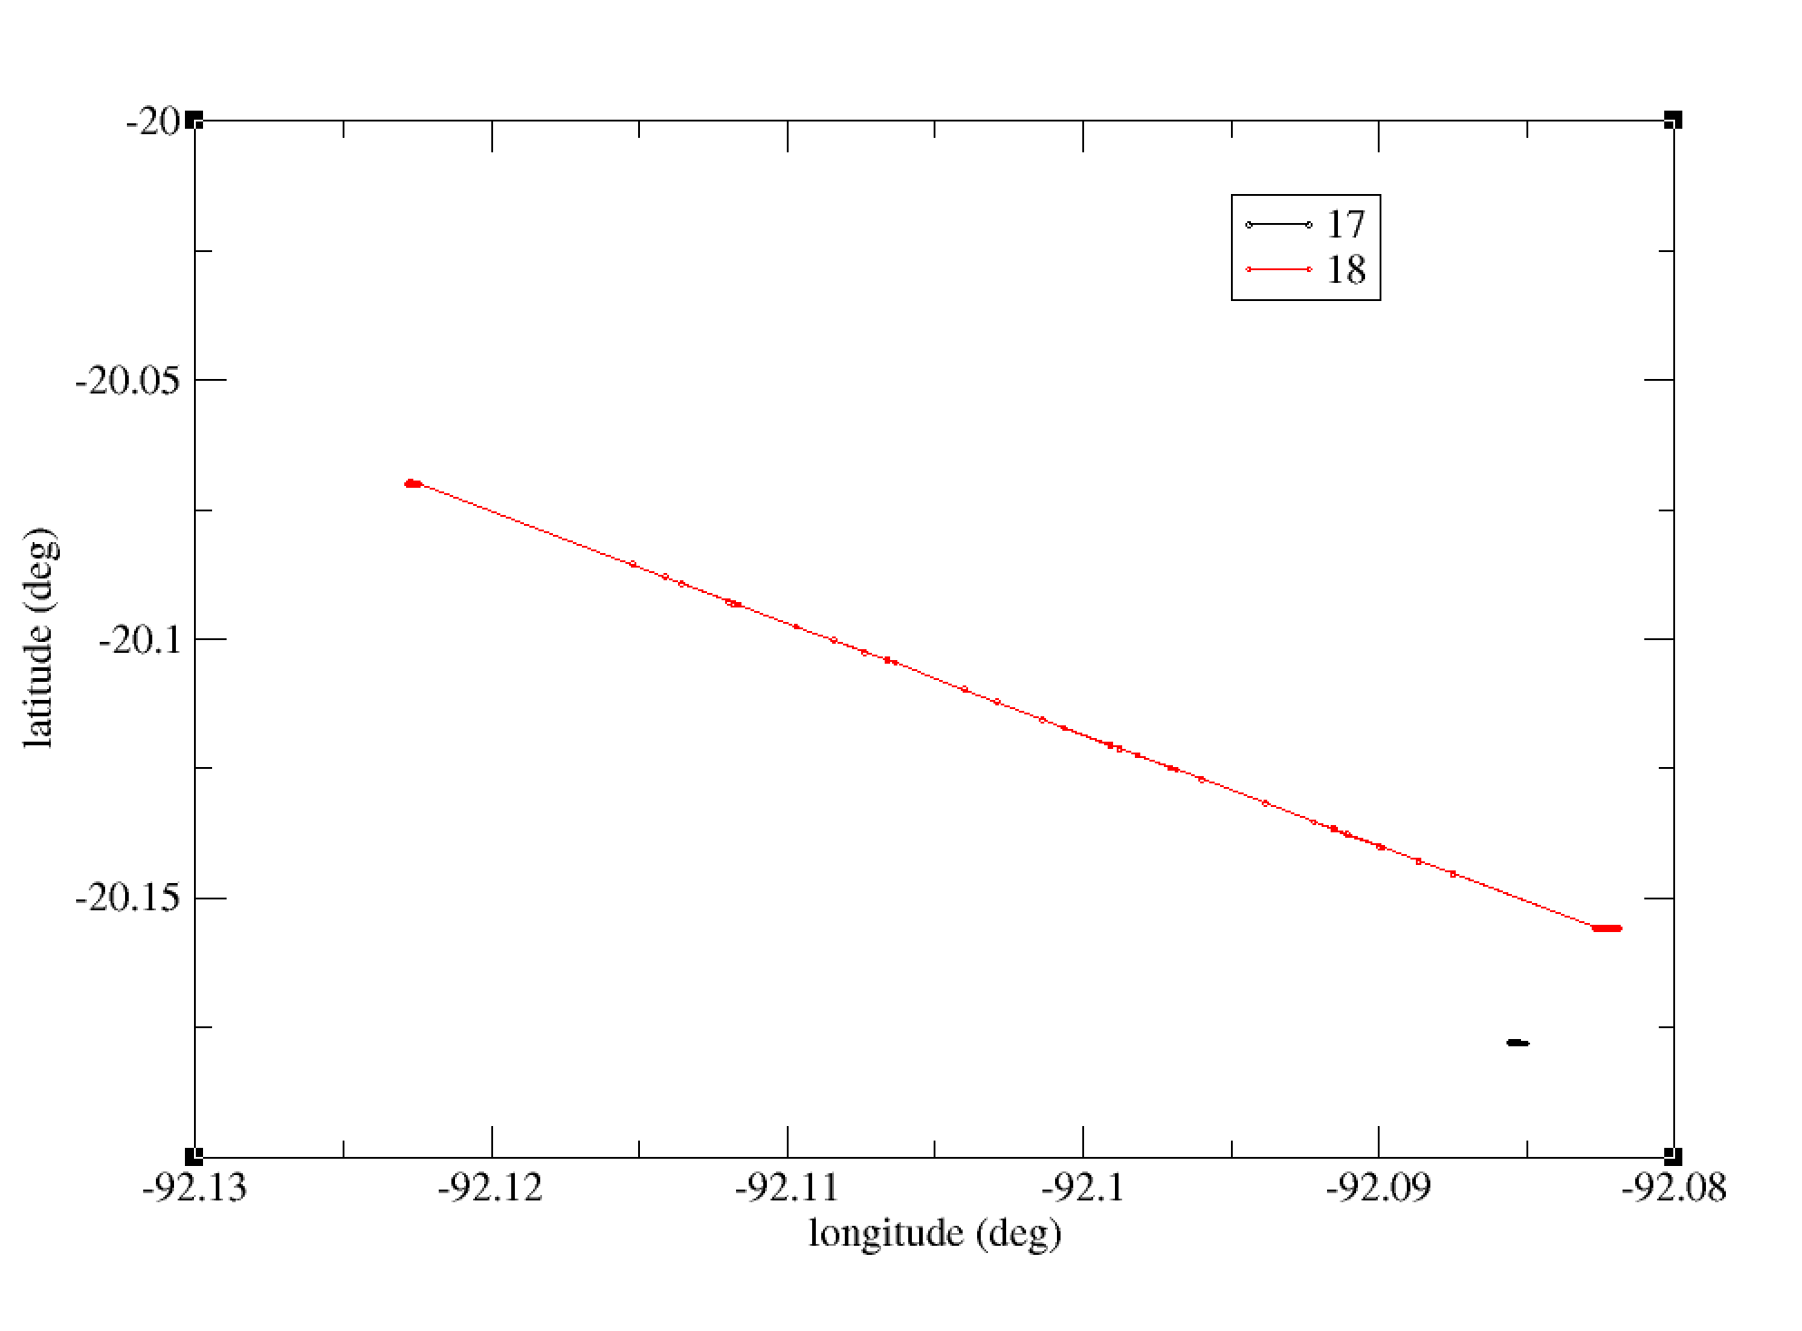
Bolide Event 08/15/2022 08:14:15
Location 20.4S, 92.1W
Light Curve Comparison
Ground Track Comparison

Slide 4
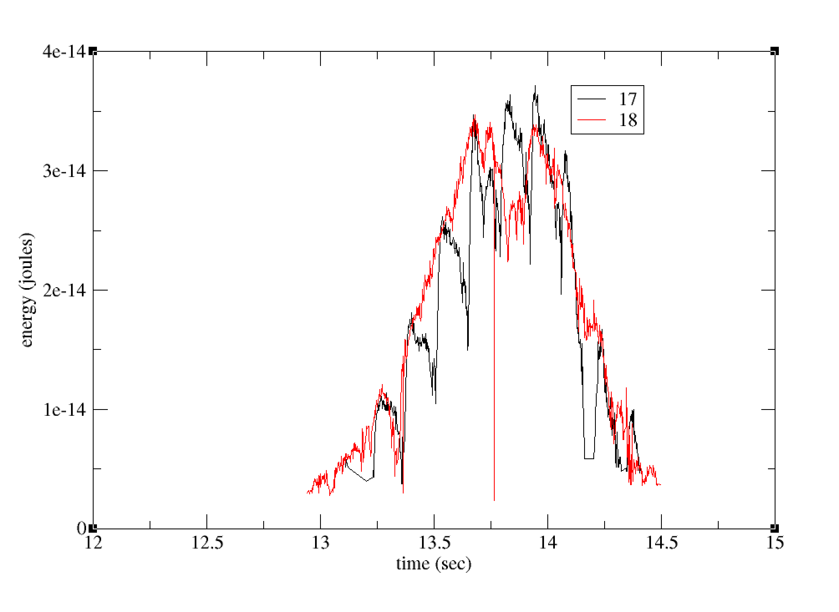
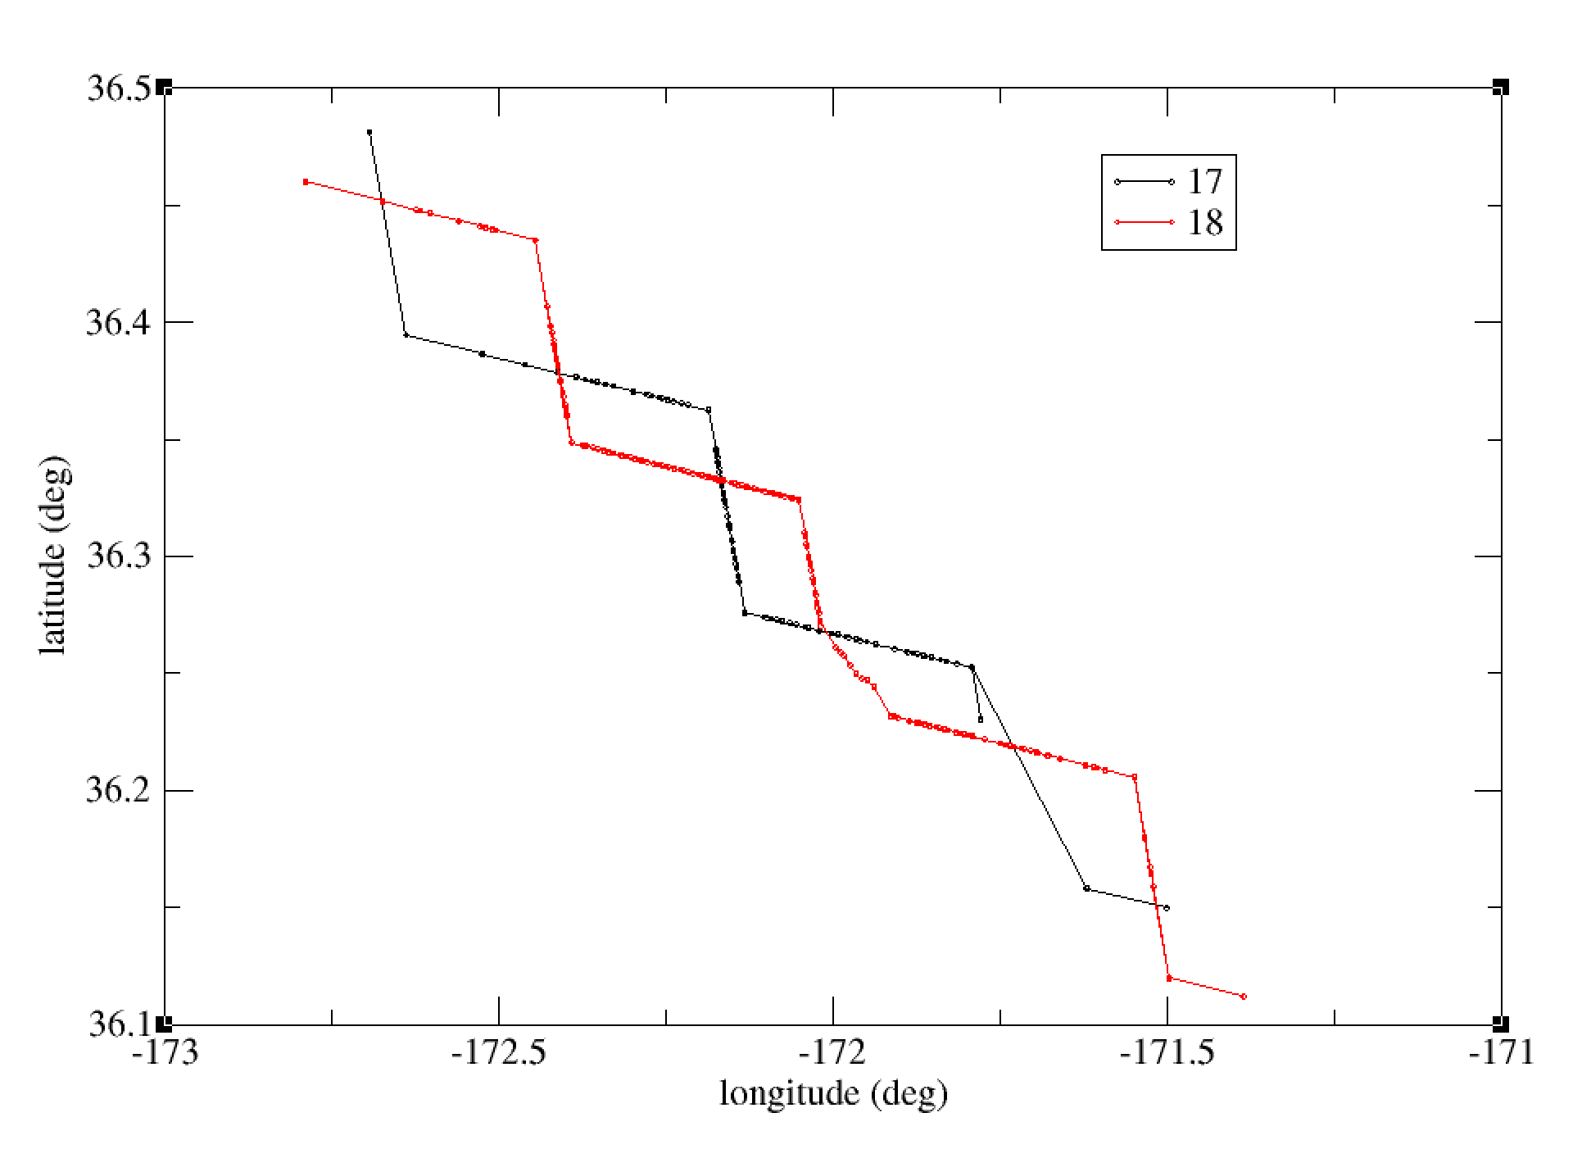
Bolide Event 08/14/2022 22:27:53
Location 36.3N, 172.2W
Light Curve Comparison
Ground Track Comparison

Slide 5
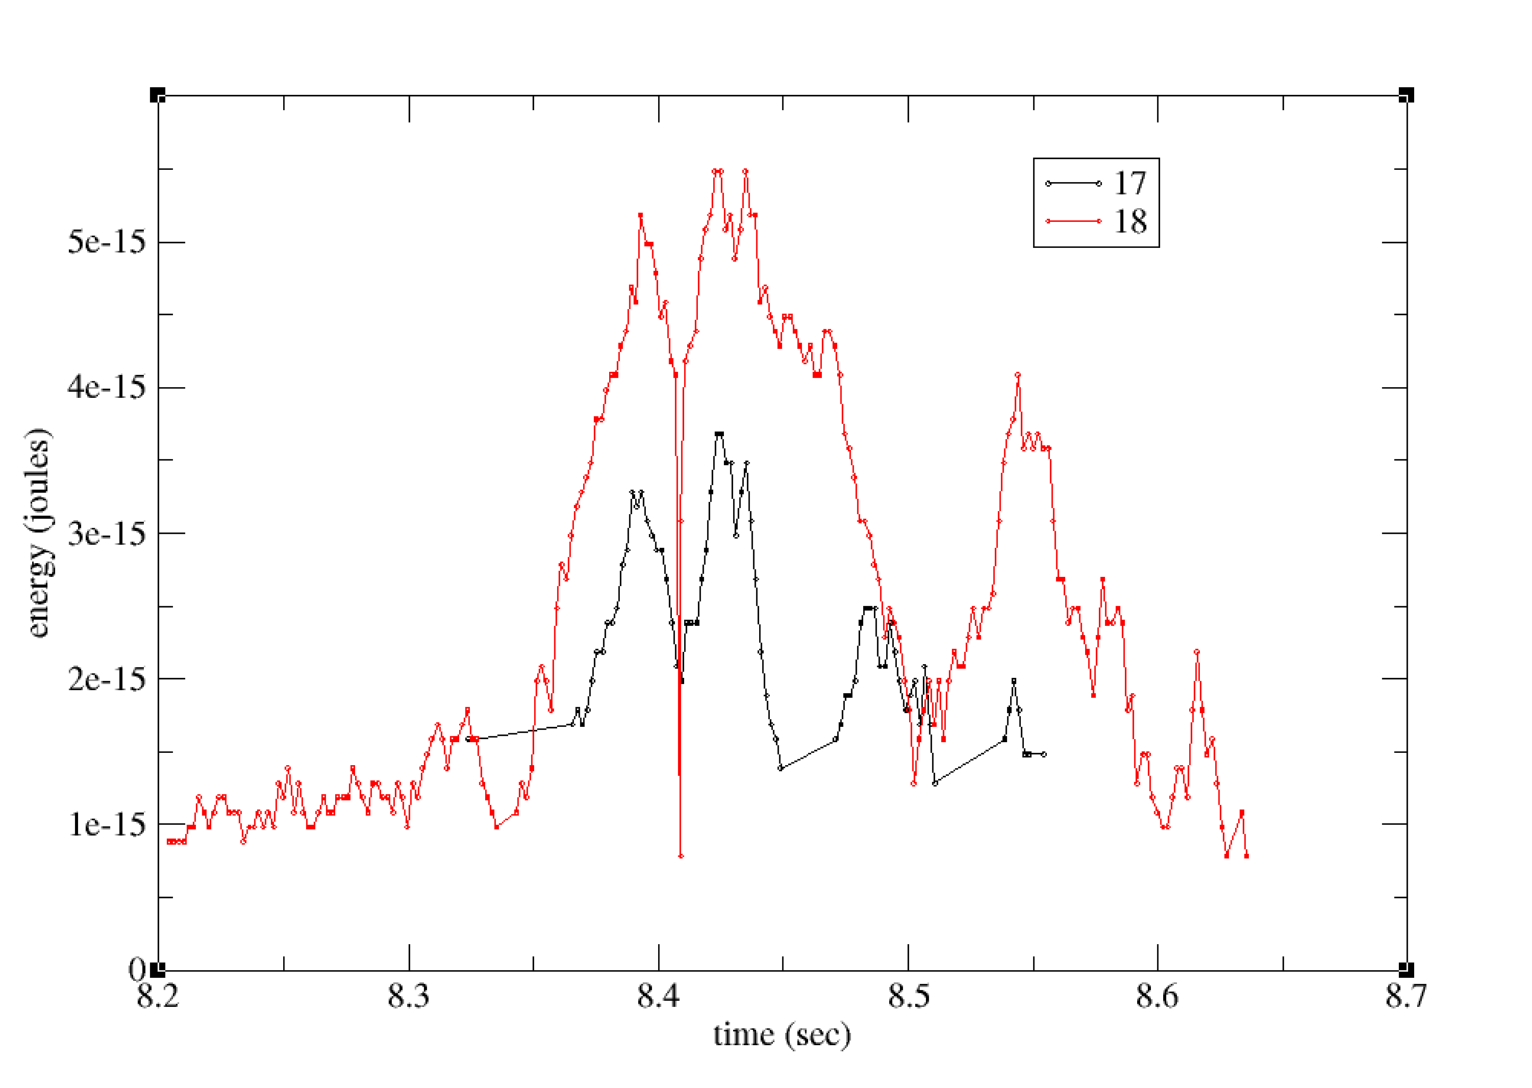
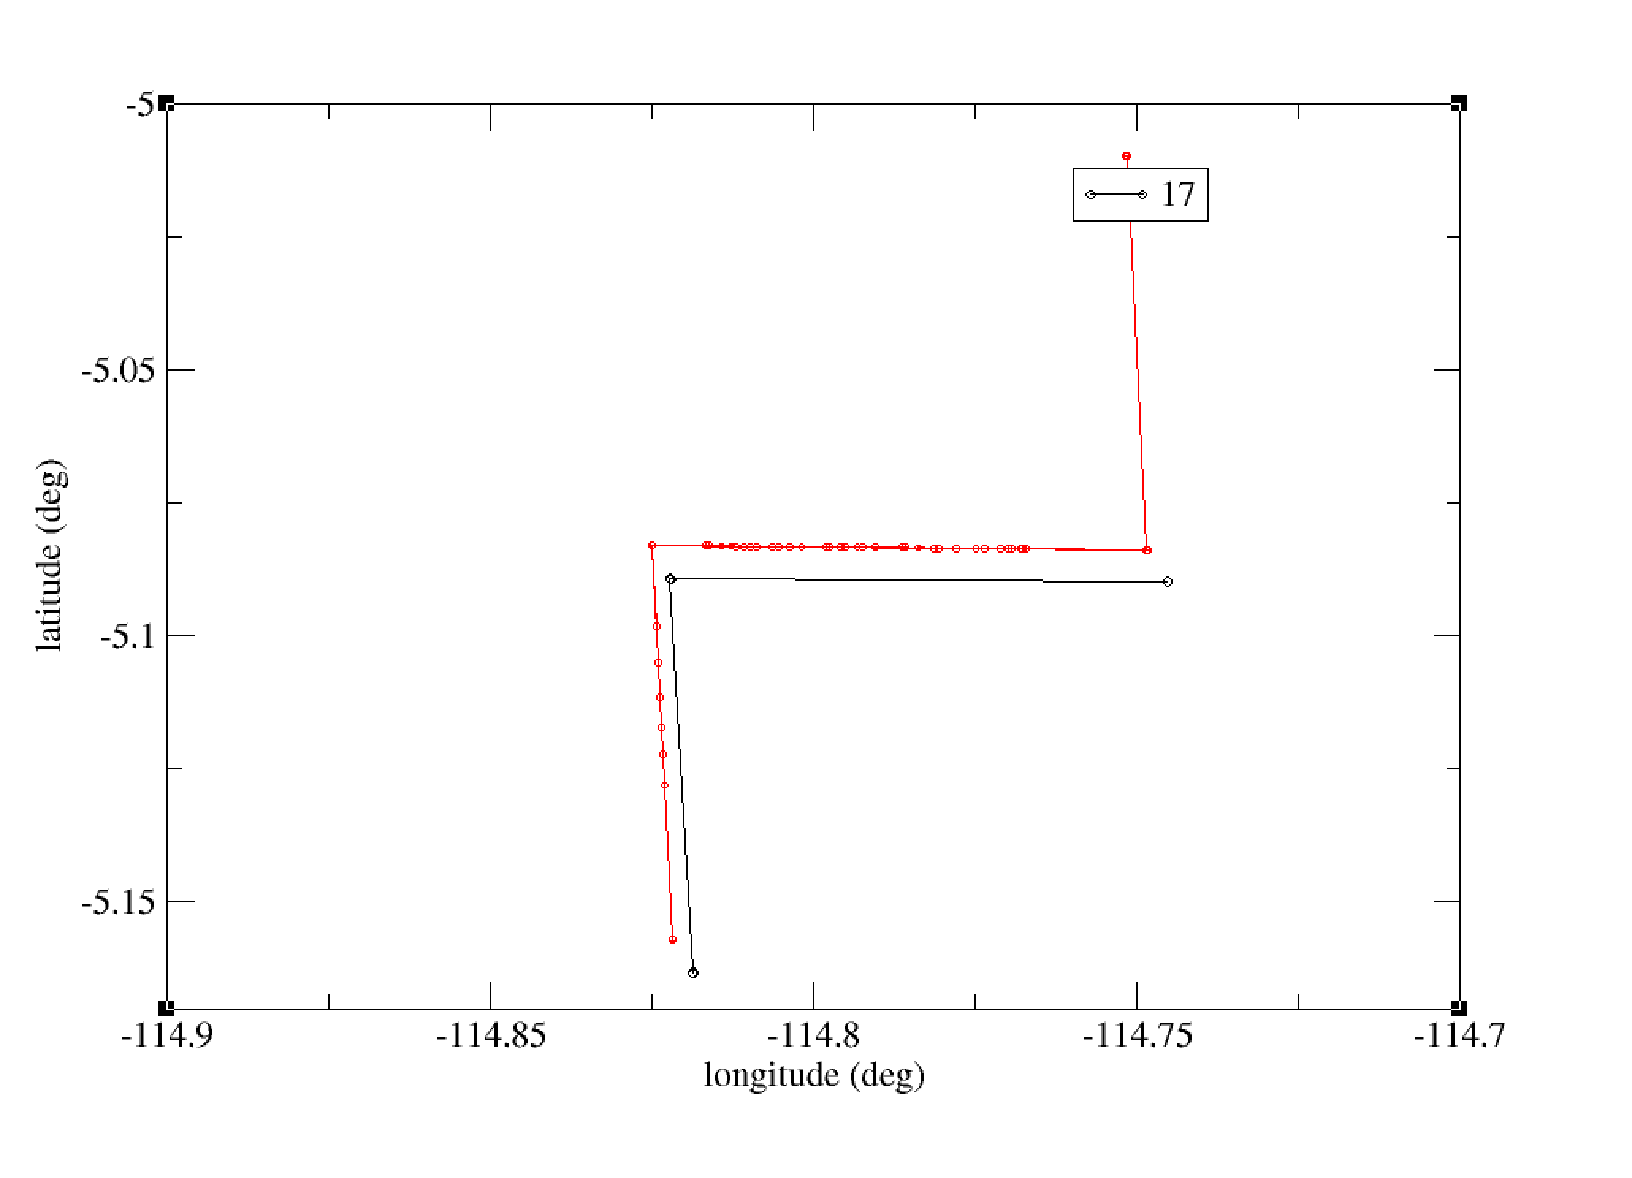
Bolide Event 08/13/2022 12:41:48
Location 5.1S,115.0W
Light Curve Comparison
Ground Track Comparison

Slide 6
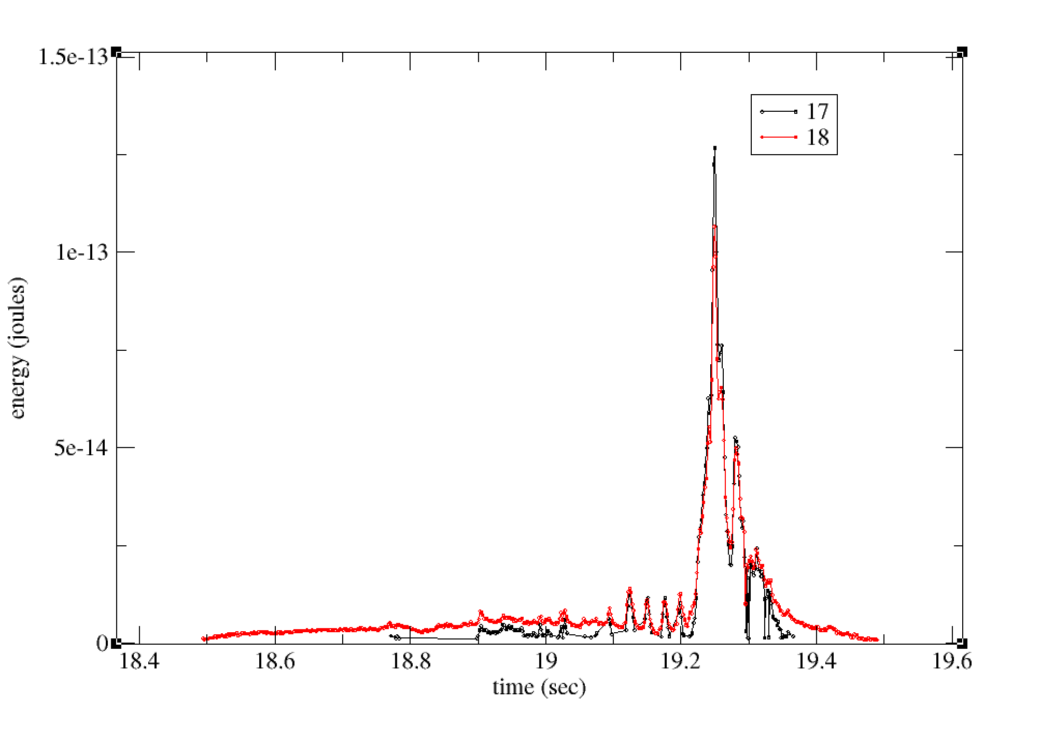
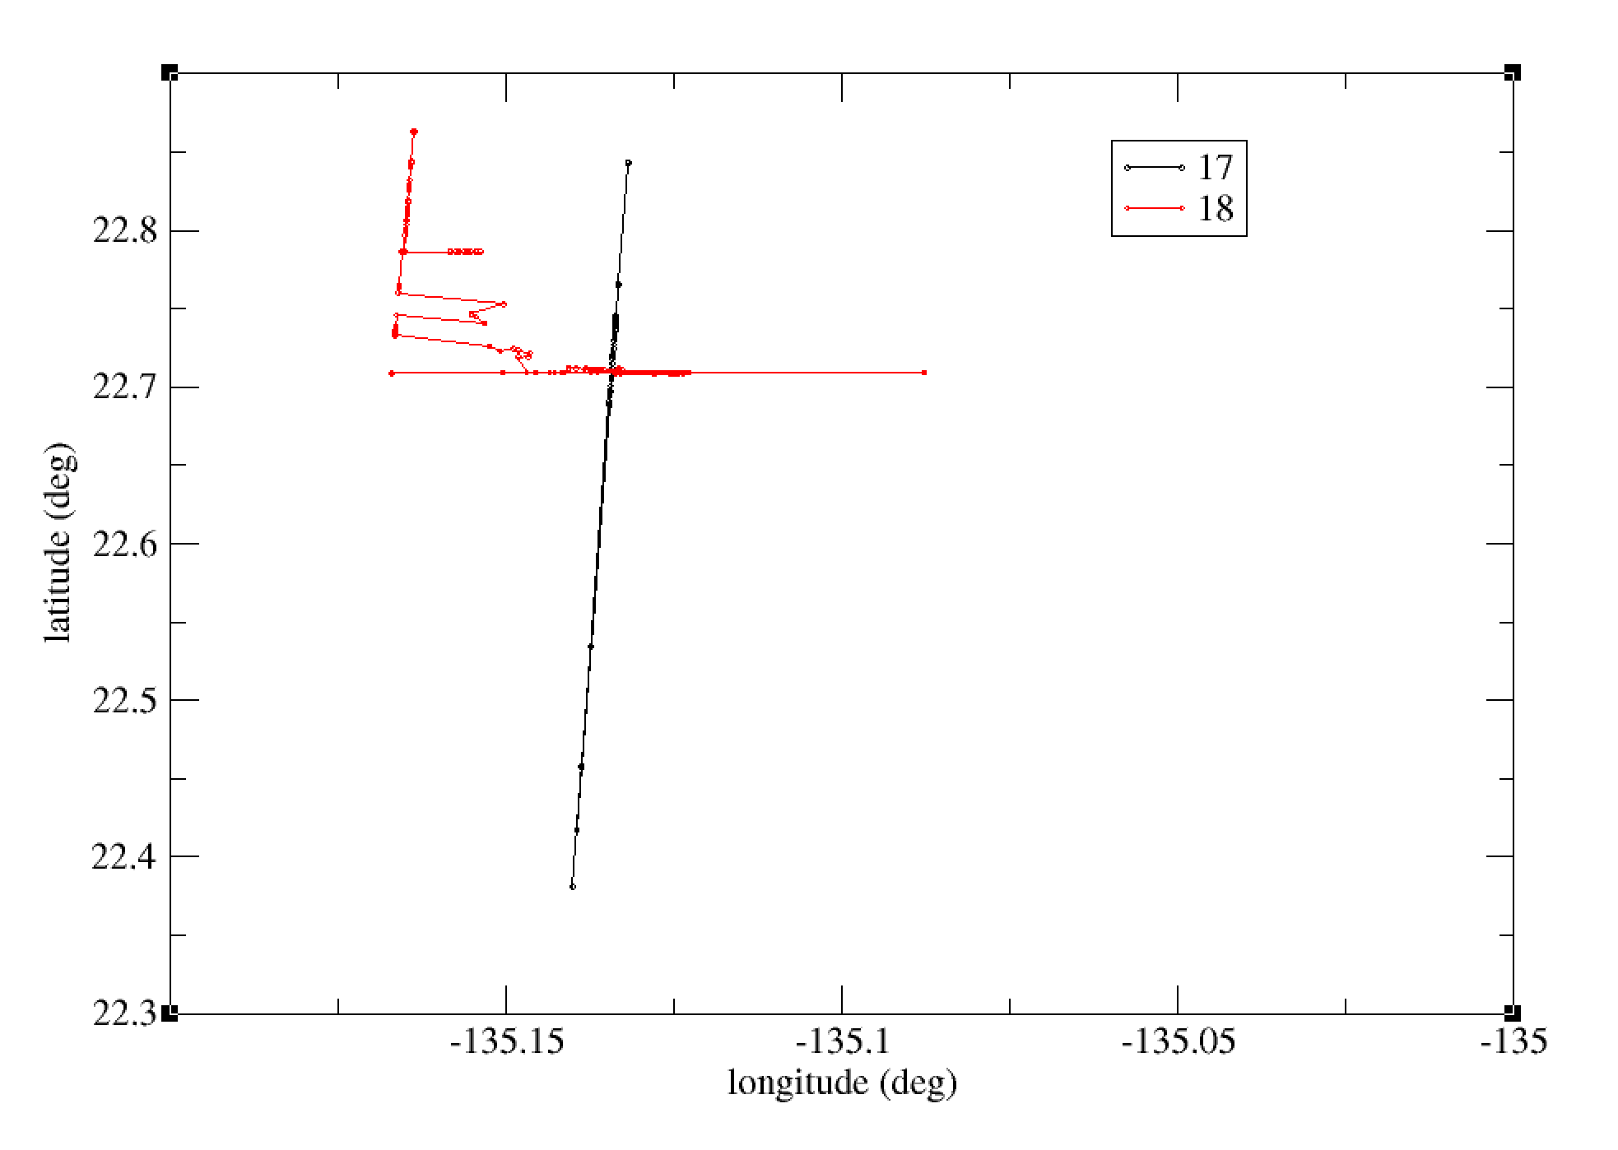
Bolide Event 08/12/2022 21:01:18
Location 22.8N,135.1W
Light Curve Comparison
Ground Track Comparison

Slide 7
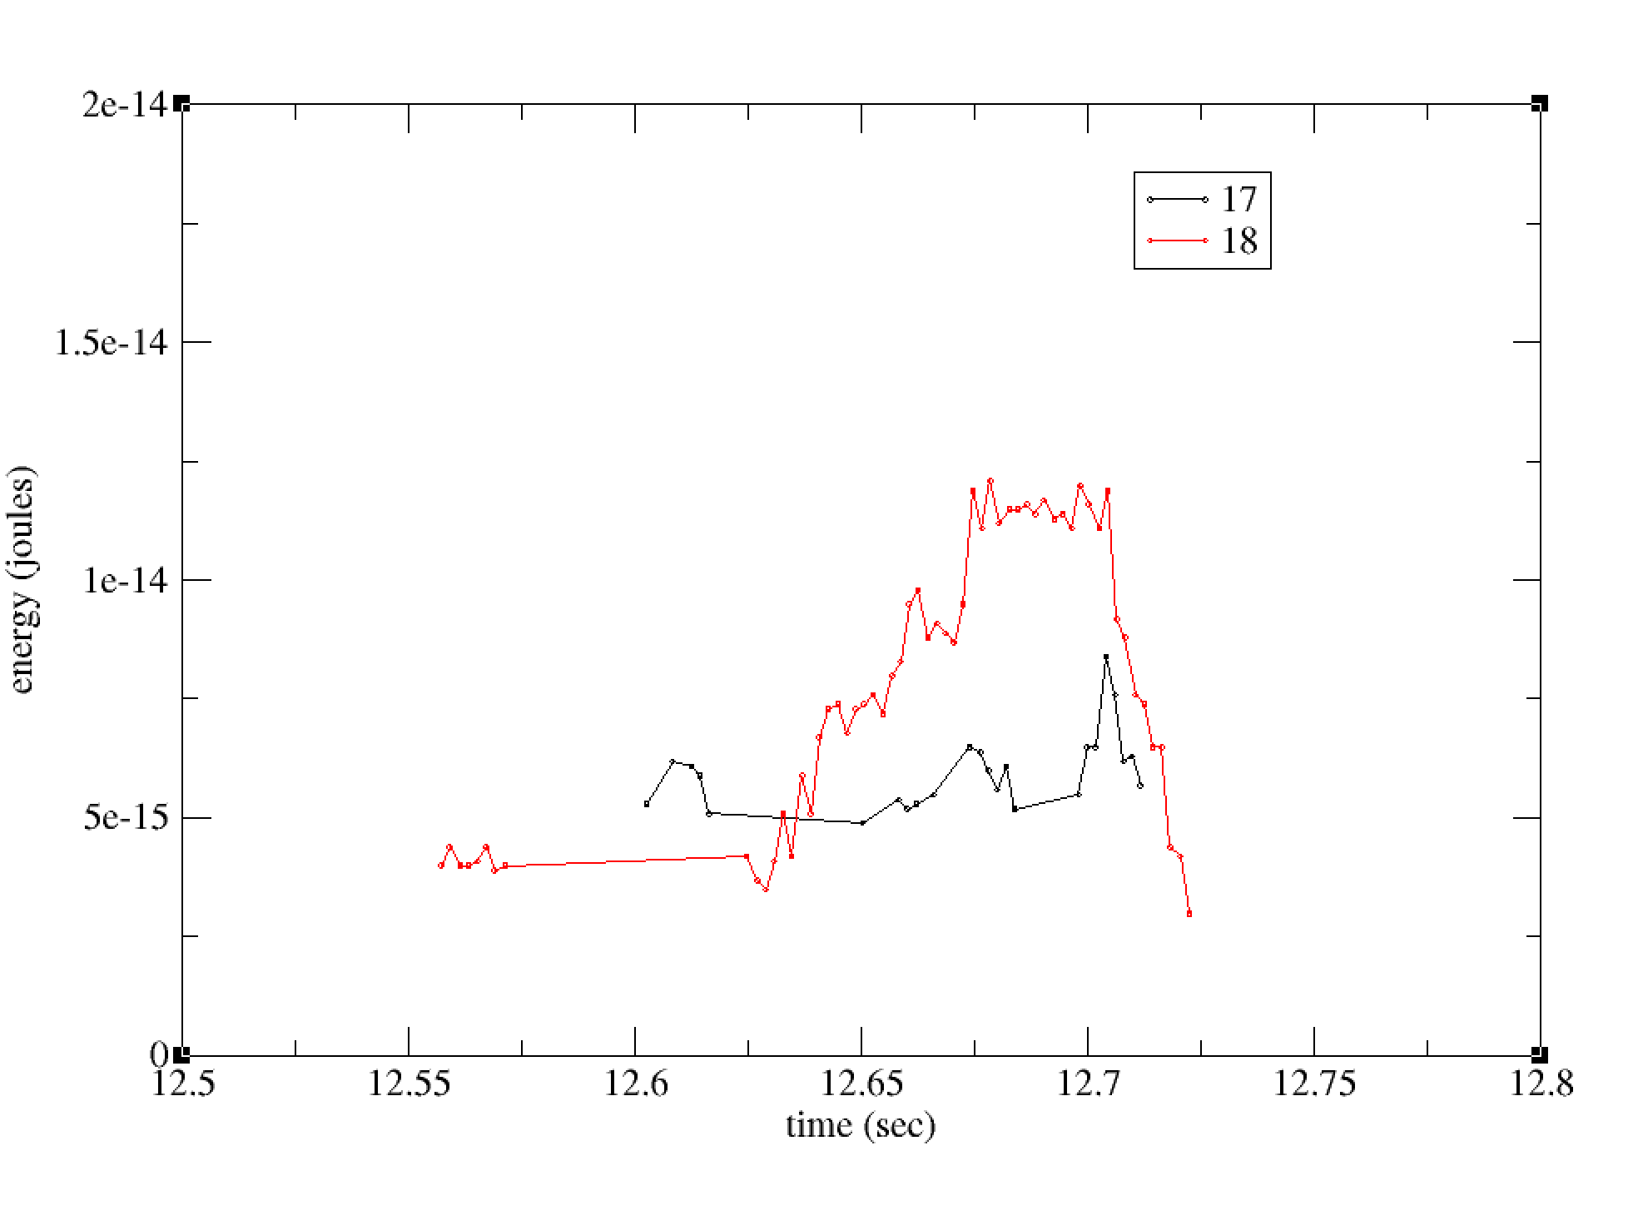
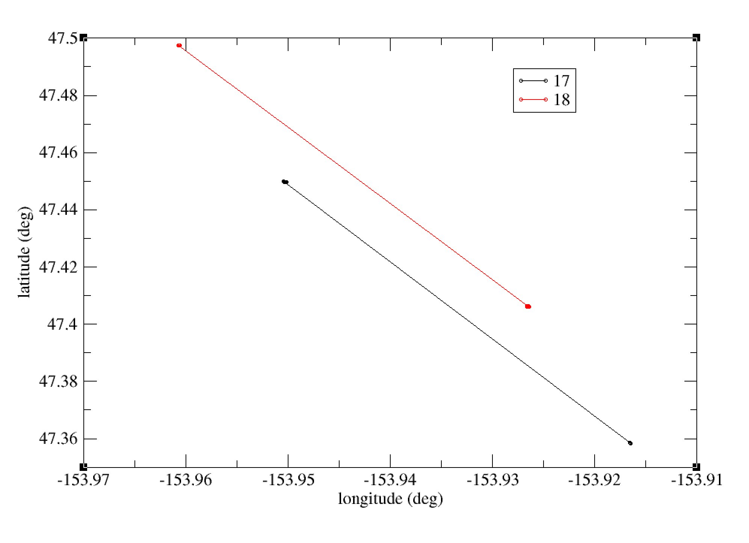
Bolide Event 08/11/2022 20:11:12
Location 47.5N,154.0W
Light Curve Comparison
Ground Track Comparison

Slide 8
Summary
Not many comparison so general conclusions are hard to make
In all comparisons presented GLM-18 has more observations than GLM-17
In some cases the GLM light curves have significant differences
In some cases there are significant differences in the ground tracks a
In most cases GLM-18 has higher peak amplitudes but not always

