Slide 1
Single-Flash Mapping with the Geostationary Lightning Mapper
Author:
R. Stetson Reger – Langmuir Lab, New Mexico Tech
Advisors:
Richard G. Sonnenfeld – Langmuir Lab, New Mexico Tech
Julia N. Tilles – Sandia National Labs

Slide 2
Single-flash mapping with GLM
Department of Physics

Slide 3
Single-flash mapping with GLM
OUTLINE
GLM group clustering
Lightning Mapping Array (LMA)
Methods: LMA as ground-truth
Results: source-location accuracy of GLM group centroids
Conclusions
OUTLINE
GLM group clustering
Lightning Mapping Array (LMA)
Methods: LMA as ground-truth
Results: source-location accuracy of GLM group centroids
Conclusions

Slide 4
GLM Data Clustering
CCD Pixels - Single Integration
GLM Level-2 Group Clustering
Event: Time, location and amplitude of a single triggered pixel
Department of Physics
Adapted from Figure 5, The GOES-R Geostationary Lightning Mapper (GLM), [Goodman et al., (2013)]

Slide 5
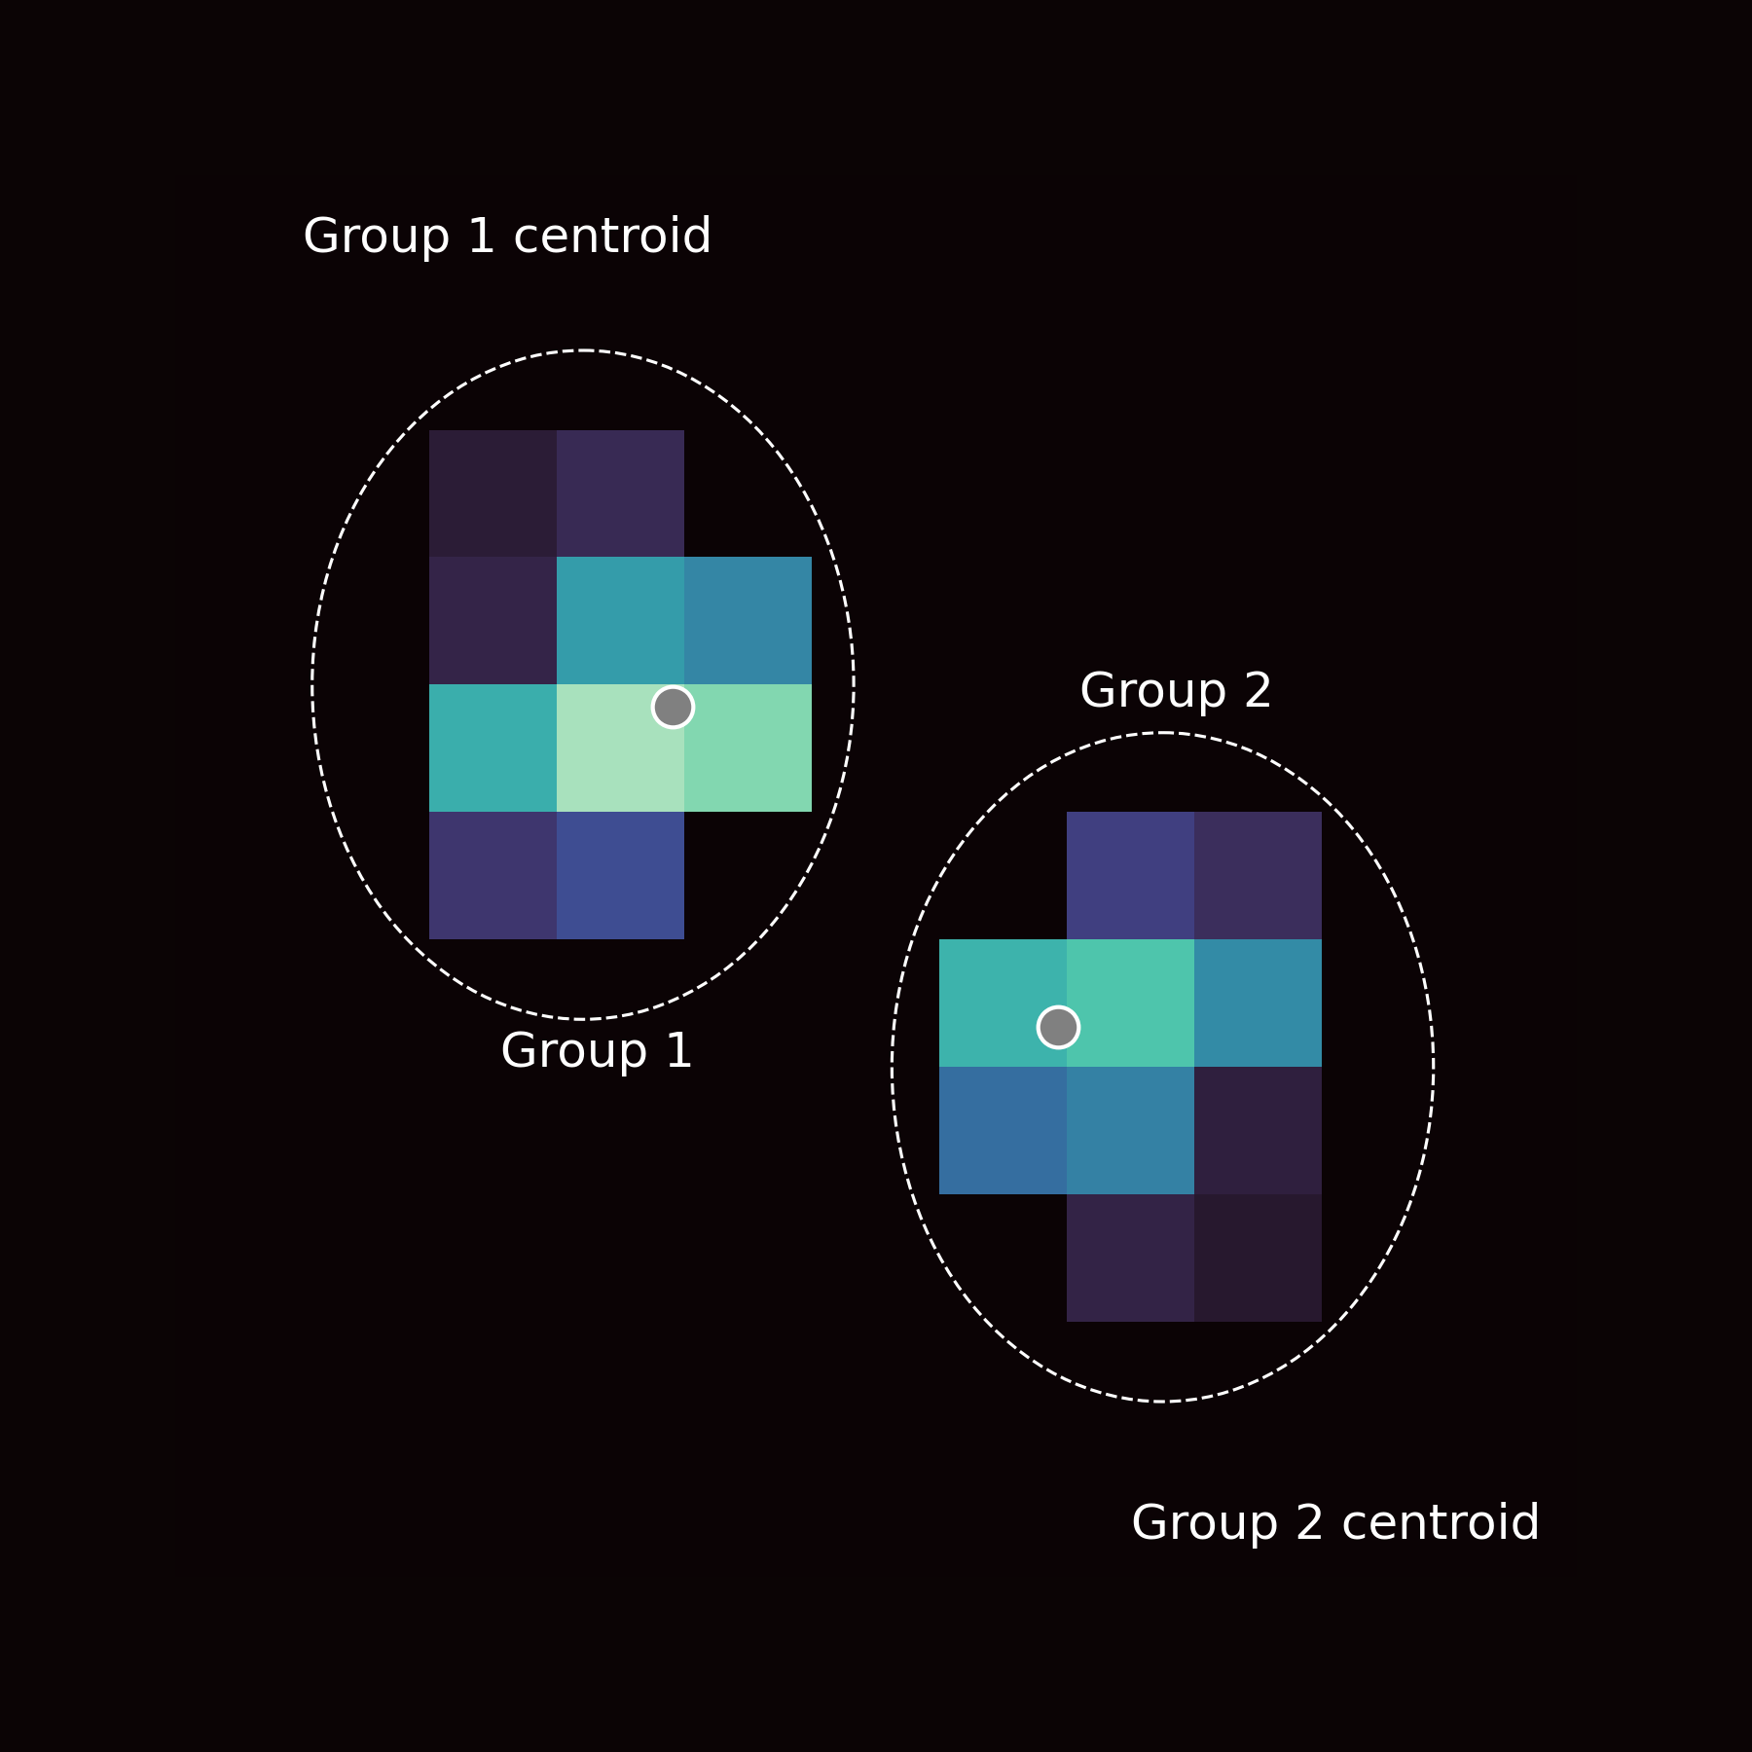
GLM Data Clustering
CCD Pixels - Single Integration
GLM Level-2 Group Clustering
Event: Time, location and amplitude of a single triggered pixel
Group: All events in adjacent pixels within the same 2 ms integration time frame
Ⓒ R. Stetson Reger. Taken 28-July-2022 in Socorro, NM
Department of Physics
Adapted from Figure 5, The GOES-R Geostationary Lightning Mapper (GLM), [Goodman et al., (2013)]

Slide 6
GLM Data Clustering
CCD Pixels - Single Integration
GLM Level-2 Group Clustering
Event: Time, location and amplitude of a single triggered pixel
Group: All events in adjacent pixels within the same 2 ms integration time frame
Group Centroid: Amplitude-weighted average of event positions in the group
Ⓒ R. Stetson Reger. Taken 28-July-2022 in Socorro, NM
Department of Physics
Adapted from Figure 5, The GOES-R Geostationary Lightning Mapper (GLM), [Goodman et al., (2013)]

Slide 7
GLM Data Clustering
GLM Level-2 Group Clustering
Event: Time, location and amplitude of a single triggered pixel
Group: All events in adjacent pixels within the same 2 ms integration time frame
Group Centroid: Amplitude-weighted average of event positions in the group
Department of Physics

Slide 8
Single-flash mapping with GLM
OUTLINE
GLM group clustering
Lightning Mapping Array (LMA)
Methods: Lightning Mapping Array as ground-truth
Results: source-location accuracy of GLM group centroids
Conclusions

Slide 9
Lightning Mapping Array (LMA)
VHF source occurs at time t and location (x,y,z)
LMA Measurement Principle
Compares time-of-arrival of VHF radiation at multiple stations
Determines time t, and position (x,y,z) of VHF source
LMA Specs
Bandwidth: 60 - 66 MHz
Resolution
Temporal: locates ≥ one source every 80 µs
Spatial: tens-of-meters
Stations needed: ≥ 6
Baseline: 1-10 km
Typical range: 100 km
Radiation arrives at station i at time t_{i}, location (x_{i}, y_{i}, z_{i})
(x_{A}, y_{A}, z_{A}, t_{A})
Department of Physics
Accuracy of the Lightning Mapping Array, [Thomas et al., (2004)]

Slide 10
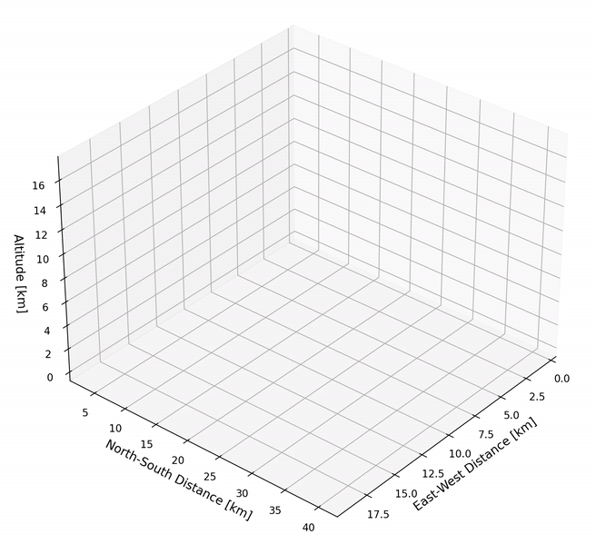
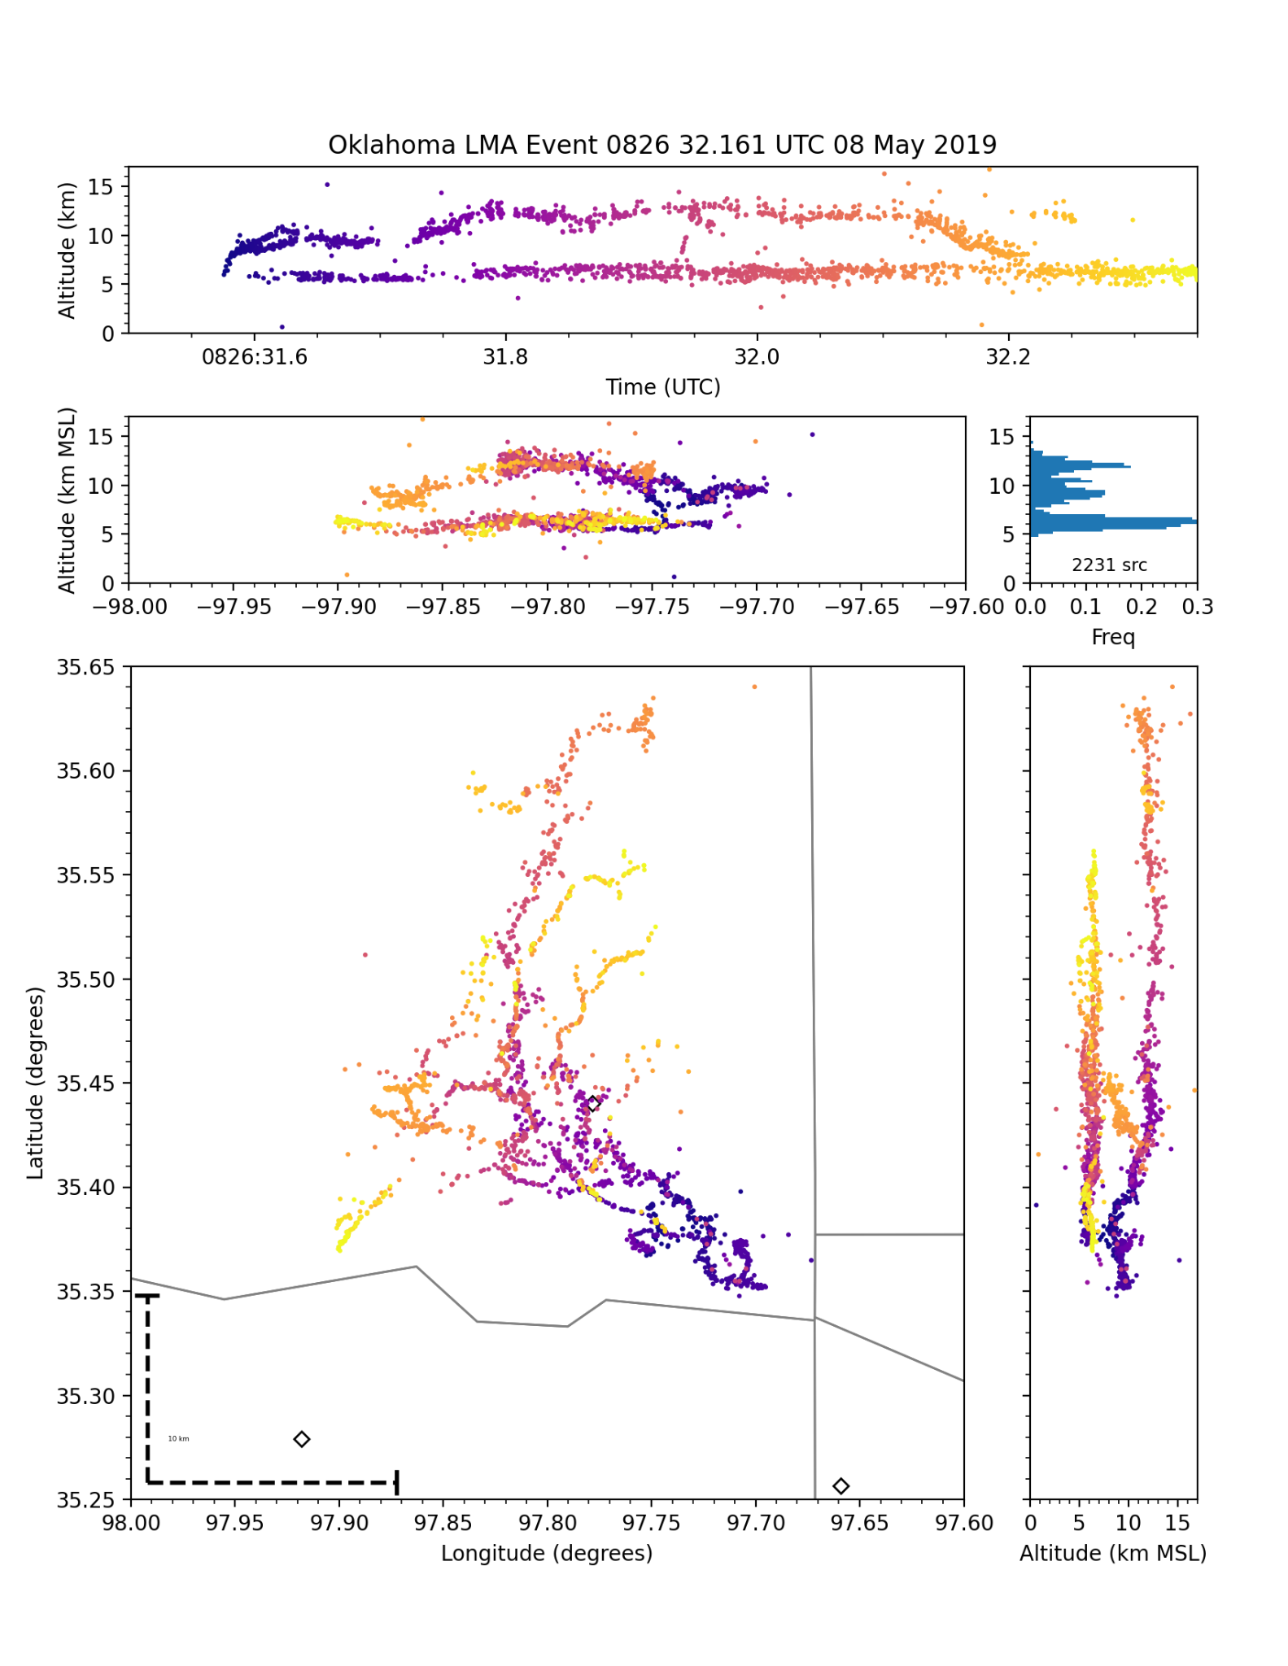
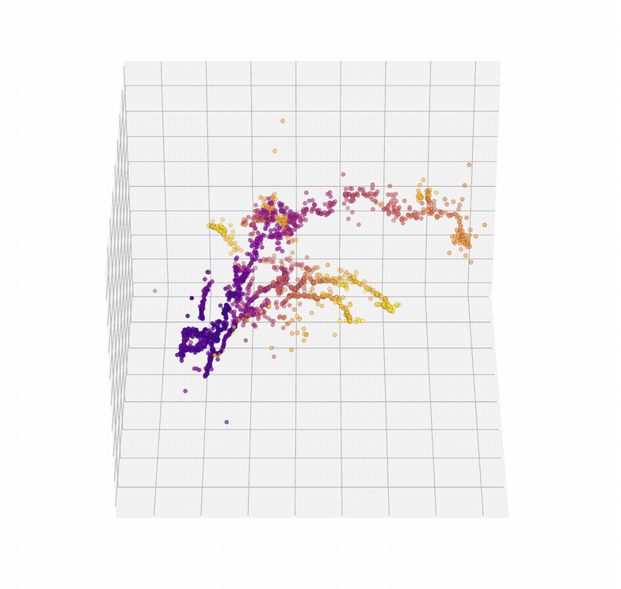
What does the LMA show?
VHF Sources Colored by Time
High resolution 3D map of the lightning channel
LMA stations are represented by ◇
10 km
Department of Physics

Slide 11
Single-flash mapping with GLM
OUTLINE
GLM group clustering
Lightning Mapping Array (LMA)
Methods: Lightning Mapping Array as ground-truth
Results: source-location accuracy of GLM group centroids
Conclusions

Slide 12
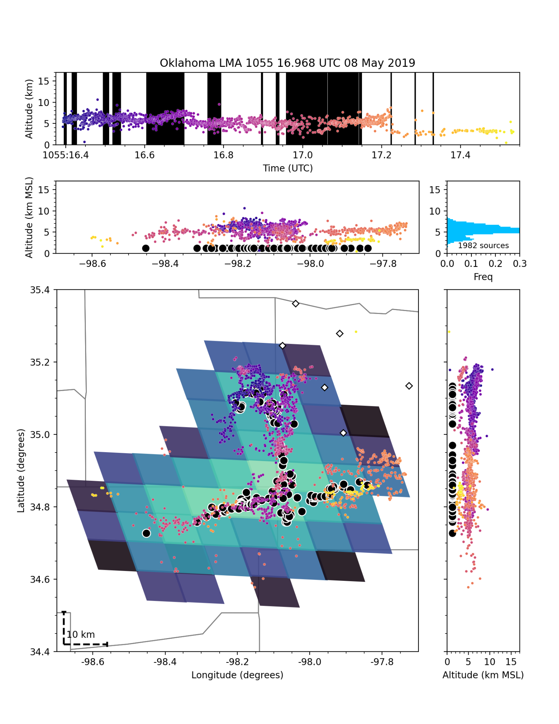
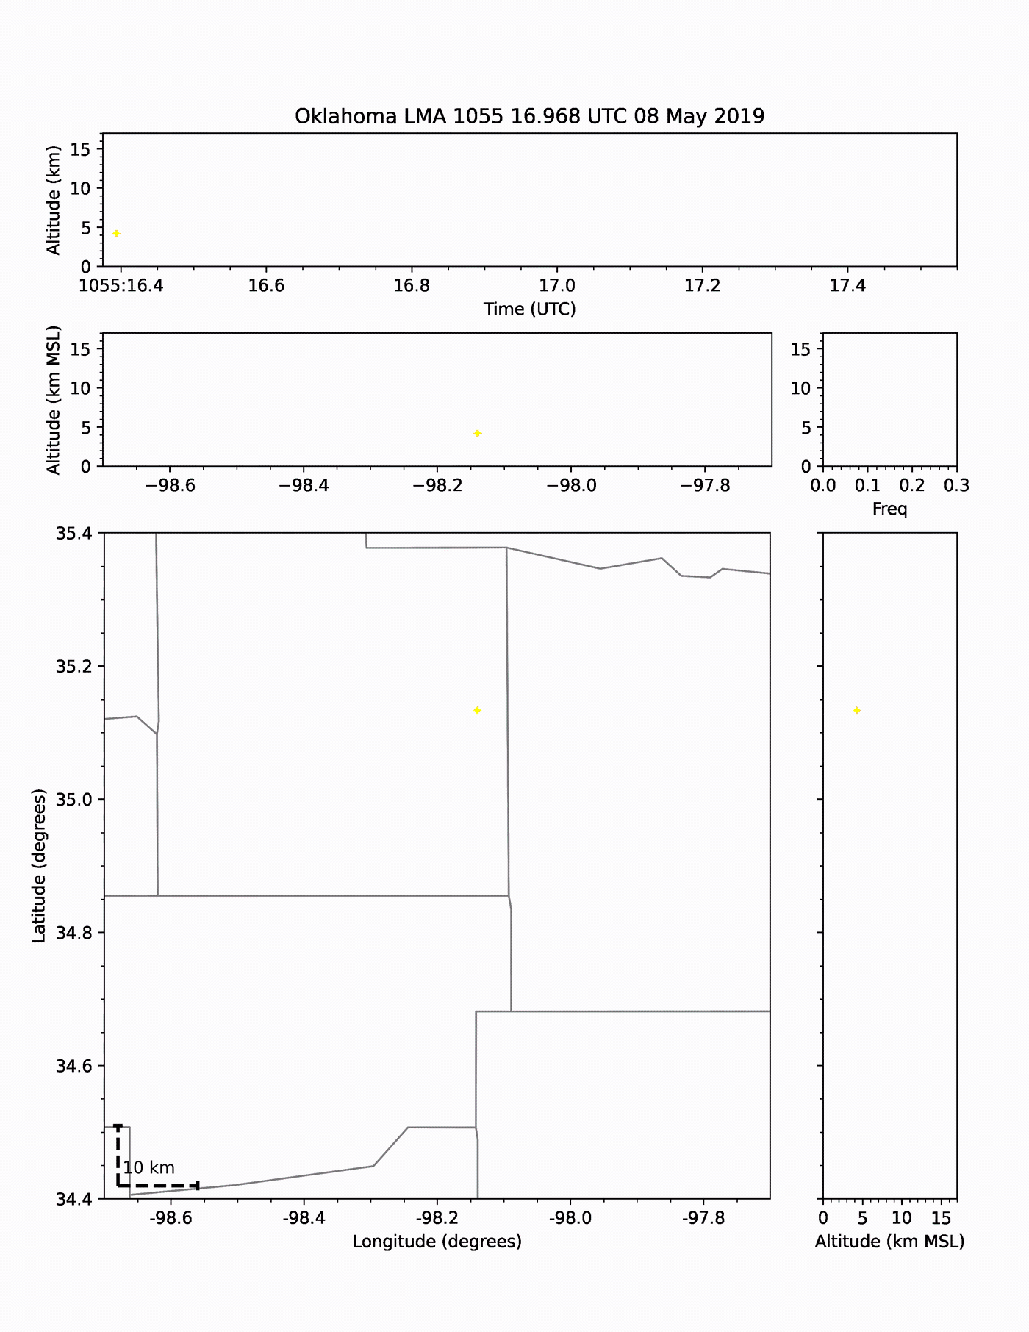
Group Centroids: How good are they?
Why use the LMA?
Ground-truth source location
LMA accurately locates the lightning channel
Quantifying source-location accuracy
≤ 25 VHF sources per GLM integration (2 ms)
Clustering is used to compute average VHF positions concurrent with each GLM group
Department of Physics

Slide 13
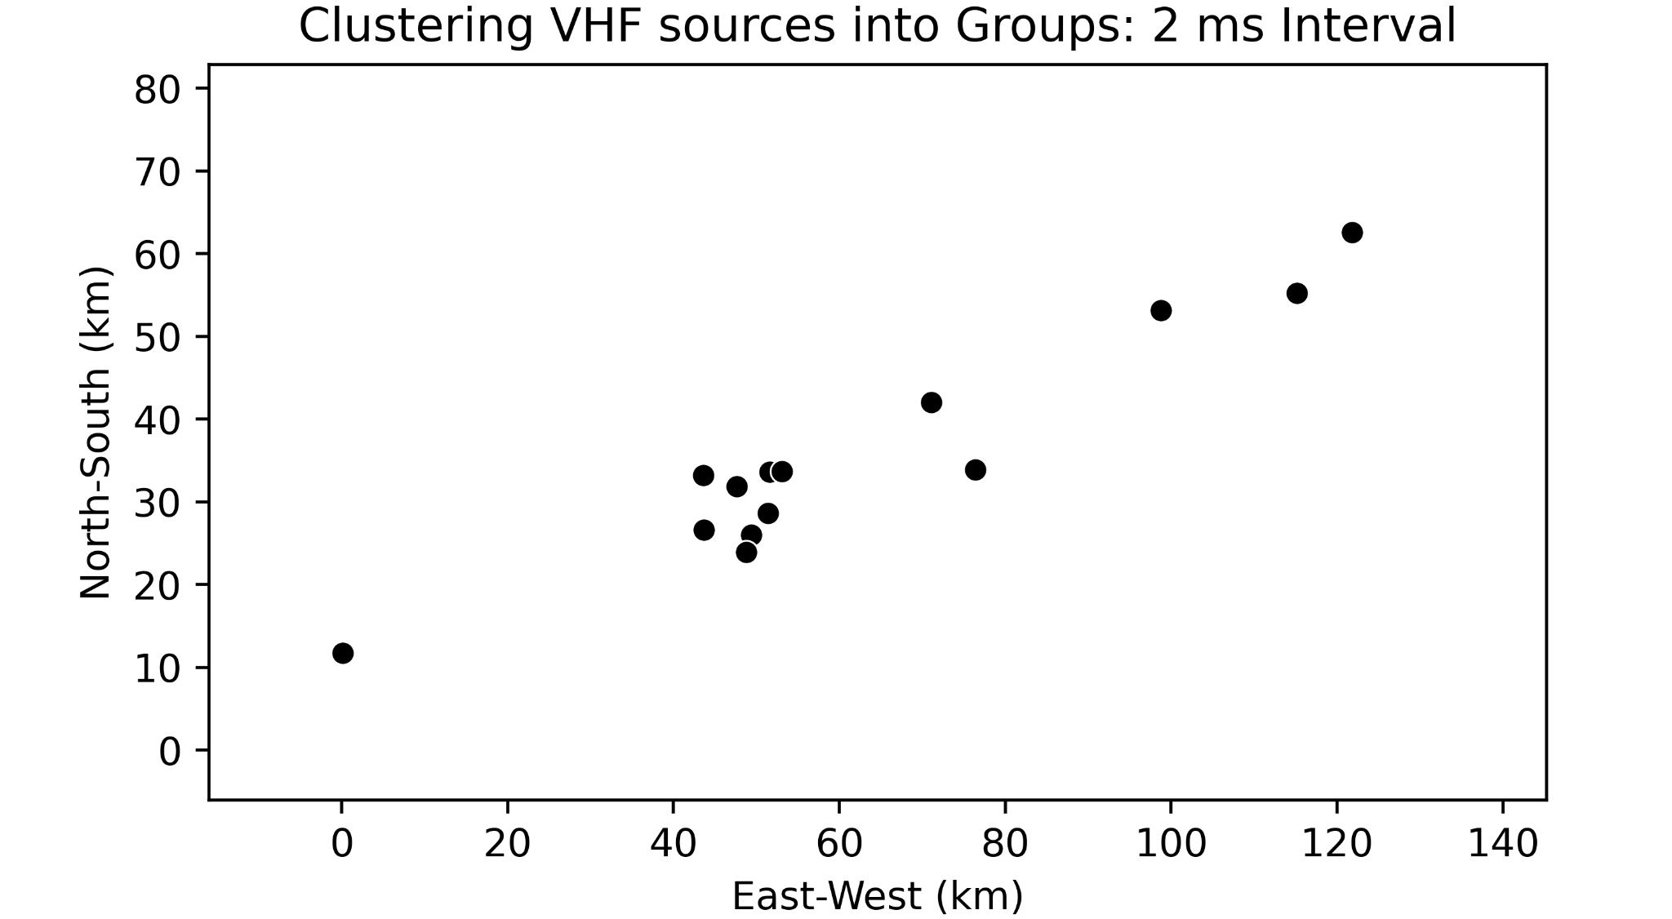
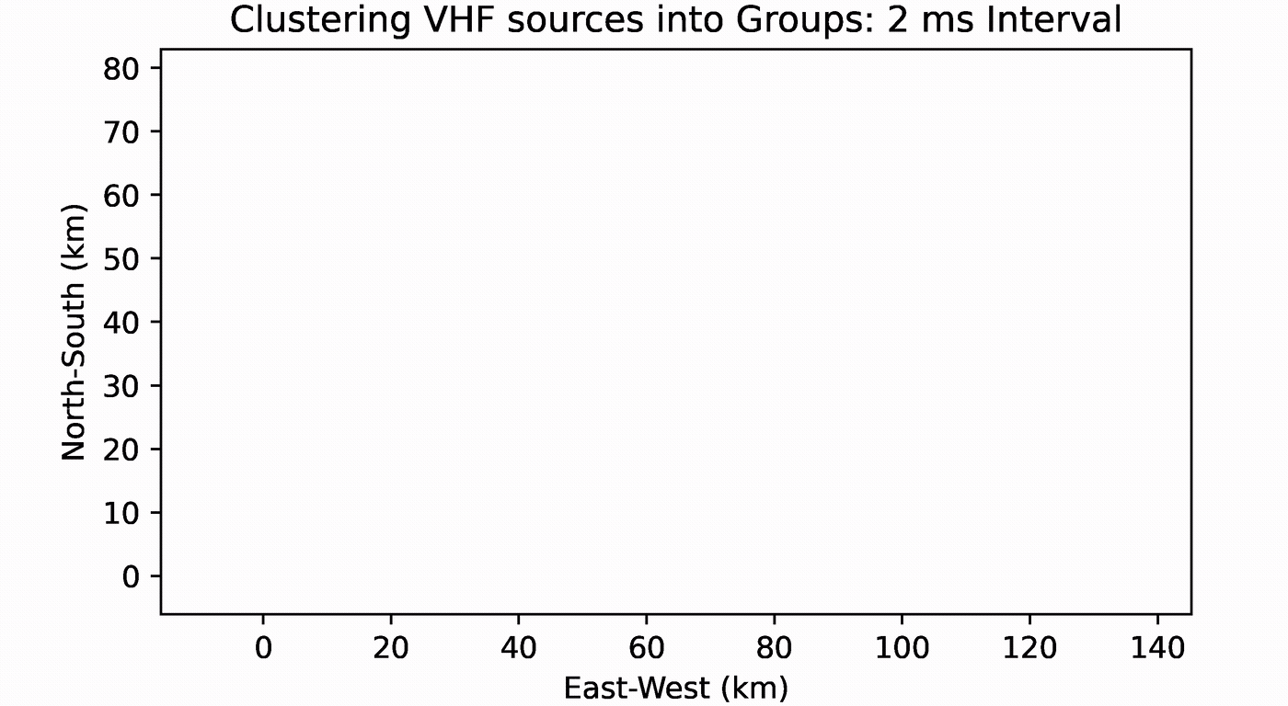
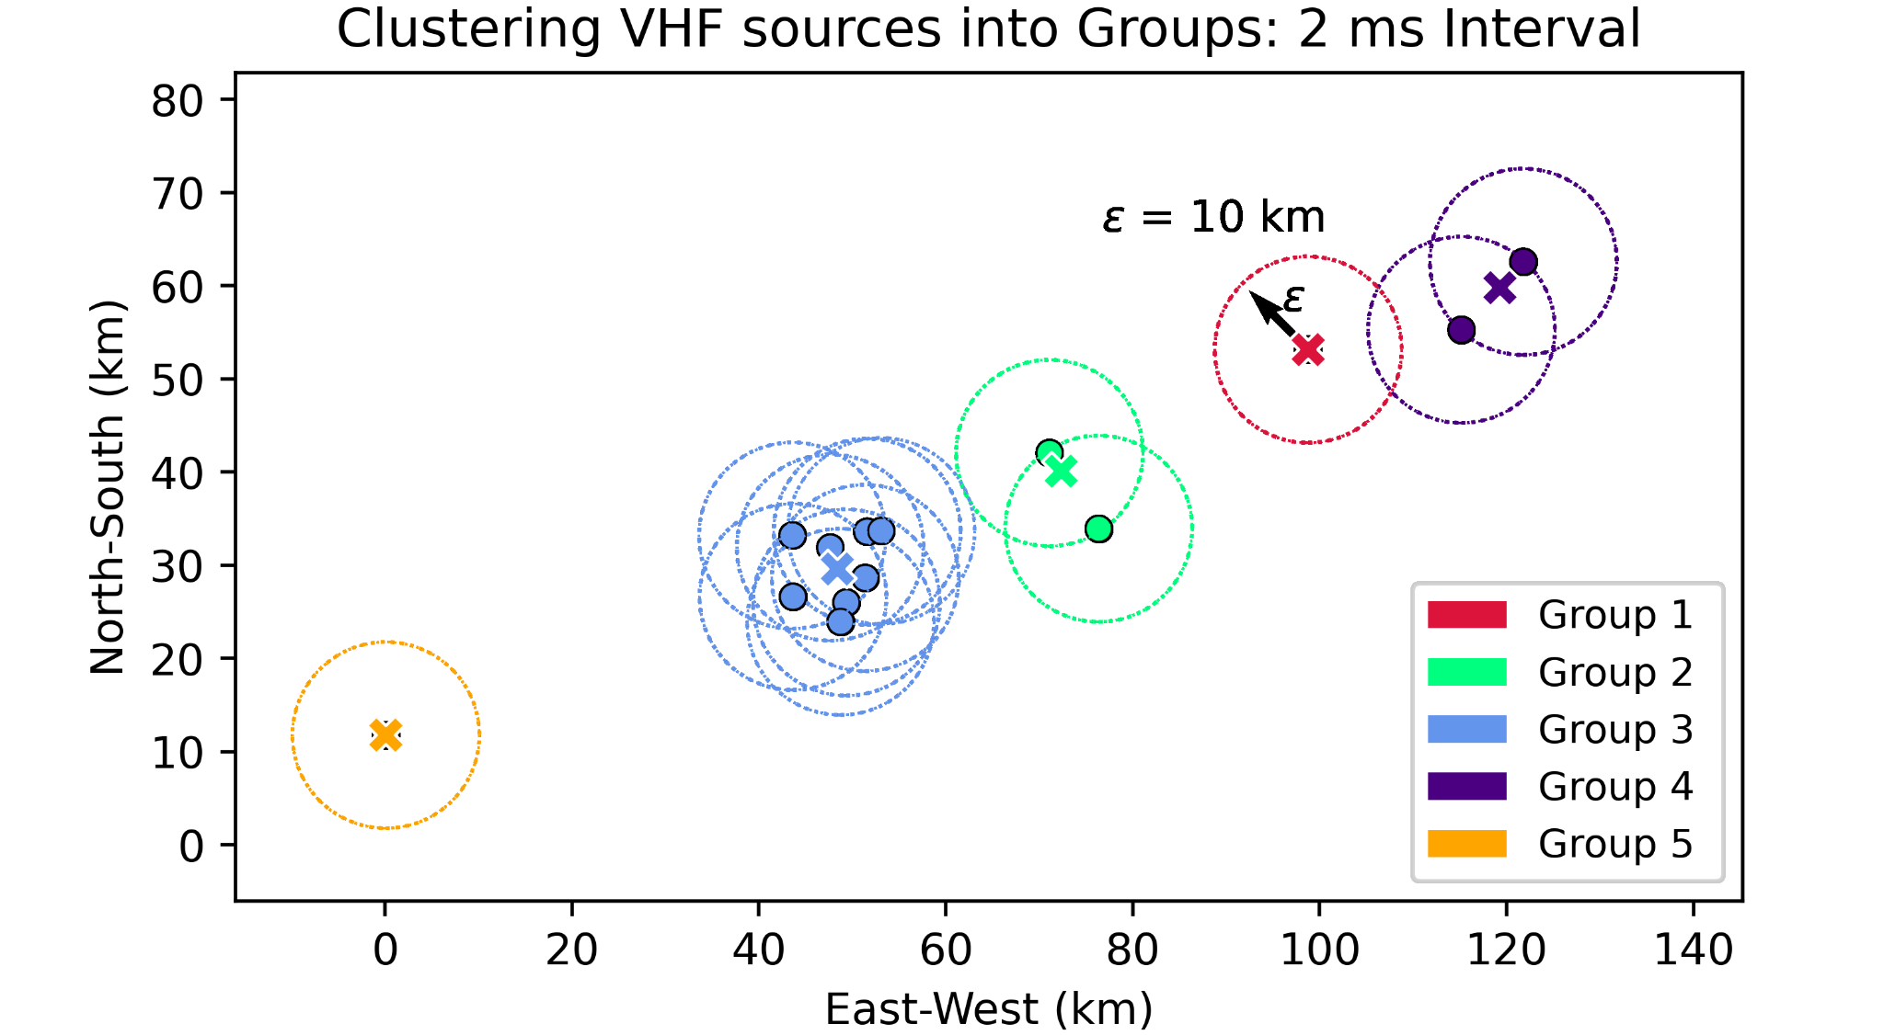
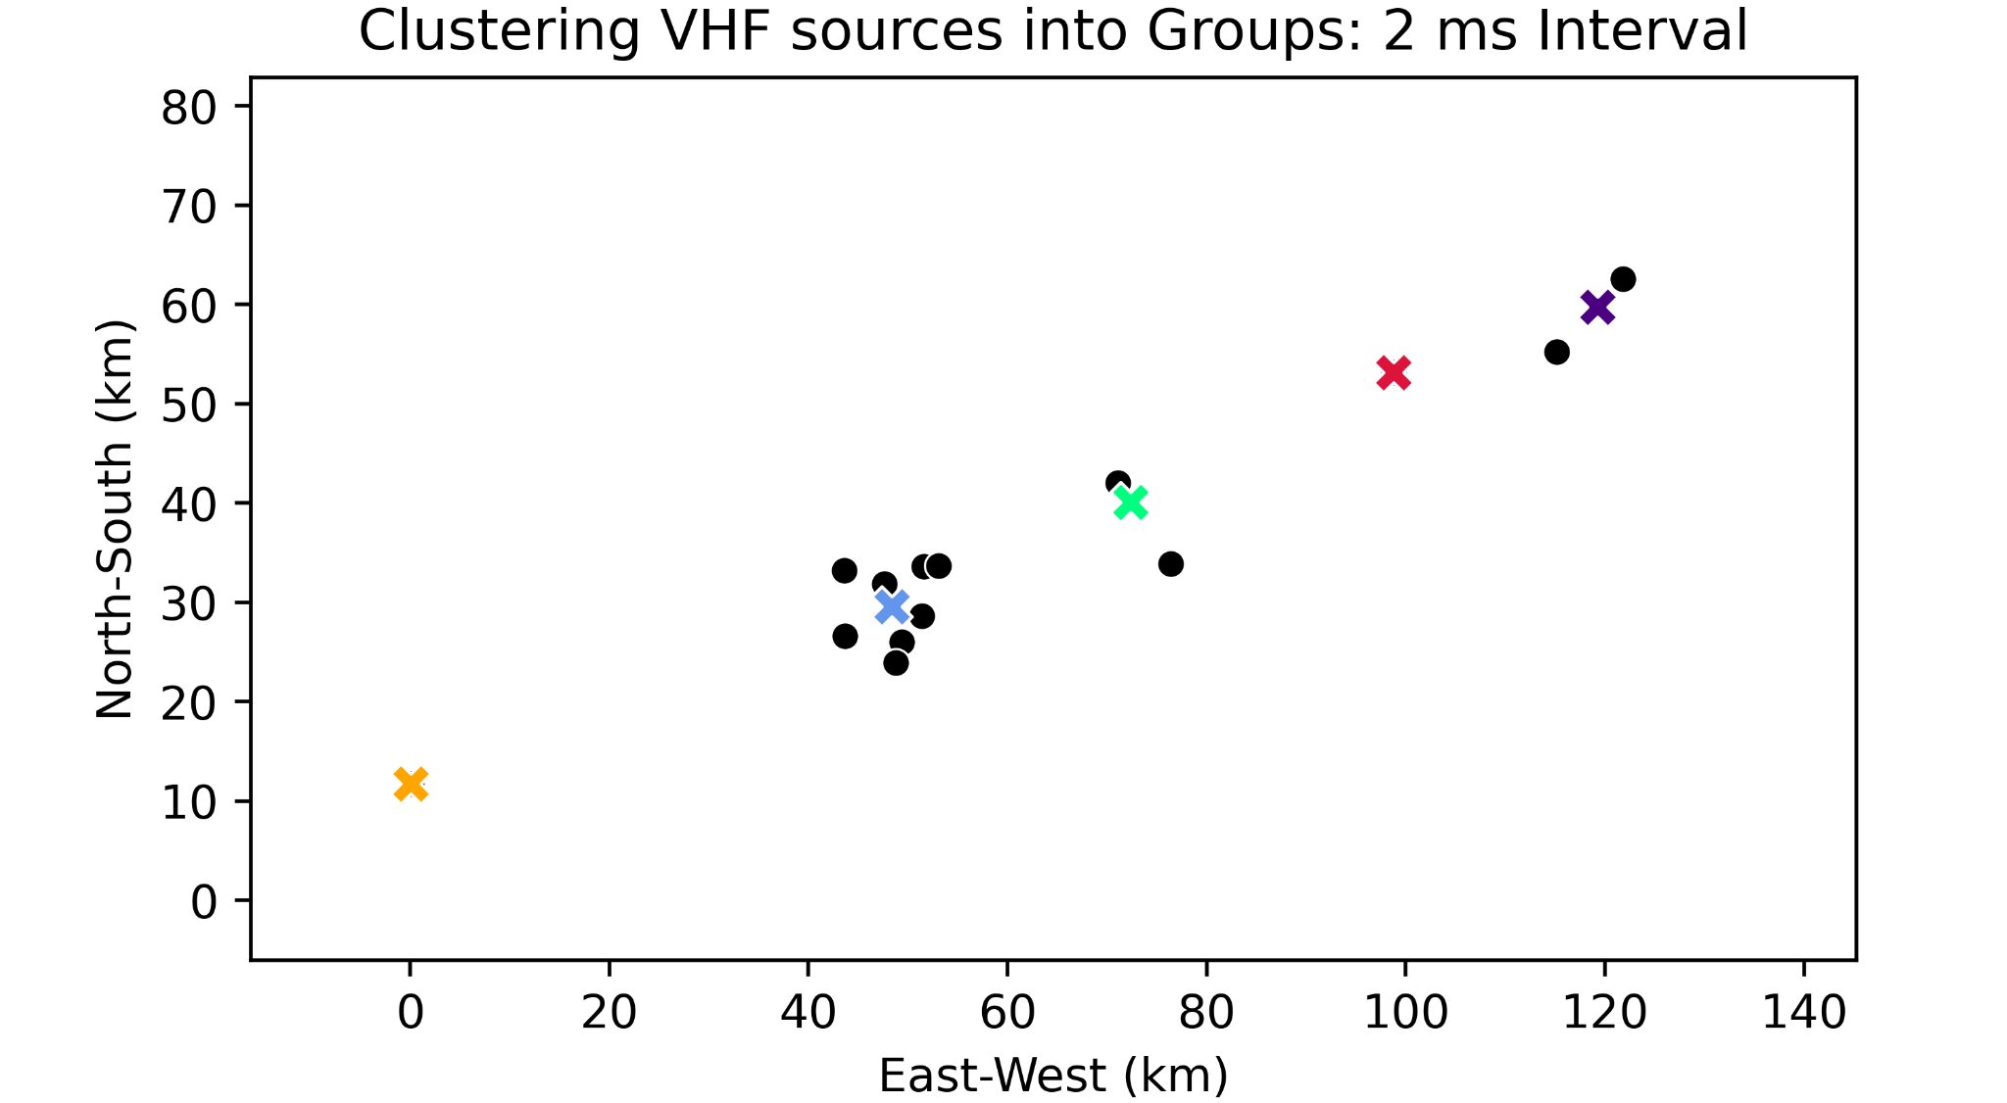
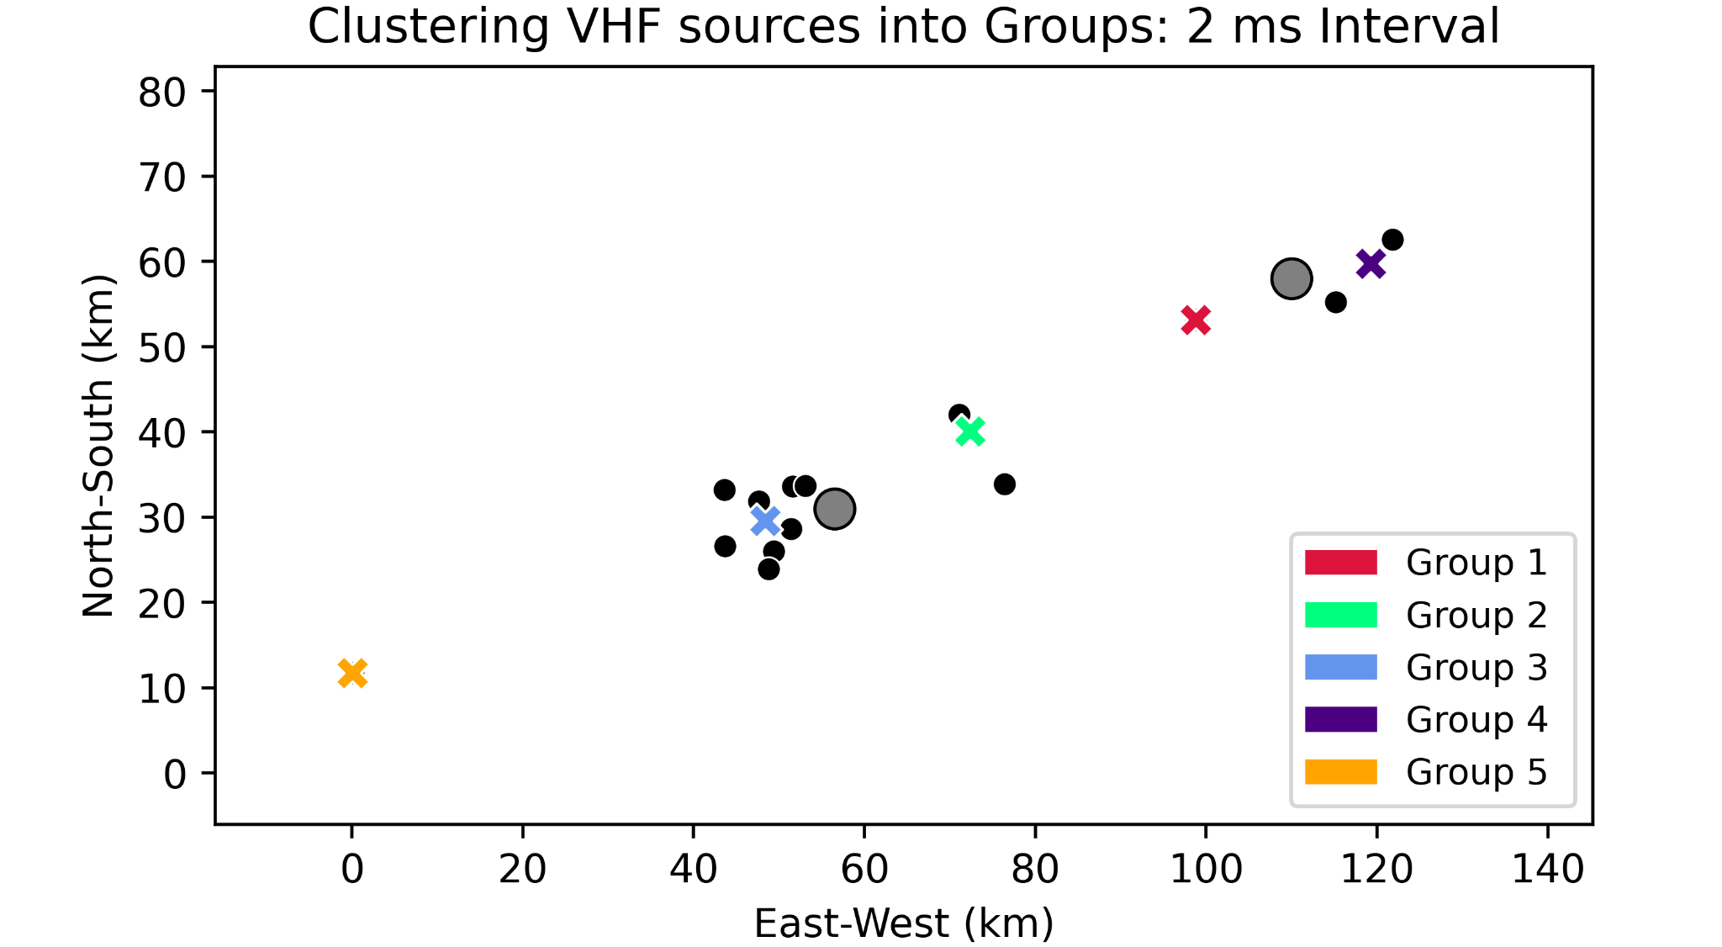
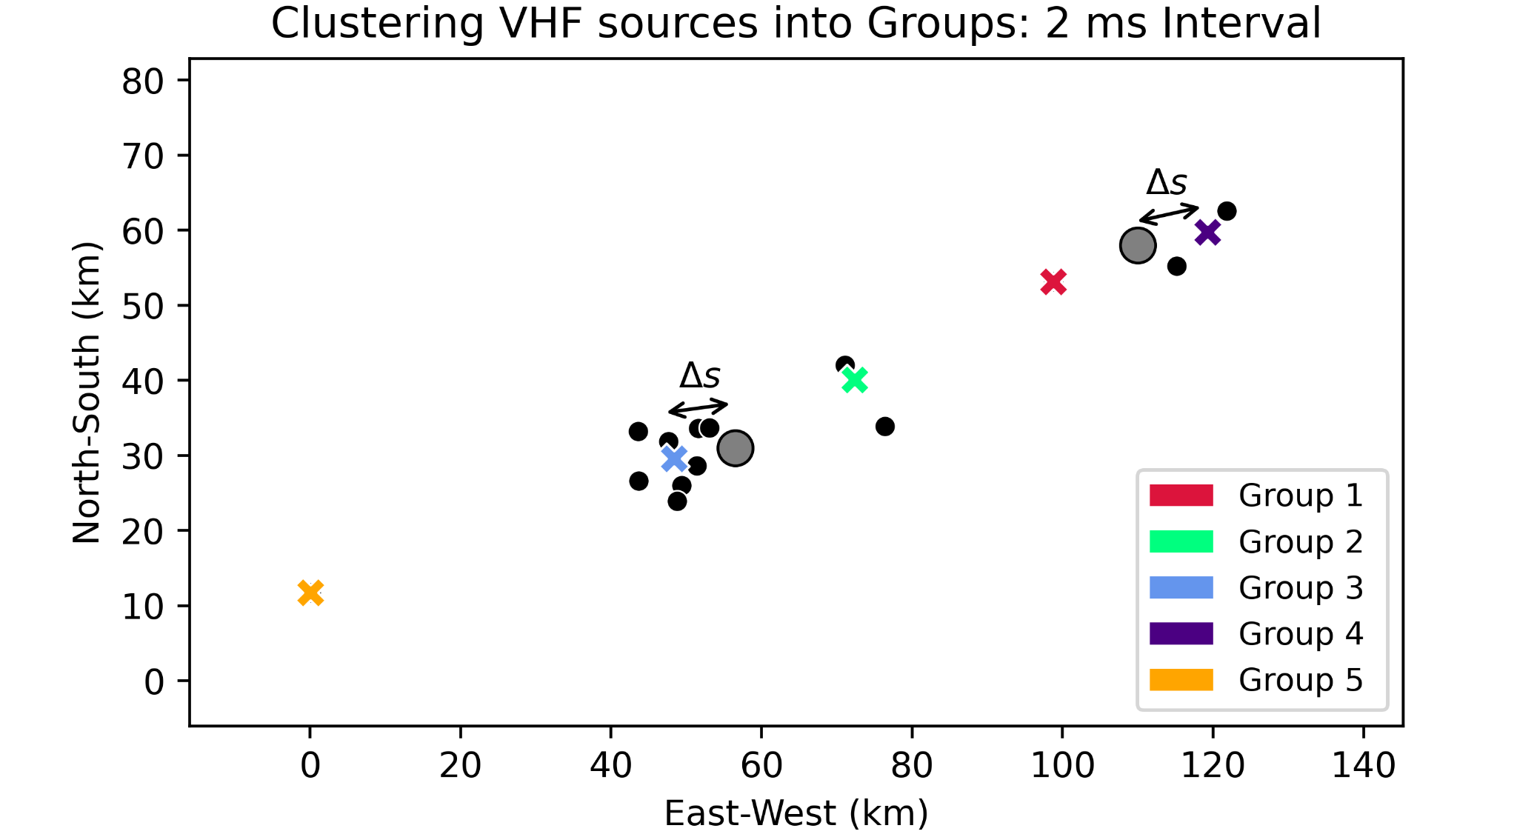
Constructing an LMA Group Centroid
Constructed LMA Group Centroid (LGC) to compare directly to GLM Group Centroid (GGC)
LMA Event: The position, time, and power of a VHF source
LMA Group: All VHF sources within a 2 ms time-frame and separated by 10 km or less
LMA Group centroid: VHF-power-weighted average of event-positions in the group
Δs: The horizontal separation between a given GGC and the nearest concurrent LGC
Department of Physics

Slide 14
Single-flash mapping with GLM
OUTLINE
GLM group clustering
Lightning Mapping Array (LMA)
Methods: Lightning Mapping Array as ground-truth
Results: source-location accuracy of GLM group centroids
Conclusions

Slide 15
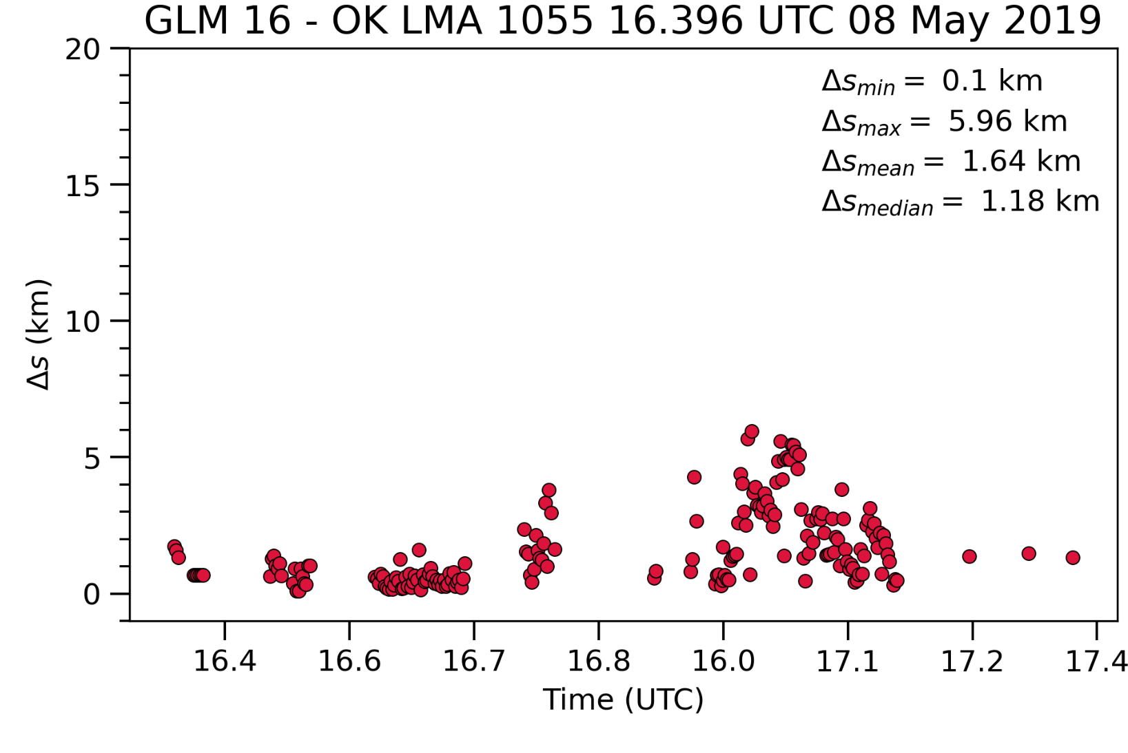
Results - Δs for a single flash
Def Δs: The horizontal separation between a given GLM group centroid and the nearest concurrent LMA group centroid
LMA gives additional source information
Altitude
VHF power
Channel extent & structure
Department of Physics

Slide 16
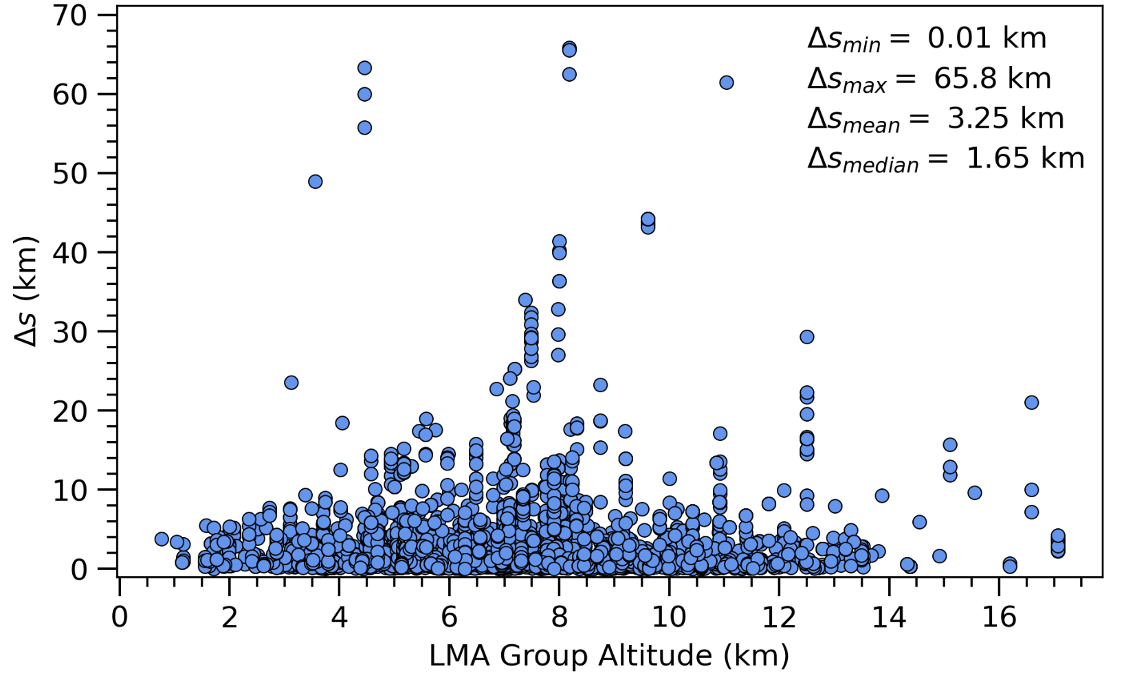
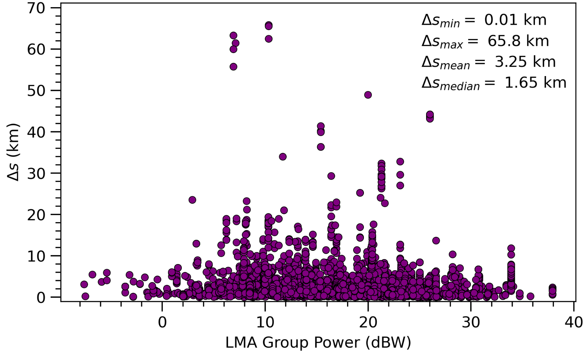
Results - Δs for 32 flashes
Do other parameters correlate with Δs?
Δs vs. LMA Group Altitude
Δs vs. LMA Group Power
Department of Physics

Slide 17
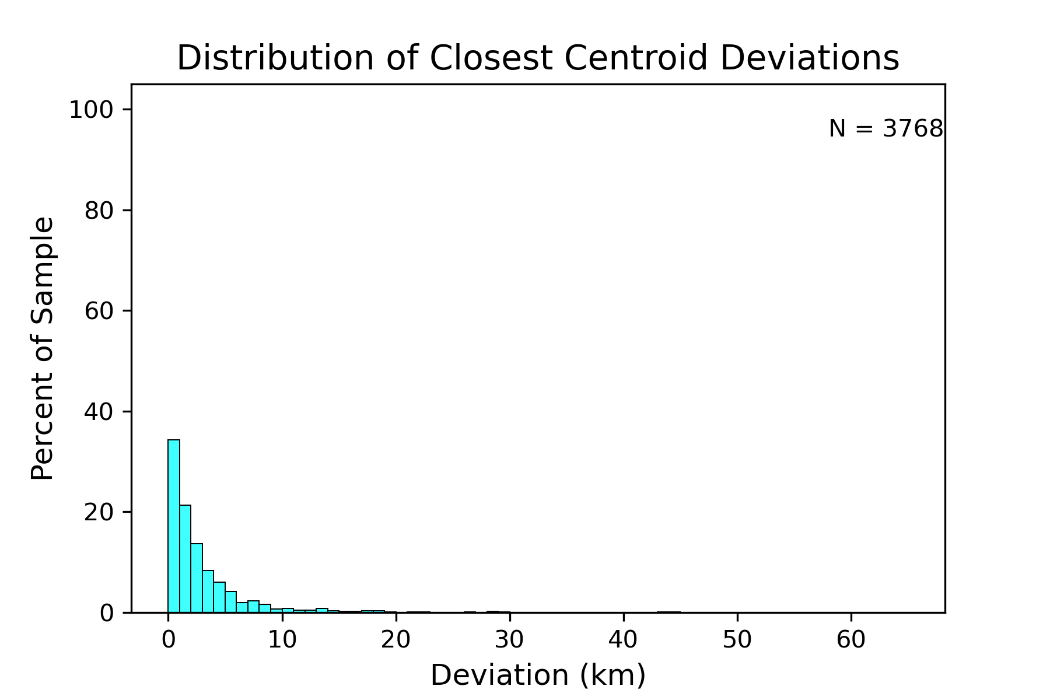
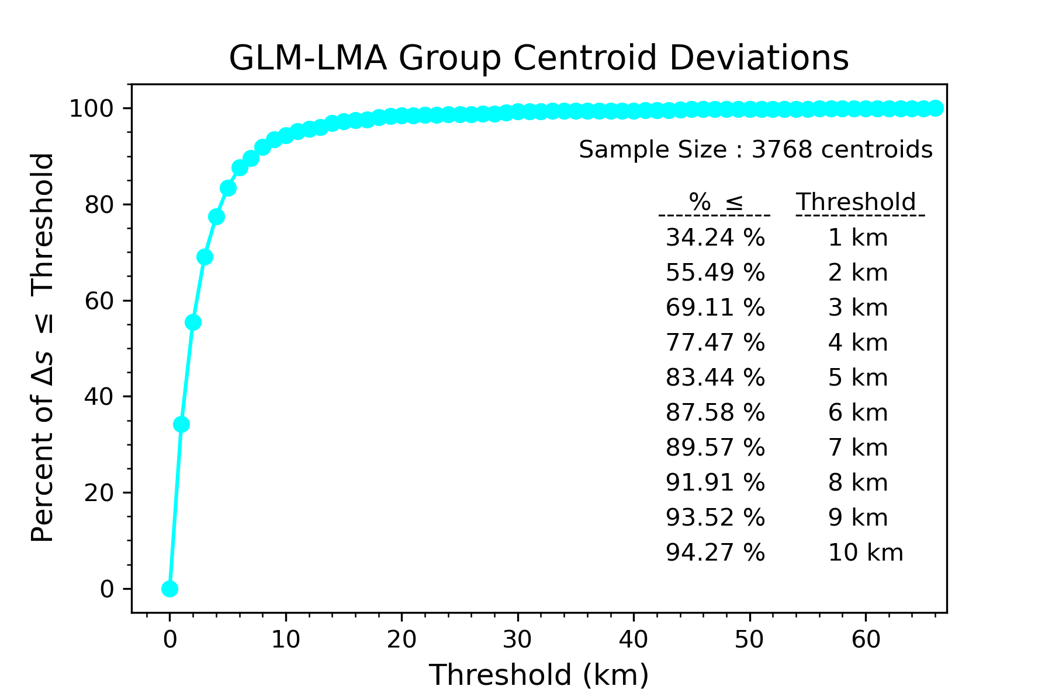
Results - Δs distribution for 32 flashes
Δs (km)
Department of Physics

Slide 18
Single-flash mapping with GLM
OUTLINE
GLM group clustering
Lightning Mapping Array (LMA)
Methods: Lightning Mapping Array as ground-truth
Results: source-location accuracy of GLM group centroids
Conclusions

Slide 19
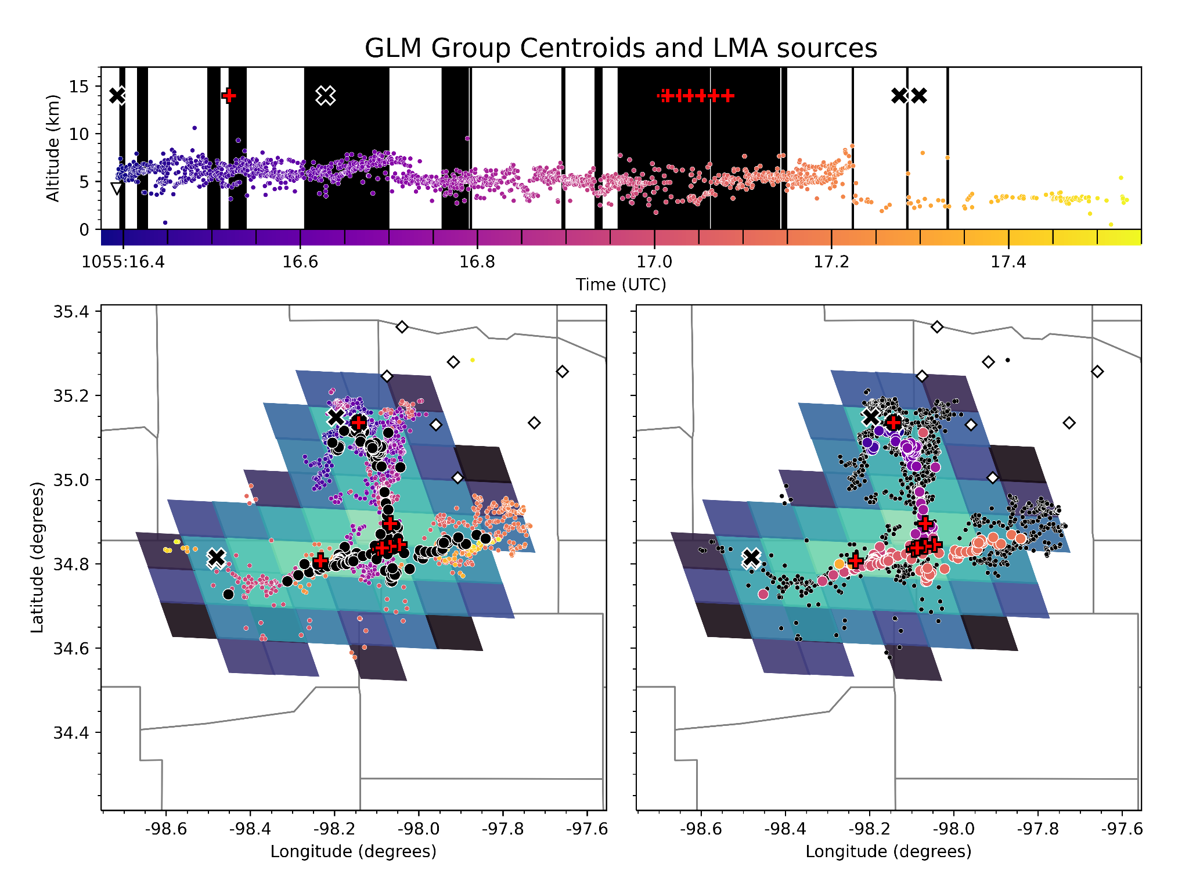
Interpretation and Conclusions
Within single lightning flashes, GLM group clustering retrieves source locations from the pixelated data.
GLM Group Centroids locate lightning channel development to within 3 km.
~ one σ confidence (69%)
Group centroids map the extent and dendritic structure of lightning within the cloud.
LMA sources colored by time
GLM centroids colored by time
Department of Physics

Slide 20
Single-flash mapping with GLM
Department of Physics

Slide 21
Single-flash mapping with GLM
References
[1] Goodman et al., (2013), “The GOES-R Geostationary Lightning Mapper (GLM)”, Atmospheric Research, 125–126, Pages 34-49, ISSN 0169-8095. https://doi.org/10.1016/j.atmosres.2013.01.006
[2] Thomas, R. J., Krehbiel, P. R., Rison, W., Hunyady, S. J., Winn, W. P., Hamlin, T., and Harlin, J. (2004), “Accuracy of the Lightning Mapping Array”, J. Geophys. Res., 109, D14207, doi:10.1029/2004JD004549.
Acknowledgements
Research funded by Sandia National Labs
Richard Sonnenfeld & Julia Tilles - for advising me
Eric Bruning - for sharing python code to view and analyze GLM and LMA data
Steve Goodman - for sharing his expertise
Harald Edens - for sparking my interest in lightning research

Slide 22
Extra Slides
Department of Physics

Slide 23
Results - Δs for 32 flashes
69% of GLM centroids are within 3 km of concurrent VHF sources.
Δs Confidence Relationships
Δs Distribution
Department of Physics

Slide 24
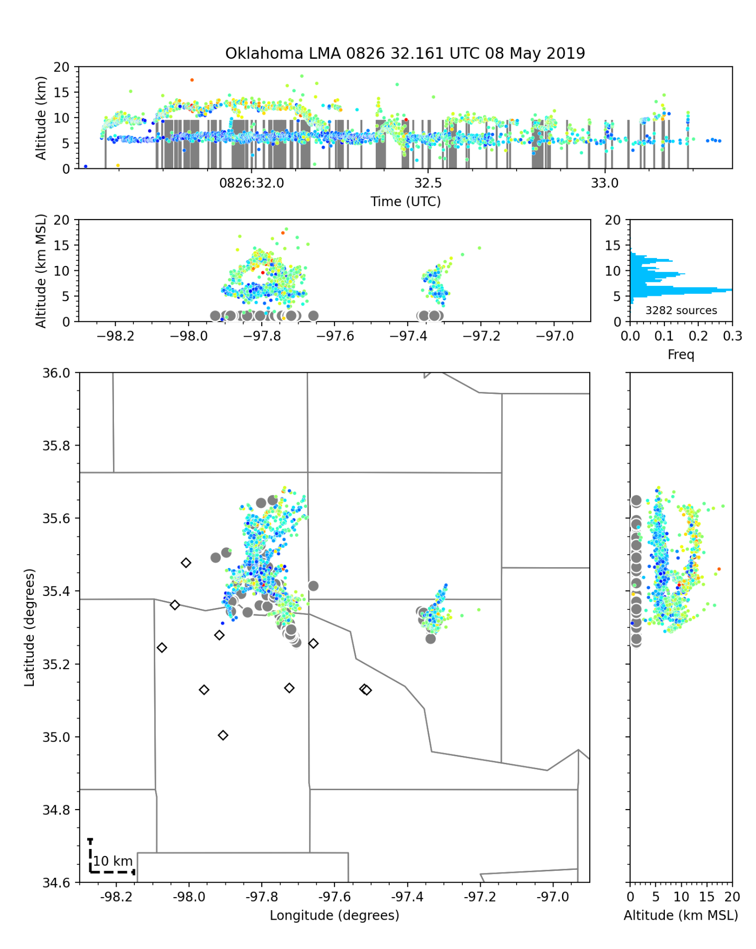
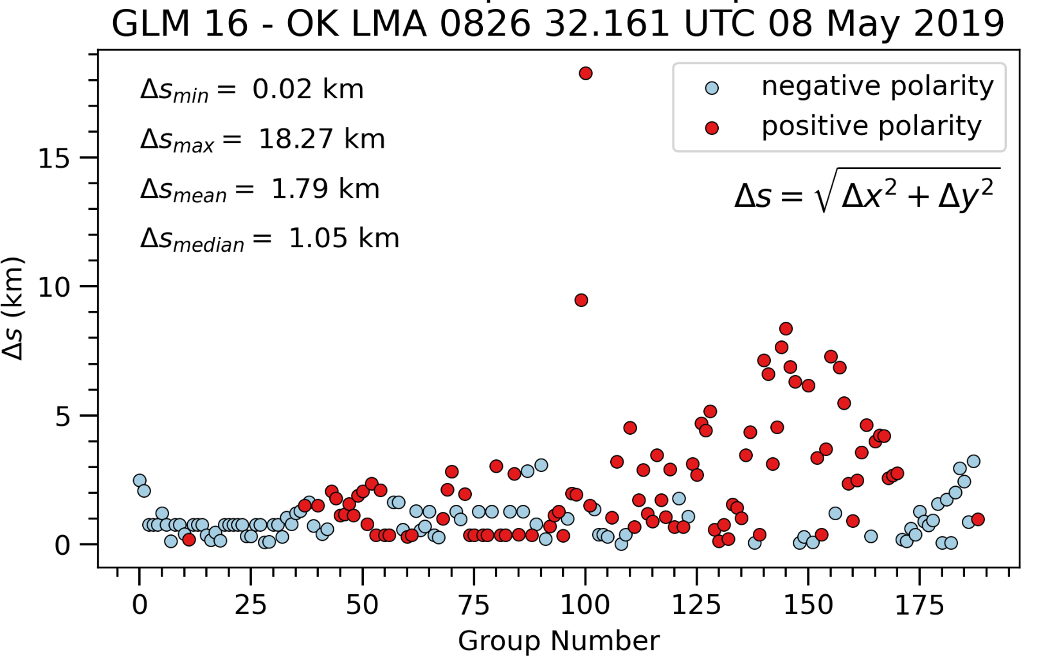
Polarity dependence?
Department of Physics

