Slide 1

Boltzmann Radiative Transfer Modeling of Lightning Cloud-Top Optical Emissions
Annual Geostationary Lightning Mapping Meeting Huntsville, AL. 26 September 2024
William Koshak, NASA/MSFC
Koshak, NASA/MSFC

Slide 2
How to Handle Lightning Radiative Transfer?
Thomason and Krider (1982), Monte Carlo
Early 1990s: Is there another, more analytic, approach?
Atmospheric Science Radiative Transfer | Lightning Radiative Transfer
Steady-State Plane Wave Solar Radiation Source | Inhomogeneous (Tortuous) Transient Lightning Source
x-y Infinite Plane Parallel Atmosphere | Finite Thundercloud
External cloud illumination | Internal cloud illumination
1-, 2-, or 3-D | 4-D
Steady-State Solution; e.g. I(z, 𝛀) | Transient Solution; I(r, 𝛀,t)
Koshak, NASA/MSFC

Slide 3
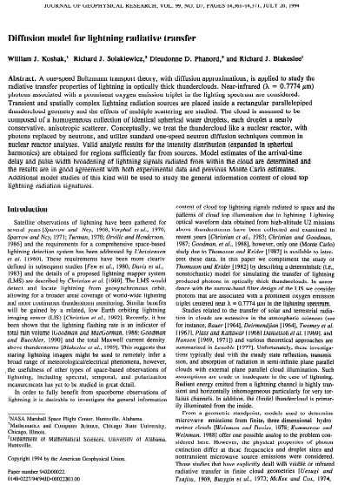
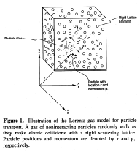
Boltzmann Transport Model: Koshak et al (1994)
Nuclear Physics | Lightning Radiative Transfer
neutrons | photons
nuclear reactor | thundercloud
²³⁵U fuel & moderator | cloud droplets
many speeds | one speed (elastic scattering, λ=777.4 nm)
scattering, absorption, fission | scattering, a little absorption
Koshak, NASA/MSFC

Slide 5
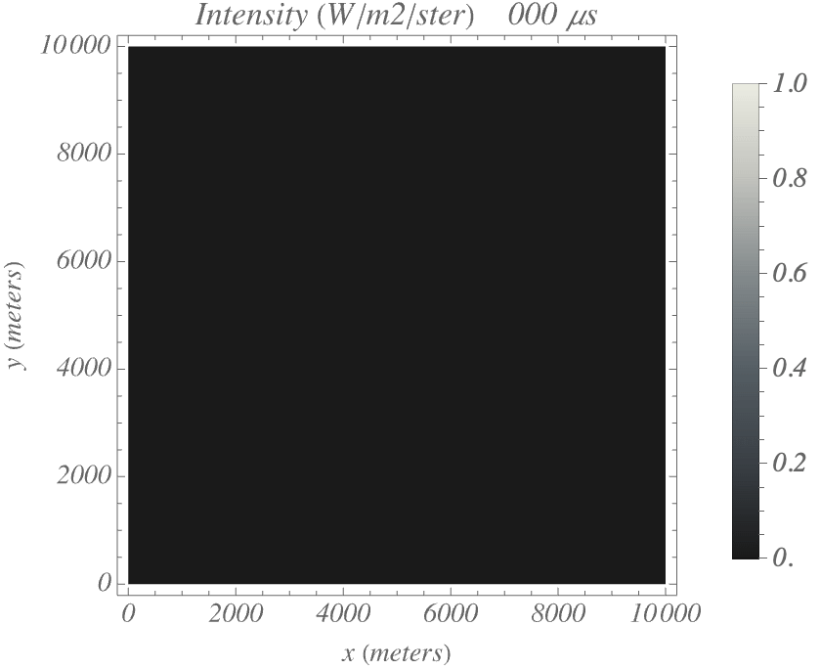
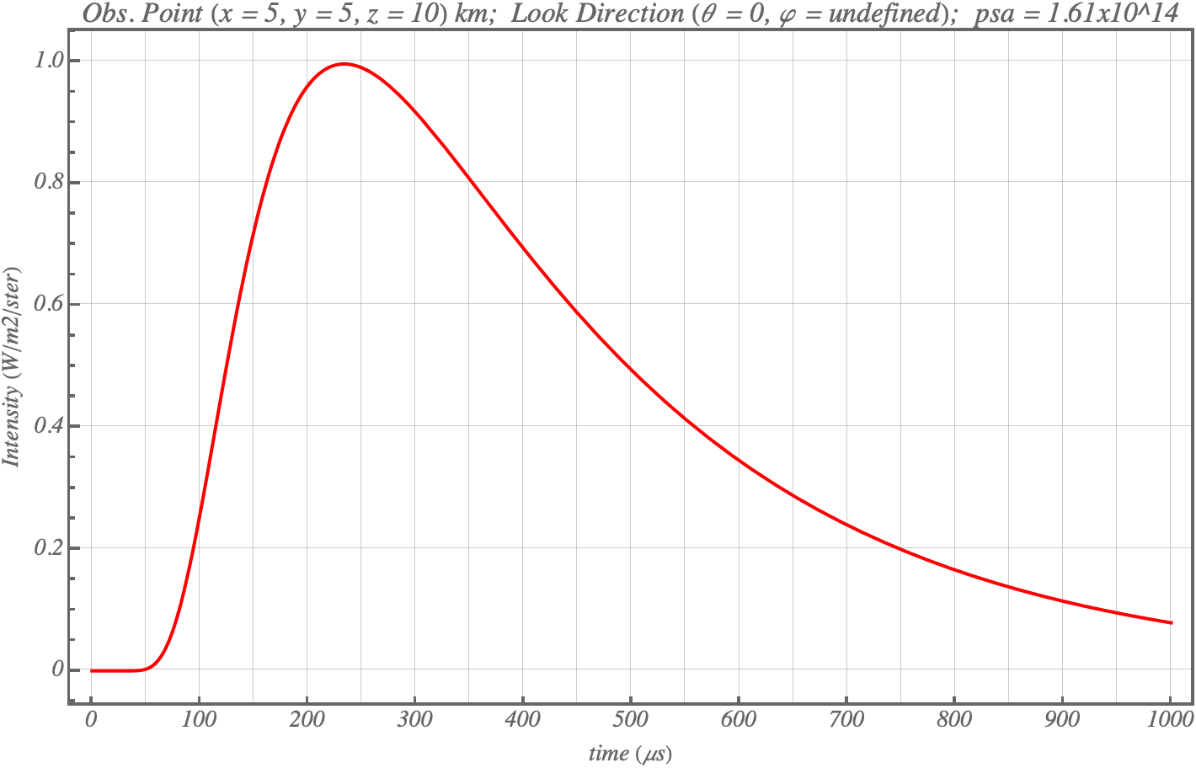
Point Source @ Center of Cubical Cloud
Koshak, NASA/MSFC

Slide 6

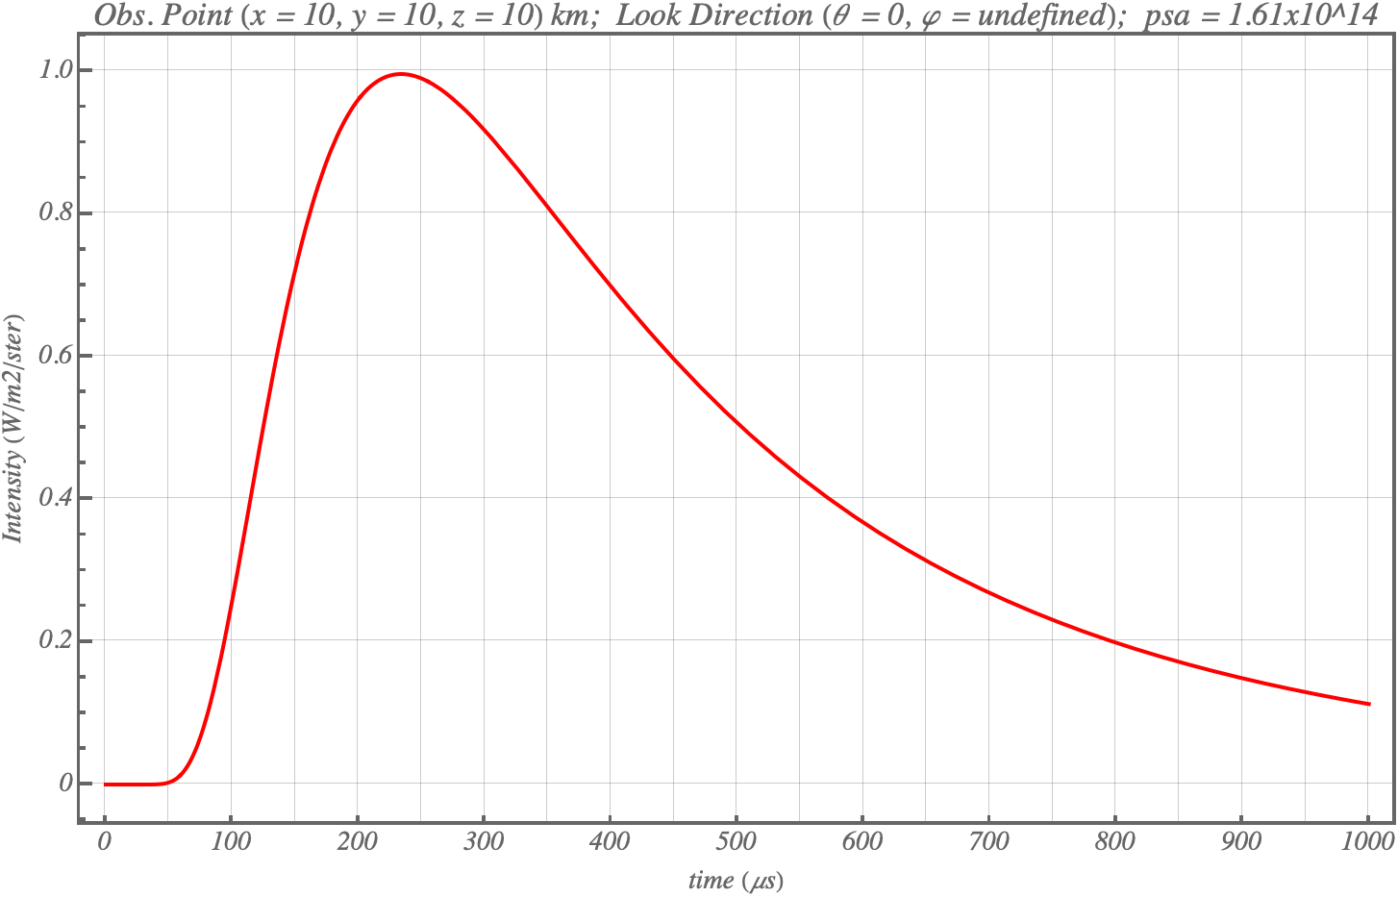
Double the Horizontal Cloud Extent of Previous
Koshak, NASA/MSFC

Slide 7
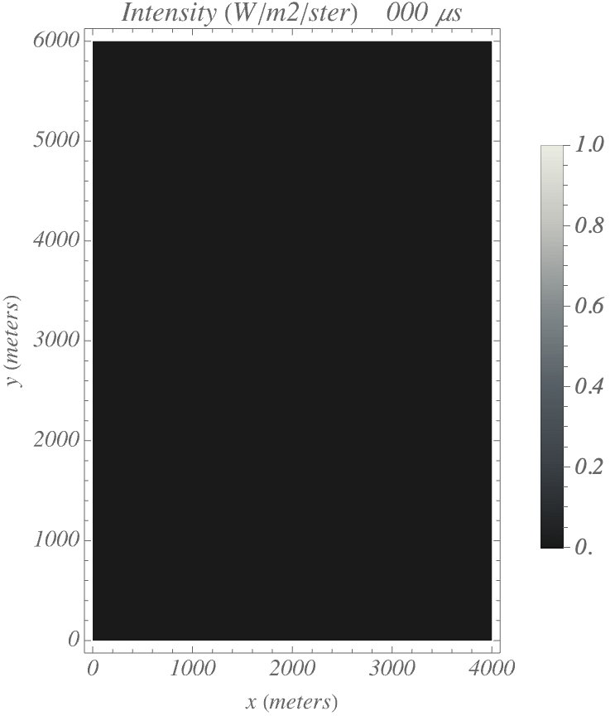
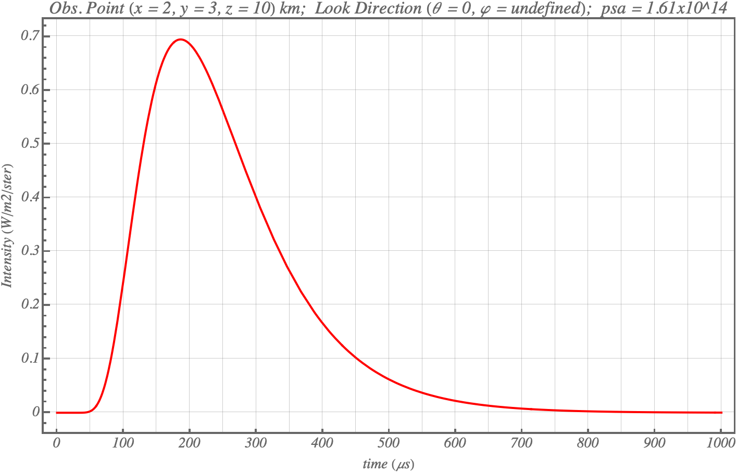
Point Source @ Center of Narrow Rectangular Cloud
Koshak, NASA/MSFC

Slide 8
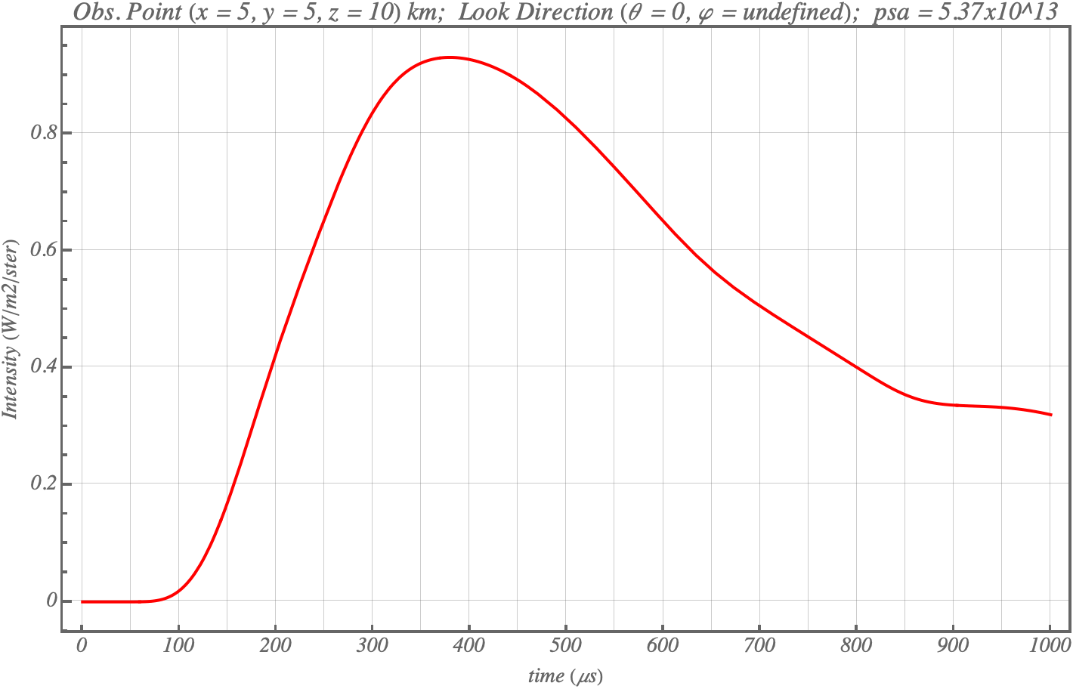
Horizontally Propagating Discharge
Koshak, NASA/MSFC

Slide 9
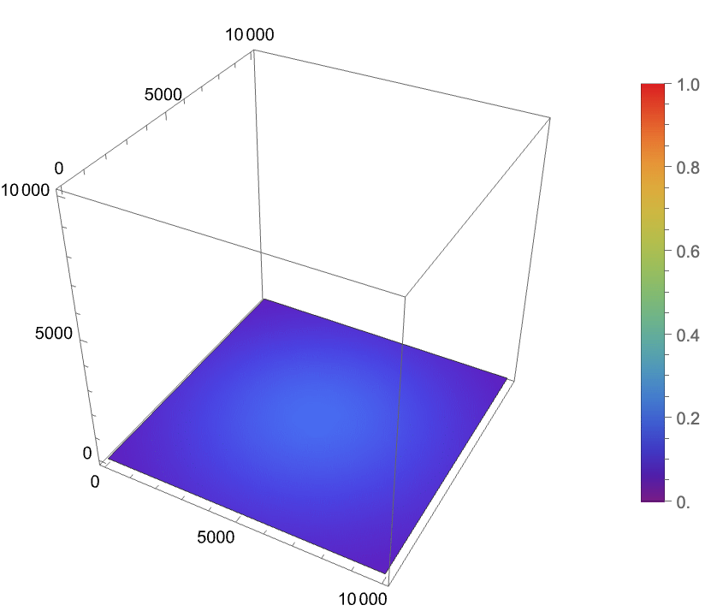
Additional Probing with Wolfram Language
Slices:
Orientations:
For illustration purposes only (not a simulation run)
Koshak, NASA/MSFC

Slide 11
Summary
Overview: Examining cloud-top optical patterns vs channel length … i.e., Can GLM be used to estimate channel length (hence LNOx) ?
Steps Taken Thus Far:
  Resurrected Boltzmann Transport Theory (BTT) from 30+ yrs ago
  Re-coded BTT in Wolfram Language (WL, v.14), better than old Fortran
  WL forward problem runs to gain insight on patterns-length dependence
  Extended BTT theory to set-up a linear retrieval problem
  Long-term goal is to use BTT forward problem runs & linear retrieval system to assist in ML approach that uses the following training dataset (GLM patterns associated with LMA-derived channel lengths).
Koshak, NASA/MSFC

