Slide 1
GLM Data Quality Product and Background Imagery
Phillip Bitzer and Eric Bruning
(and many others!)

Slide 2
Goal: Develop a data quality product that conveys real time information about GLM performance
Goal: Geolocate backgrounds

Slide 3
On demand
Daily
Read L0/Background
To generate the DQP and background, two processing loops are used.
One is run daily to find the navigation parameters, and the other is run when L0 data is received.
Match L0 and L2
Apply navigation parameters
Find best fit navigation parameters
Look up thresholds (based on background)
Navigated background
DQP
Navigate to fixed grid
Navigate to fixed grid

Slide 4
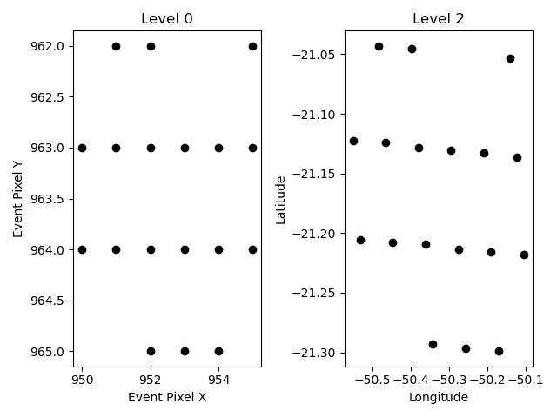
Level 0-Level 2 Matching
First, we match L0 and L2 data.
We look for “similar” shapes of groups to identify the match.
Matches over a two hour period are aggregated.
For each set of matches, find the best fit navigation parameters.
Once a day, calculate the weighted, 7-day running average of the navigation parameters.
This allows us to “reverse engineer” the navigation!

Slide 5
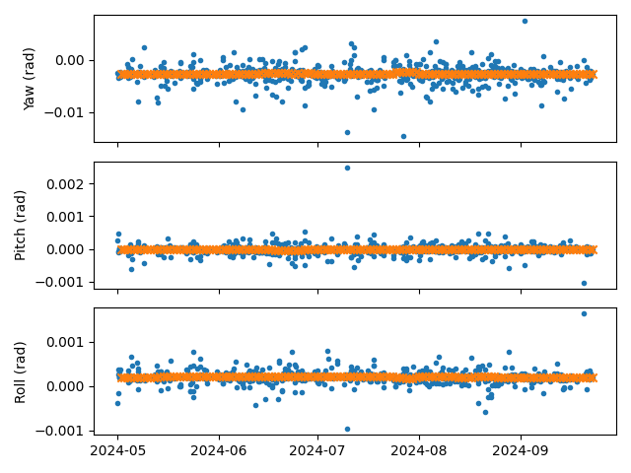
Blue – 2 hr angle
Orange – Angle used in nav
-2.7 +/- 0.08 mrad
-14 +/- 8 μrad
-0.21 +/- 0.009 mrad
The pitch is the least sensitive to fitting;
the (lack of) variation in the yaw/roll angles indicates a very stable platform.

Slide 6
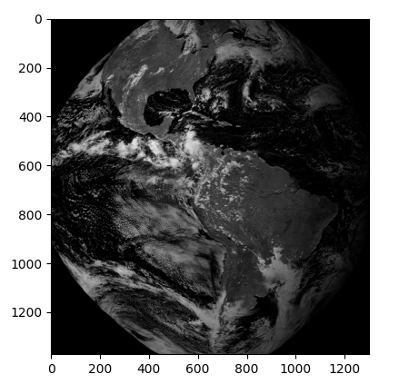
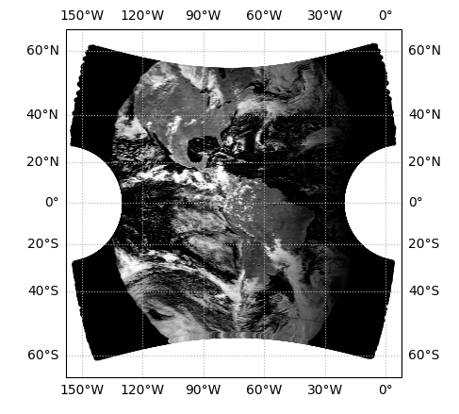
DQP and Backgrounds
Once we have the navigation parameters, we can use them to navigate the L0 data.
L0 data is received and backgrounds are extracted.
The dark current is, and the background gets navigated to lat/lon and then to fixed grid.
The 5 MSB of the background are used to look up the threshold for each pixel.
The thresholds are transformed into flash detection efficiency (via Cummins).
Other ”bad” pixels are flagged (e.g., dead pixels, near saturation pixels, etc.)
2024-09-20 18:49Z

Slide 7
Single Day
Every Day at 18Z

Slide 8
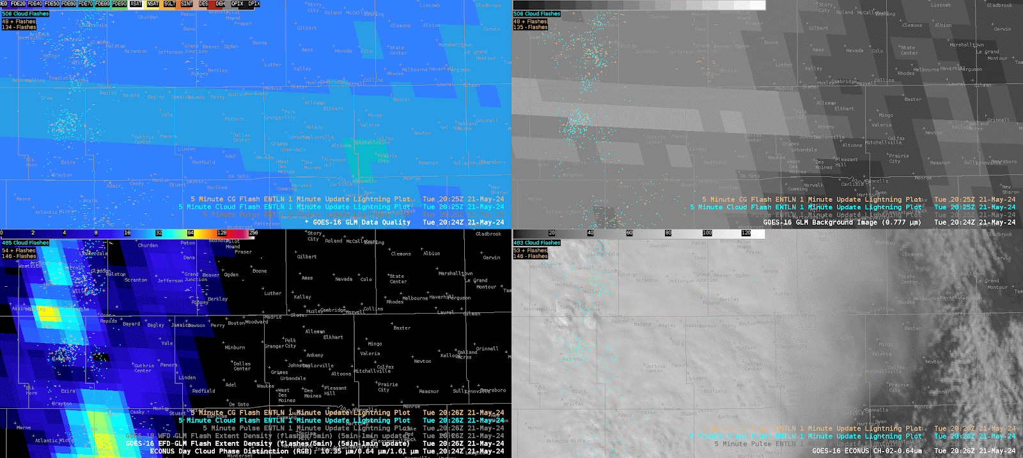
DQP
GLM Background
GLM Flash Extent Density
ABI
Credit: Kevin Thiel

Slide 9
Take Home!
DQP has been deployed in the Hazardous Weather Testbed (HWT) summer 2024.
It is in a ”beta” state – it’s working, but there are refinements that need to be implemented.
Anything ideas on what we should flag?
Navigated backgrounds are (mostly) ready now.
Nav errors are usually ~100 m.
Current work is to streamline the processing to display in AWIPS.
Code will be published soon.
Level 0 events can also be navigated.
Thanks Amitabh, Megan, Ken, and others!

