Slide 1


3D modeling of Light from Lightning: Monte Carlo and Microphysics
Dr. Kelcy Brunner¹
Collaborators:
Dr. Eric Bruning¹
Dr. ADAM HAMMOND-CLEMENTS²
Texas Tech University, The National Wind Institute
Sandia National Laboratories
This work is supported by: Sandia National Laboratories, and Texas Tech University

Slide 2
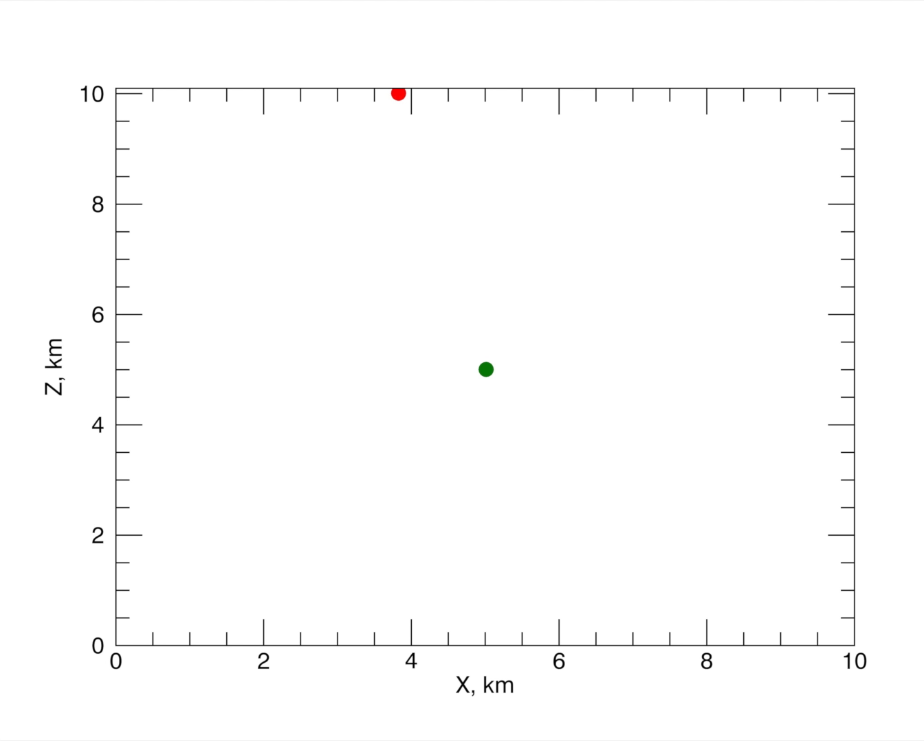
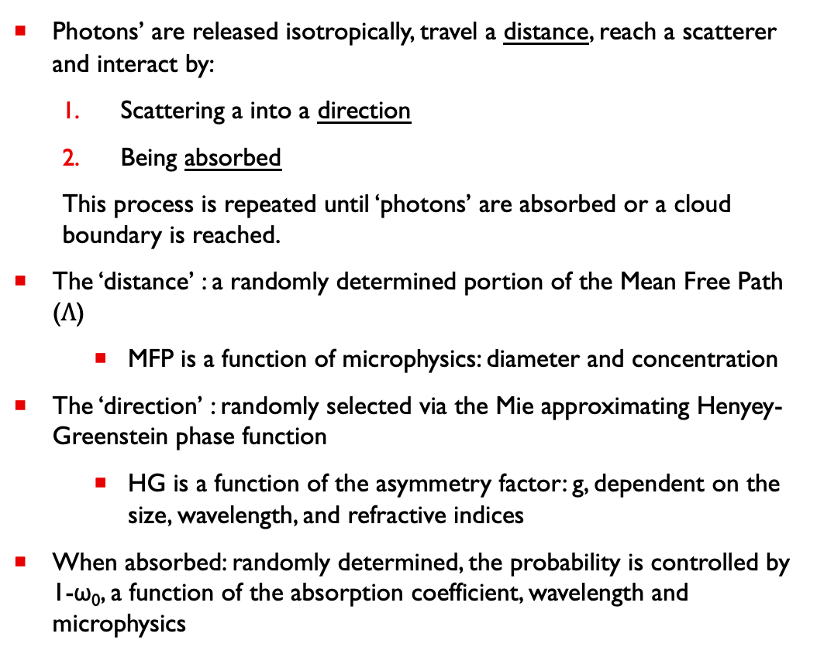
Monte Carlo methods for lightning
Photons’ are released isotropically, travel a distance, reach a scatterer and interact by:
  Scattering a into a direction
  Being absorbed
  This process is repeated until ‘photons’ are absorbed or a cloud boundary is reached.
The ‘distance’ : a randomly determined portion of the Mean Free Path ($Λ$)
    MFP is a function of microphysics: diameter and concentration
The ‘direction’ : randomly selected via the Mie approximating Henyey-Greenstein phase function
    HG is a function of the asymmetry factor: g, dependent on the size, wavelength, and refractive indices
When absorbed: randomly determined, the probability is controlled by 1-ω₀, a function of the absorption coefficient, wavelength and microphysics

Slide 3
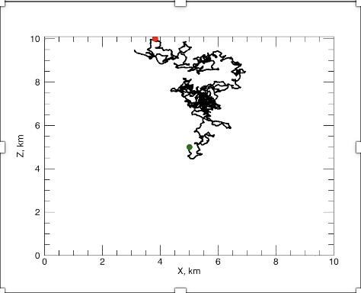
Monte Carlo methods for lightning
Photons’ are released isotropically, travel a distance, reach a scatterer and interact by:
  Scattering a into a direction
  Being absorbed
  This process is repeated until ‘photons’ are absorbed or a cloud boundary is reached.
The ‘distance’ : a randomly determined portion of the Mean Free Path ($Λ$)
    MFP is a function of microphysics: diameter and concentration
The ‘direction’ : randomly selected via the Mie approximating Henyey-Greenstein phase function
    HG is a function of the asymmetry factor: g, dependent on the size, wavelength, and refractive indices
When absorbed: randomly determined, the probability is controlled by 1-ω₀, a function of the absorption coefficient, wavelength and microphysics

Slide 4
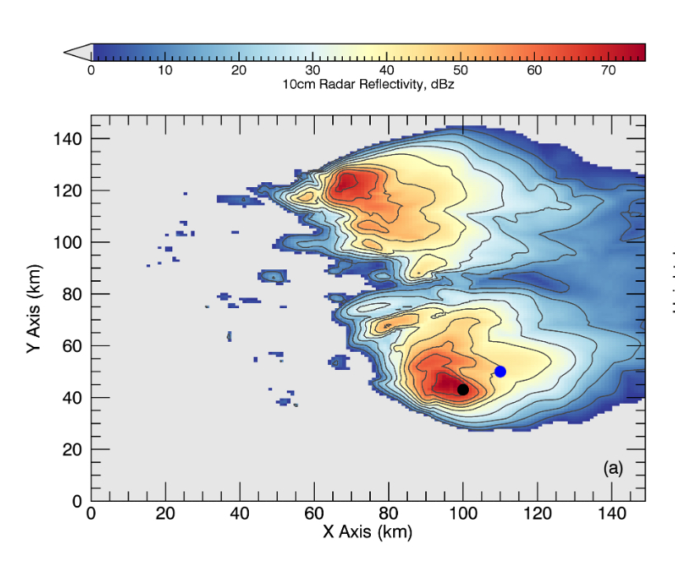
Modeled microphysics
WRF Idealized Supercell, 2-moment bulk microphysics
  1km horizontal, 0.5km vertical resolution
Mixing ratio/Mass concentration
  Droplets, raindrops, ice, snow, graupel, and hail
Concentration and drop size distribution are deconvolved (Seifert and Beheng, 2006)
  Concentration-weighted mean radii for each species
  1km vertical average
Vertical changes in scattering parameters
  Asymmetry factor and single scattering albedo

Slide 5
Monte Carlo Modeling in 3 Dimensions
What do we gain in going from 2D to 3D, and why is it impactful?
What changes in the model?
What model updates are important and get us closer to proper validation?
  Instrument modeling – (Rimboud, et al, 2024, Luque et al, 2020)
  Nonspherical scatterers/different optics (Rimboud, et al, 2024)
  More wavelengths
  Broader microphysics
  More realistic cloud representation
Notes:
So what I want to bring to your attention is what we’re working on: matching our perception of what scattering *should* be, what a cloud *should* be, to what’s in the data.

Slide 6
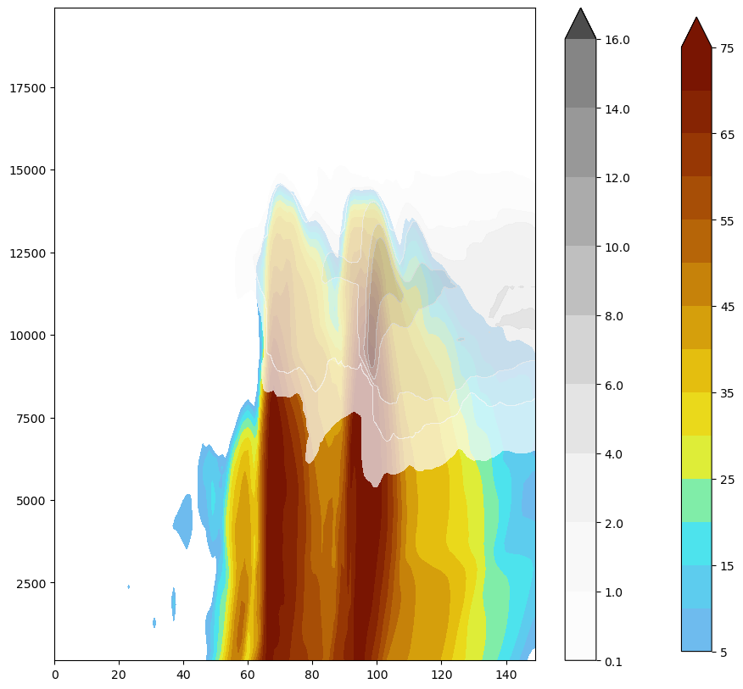
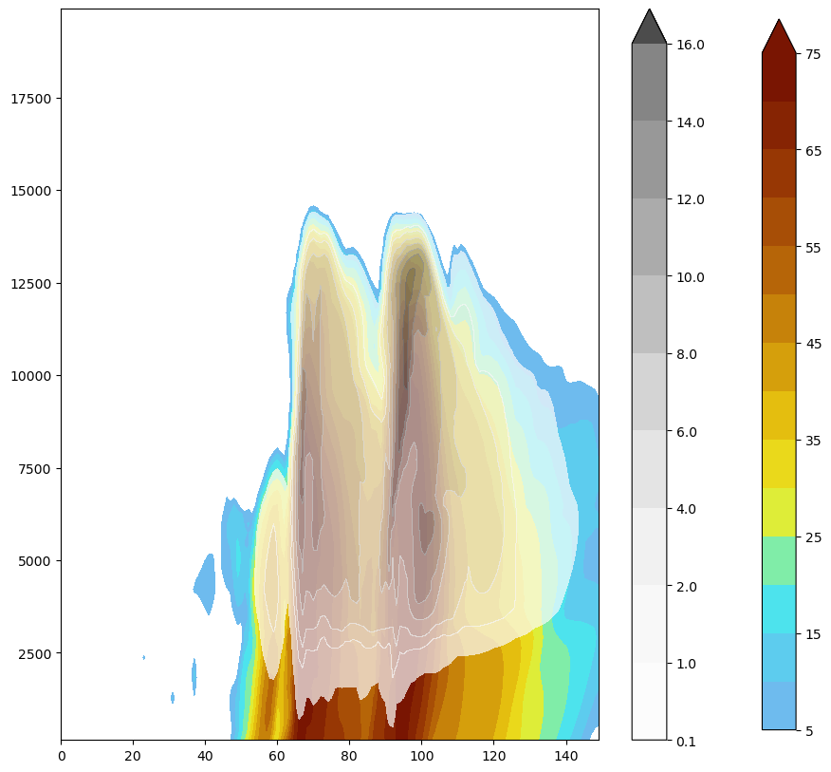
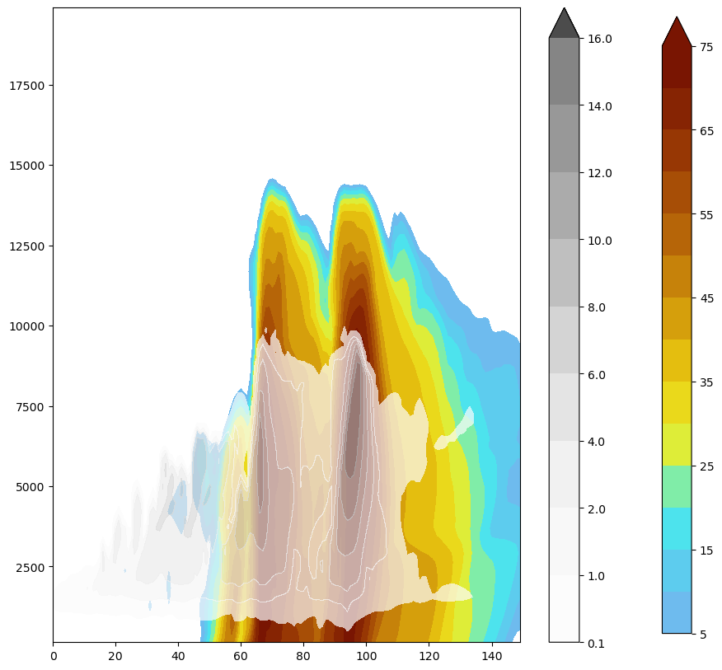
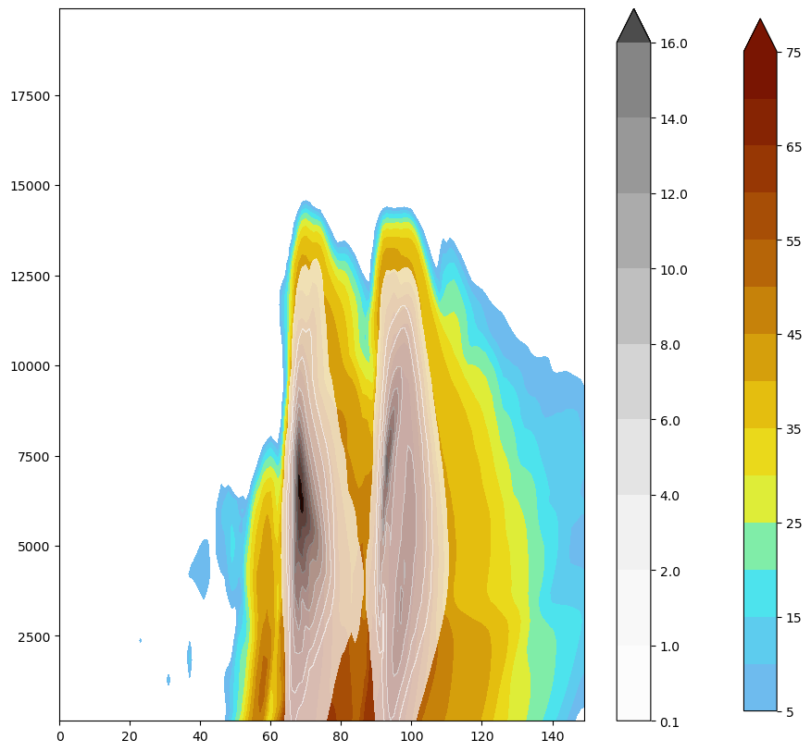
Where are the densest microphysics located?
QICE
QGRAUPEL
QCLOUD
QHAIL
Notes:
We could combine all of these microphysics, use something like just a graupel, it fits a shape similar to reflectivity, but this becomes a question of
Combining any number of micreophysics. We

Slide 7
Cloud boundary Via Mean free Path
Sub-grid size mean free path is widespread over entire storm
Objective boundaries, driven by the microphysics
Mean free path increases quickly away from the highest reflectivity regions, but there are high reflectivity areas outside of our ‘cloud’
Two sources of ‘lightning’ at blue dots
Notes:
We could combine all of these microphysics, use something like just a graupel, it fits a shape similar to reflectivity, but this becomes a question of
Combining any number of micreophysics. We

Slide 8
Line and point simulations: Light exiting the cloud
Light escaping as a % of each light source’s total light

Slide 9
Photon end points: Emitted and Absorbed
High reflectivity ≠ High absorption
Emitted
Absorbed

Slide 10
Why is light so readily absorbed in Southern Cell?
QICE
QCLOUD
Higher concentration of droplets, ice, and graupel at all levels
Notes:
We could combine all of these microphysics, use something like just a graupel, it fits a shape similar to reflectivity, but this becomes a question of
Combining any number of micreophysics. We
To the naked eye that might not result in such a stark difference, but we can’t rely on what we ‘think’ is a cloud to be absorbing.

Slide 11
How does this compare to a homogeneous simulation?

Slide 12
How does this compare to a homogeneous simulation?

Slide 13
Take aways: clouds first, concentration first
Capturing optical sinks over high density regions
More light escapes in the gradient of the microphysically dense regions
With ‘simple’ hydrometeor optics (spheres) there is a significant impact at cloud boundaries
The most absorption happens in the highest concentration
A larger MFP indicates fewer scattering interactions and less absorption
 | Median duration (us) | Median distance (km) | % Absorbed
North Storm | 0.0056 | 1.7 | 0.74
South Storm | 0.27 | 79.5 | 31.5
Homogeneous North Storm | 8e-05 | 0.023 | 0.002
Homogeneous South Storm | 0.34 | 103.8 | 19.5
Photons final resting place: duration and distance traveled for those exiting a cloud boundary

Slide 14
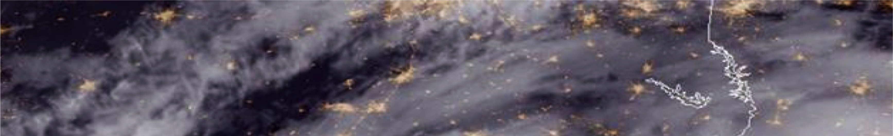
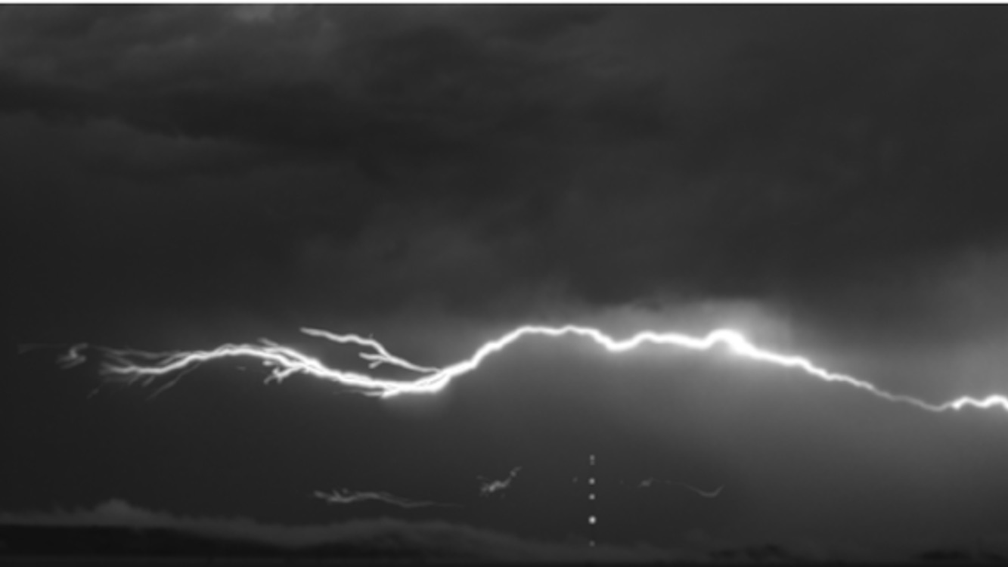

Slide 15
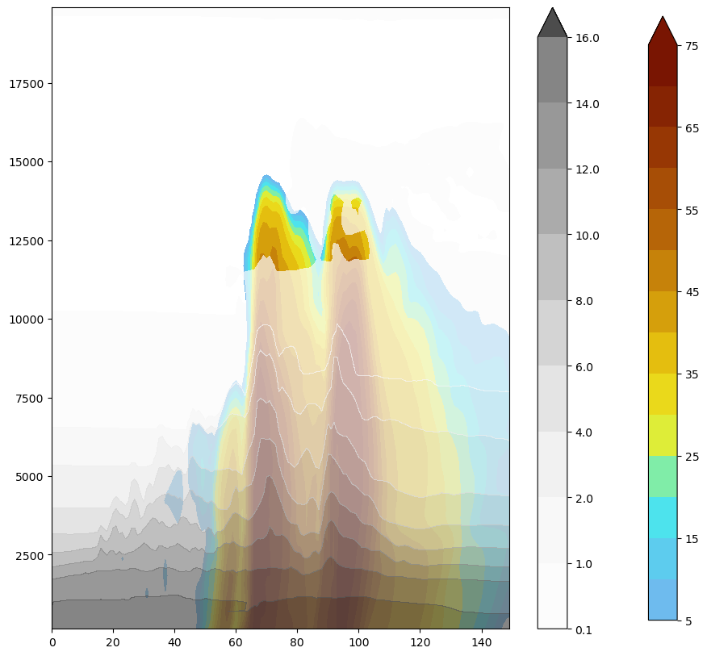
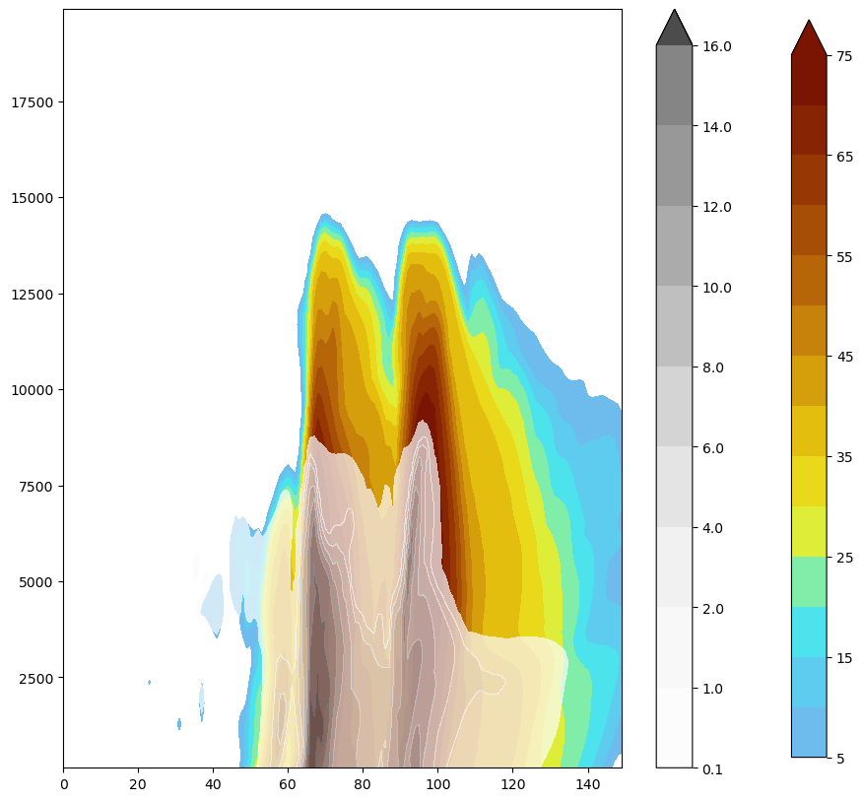
QCLOUD
QRAIN
QVAPOR
QGRAUPEL
QHAIL
QICE

Slide 16
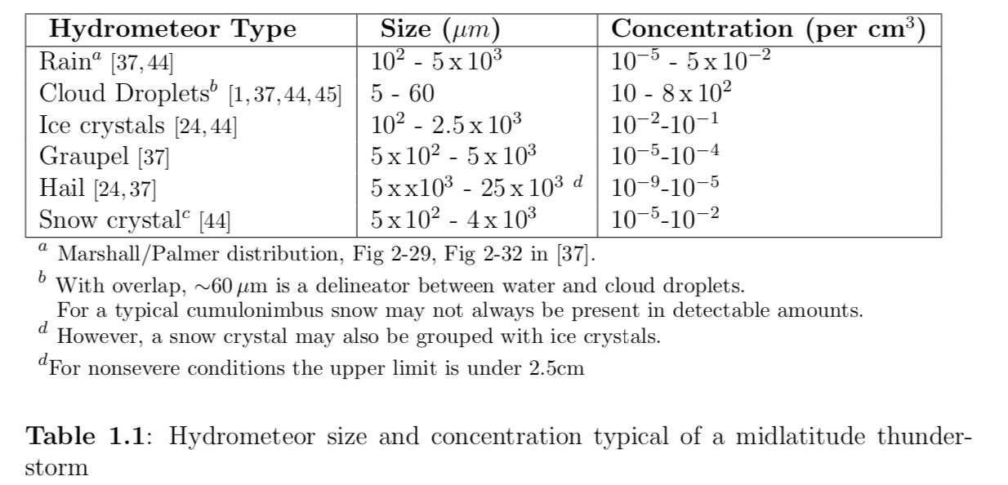
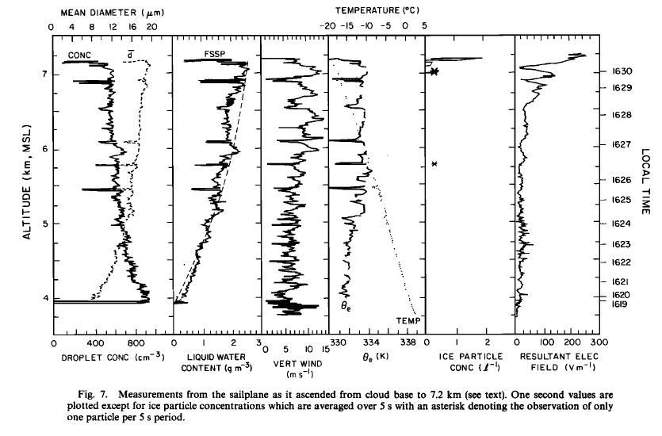
What microphysical measurement/model is available?
Notes:
The most frequent scatterers are cloud droplets and ice, but they’re not easily measured:
Droplets aren’t measured by typical weather radars
Profiling radiometers experience attenuation and large errors in thunderstorms
Satellites can observe optical thickness and radii, but not a vertical profile
The Monte Carlo model in the previous chapter is applied to an inhomogeneous microphysical profile, deviating from the standard homogeneous simulations in previous studies \cite{Koshak:1994qc,JGRD:JGRD8445,thomason_krider}.
A homogeneous cloud has been sufficient to understand how the source geometry, detector altitude, and absorption affect light reaching cloud-top.
However, in the intervening years two Geostationary Lightning Mappers (US, GLM-16/17) \cite{Goodman201334}, the Lightning Imaging Sensor on the International Space Station (US, ISS-LIS) \cite{ISSLIS}, and the Lightning Mapping Imager (CN, LMI) \cite{lmi_china} have become operational, with future Lightning Imagers (EU, LI) (MTG-LI) also scheduled.
Optical emission measured from lightning is effected by much discussed in-cloud scattering, the impact of which on satellite lightning measurements is not fully understood.
Recent studies commenting on in-cloud scattering effecting GLM measurements and applications \cite{curtis_conf, fuchs_2018, marchand, imaging_ltg} highlight that understanding in-cloud effects on satellite lightning measurements is pressing and has implications for how data is used operationally.
In order to use satellite based lightning measurements operationally, more work is necessary to understand the scattering effects on cloud-top optical emission.
One significant limitation in understanding light scattering in a thunderstorm is the extent to which scattering particles can be measured.
Cloud droplets and cloud ice typically have the highest concentration of in-cloud scatterers (\tableref{tb:hydro_conc} \cite{JGRD:JGRD442, dye_1988b, prupp_klett, milesetal}), while larger hydrometeors, including rain, graupel, snow, and hail, contribute to a lesser degree.
The most frequent scatterer, cloud droplets, are typically measured in-situ via aircraft, as with \cite{JGRD:JGRD442}, where the vertical profiles of droplet concentration can be observed, e.g., \figureref{fig:dye}.

