Slide 1
GOES-19 GLM Instrument Performance and Optimization
GLM Science Meeting
September 2024
Aran Lee, Gabrielle Sprunck
This presentation was made possible by work performed under NASA contract NNG08HZ00C
© 2024 Lockheed Martin Corporation. All Rights Reserved.

Slide 2
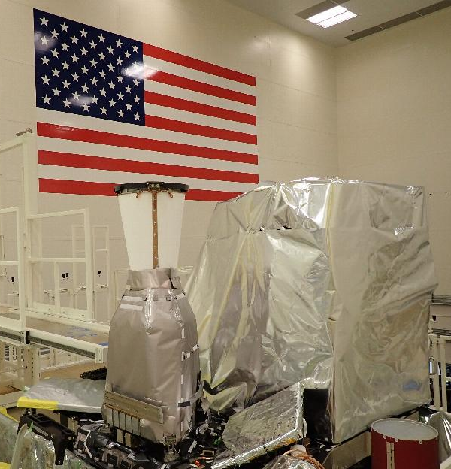
Timeline of Major Instrument PLT Events
Door Deployment
First Light
Activation
Eclipse Season
2024
2025
June July Aug Sept Oct Nov Dec Jan Feb
All ground LUTs updated
Launch
Outgas
All on orbit parameters set
GLM FM4 undergoing installation on GOES-19, next to bench mate ABI
G19 PLT is on schedule according to the planned sequence of events

Slide 3
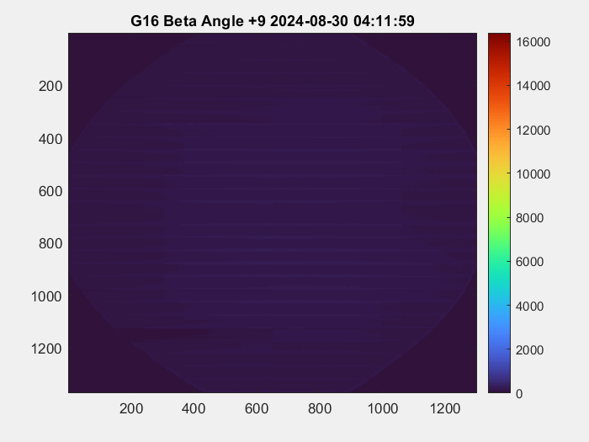
Hardware Changes from GOES-16 to GOES-19
Stray light mitigation
G19 background image intensity during solar intrusion is on average 41% less than G16, depending on FOV location
Electronic design modifications
Reduction of CCD readout artifacts (overshoot)
Better dynamic range from lower thresholds under high illumination
Over a 24hr period on August 30th, 2024:
G19 has fewer saturated pixels than G16
GOES-16
GOES-19
Worst-Case Solar Intrusion (sun shining into optics at sub-satellite midnight)
Hardware changes improved dynamic range by decreasing the number of saturated pixels
Notes:
G16 has 121,723 saturated pixels

Slide 4
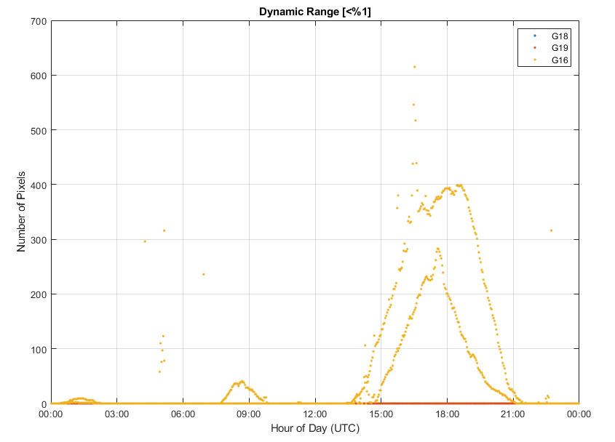
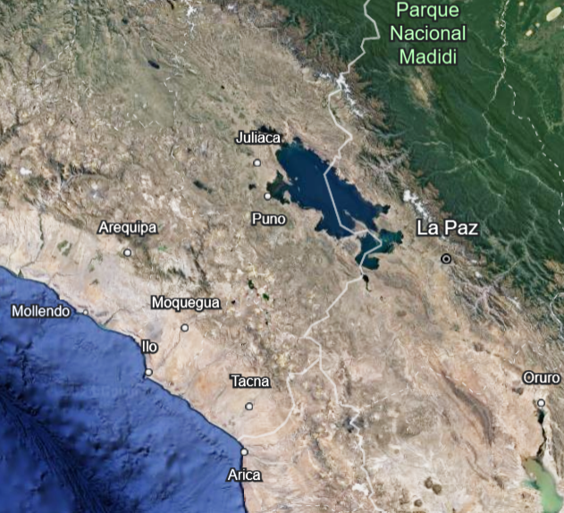
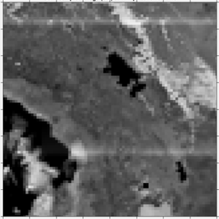
PLT On-orbit Instrument Image Quality and Focus
GOES-18
GOES-19
Lakes Titicaca and Poopó, and the coastline of Peru and Chile
GOES-19 background images are in focus and span the appropriate number of pixels
During a 48-hour data collection on GOES-19 (22-24 August 2024) there were significantly less saturated pixels than GOES-16 and the number of saturated pixels were in family with GOES-18
Number of pixels with dynamic range <1% (near saturation) for three different instruments during 48 hour data collection. Slight differences due to scene variation. G18 = G19 = zero

Slide 5
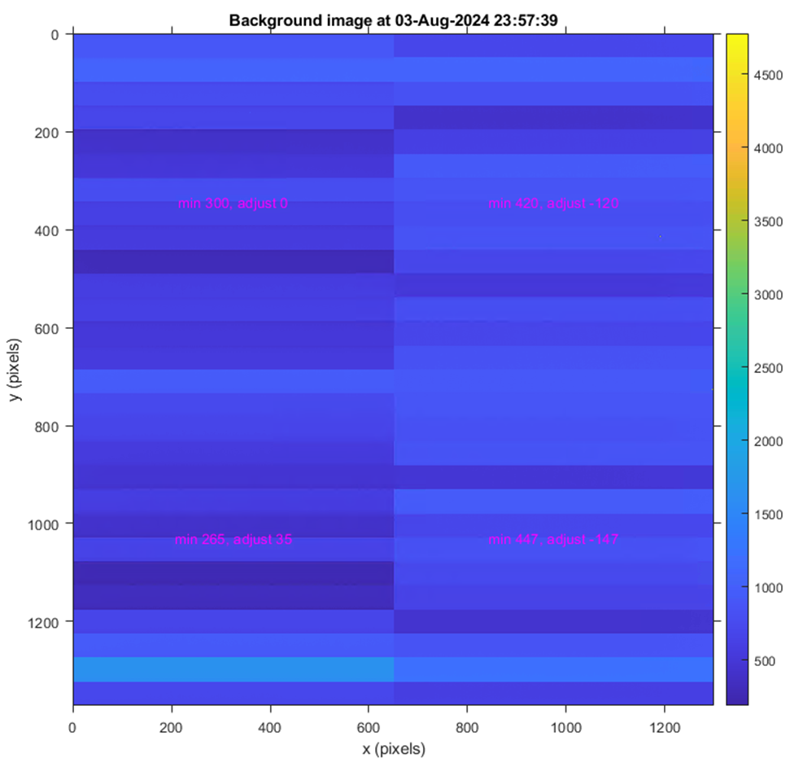
PLT On Orbit Calibration
On orbit calibration uses image data while the door is still closed to determine the optimum value for the ADC (analog to digital converter) offsets
ADC offsets are instrument parameters that control the dark level of the image
48-hour data sets are used to determine the minimum dark offsets over the temperature range of the ADCs, and to determine the change in offset as a function of temperature
Background image levels change with temperature, so temperature telemetry at the time of interest determines the margin by which each quadrant of the image should be adjusted
Notes:
Largest recommended value change was in the SE quadrant (ADC low bottom right) at -147.
Minimum value was 265 DNs in SW quadrant (ADC high bottom left)

Slide 6
Upcoming G19 GLM PLT Activities
Collecting solar intrusion data at multiple angles
Refining navigation parameters
e.g. roll, pitch, and yaw (RPY) values
Advancing the next iterations of RTEP threshold tuning
PLT is proceeding successfully according to plan!
Notes:
Instrument’s magnification parameters – navigation parameters

Slide 7
This presentation was made possible by work performed under NASA contract NNG08HZ00C
© 2024 Lockheed Martin Corporation. All Rights Reserved.

