Slide 1
International Space Station Lightning Imaging Sensor (ISS LIS) – Plans for Final Orbit and Climatology Products
Timothy Lang
Earth Science Branch, NASA MSFC
ISS LIS Mission Scientist
Coauthors: Dennis Buechler, Daniel Cecil, William Koshak, Douglas Mach, Katrina Virts, T. Daniel Walker

Slide 2
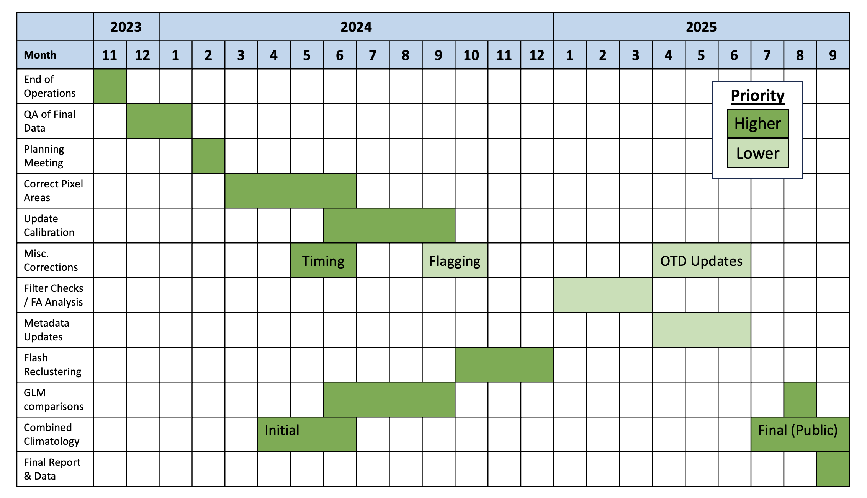
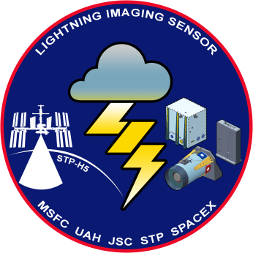
ISS LIS Mission Status
ISS LIS instrument was decommissioned and put into storage on 16 November 2023
Transferred to NG-20 Cygnus spacecraft and deorbited (i.e., burned up) on 12 July 2024
Mission is in Phase F/Closeout; currently working multiple final corrections and improvements
Final data due in FY 2025

Slide 3
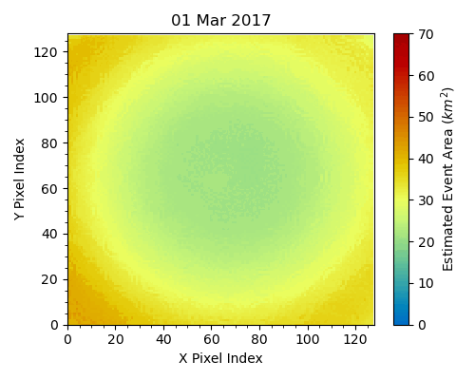
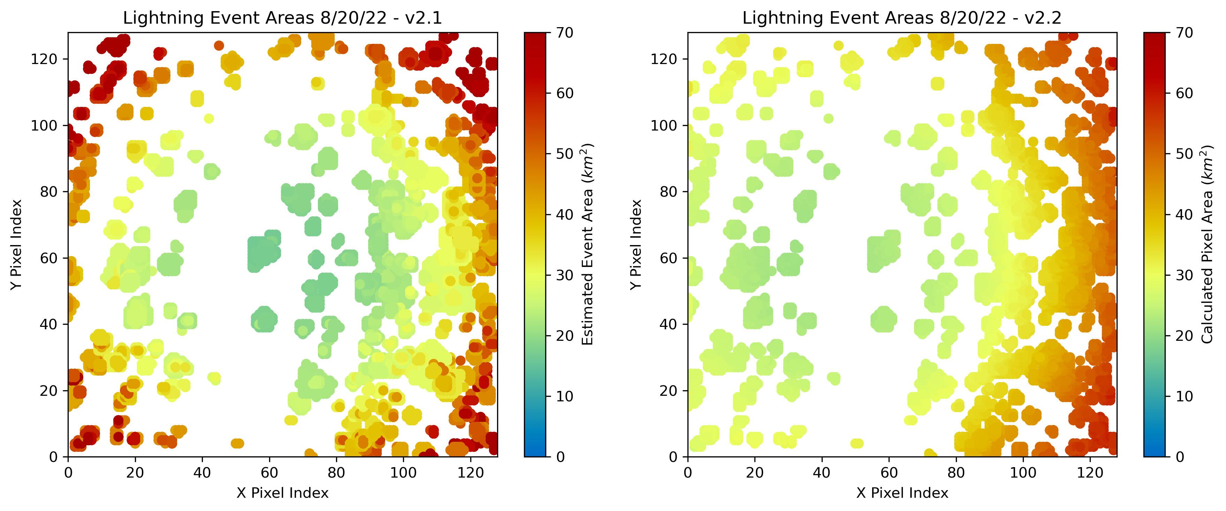
Correction of Pixel Areas
Original LIS algorithm uses trigonometric approximation to estimate pixel (and thus event/group/flash) areas – poor off-boresight performance
Fully geolocated correction being implemented as time-varying lookup table
Old
New

Slide 4
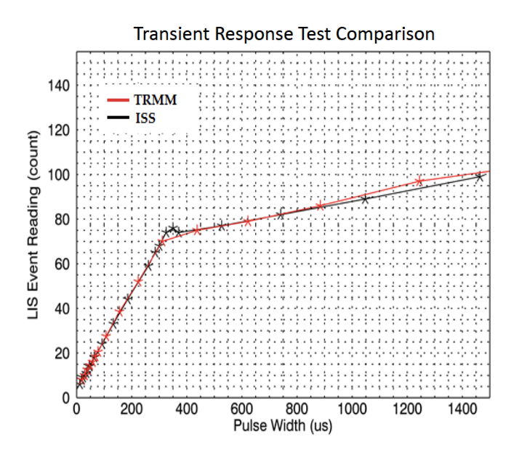
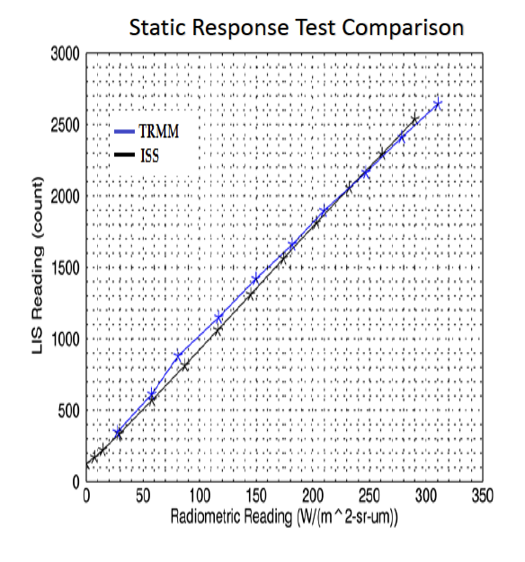
Calibration Improvements
Four Elements to Calibration
1. Field of view
Original ISS LIS lens transfer function available to be implemented (virtually overlaps TRMM LIS)
2. Spectral response
Original data missing, but have 2017 retest, could be implemented using lookup table (98.1% agreement)
3. Transient response
Original data missing, but have 2017 retest, could be implemented using lookup table (99.9% agreement)
4. Static response
Original data missing, but have 2017 partial retest, many pixels untested (95.4% agreement)

Slide 5
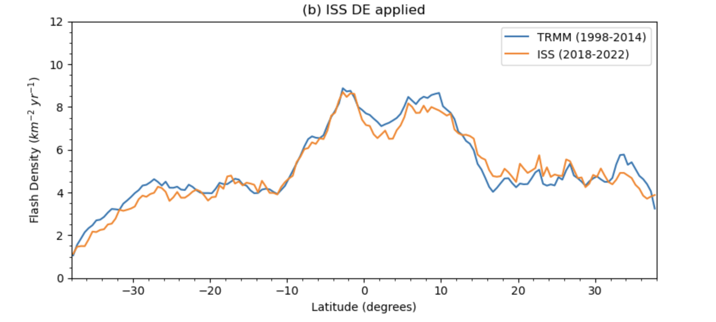
Combined Climatology
Virts et al. (2024) found ISS LIS DE to be ~5% lower than TRMM LIS: ~60% vs. ~65%
However, when developing the combined TRMM + ISS climatology, applying different DEs would lead to unrealistic offsets in global flash rates between the two missions
Since Bayesian absolute DE method only provides a best-case estimate, decision was made to apply ISS DE to the combined LIS dataset
OTD will be scaled to this following Cecil et al. (2014)

Slide 6
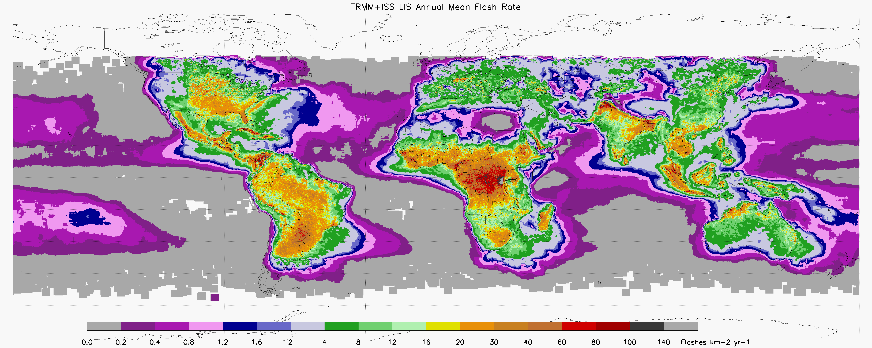
Combined Climatology
Multiscale Combined TRMM + ISS LIS Climatology
(adaptively smooths to coarser resolutions based on the local flash rate)

Slide 7
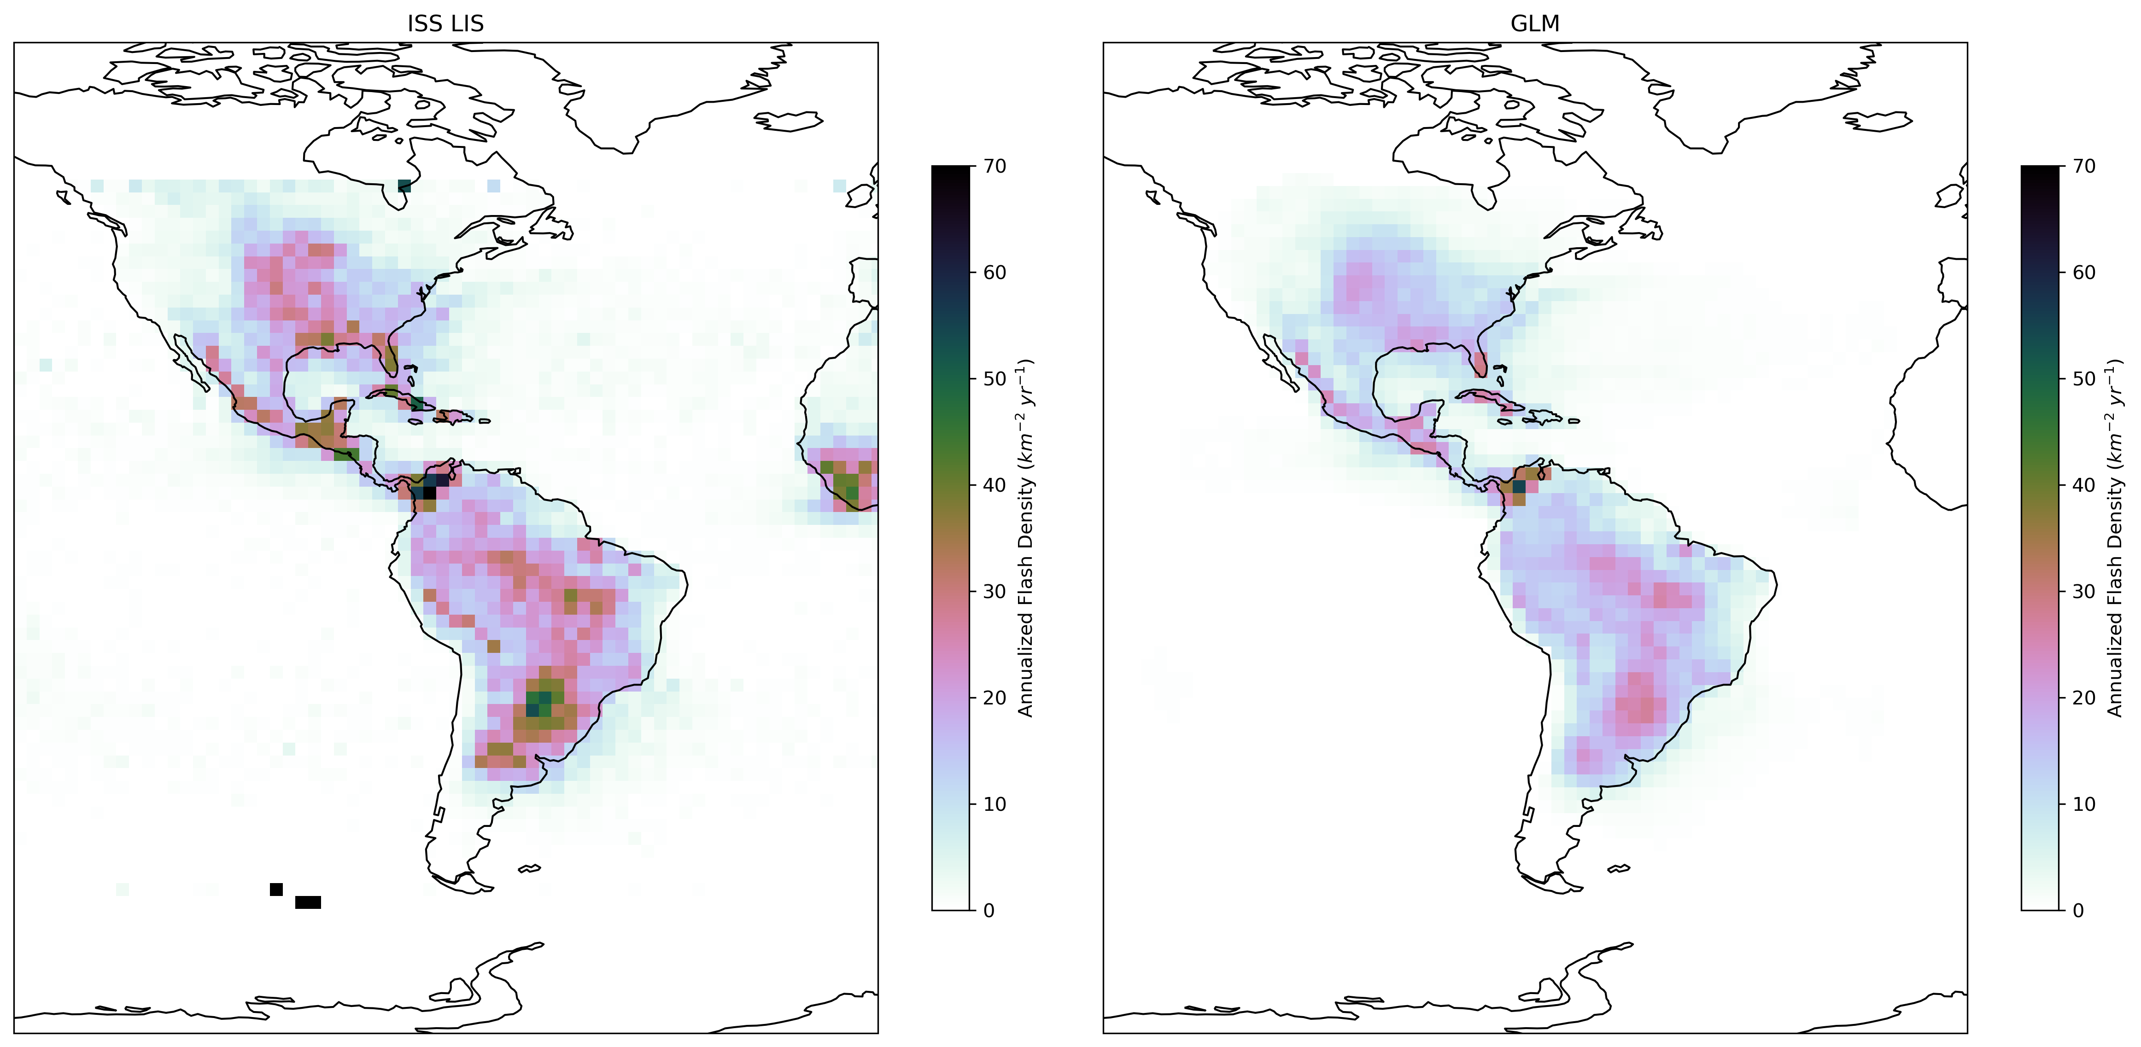
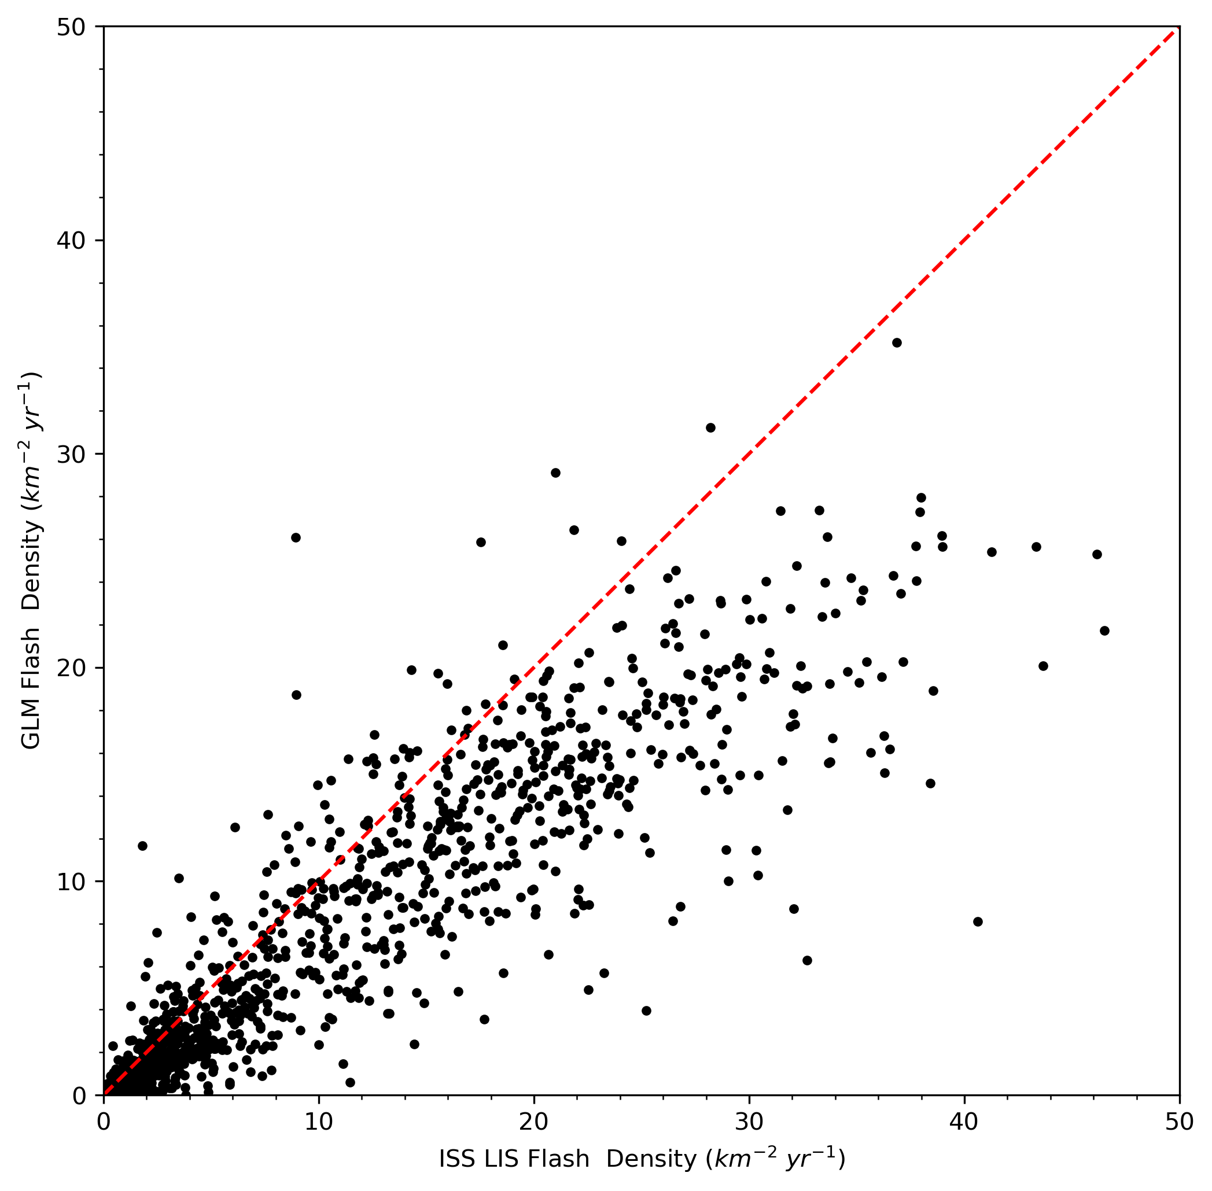
Comparing ISS LIS with GLM-16 Climatology
2018-2022
ISS LIS 2018-2022 DE-corrected climatology has 32% higher flash density than GLM DE-corrected climatology
Pearson correlation of flash densities is 0.92, primary discrepancy is the bias

Slide 8
Comparing ISS LIS with GLM-16 Climatology
When ISS LIS and GLM FOVs overlap in space and time, ISS LIS detects 22% more flashes (despite lower DE), explaining most of that 32% discrepancy
Average match between GLM and ISS LIS flashes is approximately 1-to-1; however, ISS LIS has an extremely long tail where sometimes many more LIS flashes can be matched to a single GLM flash
Likely effect of finer LIS spatial resolution, especially in intense storms
Of remaining 10% discrepancy to explain, up to half can be attributed to DE estimation uncertainty, rest is

Slide 9
Summary and Future Steps
ISS LIS Phase F is proceeding well, final data due by end of FY 2025
Final data will consist of updated ISS LIS orbit granules, with updated TRMM LIS and even OTD granules also possible
Combined ISS + TRMM LIS/OTD climatology products (1995-2023) will be based on (and subsume) the current TRMM LIS/OTD combined climatology products (Cecil et al. 2014)
We are planning to provide products that meet WMO ECV requirements (as best as possible given LEO sampling)
We’d like to hear from the community on what they’d like to see in the final datasets! timothy.j.lang@nasa.gov

