Slide 1
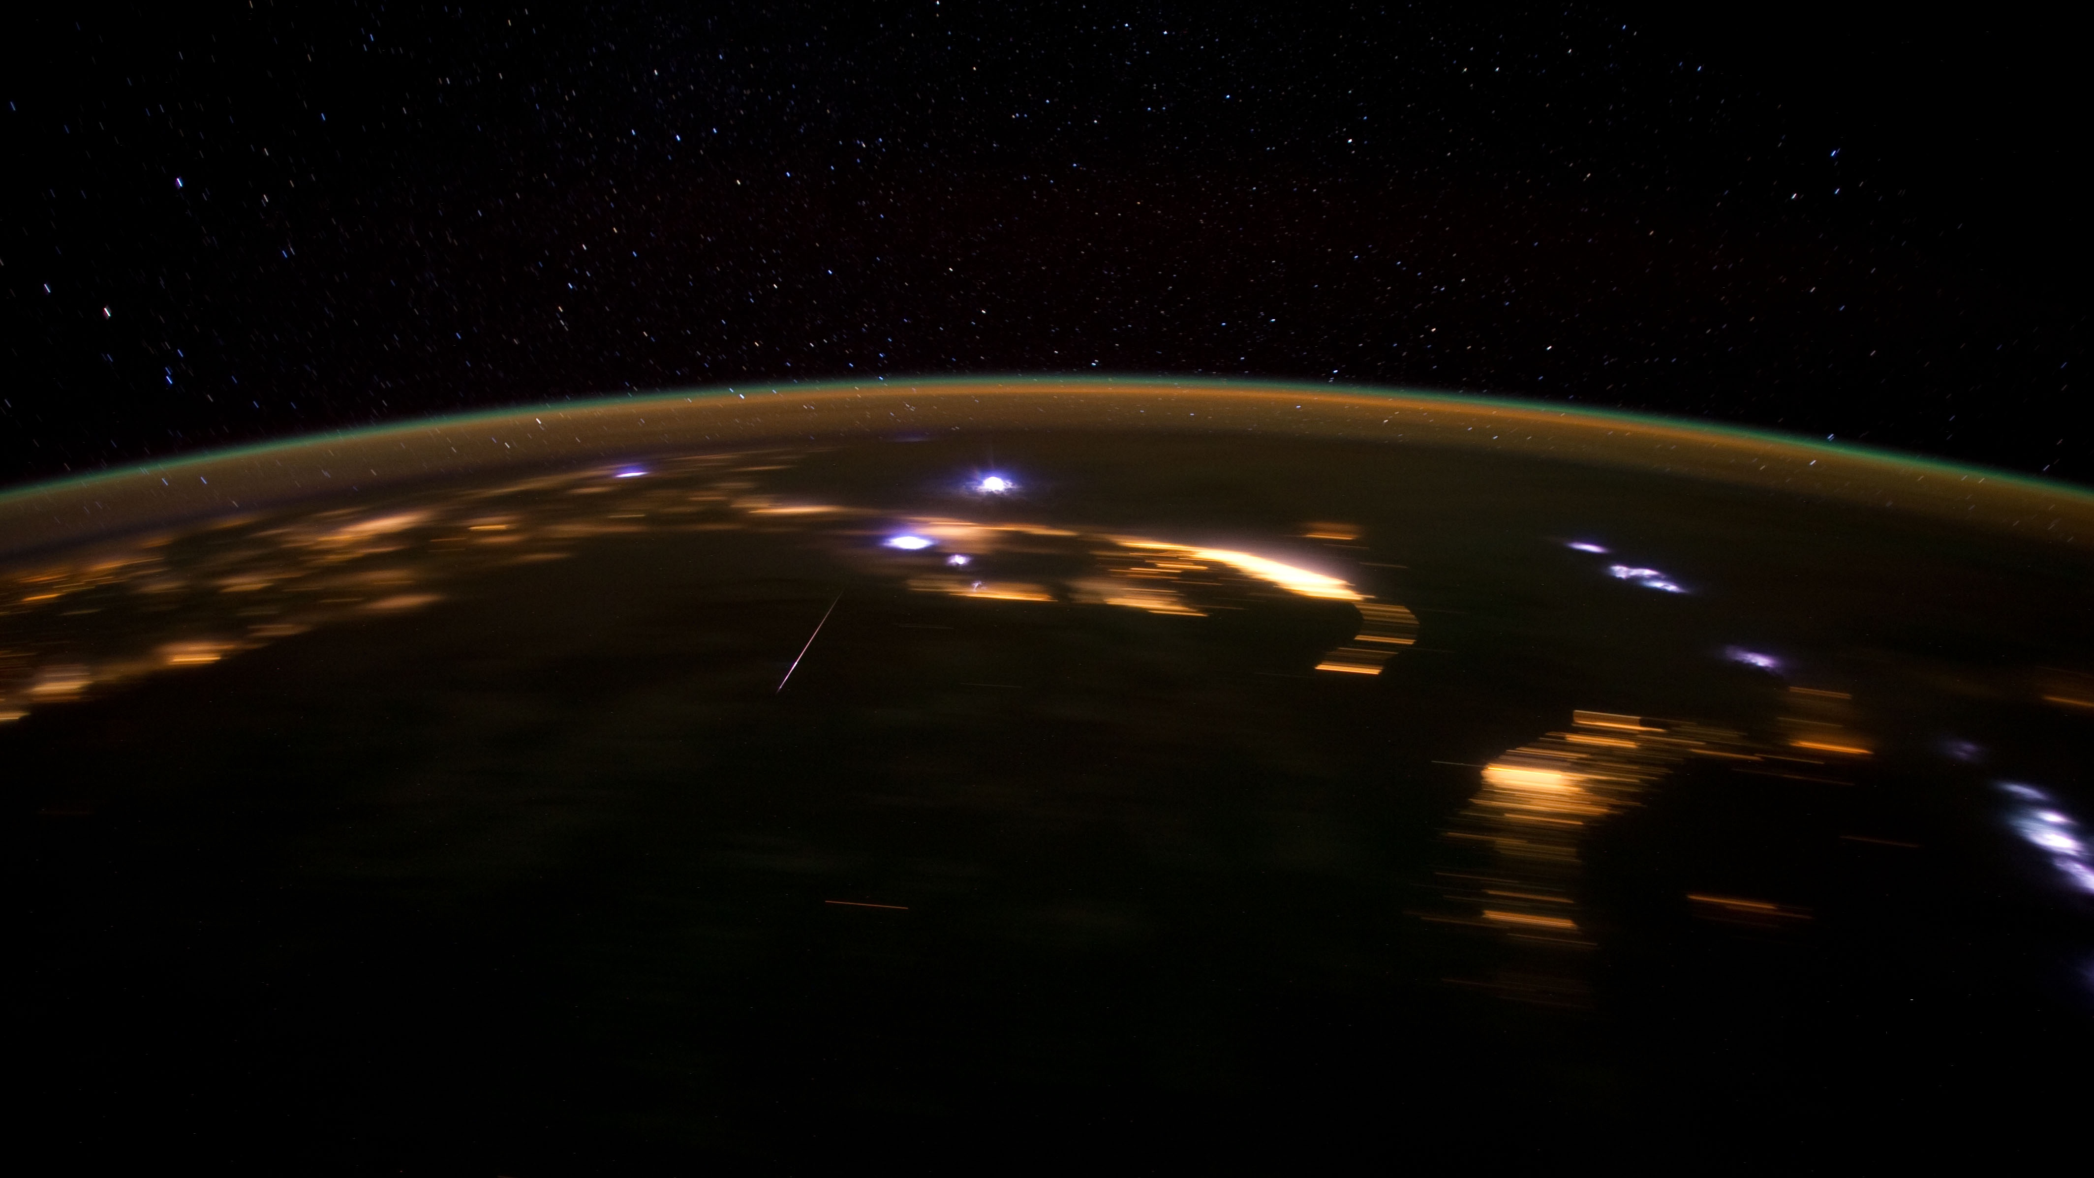
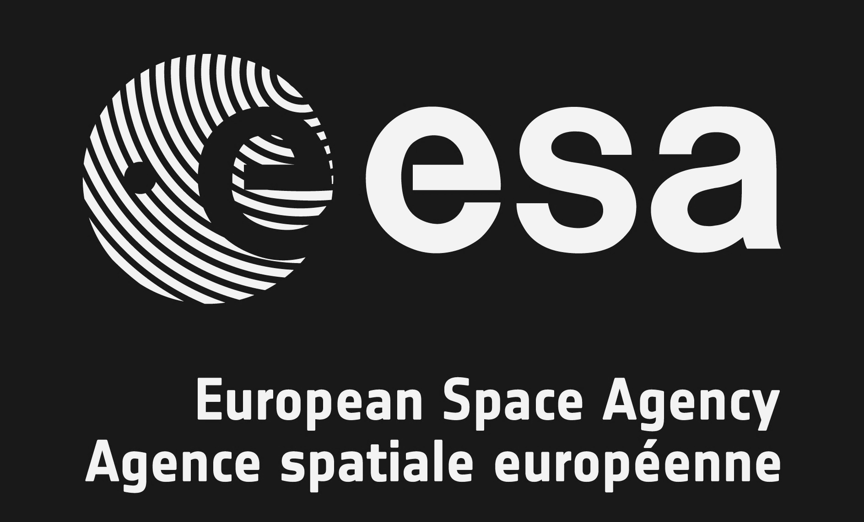
Recent Bolide Events:
Potential Collaboration
& Coordination with ESA and NASA
Rob Landis, NASA
Houston, Texas, USA
Pierre Kokou, ESA, ESTEC
Noordwijk, Netherlands

Slide 2
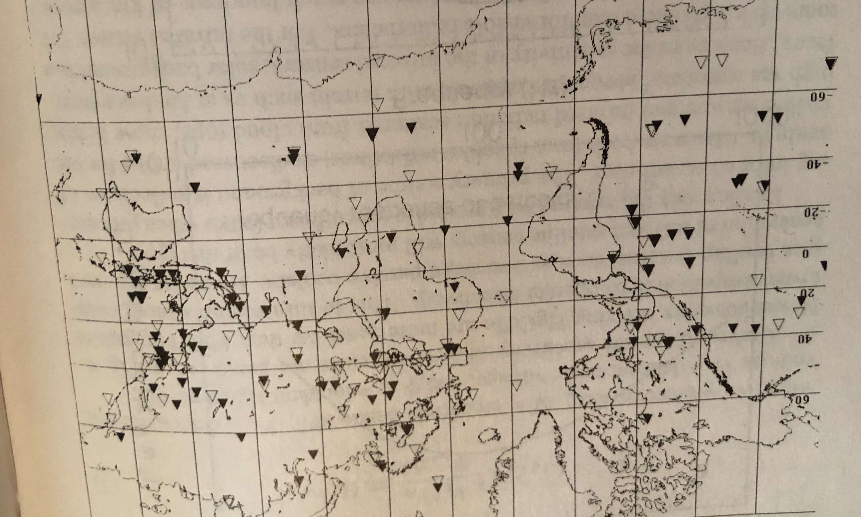
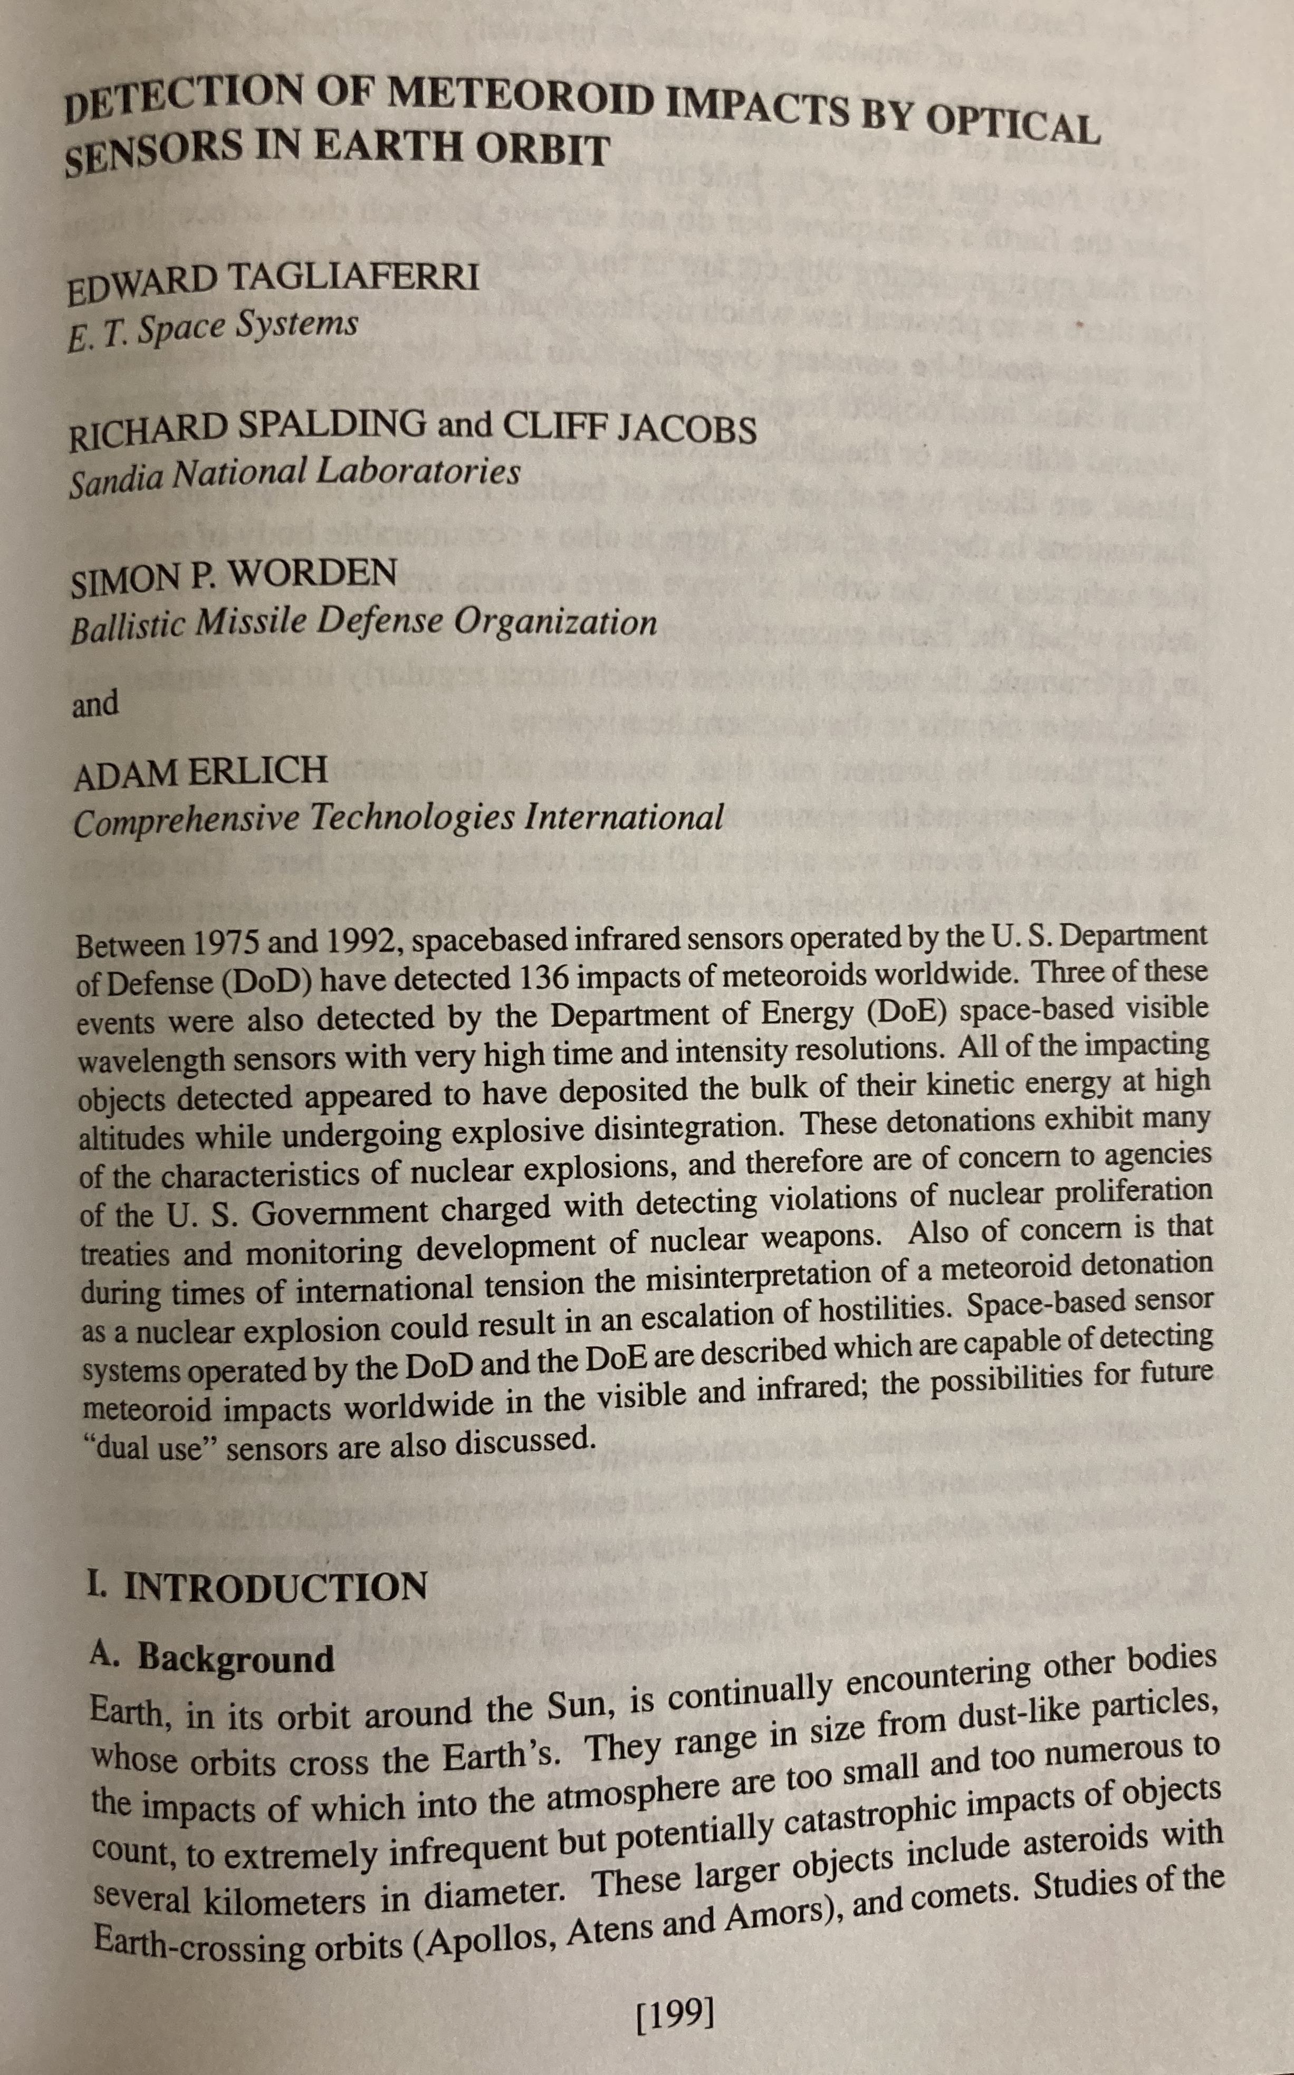
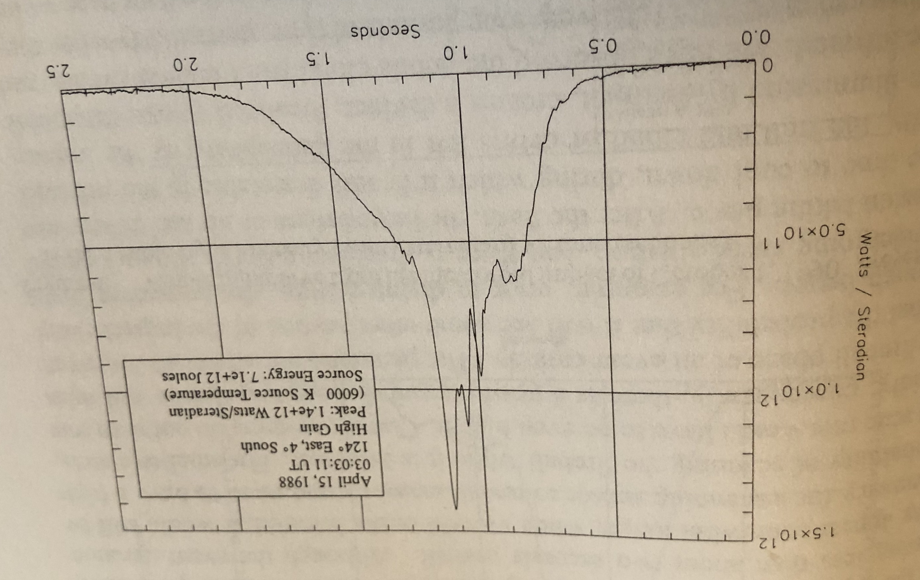
Initial Publication: Bolide Map, Light Curves, etc.
Geographic distribution of fireballs (ca. 1992)
Visible lightcurve of 15 Apr 1988 (watts/Sr over time in seconds) from Tagliaferri et al.

Slide 3
Planetary Defense Coordination Office (PDCO)
The PDCO was established in January 2016 at NASA HQ to manage planetary defense-related activities across NASA and coordinate with both U.S. interagency and international efforts to study and plan response to the asteroid impact hazard.
Reauthorized by 117th Congress NASA Authorization Act of 2022:
https://www.congress.gov/bill/117th-congress/house-bill/4346/text
Mission Statement
Lead national and international efforts to:
Detect any potential for significant impact of Earth by natural objects
Appraise the range of potential effects by any possible impact
Develop strategies to mitigate impact effects on human welfare

Slide 4
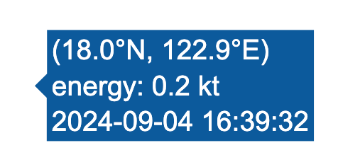

Slide 5
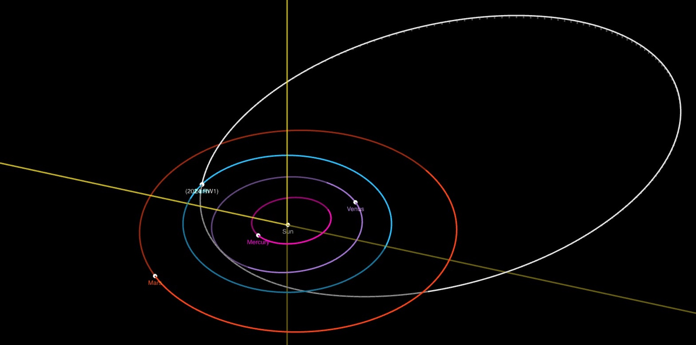
Impact of small asteroid 2024 RW₁ on 4 Sep 2024
* The impact was off the east coast of the northern Philippines on 4 Sept 2024 at 12:39pm EDT

Slide 6
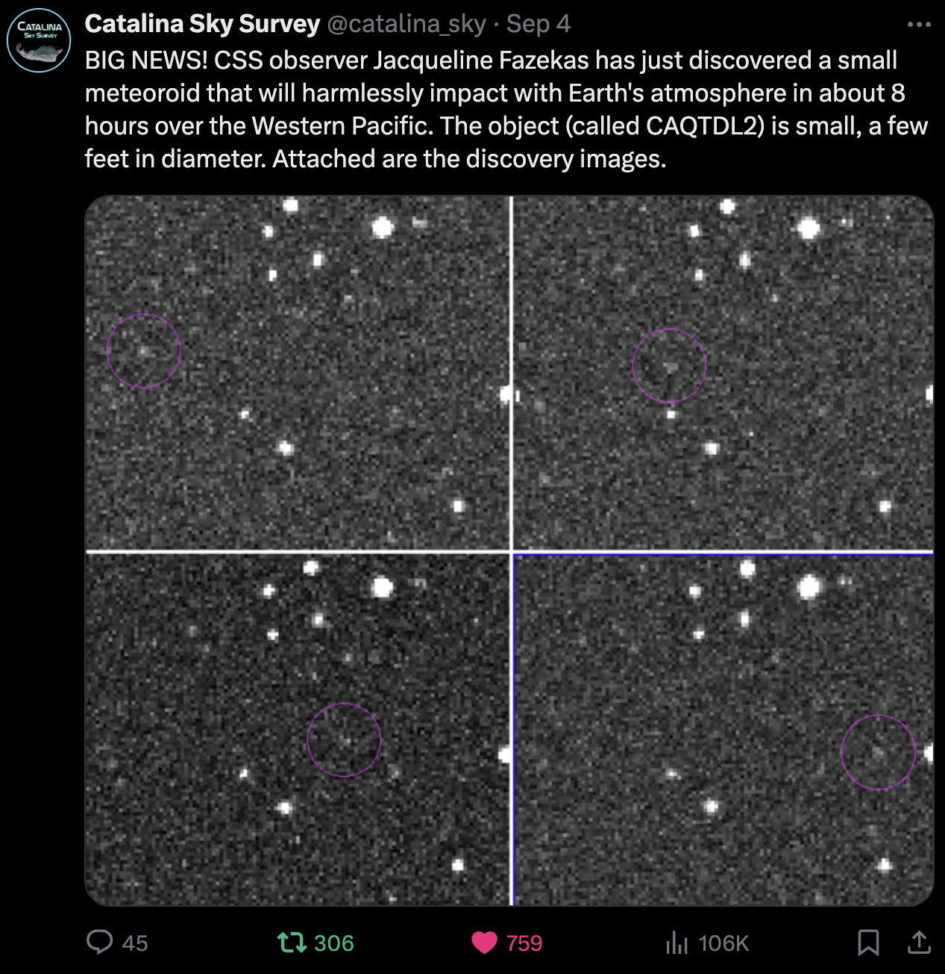
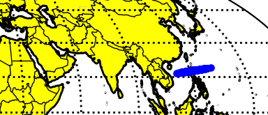
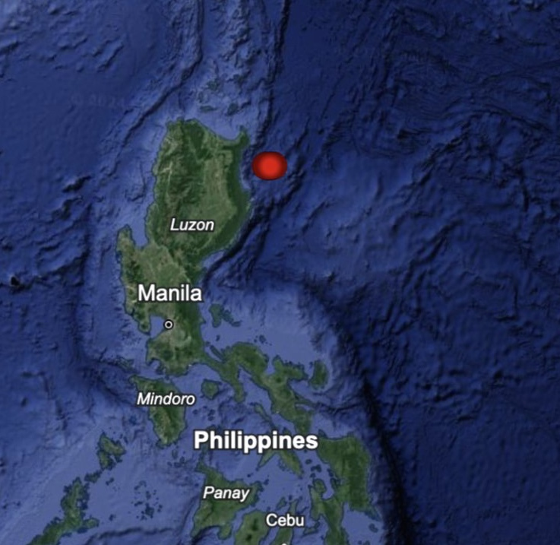
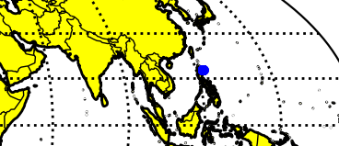
Impact of Small Asteroid 2024 RW₁ on 4 Sept 2024
NASA JPL’s Center for Near-Earth Object Studies (CNEOS) issued an alert 10 hours before impact based on observations sent to the Minor Planet Center by Jacqueline Fazekasat at the NASA-funded Catalina Sky Survey
Follow-up from observatories across the globe allowed CNEOS to quickly refine the impact prediction to off the east coast of the northern Philippines. ESA NEOCC made a similar prediction.

Slide 7
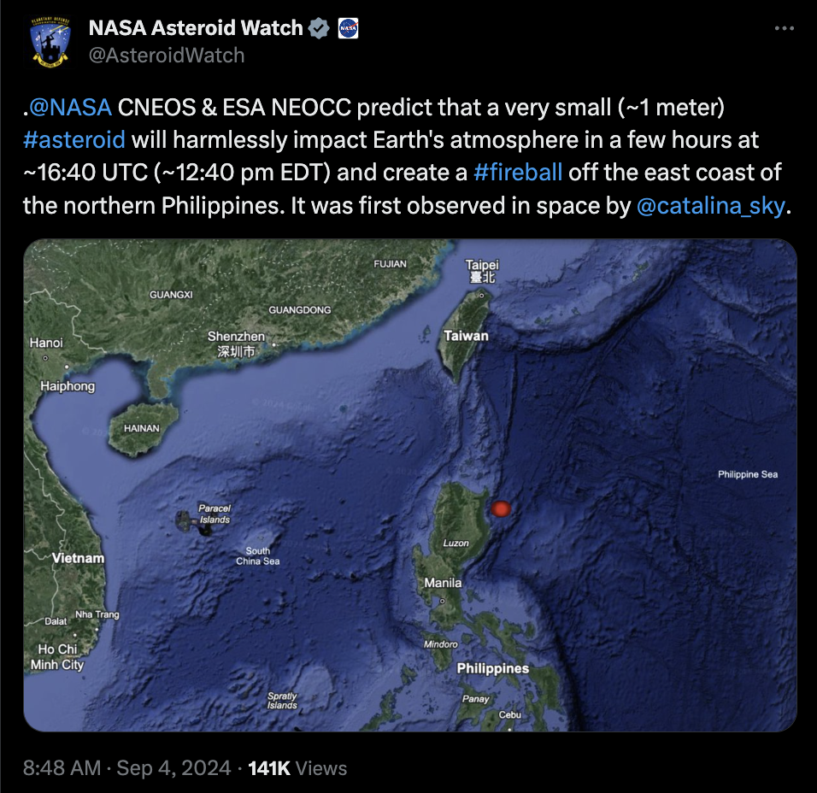
Impact of Small Asteroid 2024 RW₁ on 4 Sept 2024
The asteroid posed no threat since it was small (~1 meter in size)
It was an excellent demonstration of planetary defense capabilities: find, track and accurately predict impact location
NASA (@AsteroridWatch) and ESA (@ESA) notified the public on social media channels
Many watched the impact as it happened and reshared video on social media
https://twitter.com/SquigglyVolcano/status/1831383862435578335

Slide 8
Cross Detection of Bolides with LI and GLM
28 Sep 2023 10:43:28 UTC 13.9°N 28.8°W
25 Oct 2023 03:39:12 UTC 3.6°S 25.8°W
26 Feb 2024 09:33:02 UTC 4.1°N 32.0°W
28 Feb 2024 01:59:26 UTC 7.9°S 34.7°W
02 Apr 2024 03:35:18 UTC 54.4°N 9.6°E
30 Apr 2024 22:15:21 UTC 45.0°N 36.5°E
18 Jun 2024 21:01:32 UTC 32.2°N 31.8°W
13 Jul 2024 03:10:41 UTC 7.4°S 41.0°W
(from P. Kokou, MNRAS, 2024)

Slide 9
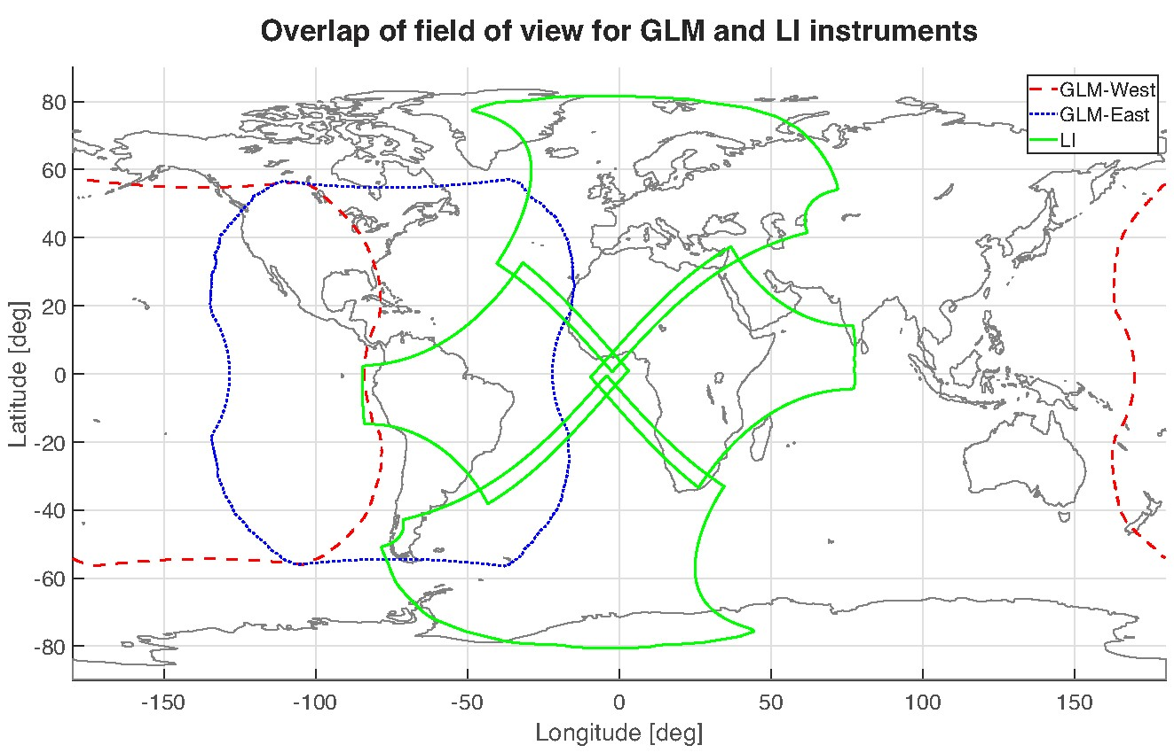
(from P. Kokou, MNRAS, 2024)

Slide 10
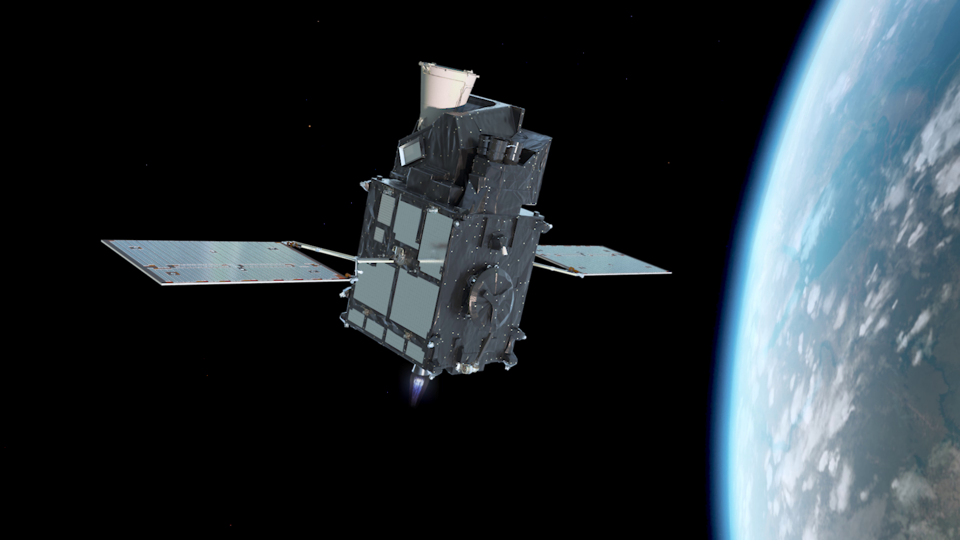
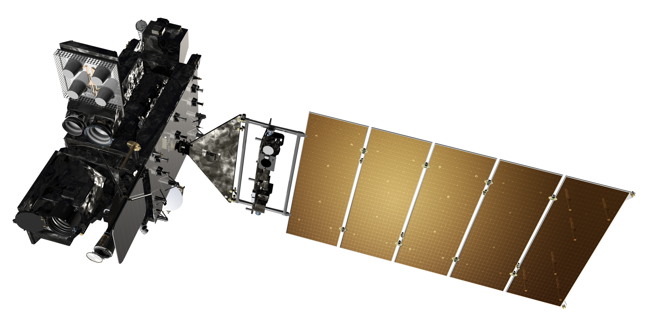
A Couple Recent Examples
24 April 2024 QueQiao-2 booster
13 July 2024 bolide event over Brazil

Slide 11
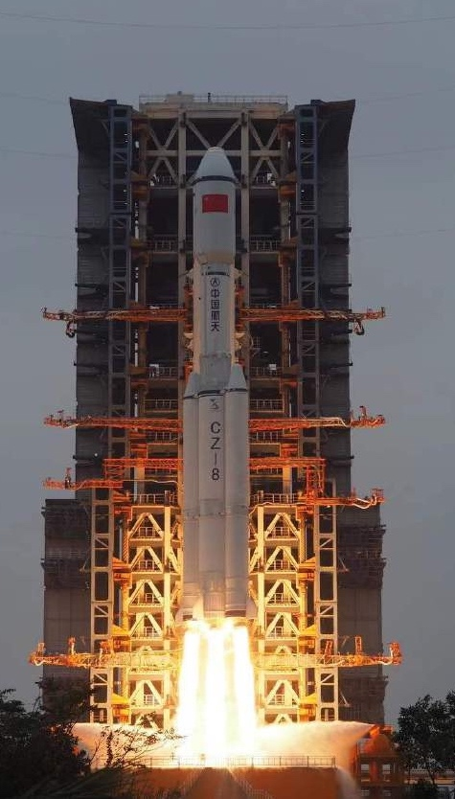
QQ-2 Booster Return to and Impact
Launched on 20 Mar 2024 out of Wenchang Province, Hainan Island
Third stage booster in cislunar orbit
Re-entry of booster over South Atlantic
At the cusp/edge of GOES-E ABI instrument
Geographic location of entry point: 36.0° S 14.1°W (near Edinburgh of the Seven Seas/Tristan da Cunha) on 24 Apr 2024 at 07:06:48 UTC.

Slide 12
QueQiao-2 Booster Animation

Slide 13
Bolide Over Brazil – 13 July 2024 (LI and GLM)
apparent direction
of bolide entry

Slide 14
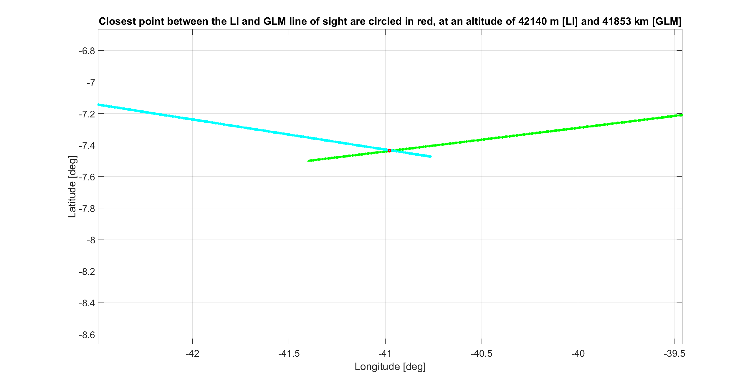
Bolide Over Brazil – 13 July 2024 (LI and GLM)
Mean altitude is 41.997 km
Distance between the two lines of sight is 607 m

Slide 15
Clear initial straight/linear trajectory
Plenty of ‘diffuse’ events at end of trajectory (reflection off of ground and/or clouds?)

Slide 17
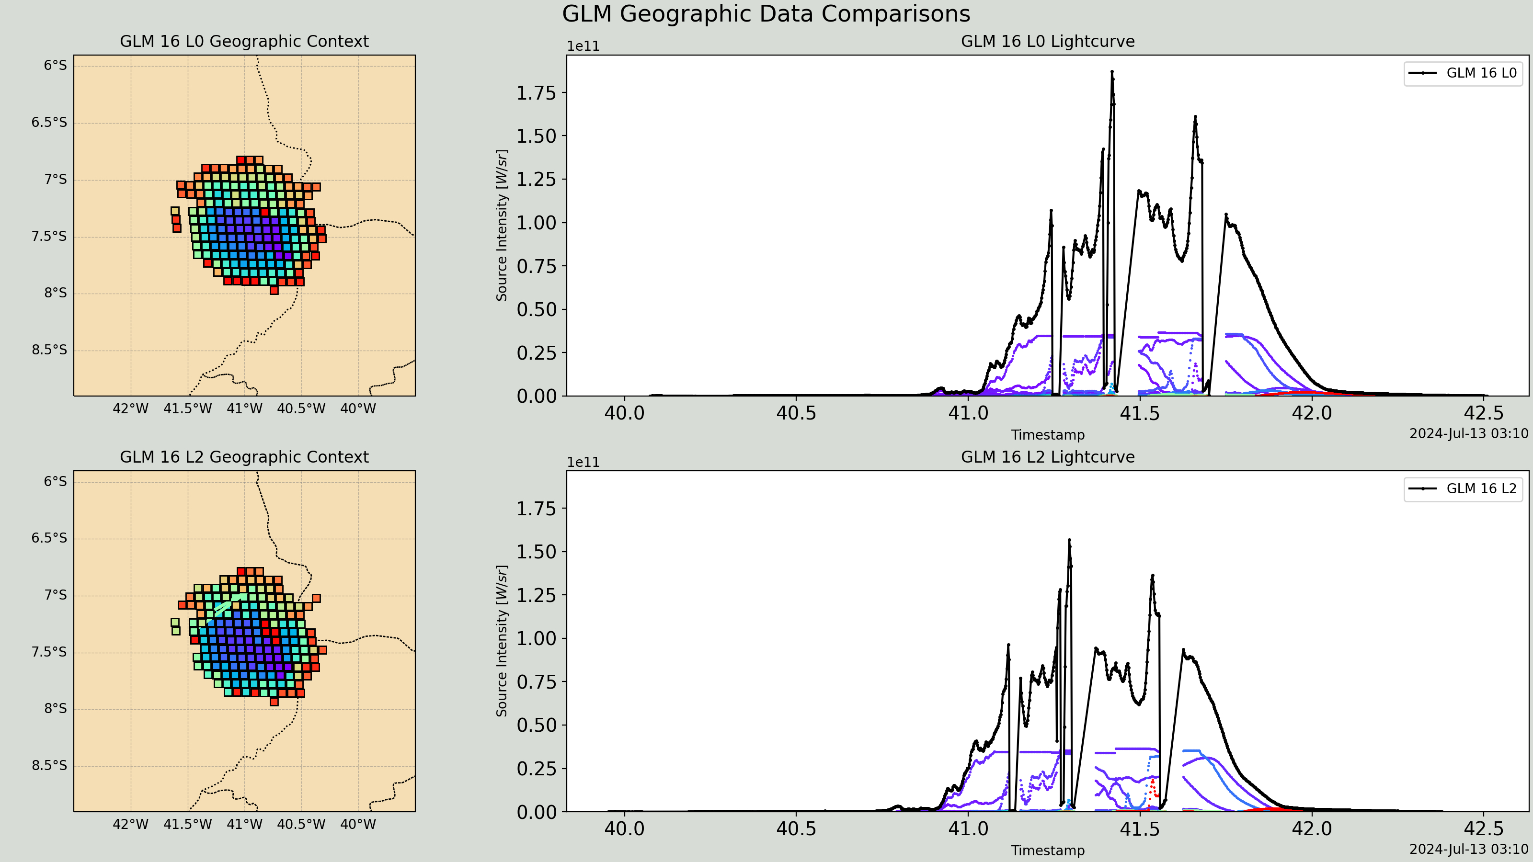
Light Curve from GOES-E (GLM – L0, L2)

Slide 18
Light Curve from Meteosat-12 (MTG LI – L0)

Slide 19
13 Jul 2024
@ 3:10 UTC
1.5 kt TNT
2024 RW₁
4 Sep 2024
@ 16:39 UTC
200 t TNT
QueQiao-2 booster
24 Apr 2024
@ 7:07 UTC
(adapted from P. Kokou, MNRAS, 2024)

Slide 20
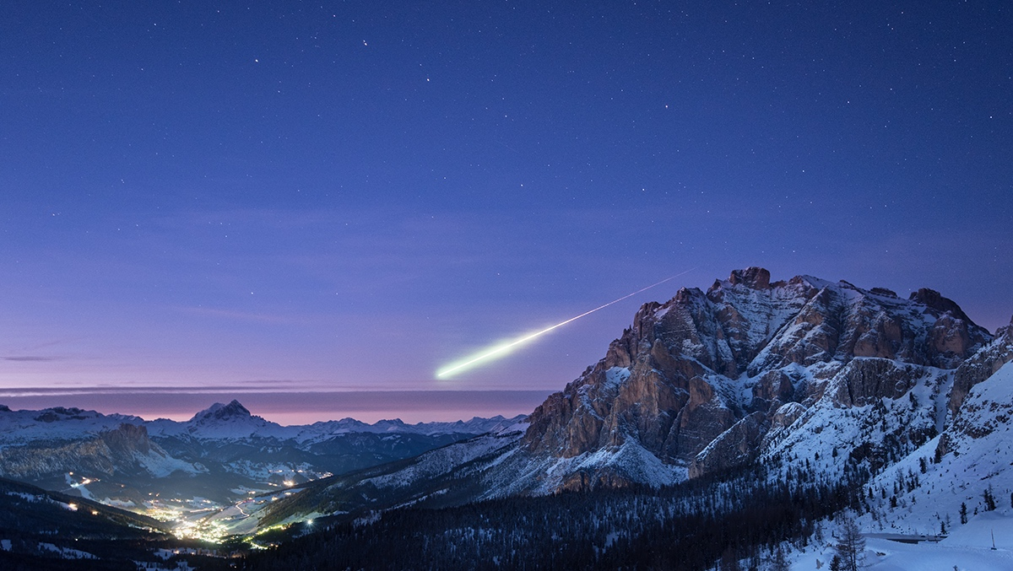
Summary
Coordinating between space agencies is of great value to planetary defense, planetary science, Earth science, and space safety
Data Exploitation
Dual use technology instruments (i.e., lightning imaging sensors) can also be used to detect impacting meteoroids stereoscopically
In turn, leading to sample recovery

