Slide 1
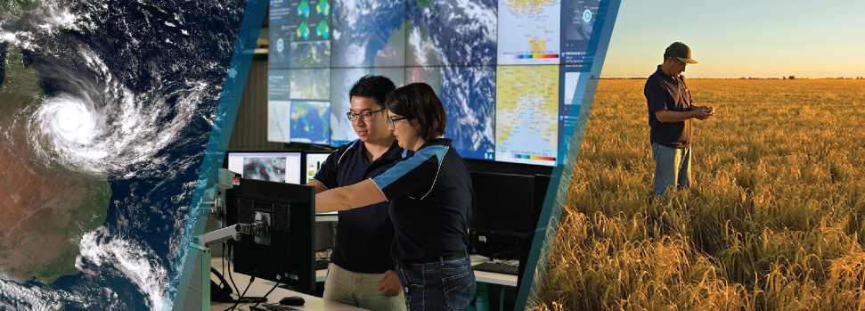
Can space based lightning observations aid in the earlier identification of lightning ignited fires?
Caroline Poulsen, Andrew Dowdy
Caroline.poulsen@bom.gov.au
Bureau of Meteorology & University of Melbourne
Thanks to everyone who has looked at this before me Schulz, Fairman, Bitzer, Perez-Invernon, Rudlosky…
Notes:
This work has its origins in the NSMEO program, as the Bureau conducted a phase A study into the possibility of launching a geostationary lightning sensor.
Lightning sensors are predominantly being used for severe thunderstorm identification this work posed a completely different application.

Slide 2
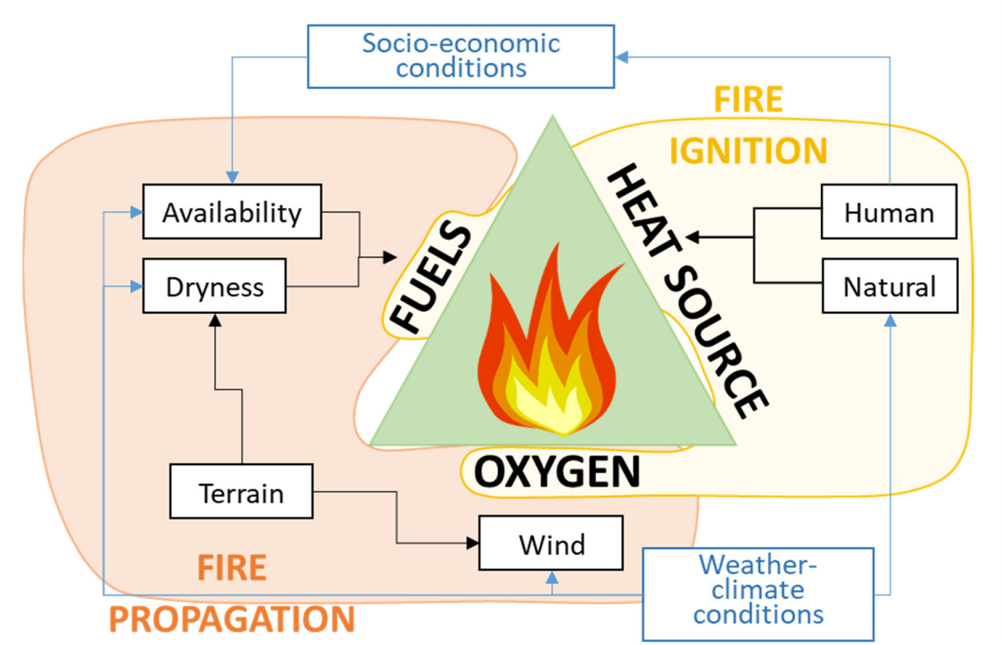
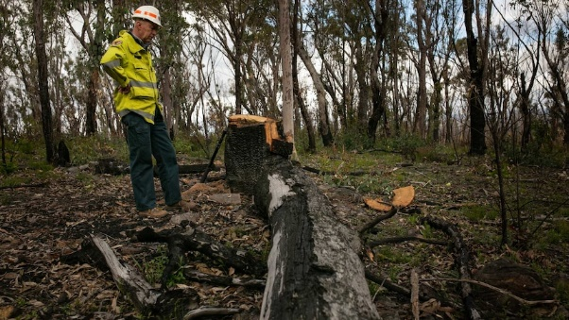
Lightning and Fire Ignition
Bushfires can originate from both human activity and natural causes
Lightning accounts for half of all ignitions in Australia and majority of the area burnt
Identifying a fire early is key to prioritising fire resources and decreasing the response time to tackle the fire.
What if we could identify the lightning strikes more likely to ignite a fire?
Drone, flight, people on the ground?
Previous studies have looked at weather and environmental feature of Lightning ignited fires
Does knowledge of the lightning characteristics improve this prediction?
Notes:
Of curse for lightning to ignite a fire, there also need to be the fuel and weather condiyions conducive to fire ignitions, this is commonly described as the fire triangle.
There are numerous studies out in the lietarture where envioronematil and weather are used to I
To my knowledge this is the first that also includes the characteristics of the lightning
Even small improvementhttps://www.forestleaves.blog/post/bolts-from-the-blue-lightning-and-forest-fires

Slide 3
Long Continuing Current (LCC)
LCC hypothesized to more likely ignite a fire
LCC is often accompanied by continuous optical emission.
In 2020 Fairman and Bitzer (https://doi.org/10.1029/2020JD033451) analysed the characteristics of GLM lightning measurements and found GLM flashes with higher probabilities of continuing current tend to
cover a longer distance
a brighter maximum optical energy
and a larger maximum area over the span of the continuous optical emission.
In this analysis I use the individual components of the F&B LCC regression
Notes:
In a typical return stroke, electricity flows for only a short period and does not generate the heat required to ignite a fire; however, in long continuing current (LCC), electricity flows over tens to hundreds of milliseconds and generate considerably more heat.
More likely to ignite a fire
Particually
arly away from ground observations
It has been estimated that up to 20% of cloud to ground flashes contain continuing current.

Slide 4
Methodology: Does knowledge of the lightning characteristics improve the prediction of lightning ignited fires
Input data
Topography/slope/aspect
Lightning GLM and ground lightning characteristics
Null data set corresponding to lightning locations not matched to a fire
Location of Natural and Human fire locations for Western US
2019/2020 Fire season
~5000 natural fires
landcover
Upper and lower vegetation
Understand sensitivity
Data denial exp. estimate probabilities
Collocate data
Using Proximity Index
(Holdover fires)
Look at distributions, trends and
Correlations
Select features
Run machine learning model
XGboost
Experimenting with balancing the data sets and predictors
NWP IFS Weather
FWI/KBDI/DC
Run diagnostics to estimate key predictors
(SHAP and XGboost)
Soil moisture SMAP
Notes:
So to see if lightning characteristics help I designed a machine learning prediction algorithm.
The study are is the US
Held back 30% of fires

Slide 5
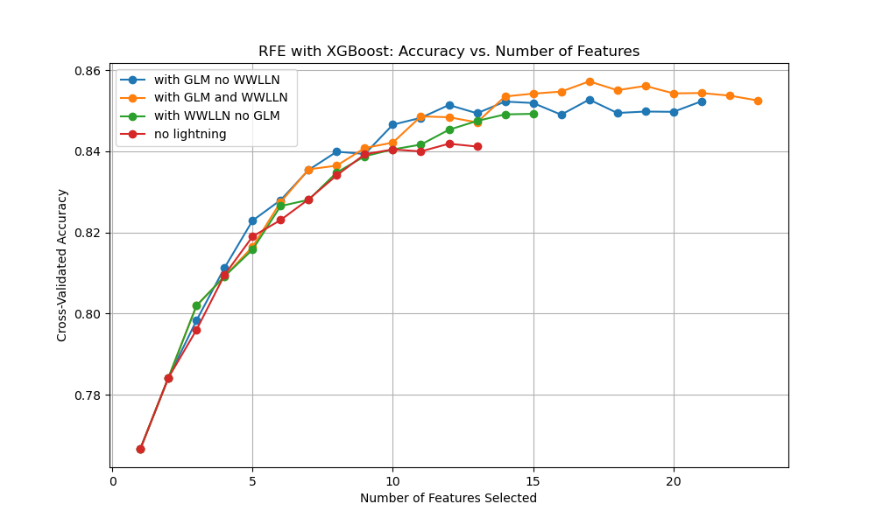
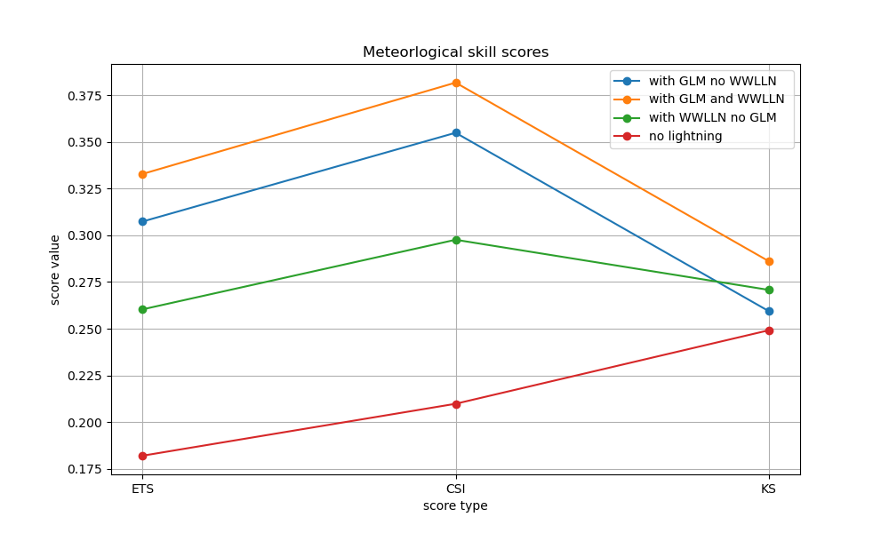
Meteorological statistical analysis of results
Reduced false alarms by 4%
CSI takes into account both false positives and false negatives
ETS adjusts CSI
for chance hits considers hits false alarms and misses
KS statistic tells us about the separation of the two distributions
Notes:
Conducted 4 experiments
ETS Significant/more suitable when it is a rare event
A higher Threat Score indicates better model performance, as it means the model has a higher proportion of true positives relative to the sum of true positives, false positives, and false negatives.
In summary, a better Threat Score indicates good overall classification performance, while a better KS score indicates good separation between classes. The choice of which metric to prioritize depends on the specific goals and requirements of your machine learning task12.
The KS score is used to measure the performance of a classification model, particularly in terms of how well the predicted probabilities separate the positive and negative classes. It is based on the maximum difference between the cumulative distribution functions (CDFs) of the predicted probabilities for the positive and negative classes. A higher KS score indicates better separation between the classes.

Slide 6
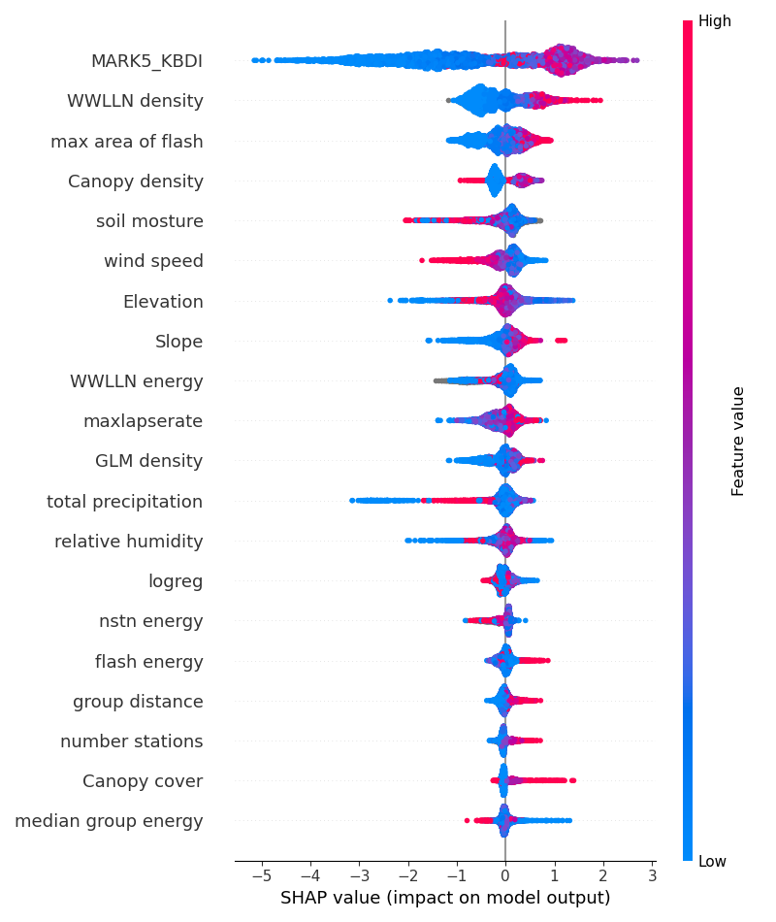
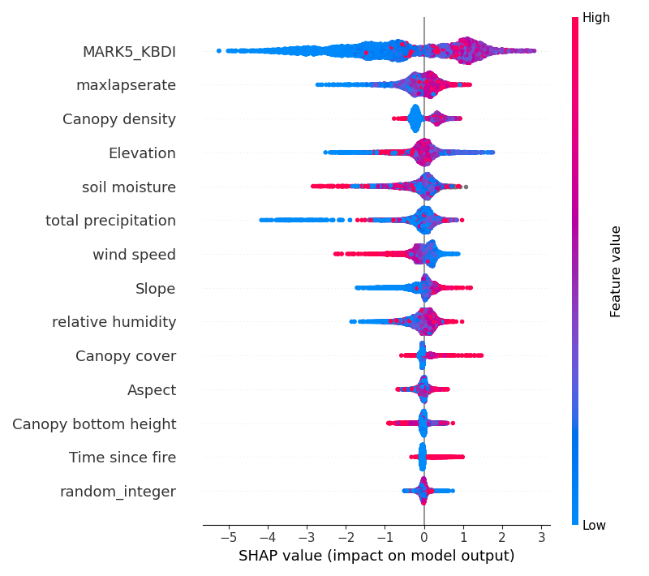
No lightning information
With GLM and WWLLN
🡨 No ignition
Ignition🡪
Notes:
The Keetch-Byram Drought Index (KBDI) is a measure used to assess the risk of fire by representing the cumulative moisture deficiency in deep duff and upper soil layers. It takes into account the net effect of evapotranspiration and precipitation. The KBDI ranges from 0 to 800, with higher values indicating a greater risk of fire due to drier conditions
Note tha correlations can push down/up treat with caution
Red2 not cont current
Canopy density
Canopy cover
Canopy height

Slide 7
Conclusions
Fire weather and environmental variables can explain the majority of the conditions for lightning ignited fires
GLM improves slightly the probability of accurate identification
GLM Lightning characteristics are correlated with each other and meteorology
GLM and ground lightning data reduces the number of false positives
In countries with no ground lightning network, satellite observations are extremely valuable
Even small improvements are valuable to the fire community.
Questions and Further work
Still a bit of predictor optimising to perform/analyse
Better collocated lightning and ignition would improve the result robustness
Translation to Australia?
This used existing GLM L2 products, could we tailor GLM products to this application?
Would MTG-LI perform better? Location accuracy is critical to Fire community
National lightning networks could provide better positioning accuracy
Notes:
Lightning ignition is quite stochastic in nature
Add something about Africa
The Keetch-Byram Drought Index (KBDI) is a measure used to assess the risk of fire by representing the cumulative moisture deficiency in deep duff and upper soil layers. It takes into account the net effect of evapotranspiration and precipitation. The KBDI ranges from 0 to 800, with higher values indicating a greater risk of fire due to drier conditions

