Slide 1
Reintroducing Single Group Flashes to Improve Geostationary Lightning Mapper Detection Efficiency
Douglas Mach¹ and Monte Bateman²
¹Senior Scientist, Science and Technology Institute, Universities Space Research Association
²Research Scientist, Earth System Science Center, University of Alabama in Huntsville
Presented at the 2024 GLM Science Meeting,
24-26 September, 2024

Slide 2
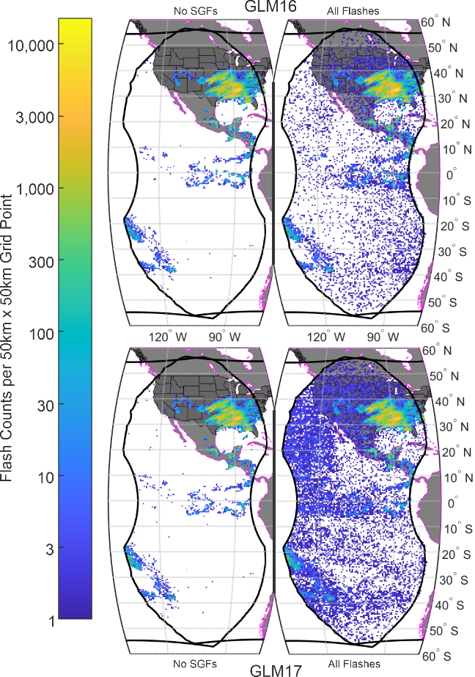
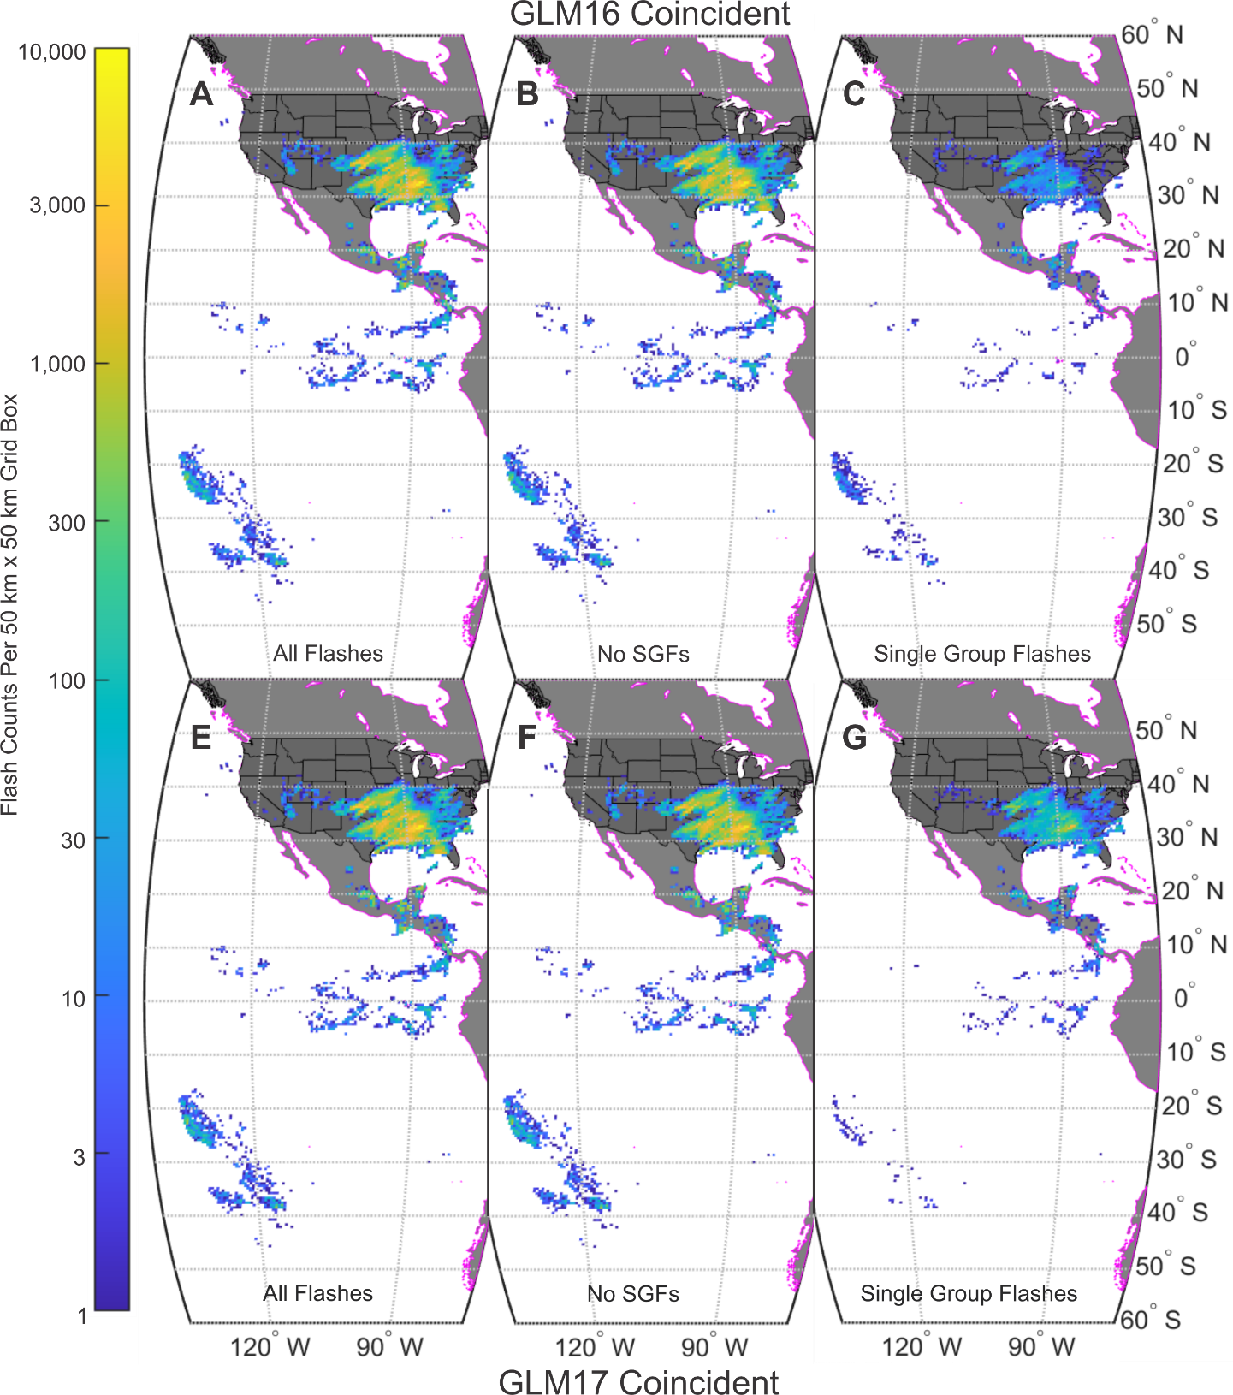
Previous Single Group Flash Analysis Summary
The GLM processing code has a filter that removes all Single Group Flashes (SGFs)
The SGF filter does a decent job in eliminating false flashes
In our previous study of GLM16/17 data in the overlap region, we found that there are a significant number of SGFs (4-13%) that are coincident between GLM16 and GLM17
The coincident data (more or less) matches the Multi-Group Flash (MGF) dataset
The “real” SGFs tend to cluster with the MGFs
This study will expand on those results

Slide 3
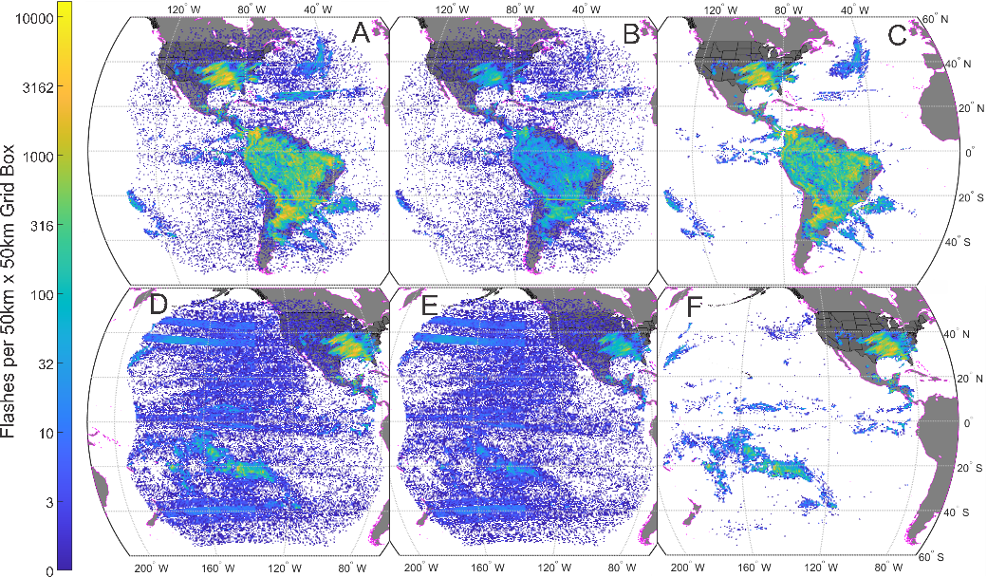
Protocol
Tested Characteristics
Internal Characteristics
Event count
Flash energy
Flash energy density (energy per event)
External Characteristics
Association with other SGFs
Association with MGFs
GLM Data
L2 Flash Data
GLM16 & GLM17
00:00:00Z 16 March 2021 to 00:00:00Z 19 March 2021
Does not have SGF filter applied
Will only test DE/FAR on SGF data
GLM flash data for this analysis. The upper row is from GLM16, while the bottom row is from GLM17. Panels A and D are all flashes, both Single Group Flashes (SGFs) and Multi-Group Flashes (MGFs). Panels B and E are the SGFs in the dataset, while panels C and F are the MGFs in the GLM dataset. The flash data is gridded on a nearly constant 50 km x 50 km grid.

Slide 4
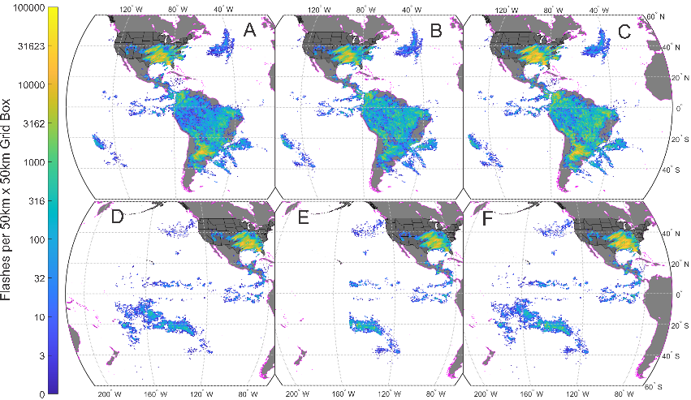
Protocol (cont.)
Ground Truth Data
GLD360 flash data
ENTLN stroke data
Combined into a Virtual Ground Truth Flash Dataset using GLM clustering algorithm
Analysis
Pick a characteristic and threshold value for that characteristic
Find all SGFs with greater/less than the threshold value
Evaluate DE & FAR (Bateman and Mach, 2020)
DE & FAR only calculated for SGFs
MGFs were not included
Goal
To find the internal/external SGF characteristics that maximize the DE while minimizing the impact on the FAR
Virtual ground truth flash dataset for this analysis. The ground truth data are divided into two sets: the top panels are for GLM16 data analysis, and the bottom panels are for GLM17 analysis. Panels A and D are GLM360 data (flashes), panels B and E are ENTLN data (strokes), and the combined data are panels C and F (flashes). The data is gridded on a near constant 50 km by 50 km grid.

Slide 5
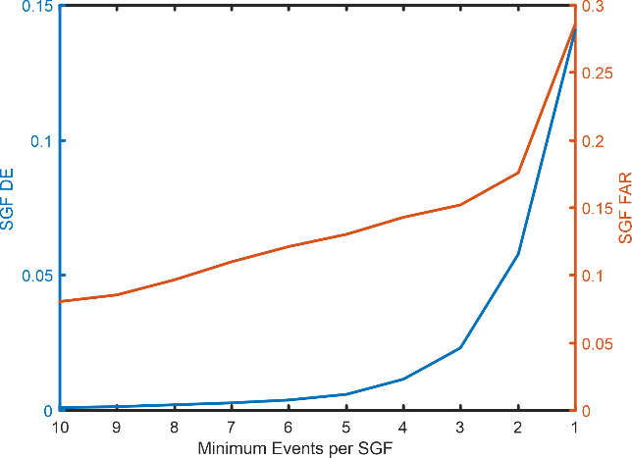
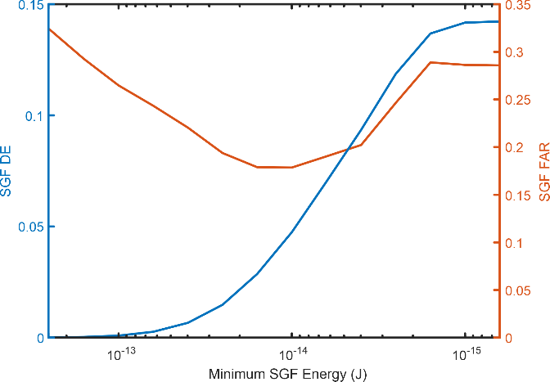
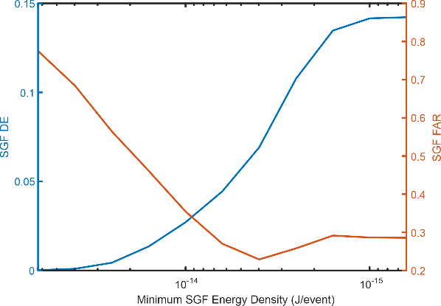
Internal Characteristics Results
Event count
2 events
DE: 0.06
FAR: 0.18
Flash Energy
~10⁻¹⁴ J
DE: 0.05
FAR: 0.18
Flash Energy Density
7x10⁻¹⁴ J/event
DE: 0.07
FAR: 0.22
The internal characteristics poorly indicated the lightning/non-lightning status of SGFs

Slide 6
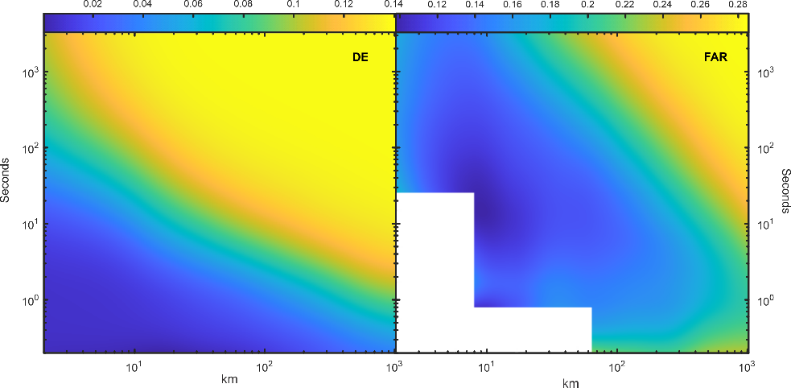
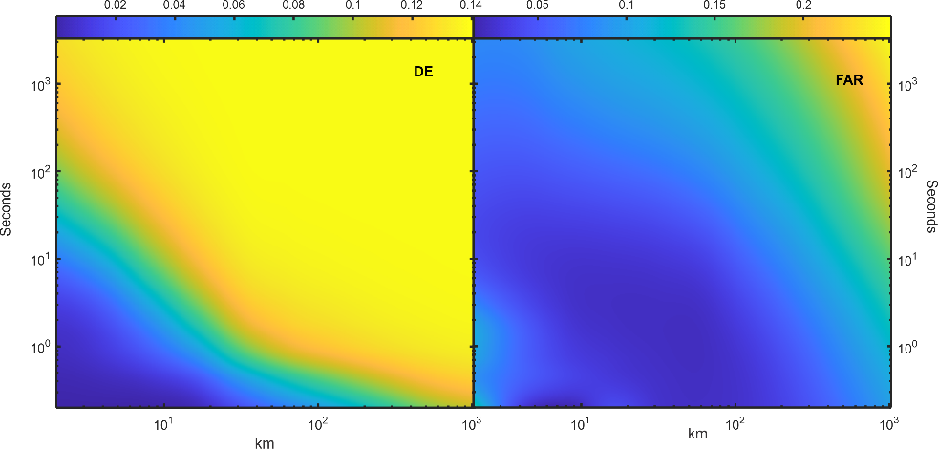
External Characteristics Results
SGF Proximity to other SGFs (SGF near SGF)
Temporal spacing (exponential):
0.2 s, 0.4 s, …, 819.2 s, 1638.4 s, 3276.8 s (~1 h)
Spatial spacing (exponential):
2 km, 4 km, 8 km, …, 256 km, 512 km, 1024 km
Results
DE rises as the distance/time increases, plateauing ~0.14 (upper plot marked “DE”)
FAR rises as the distance/time increases, plateauing ~0.28 (upper plot marked “FAR”)
DE reaches the plateau sooner than FAR
SGF Proximity to MGFs (SGF near MGF)
Same temporal and spatial spacing (exponential) as for the SGF near SGF analysis
Results
DE and FAR follow approximately the same pattern as the SGF near SGF
The DE plateau is achieved earlier (lower distance and time)
The FAR plateau is achieved later (higher distance and time)
SGF near MGF seems better
Optimal time/distance value?

Slide 7
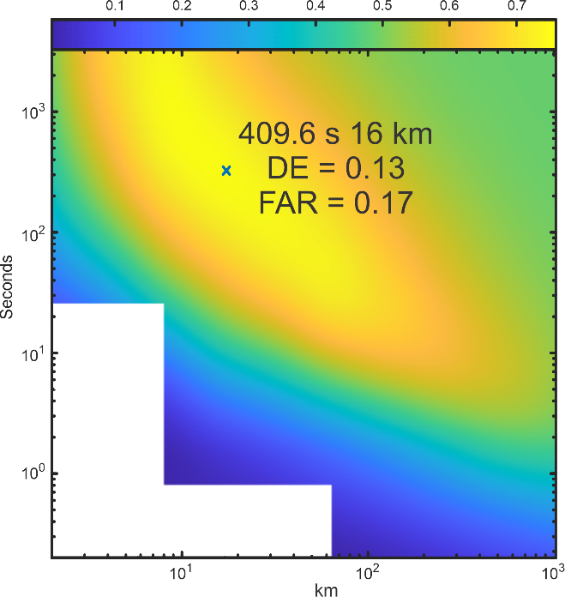
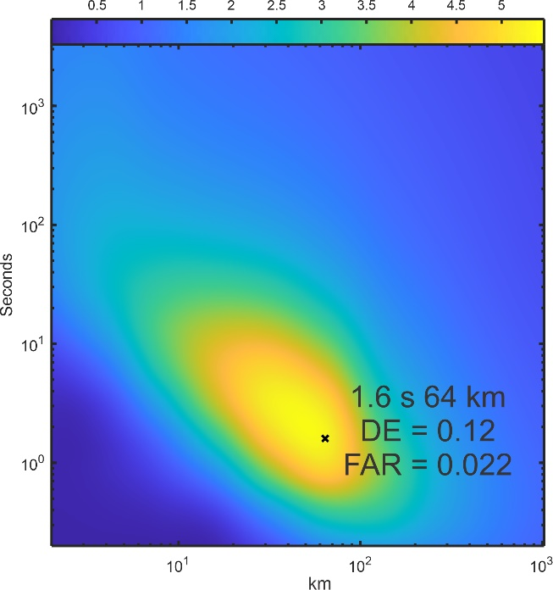
Optimal Time/Distance Values
Estimate the “optimal” distance/time to maximize DE and minimize FAR by finding the maximum of the DE/FAR plot
SGF near SGF (left plot)
409.6 s
16 km
DE: 0.13
FAR 0.17
SGF near MGF (right plot)
1.6 s
64 km
DE: 0.12
FAR: 0.022
SGF near SGF
SGF near MGF

Slide 8
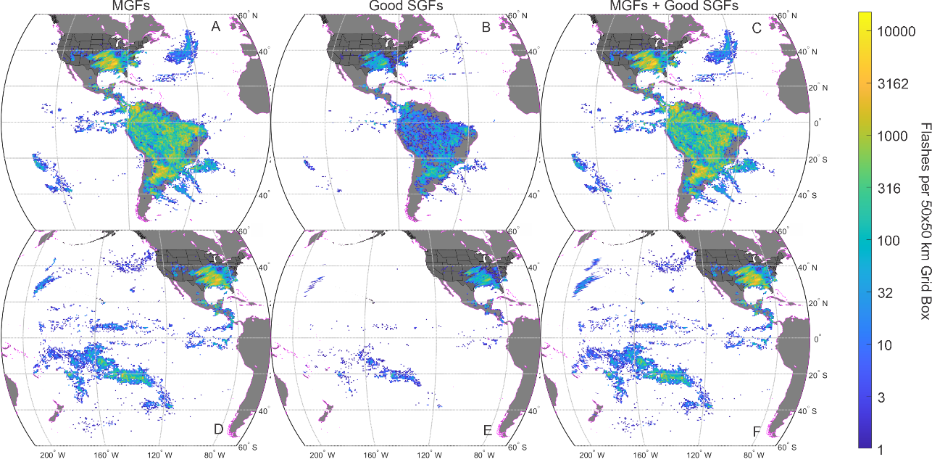
Conclusions
SGF proximity to SGFs/MGFs clearly better than any “internal” characteristic
SGFs near MGFs produced nearly the best DE (0.12) with easily the best FAR (0.022)
A small increase in the allowable FAR would result in the “best” DE
Using the SGFs near MGFs algorithm
Include MGFs
DE increases from 0.90 to 0.91
FAR does not change (~0.30)
The total “failure” of any “internal” characteristic, including energy-based characteristics may have ramifications for other GLM filters, specifically coherency. Having any amplitude-based parameter may be sub-optimal

Slide 9
Questions?

Slide 10
DE and FAR Formula and Parameters
From Bateman and Mach (2020), https://doi.org/10.1117/1.JRS.14.032406
Parameter | Definition
A | Flashes detected by GLM but not detected by the truth dataset
B | Flashes detected by GLM and detected by the truth dataset
C | Flashes detected by the truth dataset and detected by GLM
D | Flashes detected by the truth dataset not detected by GLM
DE | C/(C + D)
FAR | A/(A+B)
“Detected” means ground truth and GLM flashes were within 50 km and ±1 s

