Slide 1
Preparing GLM Data for a New Multi-Radar/Multi-Sensor System (MRMS)
Combined Lightning Product
Sarah Stough^{1,2}, Vanna Chmielewski², Kristin Calhoun², Kevin Thiel^{1,2,3,4}
¹Cooperative Institute for Severe and High-Impact Weather Research and Operations, University of Oklahoma, Norman, Oklahoma
²NOAA/OAR National Severe Storms Laboratory, Norman, Oklahoma
³NWS Storm Prediction Center, Norman, Oklahoma
⁴School of Meteorology, University of Oklahoma, Norman, Oklahoma
2024 GLM Science Meeting
24 September 2024, 2:20 PM ET

Slide 2
Creating a Combined Lightning Product for MRMS
Multi-Radar/Multi-Sensor System - 0.01°x0.01° gridded data, 2-min updates in near real time
Synthesized Data and Algorithms
Radars
Surface, upper air observations
Rain gauges
Lightning detection systems
Satellites
Models
Improved Decision-Making
Quantitative precipitation estimation
Icing
Turbulence
Convective hazards
Supports Widespread Applications
Forecasting, warning operations (NWS Weather Forecast Offices)
Numerical weather prediction
Hydrology (River Forecast Centers)
Aviation (Center Weather Service Units, FAA)
Federal agencies: DOD, FEMA, USDA

Slide 3
Creating a Combined Lightning Product for MRMS
FAA interested in basic question of, “Where is lightning happening?”
MRMS System includes lightning data but not GLM
Goal: Integrate NLDN, ENTLN, and GLM data for more complete, robust picture of active lightning
All instruments suffer from degradation, dropouts
No detection technology captures all interesting* properties of lightning at all times
Opportunities to deliver comprehensive lightning data and added meteorological insight
MRMS 1-hour lightning density map
2 mos
8 mos
2 mos
Yrs 2+
Spin-Up
Parallax Correction and Map Projection
Merge Data
Continuing Work
Data Ingest,
Tools Development
Evaluate parallax correction approaches
Project GLM data to MRMS grids
Implement real-time parallax correction
Combine GLM FED and real-time NLDN and ENTLN feeds
Merge GLM East and West, extract value-added info beyond binary lightning ID
* what is “interesting” depends on who is asked!

Slide 4
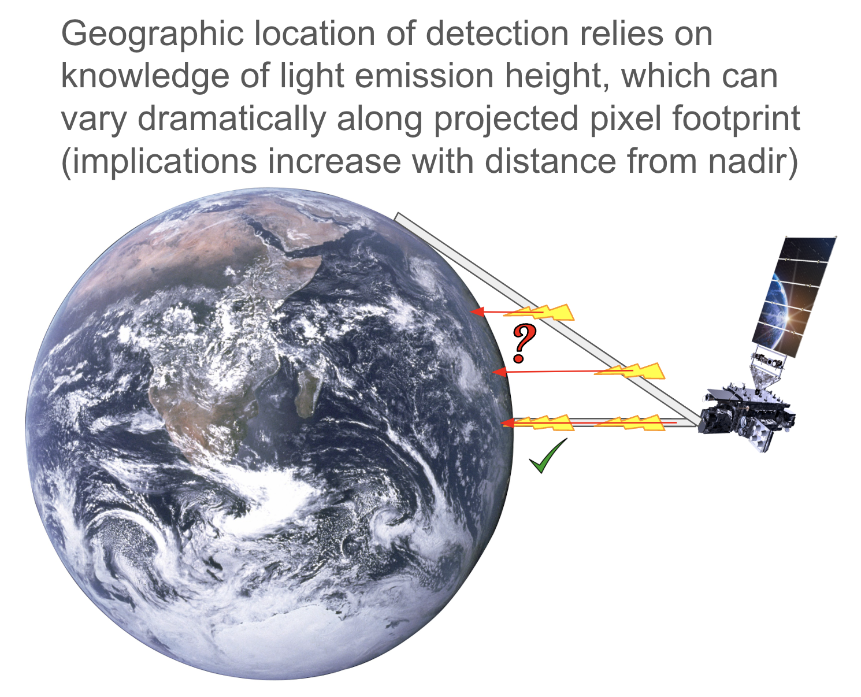
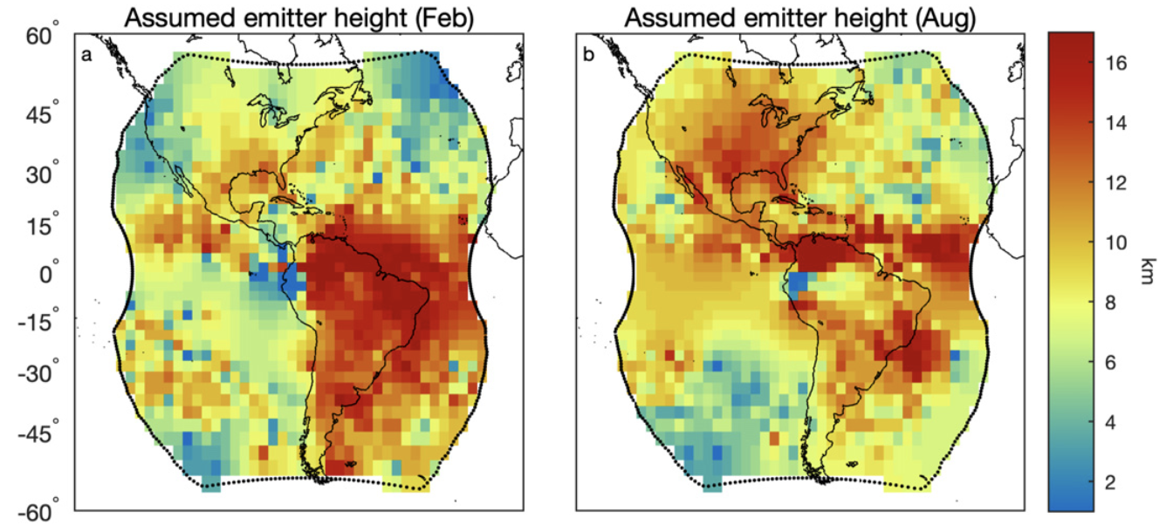
GLM Lightning Location, a.k.a. Parallax Correction
6 km
Lightning emission height models:
v2 Lightning Ellipsoid
Computationally simple
Works reasonably well
14 km
Virts & Koshak (2020) regional, seasonal maps
Improves on ellipsoid
Some increase in runtime to implement
Virts and Koshak (2020) Fig. 7a-b
GOES Advanced Baseline Imager (ABI) Cloud Top Height (CTH) retrievals
Most direct correction
Real-time challenges: computational time cost, additional risks from data lag or drop-outs, impacts from CTH algorithm assumptions/errors
Notes:
Note: add actual ABI CTH image

Slide 5
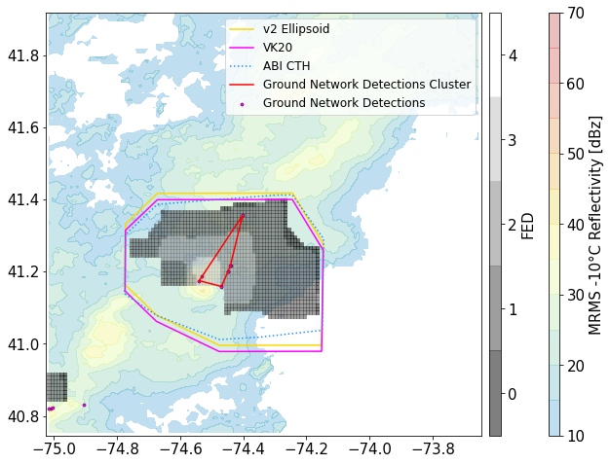
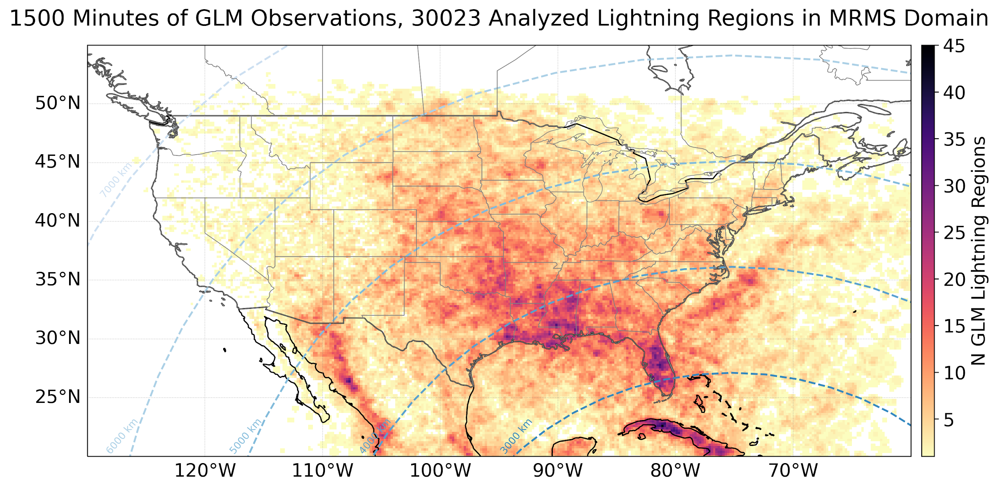
Simple Evaluation of Parallax Correction Methods
Analysis approach informed by near real-time product considerations-
Which emission height model most decreases the distance between 1-minute periods of GLM footprints and clustered groups of NLDN + ENTLN flashes?
ABI CTH data from 5-10 mins prior to lightning analysis time to evaluate impacts from latency
Notes:
Be prepared for Q: why comparing groups in GLM and flashes in NLDN+ENTLN?

Slide 6
Pop quiz
Which light emission height model performs the best over the greater GOES-East area?
a) v2 Ellipsoid
b) Regional-seasonal correction
c) ABI CTH product
Which light emission height model performs the worst over the greater GOES-East area?
a) v2 Ellipsoid
b) Regional-seasonal correction
c) ABI CTH product

Slide 7
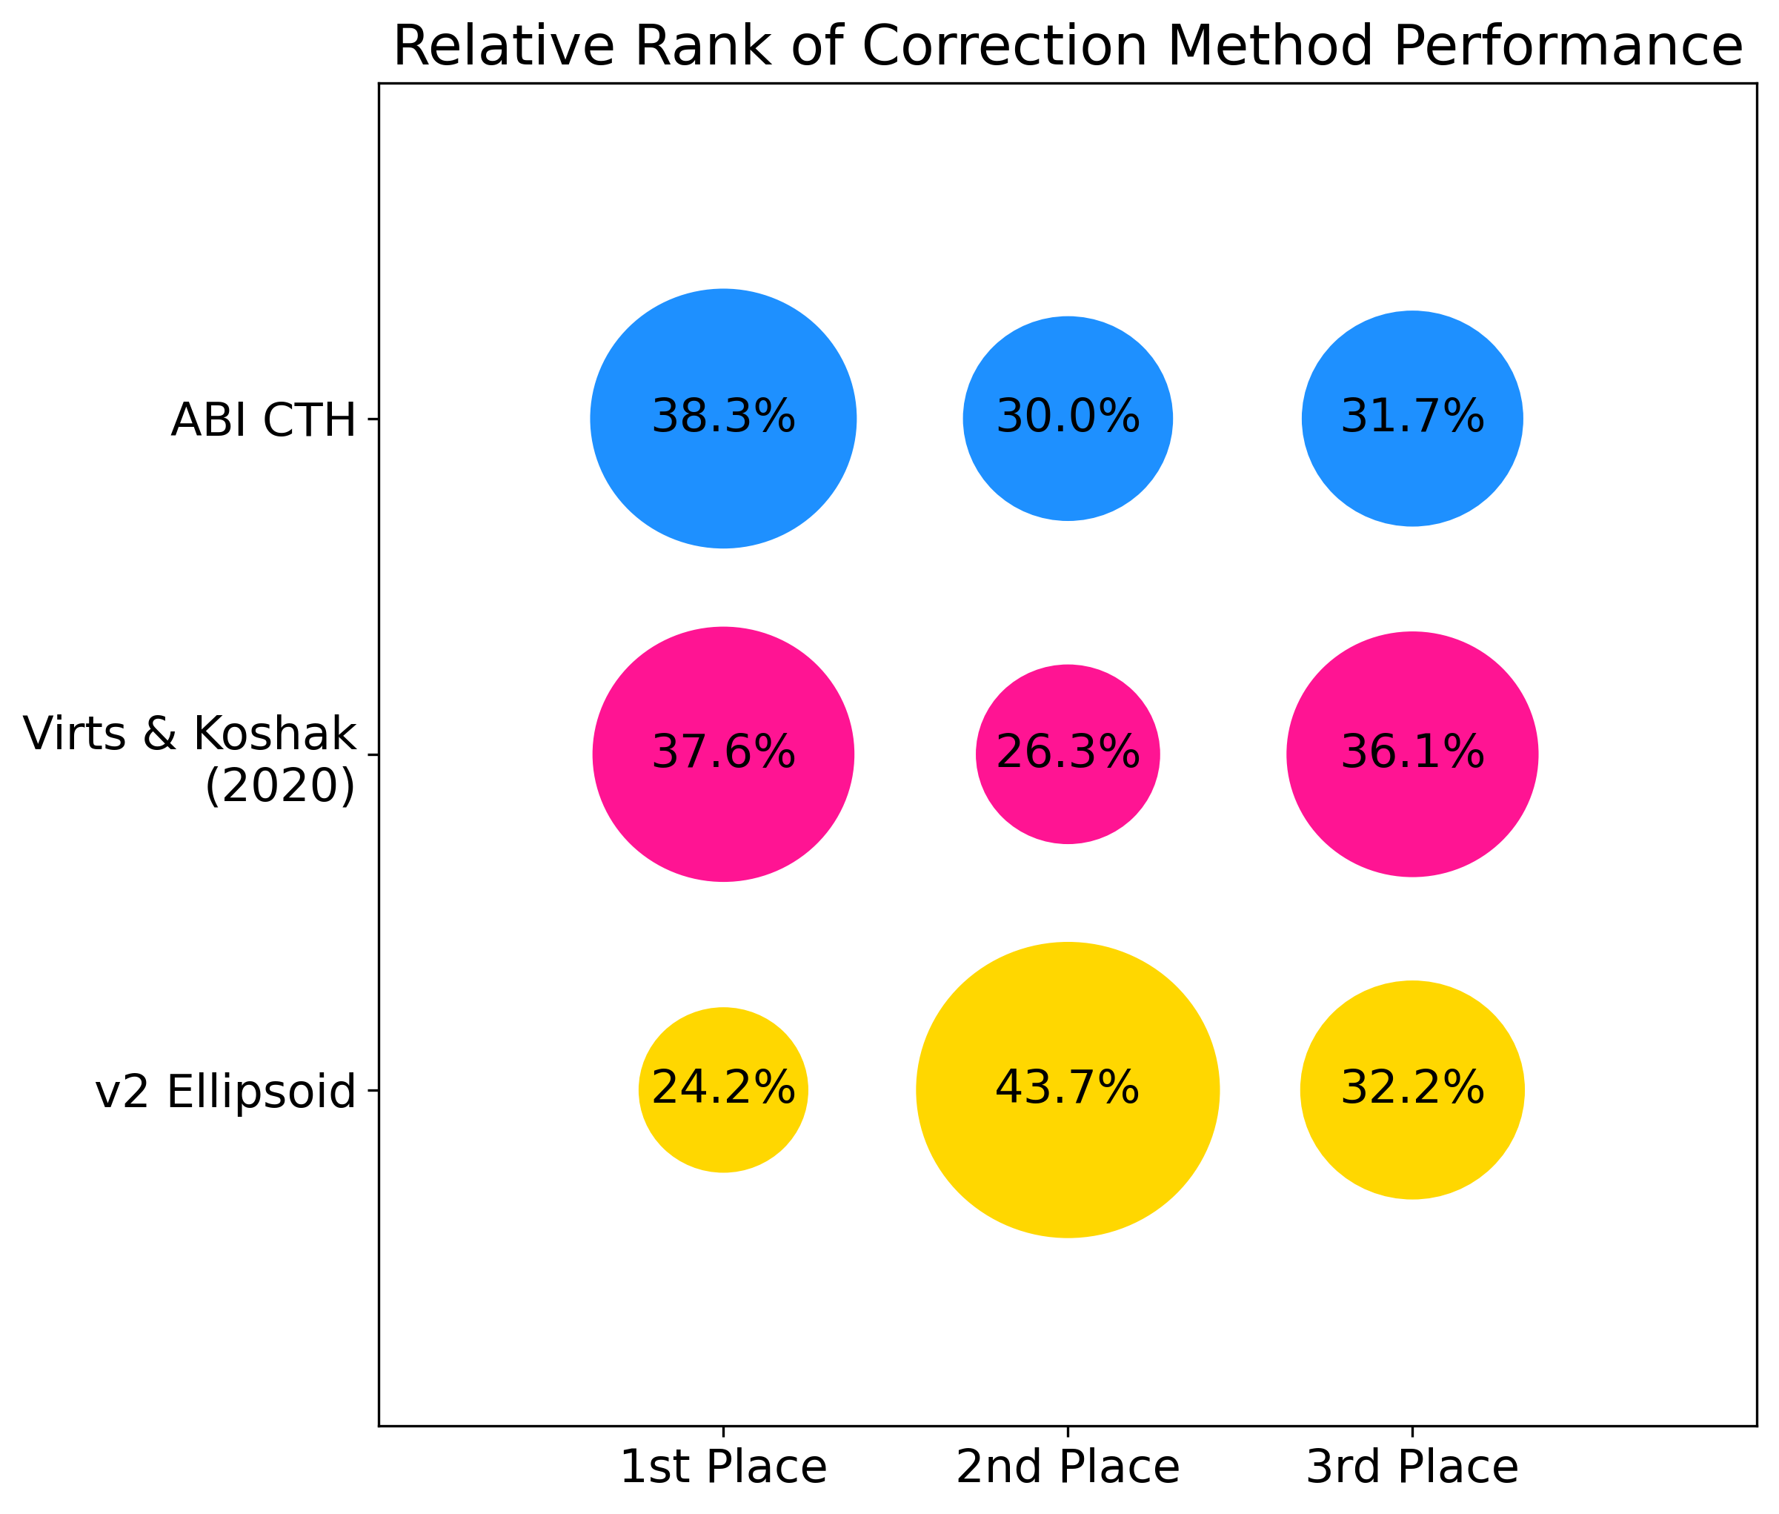
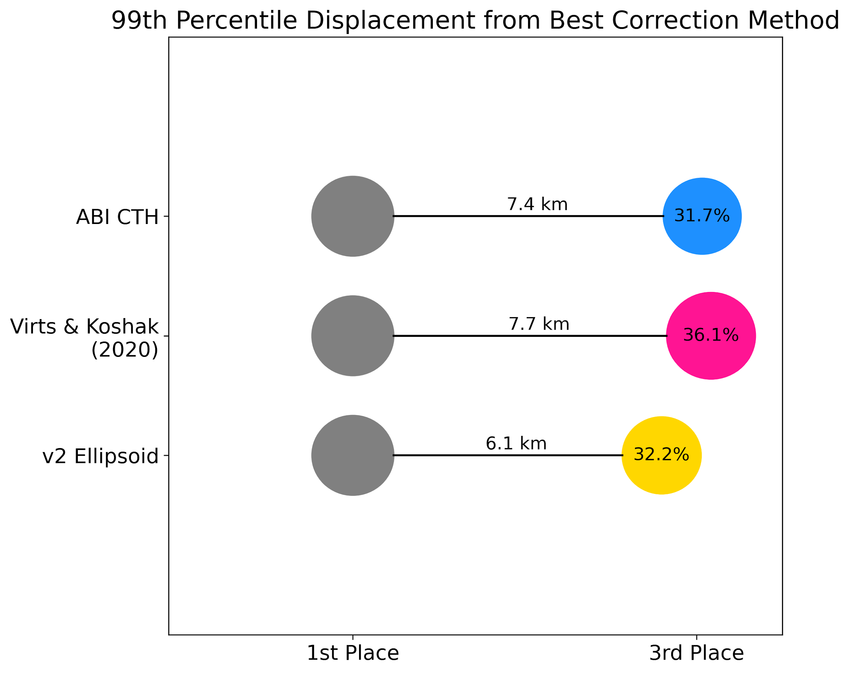
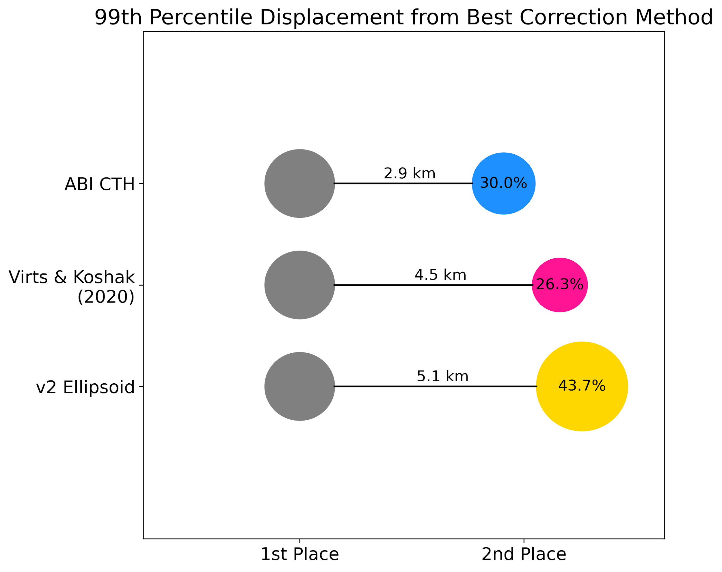
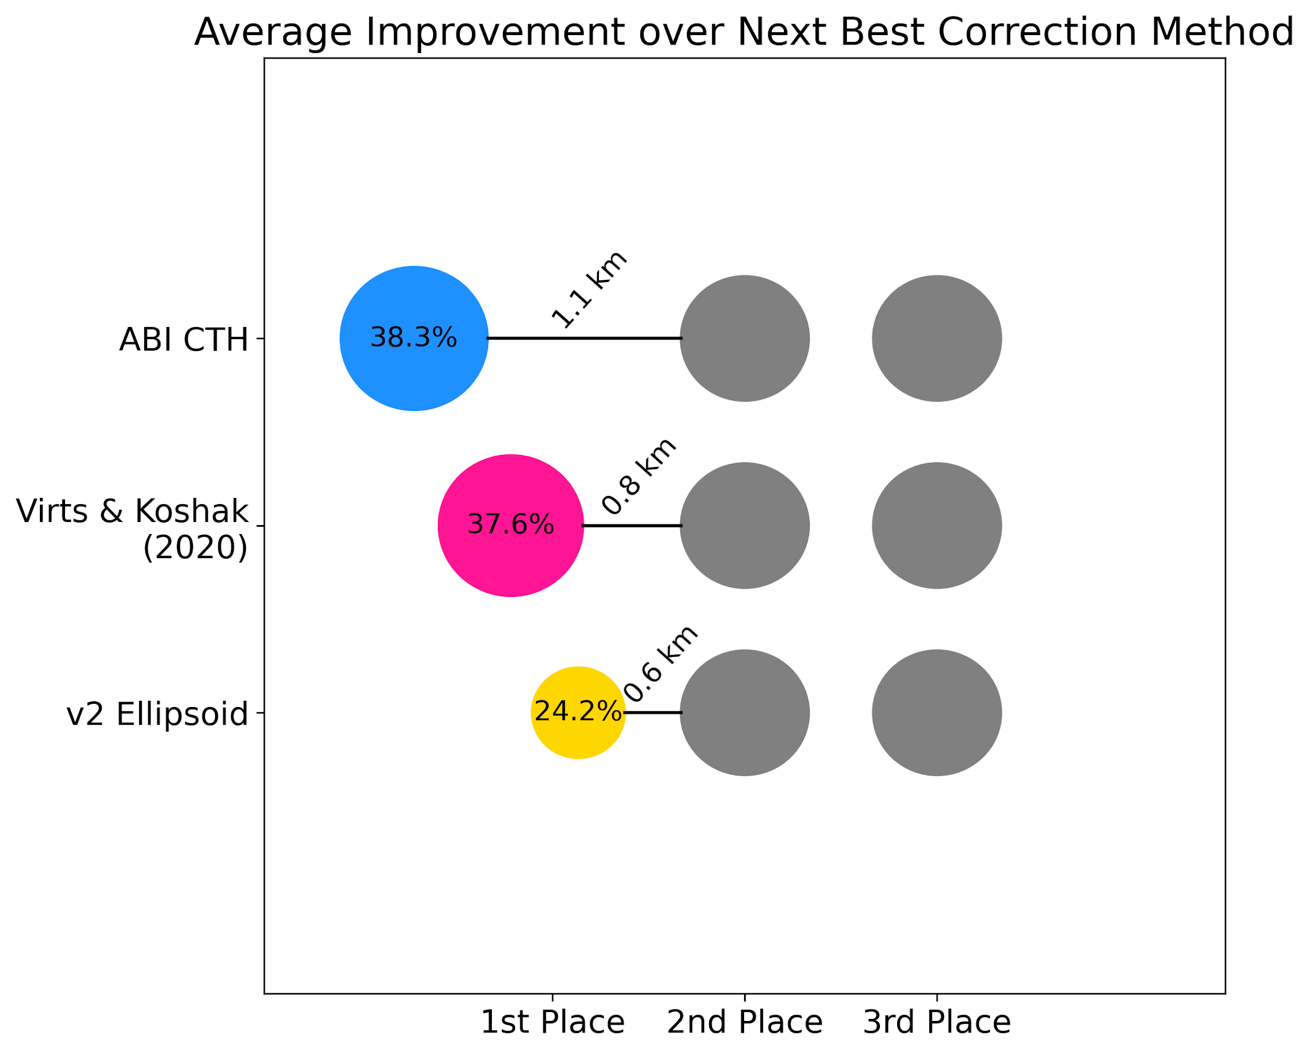
Parallax Correction Model Evaluation
Any other model in 1st
Any other model in 1st
Any other model in 2nd

Slide 8
Parallax Correction Model Evaluation
1st
2nd
3rd
ABI CTH should provide advantage of fitting a better light emission height model per GLM observation, assuming cloud top emission
When ABI CTH is successful, it notably improves on the other models
Yet, poor performance of the ABI CTH model happens at about the same frequency as the other light height emission models, and with fairly large failures
When does the ABI CTH model succeed? Perform poorly? Why?

Slide 9
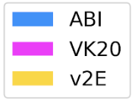
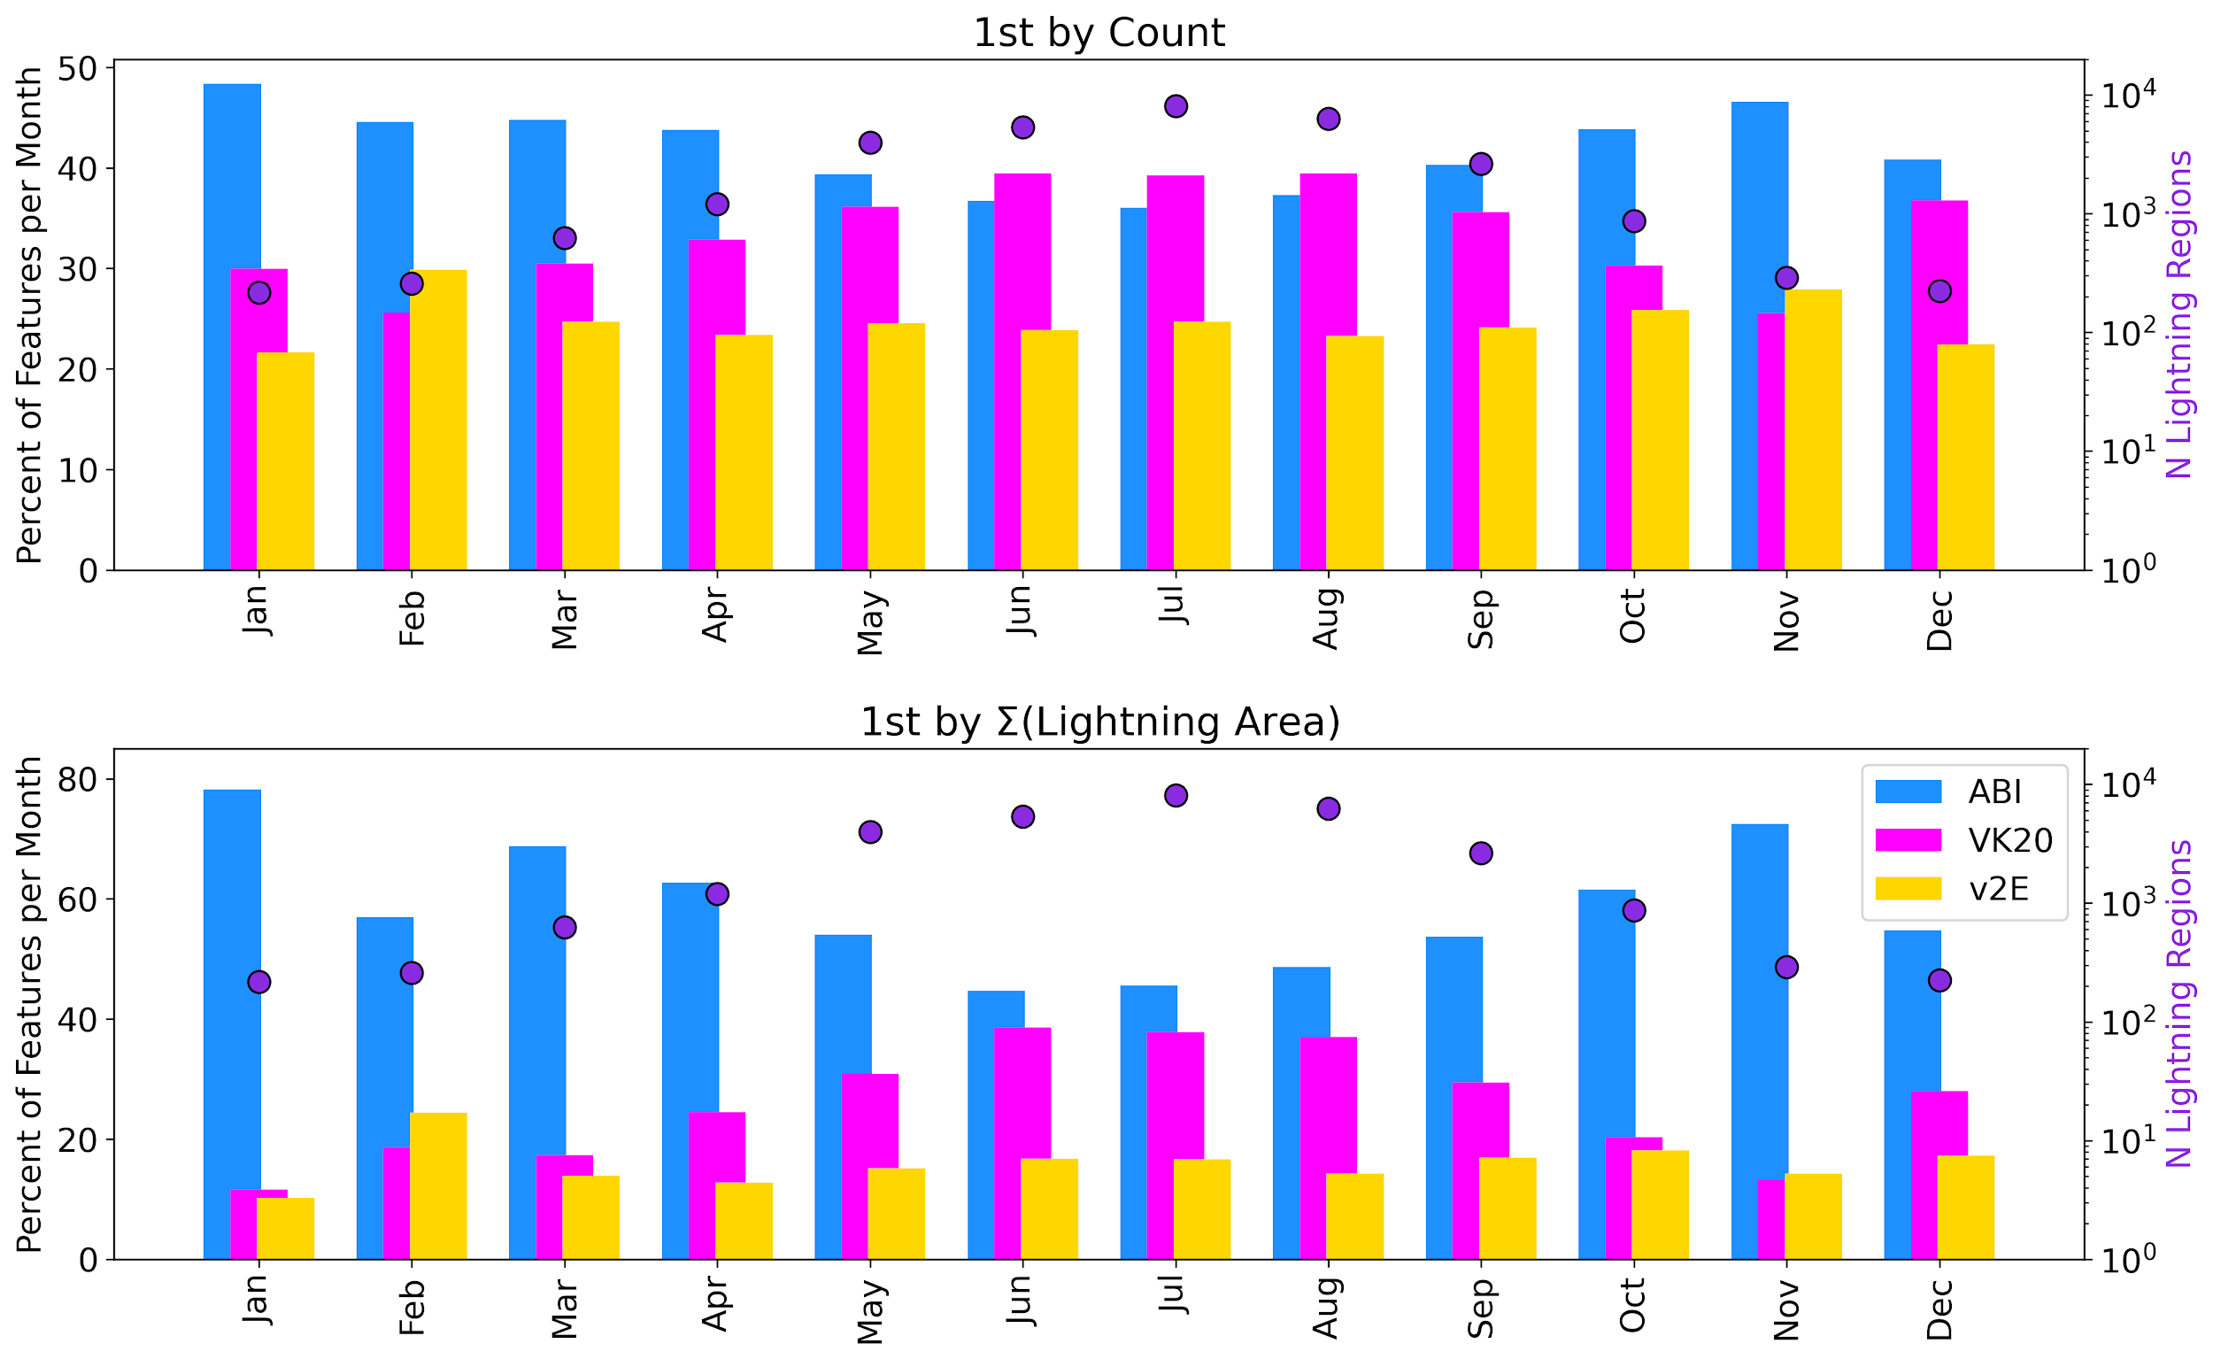
Parallax Correction Model Evaluation
More lightning regions best corrected by ABI CTH in cool season (fewer storms)
Seasonal correction effectiveness approaches ellipsoid in transitional months
ABI CTH performs better over larger lightning regions, perhaps more organized, synoptically-driven convection

Slide 10
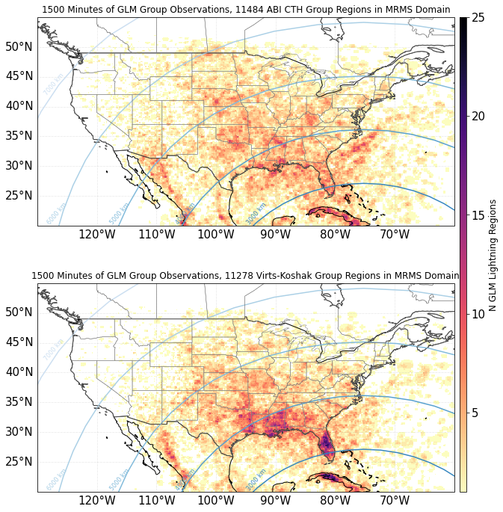
Parallax Correction Model Evaluation

Slide 11
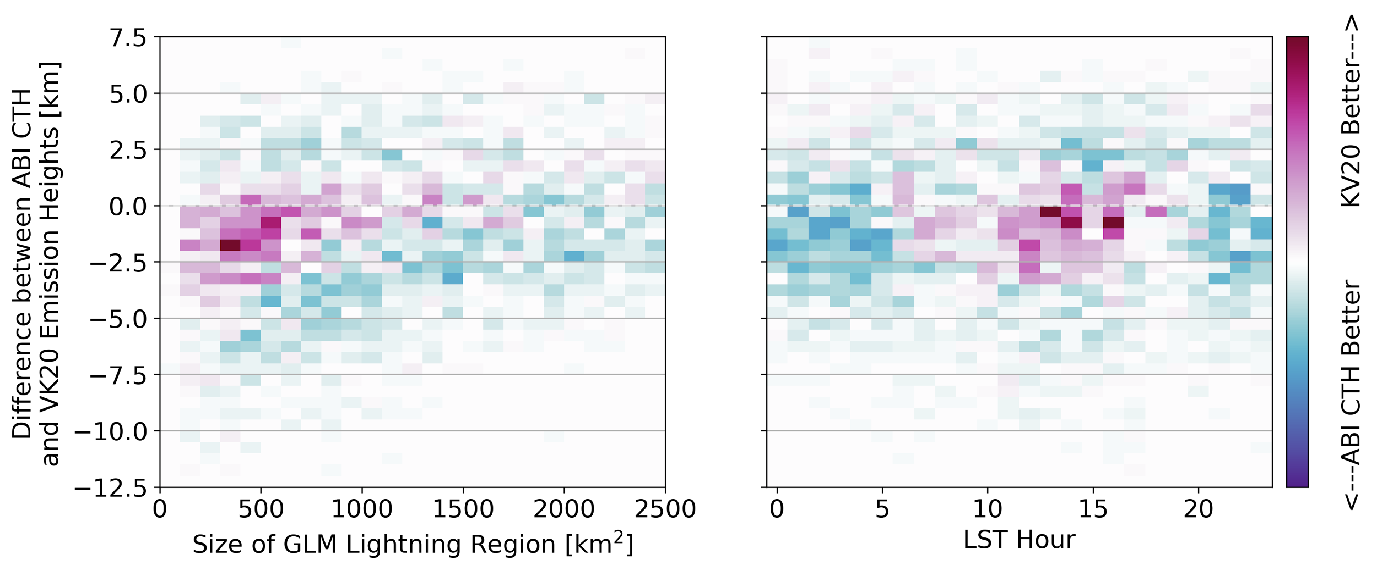
Parallax Correction Model Evaluation
When does the ABI CTH model succeed? Perform poorly? Why?
If we assume that light emission is from cloud top, then we should also assume that poor performance relates to some inaccuracy in cloud top height estimation
Can view from the perspective of how heights differ between the ABI CTH and the regional-seasonal Virts & Koshak (2020) correction
ABI CTH Taller than Coincident VK20 Height
ABI CTH More Shallow than Coincident VK20 Height

Slide 12
Parallax Correction Model Evaluation
When does the ABI CTH model succeed? Perform poorly? Why?
Implications for near real-time product:
VK20 improves over ellipsoid model as often as ABI CTH, may be used with success most of the time
Evidence that ABI CTH can improve GLM location situationally, even if it’s not the most recent data
VK20 performs best for small lightning regions
VK20 performs best with daytime lightning, especially in the mid-afternoon
ABI CTH performs best overnight
ABI CTH performs best at extreme CTH departure from VK20 model height at all size ranges

Slide 13
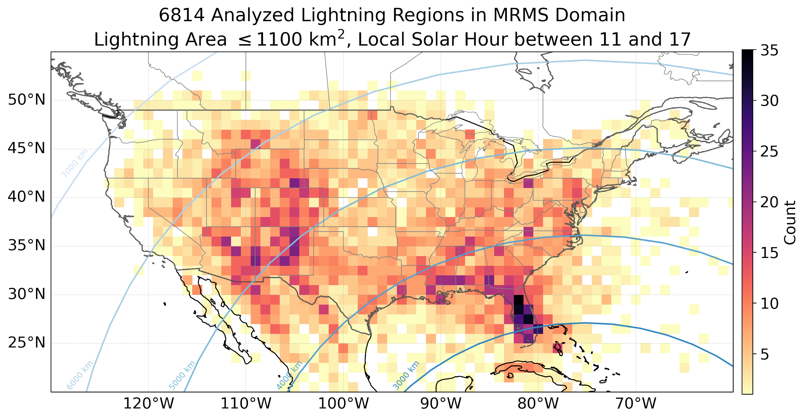
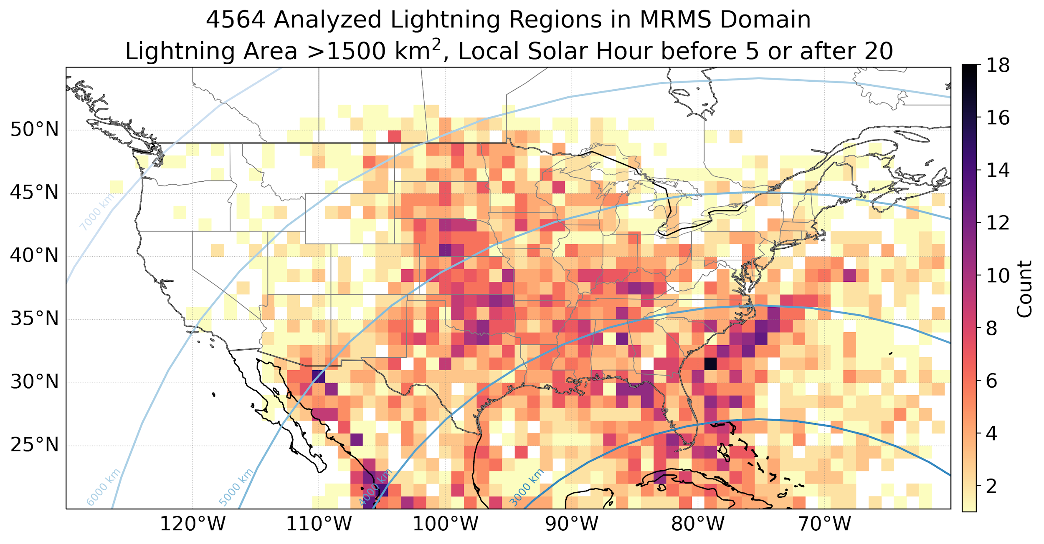
Parallax Correction Model Evaluation
Parallax correction in near real-time:
VK20 improves over ellipse model and may be used most of the time
Evidence that ABI CTH can improve GLM location situationally
Small daytime convection, with hotspots over FL peninsula (sea breeze, pop-up) and lee of the Rockies
Large, nocturnal patterns indicative of MCS activity

Slide 14
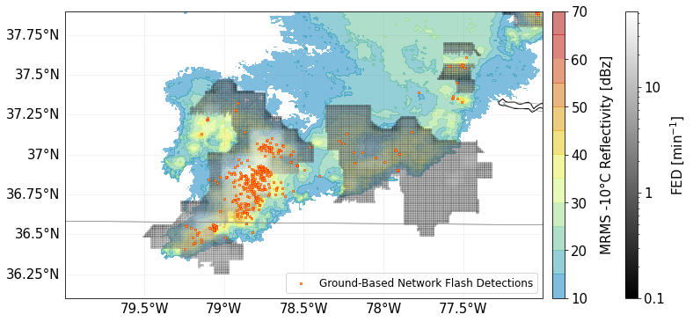
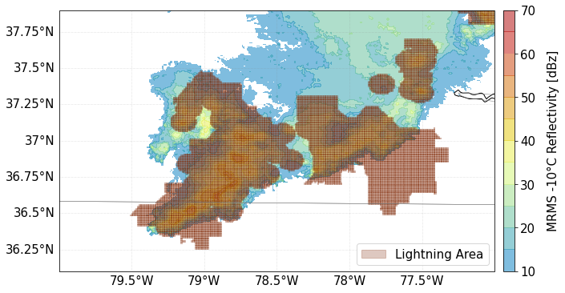
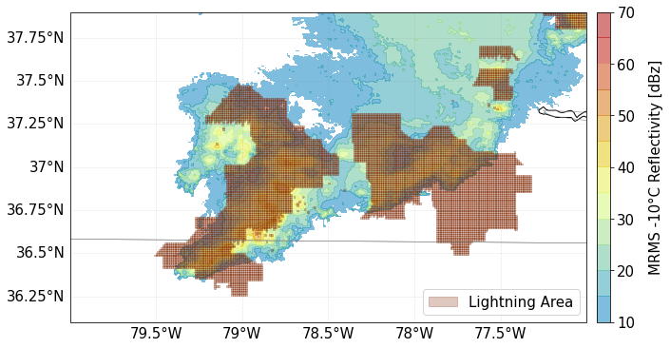
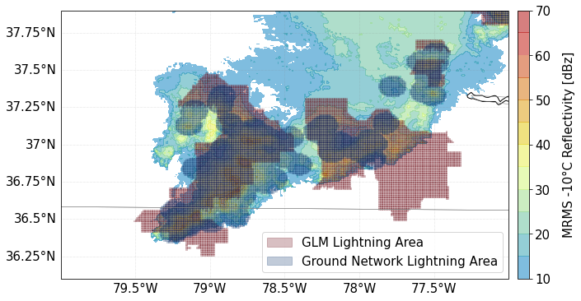
Conceptualization of combined data
sarah.stough@noaa.gov
Challenges/issues to solve in near real-time:
Have about 1 minute to make parallax correction decision & compute, then generate combined grid
Data will occasionally be missing (GLM, ABI, ENTLN, NLDN…)
Still assume light comes from cloud top
Data combination is not a new idea, not a one-size-fits-all solution
“Good” solution often depends on user, their experience (e.g., prefer point data information to gridded data)
Grid
+
Point

Slide 15
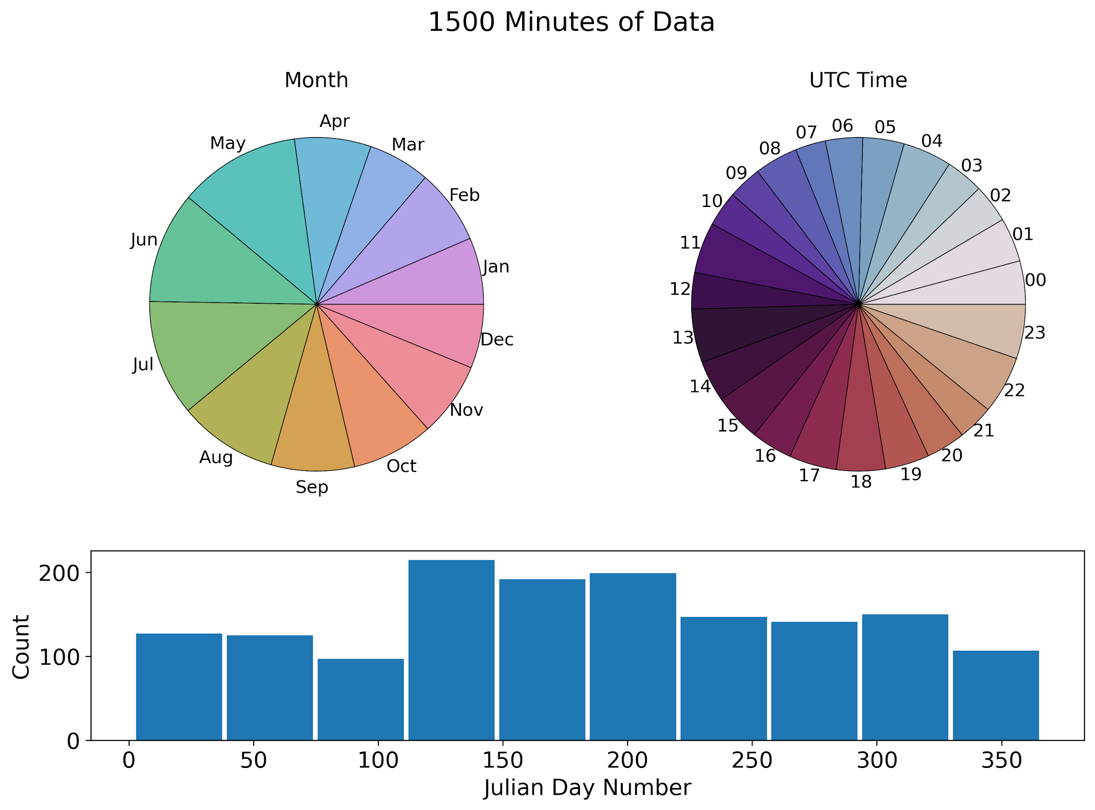
Dataset representation

