Slide 1
GLM Validation of Thunderstorm ‘First Flashes’
Kevin Thiel_{1,2,3,4}, Kristin Calhoun₃, Michael Stock_{1,3}, Jacquelyn Ringhausen₅, Sarah Stough_{1,3}, Vanna Chmielewski₃
1.OU-CIWRO 2.SPC 3.NSSL 4.OU-SoM 5.AEM
2024 GLM Science Meeting
25 September 2024

Slide 2
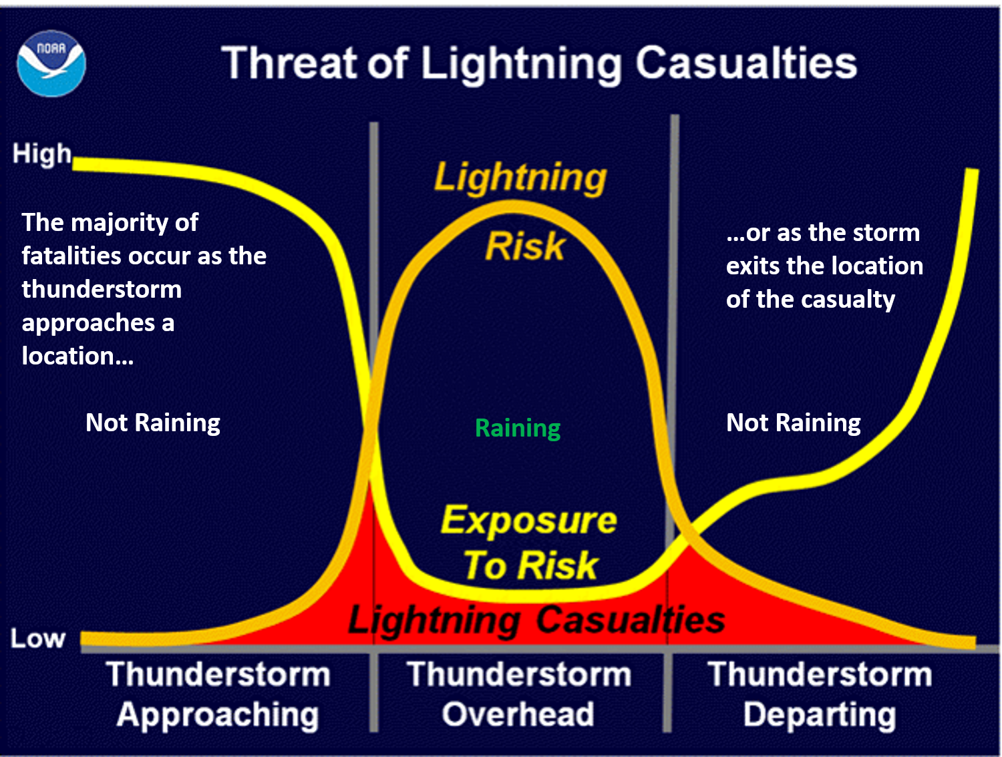
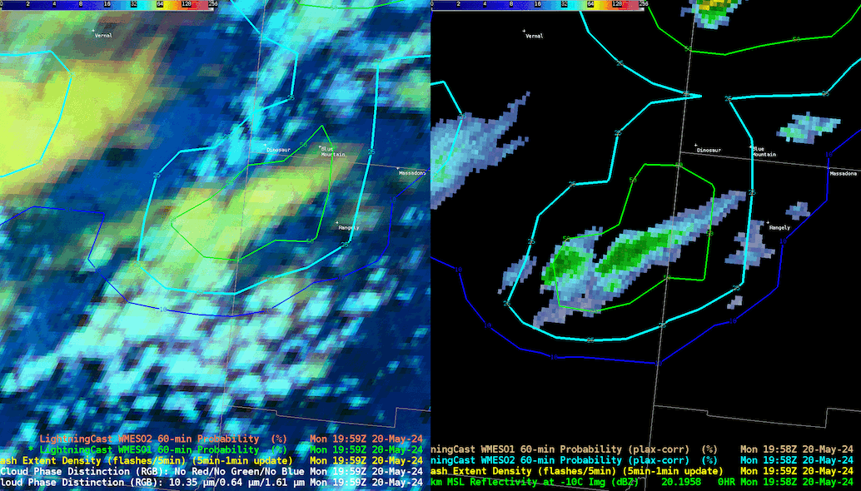
What is a ‘first flash’ and why does it matter?
Definition: The first lightning flash a thunderstorm produces
Public hazard
Nowcasting for developing convection:
CG flashes (Reflectivity based)
Total lightning (e.g. LightningCast)
Study | -10˚C dBZ | POD | FAR
Buechler and Goodman (1990) | 40 dBZ | 1.00 | 0.20
Hondl and Eilts (1994) | 10 dBZ | 1.00 | 0.18
Gremillion and Orville (1999) | 40 dBZ | 0.84 | 0.07
Vincent et al. (2004) | 35 dBZ | 1.00 | 0.41
Wolf (2007) | 40 dBZ | 0.96 | 0.11
Adapted from Mosier et al (2010)

Slide 3
What is a ‘first flash’ and why does it matter?
Definition: The first lightning flash a thunderstorm produces
Public hazard
Nowcasting for developing convection:
CG flashes (Reflectivity based)
Total lightning (e.g. LightningCast)
Research Questions
What do ‘first flashes’ look like from multiple lightning location systems?
How well does each network detect first flashes?
What are the convective signals that coincide with first flashes?
How do they change across the CONUS?
Study | -10˚C dBZ | POD | FAR
Buechler and Goodman (1990) | 40 dBZ | 1.00 | 0.20
Hondl and Eilts (1994) | 10 dBZ | 1.00 | 0.18
Gremillion and Orville (1999) | 40 dBZ | 0.84 | 0.07
Vincent et al. (2004) | 35 dBZ | 1.00 | 0.41
Wolf (2007) | 40 dBZ | 0.96 | 0.11
Adapted from Mosier et al (2010)

Slide 4
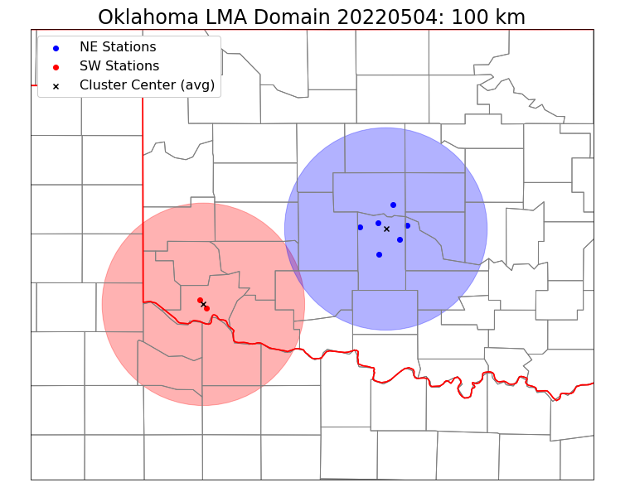
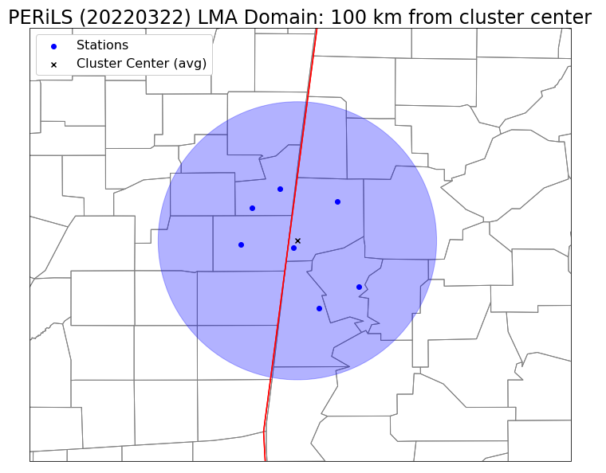
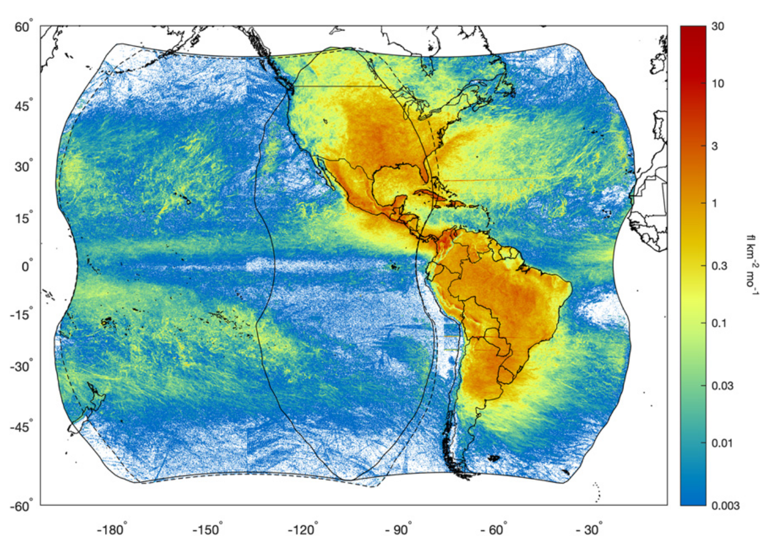
Lightning Datasets
NSSL Mobile LMA
*PERiLS IOP1, 22 March 2022
Oklahoma LMA
*NE cluster, 4 May 2022
GOES-16 GLM (GLM16)
GOES-17 GLM (GLM17)
Earth Networks Total Lightning Network (ENI)
Rudlosky and Virts 2021

Slide 5
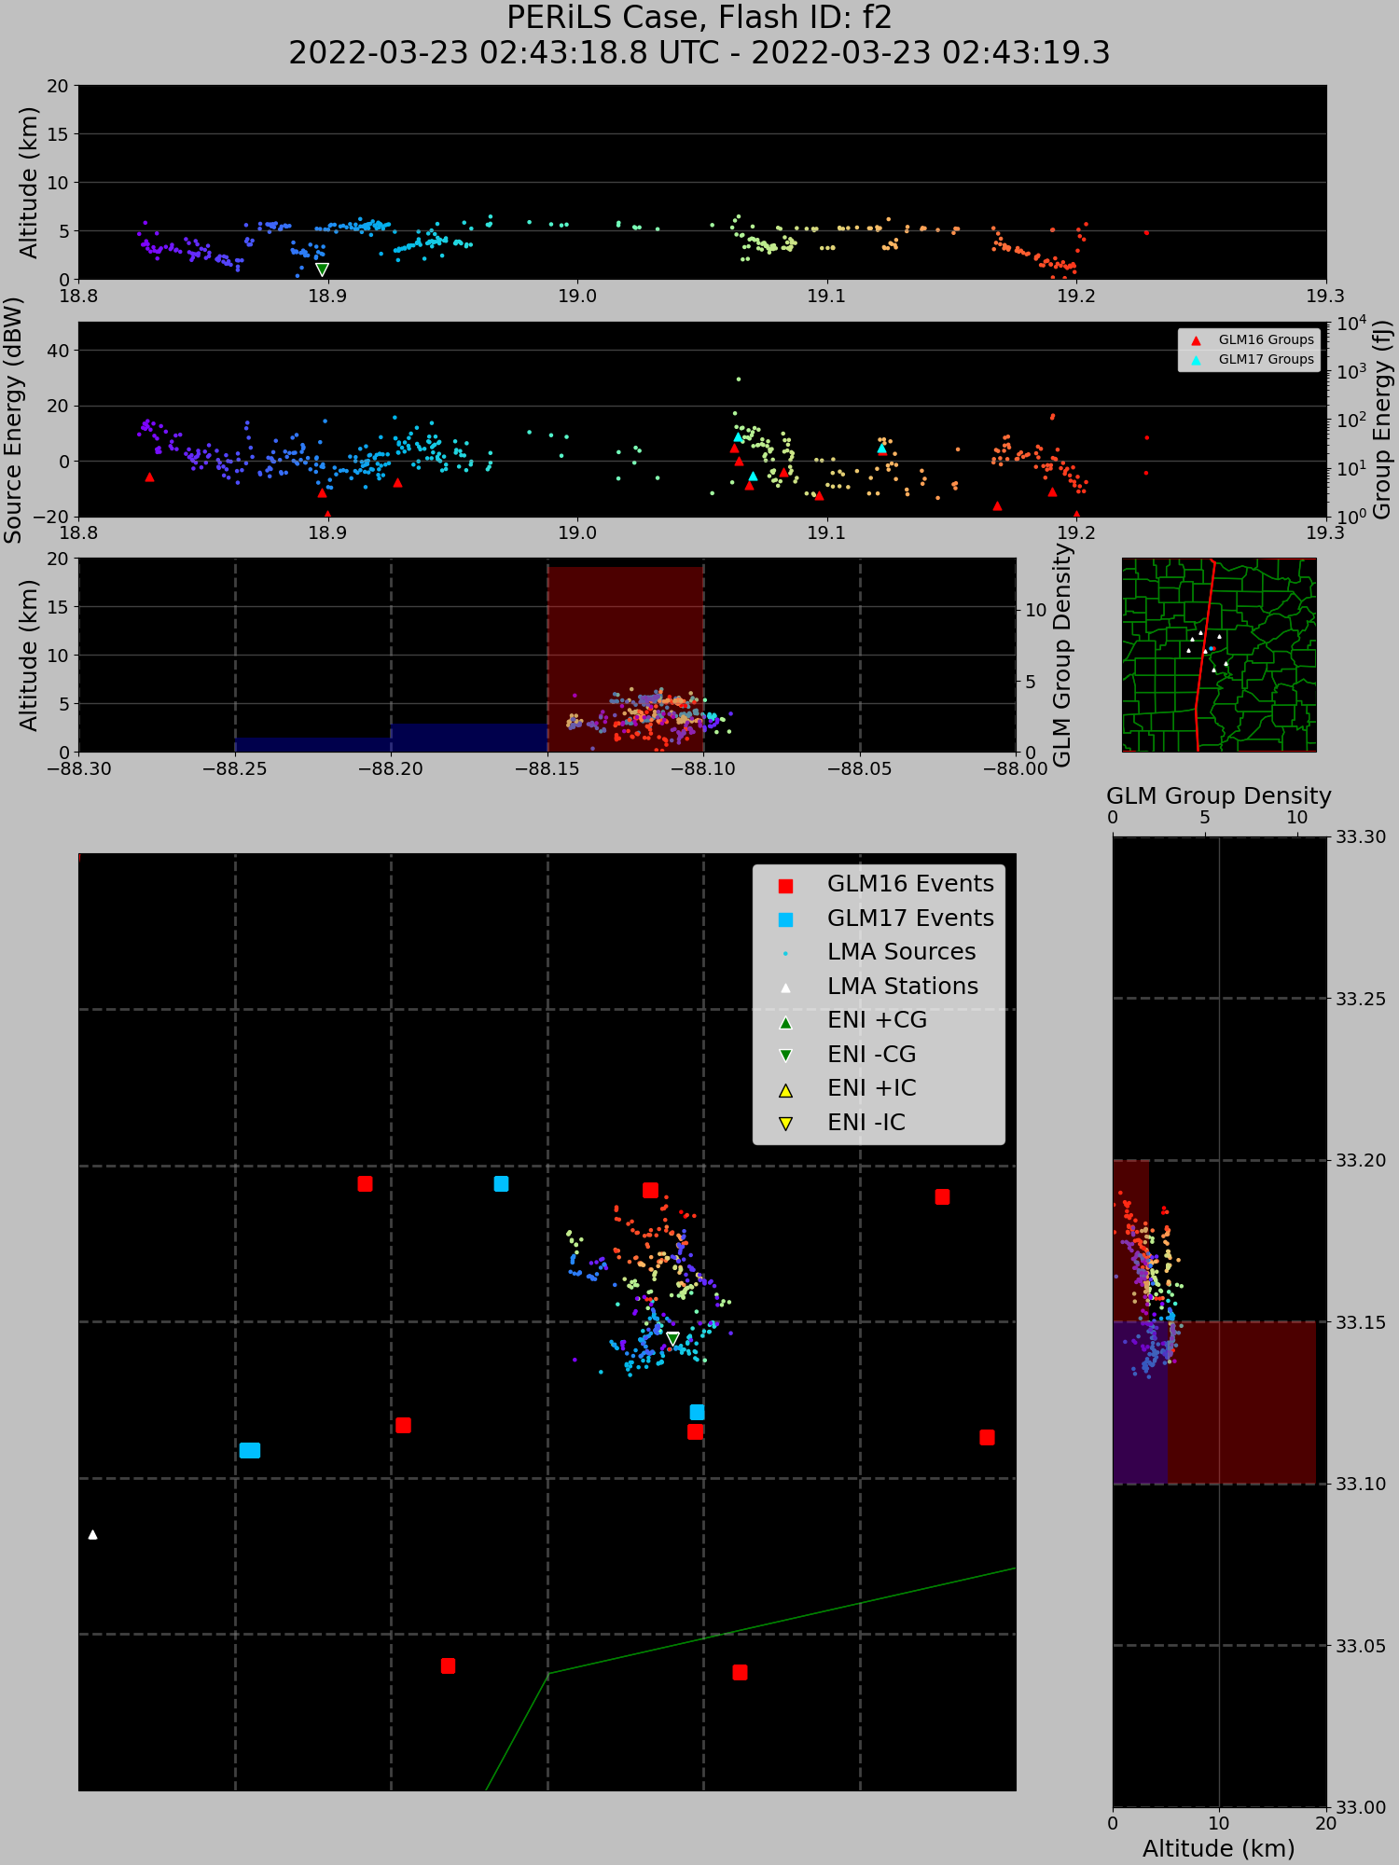
First flashes from multiple networks...
LMA Heights/Time
ENI Flash Time
LMA Source Energy/Time
GLM Group Energy/Time
GLM Group Density (Lon)
LMA Lon./Height
GLM Group Density (Lat)
LMA Lat/Height
LMA Source Lat/Lon
GLM Event Lat/Lon
ENI Flash Lat/Lon

Slide 6
PERiLS Flash
-CG: 2 return strokes (-6.6 kA)
Minimum event energies:
GLM16: 0.95 fJ
GLM17: 6.83 fJ
Peak in LMA source energy and GLM16/17 group energy ~19.05 s
LMA sources <5 km
Flash areas:
LMA: 24.3 km²
GLM16: 554 km²
GLM17: 224 km²

Slide 7
OK-LMA Flash
Missed by Earth Networks and GLM17
LMA sources ~10 km w/energies ~20 dBW
Most probable: - IC flash
Minimum event energy:
GLM16: 3.01 fJ
Flash areas:
GLM16: 150 km²
LMA: 6.8 km²

Slide 8
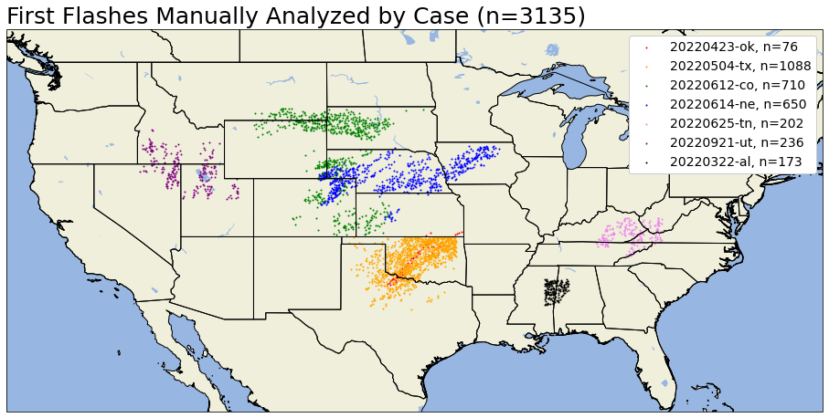
How do we find first flashes to study them in bulk?
Time and distance from other flashes
Most lenient (10 minutes, 10 km) as baseline for manual analysis
Is it a first flash? How confident?
Where did the flash occur? (Convection, anvil, stratiform, etc.)

Slide 9
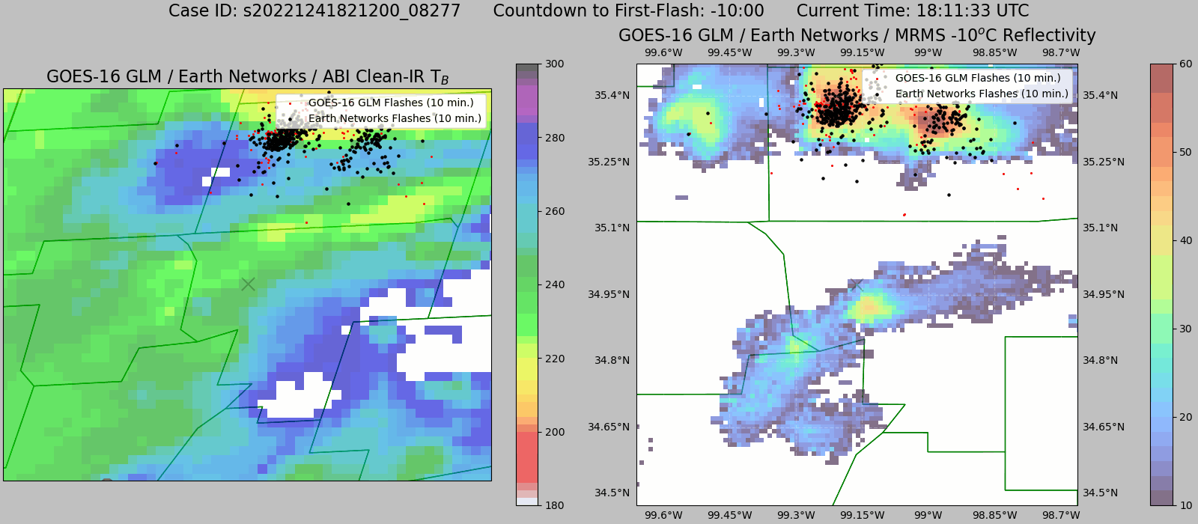
Example: Hit – High confidence – Convective Core
Most common type of ‘Hit’. Some first flashes close (<20 km) to adjacent convection.

Slide 10
Example: False alarm – High confidence – Anvil
Most common ‘False Alarm’. Other sources: Location errors, stratiform precip regions.

Slide 11
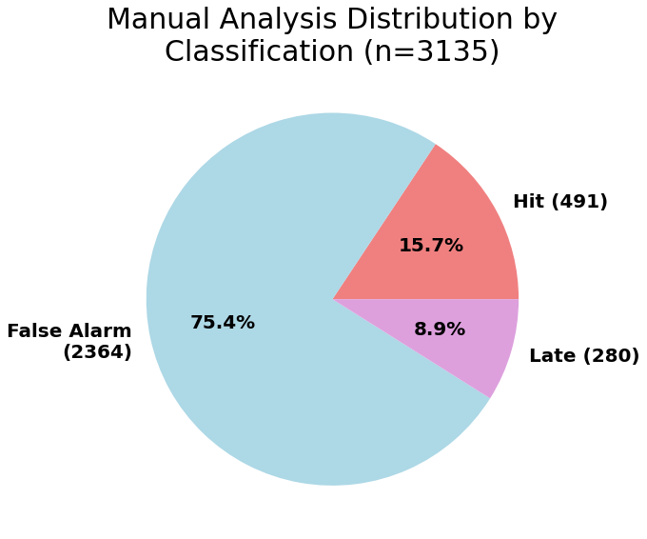
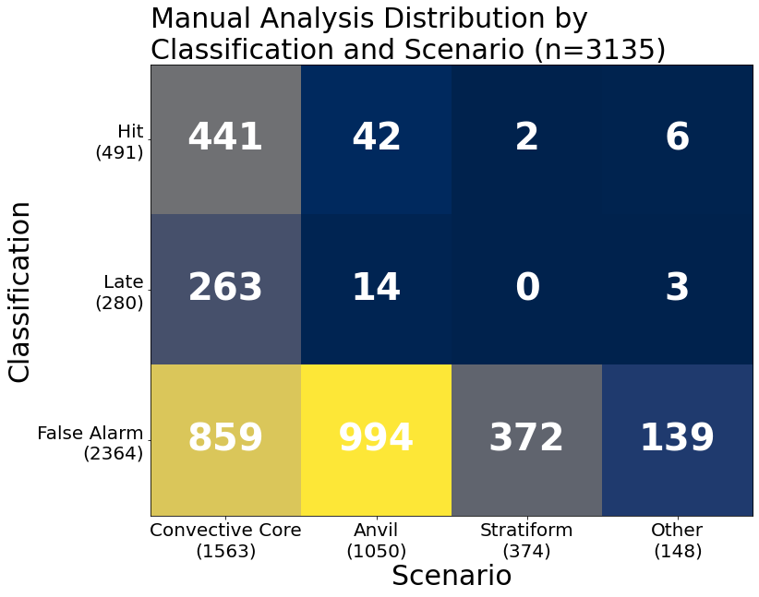
Was it a first flash, false alarm, or ‘late’?
Where did these classifications occur?

Slide 12
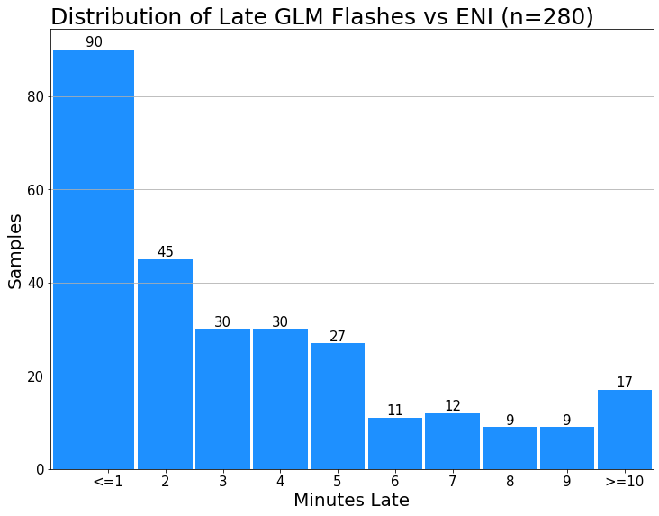
Was it a first flash, false alarm, or ‘late’?
Where did these classifications occur?

Slide 13
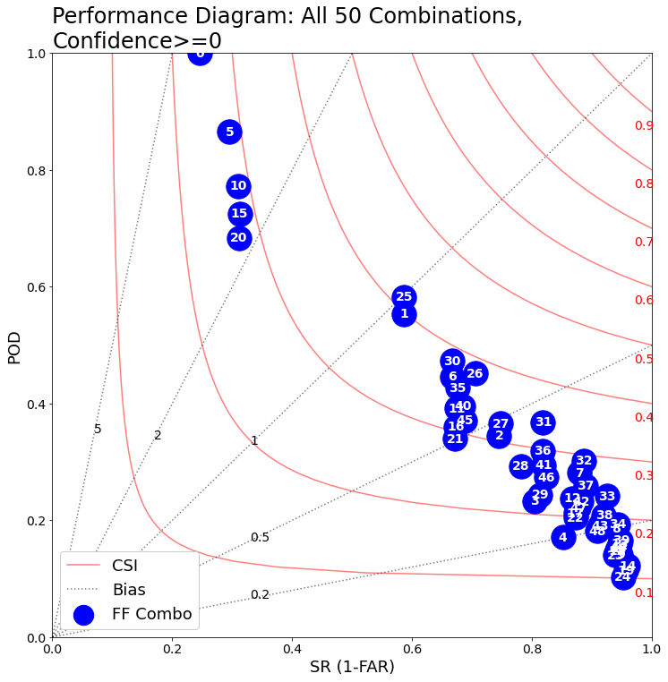
How do more stringent combinations perform against this baseline?
Baseline
50 different combinations
POD and FAR for each wrt baseline (0)
Sensitive to changes in distance
Subjective Winner: #32
20 minutes, 20 km + flash area radius
Penalize larger anvil flashes that ‘break’ the distance criterion
More sensitive to false alarms to capture convective signals

Slide 14
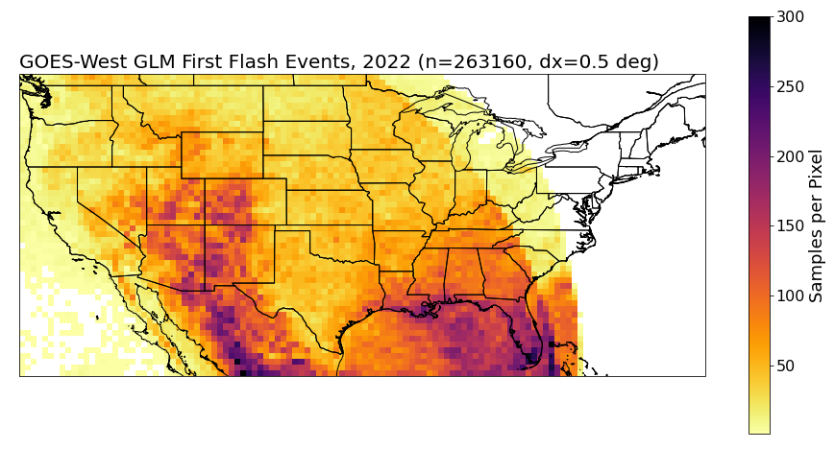
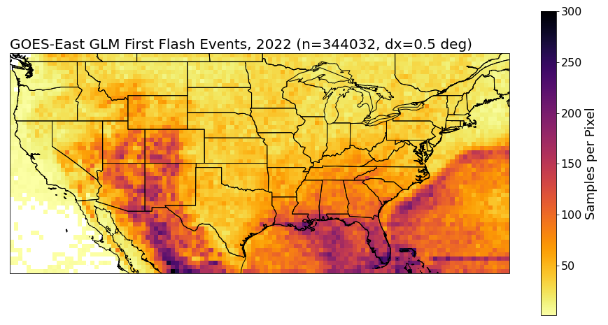
Summary
What do ‘first flashes’ look like from multiple lightning location systems?
Small areal extent, low luminosity
GLM detection of first flashes depends on instrument sensitivity (min. event energy) → 5-10% of first flashes missed (wrt Earth Networks)
What are the convective signals that coincide with first flashes?
Stay tuned!
kevin.thiel@noaa.gov

Slide 15
References
Buechler, D. E., and S. J. Goodman, 1990: Echo Size and Asymmetry: Impact on NEXRAD Storm Identification. Journal of Applied Meteorology and Climatology, 29, 962–969, https://doi.org/10.1175/1520-0450(1990)029<0962:ESAAIO>2.0.CO;2.
Gremillion, M. S., and R. E. Orville, 1999: Thunderstorm Characteristics of Cloud-to-Ground Lightning at the Kennedy Space Center, Florida: A Study of Lightning Initiation Signatures as Indicated by the WSR-88D. Weather and Forecasting, 14, 640–649, https://doi.org/10.1175/1520-0434(1999)014<0640:TCOCTG>2.0.CO;2.
Hondl, K. D., and M. D. Eilts, 1994: Doppler Radar Signatures of Developing Thunderstorms and Their Potential to Indicate the Onset of Cloud-to-Ground Lightning. Mo. Wea. Rev., 122, 1818–1836, https://doi.org/10.1175/1520-0493(1994)122<1818:DRSODT>2.0.CO;2.
Mosier, R. M., C. Schumacher, R. E. Orville, and L. D. Carey, 2011: Radar Nowcasting of Cloud-to-Ground Lightning over Houston, Texas. Weather and Forecasting, 26, 199–212, https://doi.org/10.1175/2010WAF2222431.1.
Rudlosky, S. D., and K. S. Virts, 2021: Dual Geostationary Lightning Mapper Observations. Monthly Weather Review, 149, 979–998, https://doi.org/10.1175/MWR-D-20-0242.1.
Wolf, P., 2006: Anticipating the Initiation, Cessation, and Frequency of Cloud-to-Ground Lightning, Utilizing WSR-88D Reflectivity Data. NWA Electronic Journal of Operational Meteorology, 19.
kevin.thiel@noaa.gov

