Slide 1
Identification of
IC and CG Discharges
Based on Optical Observations
from the ISS
Mitsuteru SATO⁽¹⁾, T. Ushio⁽²⁾, Y. Sato⁽¹⁾,
B. Kittanapat⁽³⁾, and Y. Honda⁽⁴⁾
Faculty of Science, Hokkaido University
Graduate School of Engineering, Osaka University
Department of Physics, RMUTT
Center for Environmental Remote Sensing, Chiba University

Slide 2
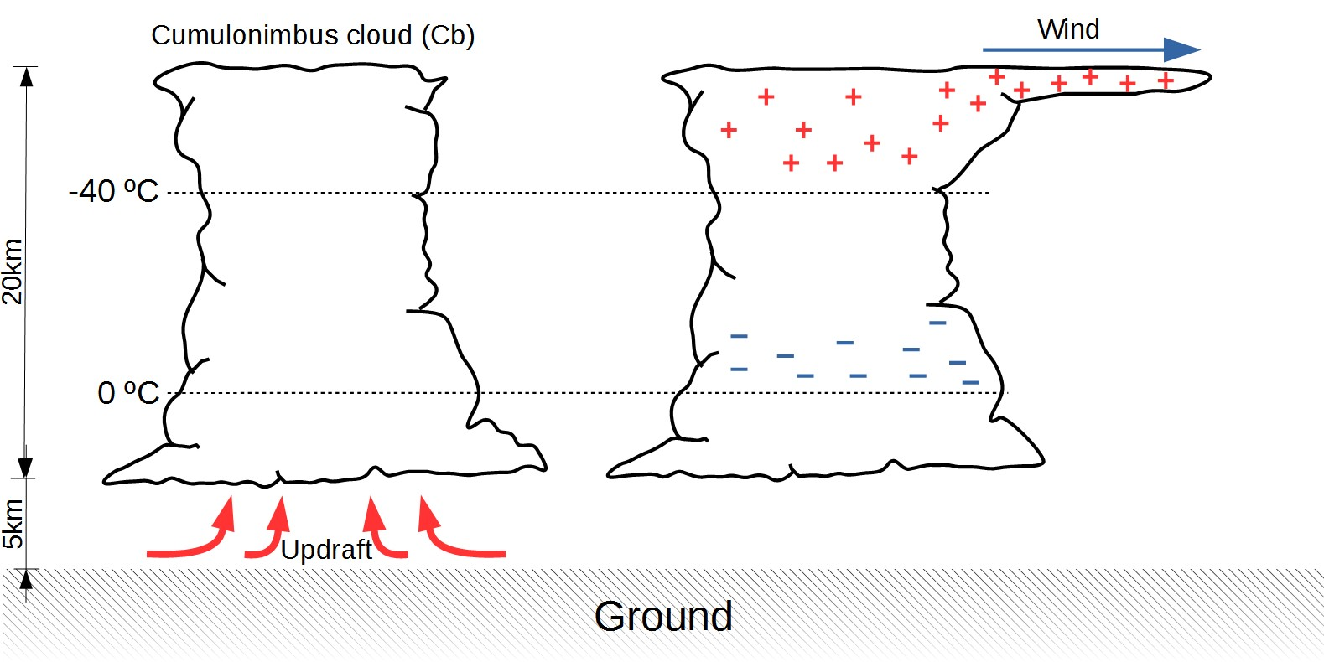
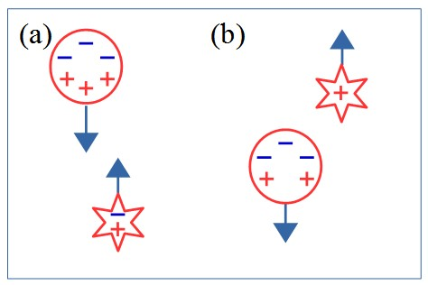
Thunderclouds and Lightning
Water droplet Ice crystal Grapuel
+CG
IC
E_{z}
-CG
- - - - - - - - + + + + + + + + + + + + - - - - - - - - -
Global rate : 44 ± 5 /s [Christian et al., 2003]
IC : +CG : -CG = 33 : 0.7 : 10 [Rakov and Uman, 2003]
Ground-based lightning networks mainly detect CG discharges.

Slide 3
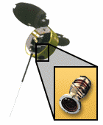
Thunderclouds and Lightning
Lightning Activities in Tornadic Storm
MicroLab-1
OTD
[Buechler et al., 2000]
Not only CG discharges but also IC discharges are important for the nowcasting and forecasting of severe weather.
Similar “Lightning Jump” is observed by GLM. [yesterday’s report]

Slide 4
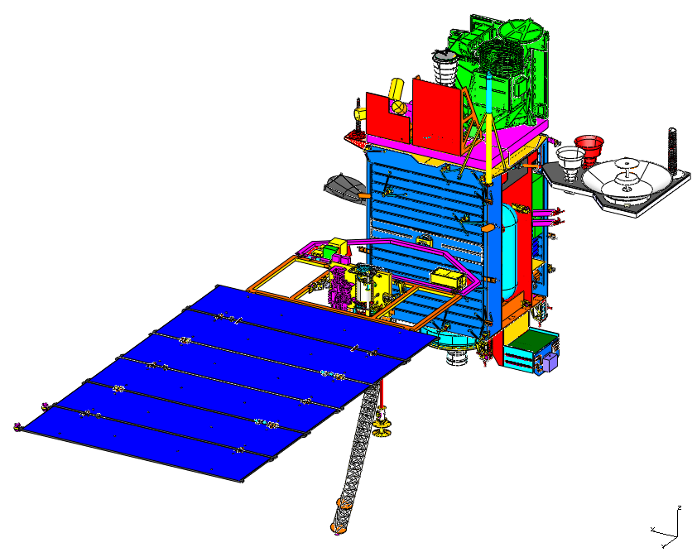
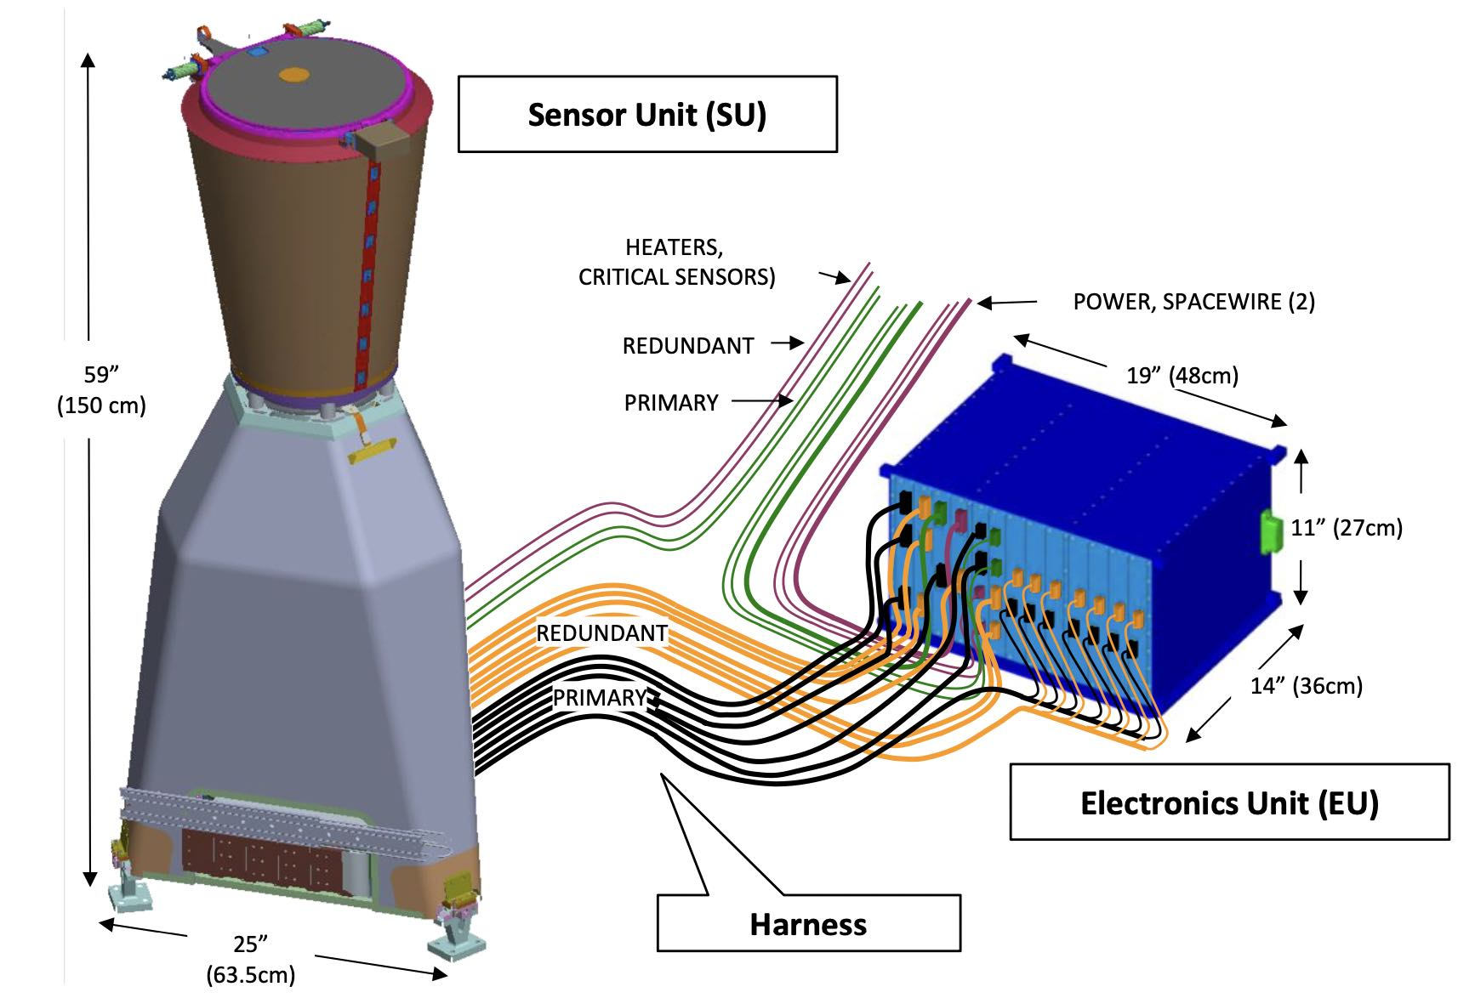
GOES-R Geostationary Lightning Mapper (GLM)
GLM
GLM
Very powerful tool to continuously monitor lightning activities in wider latitudinal/longitudinal regions in dayside/nightside from space.
OI emission (777.4 nm)
Near uniform spatial resolution/ coverage of total lightning (both IC and CG) up to 52° latitude.
Only from the GLM observations, it may be difficult to distinguish IC and CG discharges.
LIS/OTD 1997-2005
[Edgington et al., 2018]

Slide 5
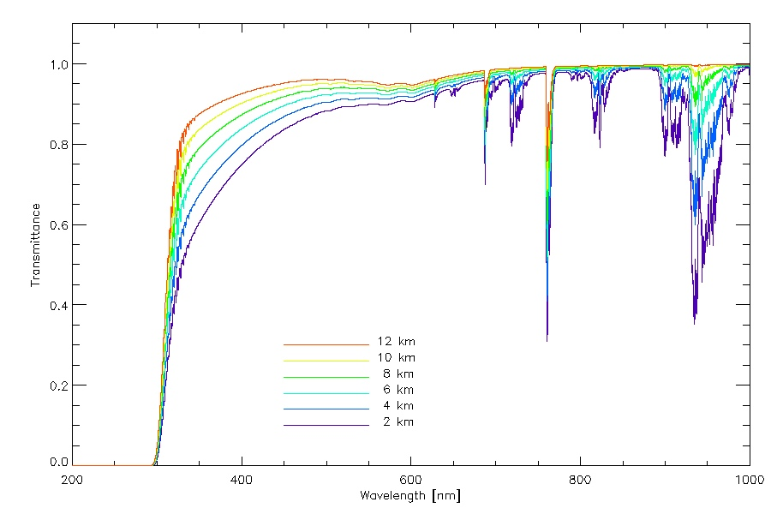
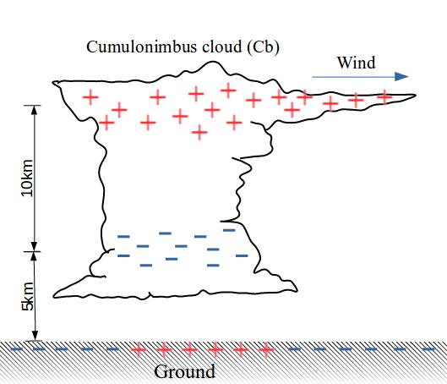
Identification of IC and CG Discharges
The intensities of blue and red emissions escaping to space are different depending on the discharge altitude.
Atmospheric Transmittance
Intensity ratio of the blue/red emissions must be a key to clarify the discharge altitude and type !!

Slide 6
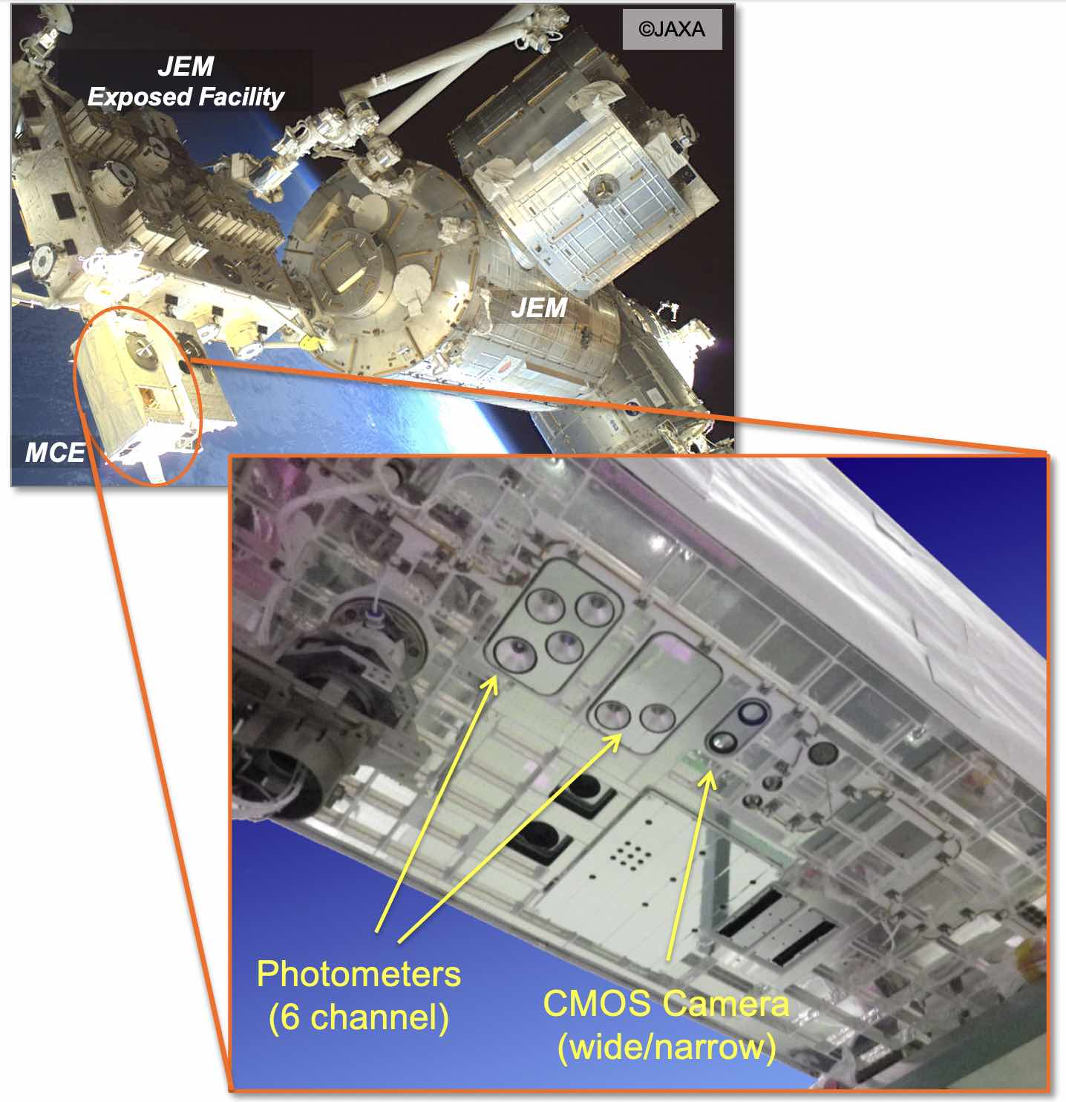
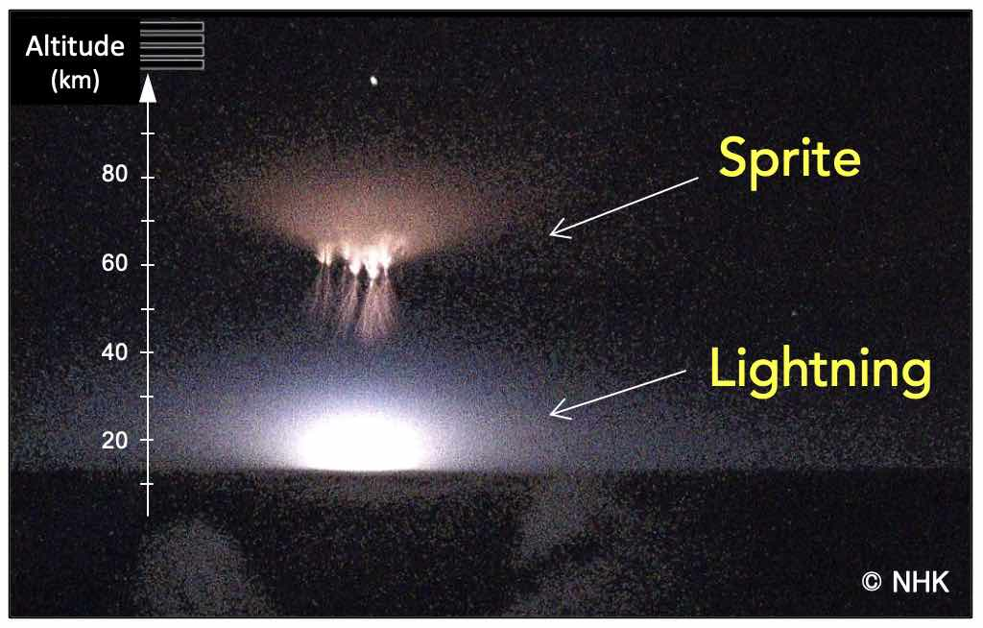
Identification of IC and CG Discharges
GLIMS Mission
Optical and electromagnetic wave observations of lightning and transient luminous events (TLEs) at the ISS in 2012-2015.
Nadir observations of lightning and TLE emissions.

Slide 7
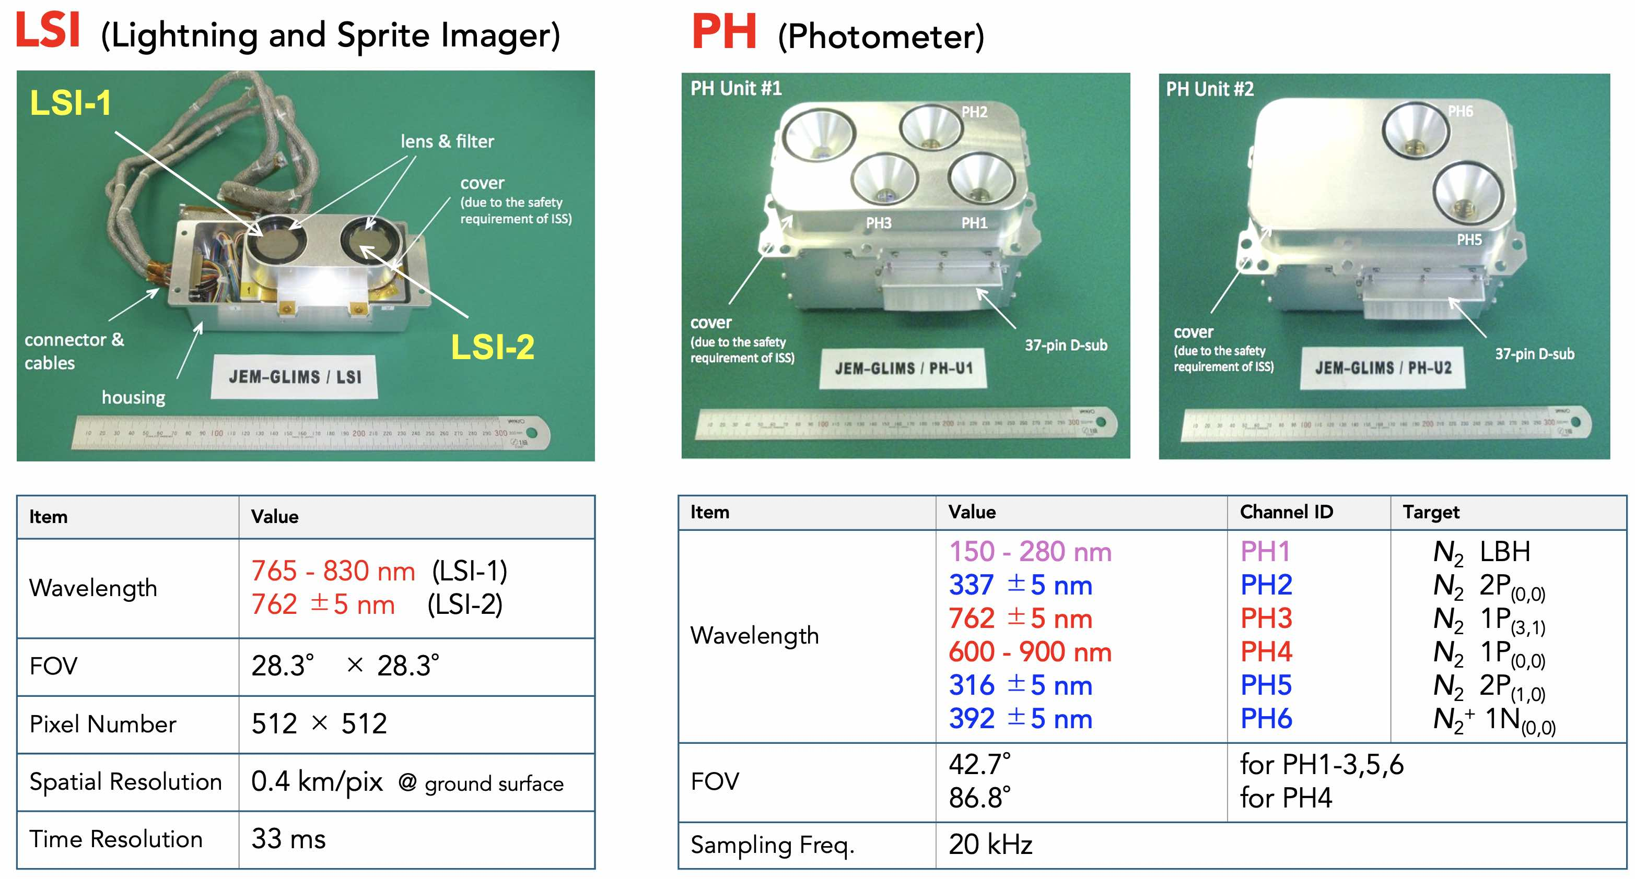
Identification of IC and CG Discharges

Slide 8
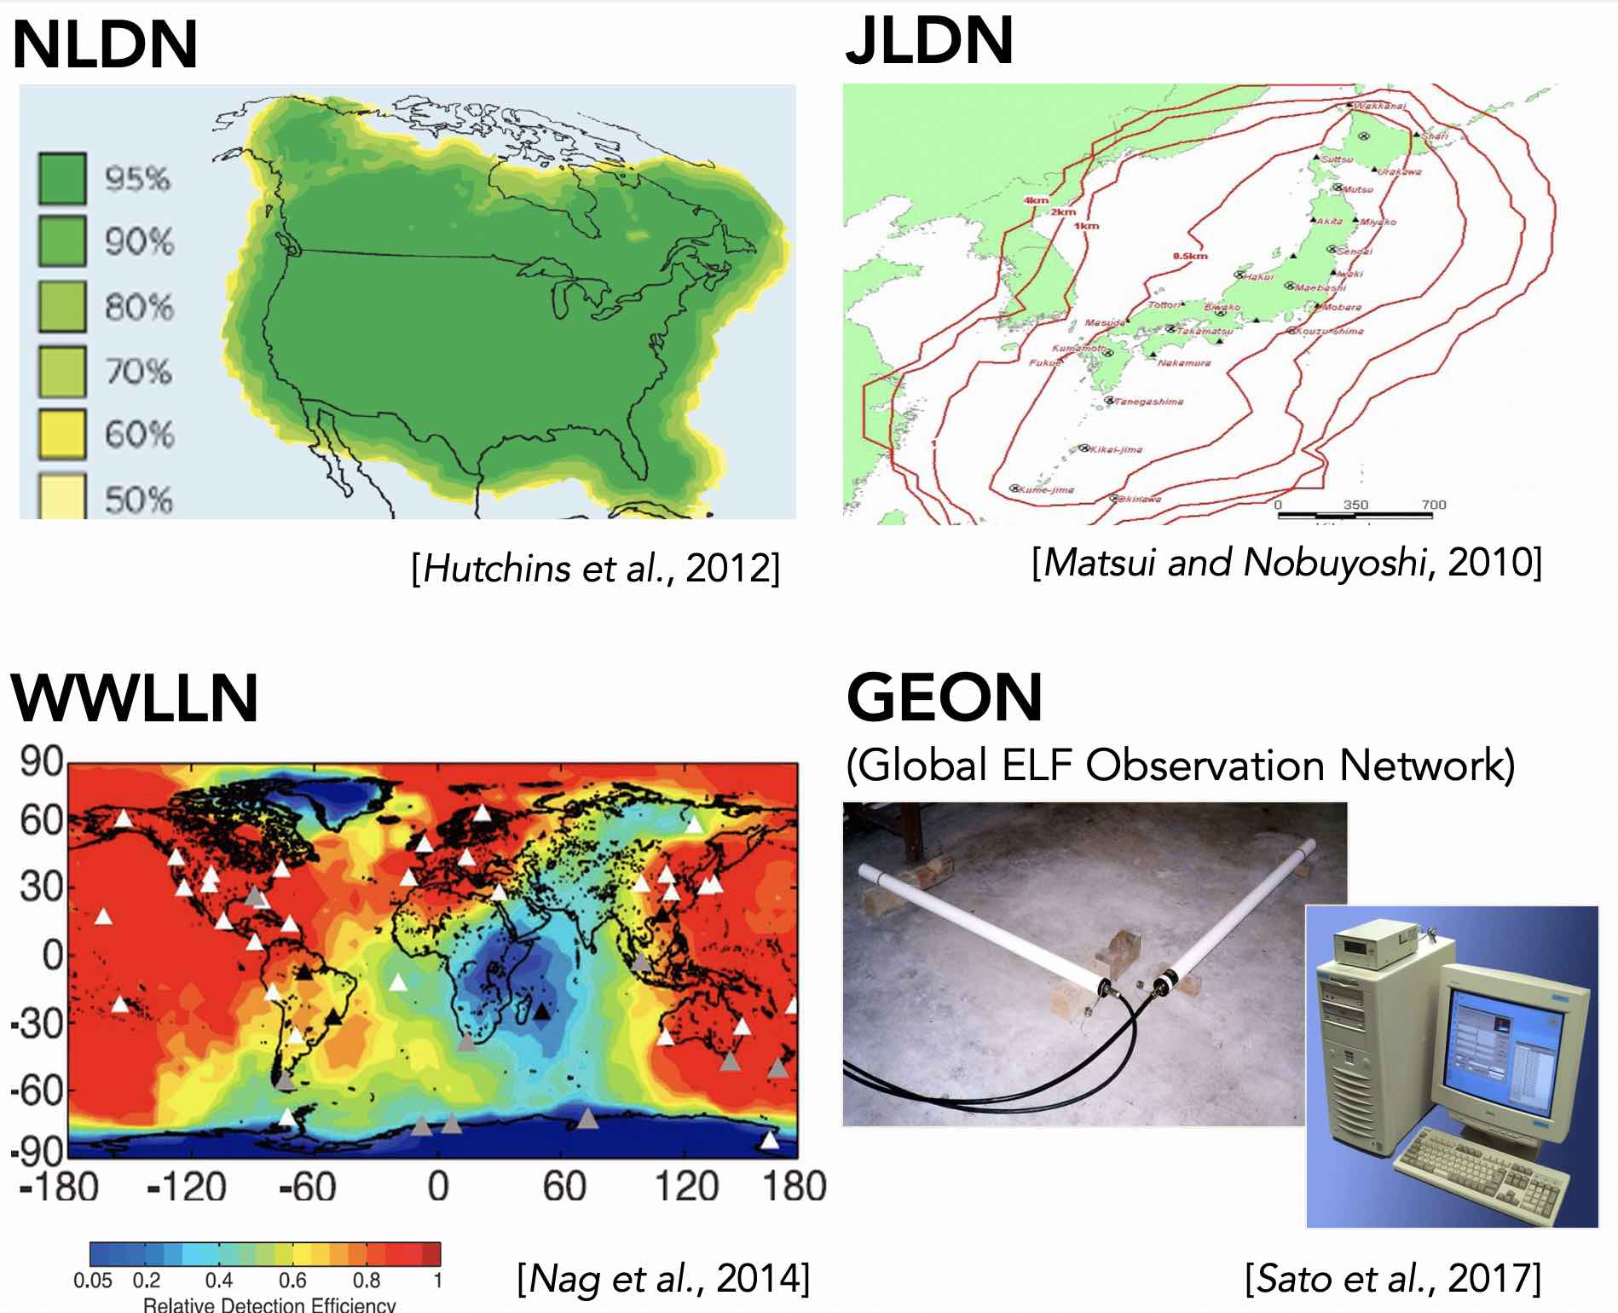
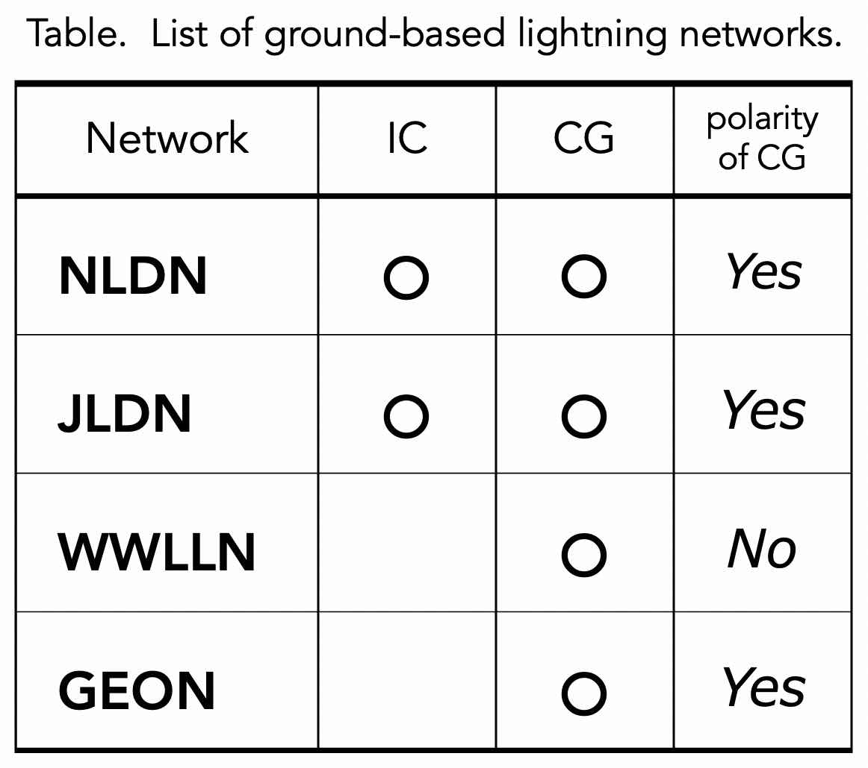
Identification of IC and CG Discharges

Slide 9
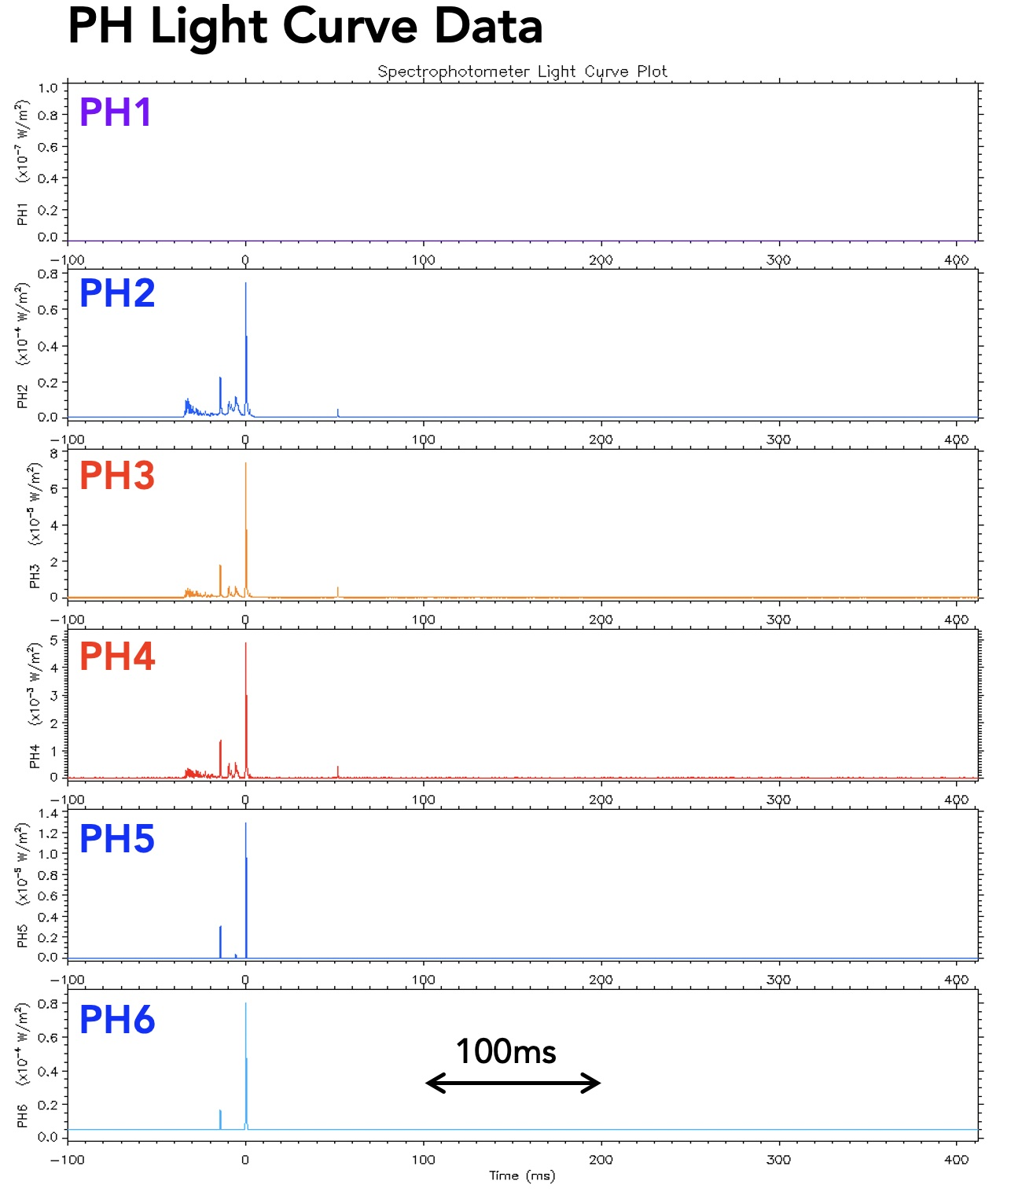
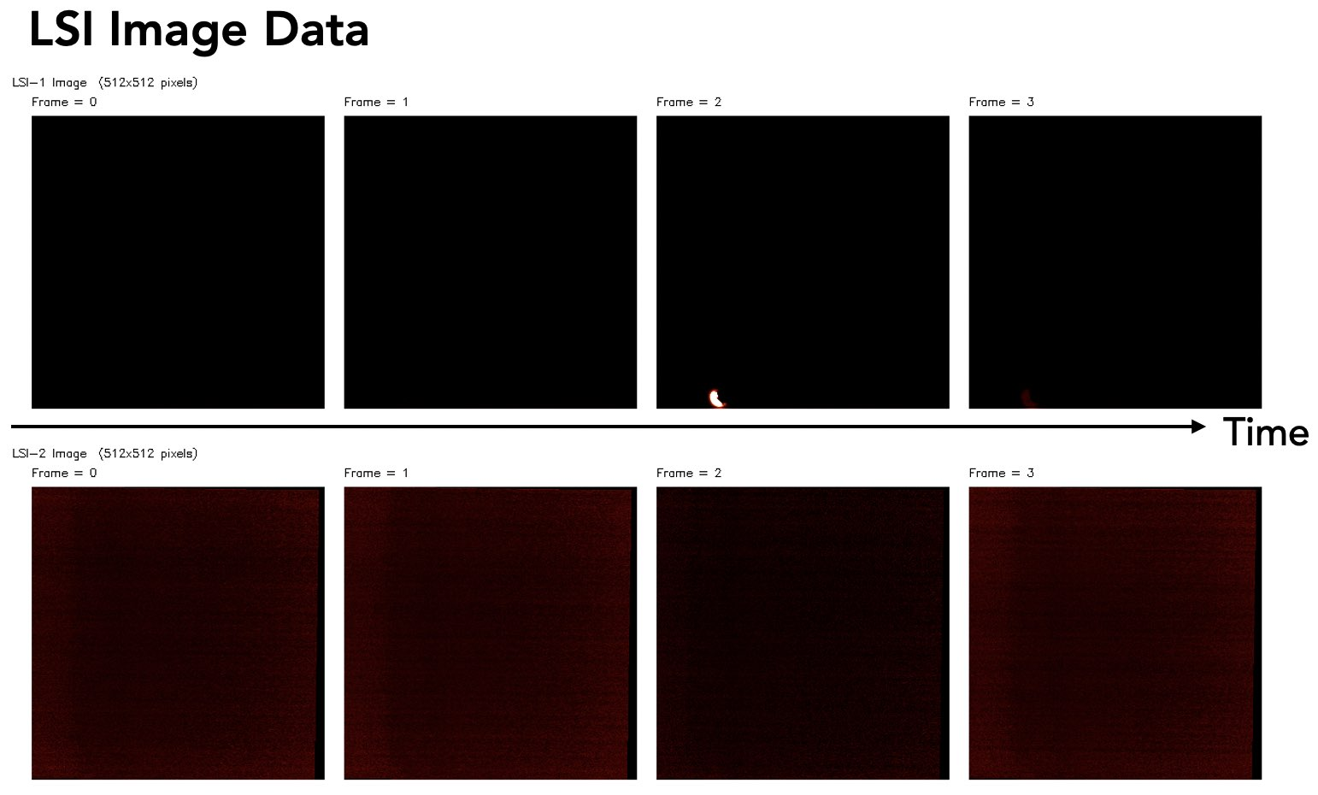
Identification of IC and CG Discharges
-CG Event
Date : 2014-08-06 17:08:14.879 UT
Location : (157.61°E, 22.62°N)
LSI-1
LSI-2

Slide 10
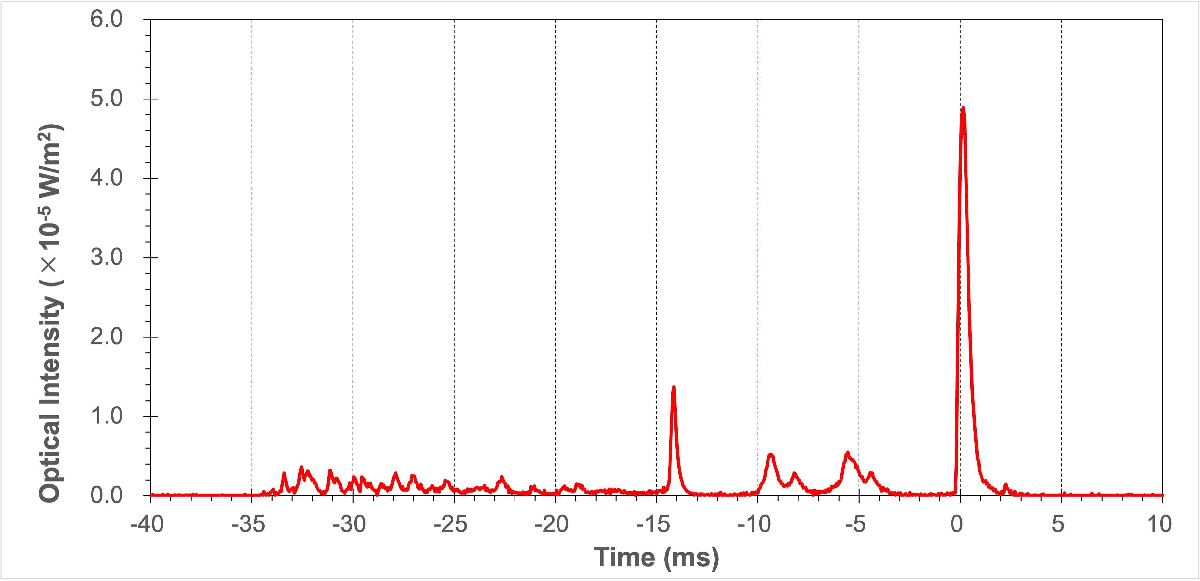
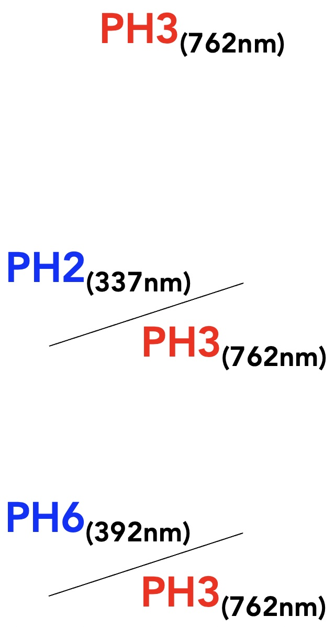
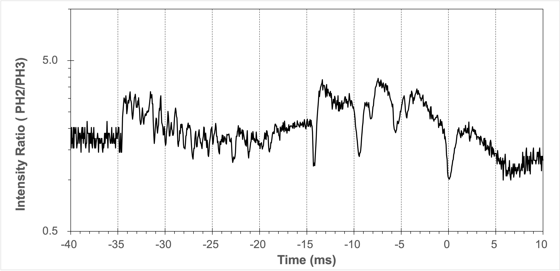
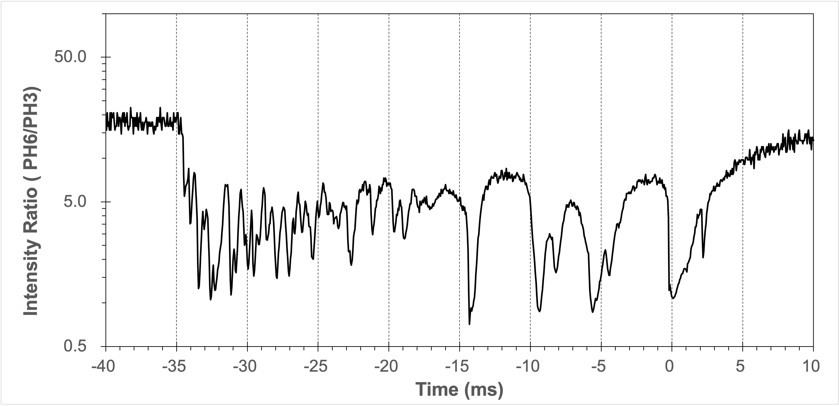
Identification of IC and CG Discharges
-CG Event
return stroke
preliminary breakdown
10 ms

Slide 11
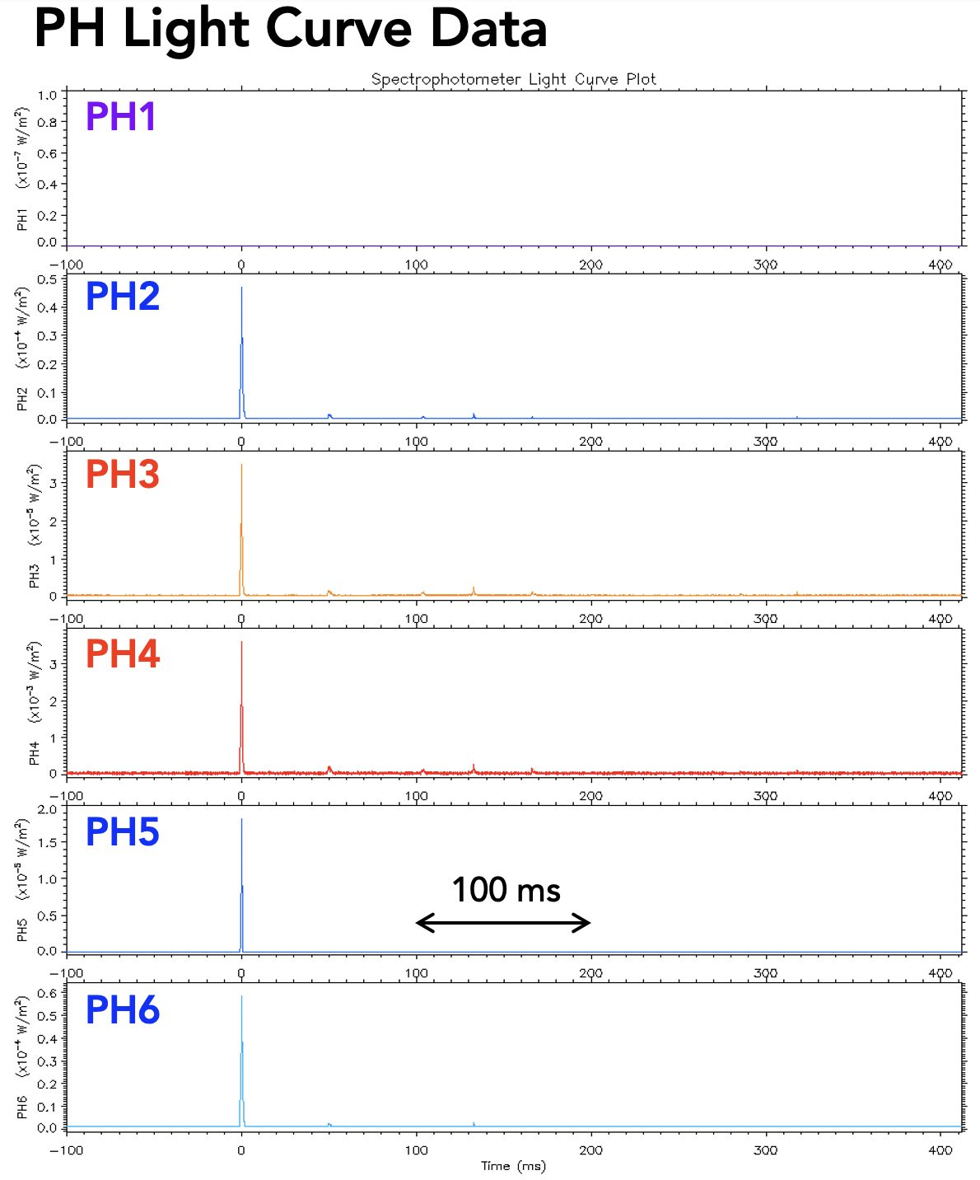
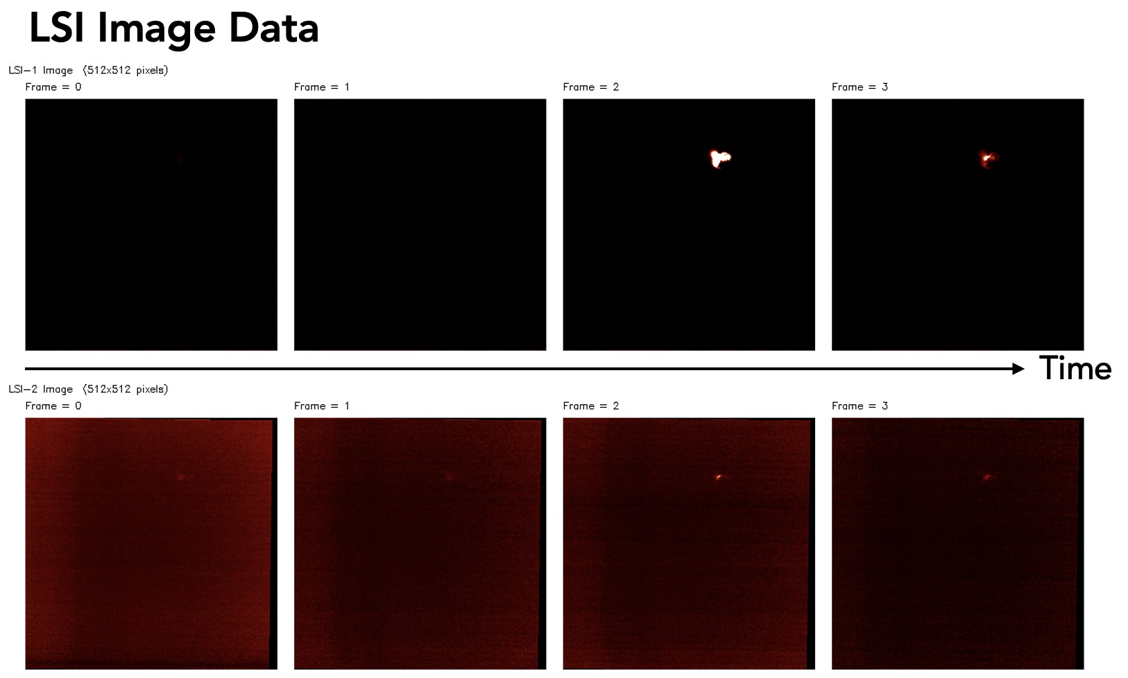
Identification of IC and CG Discharges
IC Event
Date : 2013-01-30 04:20:49.743 UT
Location : (91.65°W, 31.94°N)
LSI-1
LSI-2

Slide 12
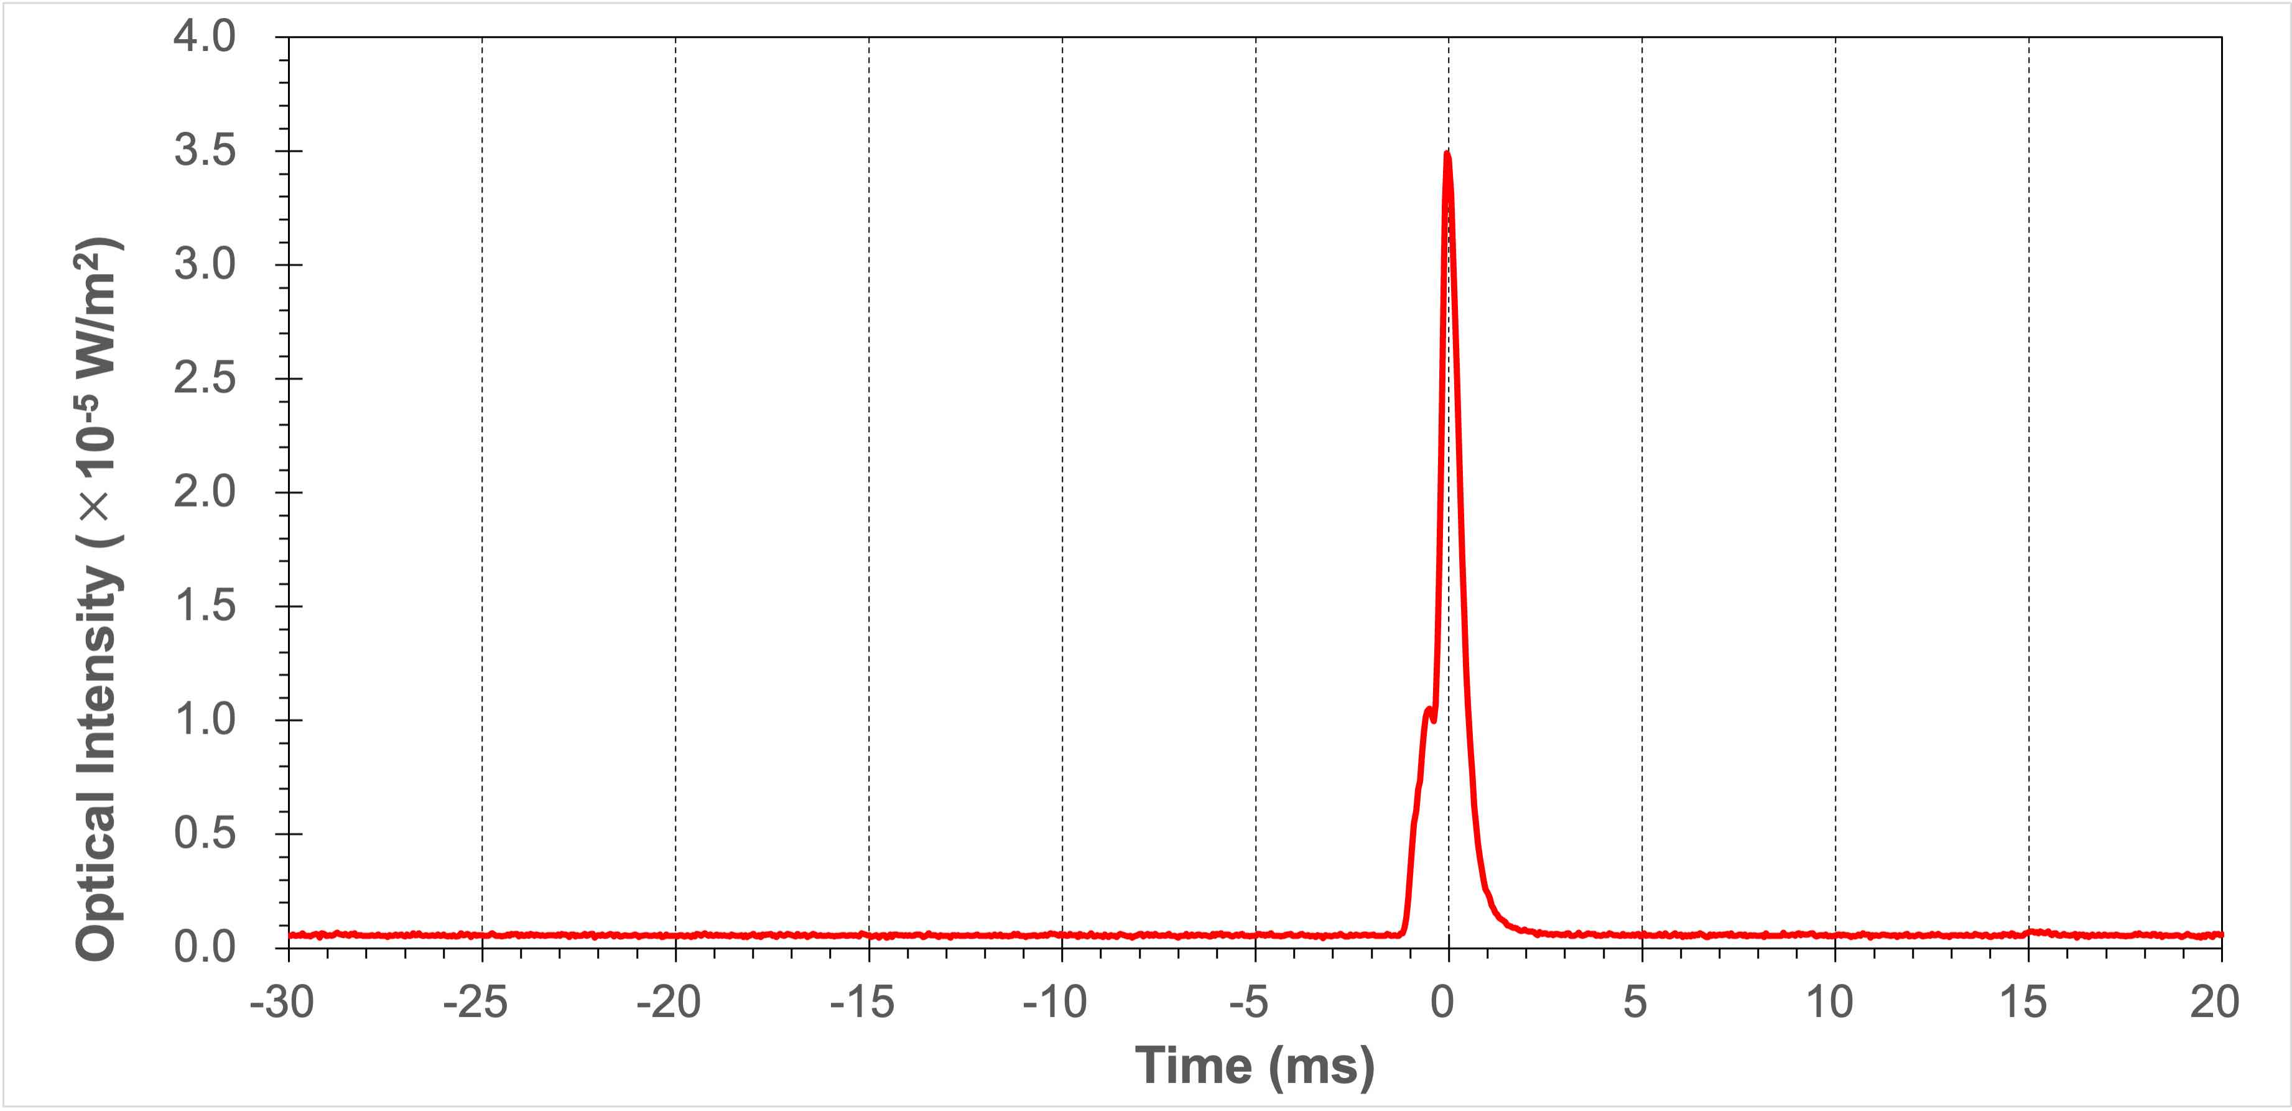
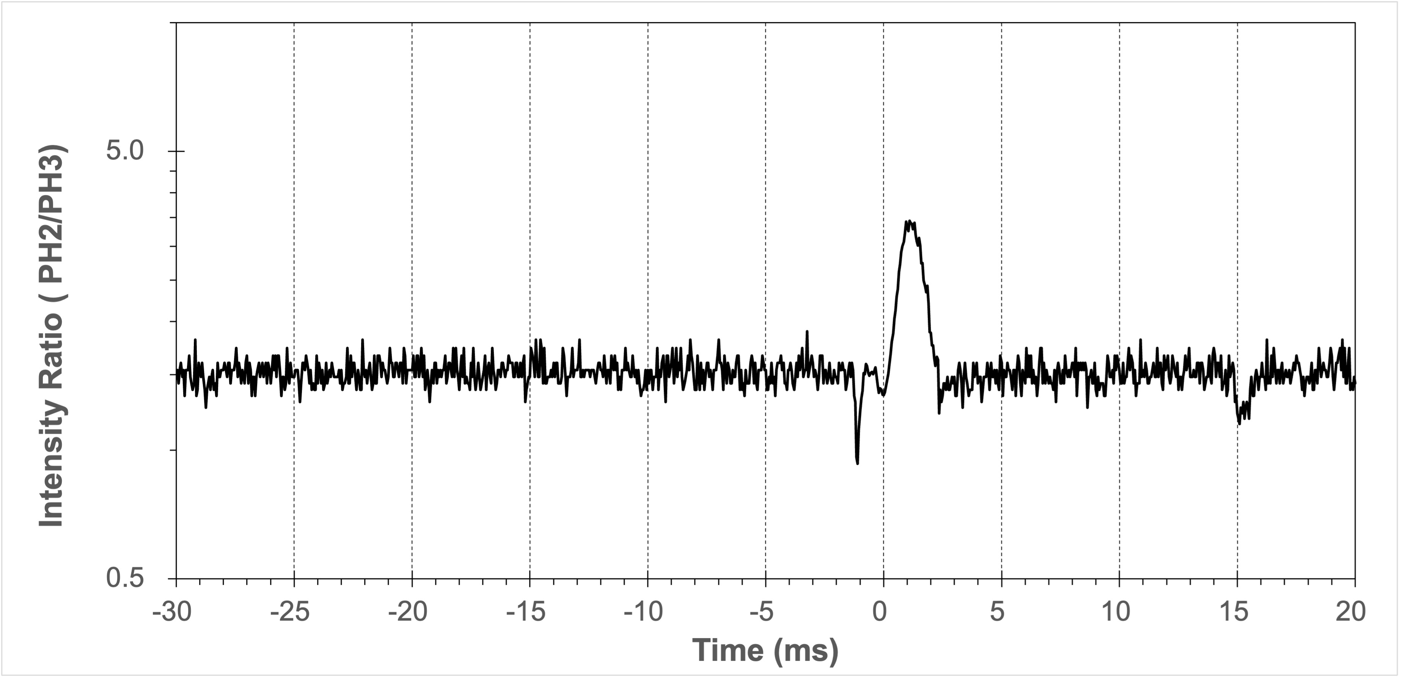
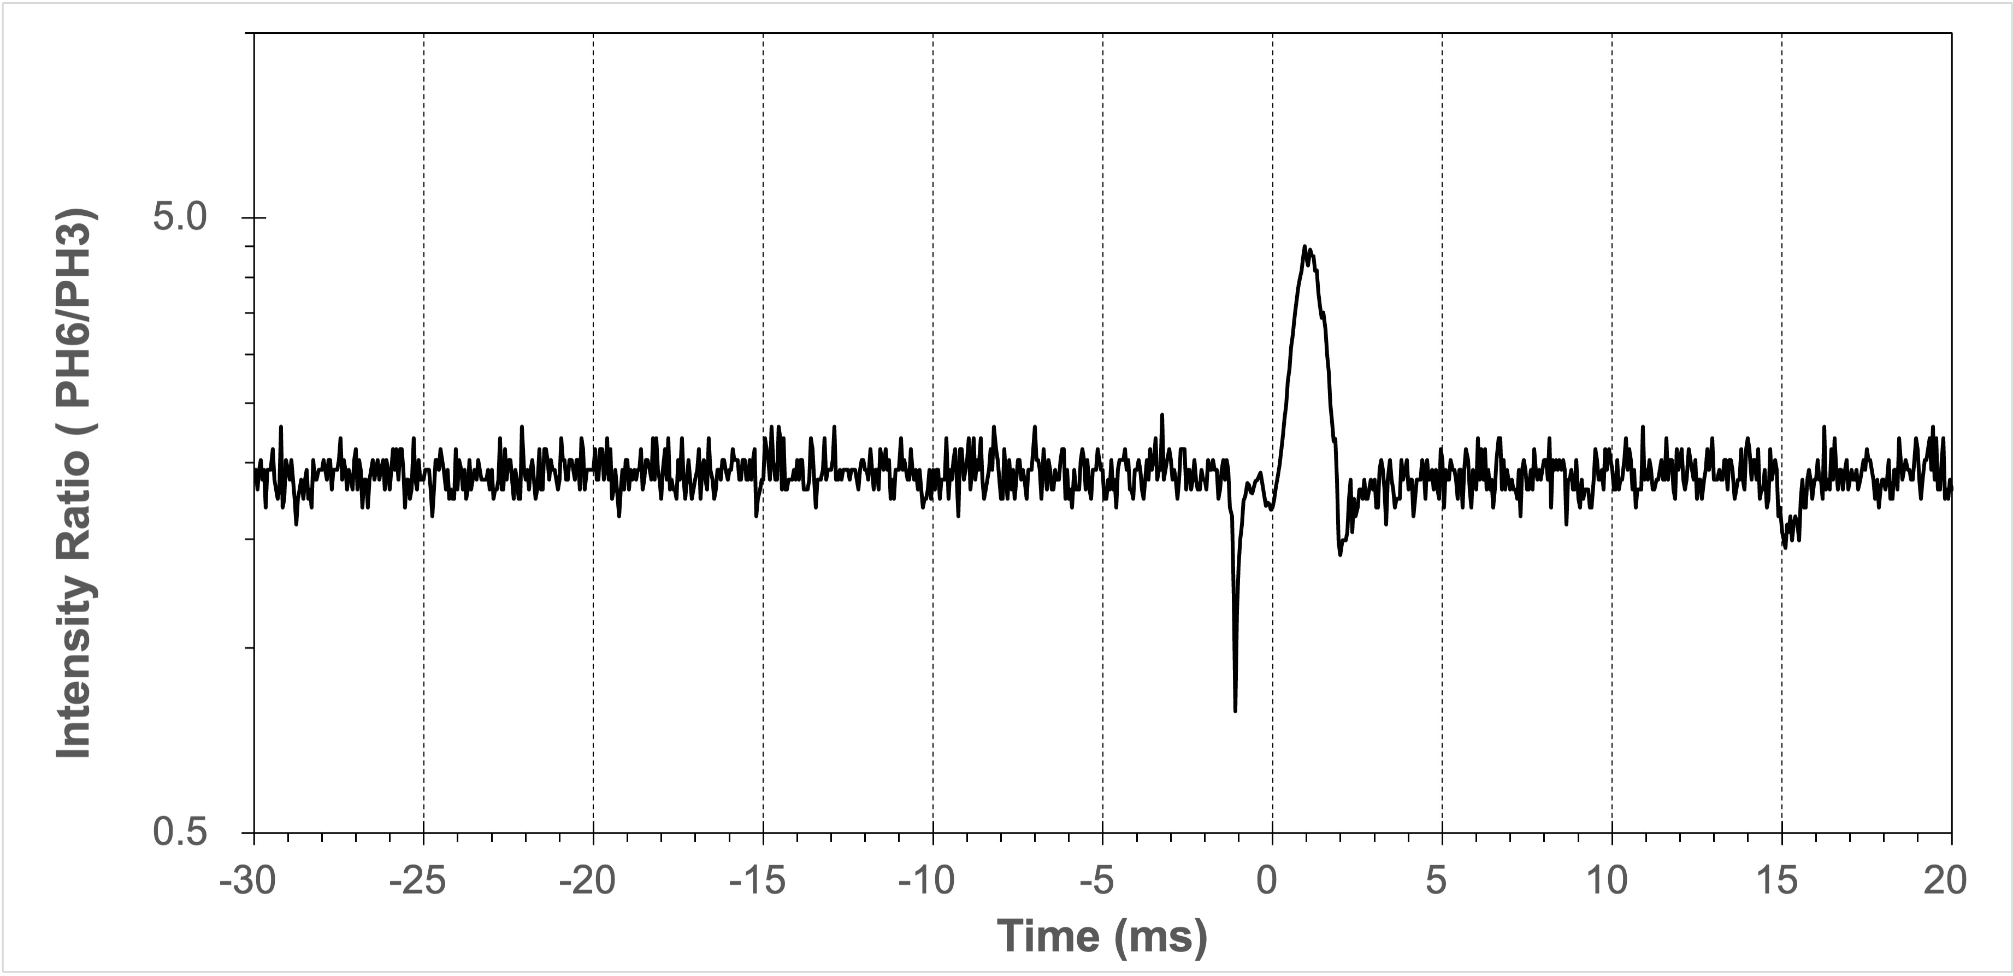
Identification of IC and CG Discharges
IC Event
10 ms

Slide 13
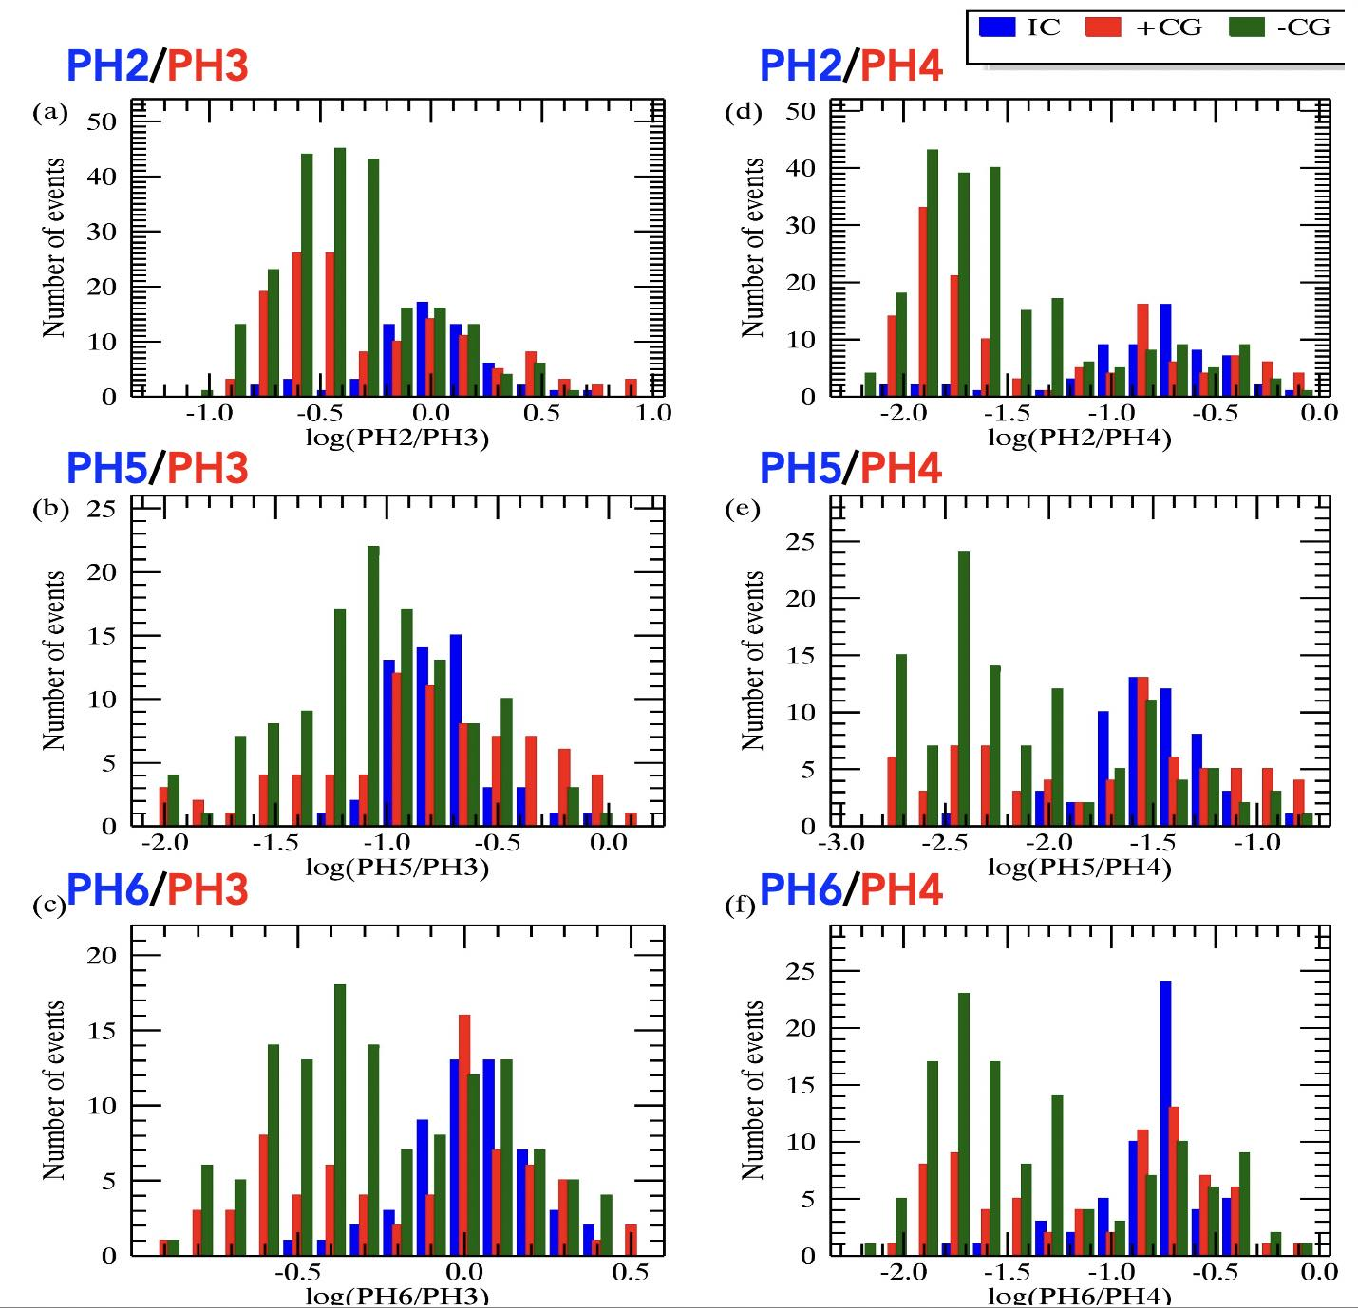
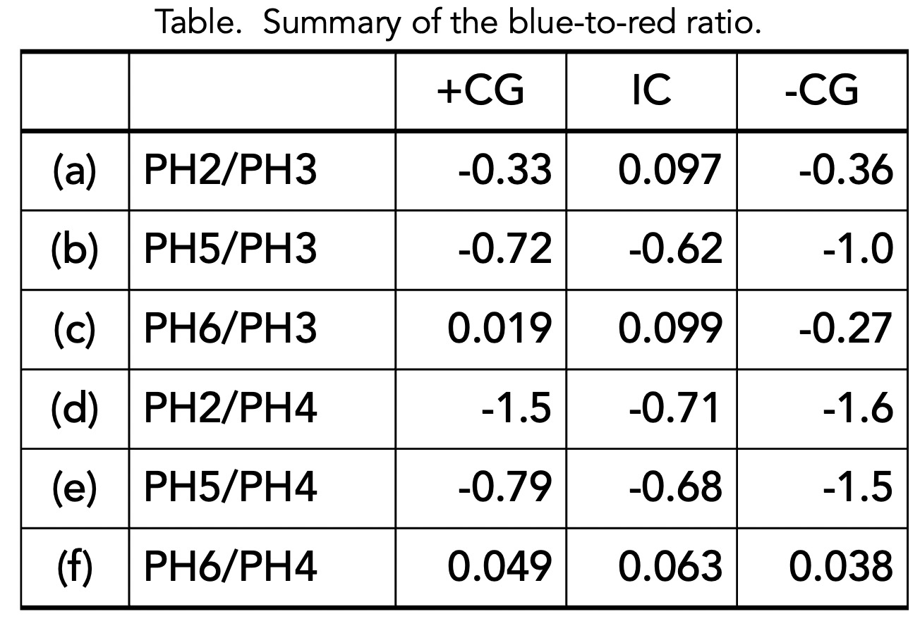
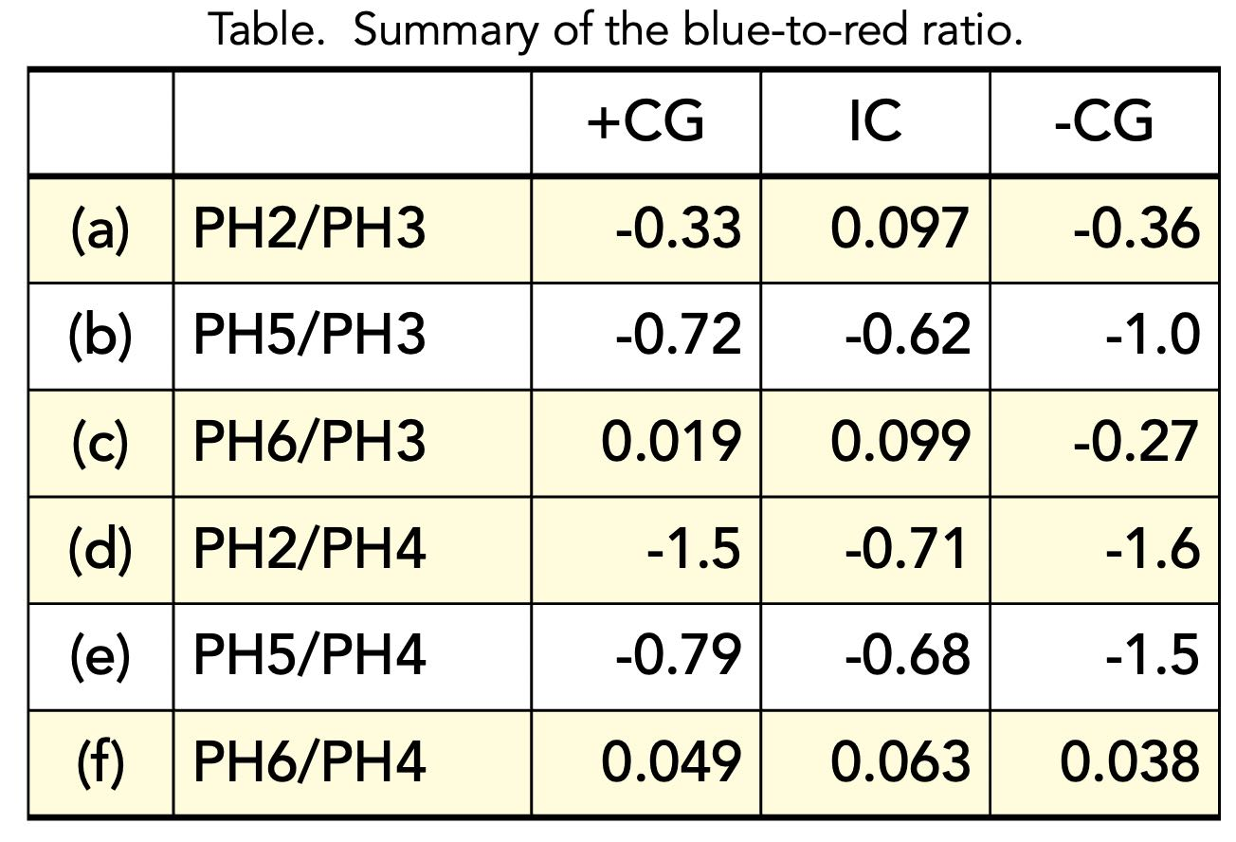
Identification of IC and CG Discharges
Distribution of PH ratios between IC, +CG, -CG shows a clear difference, i.e., (a) PH2/PH3, (c) PH6/PH3, (d) PH2/PH4, and (f) PH6/PH4.
[Kittanapat, 2020]

Slide 14
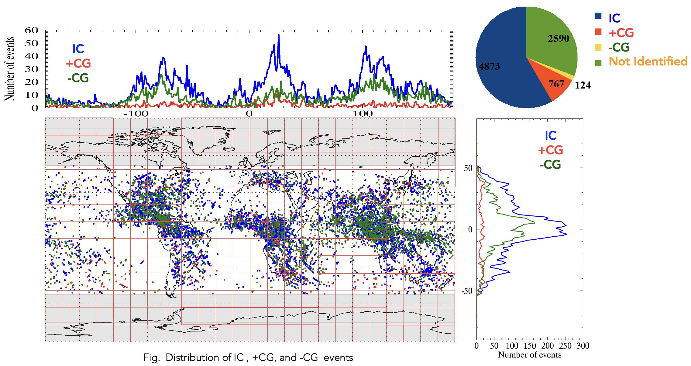
Identification of IC and CG Discharges
5,764 of 8,354 GLIMS lightning events were classified.
[Kittanapat, 2020]

Slide 15
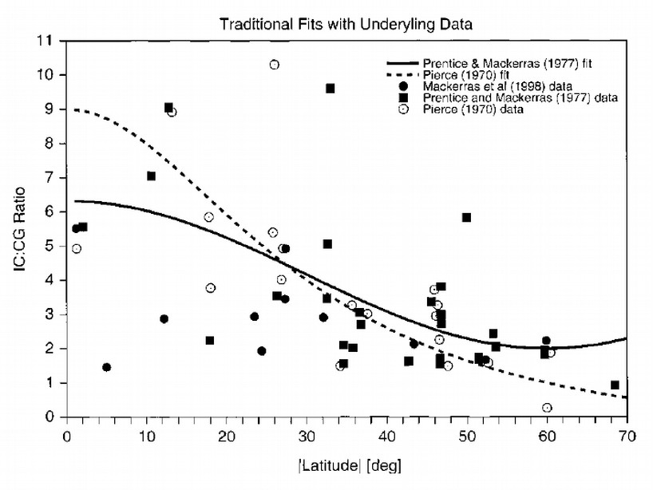
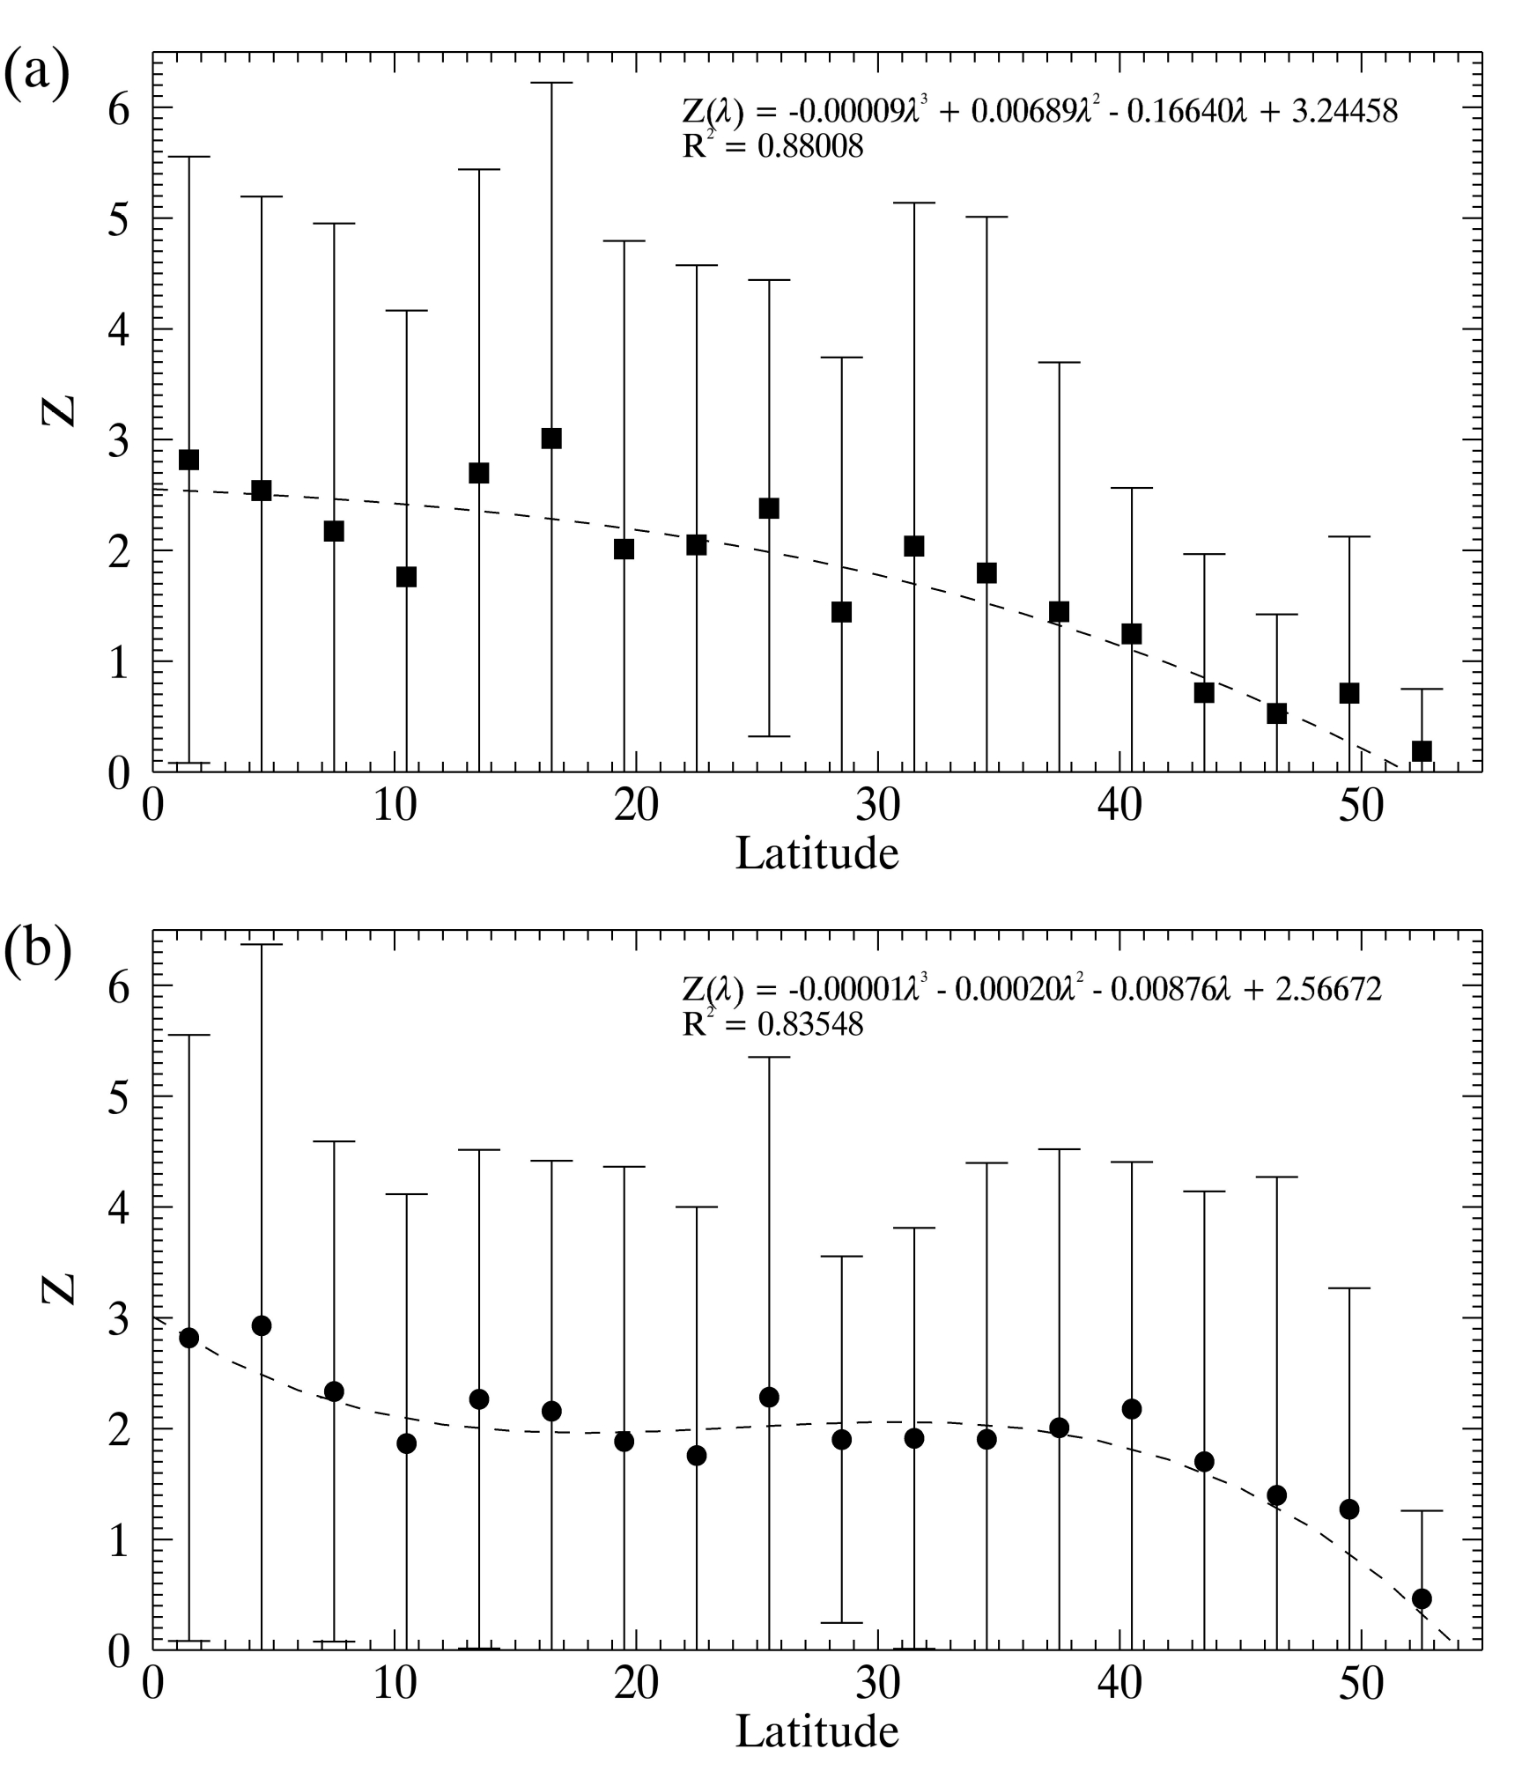
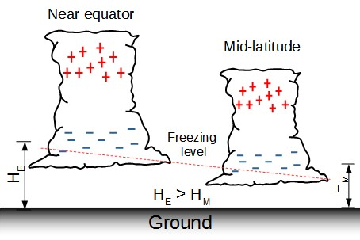
IC/CG Ratio ( = Z ratio )
Northern hemisphere
[Boccippio et al., 2001]
Absolute Z values are smaller to previous studies
Southern hemisphere
Latitudinal dependence of Z relates to an altitude of the main negative charge region
[Kittanapat, 2020]
!!! More reliable than previous studies !!!

Slide 16
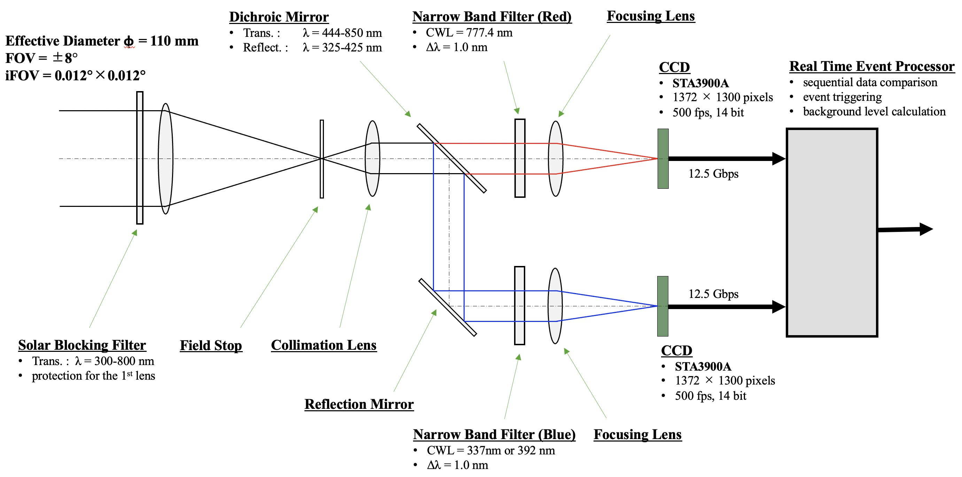
Lightning Sensor for Future HIMAWARI
We are proposing new lightning sensor onboard the future HIMAWARI.

Slide 17
Summary
Lightning activity can serve as a good proxy for monitoring severe weather.
Both CG (cloud-to-ground) and IC (intra-cloud) discharges are important for nowcasting and forecasting severe weather.
Space-based optical observations of lightning discharges, such as GOES-GLM and MTG-LI, are powerful tools for monitoring thunderstorm activity.
We analyzed the photometer data obtained from the GLIMS mission, conducted on the ISS between 2012 and 2015.
The intensity ratio of blue to red emissions from lightning discharges can be a good tool to classify discharge types, i.e., CG and IC discharges.
We are currently proposing a new lightning sensor to be onboard the future HIMAWARI satellite.

Slide 18
Appendix

Slide 19
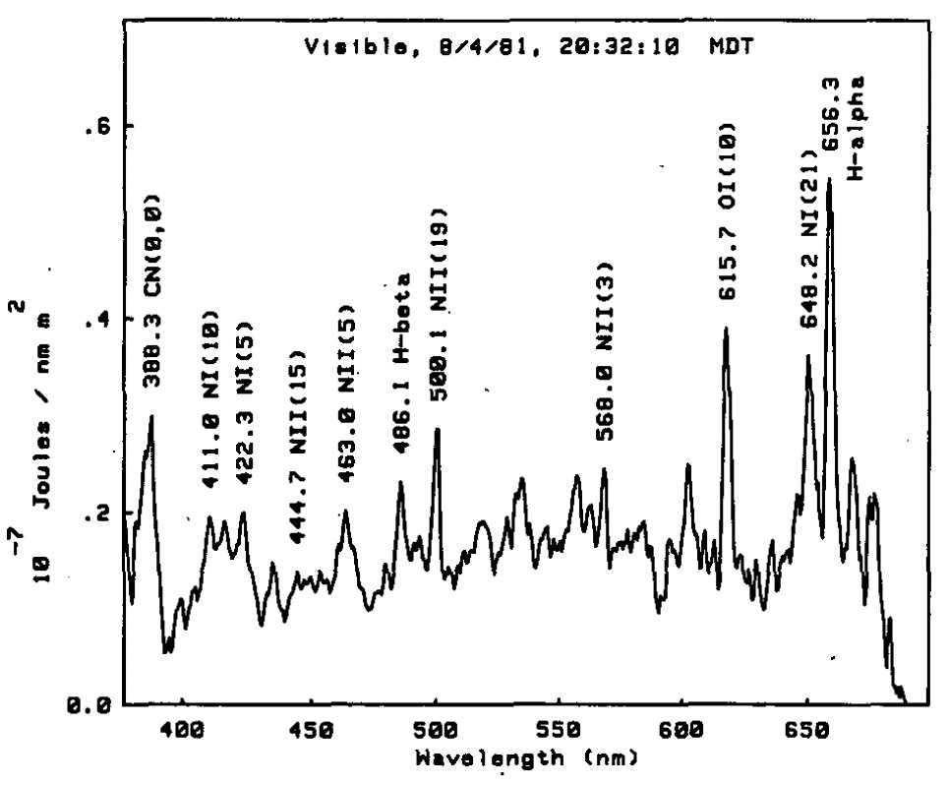
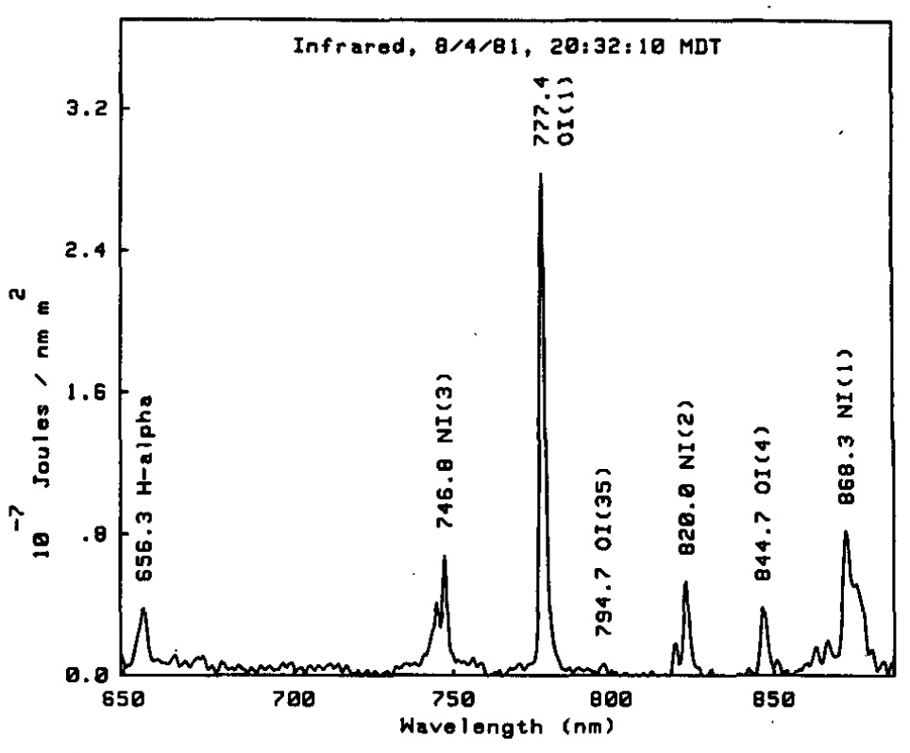
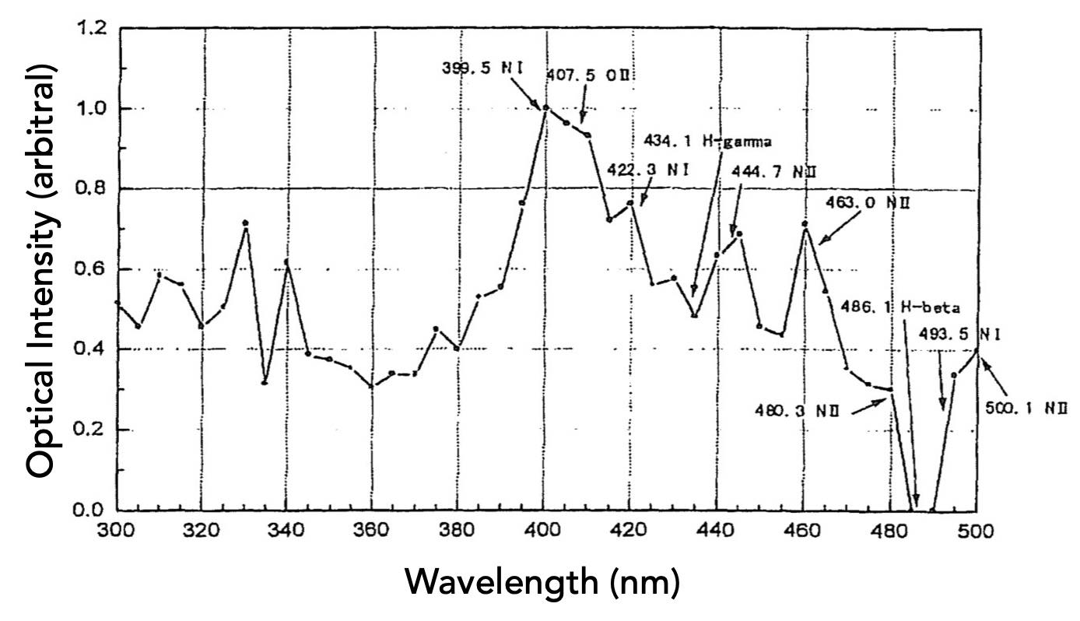
Spectrum of Lightning
CN 388.3nm
[Orville and Henderson, 1984]
NI 399.5nm
[Yamamoto et al., 1999]

Slide 20
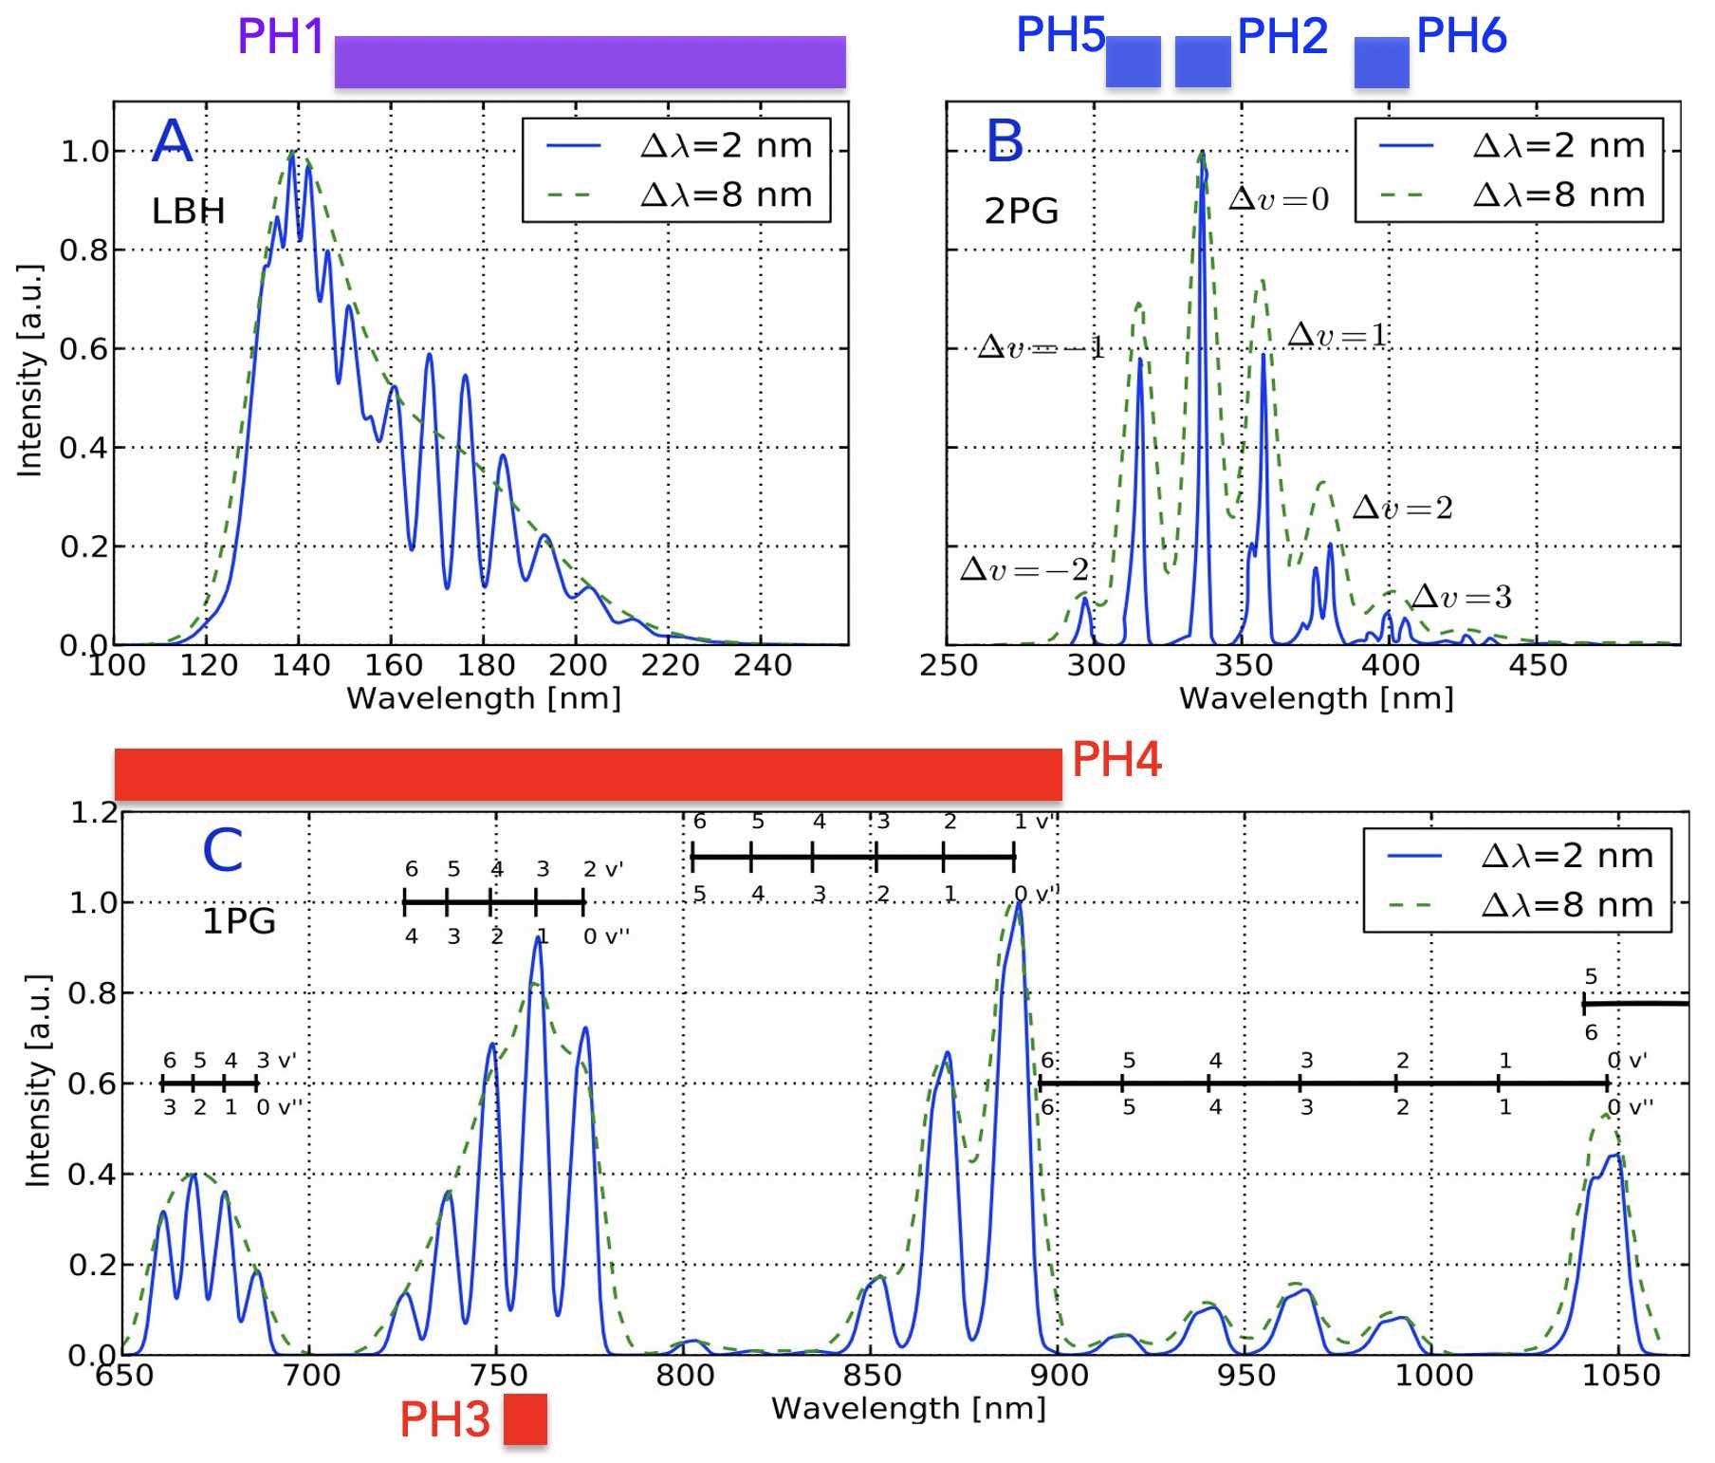
Spectrum of TLEs
spectrum of
sprite halo
[Gordillo-Vázquez et al., 1999]

Slide 21
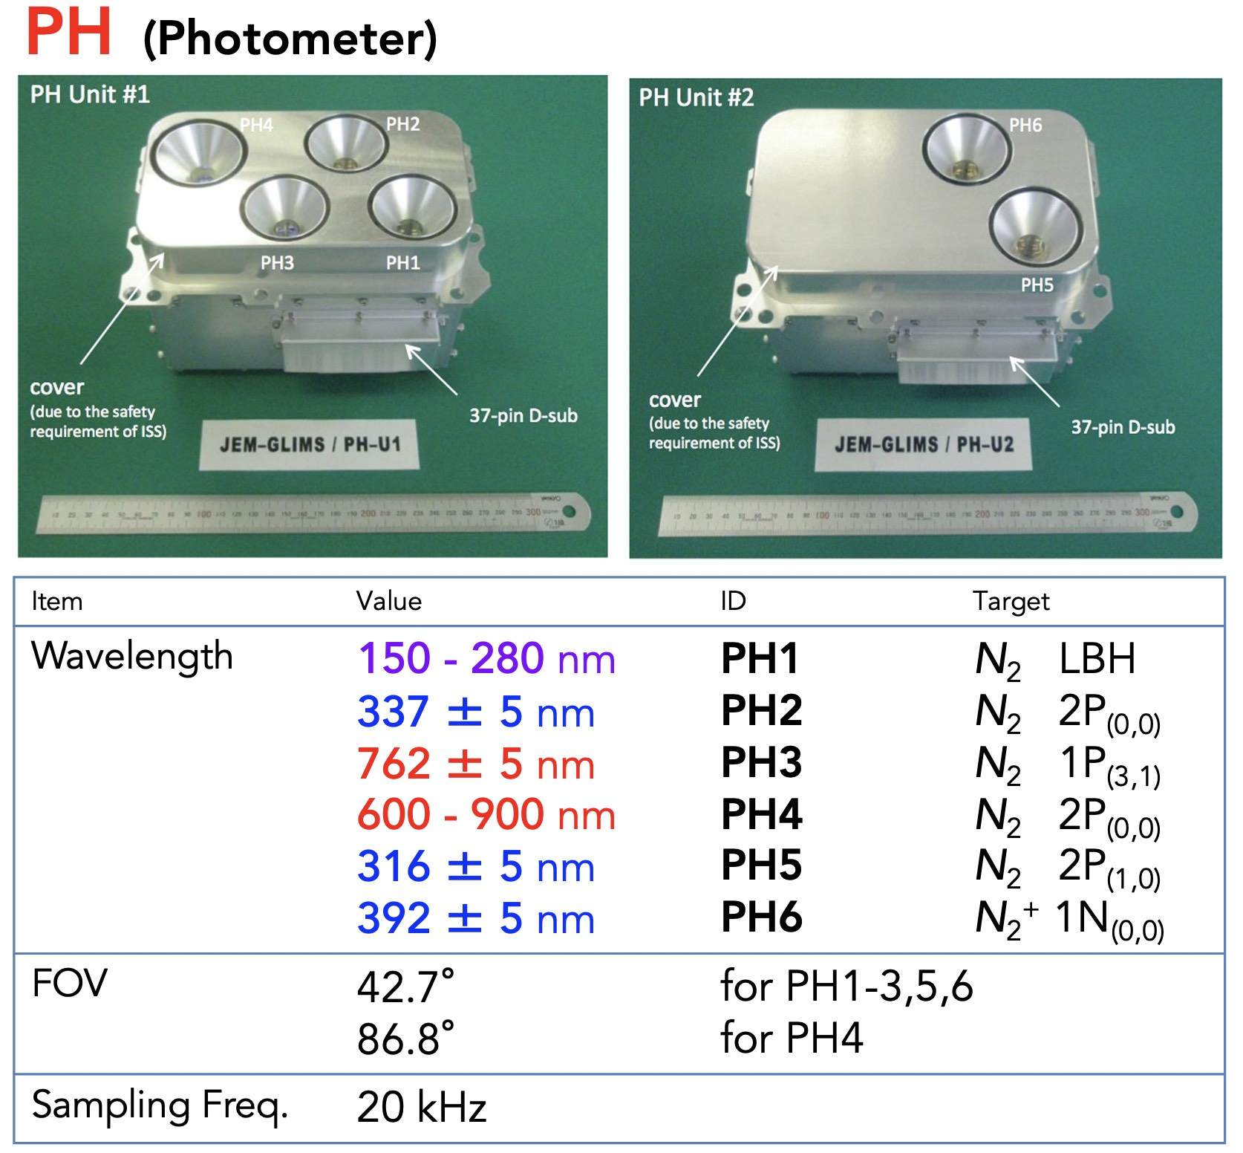
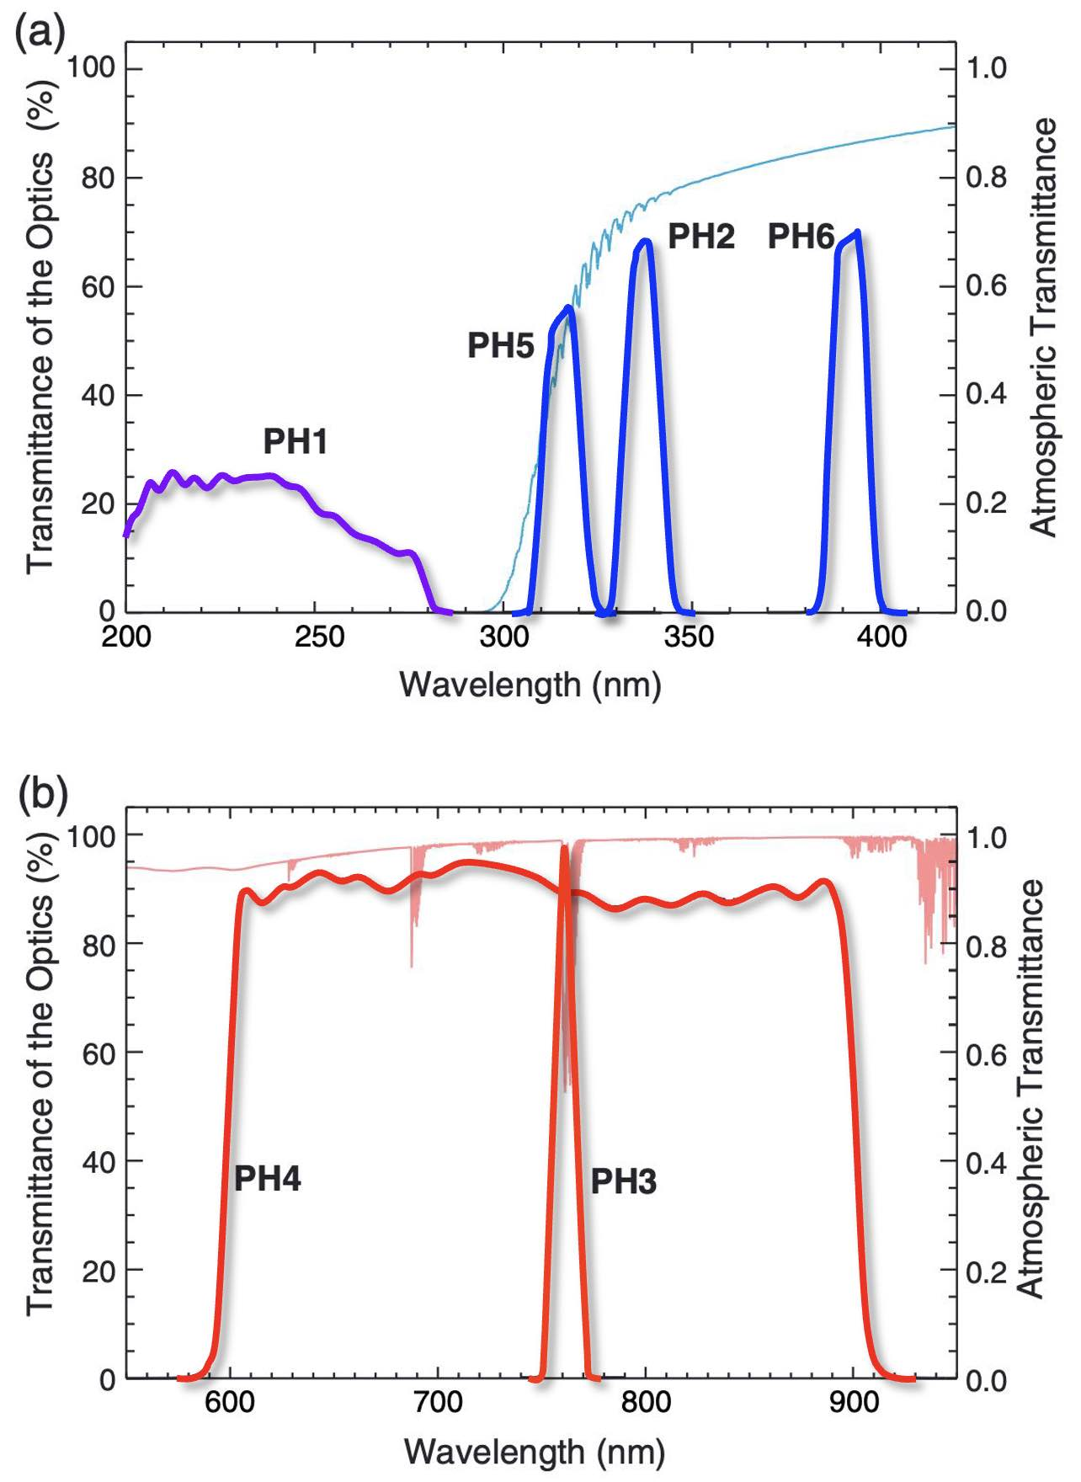
Identification of IC and CG Discharges
[Sato et al., 2015]

Slide 22
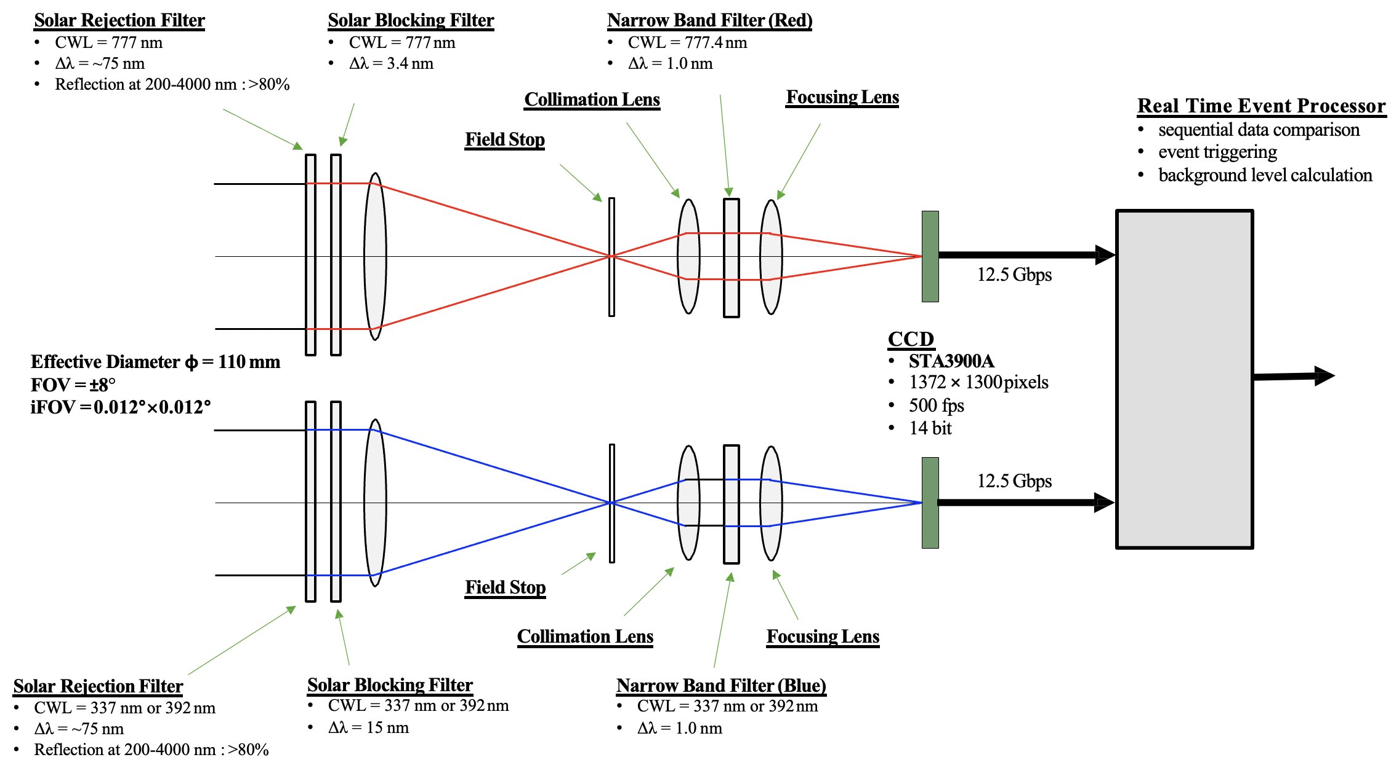
Lightning Sensor for Future HIMAWARI

Slide 23
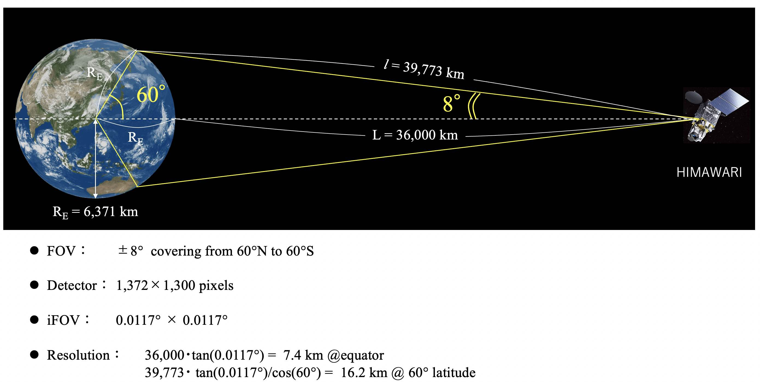
Lightning Sensor for Future HIMAWARI

Slide 24
夜間日中を問わず，雷放電に伴って放射される平均的な光量が検出可能であることが示された．
Lightning Sensor for Future HIMAWARI

Slide 25
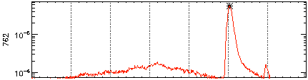
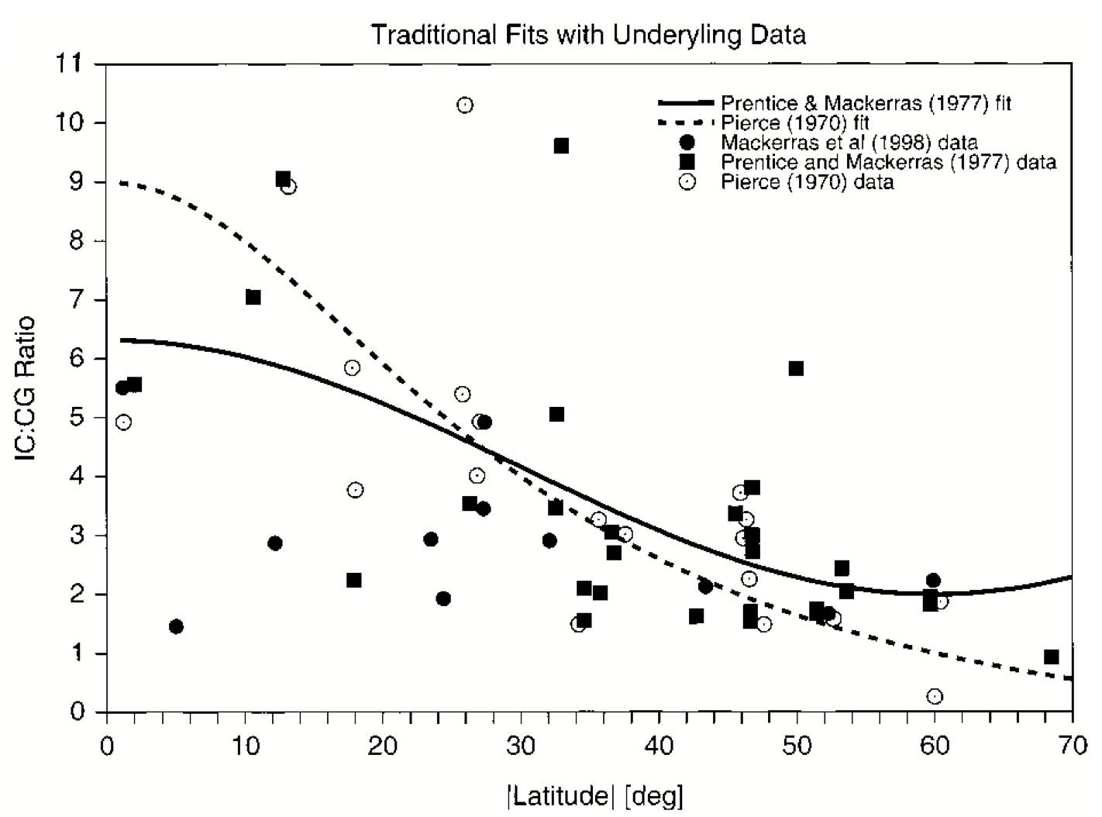
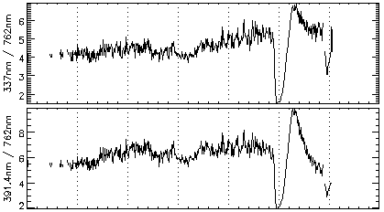
Identification of IC and CG Discharges
Quantitative estimation of the occurrence rate of lightning and TLEs and their LT dependences
For the present, only JEM-GLIMS data enable us to estimate the occurrence rate of lightning and TLEs and their LT dependences.
Quantitative estimation of IC/CG ratio (Z value)
preliminary
breakdown
return
stroke
From the blue/red ratio calculated from PH data, it is possible to distinguish IC and CG discharges. (Fig.3.1-2)
Latitudinal variation of IC/CG ratio (Z value) can be quantitatively estimated from the GLIMS PH data. (Fig.3-1.3)
PH4 (Red)
20 ms
Blue/Red Ratio
Fig. 3.1-3 Latitudinal variation of IC/CG ratio [Boccippio et al., 2001]
Fig. 3.1-2 Blue/red ratio derived from PH data.

Slide 26
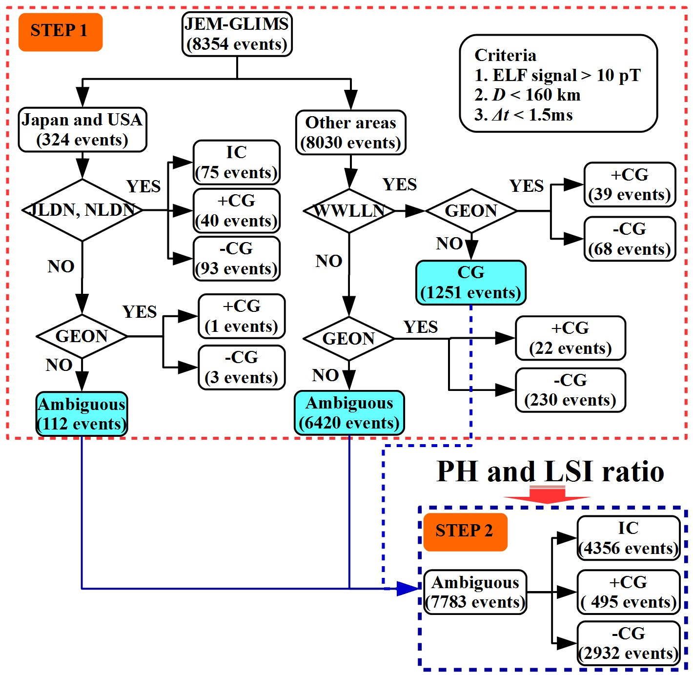
Identification of IC and CG Discharges
STEP 1
571 of JEM-GLIMS events were identified
  IC => 75
  +CG => 102
  -CG => 394
7783 Ambiguous events
STEP 2
New method is needed for classifying this lightning events

Slide 27
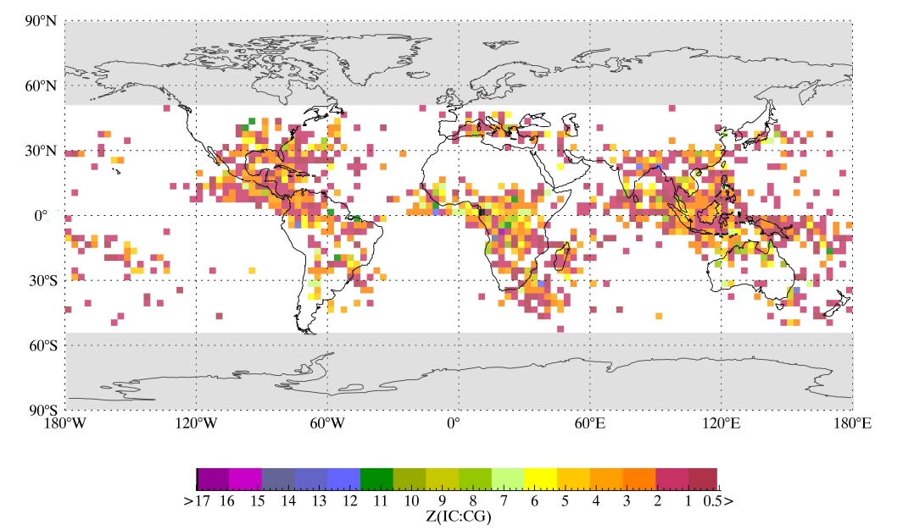
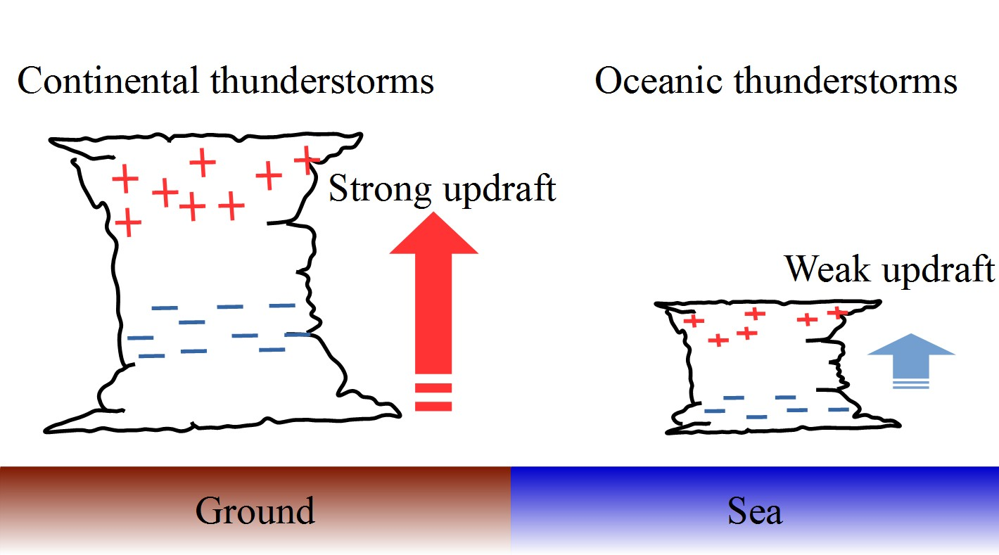
IC/CG Ratio ( = Z ratio )
Average of Z = 1.6
( 1.9 by Mackeras et al., 1998)
Z_{Land} (1.7): Z_{Ocean} (1.1)
Strong updraft in continental thunderclouds enhances to occur ICs. (Zipser and Lutz, 1994).

Slide 28
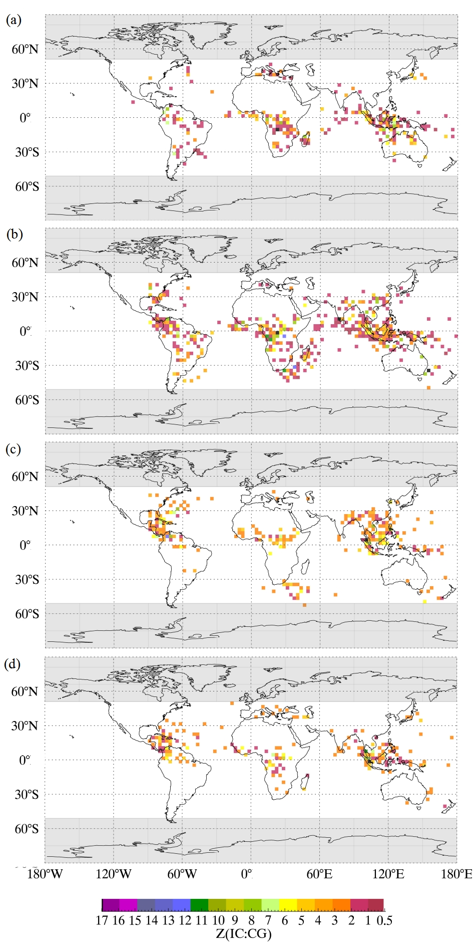
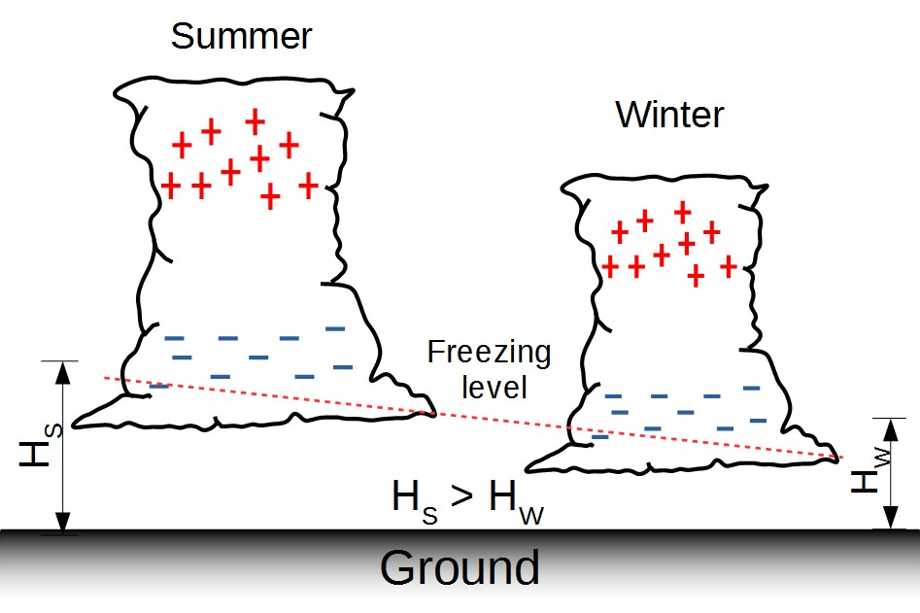
IC/CG Ratio ( = Z ratio )
(a)
High Z-ratio can be found in the local summer than local winter.
(Z_{Summer} (1.0): Z_{Winter}(0.52))
Dec-Feb
Summer
(b)
Mar-May
(c)
Summer
Jun-Aug
(d)
Sep-Nov

