Slide 1
A Comparison of GLM and VIIRS/Modis
Michael Stock, Julia Tilles, Joseph Berry
GLM Science Meeting
Sept. 2024

Slide 2
Does Lightning Even Ignite Wildfires?
Michael Stock, Julia Tilles, Joseph Berry
GLM Science Meeting
Sept. 2024

Slide 3
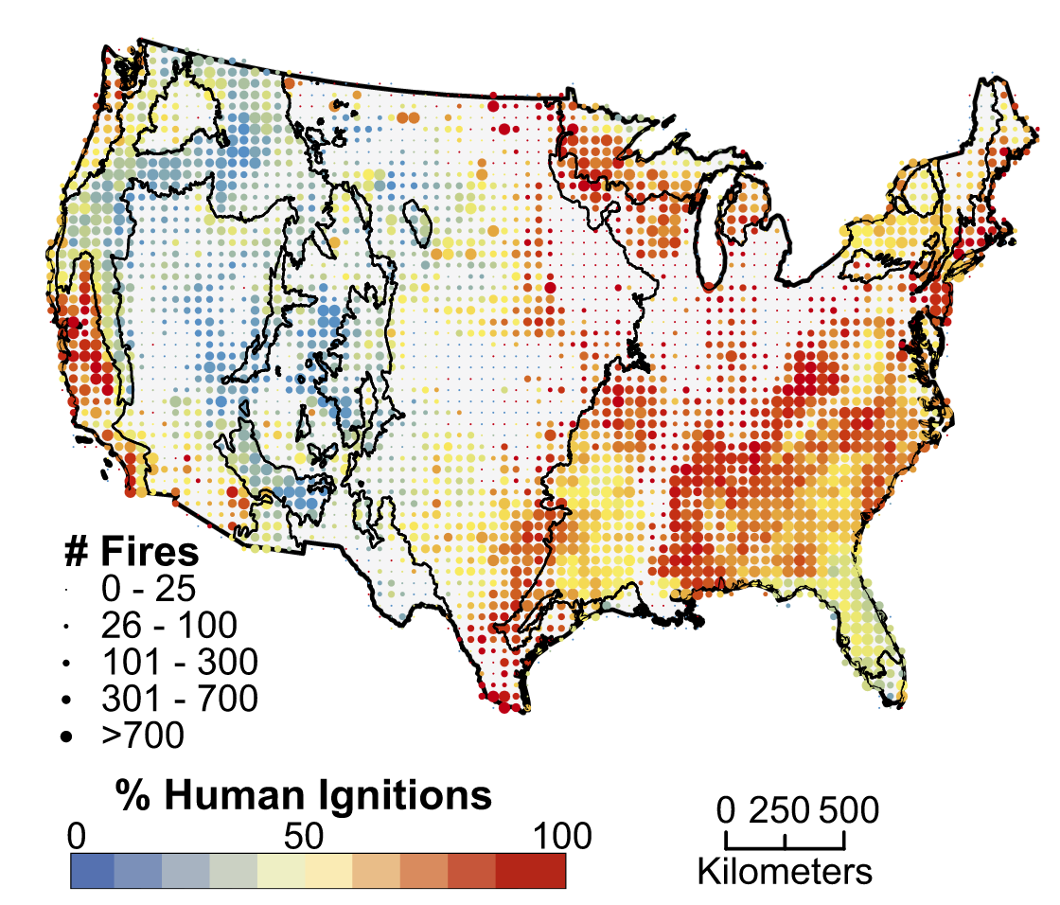
Motivation
Balch et al. 2017
Lightning:
16% of all fires
56% area burned
Data From:
Short, 2014

Slide 4
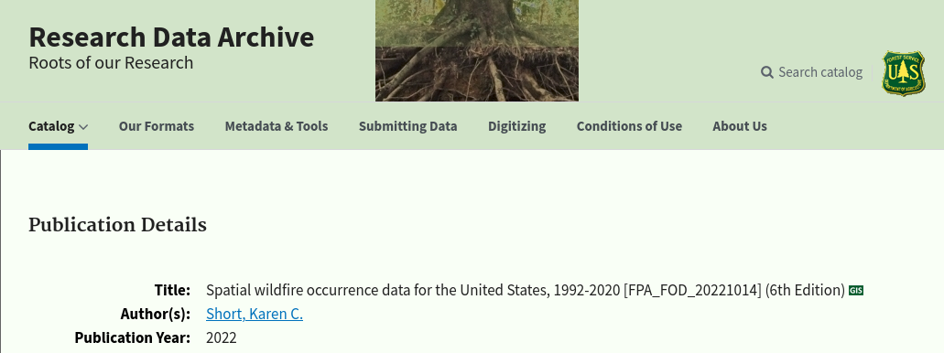
Motivation
Short 2014
Spatial wildfire occurrence data for the United States, 1992-2012

Slide 5
Warning: Amateur at work

Slide 6
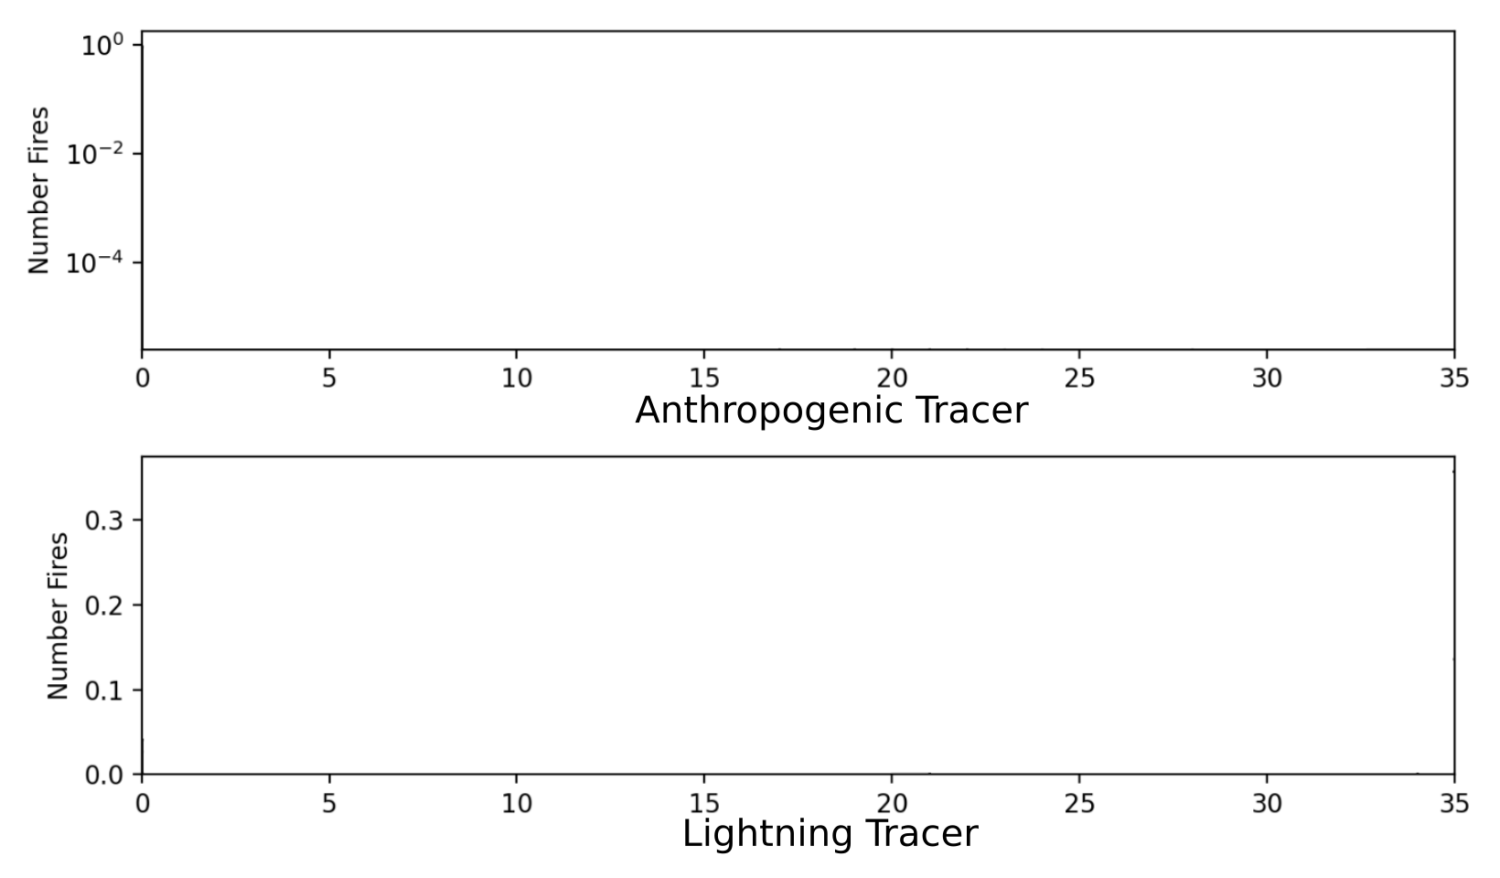
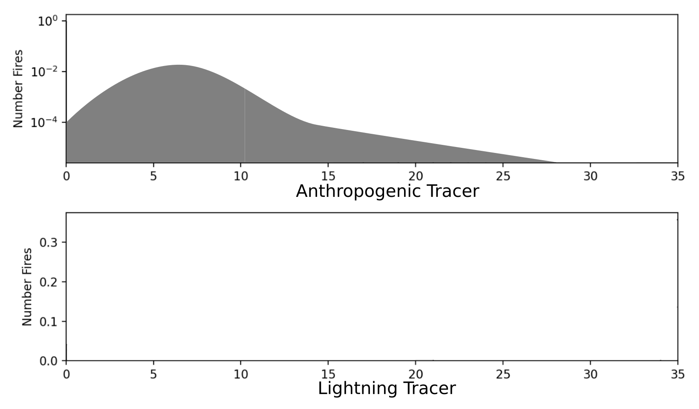
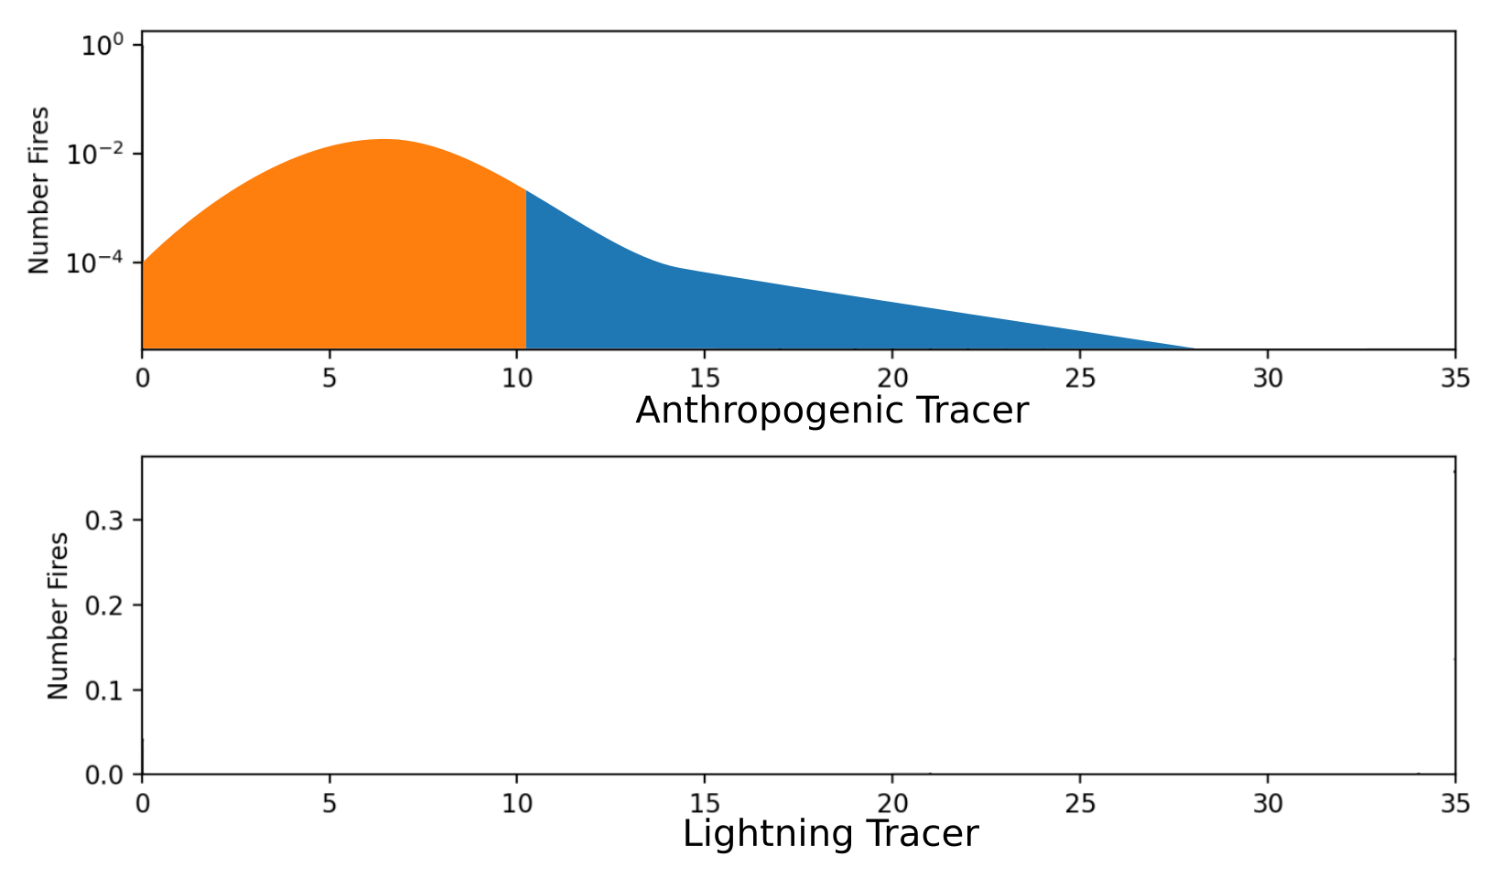
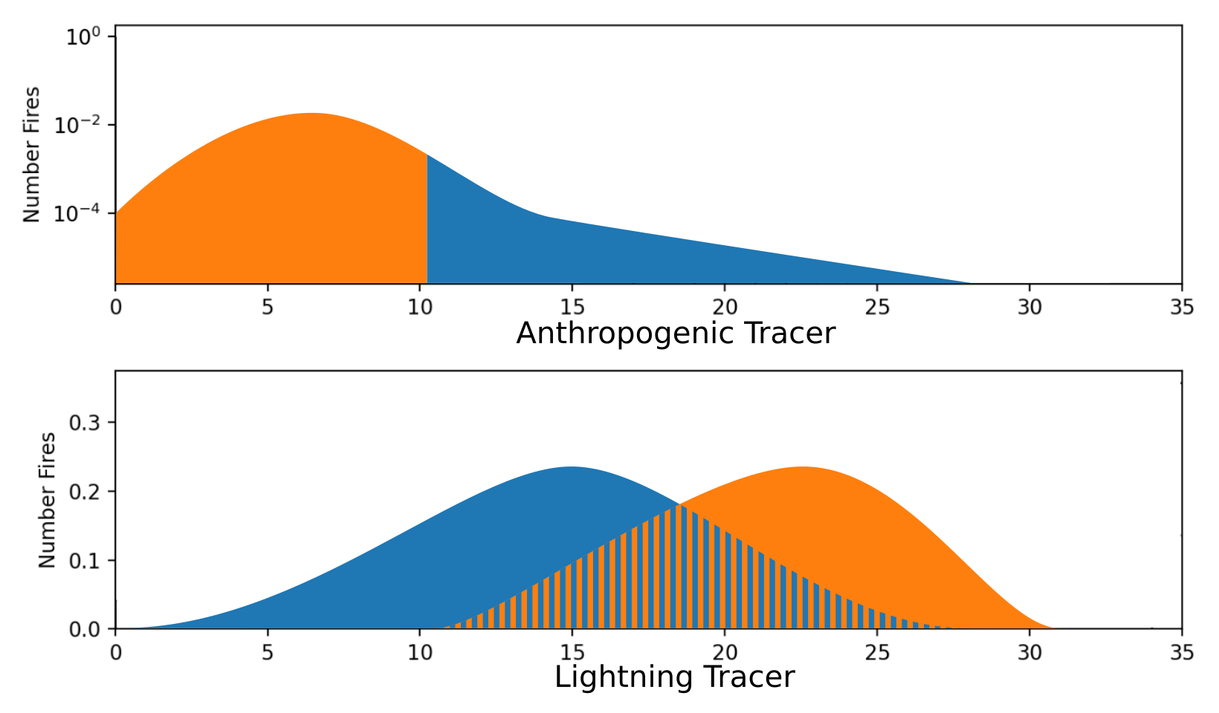
The “Plan”

Slide 7
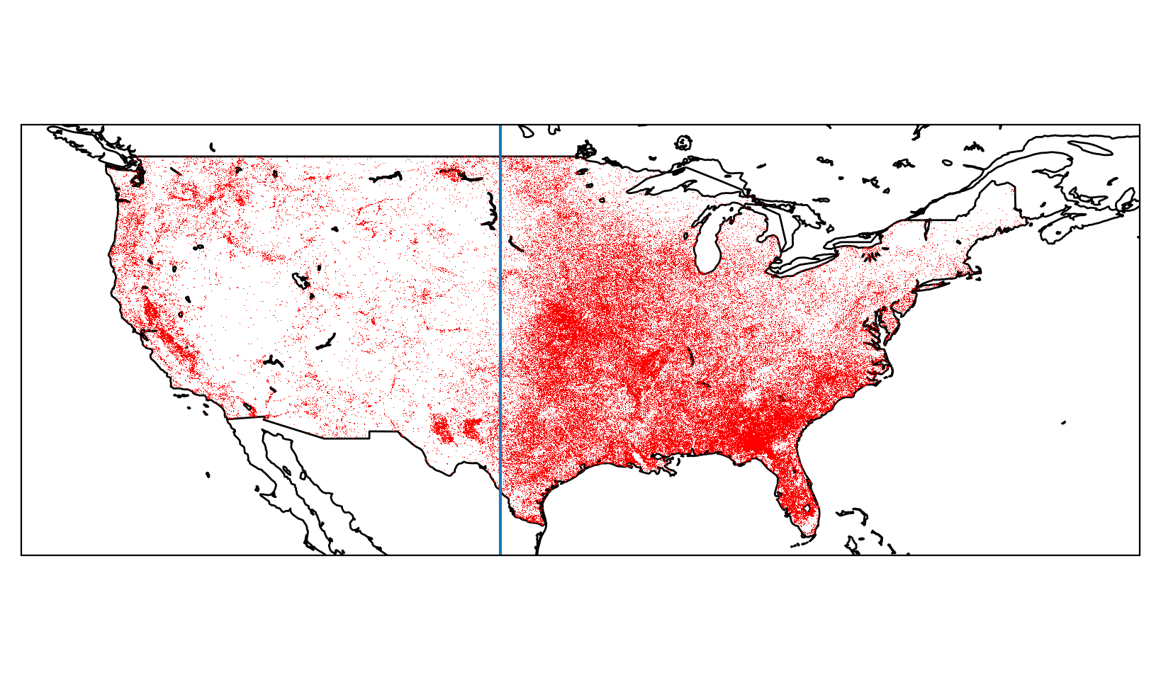
Fires
Merged and grouped VIIRS and Modis detections into fire objects
270,524 fire objects between 11/30/2022 and 6/10/2024
West
East

Slide 8
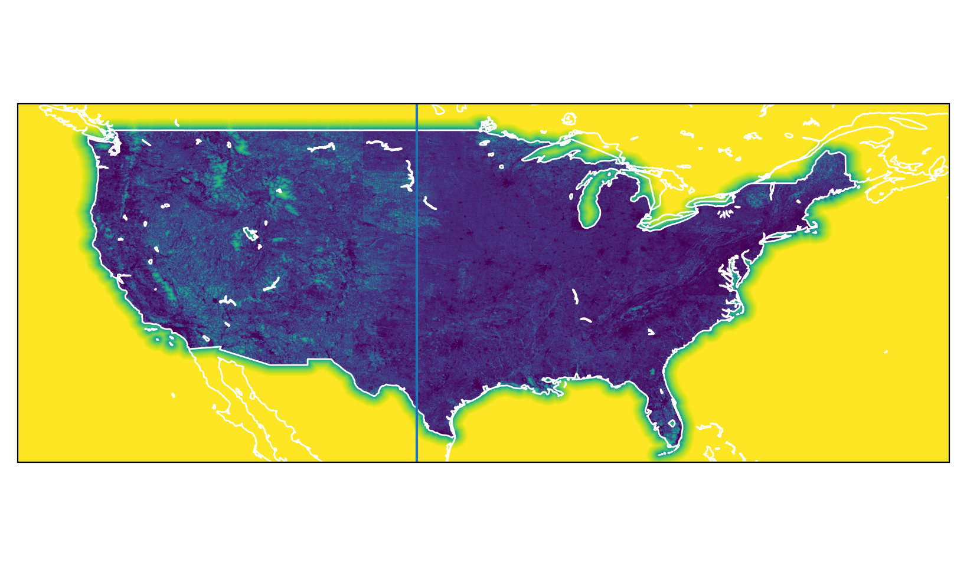
Anthropogenic Tracer: Distance to nearest road
Data from US Census
0.005 degree grid

Slide 9
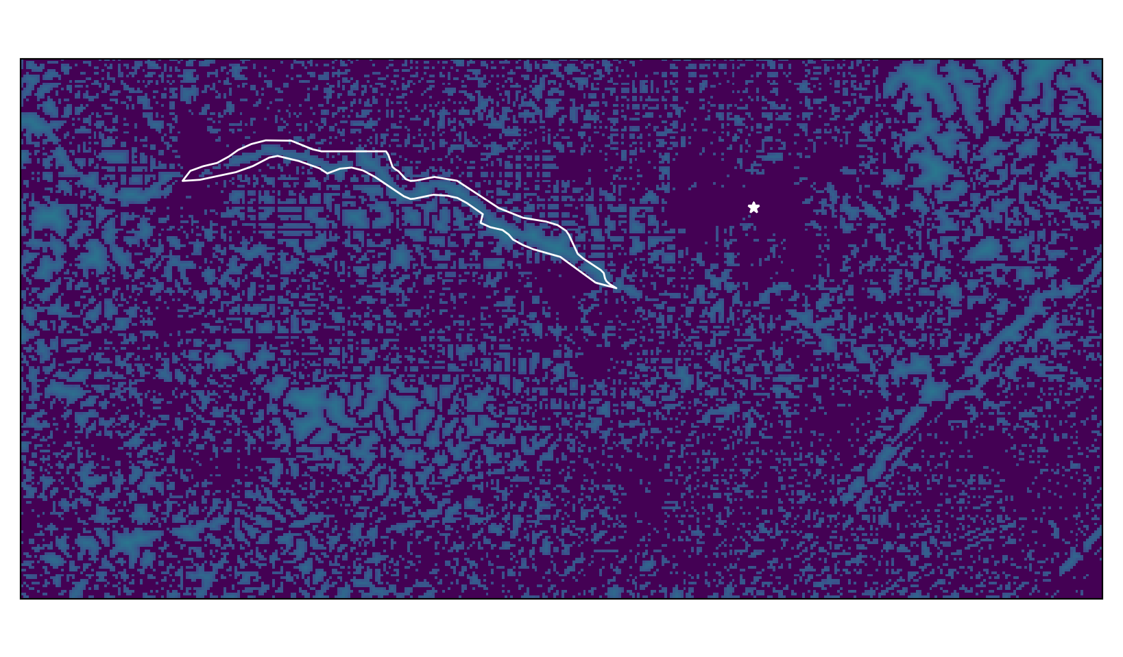
Anthropogenic Tracer: Distance to nearest road

Slide 10
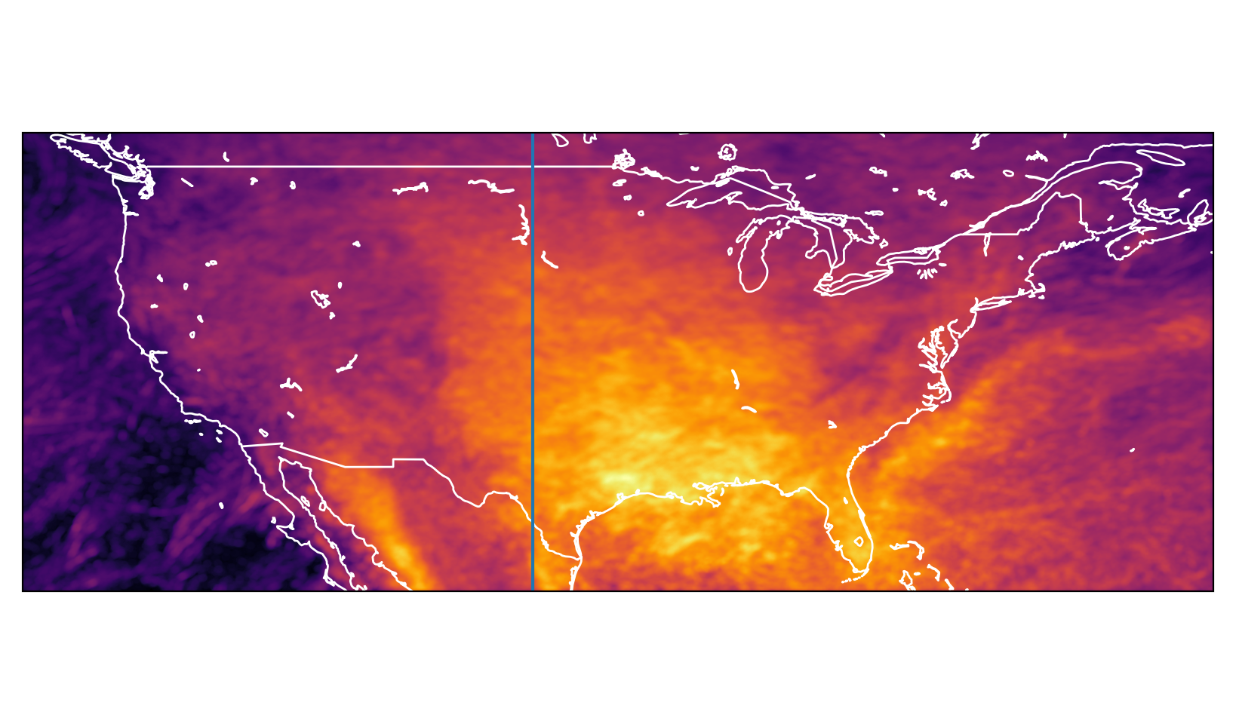
Lightning Tracer: Time since lightning
Group level data from GOES16 and GOES18
25 km radius, 1 hour time integrations
0.005 degree grid

Slide 11
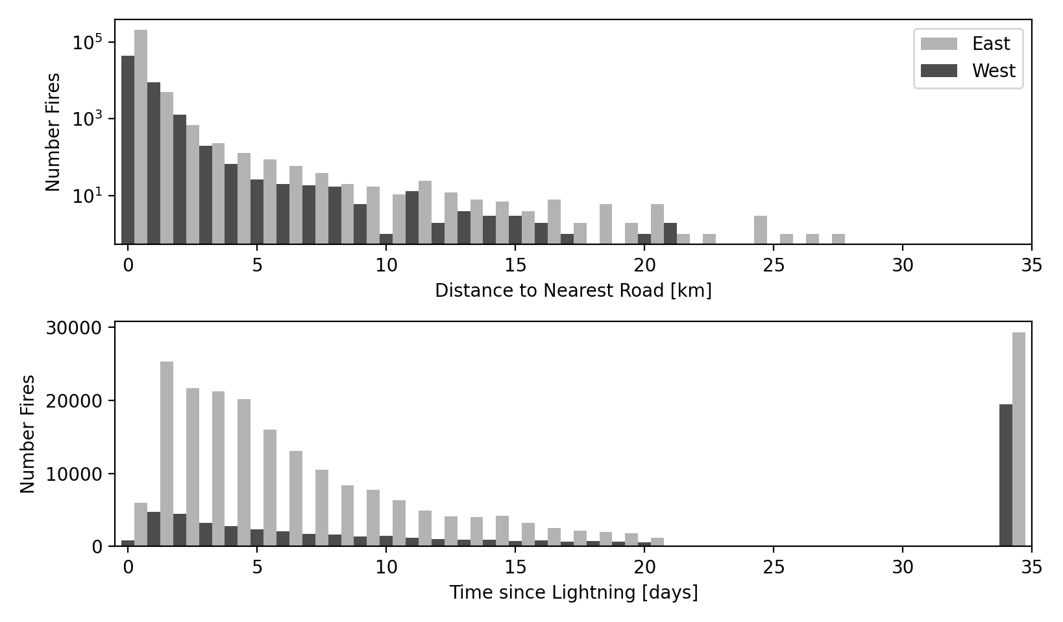
Results: East vs. West

Slide 12
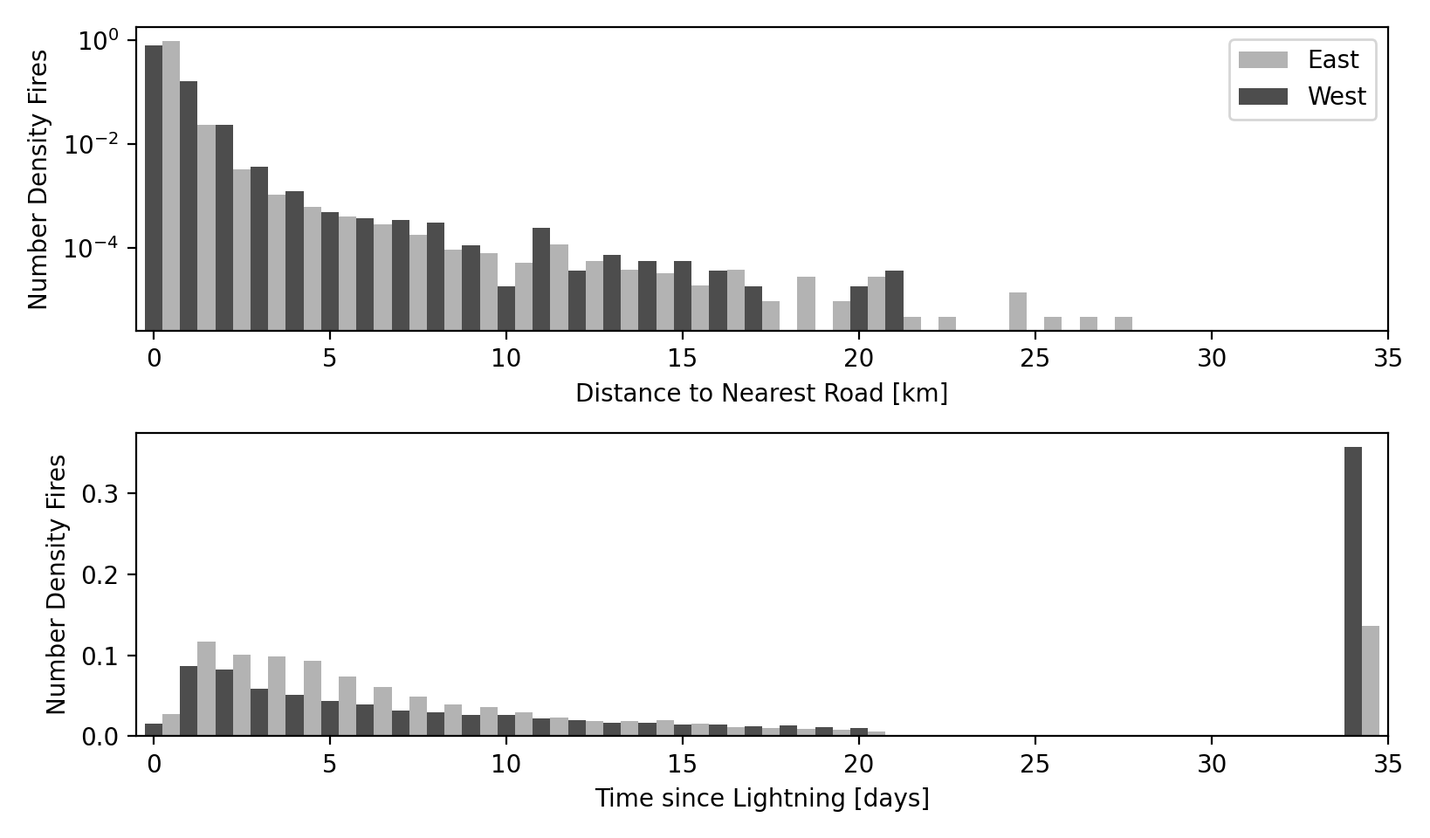
Results: East vs. West

Slide 13
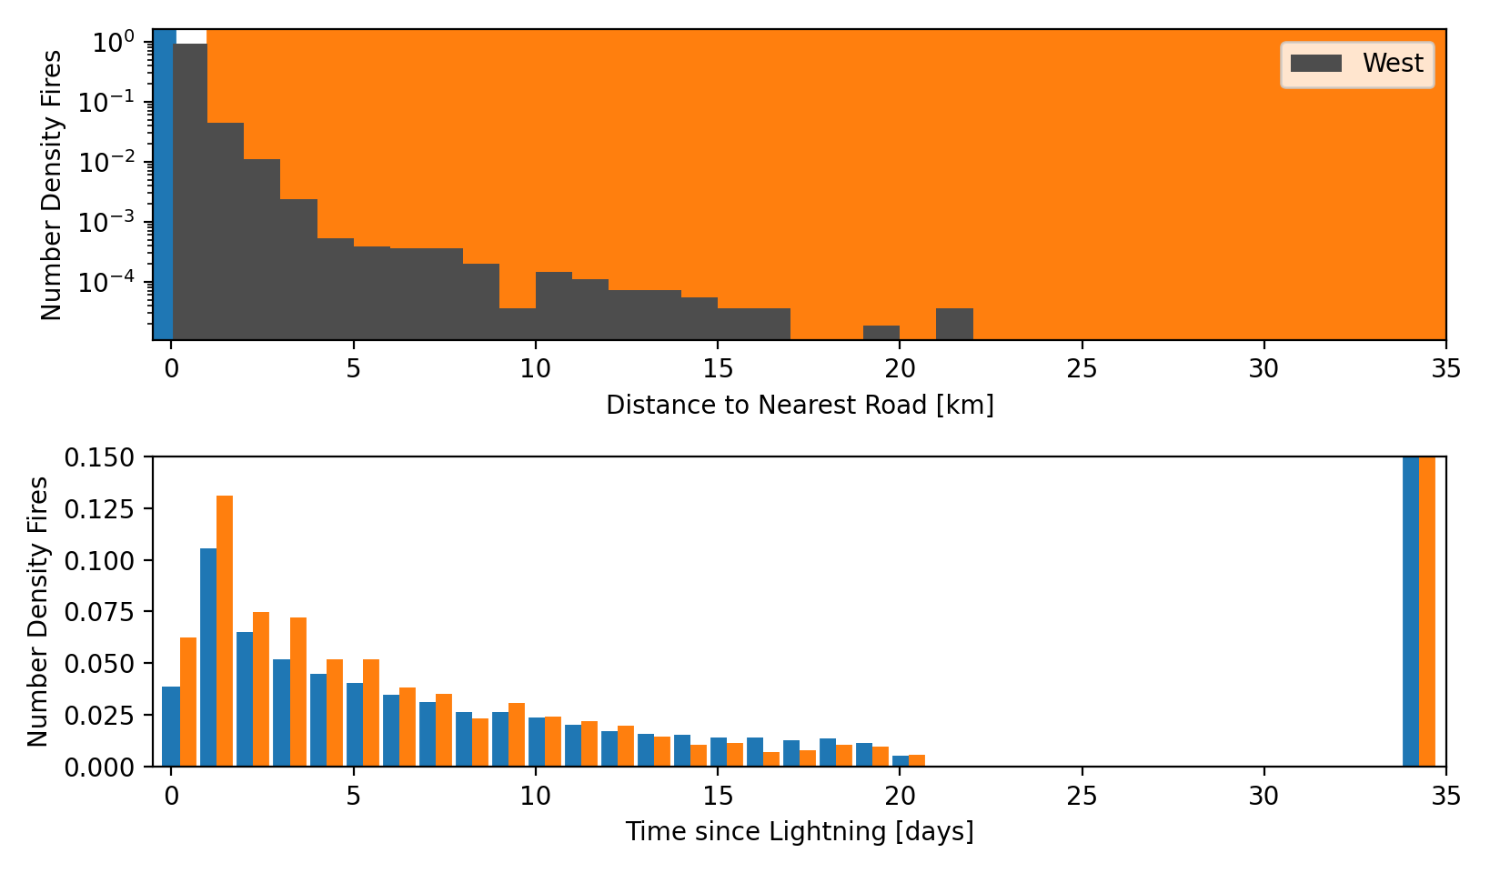
Results West: Roads vs. Holdover

Slide 14
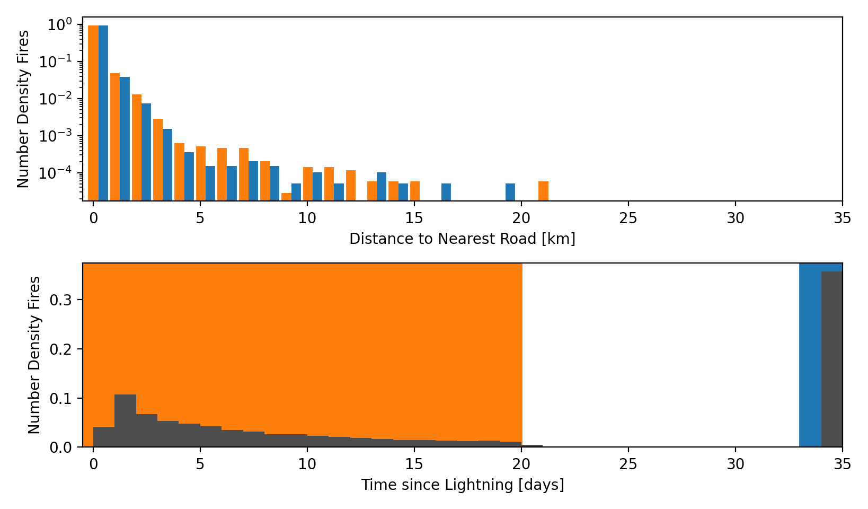
Results West: Holdover vs. Roads

Slide 15
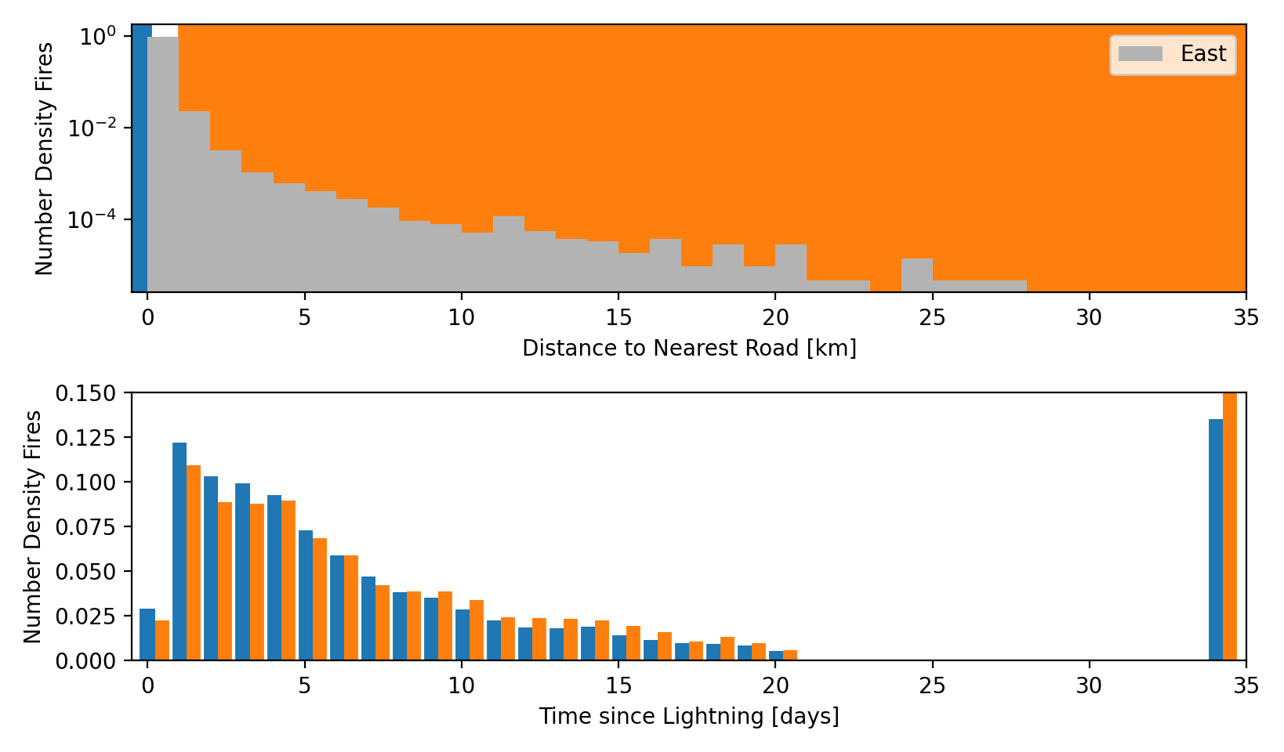
Results East: Roads vs. Holdover

Slide 16
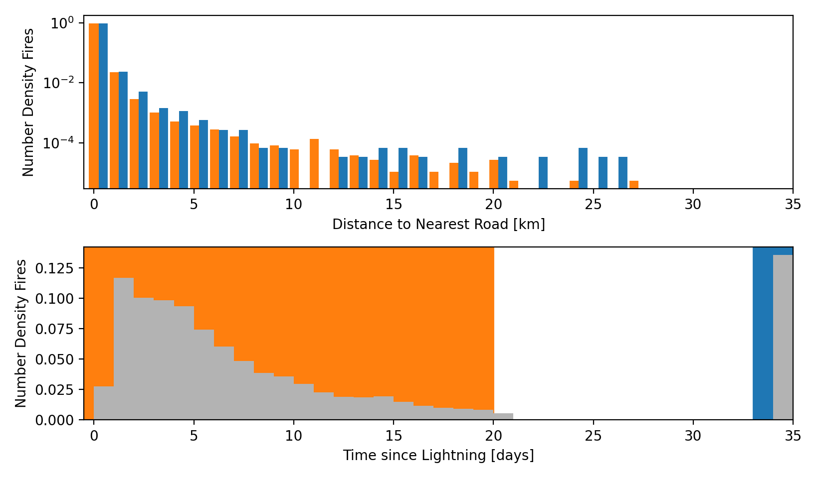
Results East: Holdover vs. Roads

Slide 17
Fake Fire ‘Models’
Random Arsonist
Start on a Road + normal displacement
Uniform random time
(σ=4 km)
Random Lightning
Random lightning group + normal displacement
Lightning Time + lognormal holdover
(σ=25 km)
(σ=0.9, 𝜇=1.5 ‘days’)
Rash Assumption: 10% of fires ignited by lightning

Slide 18
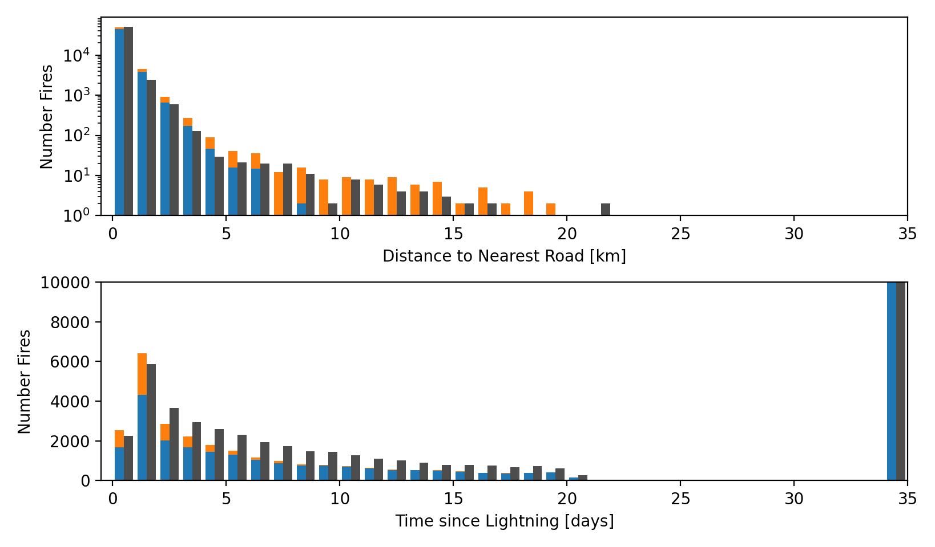
Fake Fires model: West
28k
19k

Slide 19
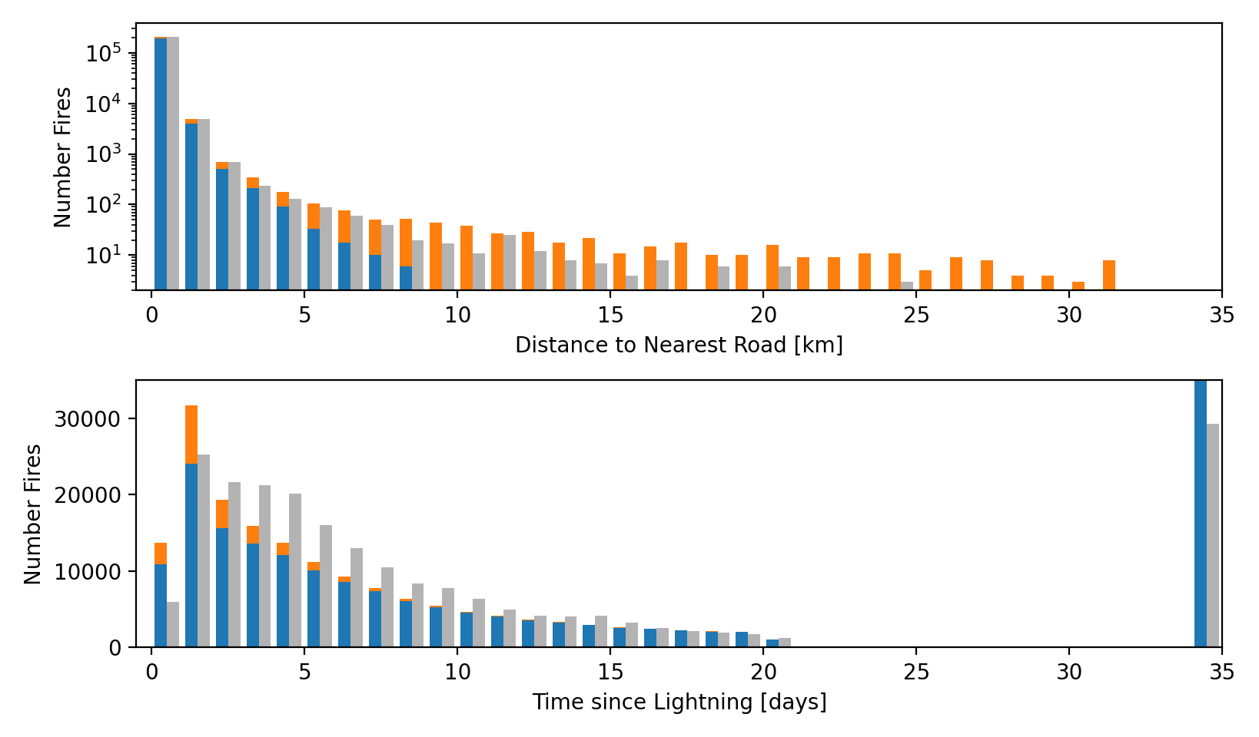
Fake Fires model: East
50k

Slide 20
Summary
Does Lightning Ignite Fires?
Probably?

