Slide 1

Precipitation Microphysics Retrieved with GLM and GPM
Antonio Quispe Rivera and Carlos A. Morales
Department of Atmospheric Science
Institute of Astronomy, Geophysics and Atmospheric Science
University of São Paulo – USP
Brazil

Slide 2
Objectives
Retrieve and depict the precipitation microphysics of the GLM/GPM observed thunderstorms in South America
Understand how the precipitation microphysics (Nw, Dm and Z) change for:
    Storms with and without lightning
    Lightning activity
    Thunderstorm size
    Maritime x Continental
    Latitude dependence
    Hotspots

Slide 3
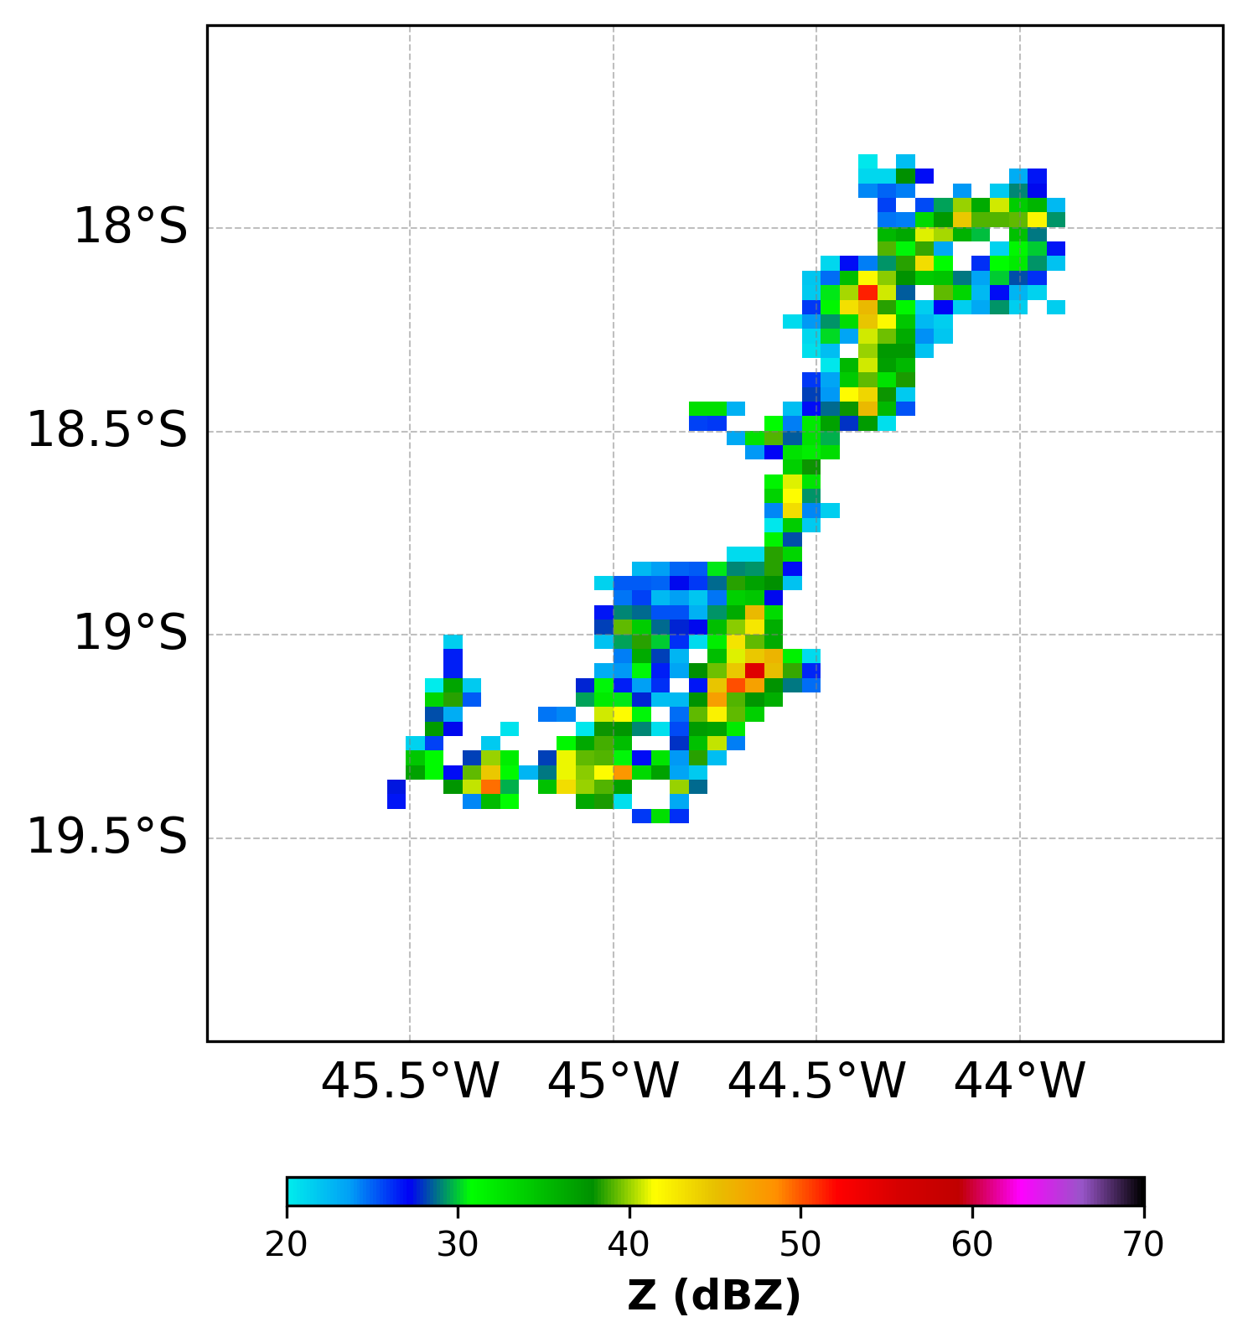
Methodology
We used 2020-2023 Global Precipitation Measuring – (GPM) Dual Precipitation Radar (DPR) measurements to identify precipitating systems (storms) over South America (798 orbits)
Storms are defined as contiguous pixels of radar reflectivity factor (Z) with values above 20 dBZ at 2 km height [Morales et al, 2019; Nesbitt et al., 2000]

Slide 4
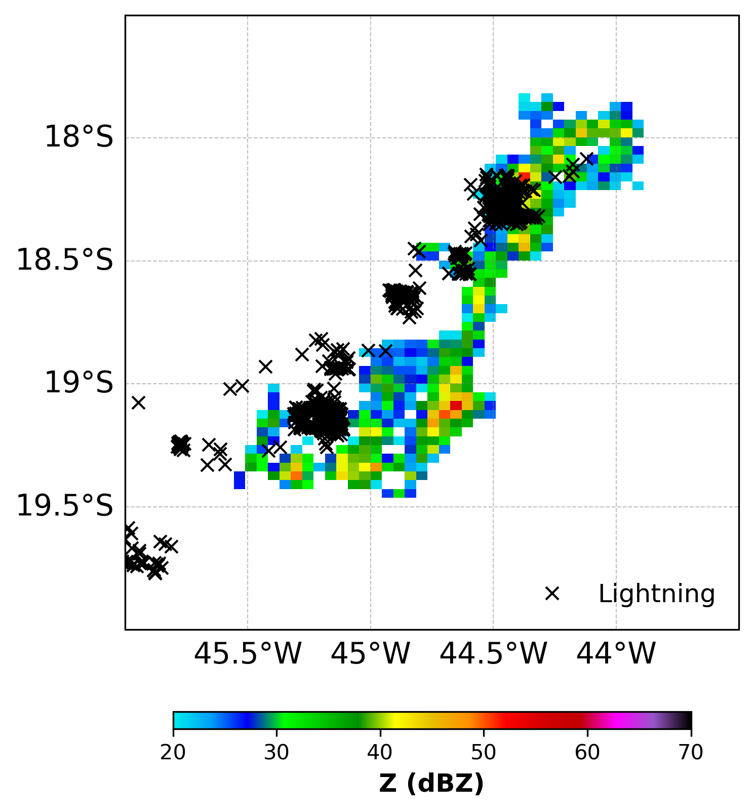
Methodology
Storms with (5,528) and without (150,505) lightning are identified with coincident lightning flashes measurements from GOES Lightning Mapper (GLM) within +/- 15 minutes of GPM-DRP orbit .
For every identified storm, we compute the mean vertical profile Z, Mean mass diameter (Dm), and the Normalized intercept parameter (Nw) available at GPM-DPR 2A.GPM.DPR (Ku + Ka) version 9.
We use ERA5 reanalysis to convert DPR height levels (km) to temperature (°C).

Slide 5
STORMS WITH LIGHTNING X WITHOUT LIGHTNING

Slide 6
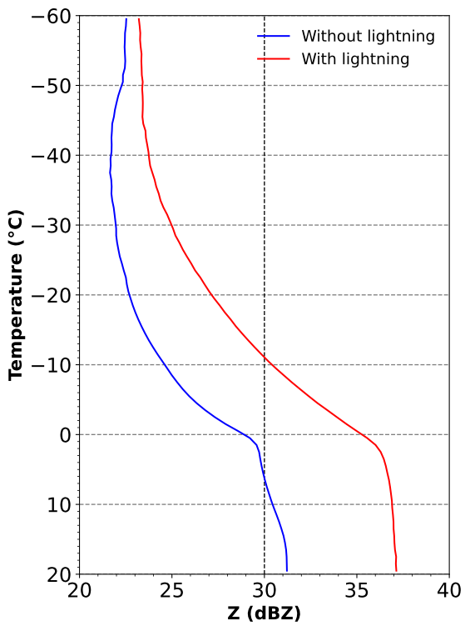
Radar Reflectivity - Z
With lightning:
Z is higher (2-5 dBZ) at all temperature levels
30 dBZ is observed at the -12 °C
From 10 °C to 20 °C:
Without lightning:
Z increases →coalescence
With lightning:
Z equilibrium →breakup and coalescence
From 0 °C to -20 °C
Without lightning: -6.57 dBZ/20°C (aggregation)
With lightning: -8.55 dBZ/20°C (accretion)
This suggests a higher probability of super-cooled water droplets and dense hydrometeors like graupel and hail.
Mixed phase
Warm phase

Slide 7
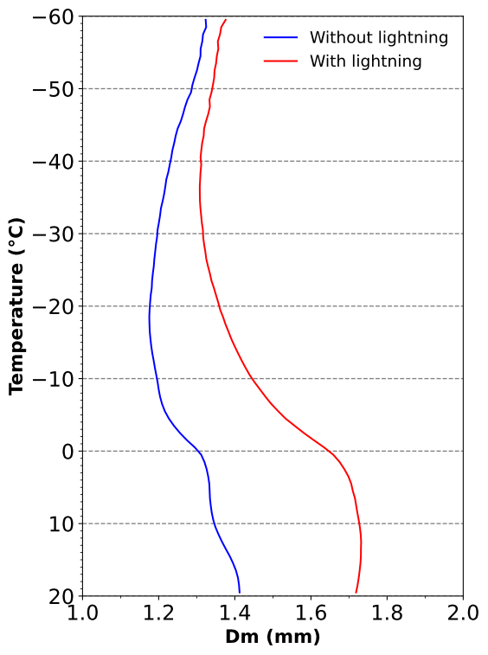
Mean Diameter - Dm
With lightning:
Dm is higher (0.1-0.5 mm) at all temperature levels.
From 10 °C to 20 °C:
Without lightning:
Dm increases coalescence
With lightning:
Dm decrease breakup + evaporation
From 0 °C to -20 °C
Without lightning:
  Small Dm (< 1.3 mm): aggregation and sublimation
With lightning:
  Large Dm (>1.45 mm): accretion and condensation of super-cooled water droplets.
Mixed phase
Warm phase

Slide 8
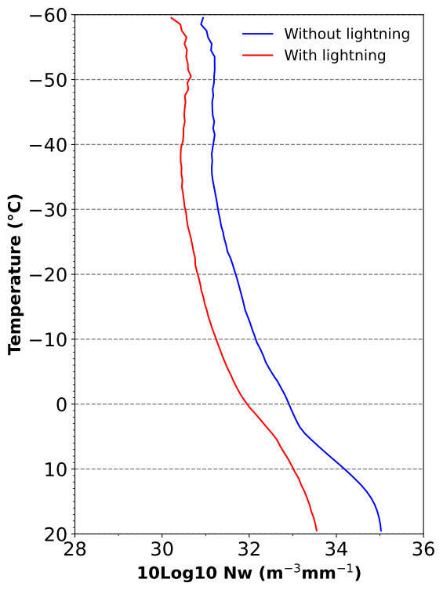
Normalized Scaling Parameter for Concentration - Nw
Without lightning:
Nw is higher at all temperature levels.
From 10 °C to 20 °C:
Drop Breakup
inance of the breakup microphysical process
From 0 °C to -20 °C:
Without lightning: Higher concentration of small ice hydrometeors (aggregates).
With lightning: Lower concentration of large dense hydrometeors (graupel/hail).
Small ice hydrometeors are more abundant than dense hydrometeors such as graupel and hail
Mixed phase
Warm phase

Slide 9
LIGHTNING ACTIVITY

Slide 10
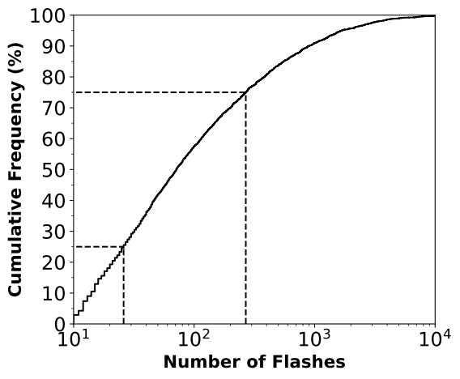
Thunderstorm classification according to total lightning flash
> 75%
LOW ACTIVITY (<25%):
10 - 25 flashes
MODERATE ACTIVITY (25-75%):
26 - 267 flashes
HIGH ACTIVITY (>75%):
≥ 268 flashes
25-75%
25%

Slide 11
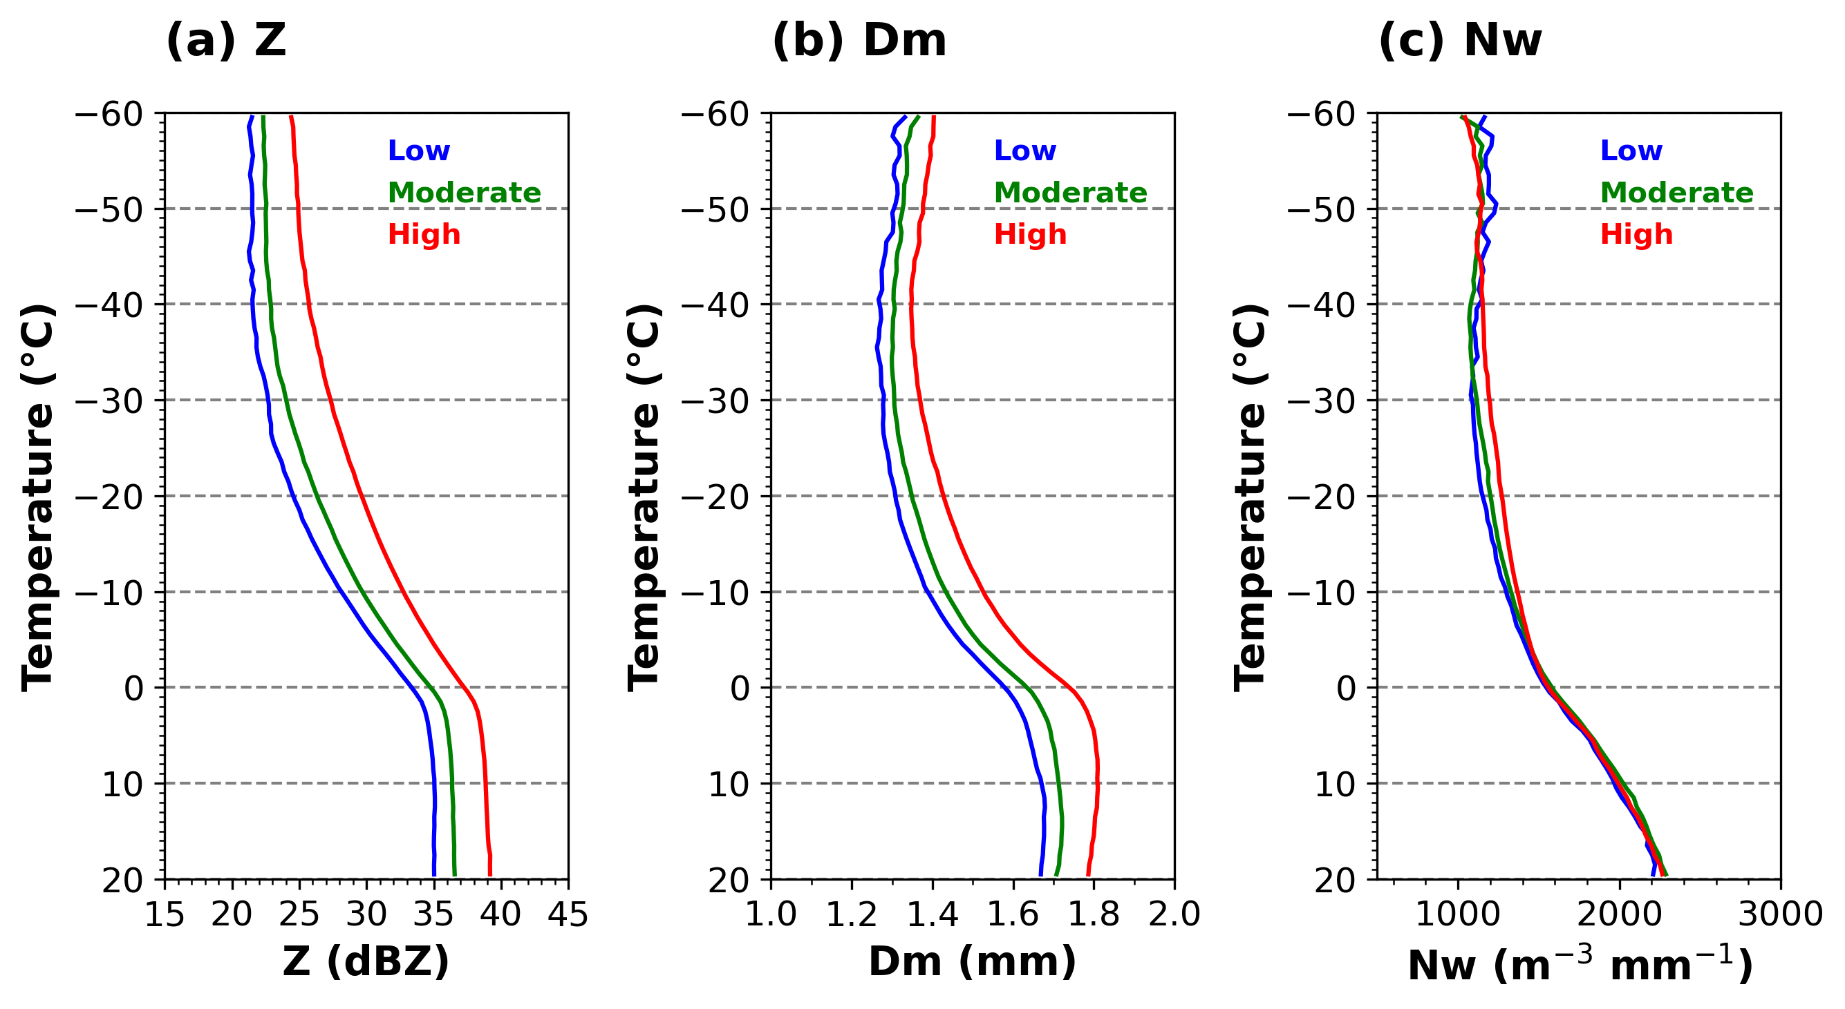
Thunderstorm classification by total lightning flash
From 0 to -30 °C:
High Electrical activity: Z is higher by 2-4 dBZ.
This suggests a higher probability of supercooled liquid water and larger graupel and hail.
This implies a more efficient accretion process.

Slide 12
Thunderstorm classification by total lightning flash
From 0 to -30 °C:
High Electrical
activity: correlated with larger Dm.
This suggests a production of larger hydrometeors (graupel and hail).
Confirming the effectiviness of accretion process

Slide 13
Thunderstorm classification by total lightning flash
From 0 to -30 °C:
High Electrical activity: Nw is slightly higher.
This suggests a higher concentration of large hydrometeors (graupel/hail) and new formed small ice crystals

Slide 14
Conclusions 1/3
Thunderstorms X Storms without lightning
Z_{T} > Z_{W}
D_{MT} > D_{MW}
N_{WT} < N_{WW}
Larger particles and super cooled water droplets → efficient accretion process that in turn helps charge separation and produces lightning
Small particles with aggregation lead to weak electrification process and no lightning

Slide 15
Conclusions 2/3
Lightning Activity
Z with # of lightning discharges
Dm with # of lightning discharges
Nw with # of lightning discharges
  Slight increase between
  -10 and -40ºC
  dZ/dT is smaller
  The presence of more super-cooled water droplets and water vapor will lead to the growth of smaller ice particles.
  As result, smaller ice particles collide with larger hail and graupel, enhancing the charge transfer and consequently producing more lightning discharges.

Slide 16
Conclusions 3/3
The presence of hail, graupel and super-cooled water droplets in the mixed region controls the development of thunderstorms.
The lightning activity is controlled by the size of the denser ice parti.cles (graupel and hail)

Slide 17
THANKS
carlos.morales@iag.usp.br

